Slide 1
Some input for discussion, updated
（Kentaro Miuchi Jan 9th, 2016@ Bouｌｂｙ）
  Japan/NEWAGE status
  CYGNUS strategies
  back of the envelope FoM（slide 18-）
#Everything is preliminary, not a strong opinion.

Slide 2
Japan/NEWAGE status

Slide 3
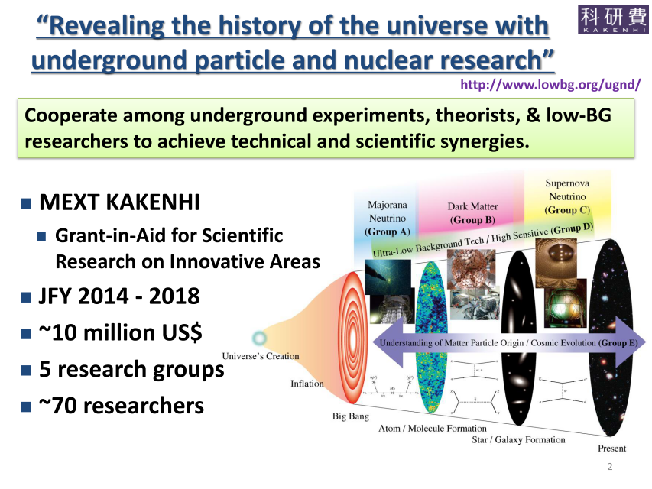
Takeuchi
@NDM2014
leader: Kunio Inoue(KAMLAND)

Slide 4
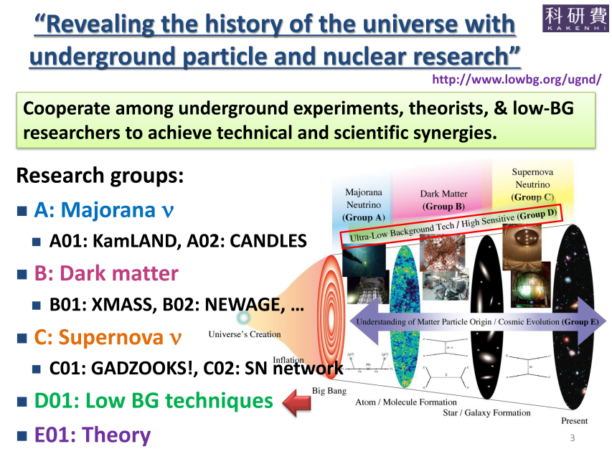
Takeuchi
@NDM2014
MEXT “Scientific Research on Innovative Areas”
  FY 2014-2018
  KAMLAND, CANDLES, XMASS, NEWAGE, SK…
  Additional proposal for “International collaborative work” is being announced.
＋Emulsion
（$0.6M）
International workshop
May,2016
Tokyo

Slide 5
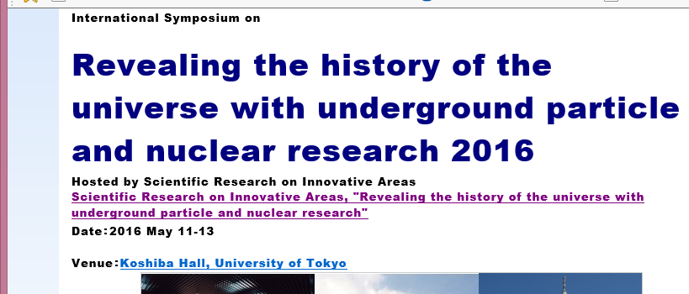
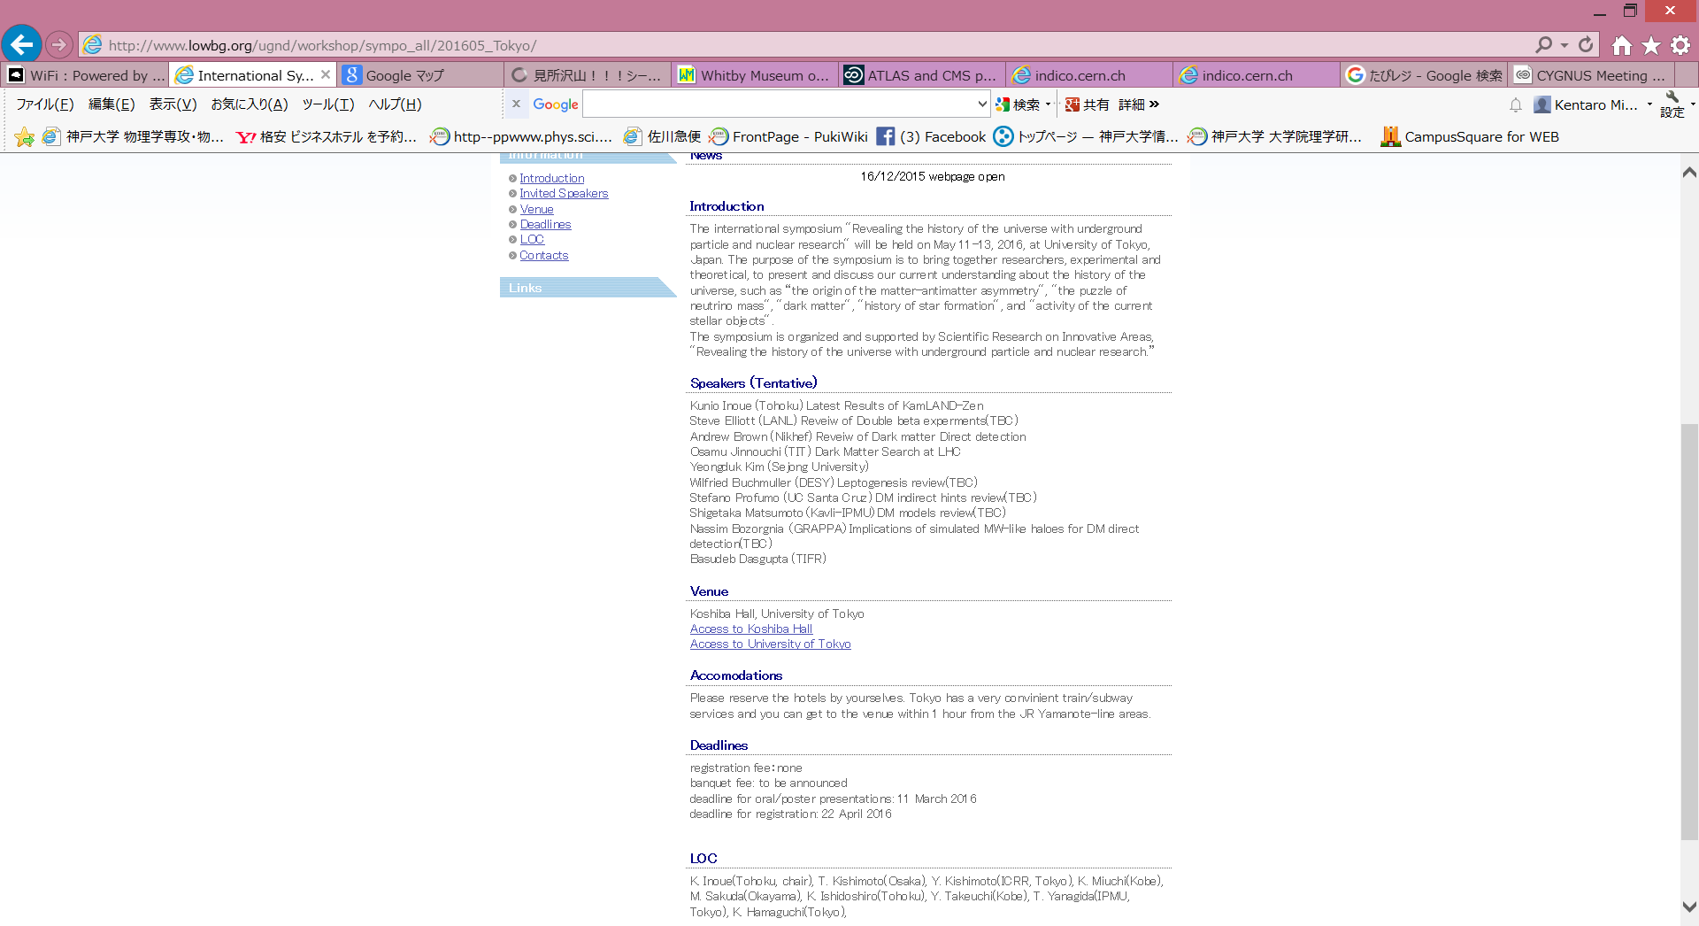
International symposium in upcoming May
http://www.lowbg.org/ugnd/workshop/sympo_all/201605_Tokyo/
Registration open （till March 11th）
Think of coupling KOBE/Kamioka visit.
(James is visiting us early June)

Slide 6

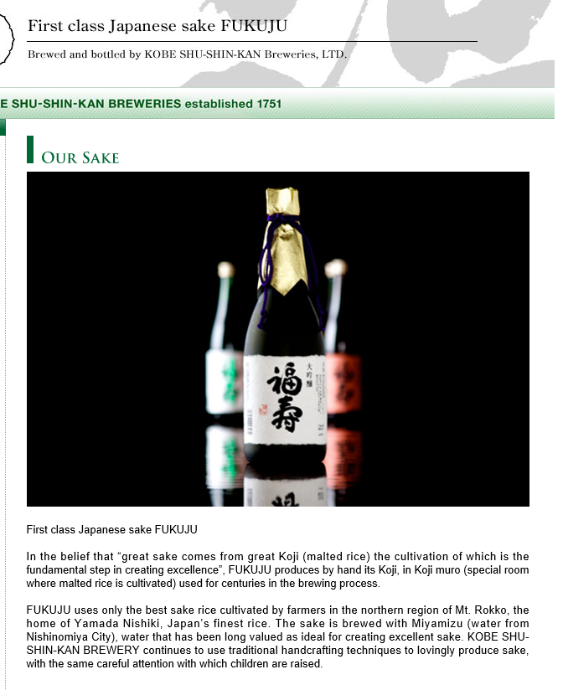
Important information for Neil
FUKUJU brewed in Kobe
served in Nobel prize dinner

Slide 7
NEWAGE publications
PLB 578 (2004) 241-246
proposal
PLB 654 (2007) 58
0.3a surface
PLB 686 (2010) 11
0.3a Kamioka
PTEP (2015) 043F01s
0.3b Kamioka
for low-BG (1/100) μPIC development

Slide 8
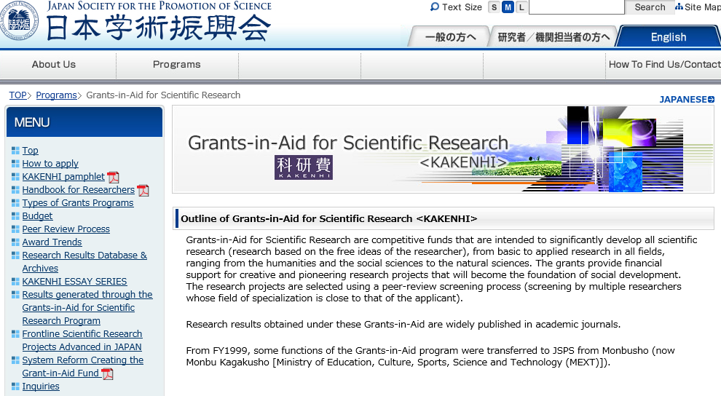
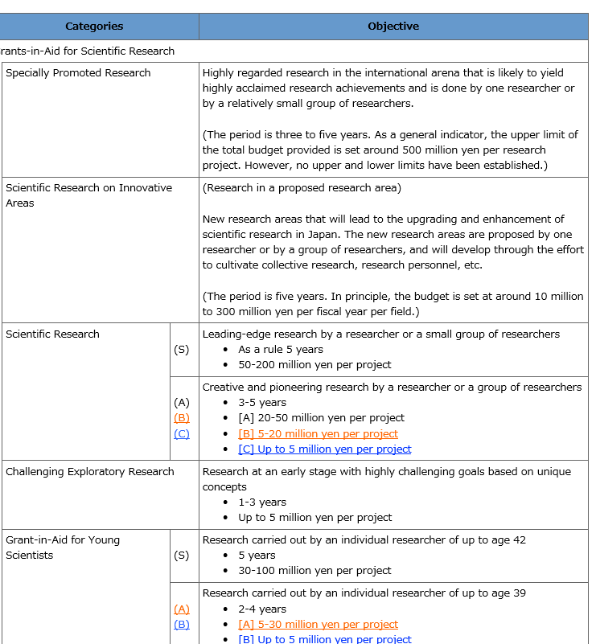

Funding in Japan
30Myen in 2014-2018
lowBG μ-PIC
I can have both
CYGNUS prototype/ NEWAGE-0.9 2016-?
20Myen in 2004-2006
0.3a surface
20Myen in 2007-2009
0.3a Kamioka
20Myen in 2011-2014
0.3b Kamioka

Slide 9
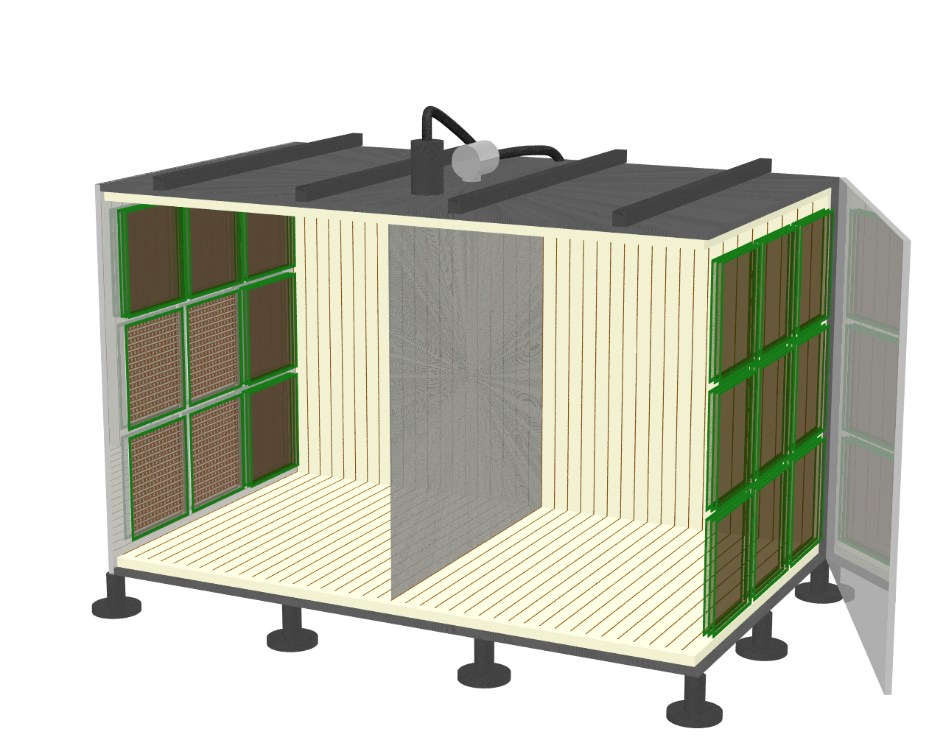
Budget proposal for Japanese KAKENHI（Result in coming April）
  Total 0.4M (40 million yen) (4 years)
  half-NEWAGE half-CYGNUS “observatory”
1m
HV
X-ray tube
triple GEM
（5×30×30cm²）
1m
1m
1m
SF₆ 50Torr
triple GEM
(can be replaced by request)
（9×30×30cm²）
DRIFT Plane
μPIC+GEM
（4×30×30cm²）
NEWAGE-0.6a
0.36 m³×70%×2years×300g/m³ > 50kg days
CYGNUS-KM1a
1.26 m³×85%×2years×300g/m³ > 200 kg days

Slide 10
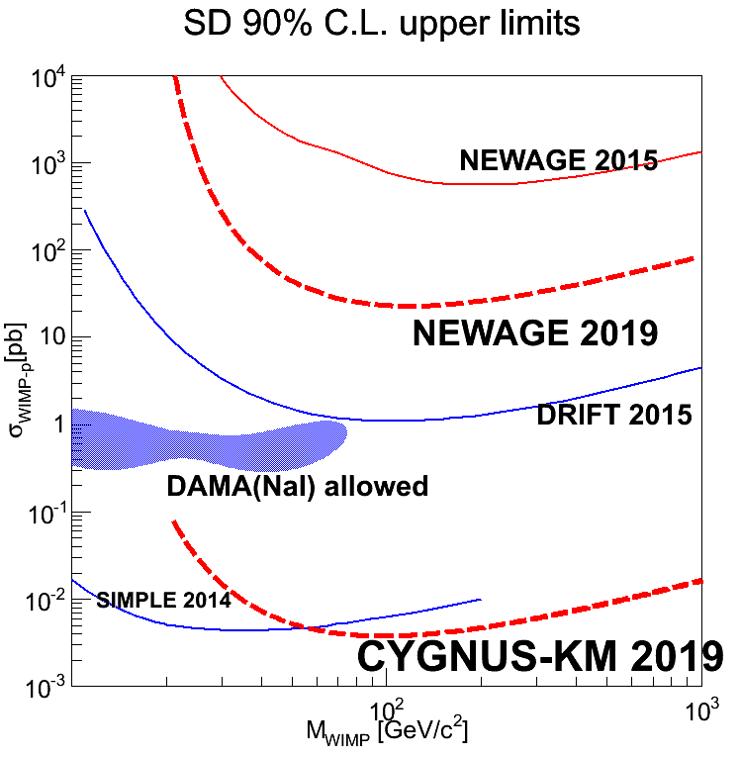
NEWAGE2019 expected
50kg days 1±0.1dru @50keV ee
CYGNUS KM1a expected
200kg days eff=0.8 1BG @50keV recoil

Slide 11
CYGNUS strategies

Slide 12
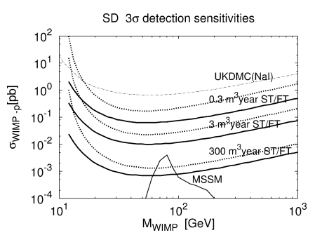
Global consensus (?):
Once we can pin-down the goal, detector size is automatically determined.(～10 events/year)
Budget size is (semi-)automatically determined by the importance of Physics (and the strength of CYGNUS)
⇒Technologies
(MWPC/strip-MPGD/pixel-MPGD)
is (semi-)automatically determined
independent

Slide 13
Global consensus (?):
Once we can pin-down the goal, detector size is automatically determined.(～10 events/year)
Budget size is (semi-)automatically determined by the importance of Physics (and the strength of CYGNUS)
⇒Technologies
(MWPC/strip-MPGD/pixel-MPGD)
is (semi-)automatically determined
discussion point 1
independent
discussion point 2

Slide 14
Budget size: where can CYGNUS be?
ILC
10000
10000M
LHC
1000
BELLE-II
HYPER-K
1000M
1 gigantic detector
LEP,TEVATRON
Cherencov Telescope Array
BABAR,BELLE
LIGO, VIRGO, KAGRA
100M
SUPER-K
MAGIC, HESS, CANGAROO
100
budget
L-Z
#of people
KAMIOKNADE,IMB
ZEPLINE, LUX
large detectors
10M
R&D
1M
DRIFT
DM-TPC
NEWAGE
0.1M
1990
2000
2010
2020
Time scale

Slide 15
CYGNUS LOI preparation (from November TV meeting)
LOI draft of
CYGNUS direction sensitive dark matter search
We can agree
  We need direct detection of the dark matter.
  Need directionality for a clear evidence and halo investigation.
who is CYGNUS
theorists + experimenters, TPC + non-TPC
NOT just TPC experimenters
LOI for general CYGNUS
potentially more than 150 authors
need to discuss the purpose of the LOI
to show we are here (update of the white paper)? 4
to get funded? 2
to propose something? (but not a large TPC in five years)? 1
to discuss the possibilities for future proposal? 5
Do we agree?
MY rating
5 YES
1 NO
YES
NO
LOI for large TPCs’ proposal
(LOI CYGNUS-TPC)
specific
～50 authors
can be discussed in January meeting?
Do you agree?
NO
discussion
YES
next page

Slide 16


Slide 17
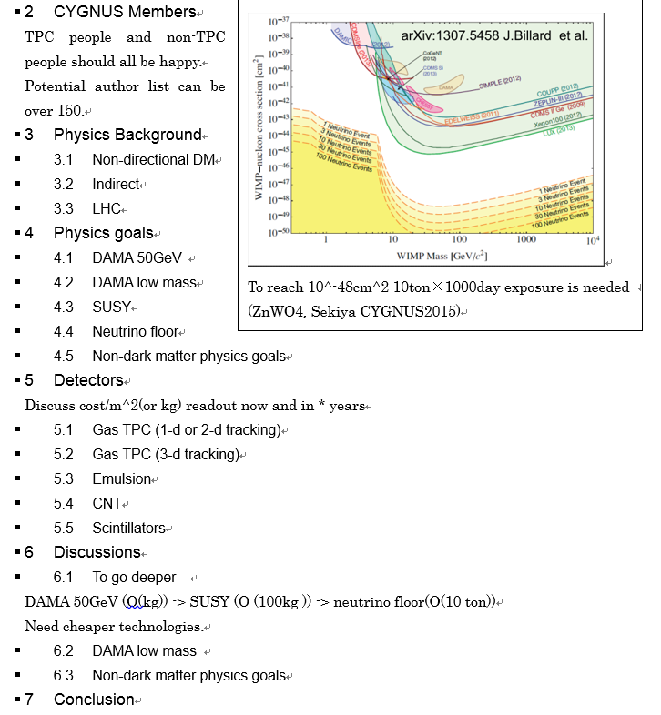
FoM sensitivity/volume/$

Slide 18
Global consensus (?):
Once we can pin-down the goal, detector size is automatically determined.(～10 events/year)
Budget size is (semi-)automatically determined by the importance of Physics (and the strength of CYGNUS)
⇒Technologies
(MWPC/strip-MPGD/pixel-MPGD)
is (semi-)automatically determined
discussion point 1
independent
discussion point 2

Slide 19
Back of the Envelopment Figure of Merit

Slide 20
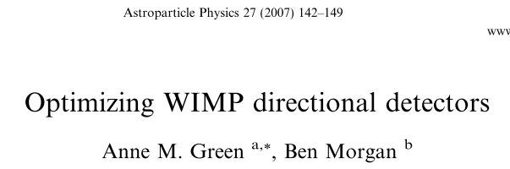
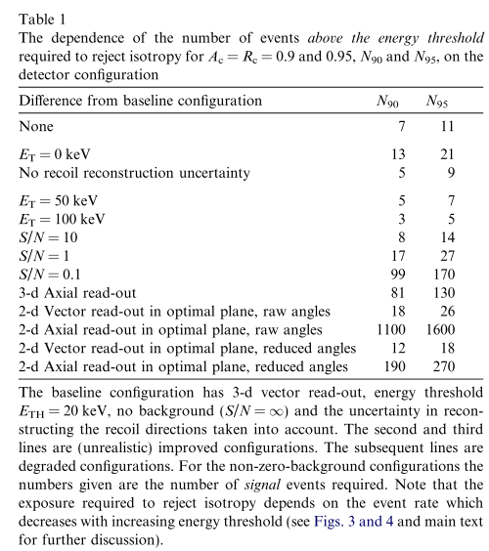
FoM for discovery
  Events needed for discovery
  1-D vector 400×? events ～1000events
  3-D Axial (μ-PIC conservative) ～100events
  3-D Vector (μ-PIC or pixel) ～50events
  ( equivalent for 0.2pb discovery sensitivity. See next slides)
  1/10 exposure with 3-D axial detector have same discovery potential as 1-D vector detector. With SKY MAP for convincing non-directional people and potential for non-WIMP-wind sensitivity.
  while limit sensitivity with 0 BG (exposure matters) is 10 times worse.
  STRATEGY: start with 1-D vector + 3-D axial (10% for discovery potential and BG study)
  → Eventually replace with finer readout

Slide 21
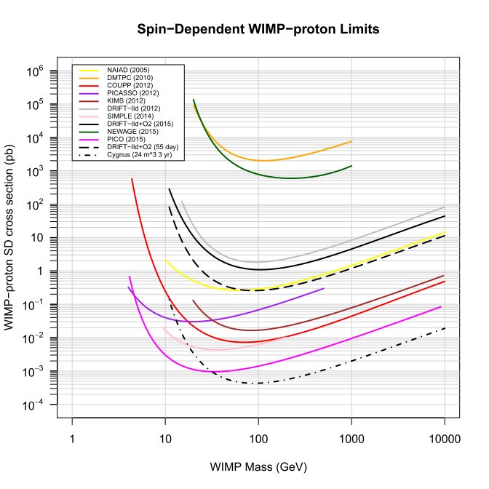
DRIFT-III Reach
1000 events means
0.5e-3×(1000/2.3)=0.2pb
discovery for 0.2pb
DAN’s plot
2.3 evts

Slide 22
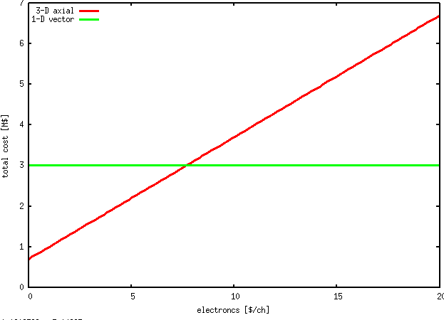
COST for same-order discovery potential
  1-D 24m^3 $3M (total)
  3-D axial 2m^3 $0.5M(vessel+TPC) + 20×$(/30×30cm readout) + 20×1500×$/ch (electronics)
  3-D vector 1m^3 $0.5M(vessel+TPC) + 10000×$/cm^2 (pixel electronics)
  readout $10K/30×30cm² reasonable
  electronicsdependence
figure of demerit comparison for discovery
(reach 0.5pb by 1year)

Slide 23
Budget proposal for Japanese KAKENHI（Result in coming April）
  Total 0.4M (40 million yen) (4 years)
  half-NEWAGE half-CYGNUS “observatory”
1m
HV
X-ray tube
triple GEM
（5×30×30cm²）
1m
1m
1m
SF₆ 50Torr
triple GEM
(can be replaced by request)
（9×30×30cm²）
DRIFT Plane
μPIC+GEM
（4×30×30cm²）
NEWAGE-0.6a
0.36 m³×70%×2years×300g/m³ > 50kg days
CYGNUS-KM1a
1.26 m³×85%×2years×300g/m³ > 200 kg days

Slide 24
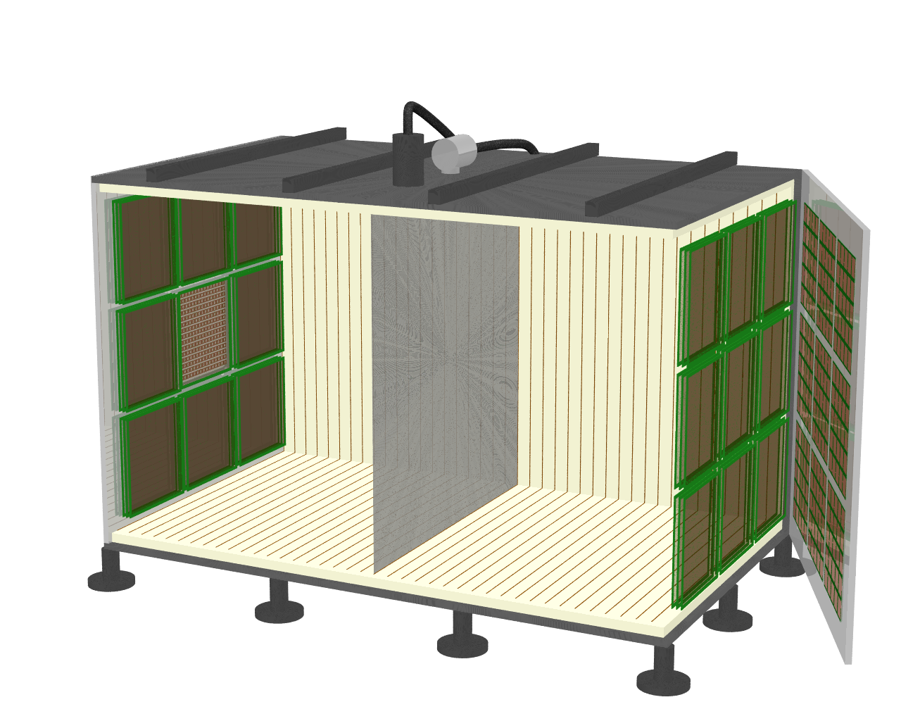
Modified version of CYGNUS-KM01a observatory
  Total 0.4M (40 million yen) (4 years)
  half-NEWAGE half-CYGNUS “observatory”
1m
HV
X-ray tube
triple GEM
（8×30×30cm²）
1m
1m
1m
SF₆ 50Torr
triple GEM+PAD readout
(can be replaced by request)
（9×30×30cm²）
DRIFT Plane
μPIC (or fine-pitch strip-readout) +GEM
（1×30×30cm²）
NEWAGE-0.6a
0.09 m³×70%×2years×300g/m³ > 10kg days
CYGNUS-KM1a
1.5 m³×85%×2years×300g/m³ > 250 kg days

Slide 25
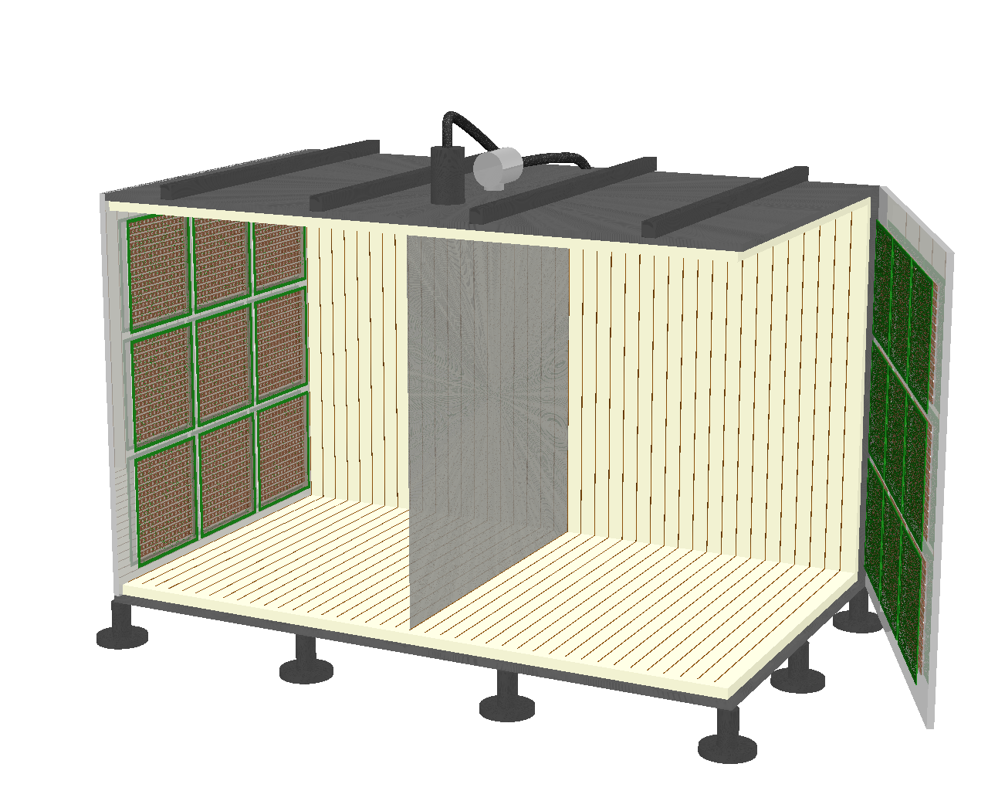
Modified version of CYGNUS-KM01b observatory
  Total <4M
  CYGNUS/NEWAGE “observatory”
1m
HV
X-ray tube
1m
1m
1m
SF₆ 50Torr
DRIFT Plane
μPIC (or fine-pitch strip-readout) +GEM
（18×30×30cm²）
some readout can be “HD”
NEWAGE-0.6a
1.6 m³×70%×2years×300g/m³ > 200kg days

Slide 26
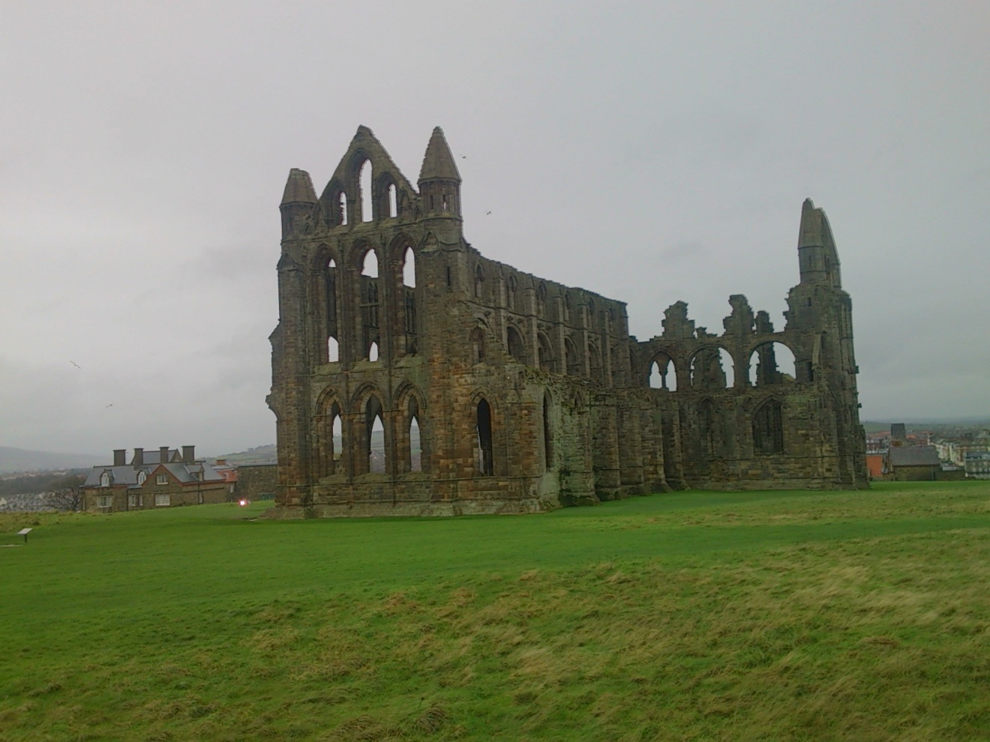
WHITBY

Slide 27
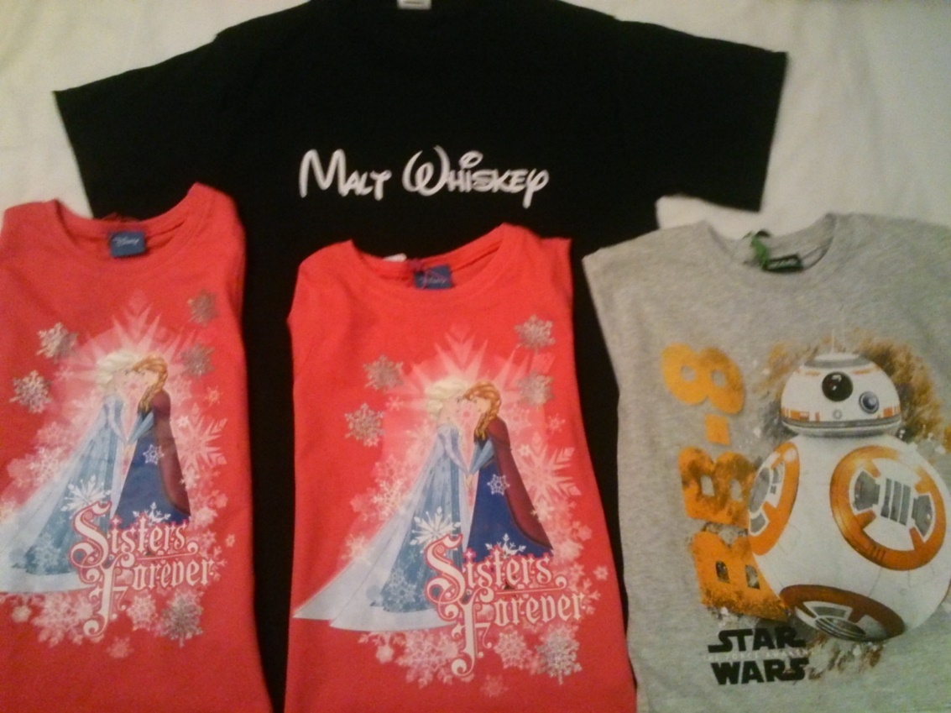
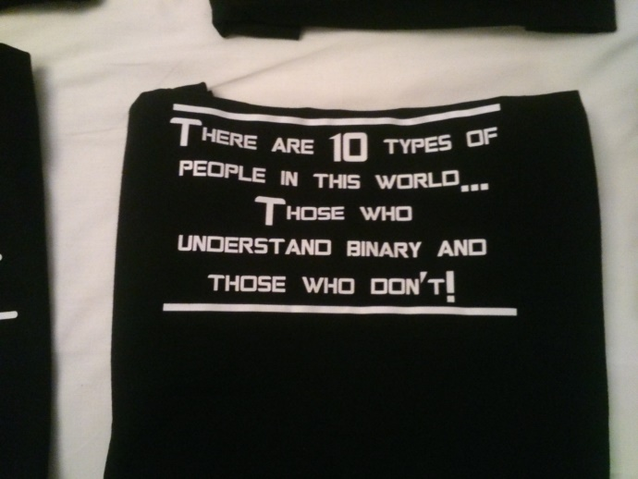
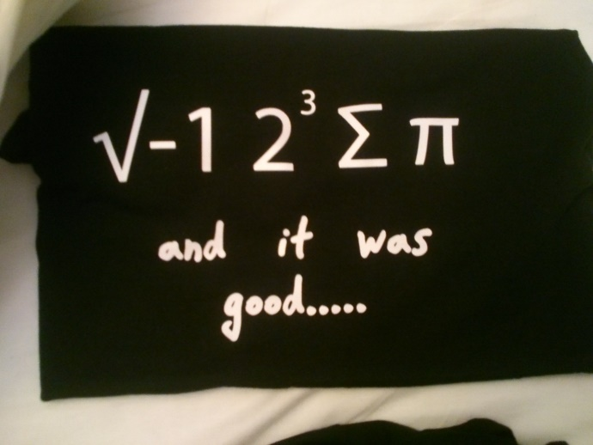
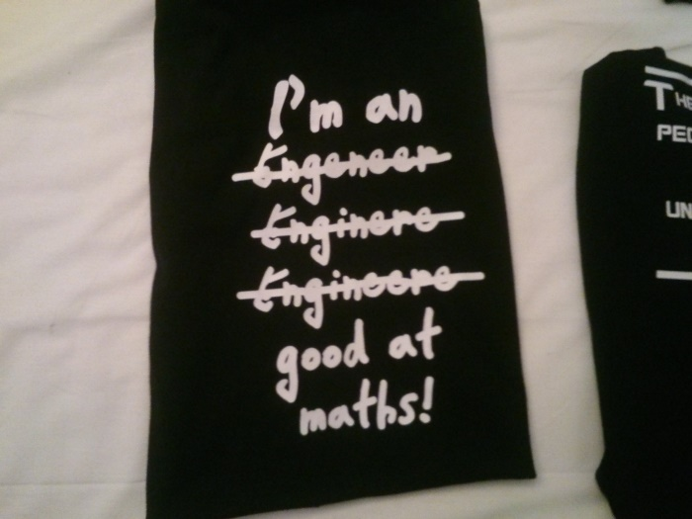
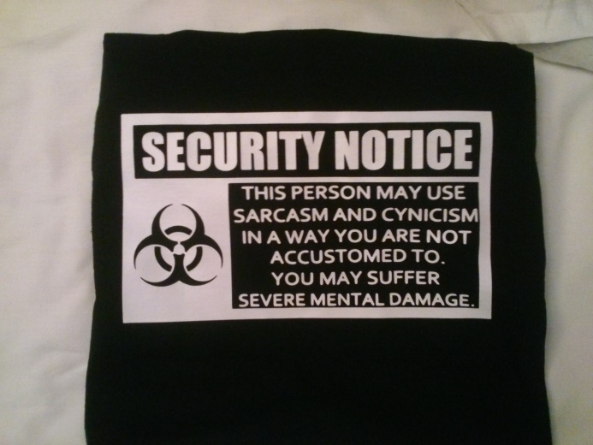
for my kids and myself
for my students

