Slide 1
Cygnus Collaboration Discussion

Slide 2
The Issue
DRIFT has achieved background-free, 0.8 m³, directional operation with 55 days of live time with significant limits. There is every reason to our sensitivity will greatly improve.
Nevertheless the NSF has been opposed to any scale up on the grounds of funding.
DRIFT is not alone in wanting to scale up but not being able to do so.

Slide 3
Benjamin Franklin
“We must all hang together, or assuredly we shall all hang separately.”
At the signing of the Declaration of Independence

Slide 4
The Opportunity
An international pooled effort might be able to break through this logjam.
Could we form an international collaboration “The Cygnus Collaboration” whose purpose it is to build a large directional dark matter detector?
The people to answer that question are in this room.

Slide 5
DRIFT-III

Slide 6
DRIFT-III Module

Slide 7
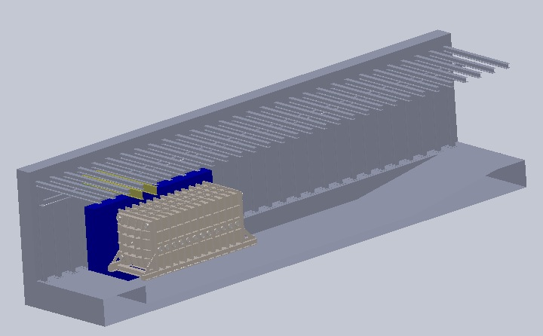
DRIFT-III in Boulby

Slide 8
DRIFT-III Specs
24 m³
41 Torr gas (30 Torr CS₂, 10 Torr CF₄ and 1 Torr O₂.
4.152 kg gas mass

Slide 9
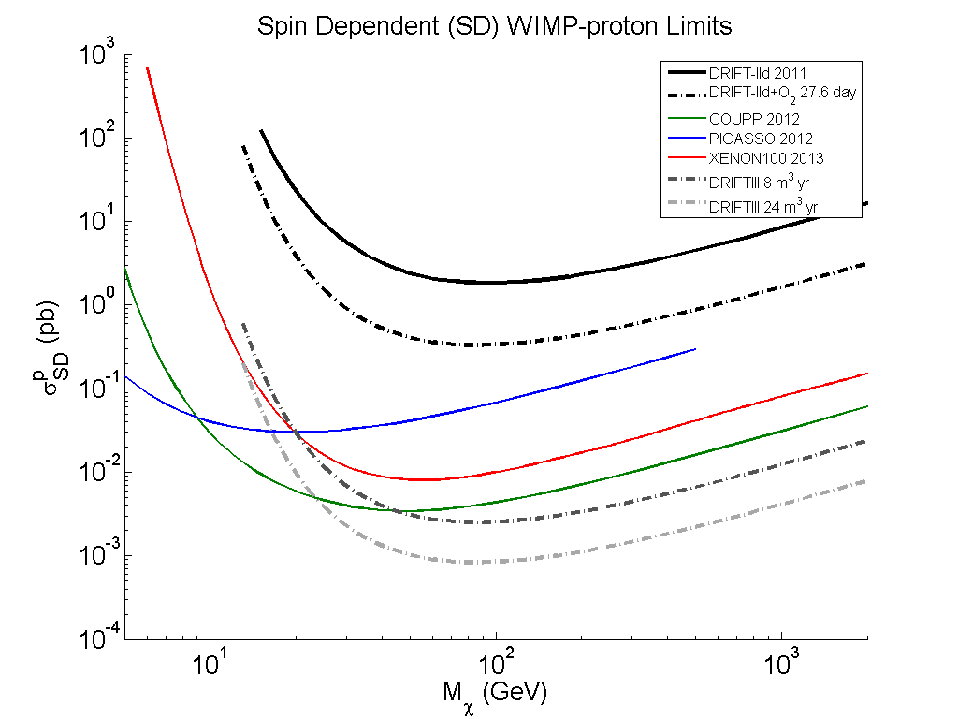
DRIFT-III Reach

Slide 10
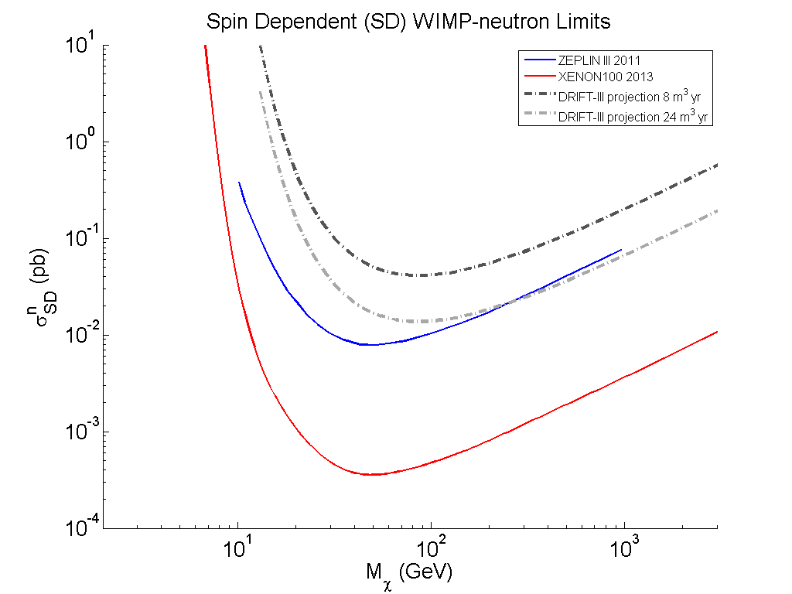
DRIFT-III Reach

Slide 11
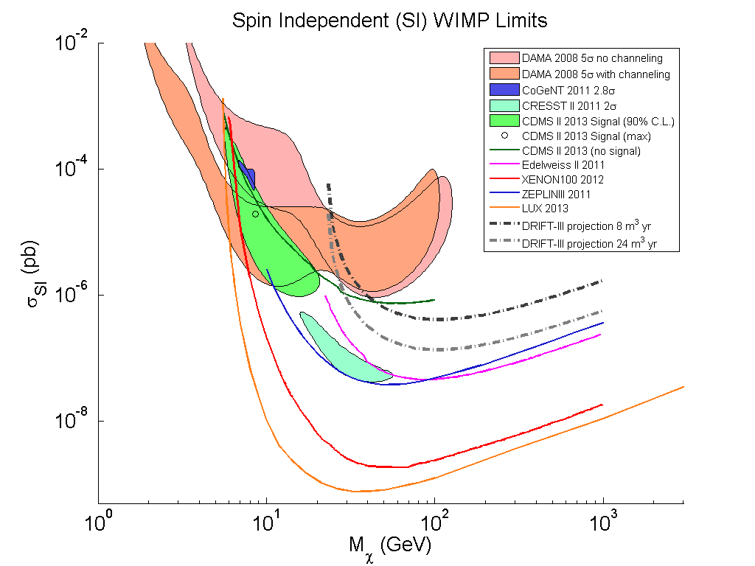
DRIFT-III Reach

Slide 12
DRIFT-III Cost
From our “Underground Science Proposal” to the NSF in 2013.

Slide 13
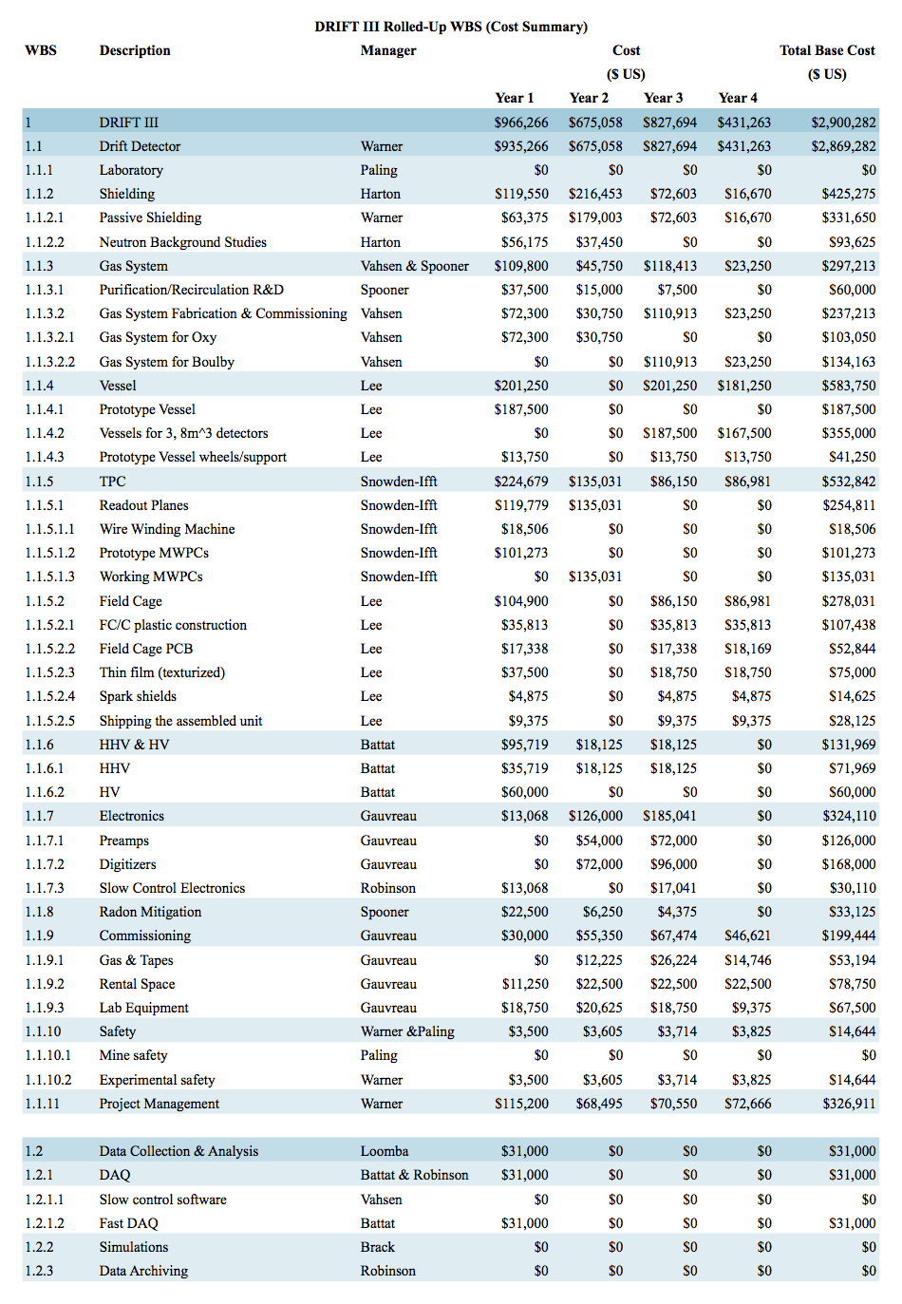

Slide 14
