Slide 1
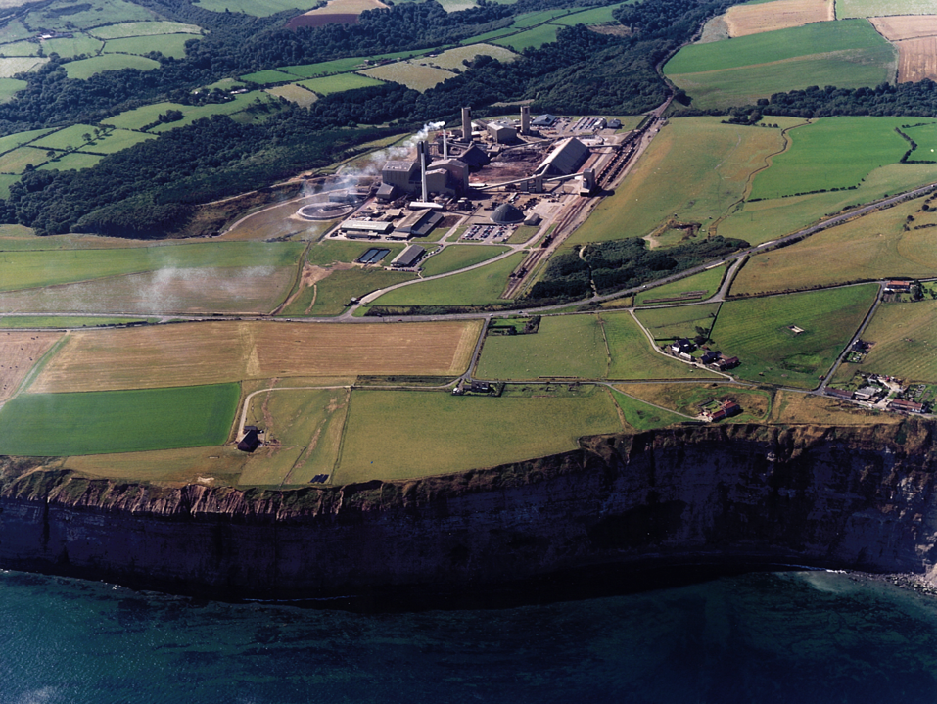

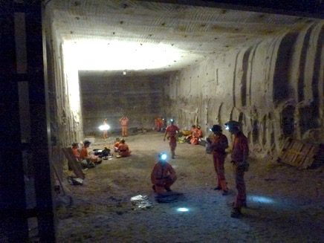

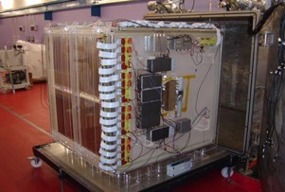
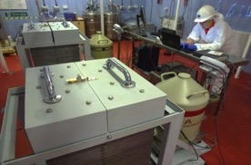
Sean Paling
STFC Boulby Underground Science Facility
DRIFT- Directional Dark Matter Search
Multi-disciplinary studies: climate, the environment, life on earth & beyond!
Deep Science at Boulby Underground Laboratory:
Current studies & details of new underground facilities to support astro-particle physics studies & beyond.
Low background counting

Slide 2


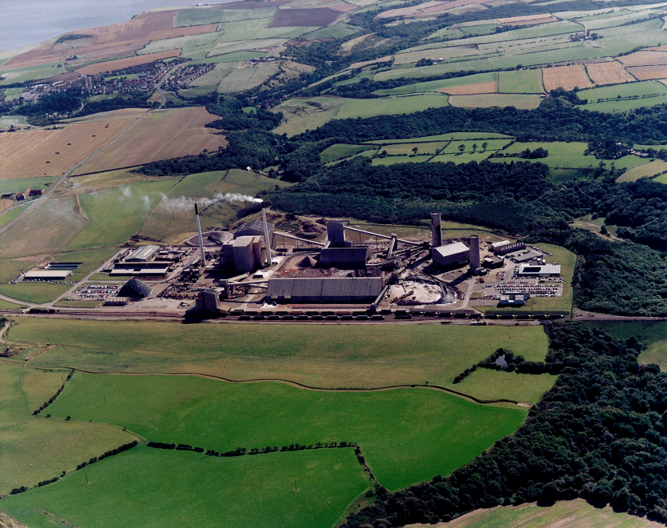
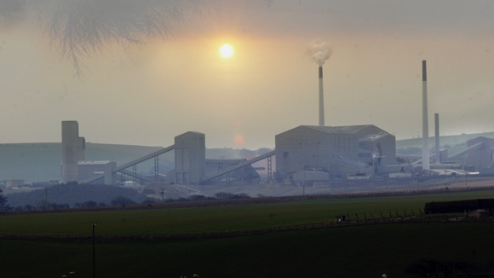
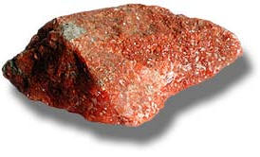
Boulby Mine
A working potash and rock-salt mine on the North East of England.
Owned by Israel Chemicals Ltd. (ICL-UK)
Major local employer - ~1000 direct and 4000 indirect employment.
Middlesborough
Staithes
Whitby
Opened for mining in 1973
York
Mines ~1MT Potash per yr
Deepest mine in Britain – 1100m deep Cosmic ray muon flux reduced by ~10⁶ (2805 mwe)
Potash (KCl)
View from Staithes
S.M.Paling - Boulby@stfc.ac.uk

Slide 3
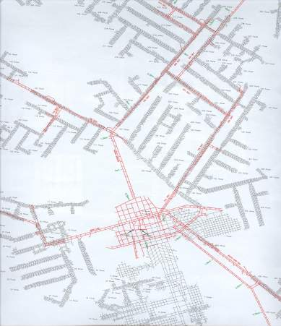
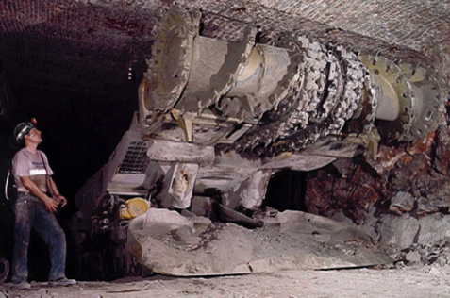
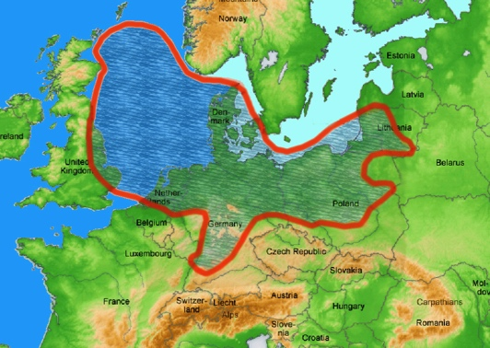
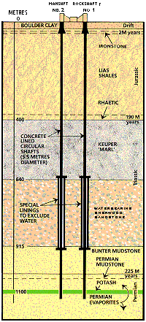
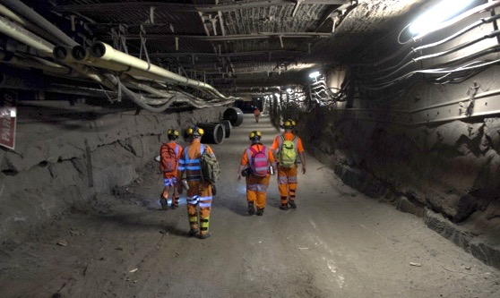


Boulby Mine
Over 40 kms of tunnel mined each year (now >1,000kms in total)
Long lived roadways cut in salt (NaCl) giving access to potash (KCl) levels above
Heliminer
U: 67 ± 6 ppb
Th: 125 ± 10 ppb
Low γ & n backgrounds
Low Rn (<3 Bqm⁻³)
Typical roadway
Mine Shafts
Rock-Salt
Potash
Palmer Lab
Surrounding Rock-Salk low in natural radioactivity (U/Th)…
Plan of excavations
S.M.Paling - Boulby@stfc.ac.uk

Slide 4
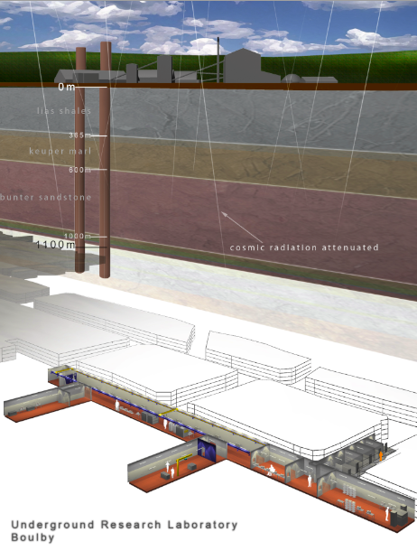
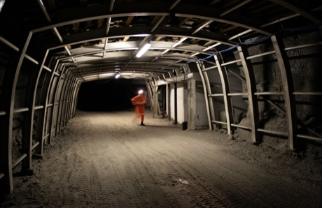
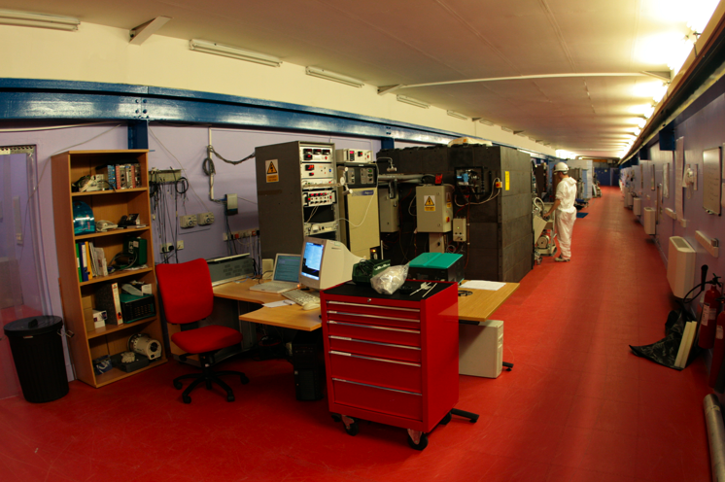


Boulby Underground Laboratory
‘JIF’ Science Facilities (opened 2003).
‘Palmer Lab’: a 100+m, fully equipped underground lab. Power, internet and telephone communications, lifting. AC/filtration, clean room.
1.1km of rock overhead provides factor ~ million
Reduction in cosmic rays (2805 mwe).
Facility and staff provide safe supported access to the wider mine environment.
BUGs
DM-Ice
ZIII Castle
DRIFT-II
A QUIET place in the Universe
S.M.Paling - Boulby@stfc.ac.uk

Slide 5

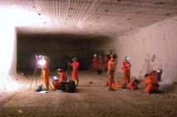

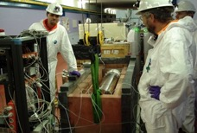


Underground Science @ Boulby Mine
DRIFT: Directional Dark Matter Search
DM Ice: Nal(TI) Dark Matter detector
Ultra-low background material screening
Deep Carbon: Muon Tomography for CCS (etc)
ERSaB: Environmental gamma spectroscopy
BISAL: Geomicrobiology / Astrobiology studies
MINAR: Space Exploration Tech. Development
Misc. Geology / Geoscience
Misc. Low-background support projects
Etc... (More to come).
A growing multi-disciplinary science programme: from astro-particle physics to studies of geology, climate, the environment, life on Earth & beyond.
S.M.Paling - Boulby@stfc.ac.uk
S.M.Paling - Boulby@stfc.ac.uk

Slide 6

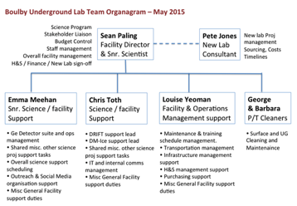

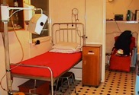
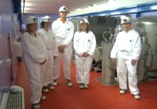
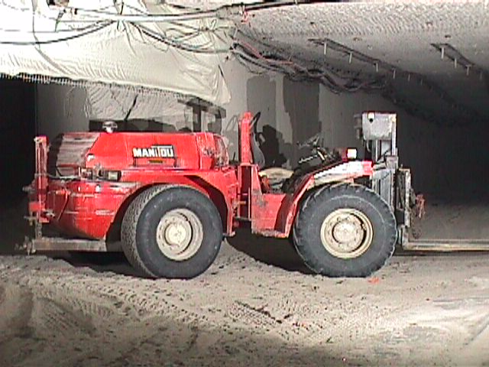
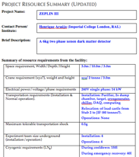
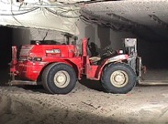


Boulby Facility Details…
• Supports work of 9 collaborative projects (astrophysics to climate, geology, environment, life etc), 20 institutions, > 70 scientists and students.
Facility funded and operated by the Science and Technology Facilities Council (STFC) in partnership with CPL/ICL.
Operations, H&S & science programme managed by 4(+4) onsite staff and supported by Rutherford Appleton Lab (PPD).
CPL / ICL provide wide-ranging operational & higher level support.
Environment monitoring
Management
H&S, medical support
User and science support
‘A hole in the ground does not make a facility’
S.M.Paling - Boulby@stfc.ac.uk
Project tracking, H&S
Materials transport

Slide 7

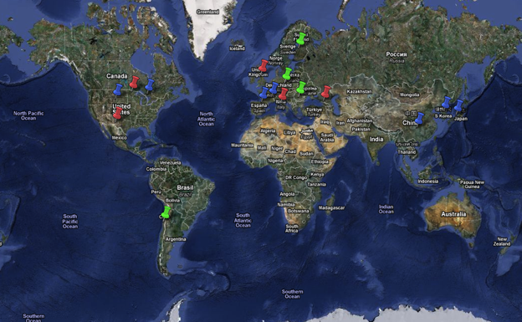
World Deep Underground Science Labs
Overview of status & future plans of (some of) the world’s underground facilities…
Europe
Gran Sasso
Modane
Canfranc
Boulby
North America
SNOLAB
SURF
Soudan
WIPP
Asia
Kamioka
Jinping
Yangyang
Ino
Southern Hemisphere
Andes
Stawell
Lots going on. Many and varied science projects and laboratories progressing and emerging.
S.M.Paling - Boulby@stfc.ac.uk
Notes:
Overall though my aim is to give you an overview of developments and future at the world’s other uUG labs.
Actually I should say SOME of the Underground lab. There are many labs in the world operating now – and a lot going going on in these labs – too much for me to cover in detail here. What I am going to do is cover just some of these from these regions here – and tell you what I know to be lates develoments.
Start with Euorpe – which I know best – then Norht Maerica Labs Asi and Sitherh hmespher labs – of which there are 2 new lab starting in the comig years I have news of.
I should tellnot I am not an expert on these lab – I am an expert of my own that’s all – I’ve been to some and not all. I’ll tell you what I know based on the latest information that the other lab directors have given me. Please do feel free to correct me or add information on any lab that you might know better than me. I’m aware you are an expert audience here.

Slide 8
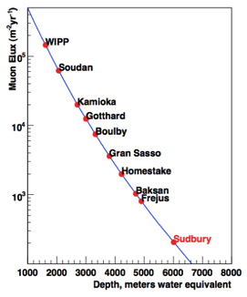
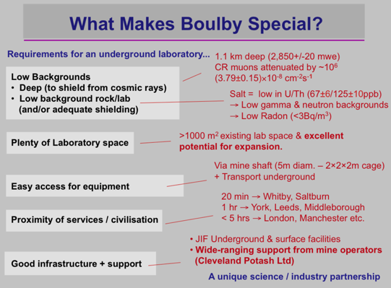
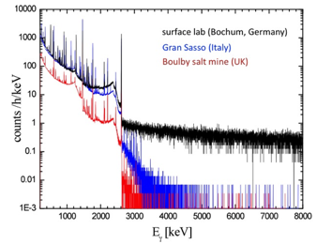
How does Boulby compare?
6 onsite staff supporting 70 users from 20 UK & international universities and research institutes
Muons vs. depth
Low ambient gamma backgrounds
VERY low ambient Radon background: <3 Bq/m³
Interesting geology, diverse science programme
Operations well-supported by mine owners ICL
Low ambient gamma backgrounds
S.M.Paling - Boulby@stfc.ac.uk

Slide 9

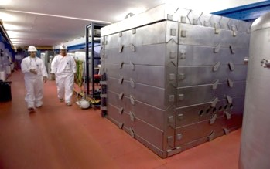
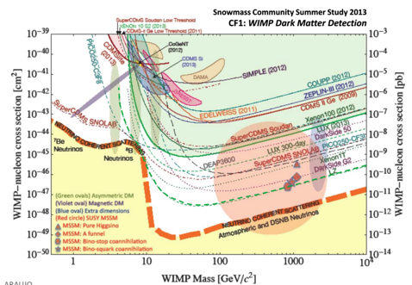
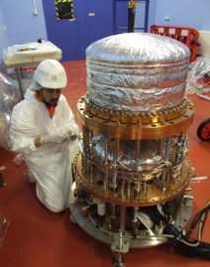
Boulby Dark Matter Studies
Boulby has hosted Dark Matter search studies for two decades. Including the NAIAD, DRIFT & ZEPLIN experiment programmes.
Boulby now hosts two on-site dark matter studies (DRIFT & DM-Ice) & provides ULB material screening for other studies, inc LUX-ZEPLIN
ZEPLIN-III @ Boulby
Alpha
DM-Ice
ZEPLIN: The world’s first
2-phase Xenon dark matter detector (Finished 2011)
DRIFT-IId
Current limits & future projections
S.M.Paling - Boulby@stfc.ac.uk

Slide 10

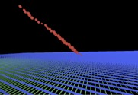
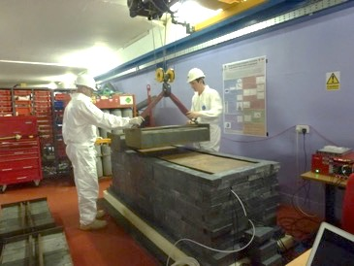
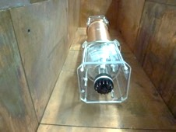
Boulby Dark Matter Studies
DRIFT-II: A DIRECTIONAL Dark Matter Detector…
Participants: Occidental College, New Mexico, Colorado State, Hawaii, Wesley Coll. Sheffield, Edinburgh, Boulby
STATUS: Programme operating at Boulby since 2001. Currently limit-setting and conducting system performance and scale-up R&D
Alpha
DRIFT-II
1m³ (Fiducial) Low-pressure gas TPC with MWPC readout
Alpha track
DM-Ice: NaI(Tl) array for studying WIMP wind annual modulation
Participants: Wisconsin, Yale, Fermi Nat. Accel, Lab, Illinois, Alberta, Sheffield, Boulby
DM-Ice
STATUS: ULB NaI (Tl) detector array assembly, characterisation & operation prior to installation at the South Pole.
Boulby Ultra-low background Germanium detectors
~18kg ULB NaI(Tl) detector units
S.M.Paling - Boulby@stfc.ac.uk

Slide 11

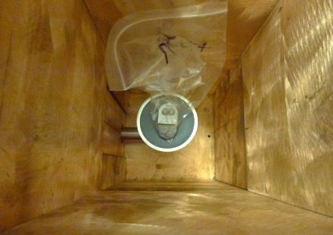
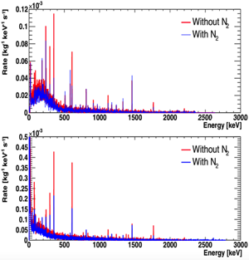
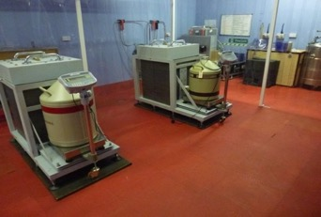
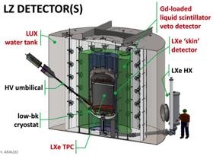
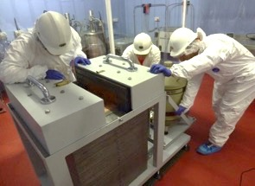
ULB Material Screening
Growing suite (‘BUGS’) of Ultra-Low-Background germanium detector systems to support Dark Matter & misc ‘rare-event’ studies…
Activity testing steel samples
Ortec
Background Spectra
Boulby Underground Germanium Suite (BUGS)
• Ortec 2kg Coax (90% eff).
• 2 Canberra BEGe detectors
• Canberra SAGe Well-type
Canberra
Sensitivity down to 50ppt
U/Th per sample, & improving
Ultra Low background counting
studies supporting UK DM (LZ)
& 0nuBB communities.
Now EXPANDING low BG
counting capabilities to meet
international demand.
Working in collaboration with
UCL, Oxford, STFC-RAL
LZ
LUX-ZEPLIN
Boulby undertaking major role in material selection for LUX-ZEPLIN
S.M.Paling - Boulby@stfc.ac.uk

Slide 12
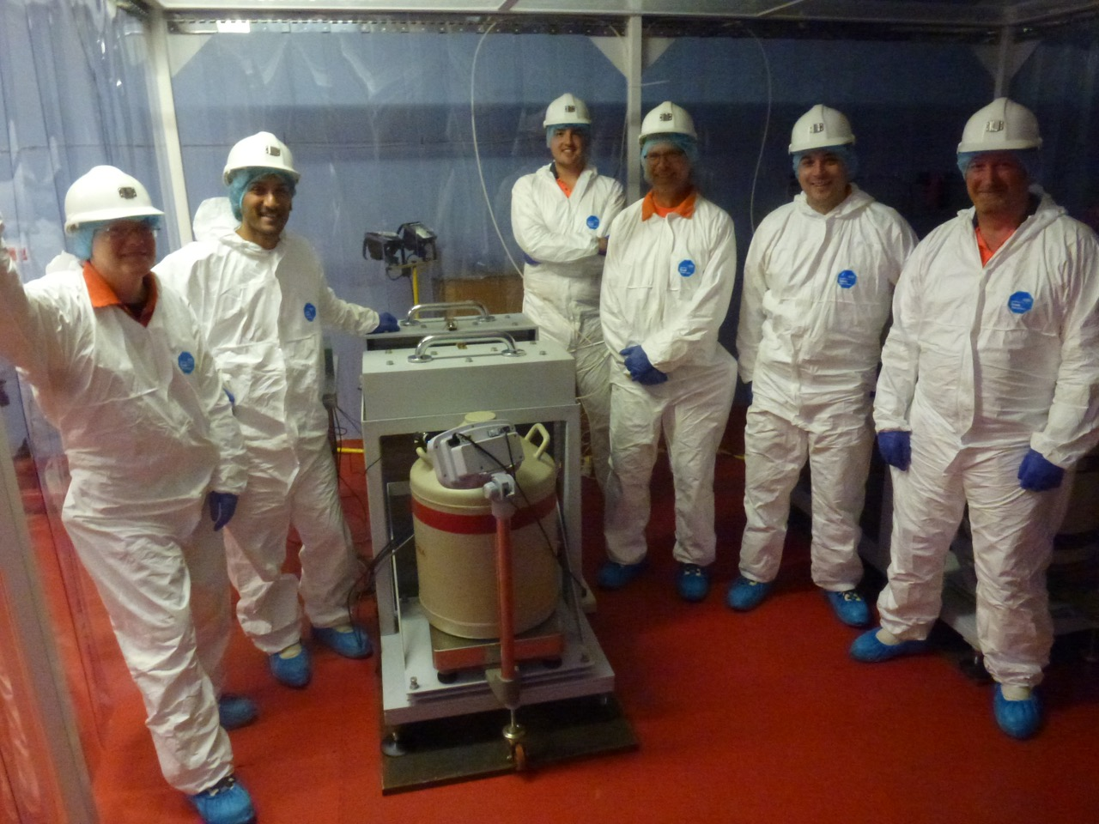
ULB Material Screening
SURF Lab and LZ project management team visit to Boulby Ge Suite – Aug 2015
S.M.Paling - Boulby@stfc.ac.uk

Slide 13

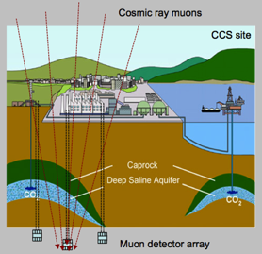
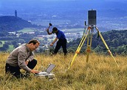
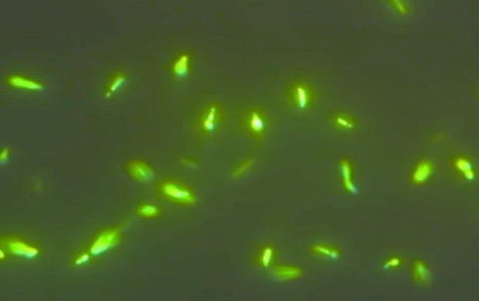
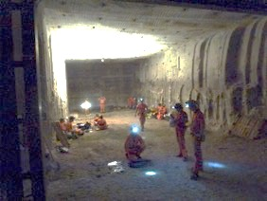

Expanding Multi-Disciplinary Studies
DEEP-Carbon: Muon Tomography for deep geological mapping applications including CCS
Boulby, Durham, Sheffield, Bath, Premier Oil, CPL.
ERSaB: Gamma spectroscopy & low background counting environmental radioactivity studies
From astrophysics to climate, geology, the environment, life on Earth & beyond...
Boulby, Scottish Universities Env. Research Ctr (SUERC)
Life in Boulby Salt…
MINAR: Space Technology
Development
Boulby, Edinburgh, NASA, DLR, CPL etc.
Plus Misc. Geology & Geoscience (& more to come)…
BISAL: Astrobiology / Geo-microbiology. Studies of life in salt, life on Earth & beyond
S.M.Paling - Boulby@stfc.ac.uk

Slide 14


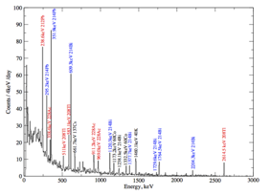
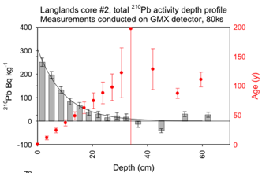
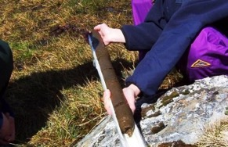


Low-BG Gamma Spectroscopy
Gamma spectroscopy and low-background counting for Environment studies & Beyond
The ultra-low background environment and Ge detectors at Boulby allow existing industrial, environmental and climate-related gamma spectroscopy studies to be extended and improved.
²³⁸U
²³²Th
Environmental applications:
Radioactive tracers for atmospheric
& ecosystem processes
Radio-dating: C-14, Pb-210, Si-32
Dosimetry in the environment
Marine radioactivity
Landscape evolution
Sedimentology…
Sample test output
Boulby
Ultra-low background Germanium Suite (BUGS)
Pb-210
Sedement dating
Pb-210 Radio-dating of the 50-250 year timescale is important for understanding RECENT affects of climate change.
S.M.Paling - Boulby@stfc.ac.uk

Slide 15
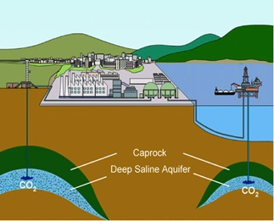
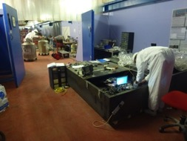
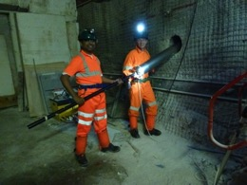
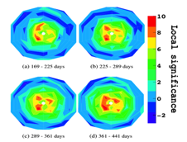
Muon Tomography / Geo-survey
Development of a Muon Tomography techniques for deep 3D geological surveying - inc Carbon Capture @ Storage (CCS)
STFC-Boulby, Durham, Sheffield, Bath, NASA
Cosmic ray muons
Potential for cheap, reliable, practical, real-time long-term monitoring of deep structures. Potential applications:
Deep geological repository monitoring.
Monitoring in Carbon Capture & Storage (CCS)
CCS site
Muon detector array
Muon-tides detector development
Bore hole detector installation
CCS site simulation
Boulby site and skills uniquely well-suited for development and testing: appropriate depth and geology, ease of access, infrastructure & expertise
Deep-Carbon Project: £1.4M funding from UK Dept of Energy & Climate change (DECC) & Premier Oil:
• Bore-hole detector development & testing @ Boulby
• Muon-Tides technology demonstrator
• Simulations of technique performance in CCS
S.M.Paling - Boulby@stfc.ac.uk

Slide 16







Astrobiology & Mars Analogue
Edinburgh, Boulby, NASA, DLR, CPL (etc)
A base for studies of life in Boulby rock – studies of limits of life on earth and on other planets
Life in Boulby salt
Sampling life in Boulby Brine
Subsurface Astrobiology Laboratory
ALSO: An important ‘Mars Analogue site’ – with geology & conditions to allow explorations & astrobiology technique & instrumentation development
Led by Edinburgh,
UKCA
Mining &
extraplanetary exploration instrumentation development
MINAR 2
S.M.Paling - Boulby@stfc.ac.uk

Slide 17





Misc Geology / Geoscience
Misc. geology & geoscience studies @ Boulby.
Durham, Imperial College, Boulby, Edinburgh
British Geological Survey (BGS)
Improved mining technologies
E.g. enhanced extraction but reduced subsidence?
Rock deformation studies
E.g. salt deformation and oil reservoirs?
Seismology
E.g. how does stress change induce earthquakes?
Carbon Capture & Storage
E.g. The effect of fractures on the sealant properties of anhydrite for CCS
Geochemistry
E.g. how does fluid (oil) move through rock masses?
Geomicrobiology
E.g. What effect do microbes of rock stuctural integrity (cliff, geological repositories)
Micro-seismic monitoring
Subsidence mapping
Geochemistry
Cliff erosion mapping
Funding past and present: One NE, CPL / ICL NERC, Crown Estate
S.M.Paling - Boulby@stfc.ac.uk
Anhydrite mechanical properties

Slide 18



Building a New UG Laboratory
Problems with the current lab…
Eastern end: Degradation of lab – due to local fault line
S.M.Paling - Boulby@stfc.ac.uk

Slide 19




A NEW LABORATORY now being built at Boulby
To replace current facility and host planned & new projects for the next decade and more…
New Laboratory construction plan
Project completion date: end 2015
Mars Analogue Area & outside testing area
Materials Entrance 1
Materials Entrance 2
Main hall: Internal Lab height/width of 4m/7m
Palmer lab
Offices & People Entrance
MaterialStore
Large Expt. Cave Area: Internal lab height/width of 6.5m/7m
Low background HPGe Lab
Fully-equipped 1000m² lab. Class 10K & 1K clean room throughout. 5-10T lifting capacity.
50m
S.M.Paling - Boulby@stfc.ac.uk

Slide 20






New Laboratory Details
10T and 5T Gantry cranes
Outfitting: Power, gas & fire detection, IT / comms, AC & filtration
Raised Steel floor
Large Experimental Cavern (6mx7m Internal HxW)
Main Hall (4mx7m internal HxW)
Steel frame throughout. 1m spacing
Expected completion
July 2015
S.M.Paling - Boulby@stfc.ac.uk

Slide 21






Boulby New Lab Construction December 2015
‘BUGS’ ULB Germanium
Facility
Main Hall
> 4000m³ of well supported class 1,000 and class 10,000 clean room experimental space
Completion
Jan/Feb 2016
Large Experimental Cavern (LEC)
Air conditioning, HEPA filtration, internet / comms, 5 & 10 Tonne lifting capacity.
Beginning to move experiments in Jan 2016
S.M.Paling - Boulby@stfc.ac.uk

Slide 22

Directional Dark Matter Studies @ Boulby…
We strongly support the directional dark matter support effort. We’ve hosted DRIFT for 15 years – and are keen to support continued efforts - CYGNUS
We have many years operational experience
We have a great new lab - well suited
Good latitude for directional signal
Good support from government (STFC)
Good support from staff and mine.
Welcome CYGNUS 2016
S.M.Paling - Boulby@stfc.ac.uk

