Slide 1

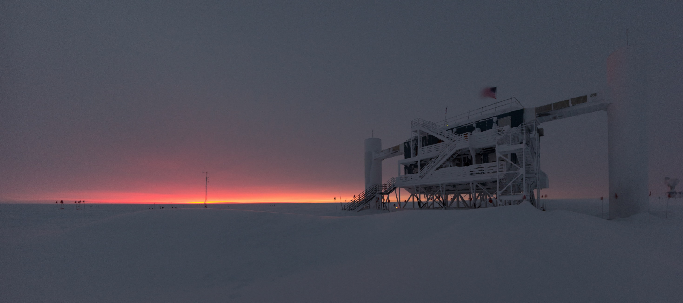
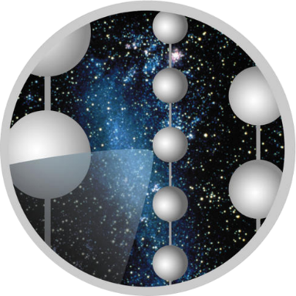


IceCube Gen2
Towards a New Generation of Neutrino Detectors
Kael HANSON
Wisconsin IceCube Particle Astrophysics Center (WIPAC) &
Department of Physics at The University of Wisconsin – Madison
VHEPA Workshop University of Hawaii at Manoa – Honolulu, Hawaii
IceCube Gen2
Collaboration

Slide 2
IceCube Gen2 – Scientific Vision
A Vision for a wide dynamic range neutrino observatory which builds on the IceCube experience

Slide 3
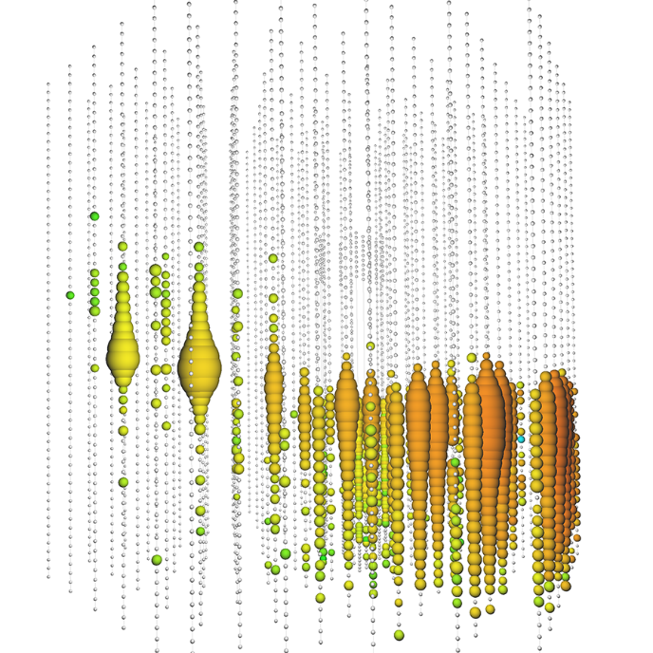
PeV-Scale Neutrinos
See IceCube-Gen2 Whitepaper http://arxiv.org/abs/1412.5106
Background-free region for study of
  Point sources
  Correlation studies
  Energy spectra
Gen2/HEA would deliver O(10) events per year above 1 PeV
At PeV scales new phenomena arise which help disentangle flavors providing information on source physics:
  Tau double bangs – with separated bangs – O(1-2) per year in IceCube Gen2/HEA
  Glashow resonance events [arXiv:1108.3163 Battacharya, et al] have pure muon, tau lollipop signatures – discrimination of pp versus pγ at source.
A muon neutrino event recorded Jun 2014 which deposited 2.6 PeV of energy in the IceCube detector. The parent neutrino’s energy is in the range 5-10 PeV.

Slide 4
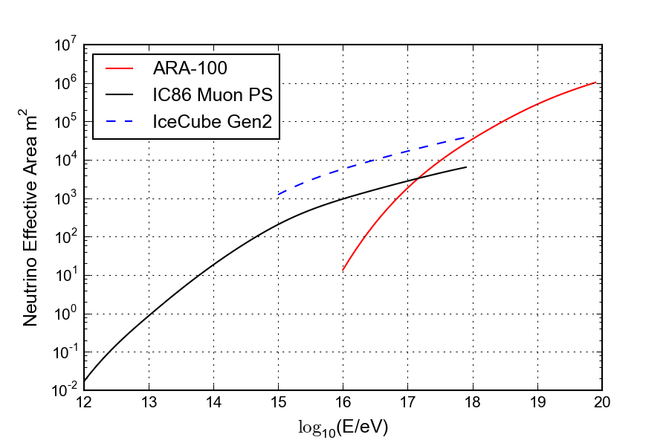
To EeV-Scale Neutrinos
A combined radio – optical detector would have a powerful reach into EeV energies where GZK phenomena could be probed.
Shown at left is a comparison of neutrino effective areas for IceCube-86, a scaling for Gen2 performance, and a putative radio deployment of 100 km² scaled from the ARA detector.
At 10¹⁷ eV radio is the better technology. Not evident from this graph is the cost difference – radio would be more than an order of magnitude less expensive.

Slide 5
IceCube Gen2 – The Observatory
PINGU
High Energy Array
Cosmic Ray Array
Radio Array

Slide 6
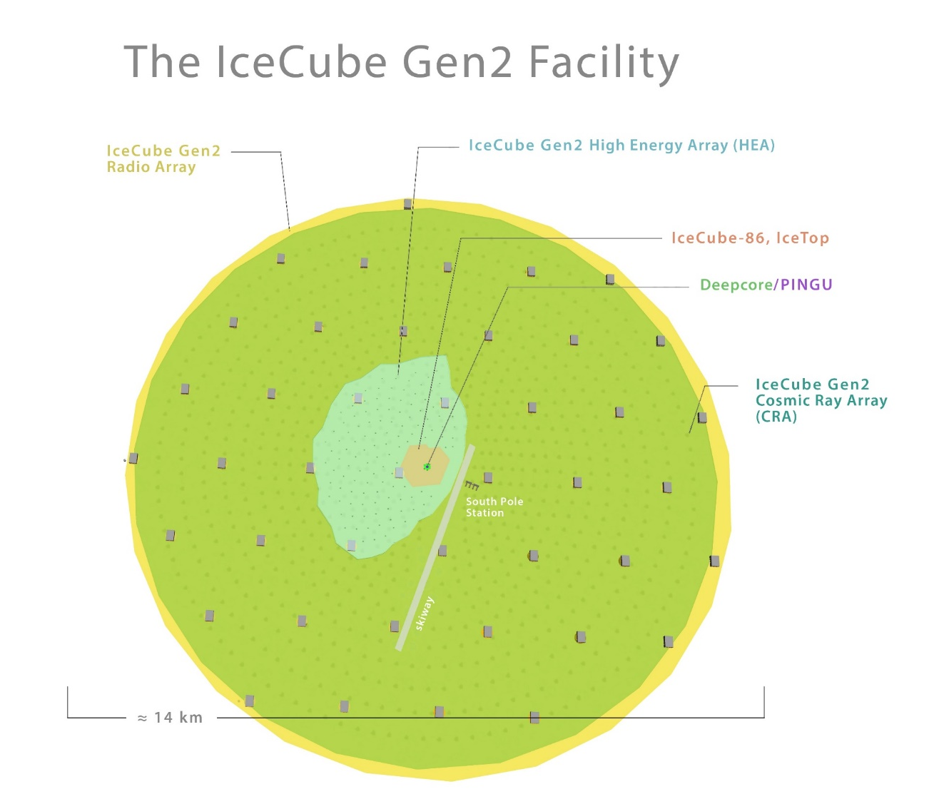
Conceptual Design
A conceptual drawing of the IceCube Gen2 Facility is shown at right. Specific points of design are likely to evolve quite a bit. However salient points are the multiple sub-detectors:
  PINGU – low energy, mass hierarchy
  High Energy Array (HEA) – PeV scale neutrino detector using optical sensors evolved from IceCube
  Cosmic Ray Array (CRA) – veto array for HEA as well as exploration of cosmic ray physics
  Radio Array (RA) – ARA-like or perhaps much denser array of RF power envelope detectors. Could even shadow CRA.

Slide 7
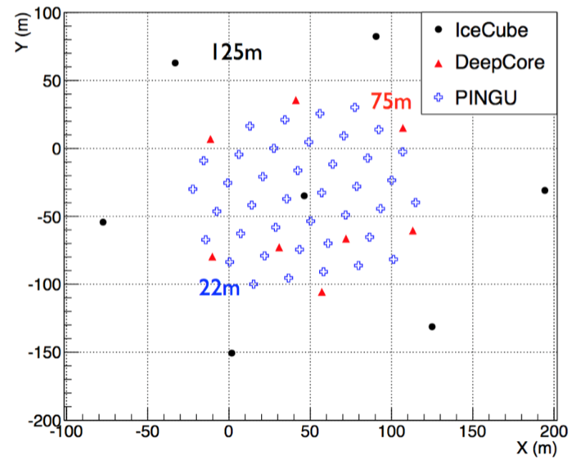
Low Energy Neutrinos and PINGU
PINGU is DeepCore infill array
Current geometry 20 m string spacing, 3-5 m DOM spacing
40 Strings, 96 DOMs per string
Major science goal NMH
Goal is to reconstruct neutrino angle / energy below 10 GeV.
PINGU is a time-critical deployment: to be competitive with other experiments it must start data taking in 6-8 years.

Slide 8
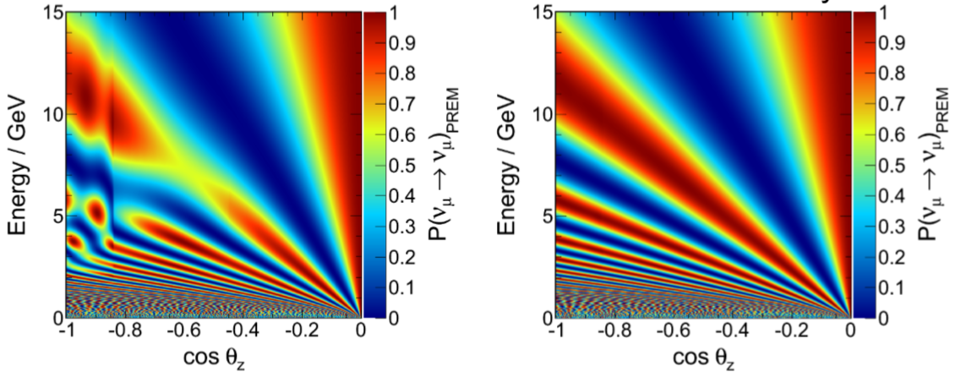
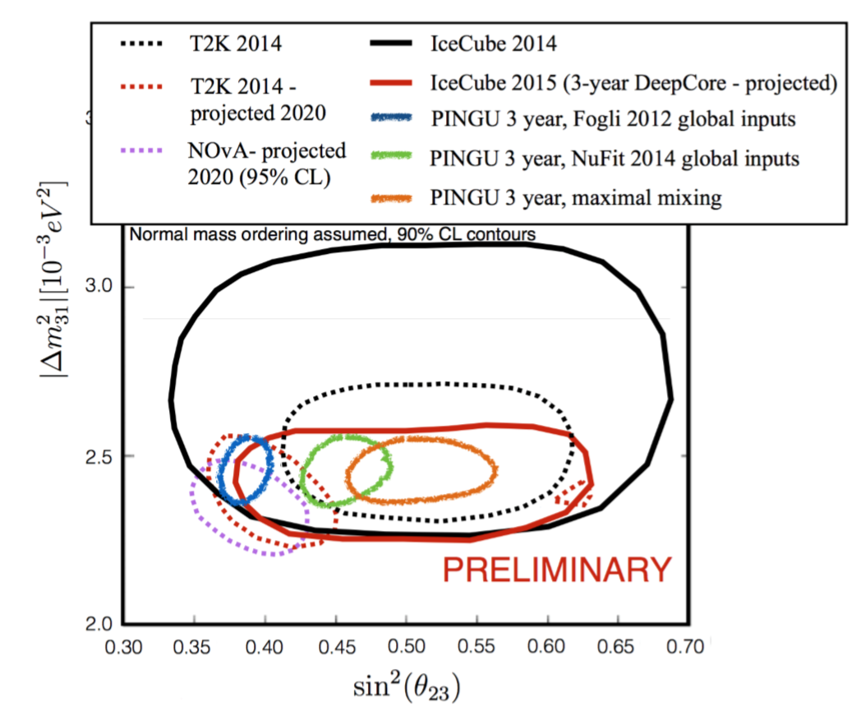
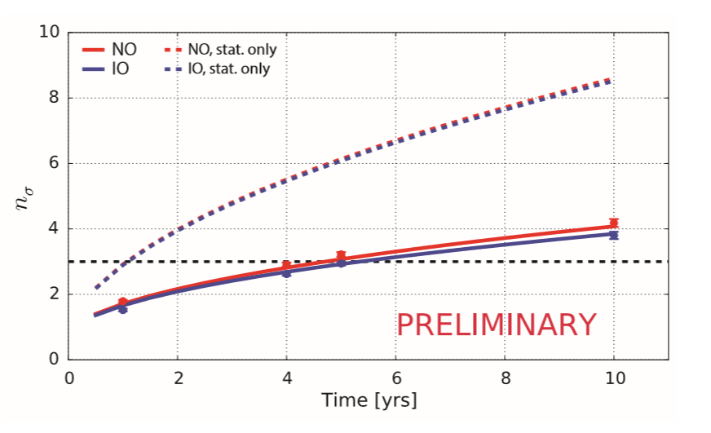
PINGU – Neutrino Physics Proper
IH
NH
Uses atmospheric neutrino beam
Discrimination of IH vs NH at X sigma level after N years (depending on neutrino mixing parameters)
Very competitive measurement of sin²θ₂₃
Additional physics topics
  Supernova neutrinos
  Earth tomography

Slide 9
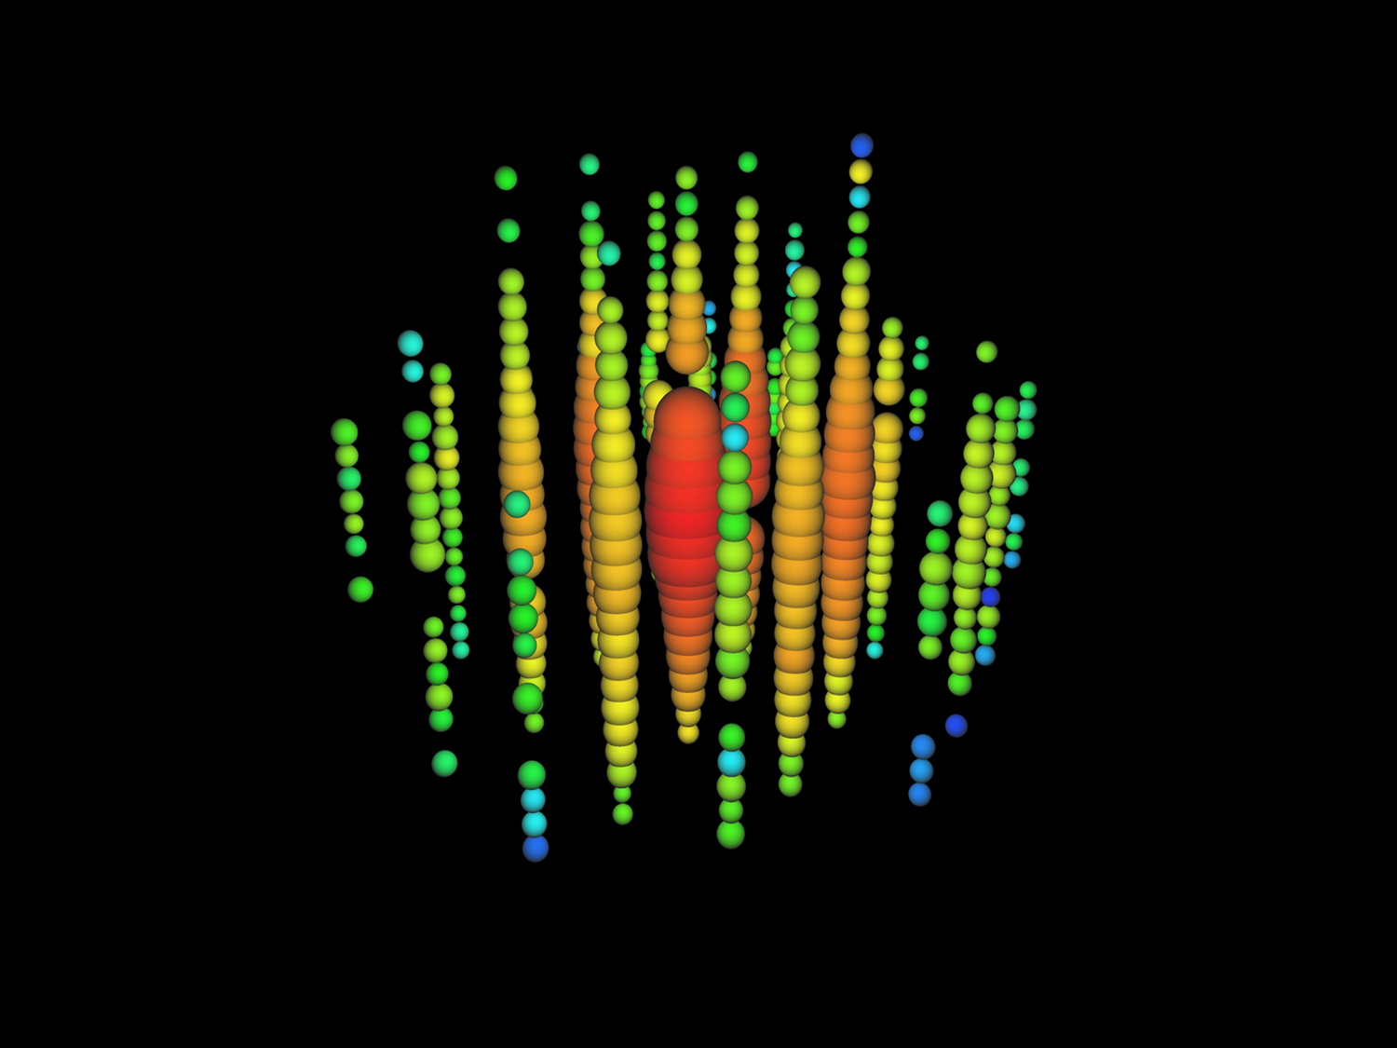
PeV neutrinos don’t need dense detector
Take Bert – one of the two original ~ 1 PeV neutrinos found in IceCube data.
Study reconstruction of this event with real sparse detector: IceCube with strings removed to simulate wider spacing. With 20 strings separated by 250 m
Vertex resolution 12 m
Angular resolution 30°
Energy resolution 10%

Slide 10
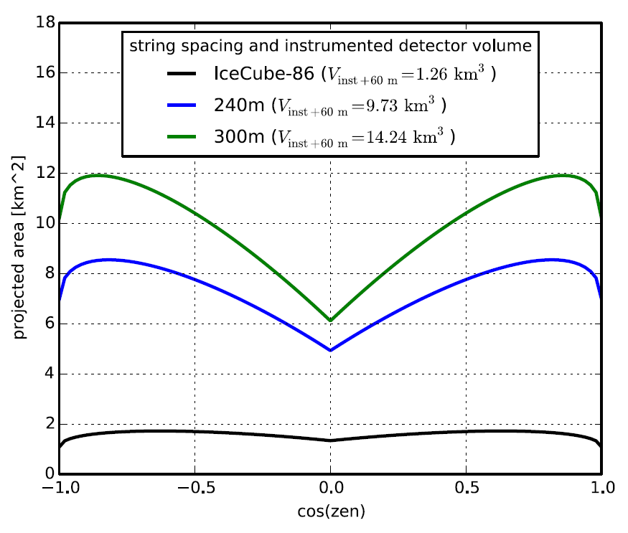
The Deep-Ice High Energy Array (HEA)
Gen2/HEA Parameters
# Strings | 120
DOMs / String | 80
String Length | 1.3 km
Gen2/HEA Performance Characteristics
Muon log₁₀ Energy Resolution | ~ 0.33
Muon Angular resolution | < 0.5°
Cascade Energy Resolution | 10%
Studies have focused on “sunflower” design given by Fermat spiral (no lanes). Keep-out regions at Pole limit extension to a wedge in SP Dark Sector but may be extended. Studies done simulating baseline string spacing of 240 m from IceCube data (remove strings from analysis) indicate no loss in event reconstruction for PeV-class events.

Slide 11
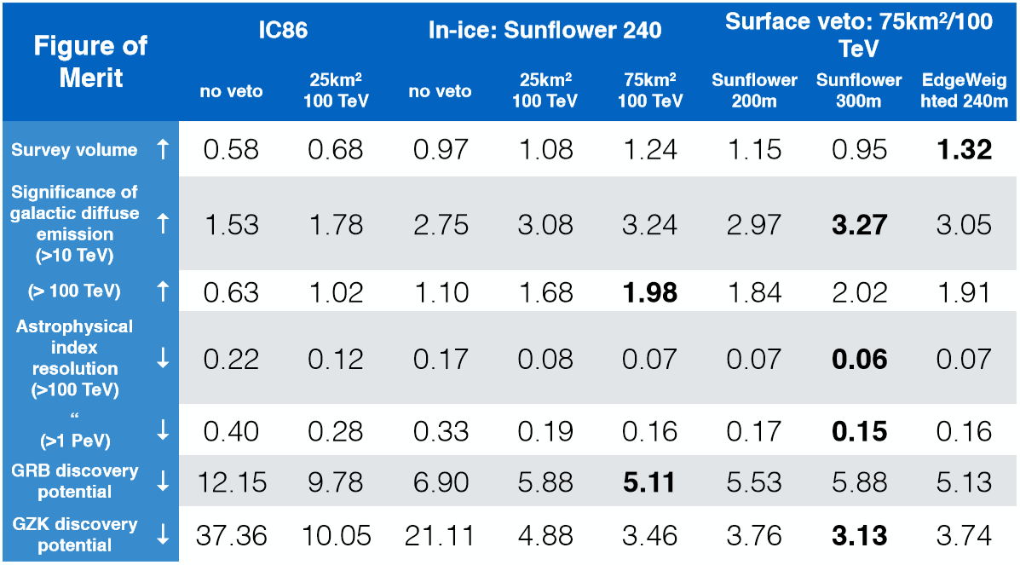
FoM Study (J. van Santen)
Notes:
JvS corrected bug 17 nov G2 phone call

Slide 12
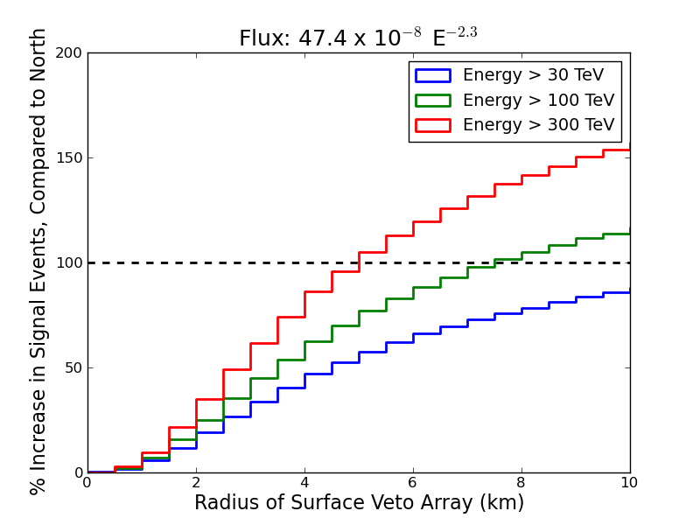
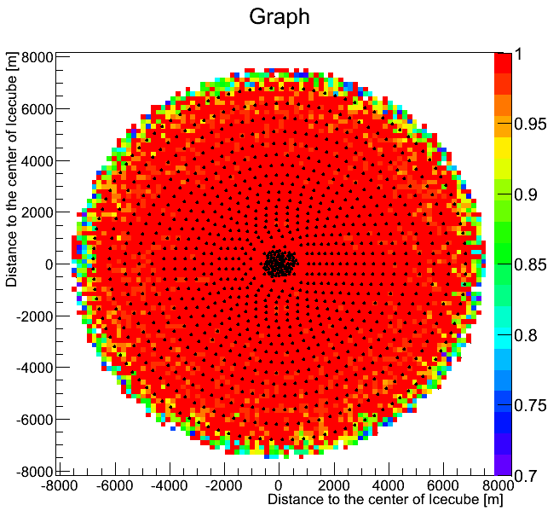
Surface Veto
Generic surface array simulations just released at IceCube Gen2 meeting actually predict substantive gains in several FoM for CRA in the 10’s of millions price. We have just adopted a 75 km² CRA as baseline. Technology still unspecified: scintillator, frozen pool, IACT(??) or combo.
New

Slide 13
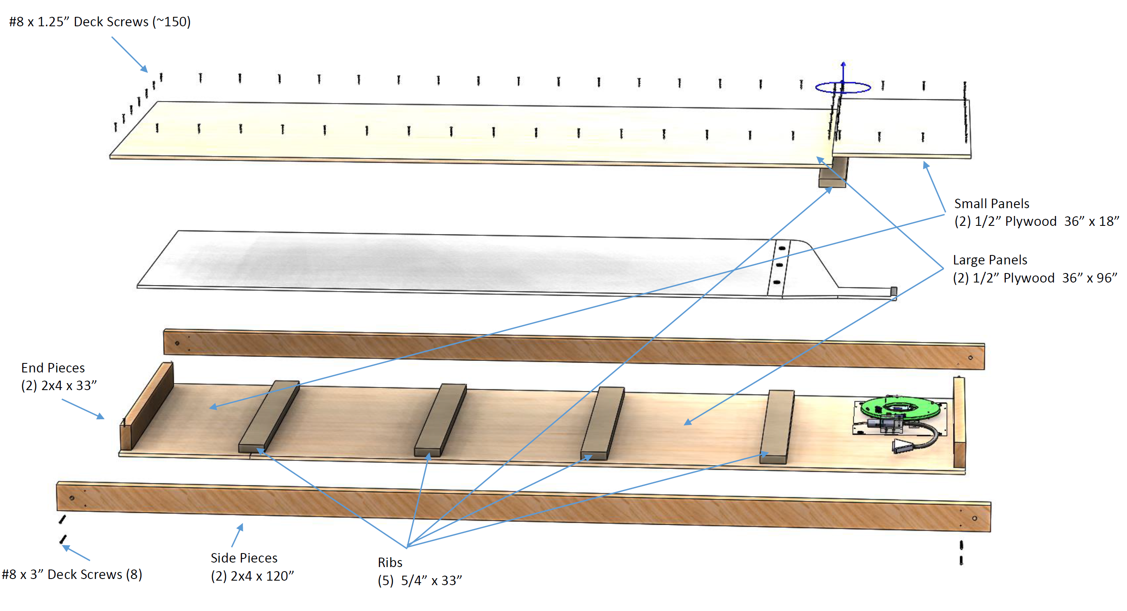
Scintillator Module ‘Prototypes’
Deploying thin sheets of extruded scintillator panels from MINOS: WLS fiber readout. Being deployed for purpose of understanding snow accumulation on IceTop tanks
Panels are cheap (these are free in fact). Extruded scintillator is 10x cheaper than cast plastic.
2 sheets left for Pole Sept 2015.

Slide 14
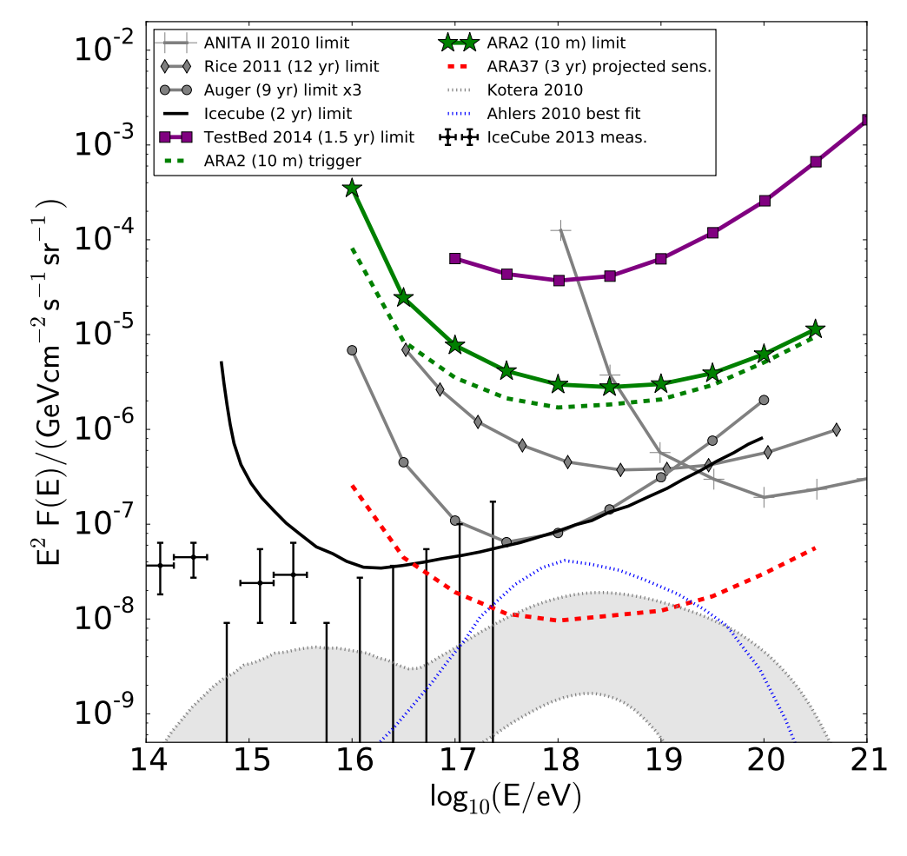
The Radio Array
Absolutely clear: when measuring effective area / cost, RF detection is at least 10x better than optical above 10¹⁷ eV.
Not clear: what is best method for RF detection:
Full band digitization (2-4 GSPS)
  Pros: very good time resolution (50 ps)
  Cons:
    Finicky digitizers
    Needs precise analog amplifier chain (pwr/cost)
    Time resolution dominated by other systematics
    Fine vertex angular resolution, no range.
RF power envelope detection
  Pros: low cost low power hardware and scalable.
  Cons: unproven, is information content sufficient for background discrimination?
Also not clear: can radio techniques be improved to obtain effective areas competitive with optical at 1-10 PeV? Interferometric techniques?
See A. Karle talk Saturday.

Slide 15
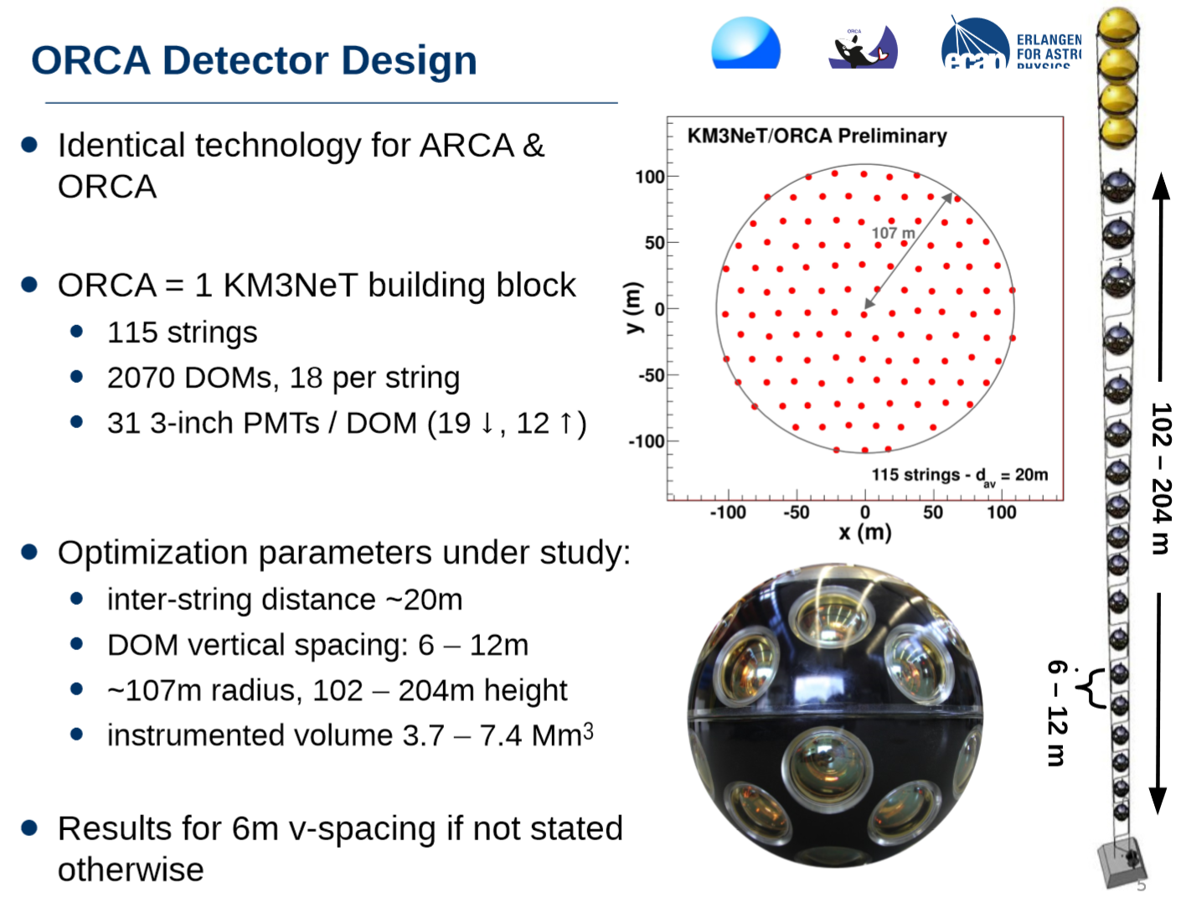
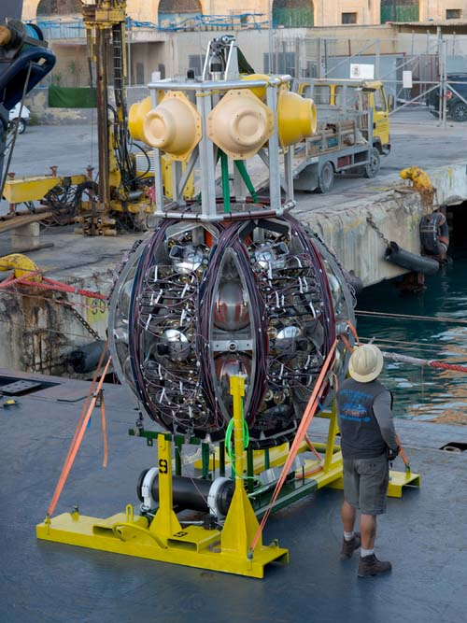
Meanwhile, in the Mediterannean
ARCA / ORCA
Slide from J. Hofestädt (Erlangen)
The new KM3NeT design baseline – blocks of 115 strings (see ORCA inset at right – ARCA spacing is O(100m)) using multi-anode optical modules. Two sites planned – ARCA (Italy) for the high-energy array and ORCA (France) for neutrino oscillations. A phased approach:
Phase | Blocks | Deliverable
1 | 0.2 | Engineering run – first science
2 | 2 ARCA | Measurement of HE neutrino flux
2’ | 1 ORCA | NMH
3 | 6 | Neutrino astronomy
News
On Dec 3rd 2015 the first string was deployed at the Capo Passero site off SE coast of Sicily.
Strings are wound up in package shown at left and dropped off deployment vessel. ROVs then connect to junction box at 3500 m depth. Reports are that string was functioning properly.

Slide 16
New Optical Detectors – New Electronics

Slide 17
Options for Future Photodetection
Play it safe: current DOM works pretty good – certainly the lowest risk option would be to make minor tweaks to this design
  For a fast deployment (i.e. PINGU) this might be the best option
  Need lots of channels however for HEA
Higher risk: Spend some time and effort on research into improved photo-detection methods – these also will have beneficial impacts for the entire community
  Maybe not for PINGU, depends on time-scale
  For Gen2/HEA we probably have some time.
A few options on the table for better photodetectors: mDOM, WOM, and dual-PMT d-Egg

Slide 18
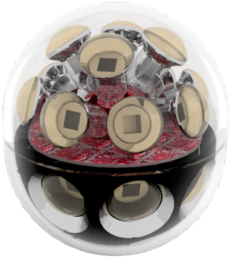
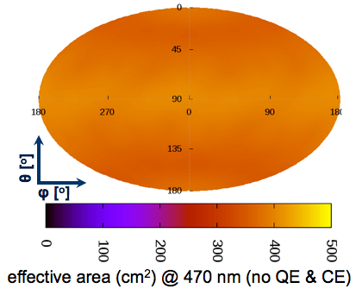
A multi-PMT optical module for IceCube-Gen2
Features
  24× 3” PMTs (Hamamatsu 12199-02)
  14” borosilicate glass pressure vessel
  rated @ 700 bar (Nautilus)
  Based on proven KM3NeT design
  Prototype to be tested in PINGU
  Advantages
  Uniform 4π acceptance
  2 times effective area of IceCube DOM
  @ similar price per photocathode area
  Directional sensitivity
  Local coincidences for e.g. background suppression
  Improved TTS (σ = 1.7 ns)
  (important for leading-edge timing precision)

Slide 19
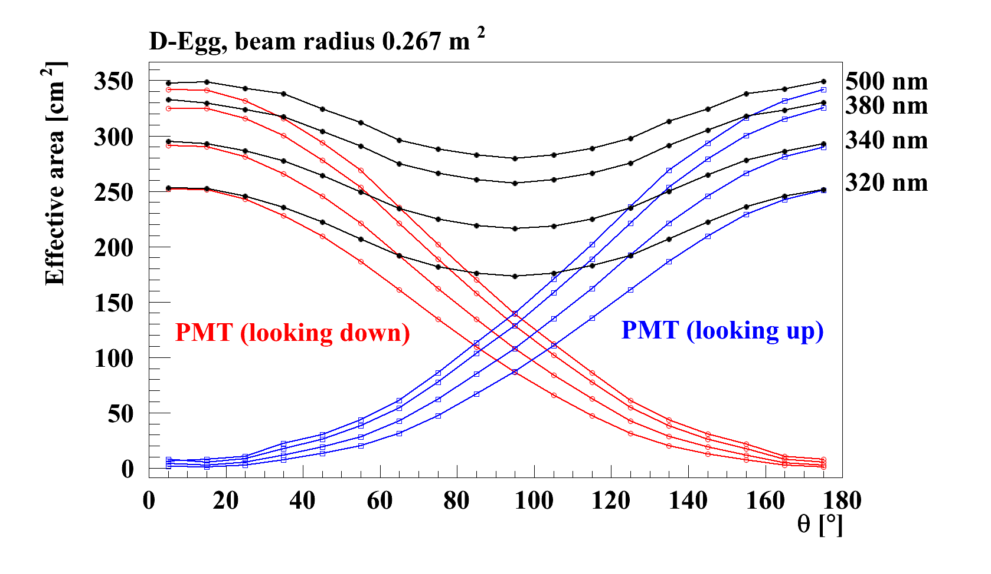
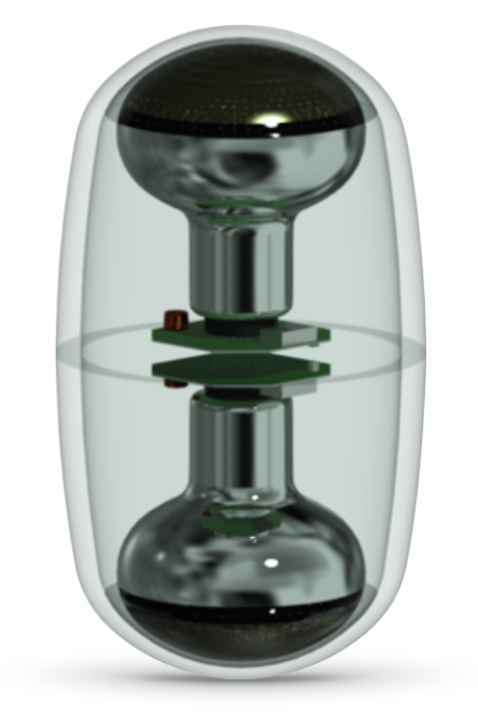
The D-Egg Dual 8” PMT + Improved Glass
My personal comments:
Whether or not we decide to use 2x 8” or 1x 10” PMT, the gains in UV photon collection from better glasses is well worth the research effort and should be a priority of the photodetection R&D.
Two PMTs could probably still be readout separately with new DOM mainboards equipped with two ADC channels. TODO: investigate whether individual UP/DOWN tube hits give increase in performance versus simple ganged readout.
D-Egg uses 2x 8” PMTs. Naively, one would expect only about 30% enhancement in the photon effective area, however, better collection efficiency relative to 10” PMT and massive improvements in UV transparency of glass.

Slide 20
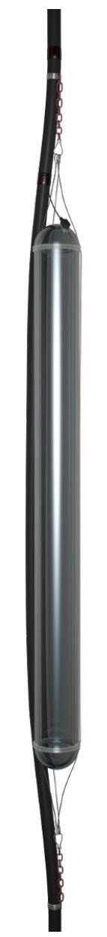
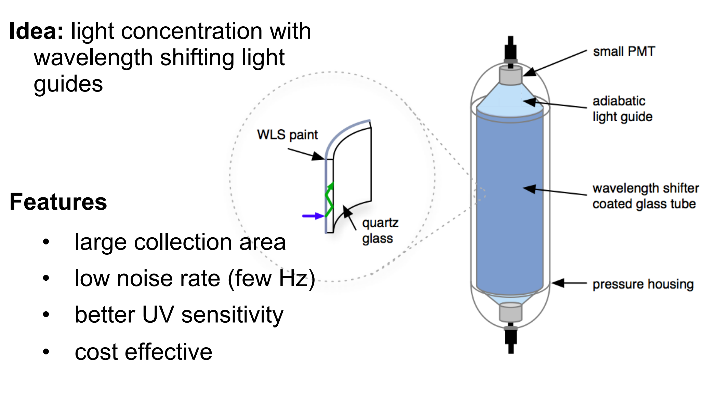
Wavelength-Shifting Optical Module (WOM)
Wavelength shifter painted on long cylindrical tube.
Two small 1-2” PMTs at each end
Time precision, if it does turn out to be worse than IceCube’s (< 5 ns) is a critical parameter for PINGU but not a critical parameter for HEA.
WOM has potential to dramatically increase effective photo collector area.
Still in early stages of development.

Slide 21
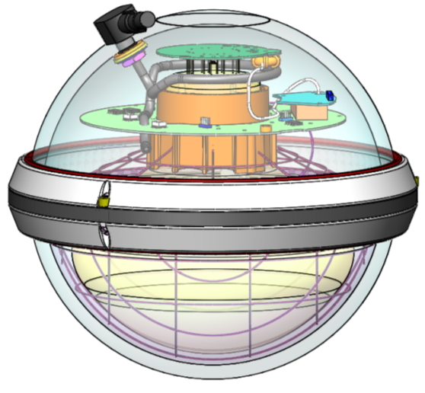
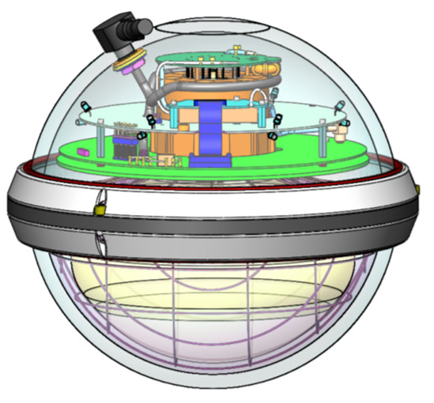
Evolving the IceCube DOM
To Improve
What’s good
Self-contained DAQ
300 MSPS, 14-bits (eff) waveform capture
Integrated high-voltage
0.5 Mpbs digital data comms
RAPCal: automatic clock sync in comms subsystem – O(1 ns) absolute precision.
Large-area, low-noise PMT
Pretty low-noise glass (500 Hz / 700 Hz background counting from STD/High QE)
Integrated optical calibration hardware (flasher board)
Very robust & reliable – of 5484 total channels deployed 5404 are now taking data.
Replace transient waveform capture ASIC with modern pipelined 14-bit 250 MSPS ADC:
    Eliminates need to pre-trigger ASIC (72 ns delay board)
    Unify 3 disparate gain channels to single channel – tricky calibration in IceCube
    Permit capture of arbitrarily long waveforms (currently limited to ~500 ns)
Update FPGA to modern process, high-density (Cyclone V)
Replace HV module (good performance but 25% efficiency)

Slide 22
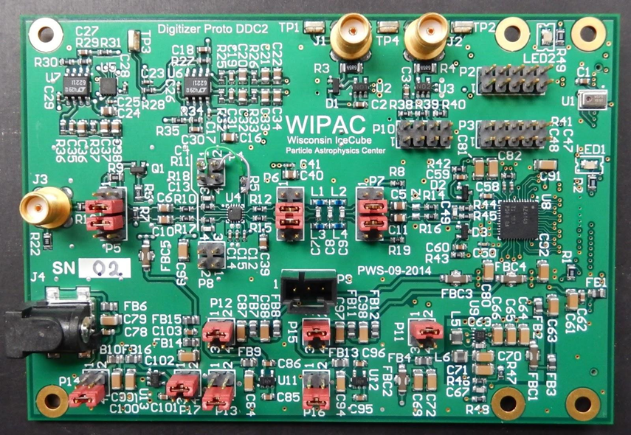
Gen2 DOM Electronics
Early prototype firmware with advanced features: full throughput at 250 MSPS (quad pipeline) and control via soft core Nios on Cyclone V FPGA.
T. Anderson – Penn State
Analog/digital front end boards fabbed 2015Q1 – good performance – 250 MSPS 14-bit, < 300 mW. Noise at 2 LSB. Plug-in via HSMC to standard FPGA development board.
P. Sandstrom - WIPAC
Rev0 Gen2 mainboard release planned for 2016Q1

Slide 23
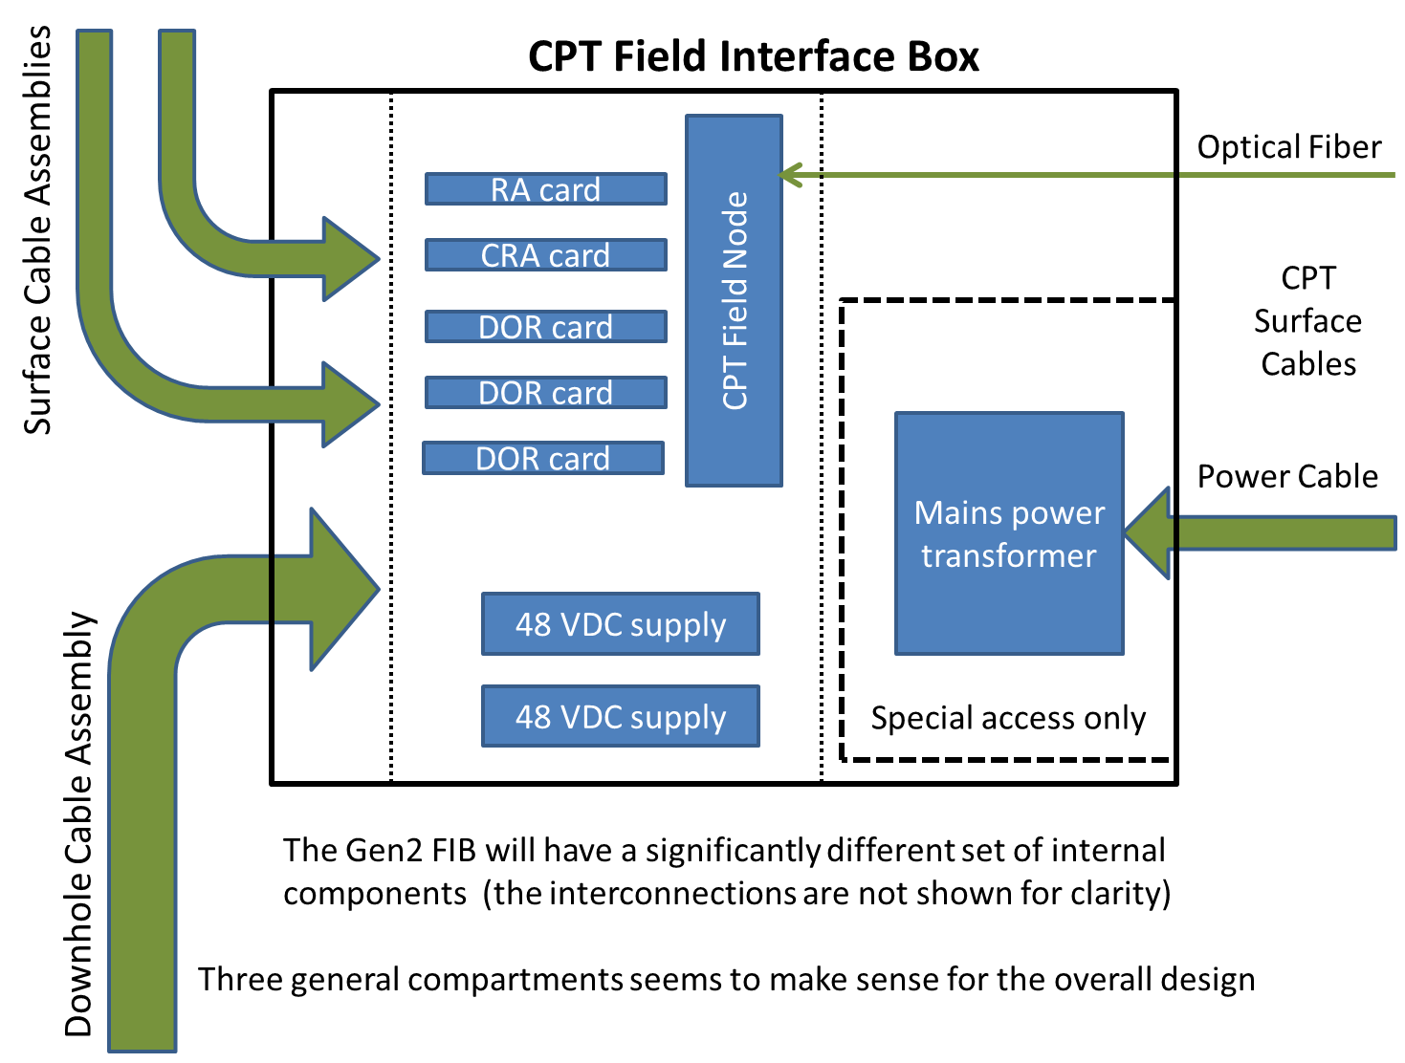
Field Hubs and Comms
Communications for large-scale array differ from IceCube. 3.5 km is approx. max distance → fiber out to holes (infinite BW). Downhole cables are then conceptually very similar to IceCube cables – actually shorter.
Ericsson out of cable business. However copper cable division passed to Hexatronic – MSU working with them on Gen2 cables.
Rev0 comms card (analog to IceCube DOR) is fabbed – in test (KH Sulanke – DESY)

Slide 24
Drilling

Slide 25
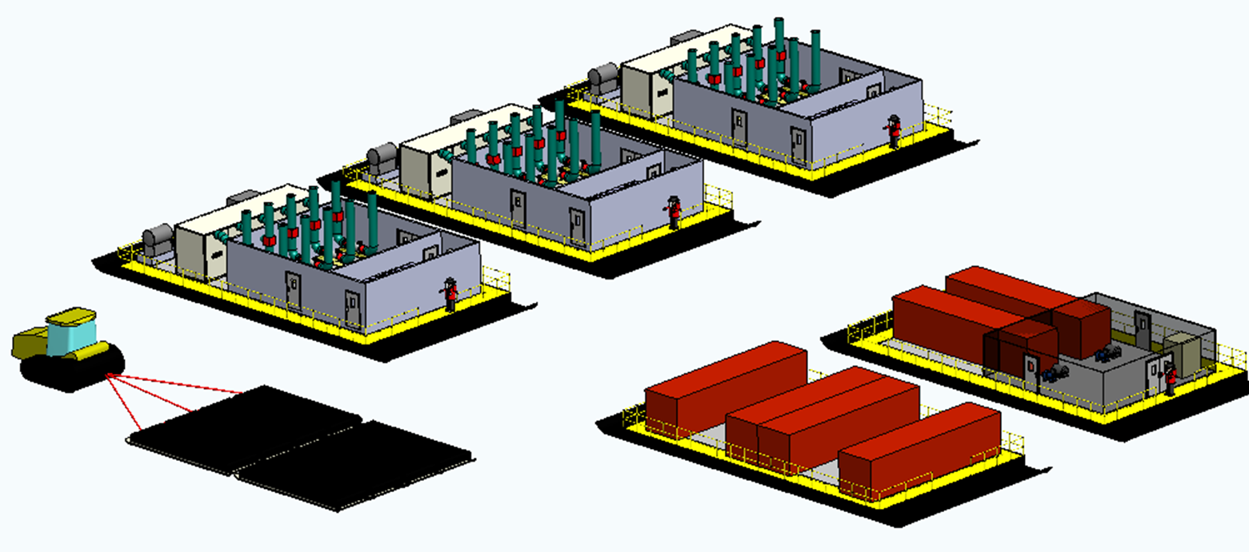
Mobile Drilling System
Meet or exceed EHWD thermal performance
G2 Improvements
4.7MW thermal delivery to drill nozzle
48 hour hole production rate
90% thermal efficiency
Safety
Mobility
Reliability
Degassed holes
(+8 hours)
Cleaner drill water
Reduced manpower
Reduced setup / decommission time
Quick Specs
Compatible with trending logistics
Hole diameter | 60 cm
Hole depth | 2600 m
Hole spacing | 300 m
Hole lifetime | 30 hr
Total Thermal Output | 5.4 MW
Nom. Thermal power delivered to nozzle | 4.7 MW
Dry weight (est.) | 365 tons
Fuel/hole | 21,000 L
Max holes/season | 20-23
Crew size | 28
Construction cost | $20 M
Equipment and fuel delivered to Pole via traverse, minimize dependence on LC130s
Reduced logistical footprint at Pole, smaller crew
Power Plant Sleds (3x)
Water Storage & Filtration
Fuel Bladders
Control Hub & Workshops

Slide 26
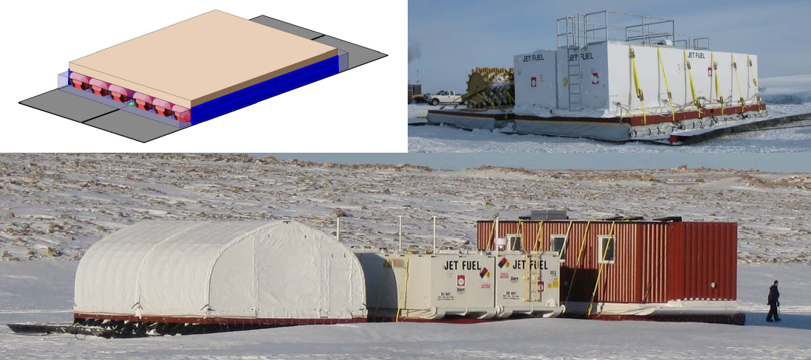
EHWD-G2: Air-Ride Cargo Sleds (ARCS)
Rigid deck atop of air bladders atop of PE panels
Far superior to ski-based traverse designs
In active development for high-payload traverses in Antarctic and Greenland
Drill system is “traverse ready”
Figure from Lightweight Cargo Sleds for Polar Traverses. Lever, Song, Weale. Polar Technology Conference 2014
Notes:
The great news here is that this idea passes Jim Lever’s sanity check, and he thinks it is a good idea and is willing to work with us on it. This sled concept is critical to mobility.

Slide 27
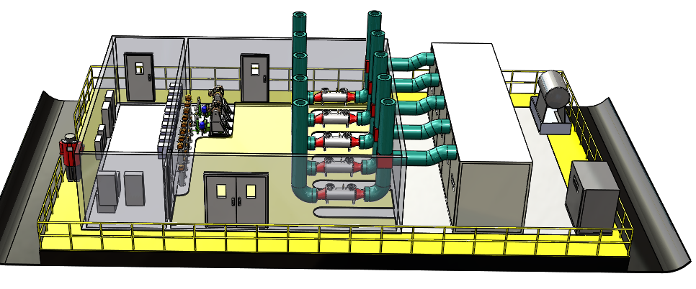
EHWD-G2 Overview: Power Plant Sled
High Pressure Pumps
Exhaust Heat Exchangers
C1000 Microturbine array
Fuel Daytank
Electrical Heater Bank
Electrical Closet
Air-Ride Cargo Sled

Slide 28
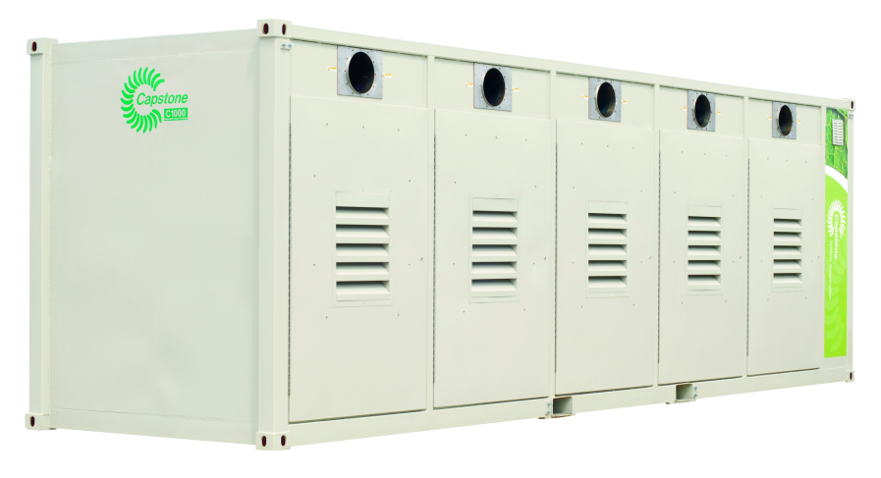
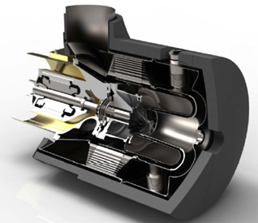
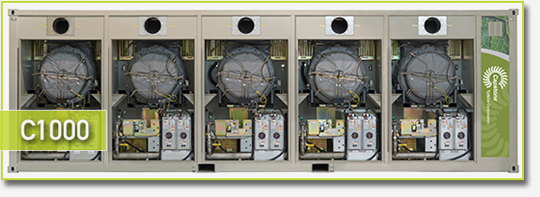
EHWD-G2: Microturbines
Fuel combustion in Capstone C200 microturbine. Flexible fuel – AN8 OK. High power density, low maintenance, ultra-low emissions. Easier recovery of waste heat. Combined heat and power thermal efficiency at 90%. Turnkey solution.
C1000 is 5 C200’s in parallel. Total output @ 3 km: 1.8 MW primarily from exhaust heat recovery. 3x power plants = 5.4 MW.
Challenges: large upfront cost – $1.5 M each; no experience in Antarctic environment. However Spring 2016 NSF is running evaluation at Summit Station in Greenland (J. Cherwinka).

Slide 29
Alternative Approaches to Consider
The preceding slides describe only one possible approach. Other approaches should be considered:
Minimal EHWD Restart (PINGU drill plan from 2013)
  Replace equipment
  Drill up to a couple dozen holes before boilers die
Other boiler options (fewer, larger boilers)
Hybrid options – some microturbines, some boilers
Alternative approaches are centered around thermal plant, whereas packaging is likely to stick with the air-ride cargo sled concept
Build two drills and cut production time by significant amount – this is now becoming the baseline plan.
Notes:
Other approaches and next steps will be discussed in the coming weeks

Slide 30
Project Matters
Cost & Schedule

Slide 31
Total Project Cost
Project cost is 300-360 Million USD /wo/ contingency. The input to the figures in the pie chart at right are based on IceCube numbers but, given the stage of the development, putting good estimates out at this point is very difficult. Inflation has been very low, costs associated with some items should go down.
Instrumentation costs alone are 150 M$.

Slide 32
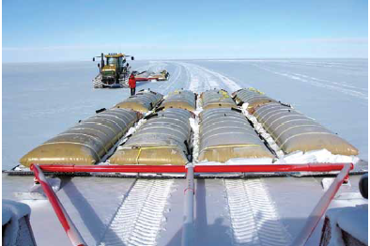
Logistics
McMurdo – Pole Traverse
It should be noted that MREFC projects include logistical support costs. In the current USAP environment this means that many aspects of the construction must be handled by the project itself (IceCube received support from RPSC, paying for it): transportation of people and cargo, housing at SP site, heavy equipment, …
Despite concerns in a recent NAS report that IceCube Gen2 would be a logistical burden on USAP, the opposite is probably true: a large construction effort is likely to bring more resources into the logistical infrastructure.
The traverse has supplied S Pole with fuel and cargo for several seasons and could dramatically reduce IceCube Gen2 logistics costs. Compared to the airlift capabilities of LC-130s (11,800 kg) the traverse capacity is 30x (354,000 kg). Travel time is 30 days to Pole, 15 days return.

Slide 33
Deployment Schedule
This schedule is premised on the drill being in the critical path. Instrumentation development is not explicity listed here but assumed available when holes are delivered.
Note: this schedule is achievable but is optimistic.
Of course money (== flights) could be spent to accelerate the shipping delays.
Notes:
Drill must be relocated after every 7 holes → probably each drill season practically deliver quanta of 7

Slide 34
Funding Status - Projections
The MREFC Process
A project this scale funded by NSF goes through the MREFC program (other examples: LIGO, LSST, …)
MREFC construction funds follow only after a now very formalized sequence of design phases paid by R&RA funds:
  Concept design: science, requirements, conceptual design plus initial cost, risk, and project execution plans;
  Preliminary design: technology development, better cost and risk models, and PMCS development;
  Final design: technology ready and buildable; complete bottoms up cost and risk; key staff members present.
Must pass all reviews - only then does MREFC construction money flow. MREFC construction funds are separate from NSF Directorates and pay all logistics associated with construction activities.
Once construction finished – operations phase again supported by the Directorates. In the case of IceCube Gen2, we anticipate only modest increase in operating budget. IceCube is one of the most economical facilities in operation in the NSF large facilities portfolio.
We are still in the development phase – i.e. NSF has not committed any funds for design work. We are working with our program officers and expect to make a proposal for conceptual design work within the next 6-9 months.
Current Status
Support from international collaborators is an important asset and it appears that significant non-US funding contributions are not only possible but likely. Of course everyone, including NSF, acknowledges that NSF must be the first to commit resources toward such a project.
Foreign Funding

Slide 35
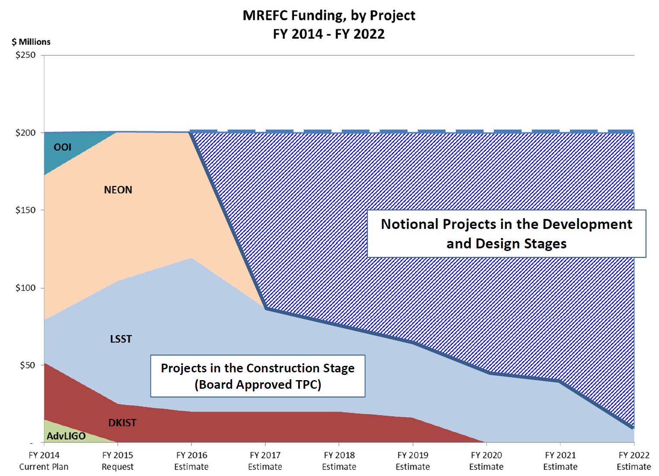
MREFC Budget
Figure at right shows NSFs long-range MREFC planning. NEON was recently de-scoped and may end sooner than planned.
No projects aside from AIMS and RCRV – both GEO division – in MREFC queue. There could be others in development stage like IceCube Gen2.
Assuming budget stays flat, there is budget in MREFC account past 2018.

Slide 36
Summary
Neutrino astrophysics has come from limit setting to detection to confirmation in just over 2 years. The field is alive and invigorated – we now have events but what are their origins?
The Collaboration is looking to issue a more detailed LoI to follow the Whitepaper using our current baseline.
IceCube Gen2 is not just more DOMs. It is a wide band neutrino observatory (MeV – EeV) that will use a number of detection technologies – optical, radio, and surface veto – to achieve the science in this rapidly evolving new field.
  The initiative has stimulated research into new photodetection – multi-anode PMTs, better glasses, and wavelength shifting materials for use in ice.
  Rethinking radio detection, in particular with an eye on scalability to large arrays is also prudent.
  Surface arrays may help significantly – we need R&D money to fully explore our options
In every possible scenario, this is a large-scale project which will not be completed within ten years from this point.
Technically the project is feasible given the long experience with IceCube.
Funding is challenging and spans many constraints in many countries, however a window exists.
NEW! KM3NeT is happening – this is great news we congratulate them and look forward to data from the Med.

Slide 37
The END – Mahalo!

Slide 38
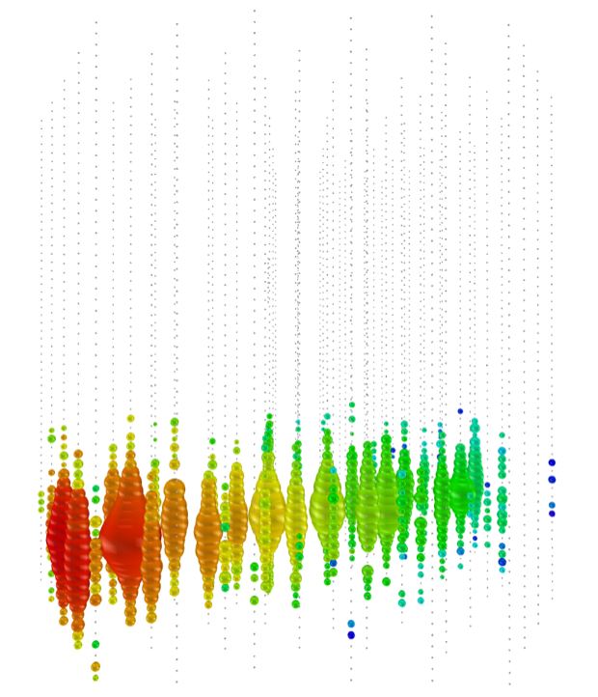
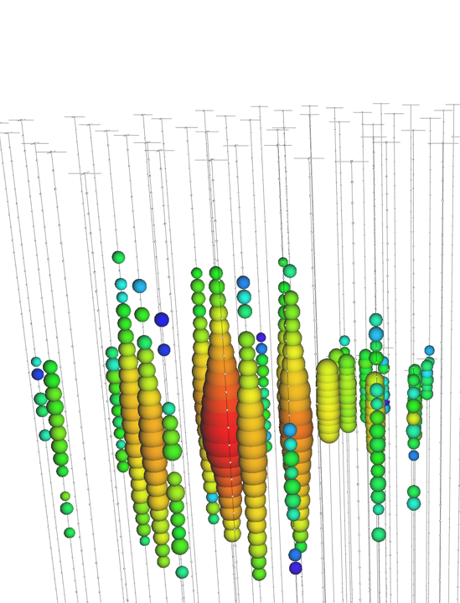
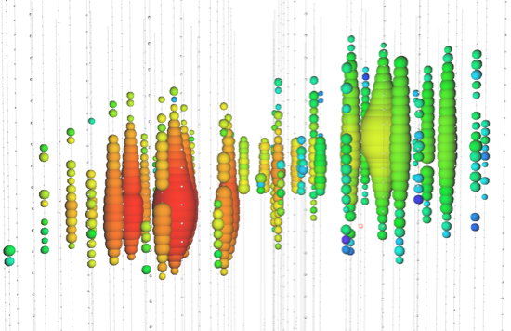

Neutrino event signatures
Charged-current νμ
Neutral-current / νe
Charged-current ν τ
(data)
(data)
(simulation)
Up-going track
“Double-bang”
Isolated energy deposition (cascade) with no track
Factor of ~2 energy resolution
< 1 degree angular resolution
15% deposited energy resolution
10 degree angular resolution (above 100 TeV)
(none observed yet: τ decay length is 50 m/PeV)
Early
Late

Slide 39
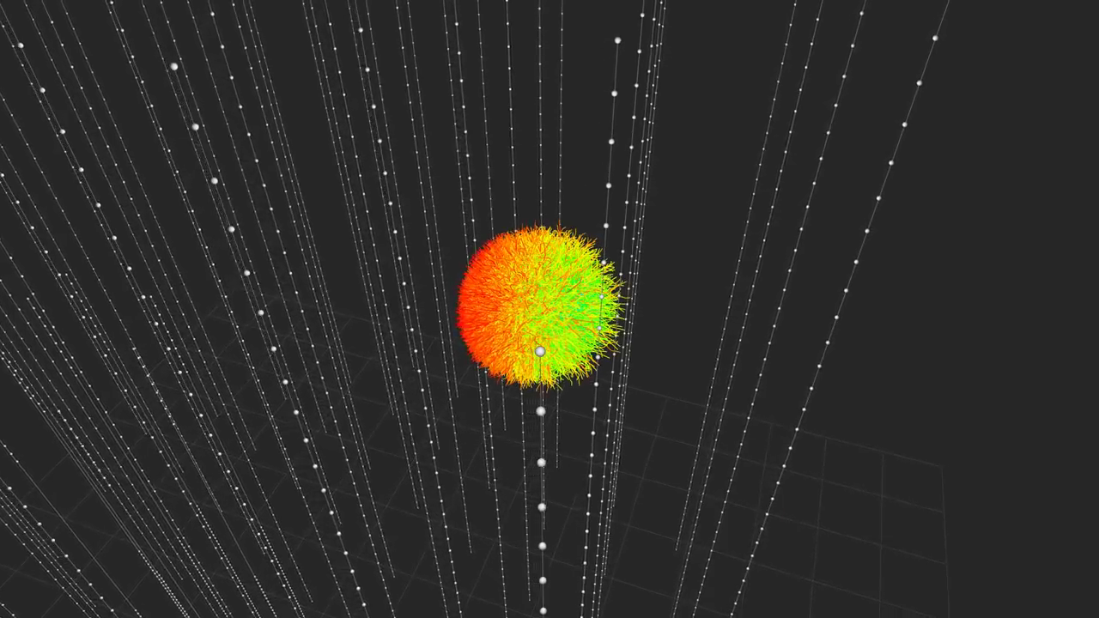
An electromagnetic cascade in ice
(C. Kopper)

Slide 40
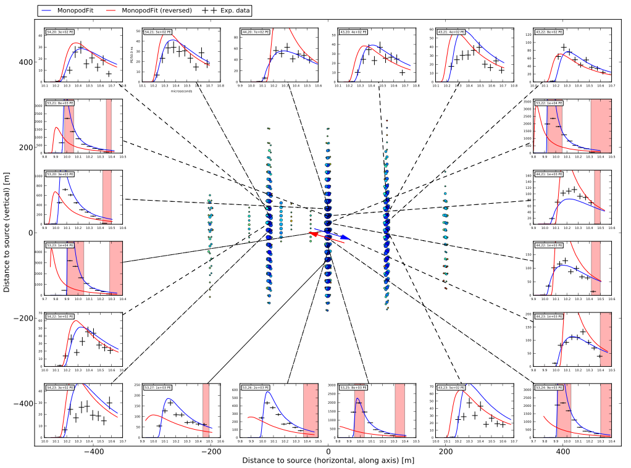
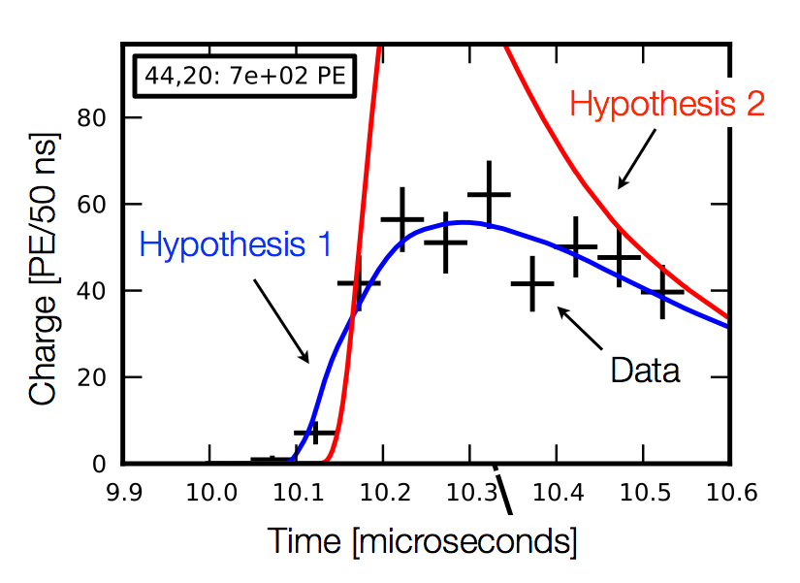
Likelihood fit: Millipede/Monopod

Slide 41
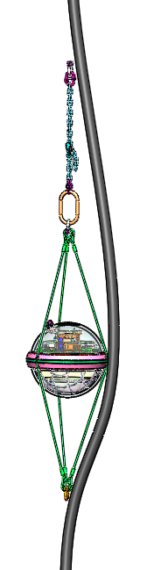
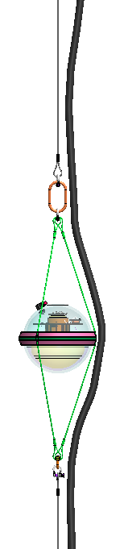
Proposed PINGU String Architecture
Cable
Grip
Adjustable
Link Chain
Wire
Rope
Link
Main
Cable
Lifting Ring
MainCable
1.5m Harness
Breakout
Cable
Assembly
(BCA)
To “T” DOM
Lifting
Ring
1.75 m Link
Cable
Breakout
Lifting Ring
“U” DOM
1.75 m Link
PDOM
Harness
PDOM
Connector
(0-3)
Lifting Ring
1.5m Harness
To Quad
Breakout
Cable
Grip
5m PDOM
Spacing Shown
IceCube Detail
PINGU String
PINGU Detail

Slide 42
Drill Costs (EHWD-G2, 1 Drill Scenario)
Drill development and construction | $25 M
9 field seasons | 9 * $1.2 M
Setup / teardown | $1.8 M
Costing for the 2 drill scenario has not been worked out …
Cost reduction of 3 seasons will be eaten up by larger drill crew footprint per season.
It’s going to be significantly more expensive building and operating 2 drills vs 1.

Slide 43
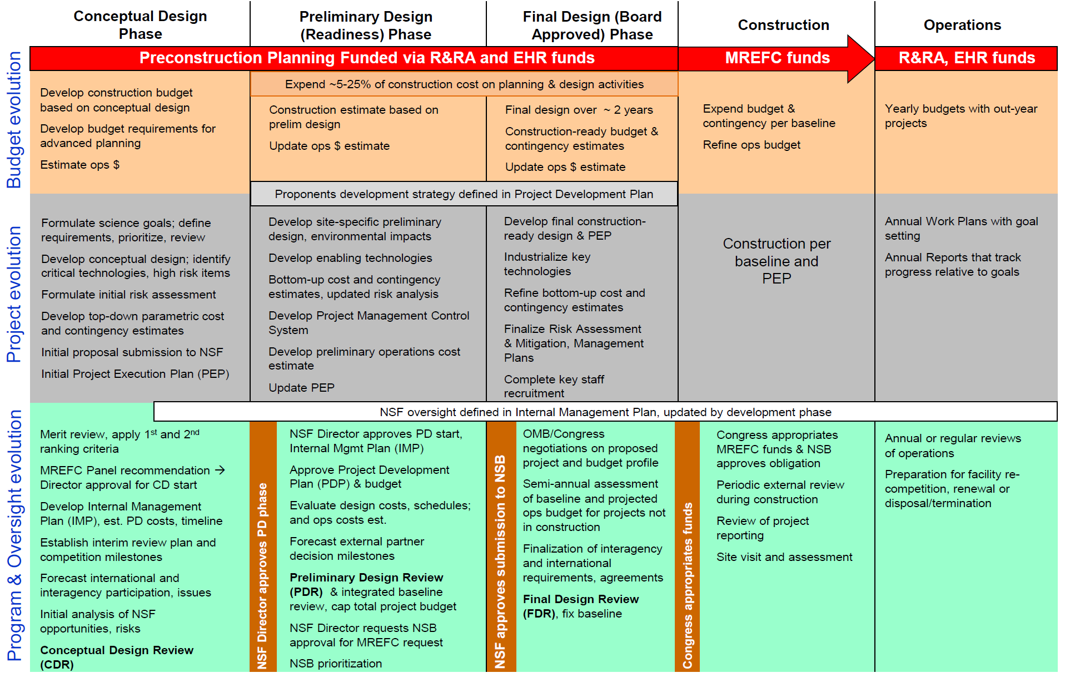
MREFC Process

