Slide 1
Feedthroughs & HV supplies
Sven Vahsen 4/1/2015

Slide 2
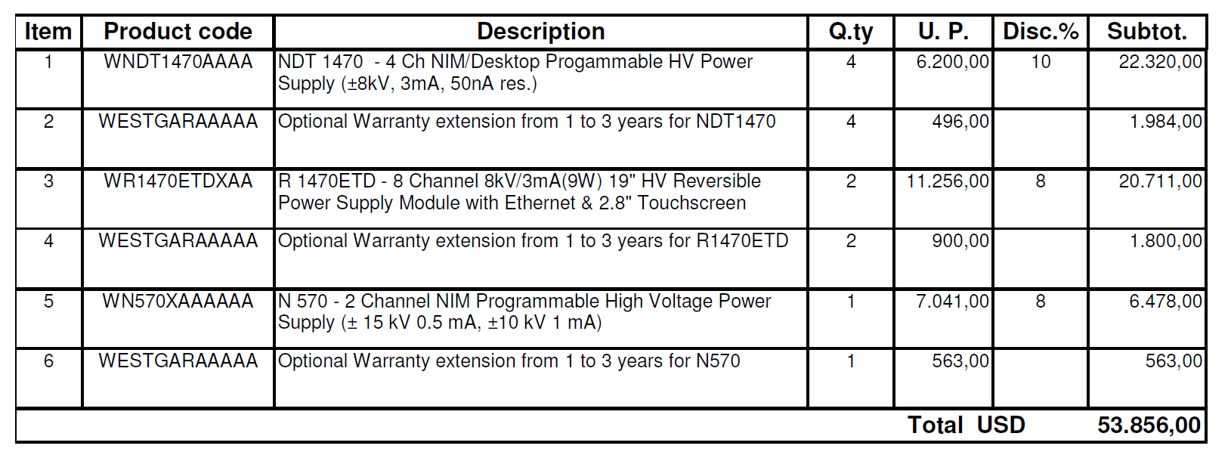
HV supplies: quotes
10-15 KV CAEN HV supplies are to pricey (~$25k for 8 channels of 15kV)
So, I want to buy 16 channels of 8kV. Now. Delivery time is 10 weeks.
Bonus: We can use the extra channels for other detectors in phase 1
Also will buy one extra NDT 1470 (4x8kV) w/ startup funds for our lab. Can use this for production testing at UH.

Slide 3
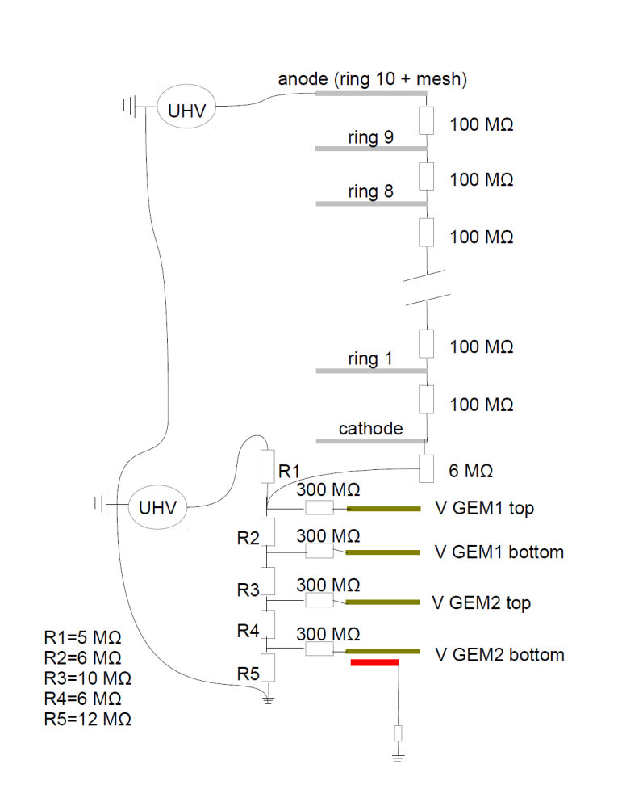
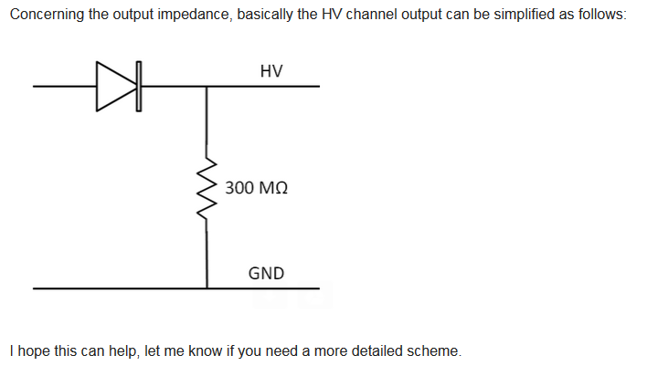
HV supplies: Negative currents

Slide 4
Feedthroughs: approach
Waiting for quote for welded 316 stainless sideplate w/ welded fdthrus
Will in addition get 2 aluminum sideplates w/o holes. We can use these for leaktesting, and mount or own base-plate feedhthrouhgs if we want
After first two vessels, decide on stainless+welded versus aliminum+baseplate for the remaining six vessels.

Slide 5
Welded feedthrough quote (Ceramtech)
Quoted amount: $7,172
Budgeted amount: $15,848

Slide 6
feedthrough plate
Sven Vahsen 3/25/2015

Slide 7
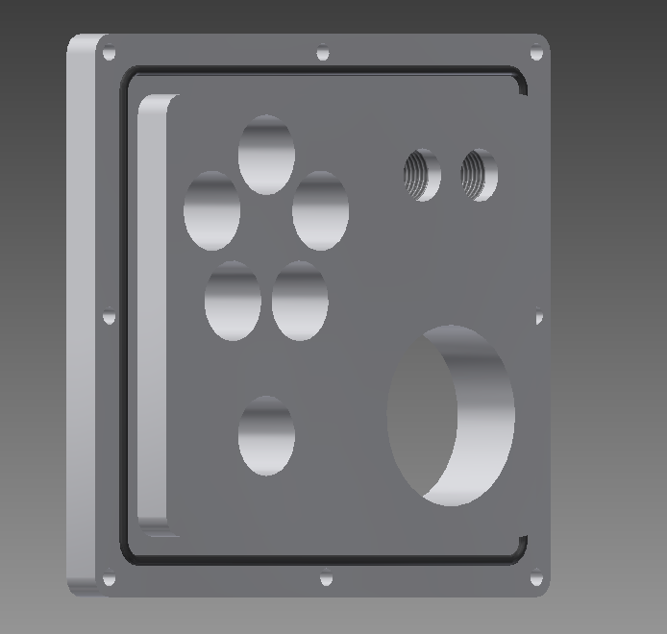
Option1 : welded electrical feedthroughs
2 x threaded hole : for 1/8 NTP fitting http://swagelok.com/search/find_products_home.aspx?part=SS-400-1-4&item=20b6dcb5-5a04-42f1-9df7-a5d3fd3672c3#
5 x SHV : 1/2" holes ($60) http://www.solidsealing.com/parts/documents/FA12842SL.pdf Solid Sealing part number FA12842 ($60 / each)
1 x mil-C 19 pin: 1 1/8” hole ??? Ceramtech part # 16003-02-W http://shop.ceramtec.us/catalog07/view_subsubsection.cfm?SectionID=36&SubsectionID=237&SubSubsectionID=215
1 x BNC : 1/2" hole ($35) http://www.lesker.com/newweb/feedthroughs/instrument_feedthroughs_bnc_singleend.cfm?pgid=weld
swap
Swap one of the NTP holes with the BNC hole

Slide 8
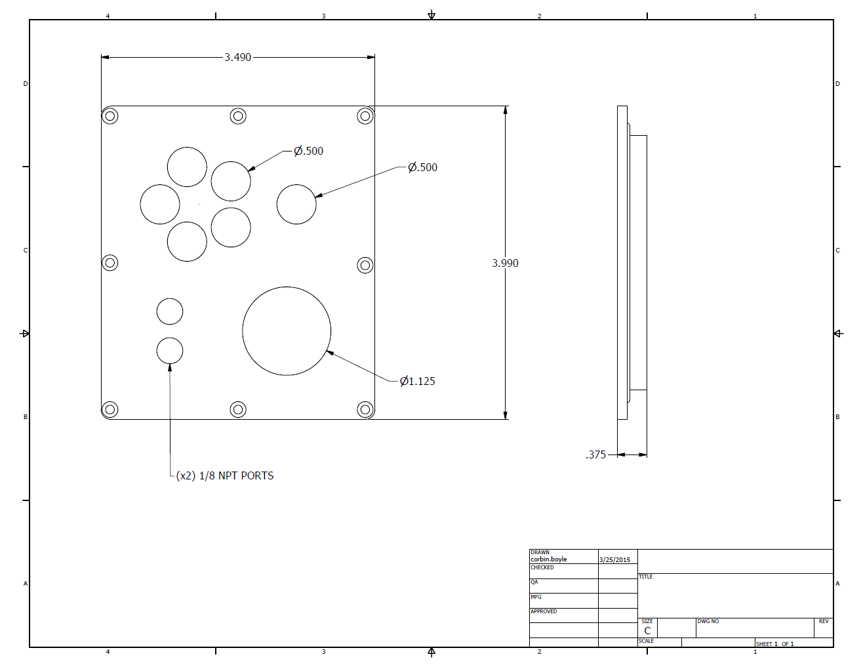

Slide 9
We may want to move around the feedthrough locations as shown above – let’s revisit the exact positions after we have 3D CAD in hand

Slide 10
Backup material – please ignore

Slide 11
Open questions
Exact positioning – wait for 3D CAD
Nickel in HV feedthrough pins – problem?
Is there shielding on vacuum side of 10-kV baseplate feedthrough? Exposed option possible?

Slide 12
Option 2: baseplate electrical feedthroughs
1 x SHV : 1.0” hole (1x$225) http://www.lesker.com/newweb/feedthroughs/instrument_feedthroughs_shv5_singleend.cfm?pgid=baseplate
Mil-C:
$480 for 10 pins: http://www.lesker.com/newweb/feedthroughs/instrument_feedthroughs_multipin_ms_singleend.cfm?pgid=baseplate
$325 for 10 pins w/ air side plug
http://mpfpi.com/stock-products/multipin/ms-multipin/multipin-10-pin-700v-10a-baseplate.aspx
2 x threaded hole for 1/8 NTP fitting. < 1/2" (not sure of exact size)
swap

Slide 13
Feedthrouhg on long side of vessel
SHV-10: $300 http://www.lesker.com/newweb/feedthroughs/instrument_feedthroughs_shv10_singleend.cfm?pgid=baseplate

Slide 14
Weldable BNC
Single side BNC : 1/2" hole ($35) http://www.lesker.com/newweb/feedthroughs/instrument_feedthroughs_bnc_singleend.cfm?pgid=weld
Stainless pin, alumina insulation
Single side BNC : 1/2" hole ($35) http://www.mdcvacuum.com/DisplayProductContent.aspx?d=MDC&p=i.2.1.1.3&g=m61011
Stainless pin, alumina insulation
Single side BNC : 1/2" hole Solid Sealing part number FA10326 ($25) http://solidsealing.com/parts/documents/FA10326SL.pdf
Nickel pin, not ideal

Slide 15
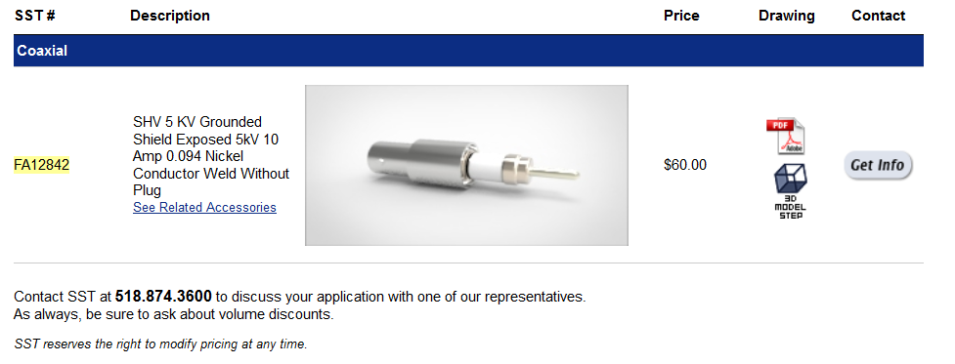
Weldable 5-kV SHV

Slide 16
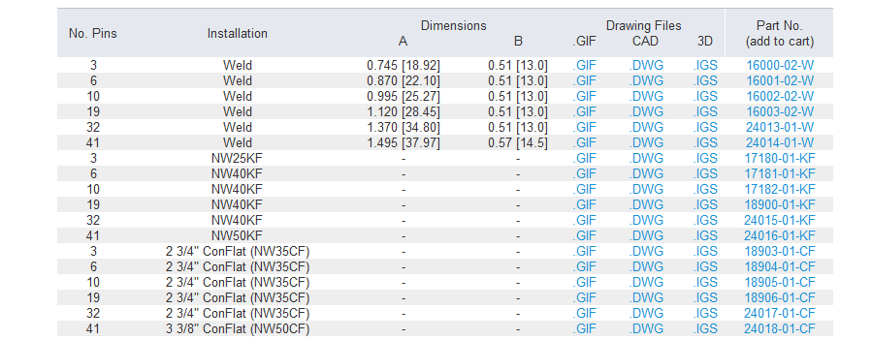
Weldable MIL-C 19 pin
http://shop.ceramtec.us/catalog07/view_subsubsection.cfm?SectionID=36&SubsectionID=237&SubSubsectionID=215
Ceramtech part # 16003-02-W

Slide 17
Other options [Ignore]
mini HV: http://shop.ceramtec.us/catalog07/view_subsubsection.cfm?SectionID=35&SubsectionID=285&SubSubsectionID=263

Slide 18
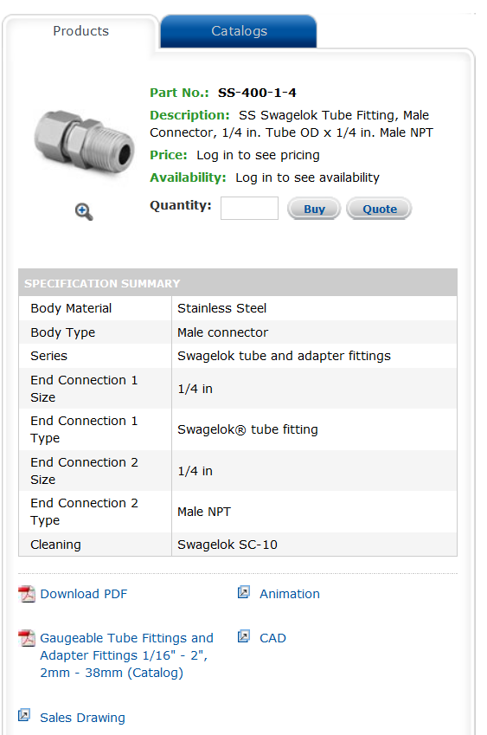
NPT fittings
http://swagelok.com/search/find_products_home.aspx?part=SS-400-1-4&item=20b6dcb5-5a04-42f1-9df7-a5d3fd3672c3#

Slide 19
# MIL-C pins needed
LVDS: 8 (ethernet cable)
LV: 2
HIT-OR: 1
Copper plate R/C circuit: 1
-----------------------
12 total

Slide 20
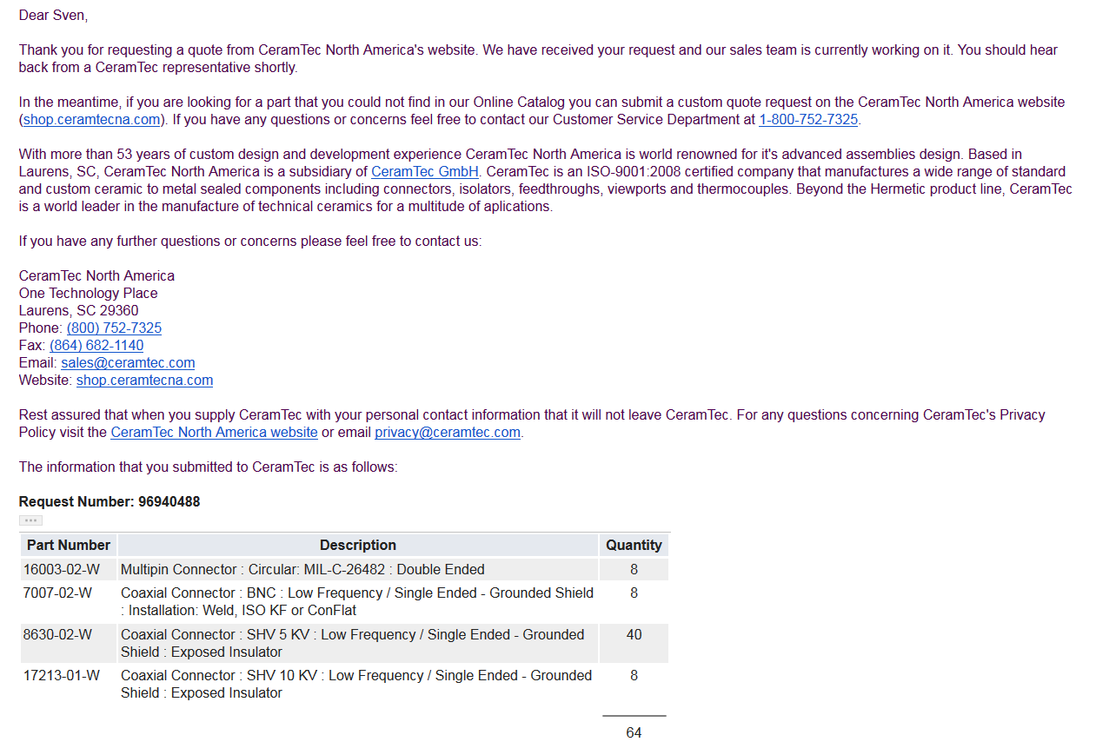
All from one vendor?

