Slide 1
Vacuum vessel and
HV supply purchases: Status
Have quotes in hand for both (attached pdfs)
Both under budgeted amount (budgeted versus quoted for all parts will go into Wiki)
Would like to order ASAP
There are, however, a few open questions to be addressed before placing orders

Slide 2
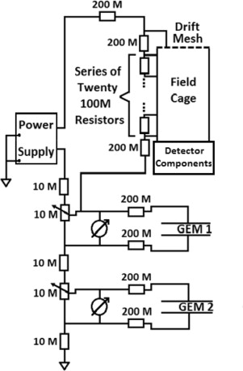
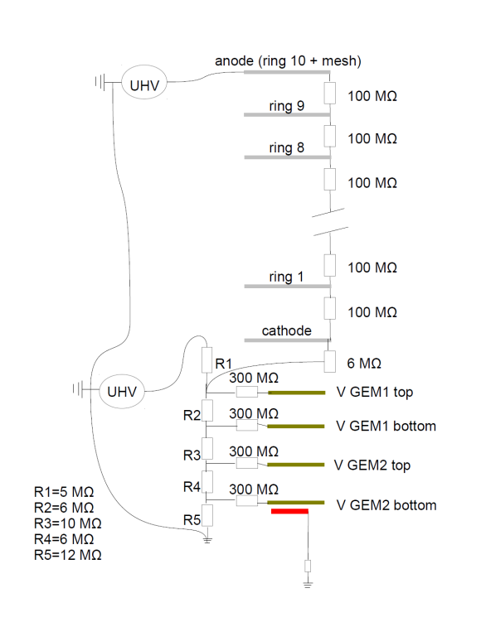
Open questions: HV supply
Note: We have decided on 10 cm field cage
  approved by PNNL / DOE
The supply will be 8kV
Need updated resistor network diagram to check compatibility of our intended use case with vendor
  Need to finalize resistors values
LBNL
Hawaii
R1 to R5 values can be multiply by 5, above 5 the resistors will be too big to fit on a small bread board, note the 300MOhm resistors should also be multiplied by 5
I = 102.564 (51.282) nA for HV in = 4 (2) kV, with resistor values x 5, I = 20.5128 (10.2564) nA for HV in = 4 (2) kV

Slide 3
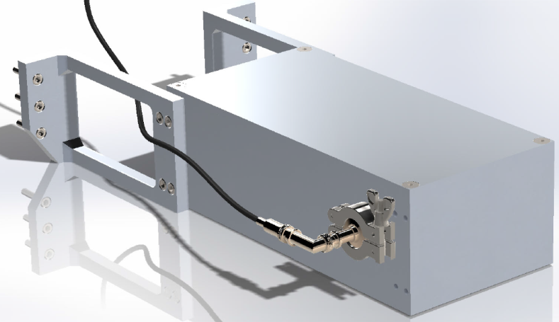
Open questions: Vacuum vessel
Need to decide how to structure order
  (build 2 vessels first, the six more after we inspect the first 2)?
Need to finalize SHV feedthrough for field cage
  Will sit on side of vessel
  Point at He-3 tubes in Belle II dock space
  CAD study shows it fits
  Need select feedthrough mounting type + connector type
    KF-16 versus base plate
    Mini-HV (90 degree) versus SHV (does 90 degree exist?)
  Need to ensure explicit Belle II approval for using this space
I’m assuming vessel design will not be affected by grounding scheme and feedthrough plate design choices, which are not 100% finalized

Slide 4
Next steps
Finalize resitors estimate, send resistive network to vendor (CAEN) tomorrow
Look for final UHV feedthrouh, connector, and request Belle II approval (to who?) + final CAD checks (by Alex) tomorrow
Order vessels / HV supply and as soon as we hear back from Belle 2 / CAEN
Upon order, we get detailed vessel cad for review
Once we OK CAD, construction begins

Slide 5
Also urgent / closely related
Finalize feedthrough plate on front of TPC vessel
Finalize grounding scheme

