Slide 1
Correspondence with Corbin @ HuntVac

Slide 2
Jan 13
Sven,
Thanks for the call.
Just to recap (and so I don’t lose my notes):
· Redesign AL box vessels.
· QTY of 8 total, some may have slight dimensional variances.
· Look into an agreement on producing 1 or 2 first for trial, then issue the remaining units later.
· Major design change is to make side plate with fdthrus removable, and have fdthrus welded directed to plate to eliminate claw-clamps.
· HML to price first with general welding labor for the fdthrus. Look into supplying fdthrus later on.
· Change O-ring design to dual dovetail to accommodate both positive and negative pressures.
· Run simulation on different top lid thicknesses as well as adding additional bolts to rectify bowing/sealing issues under positive pressure
· Titanium inserts for all threads
· Reduce depth of plate mounting slots to enable production with CNC Mill rather than EDM.
· Reduce overall outside length to 26 cm.
· Keep Parylene coating on inside of vessel.
· Add NW16 port for 8kV fdthru on side of vessel while keeping minimal profile.
Feel free to add onto this list if I left anything out, or if something else comes up.
Looking forward to working with you!
Best Regards,
Corbin J. Boyle
Technical Sales
Huntington Mechanical Laboratories
Jan 14
Hi Corbin, Thank you for the productive meeting and excellent summary. It all looks good, but I have one change request: When we talked (and in my slides), I requested that the vessel length be reduced from ~31cm to 26cm. However, in a subsequent meeting with our collaborators in Japan they confirmed that the original 31cm length is almost certainly fine, and fits in the intended space. So please just keep the vessel at 31cm outer length for now. (It may not have been exactly 31cm since we were not using metric units before, in which case you could just make it 31 cm exactly now).
best regards, Sven
----------------------
Hi again, I think two things are missing from the list
- threads for mounting brackets, 16 total, 4 near each corner
- position both mounting slots 5cm from inner surface of vessel ends
Best regards,
Sven

Slide 3
Jan 19
From Corbin:
I am working on the new side plate design, but I have a question about the electrical fdthrus you are using.
Do you know what size holes they are going to need to be welded in to? Right now I am using ½” holes for these BNC connectors, but I am not sure if that is the size of the ones you intend to use.
I also need to know the sizes for the other multipin fdhtrus.
Basically I am making the side plate socket into the wall of the vessel and seal via and O-ring along with additional mounting screws so they it keeps a good seal under both positive and negative pressure.
Jan 20
Hi Corbin, You CAD figure looks great - exactly what I had in mind for the feedthrough lid. I went and measured the feedthroughs we plan to use with a caliper, see list below. Please note: this list is preliminary. One reason for going with the removeable lid, is that we can change the list of feedthroughs later if needed. For that reason it would be ideal if the welding of these feedthroughs can be broken out in the quote. Even just a quote without any feedthrough welding would already be very useful to us for planning.
[I said we would do all dimensions metric, but these feedthroughs all seem to be made to British units, and my caliper measures inches only.]
5 x SHV (5 KV): 1/2" hole
1 x BNC: 1/2" hole 1 x mil-C 19 pin feedthrough: 1 1/8" hole
2 x threaded hole for 1/8 NTP fitting. < 1/2" (not sure of exact size)
thanks, Sven

Slide 4
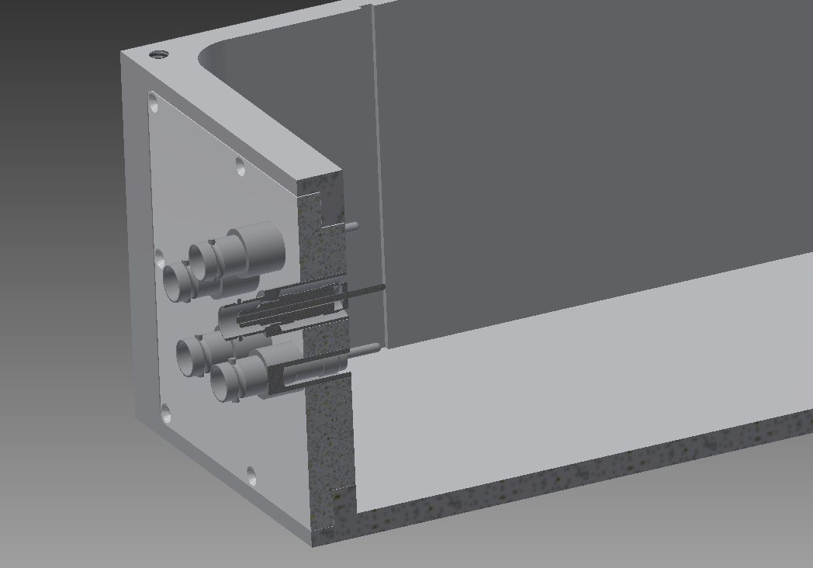

Slide 5
VXD Dock mechanical compatibility check by Alex (Victoria U.)

Slide 8
1/23/2015 Update

Slide 9
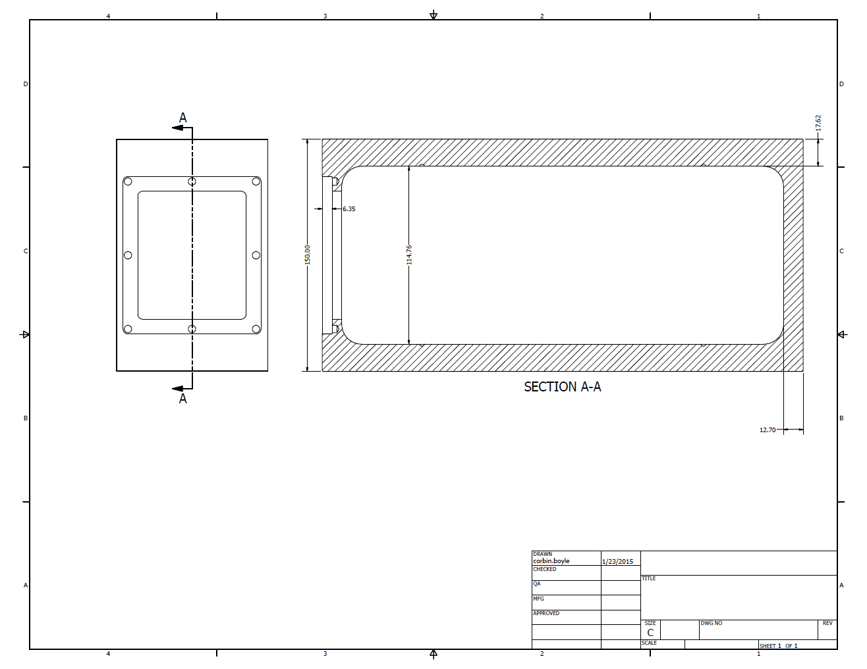

Slide 10
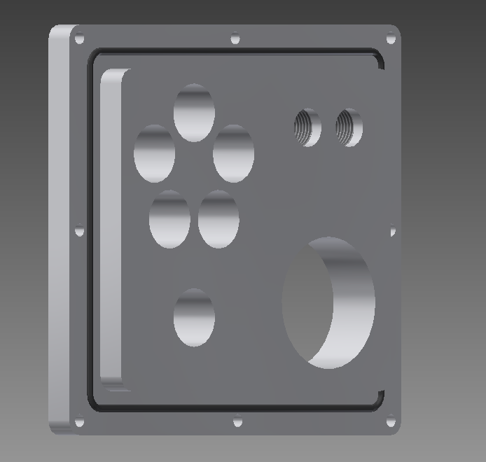

Slide 11
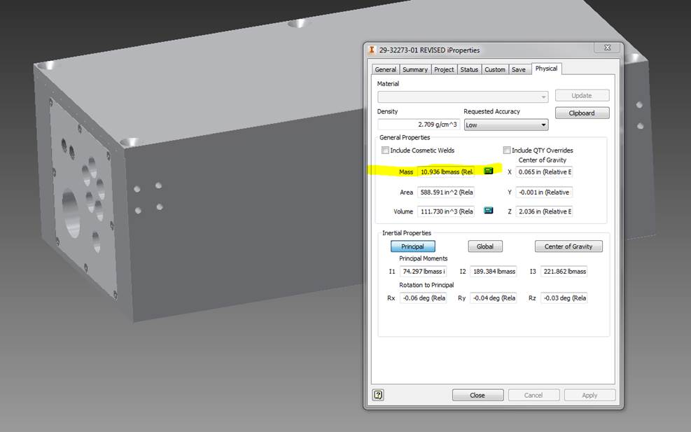

Slide 12
1/26/2015 Update

Slide 13
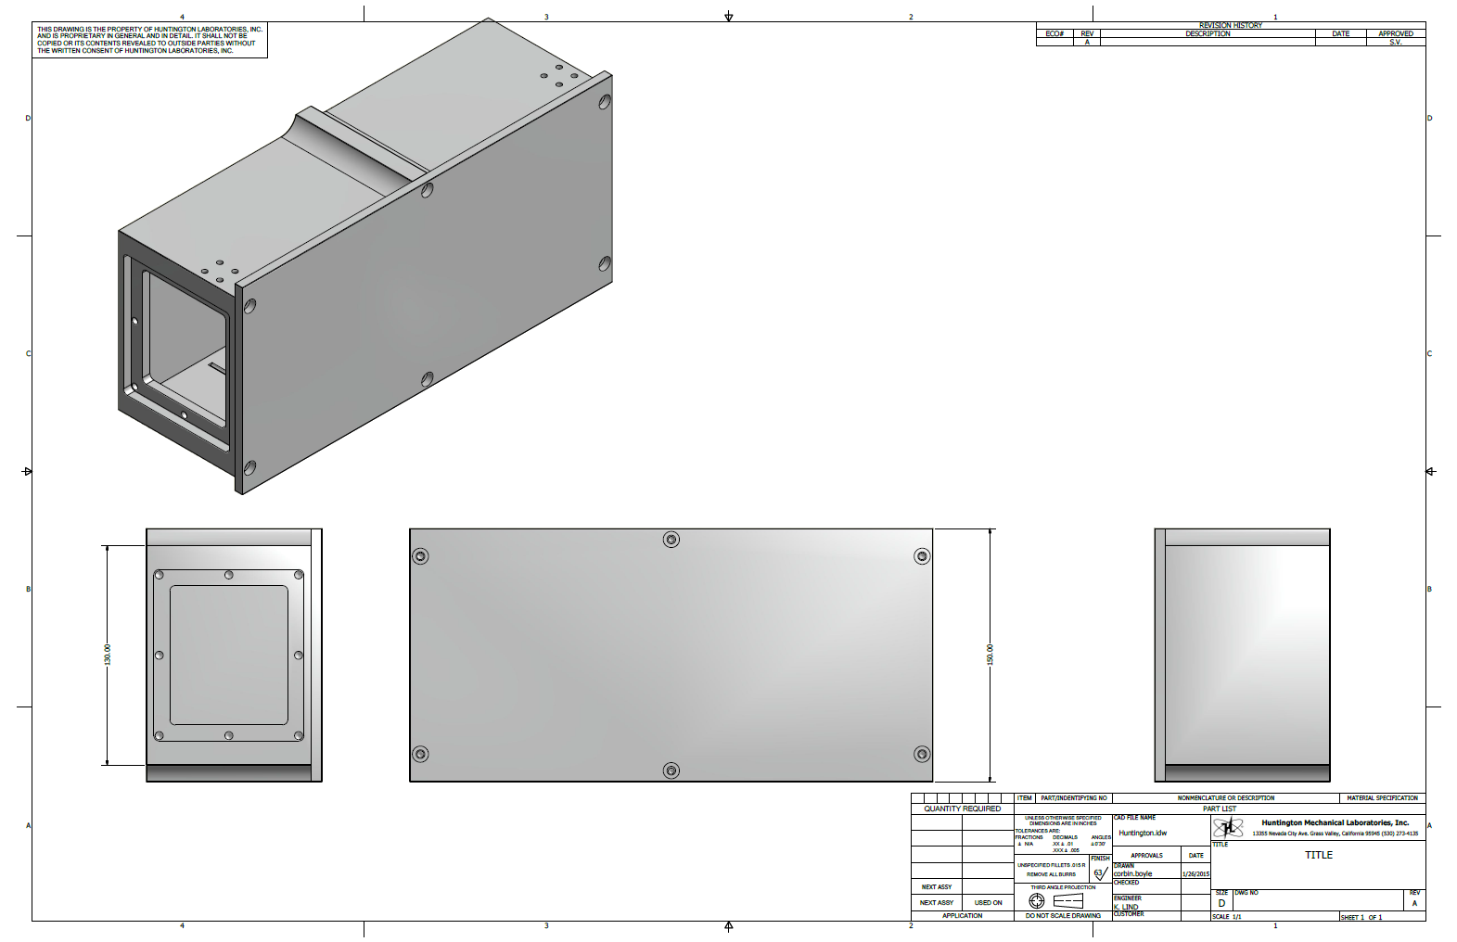
Lid can match vessel, but will drive up cost
I had wanted lip on inside
OK from HuntVac (discuss)
Will round to avoid sparking
Other remaining changes
Screw for vacuum seals:
SHCS (discuss)
Metric
Move mounting holes

Slide 14
Cost estimates versus original budget
HuntVac rough cost estimate:
1 vessel: $3700
8 vessels: $2500/vessel
Parylene + end-plate w/ feedthroughs will result in extra charge
We have $3442 / vessel left in budget for this
May have to cover LV plugs, also
Budget looks OK!
Major part | component | vendor quote from | cost/item | quantity | total cost
vessel | vacuum vessel | Huntington Vacuum Products | 3961.5 | 8 | 31692
 | vacuum vessel NRE | Huntington Vacuum Products | 2050 | 1 | 2050
 | vacuum feedthroughs | Solid Sealing Technology | 283 | 56 | 15848

Slide 15
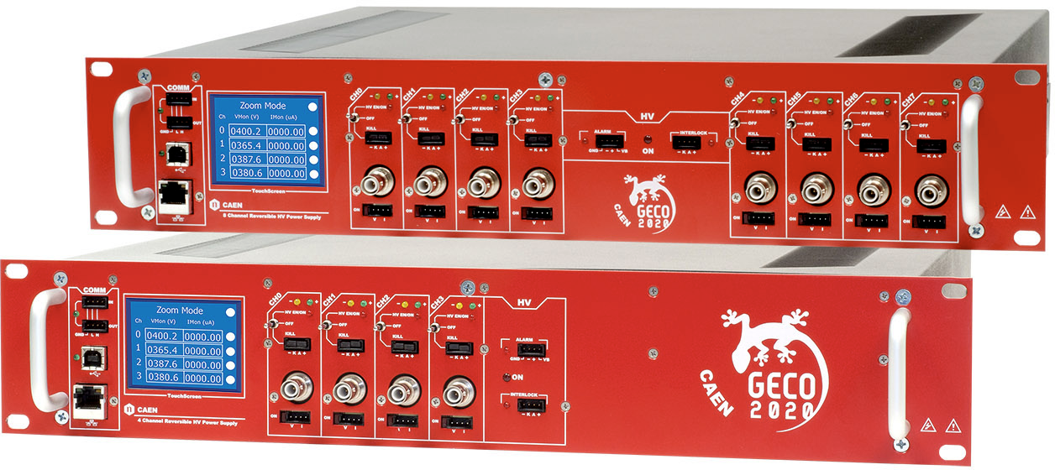
HV supplies

