Slide 1
BEAST TDR Status (Belle-wide)

Slide 2
Getting the TDR latest version
access via a web browser. https://www.phys.hawaii.edu/repos/belle2/beast/
Checkout under linux: svn checkout https://www.phys.hawaii.edu/repos/belle2/beast/
to build the TDR, use: pdflatex --shell-escape tdr_beast.tex
If you need svn access, email the following to sevahsen@hawaii.edu:
your preferred user name
the hostname(s) you will be connecting from (i.e. kek.jp, etc). (The UH sysadmin here will only allow specific hosts to connect)
→ Sven will then let you know your password

Slide 3
Schedule
May 1st: BEAST TDR draft
Including preliminary or final figures
Review and discuss outstanding issues during May 7th BEAST meeting (→ May 14th)
May 24th: BEAST TDR final version: HARD DEADLINE
Sven to integrate w/ US Belle II TDR, send out for final proofreading
May 31: Completed US BelleII TDR
In addition, suggest we turn BEAST TDR into standalone Belle note. Can it be published in JINST or similar?

Slide 4
Status of TDR sections
Chapter / Section | Authors | Status
US Role - only needed for US Project | Vahsen & Asner | CDR version in place, only minor revisions needed
Goals of BEAST, from Belle II perspective | Vahsen & Tanaka | ?
Goals of BEAST, Machine perspective | Funakoshi and Kanazawa ? | New text in place, only minor revisions needed
BEAST contributions - list/overview of subsystems for each commissioning stage, who is responsible for each, w/ CAD drawing of each stage | Vahsen, Drawing by Rosen | Rosen working on drawings, Vahsen not started on text
Beam BG simulation overview | Nakayama ? | New text written, not in SVN yet
BEAST specific simulation | Jaegle, Vahsen | ?

Slide 5
TDR authors II
Chapter / Section | Authors
PIN diodes | Cinabro | CDR text exists, needs some revision. Need new diode locations for CAD.
VXD systems incl. beam abort (SDDs, Diamonds) | Marinas | CDR text exists, but needs major revisions.
Luminosity Monitoring Device (BGOs) | Minzu Wang ? | TDR update in place, text needs only minor revisions
Micro-TPCs | Vahsen (text results) & Jaegle (simulation results) | CDR text in place, but needs major revisions. Needed for CAD.
Support Stucture & Mechanical | Rosen / Vahsen / Tanaka | Rosen working on drawings, but cannot be finished before all subsystems completely specified. No text exists
DAQ & interface w/ accelerator | ? | Sufficient to include with each subsystem?
Planned measurements | all / Vahsen / Browder? | Include in goals chapter

Slide 6
Status of UH TDR deliverables

Slide 7
Text – see previous pages
CAD style figures
BEAST T0 (Marc)
BEAST T1 (Marc)
BEAST T2 (Marc)
CAD or G4 model of single TPC (Steven)

Slide 8
Figures for micro-TPC chapter
Schematic of TPC system w/ DAQ and services (Sven)
TPC Acceptance criteria vs pre-prototype measured performance [use same figures as in NIM paper]
Alpha Angular resolution (Ilsoo)
Gain & Gain resolution (Tom)
Energy resolution (Ilsoo)
Simulated neutron efficiency (Igal)
Demonstration of neutron detection (Ilsoo & Sven), agreement of rate with expected
Simulated neutron & particle flux
In Belle frame (Igal, Ilsoo, Michael)
Rate of neutrons through TPC versus momentum, theta, phi
In TPC frames (Igal)
Expected theta, phi distributions, time-normalized, for each beam BG
Split up into: He-recoil in gas, alphas, protons, EM, other BG
TPC efficiency vs momentum (for which direction?) (Ilsoo, Igal, Sven)
Neutrons
Electrons
muons

Slide 9
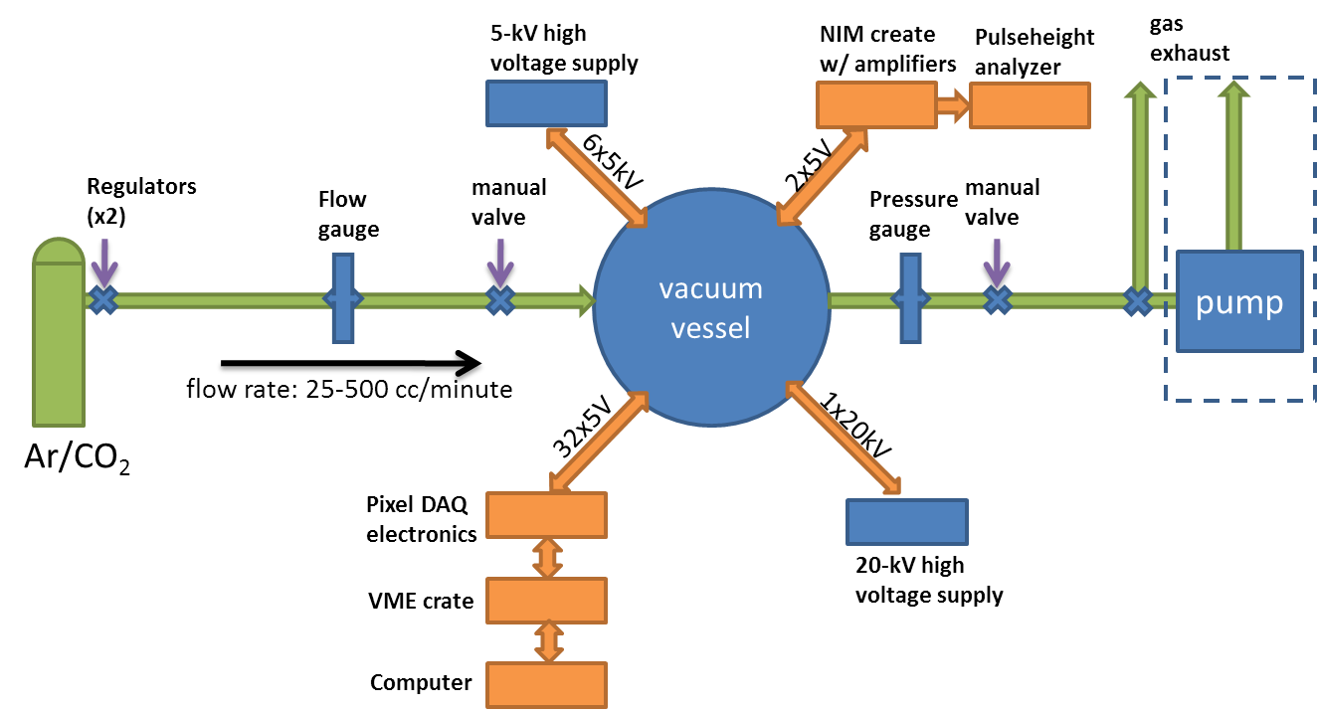
Schematic of TPC system
(figure below shows current lab prototyping system, still need to update for BEAST system)

