Slide 1
CAD style figures needed
For NIM paper:
Dcube-micro sideview (Marc)
https://www.phys.hawaii.edu/elog/DCube/39
for BEAST TDR:
BEAST T0 (Marc)
BEAST T1 (Marc)
BEAST T2 (Marc)
Schematic of TPC system w/ services (Sven)
CAD or G4 model of single TPC (Kamalu?)

Slide 2
(new version)
Phase 1
Phase 2
BEASTII-T0
BEASTII-T1
BEASTII-T2
 | w/o QCS, w/o solenoid | w/ QCS, w/o soldenoid | w/QCS, w/ solenoid , No SVD, PXD
Beam pipe | 4 cm (ID?) | ? | Mockup
PIN Diodes | Y | Y | Y
Beam abort: PIN? Radfet? Polycrystal, single channel diamonds? | N | N | Y
Micro-TPCs | 2 prototypes | Y | Y, in SVX dock
Synchrotron x-ray measuremnet |  |  | Thick PXD ladder? SDDs?
BGO | Y | Y | Y
CDC prototype | N | Y | N
SVD, PXD ladders & monitors | N | N | Y
FE-I4 pixels w/ diamond sensor near IP | Y | Y | No space
Scintillator squares/ PIN dioes (tbd) 3x8x2? |  |  | Y? tbd
Thermal neutron detector? |  |  | Y? tbd
Jeep way 1,1’,2
Jeep way 1,1’
Jeep way 1,2 (not 1’)

Slide 3
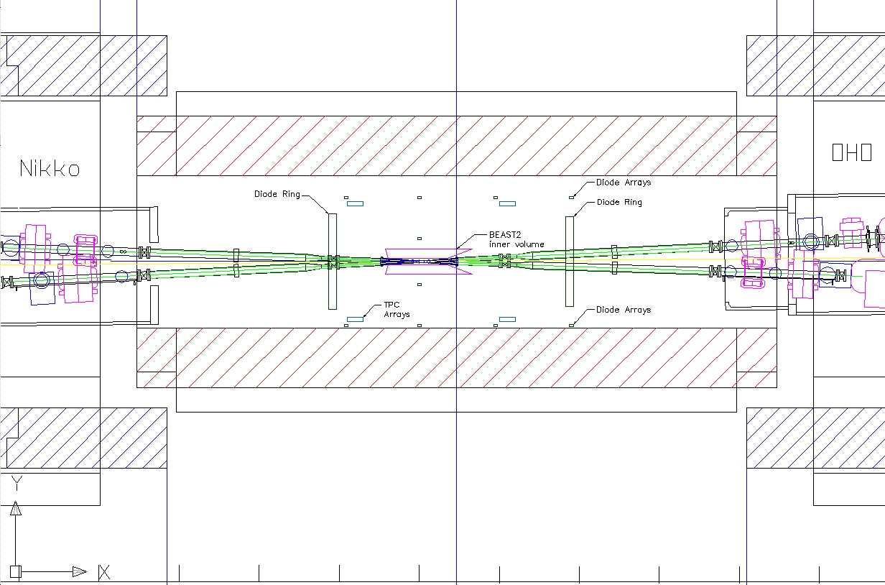
BEASTII-T0
CAD drawing by Kanazawa-San
/ Marc Rosen
Expect no luminosity during this stage
Mostly high levels of beam-gas BG, possibly some Touschek
Main BEAST goal: Measure radiation levels to determine when it’s safe to roll in Belle

Slide 4
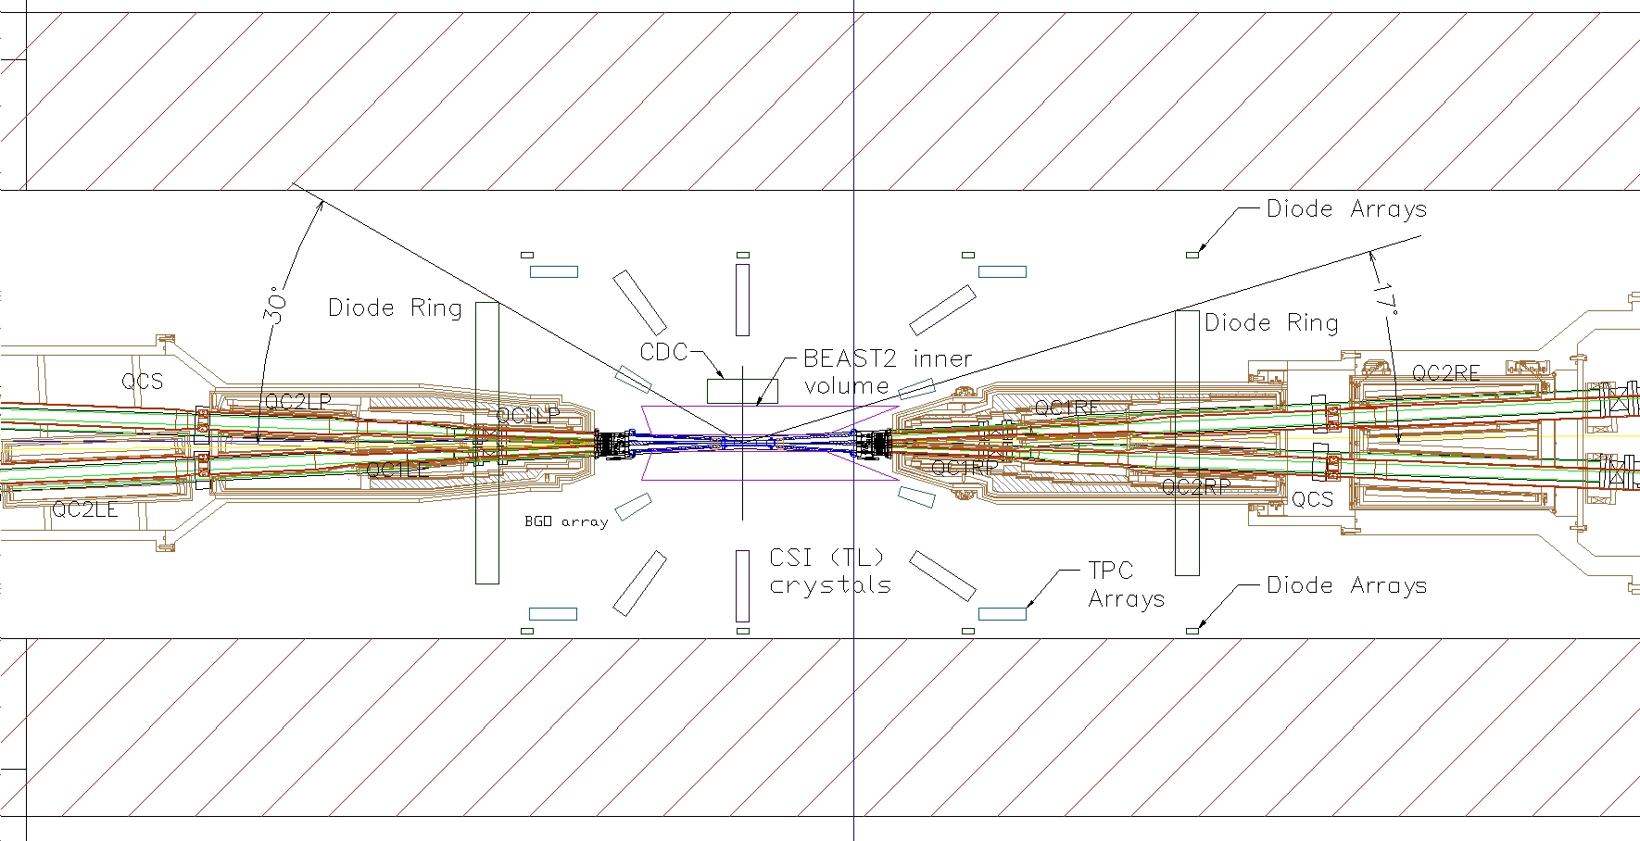
BEASTII-T1
Expect collisions, production of all beam BGs
Many BG measurements BG possible, allowing validation of simulation
Plenty of space for BEAST subsystems
Interesting stage for BEAST, but in scenario A we would skip this stage

Slide 5
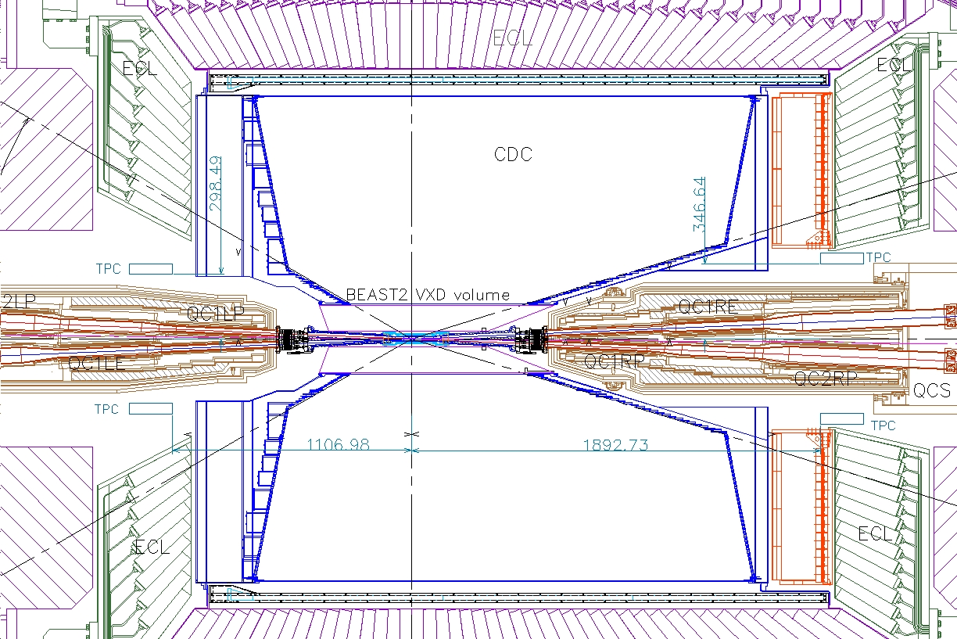
BEASTII-T2
Closest to final SuperKEKB/Belle 2
Very limited space for BEAST detectors
Good for VXD measurements and related
Place some detectors in available VXD dock space

Slide 6
Reminder of BEAST TDR schedule (expected deliverables in red)
April 19^{th:}
Draft specifications for each beast subsystem
We need this soon so that Marc Rosen can make a BEAST cad drawing
BEAST TDR chapter outlines
E.g. list of sections and expected figures
→ Review/dicuss during April 23rd BEAST meting
May 1st: BEAST TDR draft
Including preliminary or final figures
Review and discuss outstanding issues during May 7th BEAST meeting
May 24th: BEAST TDR final version: HARD DEADLINE
Sven to integrate w/ US Belle II TDR, send out for final proofreading
May 31: Completed US BelleII TDR

Slide 7
Micro TPC system Draft Specifications List of TDR Figures
Sven Vahsen, Igal Jaegle

Slide 8
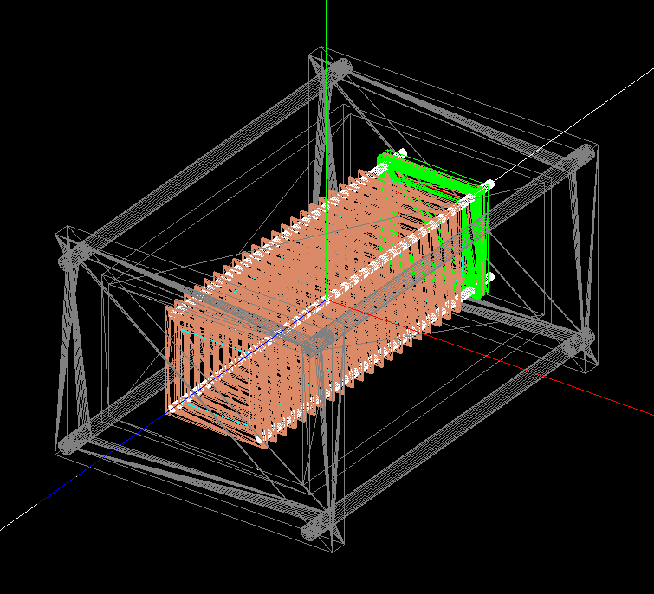
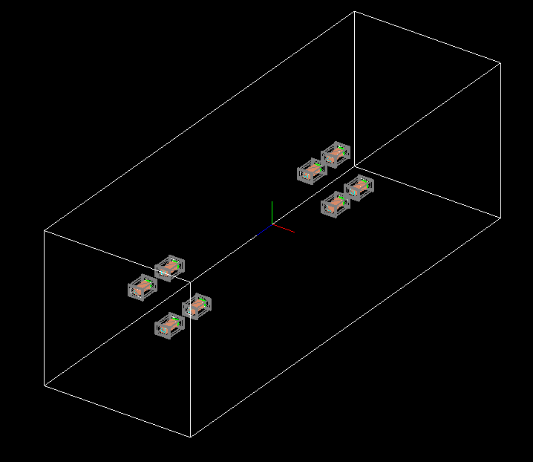
Draft Specifications of Micro-TPC System red: to be determined/checked
who will provide it, install it, operate it: U. Hawaii group; Vahsen, Jaegle (postdoc), Hedges (grad student), Seong (grad student), Rosen (engineer), X (postdoc)
expected physics measurements: fast-neutron flux, angular distribution if achievable during T2
goals
discriminate different beam backgrounds so that we can predict neutron flux at higher luminosity
verify / tune normalization and angular distribution of neutron flux in simulation
space requirements and location in T0,T1,T2
Approx. dimensions of each TPC: 6"x4"x30cm
2 TPCs during T0 (1 forward, 1 backward)
8 TPCs during T1, T2
Locations of center of TPCs:
backward: r=32 cm, z=-122cm
Forward: r=37cm, z=199 cm
Four phi positions: 0,90,180,270 degrees
4“
30 cm
6“

Slide 9
Draft Specifications of Micro-TPC System red: to be determined/checked
6”
DAQ: Input/output signals per TPC
Digital I/O of 4FE-I4 chips (trigger,LVDS in/out, combined ground) → 21 per channels per TPC
Analog signal from copper anode: 1 coax per TPC
Services
LV: ~2V, analog, digital → 4 wires if common power (parallel or serial), 16 wires if individual)
HV: 5kv: 4 CH + GND, 30 kv (field cage): 3 CH + GND
Gas in/out
Cooling: not required
whether you can take care of them all, or need KEK to provide: will/may ask KEK to provide gas
Service connections
32-pin or 50-pin mil spec LV connection on KF40 feedthough
8 HV on KF40 feedthrough (up to 2 SHV)
3 swage lock (gas in/out, overpressure)
1 KF 40 pump port for quick purge
Cable thicknesses, pipe diameters
Gas: ¼” stainless steel tubing
Cables: tbd
max distance from sensors to closest part of DAQ system / electronics, so that we can reserve space. Location of DAQ.
~20m (need to check if OK for LVDS and analog readout)
LV+DAQ
(<=50 pins)
4”
2.08”
HV (<=8 pins)
Pressure relief
gas in
KF40
to vacuum pump
gas out

Slide 10
List of Figures for micro-TPC chapter
Schematic of TPC system w/ DAQ and services (Sven)
CAD or G4 model of single TPC (Marc, Kamalu)
TPC Acceptance criteria vs pre-prototype measured performance
Angular resolution (Ilsoo)
Gain resolution (Tom)
Energy resolution (Ilsoo)
Simulated neutron efficiency (Igal)
Demonstration of neutron detection (Ilsoo & Sven)
Simulated neutron & particle flux
In Belle frame (Igal, Ilsoo, Michael)
Rate of neutrons through TPC versus momentum, theta, phi
In TPC frames (Igal)
Expected theta, phi distributions, time-normalized, for each beam BG
Split up into: He-recoil in gas, alphas, protons, EM, other BG
TPC efficiency vs momentum (for which direction?) (Ilsoo, Igal, Sven)
Neutrons
Electrons
muons

Slide 11
Schematic of TPC system
(figure below shows current lab prototyping system, still need to update for BEAST system)

