Slide 1
Reminder of BEAST TDR schedule (expected deliverables in red)
April 19^{th:}
Draft specifications for each beast subsystem
We need this soon so that Marc Rosen can make a BEAST cad drawing
BEAST TDR chapter outlines
E.g. list of sections and expected figures
→ Review/dicuss during April 23rd BEAST meting
May 1st: BEAST TDR draft
Including preliminary or final figures
Review and discuss outstanding issues during May 7th BEAST meeting
May 24th: BEAST TDR final version: HARD DEADLINE
Sven to integrate w/ US Belle II TDR, send out for final proofreading
May 31: Completed US BelleII TDR

Slide 2
Micro TPC system Draft Specifications List of TDR Figures
Sven Vahsen, Igal Jaegle

Slide 3
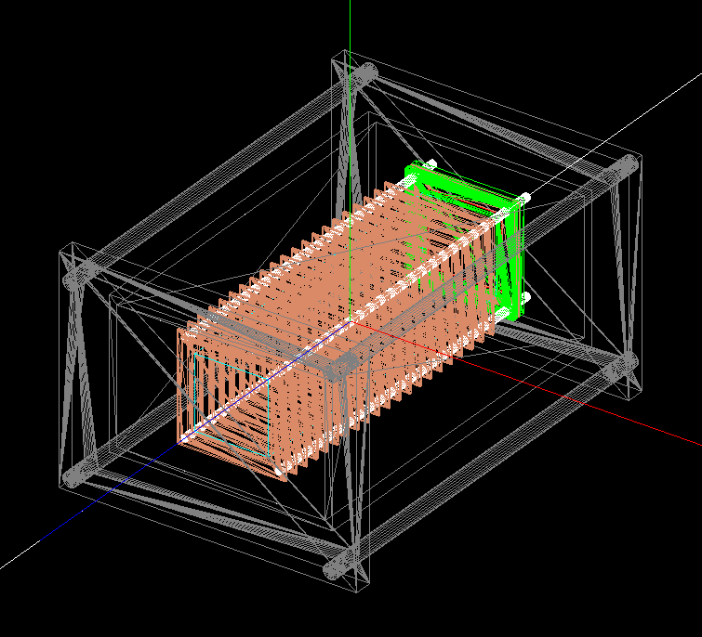
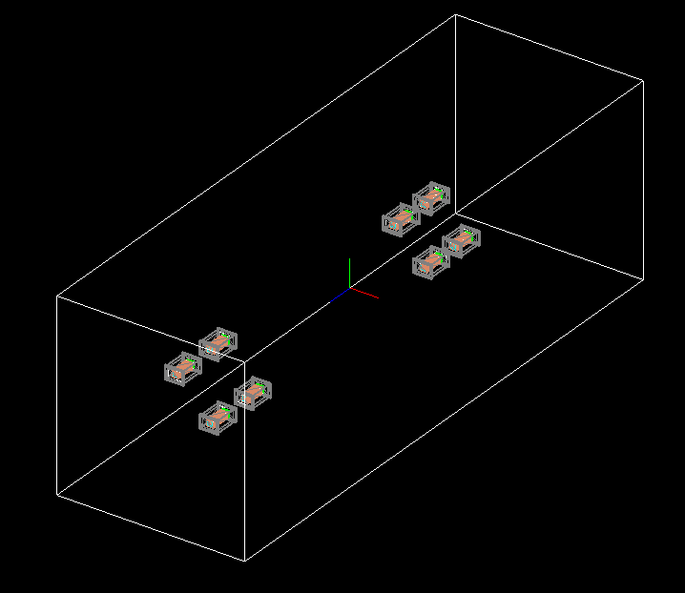
Draft Specifications of Micro-TPC System red: to be determined/checked
who will provide it, install it, operate it: U. Hawaii group; Vahsen, Jaegle (postdoc), Hedges (grad student), Seong (grad student), Rosen (engineer), X (postdoc)
expected physics measurements: fast-neutron flux, angular distribution if achievable during T2
goals
discriminate different beam backgrounds so that we can predict neutron flux at higher luminosity
verify / tune normalization and angular distribution of neutron flux in simulation
space requirements and location in T0,T1,T2
Approx. dimensions of each TPC: 6"x4"x30cm
2 TPCs during T0 (1 forward, 1 backward)
8 TPCs during T1, T2
Locations of center of TPCs:
backward: r=32 cm, z=-122cm
Forward: r=37cm, z=199 cm
Four phi positions: 0,90,180,270 degrees
4“
30 cm
6“

Slide 4
Draft Specifications of Micro-TPC System red: to be determined/checked
6”
DAQ: Input/output signals per TPC
Digital I/O of 4FE-I4 chips (trigger,LVDS in/out, combined ground) → 21 per channels per TPC
Analog signal from copper anode: 1 coax per TPC
Services
LV: ~2V, analog, digital → 4 wires if common power (parallel or serial), 16 wires if individual)
HV: 5kv: 4 CH + GND, 30 kv (field cage): 3 CH + GND
Gas in/out
Cooling: not required
whether you can take care of them all, or need KEK to provide: will/may ask KEK to provide gas
Service connections
32-pin or 50-pin mil spec LV connection on KF40 feedthough
8 HV on KF40 feedthrough (up to 2 SHV)
3 swage lock (gas in/out, overpressure)
1 KF 40 pump port for quick purge
Cable thicknesses, pipe diameters
Gas: ¼” stainless steel tubing
Cables: tbd
max distance from sensors to closest part of DAQ system / electronics, so that we can reserve space. Location of DAQ.
~20m (need to check if OK for LVDS and analog readout)
LV+DAQ
(<=50 pins)
4”
2.08”
HV (<=8 pins)
Pressure relief
gas in
KF40
to vacuum pump
gas out

Slide 5
List of Figures for micro-TPC chapter
Schematic of TPC system w/ DAQ and services (Sven)
CAD or G4 model of single TPC (Marc, Kamalu)
TPC Acceptance criteria vs pre-prototype measured performance
Angular resolution (Ilsoo)
Gain resolution (Tom)
Energy resolution (Ilsoo)
Simulated neutron efficiency (Igal)
Demonstration of neutron detection (Ilsoo & Sven)
Simulated neutron & particle flux
In Belle frame (Igal, Ilsoo, Michael)
Rate of neutrons through TPC versus momentum, theta, phi
In TPC frames (Igal)
Expected theta, phi distributions, time-normalized, for each beam BG
Split up into: He-recoil in gas, alphas, protons, EM, other BG
TPC efficiency vs momentum (for which direction?) (Ilsoo, Igal, Sven)
Neutrons
Electrons
muons

Slide 6
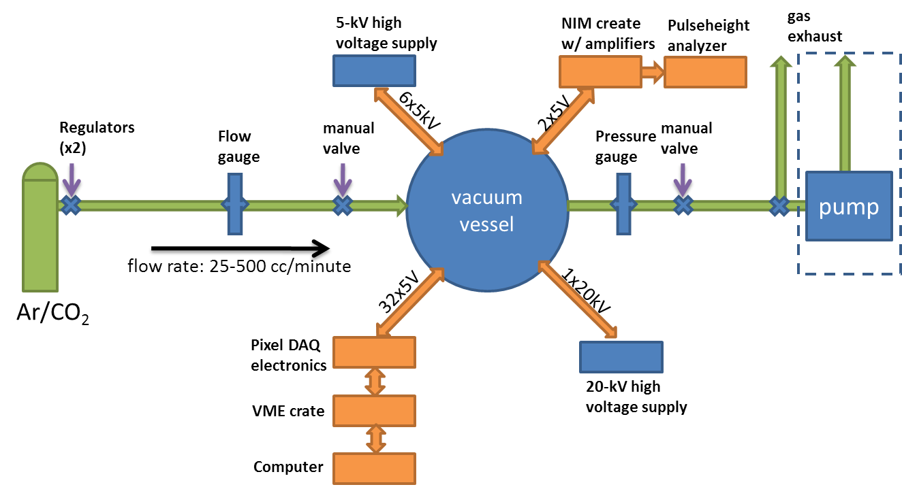
Schematic of TPC system
(figure below shows current lab prototyping system, still need to update for BEAST system)

