Slide 1
Belle-II iTOP Readout: HV Board
and Selected Topics on Front Board
and Thermal Design
iTOP Final Electro-mechanical Packaging Task Force
@ University of Hawaii, 3/20/2013
Gerard Visser
Indiana University CEEM

Slide 2
Outline
Topics for the discussion, roughly in order corresponding to Gary’s agenda for the meeting:
Pin sockets for PMT
Front board
Bypass capacitors to be included on front board
Connection of HVB to front board
HVB
Active divider circuit
Mechanical (board layout, thermal pad, cover plates)
HV cable
Temperature sensor / other monitoring?
Bypass capacitors and ground isolation resistors
Thermal coupling from HVB and other boards to cold walls

Slide 3
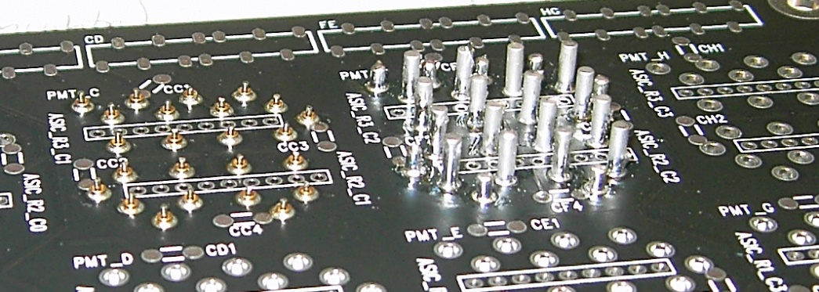
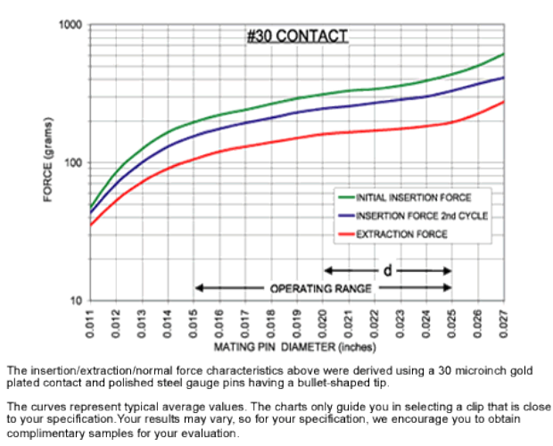
A suggestion for pin sockets for the PMT
Assembly will be much simplified, and location tolerance on assembled pin sockets improved, if we use press-fit (solderless) pin sockets.
Additionally:
open-back pins are better for wash and for inspection
pin bodies should not be much longer than the pins (waste of space)
why not use same pin socket on all 24 pins?
300 g insertion force @ actual pin diameter 0.57 mm (it feels reasonable)
SL-10 mech drawing says 0.50 mm pin diameter! Is it wrong, or is there a large, unspecified, tolerance?

Slide 4
Other suggestions for the front board
The present front board is too flexible, I think. It should be thicker, e.g. 2.4mm (3/32”), to stiffen it. [In particular I have concern about the capacitors on the front board, but in general it seems better to have it stiffer.]
Also, suggest we use the same PCB material (Isola FR370HR) as HVB. This was recommended for improved HV breakdown withstanding. Incidentally, it is stiffer than generic FR-4.
If necessary, the board could be milled down at mounting edges to 1.6mm or so, this is standard technology for the board fabricators.
If controlled-depth mechanical drilled blind vias (i.e. same technology as HVB) will be helpful in the routing, use this. It came out very nicely on HVB.
For each PMT, should have 4 bypass capacitors from local signal ground to the bottom of 2nd MCP (as it is on present front board), and (new) a small ground isolation resistor (20 – 100 Ω) from the local ground to the (common) HVB ground pins. The local signal ground is for signals only! The signals will come out cleaner if this does not connect to the long stub of HVB ground!

Slide 5
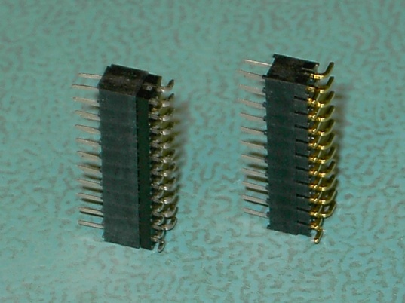
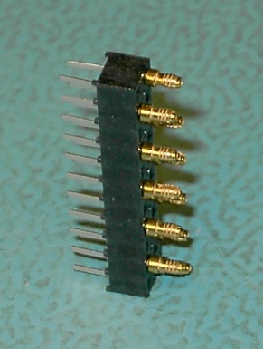
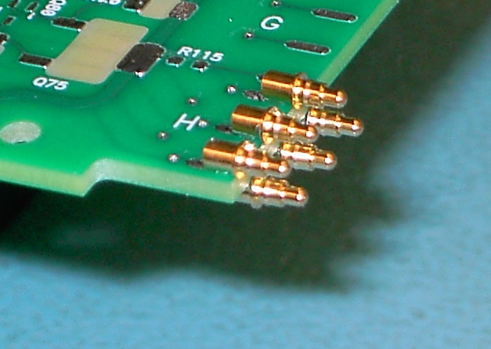
HVB to front board connections
The connectors used in present version are reasonable. Nevertheless, we could change them to save space. Whether this matters depends greatly on HV cable routing at back of module...
‘Baseline’: Molex # 79107-7010 on HVB, Molex # 87759-2250 on front board, half the pins pulled from each.
Similar but smaller and simpler: Samtec # SMM-111-01-S-D on HVB, Samtec # TMM-111-01-S-D-SM on front board, selectively loaded (custom order), ~$625 NRE each connector
Smaller and even simpler maybe: HVB as above, Mill-Max # 2617-0-01-34-00-00-03-0 press-fit (solderless) to front board
One-piece (spring-loaded) connector on HVB: Mill-Max # 0926-1-15-20-75-14-11-0, on front board only round gold contact pads
In all cases, I would like to skip the 2nd ground pin on each of the four connectors (so it will be 11 pins not 12 pins per group). The two grounds are connected together anyway (directly, on new HVB, with isolating resistor on front board). This change, besides simplifying things, provides a little more clearance on the connector between the last MCP bias voltage to ground.

Slide 6
HVB discussion
(borrowing slide from Gary
with an update)
5
1 more assembled w/o cables or covers

Slide 7
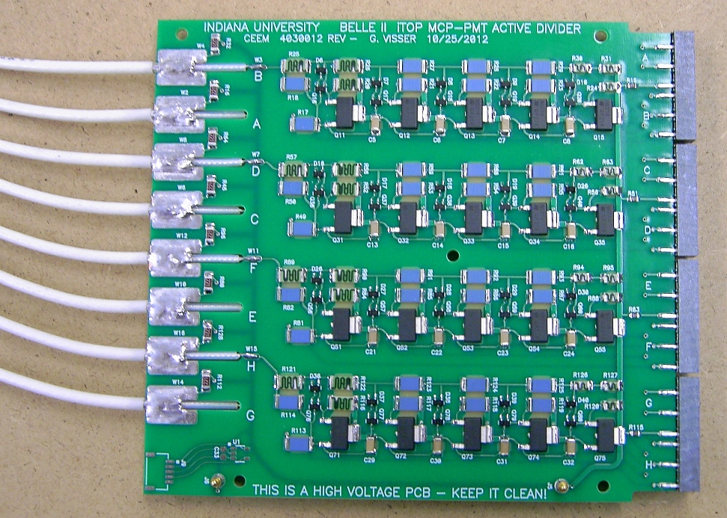
Completed HV board (shown without ground covers)
PCB dimension 104 mm × 95.6 mm
Next version can be slightly shorter (98 mm?)
Total power 3.4 W (@ 900V / MCP)
Four channels on each side
4 layer PCB using blind vias, routing outputs to connectors using inner layers only
Cable input through resistors provides protection and noise filtering
5 screws (4 stainless steel, 1 Ultem 2300)
clamp PCB between Gap-Pad sheets and aluminum ground cover plates
Series resistor (1 MΩ) provides protection to photocathode
cable lays in slot in edge of PCB, braid soldered to slot
(copper tape was needed here, next revision of board will have plated slot)
TESTED −8 kV HIPOT OK
Belden # 83284 (RG-316 type)
teflon insulation, FEP jacket
Front board connectors same as before
(2 mm pin header / socket style)
surge-rated 220 Ω resistor in series with each cable ground
(reconcile safety with EMI considerations)
I²C temperature sensor (future use)
spring pin ground contacts (2 each top & bottom)

Slide 8
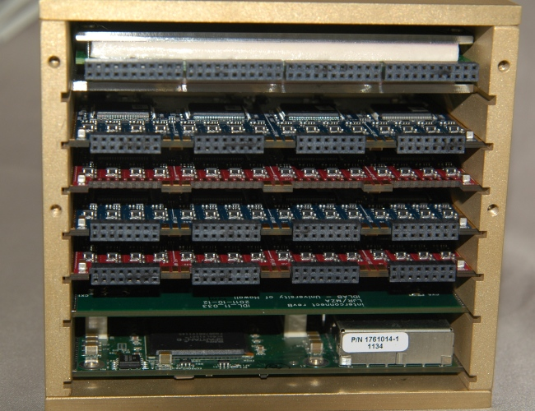
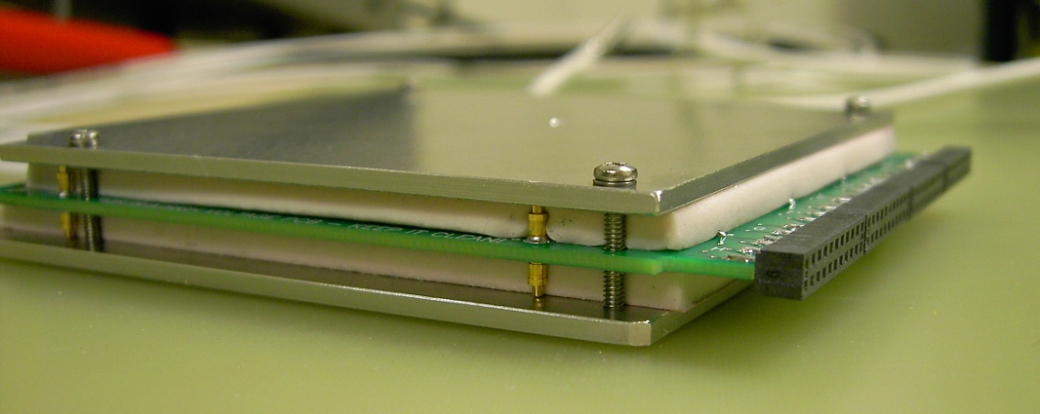
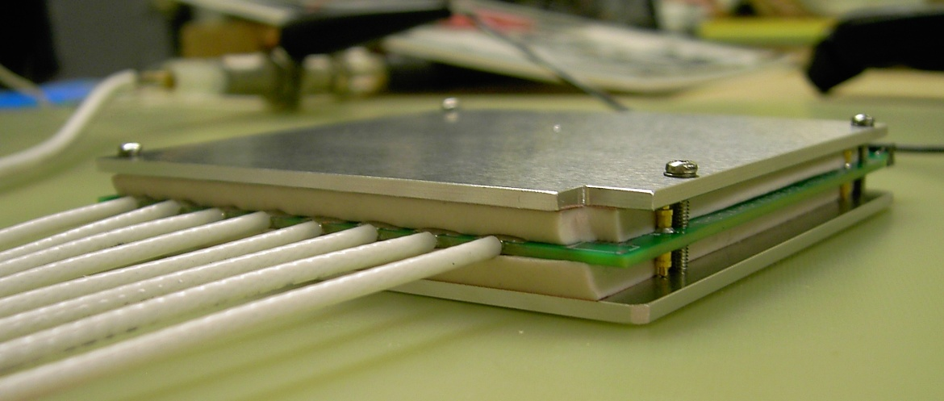
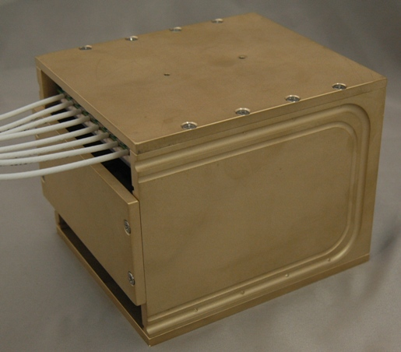
Completed HV board
My hope is that the basic mechanical (as well as electrical) characteristics of the HVB are compatible with our system requirements. Improvements in detail are of course expected and some are already planned.

Slide 9
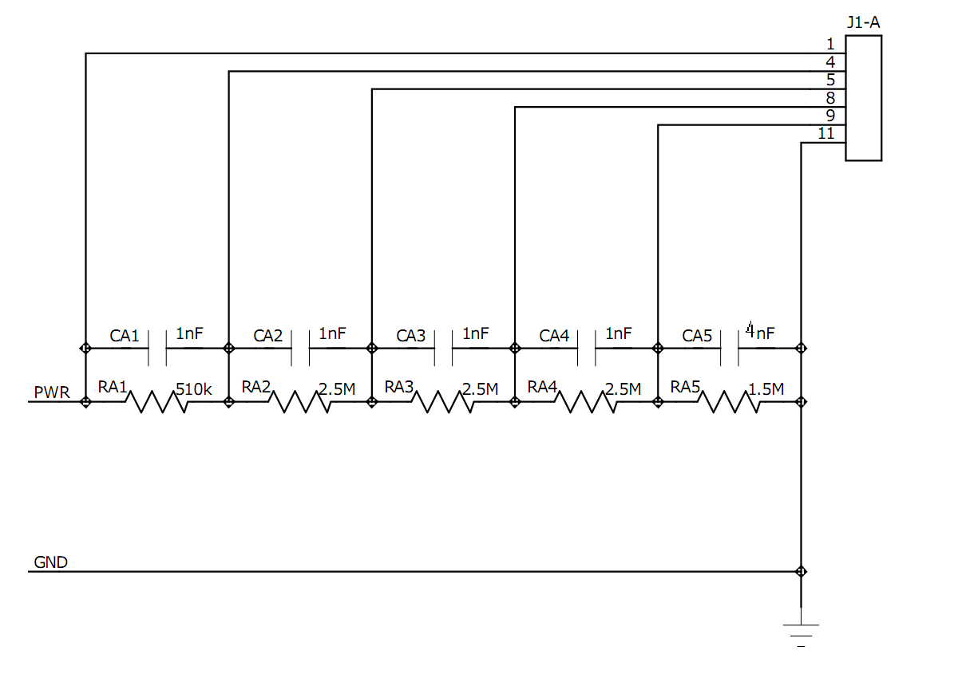
Baseline HV bias circuit (per HPK / Nagoya U.)
to MCP PMT
89 mW
MCP
20 MΩ typ
(10 – 30 MΩ)
MCP
20 MΩ typ
(10 – 30 MΩ)
(to front board)
HV board
1.52 W per ch
(12.2 W total)
−3800 V “max”†
424 μA
1.61 W
−3584 V
−2640 V
−1580 V
−636 V
† With this circuit, in beam test, range of actual operating voltage for appropriate gain was 3200 to 3700 V.

Slide 10
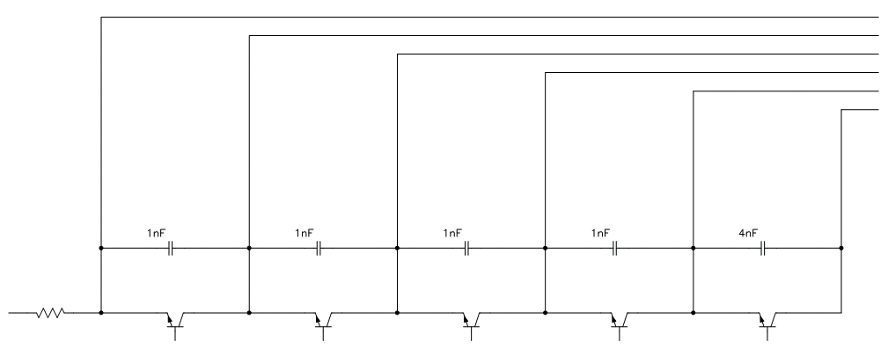
Active divider bias circuit (the basic scheme)
to MCP PMT
89 mW
MCP
20 MΩ typ
(10 – 30 MΩ)
MCP
20 MΩ typ
(10 – 30 MΩ)
(to front board)
100 μA
>5 μA
100 μA
>5 μA
100 μA
GND
−3900 V input
100 μA
390 mW
−3799 V ref
−3583 V ref
−2639 V ref
−1579 V ref
−635 V ref
The circuit is, of course, quite standard. Many similar PMT active dividers have been built. This application to an MCP PMT may be novel.
FET’s could be used, but radiation tolerance is probably worse (??), and commercially available high voltage FET’s seem to all have rather large package sizes and are intended for higher currents.
Instead, we can use a relatively new ST Microelectronics high voltage, low current NPN transistor in a reasonably small package: STN0214 [SOT223 (usual 4 leads version, but we can clip the small collector lead to improve clearance on the board), V_{CEO} = 1200 V, I_{C,MAX} = 200 mA]
The above simplified circuit of course neglects to detail the generation of the reference voltages. This will use some more power of course.

Slide 11
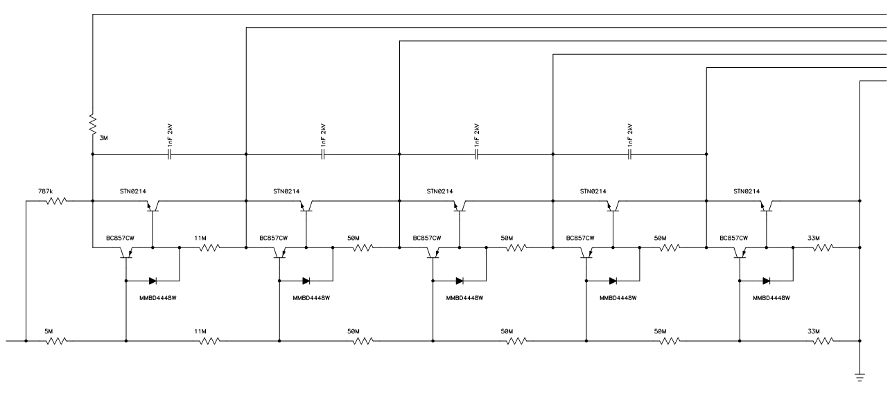
A complete active divider bias circuit
−3663 V
−3455 V
−2511 V
−1567 V
−623 V
(4nF on front board)
119 μA
19 μA
19 μA
−3757 V input
138 μA
518 mW
on HV board:
429 mW per ch
(3.4 W total)
The drift gap voltage between the MCP’s has been reduced slightly, 944 V vs. 1060 V (should be ok). This keeps the resistor values rationalized.
The STN0214 transistors have low current gain ~20. Further buffering is needed (one option shown here) or else resistor string current must still be high.
It may be necessary to parallel each of the HV transistors with Zener diode clamps (not shown here). Rather not, it ‘wastes’ a lot of board space. But, without it the circuit may not withstand all kinds of sparks in/around the tube. [perhaps 2x SMAJ550, 550 V breakdown]
Note that the input resistors (consuming about 3% of the total power) probably should be added to the baseline passive divider too. They isolate the circuit from the capacitance of the cable, and provide some useful noise filtering.

Slide 12
Double-sided high voltage sandwich
(it’s compact and friendly to neighboring boards – no exposed HV except at connectors)
overall thickness (when assembled) 9.6 mm
2 aluminum ground/cooling plates (1 mm?), spring contact to pcb
2 layers Bergqvist “Gap Pad VO Ultra Soft,” initial thickness 4 mm, compress to 3 mm (compressed a bit more over components, of course – max compressed to 1.2 mm)
4 layer PCB, 1.6 mm thick, Isola 370HR material (recommended for HV)
blind vias and components on both sides, used to implement 2 completely independent sets of 4 HV channels with insulating layer in between
divider circuit implemented entirely in outer layer 1 (4) with HV routing to connector entirely in layer 2 (3)
maintain horizontal clearance ~0.7 kV/mm (or less!), vertical clearance 8 kV/mm in PCB, 3.4 kV/mm in Gap Pad [see next slide]
clamp together with an array of plastic screws and spacers (tbd, not shown above)
HV input cables/connectors TBD ! ? (discuss...)
connector to front boards: as before, Molex 2 mm w/ pins removed... or...? tbd

Slide 13
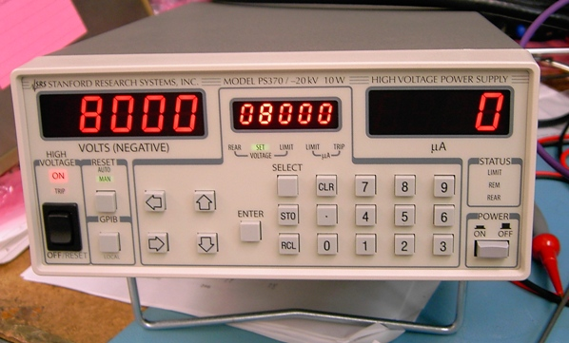
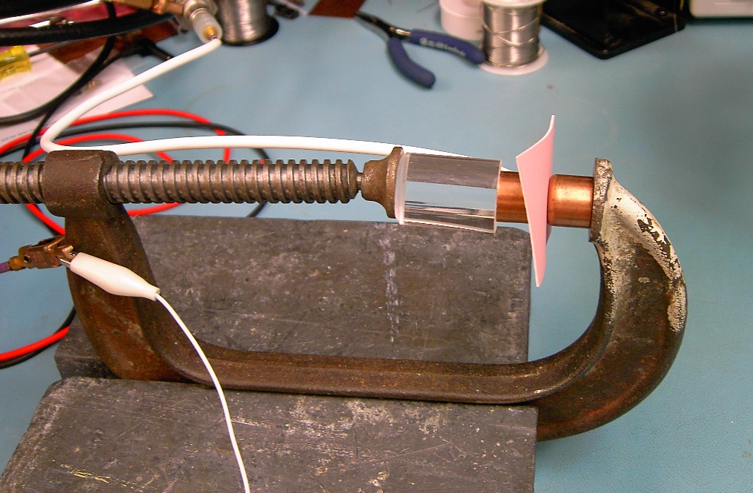
Gap Pad VO Ultra Soft dielectric withstanding test
Piece of 0.040” material sandwiched between two ½ inch copper water pipe caps (they have nice rounded edges)
“Minimally squished” (I would eyeball estimate it is squished by at most 20-50% of the starting thickness).
Supply will trip on overcurrent on any spark (verified with tests from grounded screwdriver tip to hot electrode).
First sample: Broke down at 16 kV after a couple of minutes. Held to 14 kV for at least a couple of minutes.
Second sample: Held 8 kV for 19 hours, 10 kV for 4 hours, 12 kV for 2 hours, 13 kV for 17.5 hr, 14 kV for 4 hr, 15 kV for 3 hr, 16 kV for >2 hr then failed
Conclusions:
Seems to be an adequate safety margin to have 3.4 kV /mm on this stuff.
Nevertheless, it will be good (and easy enough) to hi-pot in a real HVB sandwich assembly.

Slide 14
Active divider bias board pre-prototype
 | No load No caps 3610 V | No load No caps 4180 V | 20 MΩ P1/2 No caps 4180 V | 20 MΩ P1/2 With caps 4180 V | 20 MΩ P1/2 With caps 4180 V 14 hr later
Input | 3613.9 V | 4184.7 V | 4184.7 V | 4185.4 V | 4185.1 V
K | 3517.8 V | 4073.1 V | 4073.2 V | 4074.1 V | 4073.7 V
P1 | 3326.0 V | 3850.5 V | 3850.7 V | 3851.6 V | 3851.3 V
P2 | 2372.1 V | 2745.5 V | 2745.6 V | 2746.2 V | 2745.7 V
P3 | 1420.7 V | 1643.7 V | 1643.8 V | 1644.1 V | 1643.7 V
P4 | 471.1 V | 544.6 V | 544.6 V | 544.8 V | 544.5 V
PS current | 121 μA | 141 μA | 141 μA | 140 μA | 140 μA
No significant change in voltages with typical 55 μA “MCP” load applied. Regulation is fine... Reliability is the only remaining topic.
About 3.5 W total @ typical operating point

Slide 15
Changes planned for next/final rev HVB
Assuming same basic type of connector to front board, make HVB slightly thicker so the connector is a better fit edge-mounted on board.
Make cable center conductor solder pads fatter.
Edge-plated slot for cable ground connection.
Shorten cable ground connection and insulation length, to reduce length of the board.
Fix a HV clearance error that I noticed (which however is not breaking down (yet)).
Add pin holes for use in assembling the board to covers
Add more insulating screws for cover fastening
Perhaps make layout a little more compact (less clearance) so board can be shorter – only if it must be! [I would like this decided ~now.]

Slide 16
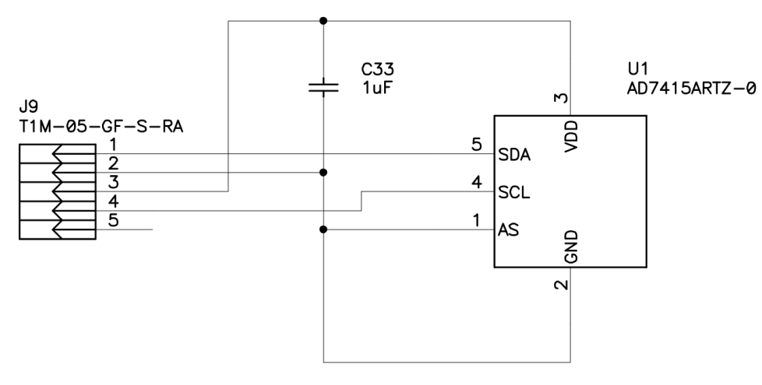
Temperature sensor
it is already included in board layout, but not used yet
connect to (future rev.) SCROD w/ micro 4-wire or 5-wire cable
I’m open to any other suggestions (as long as they are compact), but the above plan has been implemented and probably works just fine.

Slide 17
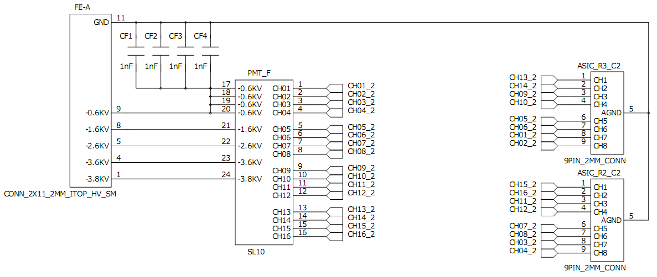
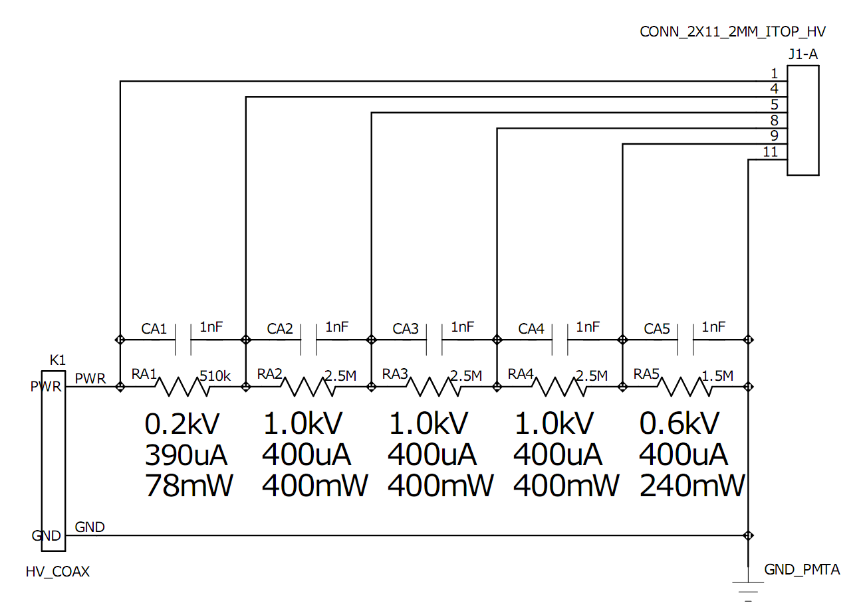
Proposed (for discussion) redline to tube HV circuit (passive or active, all the same)
G. Visser, IU, 7/9/2012
an old slide – but still applicable for the discussion
R_{NEW}2
THIS is the frontend analog ground
delete
R_{NEW}3
R_{NEW}1
Obviously, here for illustration of the complete circuit I just pasted together the divider board and front-front board
Delete CA5 which duplicates the other 4 (and potentially completes an annoying resonant circuit).
Note that anyway the point of those other 4 is to AC connect bottom of bottom MCP to the frontend ground. It has little/nothing to do with the HV divider.
Add R_{NEW}1 (10 – 100 Ω, 0402) which isolates the sensitive frontend analog ground from everything else (which anyway doesn’t need a low impedance AC ground to frontend).
Add R_{NEW}2 (1 MΩ, 5kV rated if feasible) which is the photocathode current limit resistor.
Add R_{NEW}3 (100 kΩ) which isolates center conductor of cable to the readout assembly. For EMI/ground loop suppression.
Add R_{NEW}4 (100 Ω) which isolates ground from cable to the readout assembly. For EMI/ground loop suppression.
R_{NEW}4
THIS is only a local ground net

Slide 18
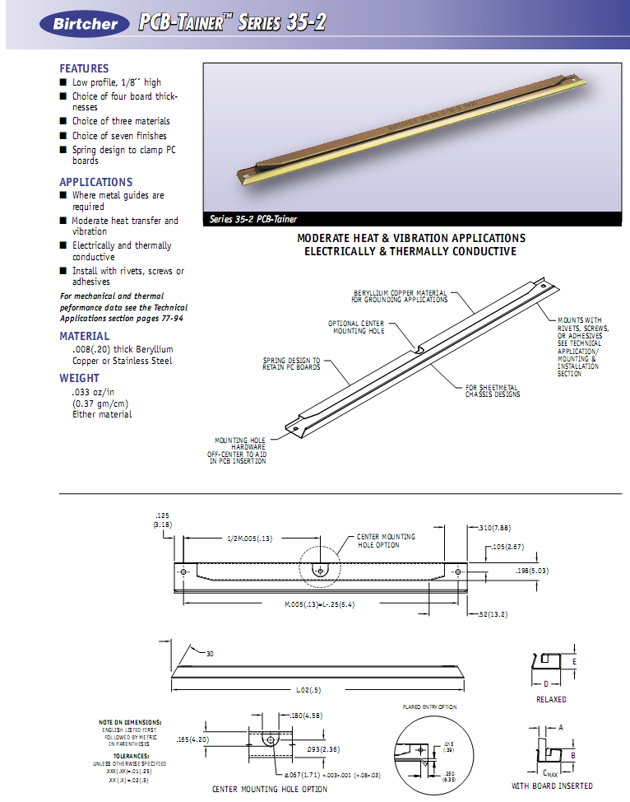
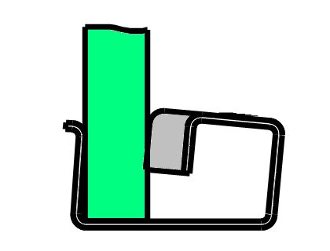
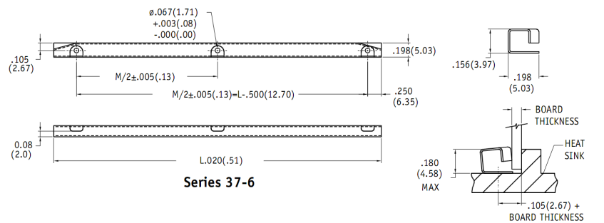
Birtcher “PCB-tainer”
Thin copper or brass cold wall
solder to cold wall
3.5 inch, silver plated, 250-499 pcs, $6.30 ea.
1.60
4.58
3.31
Alternative (better thermal conduction)
8.13

Slide 19
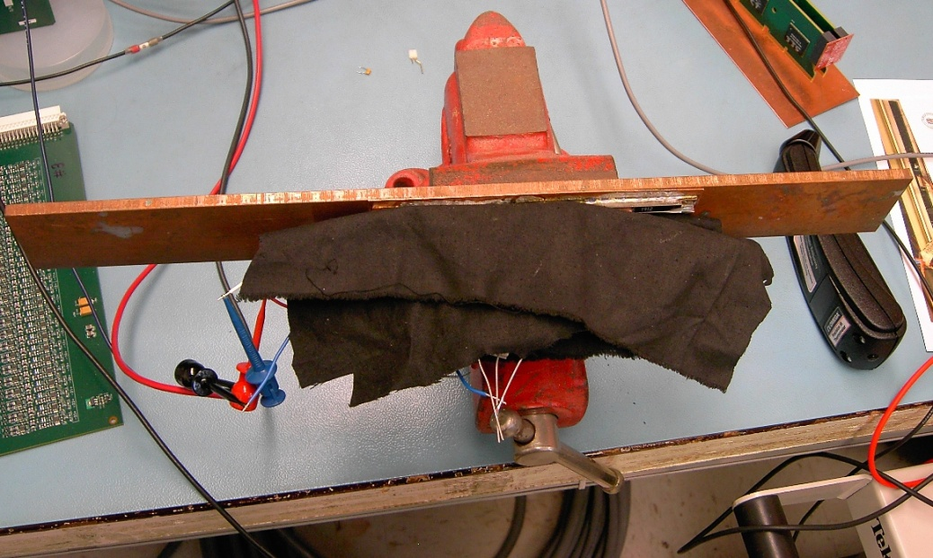
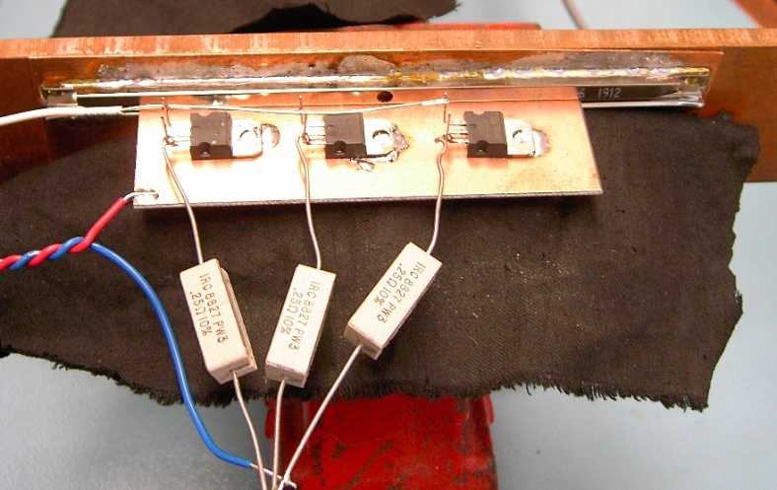
PCB-tainer thermal test
32.0
36.6
0.27 K•m/W
49.6
#35CF-1B-2-12-6
(thicker, but it is what they could sample from stock)
42.7
0.16 K•m/W
37.5
32.0
(board is flipped over for other side test)
Both sides in parallel: 0.10 K•m/W
SINGLE sided 1 Oz. copper clad load board, 6.52 W, length 100 mm
load board alone w/ blankets: ~97.0

Slide 20
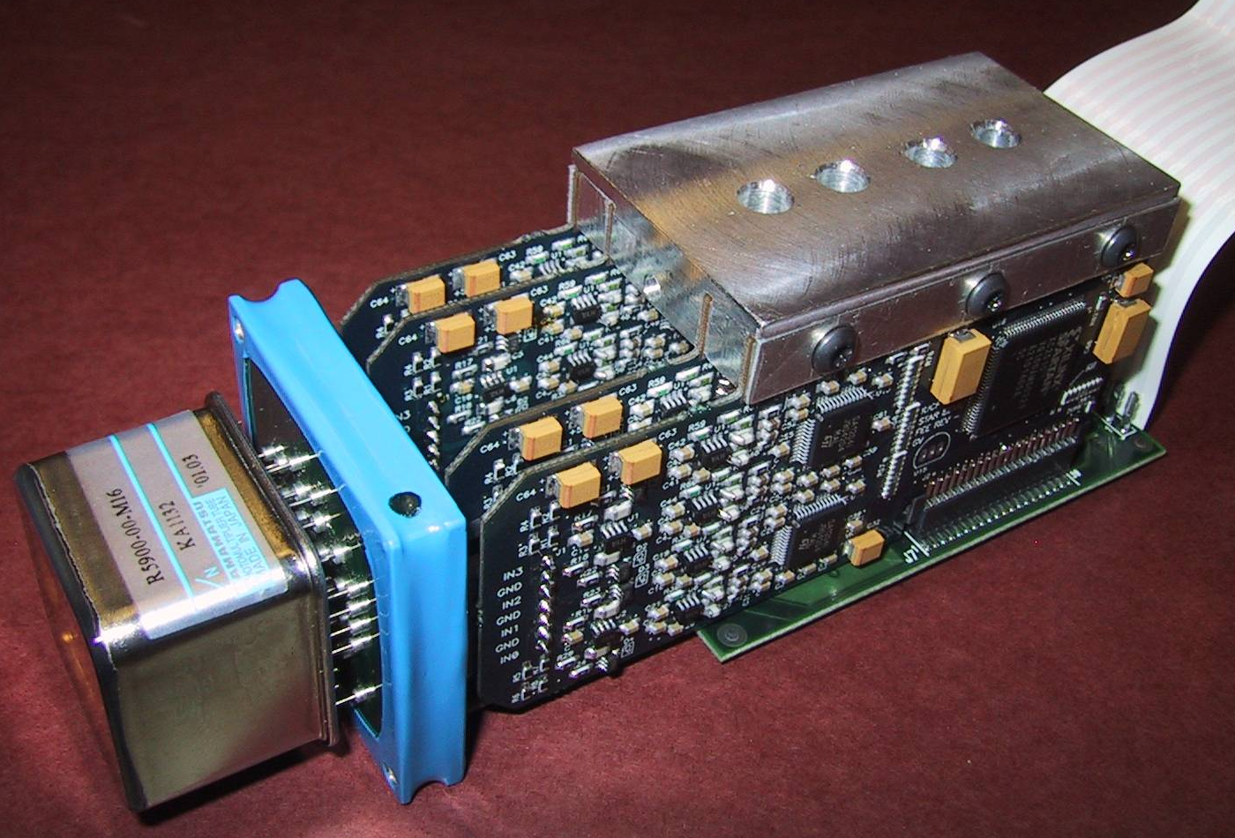
Another way? Clamp boards transversely to “cold fingers” with through screws and spacers.
A possible advantage would be compatibility with the board stacking connectors, i.e., no need to push multiple stacked boards into edge clamps, which may be difficult.
Disadvantage: Assembly from top and bottom, is it allowable?
We (IU) used a similar design in STAR EEMC SMD FEE:

Slide 21
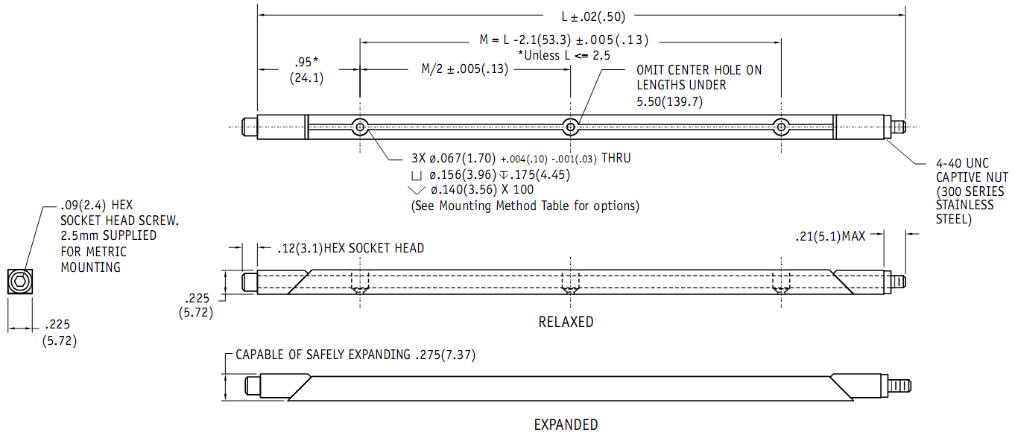
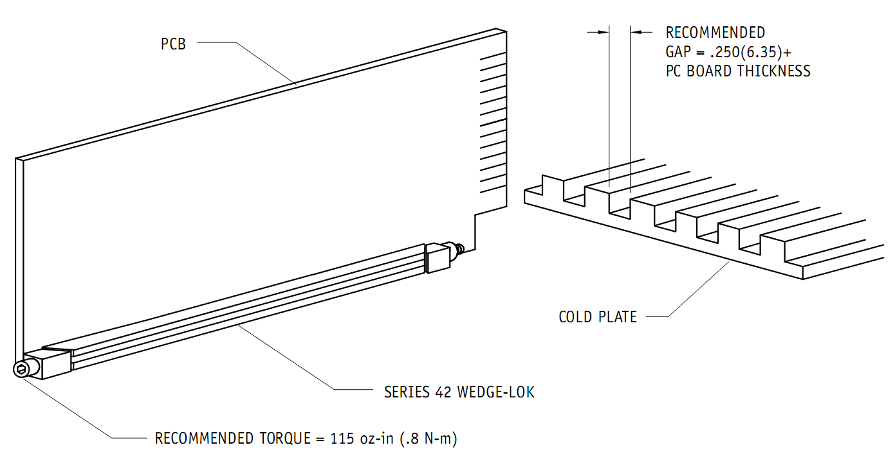
ZIF-type edge clamps: wedge-lock
This is perhaps the nicest but I think it also uses up the most space on the board edges.
Smallest type I am aware of:
cold wall must be thick enough to not deform too much from bending moments induced by wedge-locks
5.72

Slide 22
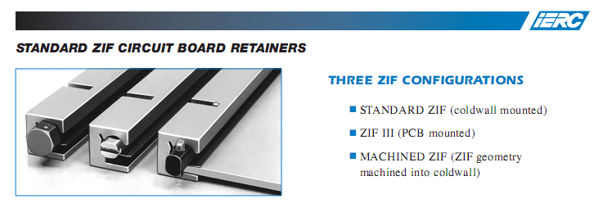
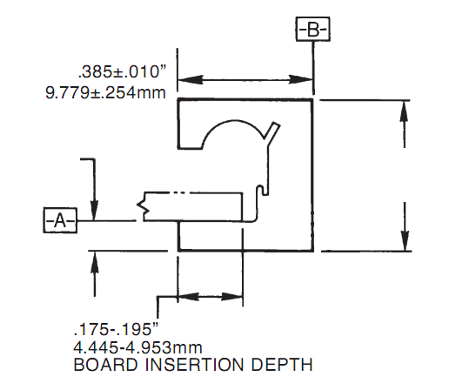
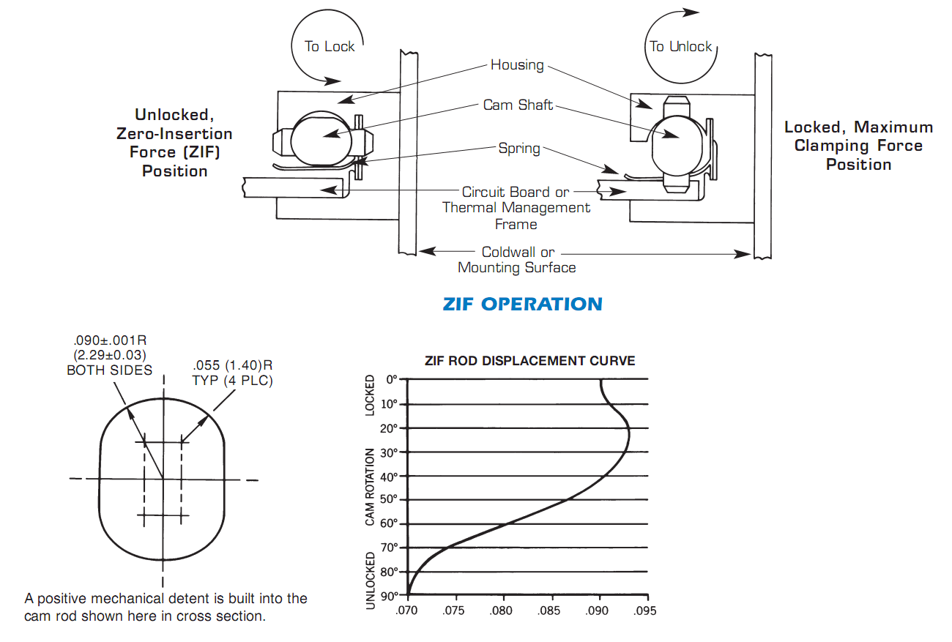
ZIF-type edge clamps: cam-lock
Not as small, except if machined into cold wall. This is a standard option!
1.60
10.16
cold wall must be thick enough to not deform too much from bending moments induced by wedge-locks
HOWEVER – bending moment is much less (shorter distance)

Slide 23
Backup slides

Slide 24
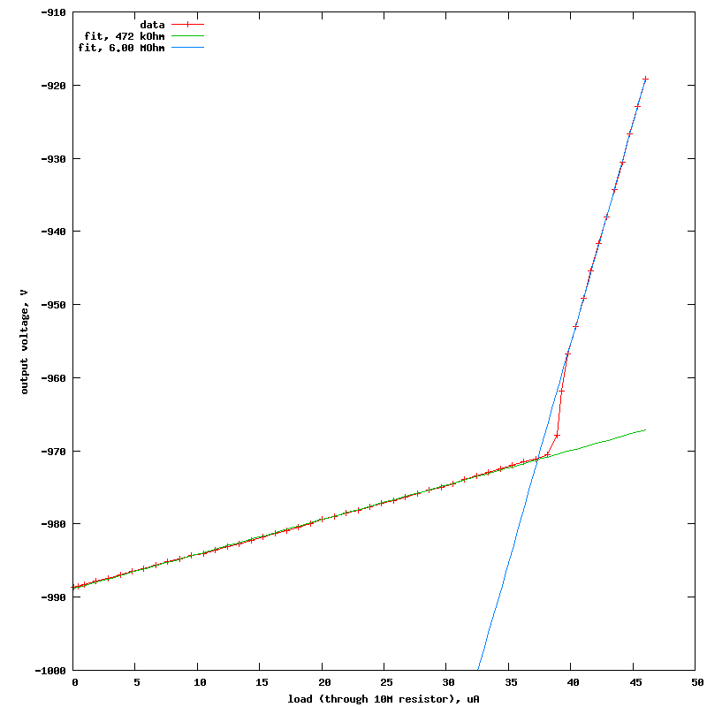
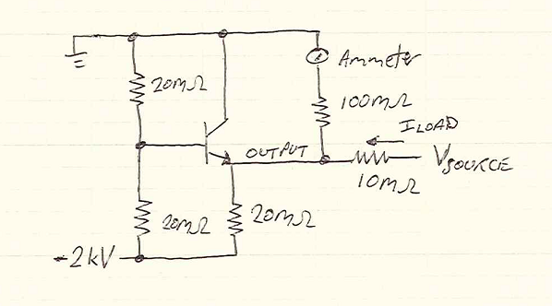
test circuit for STN0214, confirms β ≈ 20

