Slide 1
BINP tau charm plans and other projects in Turkey/China
A. Bogomyagkov
BINP SB RAS, Novosibirsk

Slide 2
History
1993, Dubna JINR (E_{cm}= 2 GeV, L=9.4×10³² cm⁻² sec⁻¹)
1994, Argonne National Laboratory (E_{cm}=3-5 GeV, L= 10³³ cm⁻² sec⁻¹ )
1995, BINP, round beams (E_{cm}= 2.0-4.2 GeV, L= 10³³ cm⁻² sec⁻¹)
1996, Spain & France (E_{cm}= 4 GeV, L= 10³³ cm⁻² sec⁻¹)
1997, Beijing IHEP (E_{cm}= 2.0-4.2 GeV, L= 10³³ cm⁻² sec⁻¹)

Slide 3
BEPC II
Two-ring e+e- collider in the tau-charm energy region (Ecm = 2.0-4.2 GeV).
Upgrade of BEPC, operating for HEP since May 2009.
“One machine, two purposes” – source of SR
Design luminosity 10³³ cm⁻² sec⁻¹ at 1.89 GeV.
Beam current 0.93 A.
Circumference 240.4 m.

Slide 4
BEPCII layout

Slide 5
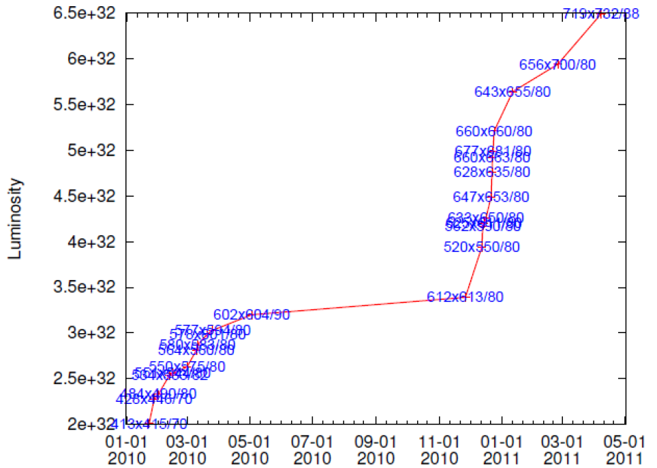
BEPC II performance

Slide 6
BEPC II future plans
More detailed optics measurement & correction is being done
We still not obtain some luminosity improvement by suppressing the parasitic beam‐beam interaction
We’ll try to achieve higher luminosity by more detailed optimization, higher beam current and lower β_{y}.

Slide 7
Turkic Accelerator Complex (TAC)
Linac-ring type charm factory
L= 1.4×10³⁵ cm⁻² sec⁻¹
Detector to search for charm physics:
CP violation and mixings of D⁰-mesons
new physics effects in the rare decays.
Synchrotron light source based on positron ring
Free electron laser based on electron linac

Slide 8
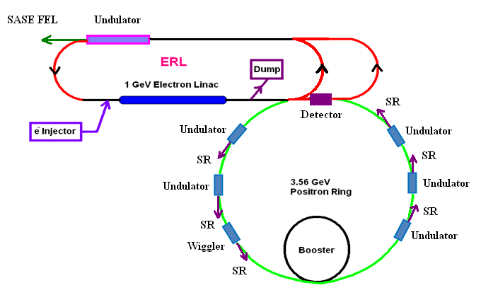
TAC Super Charm Factory

Slide 9
TAC charm factory parameters
Parameter | e⁻-linac | e⁺-ring
Energy, GeV | 1.00 | 3.56
Particles per bunch, 10¹⁰ | 2 | 20
β function at IP, mm | 80/5 | 80/5
σ_{x}/σ_{y}/σ_{z}, μm/μm/mm | 36/0.5/5 | 36/0.5/5
Beam current (A) | 0.48 | 4.8
Circumference, m |  | 600
Crossing angle, mrad | 34
Collision frequency, MHz | 150
Luminosity, cm⁻²s⁻¹ | 1.4×10³⁵

Slide 10
TAC Super Charm Factory plans
The TAC SCF was presented to ECFA 2011 as a cornerstone of the TAC project in terms of its originality and competitiveness. In order to gain more experience on the accelerator and detector and data analysis issues, they do consider to collaborate within the global projects on flavor factories.
In 2011, they have joined BES III collaboration facilitated in Beijing China.
A technical report of SCF@TAC will be completed in 2013.

Slide 11
Super-c-tau in Novosibirsk
E = 700 – 2500 MeV
Round beams L = 10³⁴ cm⁻²s⁻¹
Monochromatization L ~ 10³² cm⁻²s⁻¹
Long. Polarization L ~ 10³⁴ cm⁻²s⁻¹
Transverse polarization for precise energy calibration

Slide 12
Super-c-tau: general
Two rings with CRAB waist
Single interaction point
L = 10³⁵ cm⁻²s⁻¹ at 2 GeV
Preserving emittance and damping times through the whole energy range to optimize the luminosity
Sub-mm β_{y} at IP
Electrons are polarized longitudinally
Polarized electron source
2.5 GeV full energy linac
5 Siberian snakes to obtain the longitudinally polarized electrons for the whole energy range
to study τ at threshold
to study Λ_{c} baryons
Variable energy E_{cm}= 3 ÷ 4.5 GeV (from J/ψ to charm barions)
Energy calibration with medium accuracy (Compton backscattering (5 ÷ 10)×10⁻⁵)

Slide 13
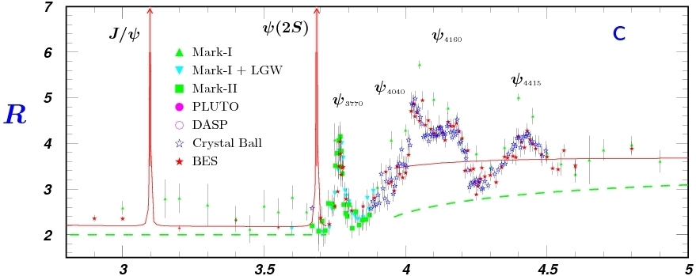
Super-c-tau: scientific case
τ
D
D_{s}
τ⁺τ⁻

Slide 14
Super-c-tau: scientific case
Charmonia
Spectroscopy, BFs
Light hadron spectroscopy
J/ψ rare decays
…
Charm
Spectroscopy
(Semi)leptonic decays
Rare decays
Mixing
CP violation
…
Tau
Spectral functions, BFs
Lorentz structure
CP violation
LFV decays
…
Charm baryons
BFs
Semileptonic decays
CP violation
…

Slide 15
Super-c-tau: parameters
Beam Energy | 1.0 GeV | 1.5 GeV | 2.0 GeV | 2.5 GeV
Circumference | 780 m
Emittance hor/ver | 8 nm/0.04 nm @ 0.5% coupling
Damping time hor/ver/long | 30/30/15 ms
Bunch length | 16 mm | 11 mm | 10 mm | 10 mm
Energy spread | 10.1·10⁻⁴ | 9.96·10⁻⁴ | 8.44·10⁻⁴ | 7.38·10⁻⁴
Momentum compaction | 1.00·10⁻³ | 1.06·10⁻³ | 1.06·10⁻³ | 1.06·10⁻³
Synchrotron tune | 0.007 | 0.010 | 0.009 | 0.008
RF frequency | 508 MHz
Harmonic number | 1300
Particles in bunch | 7·10¹⁰
Number of bunches | 390 (10% gap)
Bunch current | 4.4 mA
Total beam current | 1.7 A
Beam-beam parameter | 0.15 | 0.15 | 0.12 | 0.095
Luminosity | 0.63·10³⁵ | 0.95·10³⁵ | 1.00·10³⁵ | 1.00·10³⁵

Slide 16
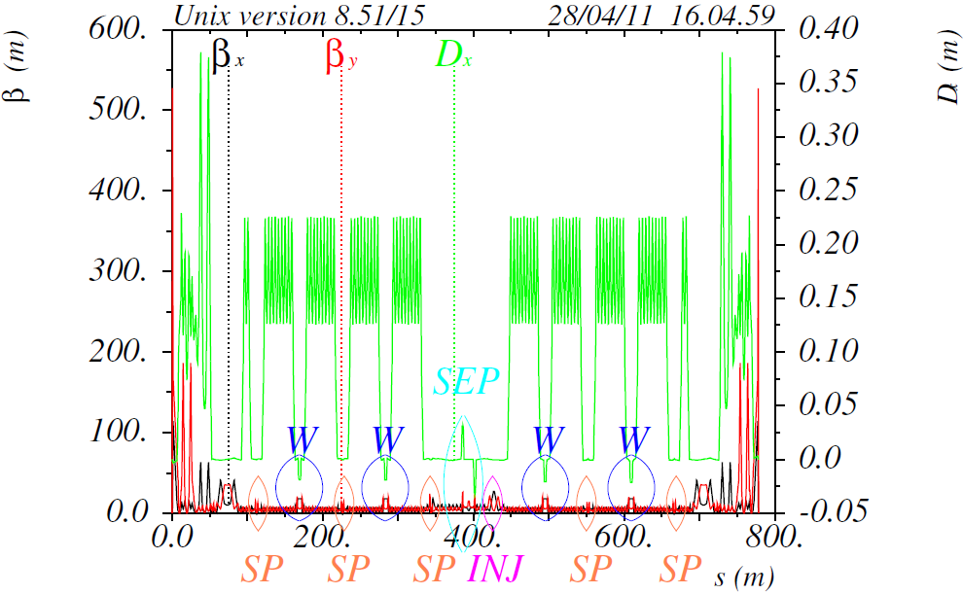
Super-c-tau: optics
IP: β_{y}=0.8 mm
β_{x}=40 mm

Slide 17
Super-c-tau: main ring

Slide 18
Super-c-tau: CRAB waist
x
β_{y}
e⁺
e⁻
q
z
Sext
CP
IP
Sext
m
M
(P.Raimondi 2006)

Slide 19
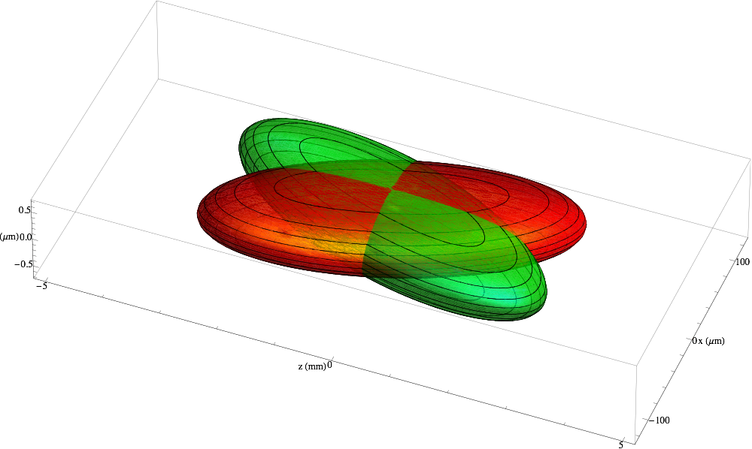
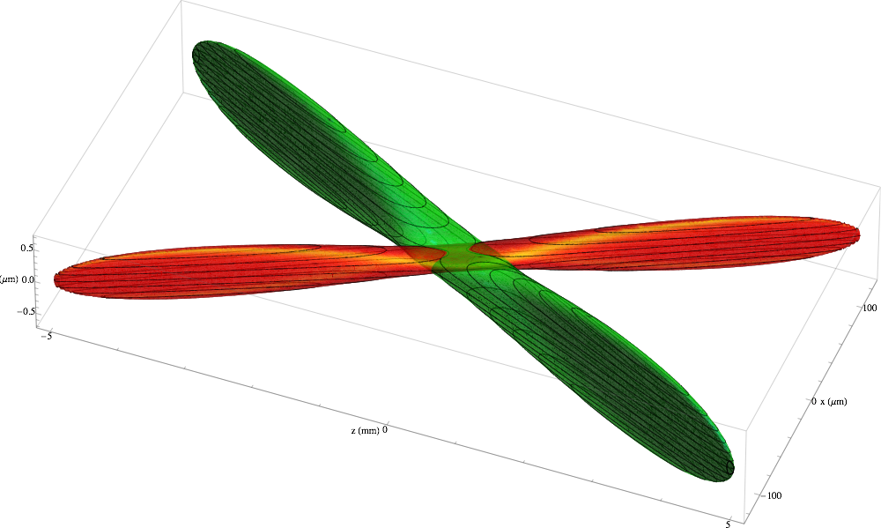
Super-c-tau: CRAB waist

Slide 20
Super-c-tau: facility artist view

Slide 21
Super-c-tau: facility cite

Slide 22
Super-c-tau: final focus
Cryostat
Compensation Solenoid
Detector Yoke
Anti Solenoid
e+
e-
QD0
QF1

Slide 23
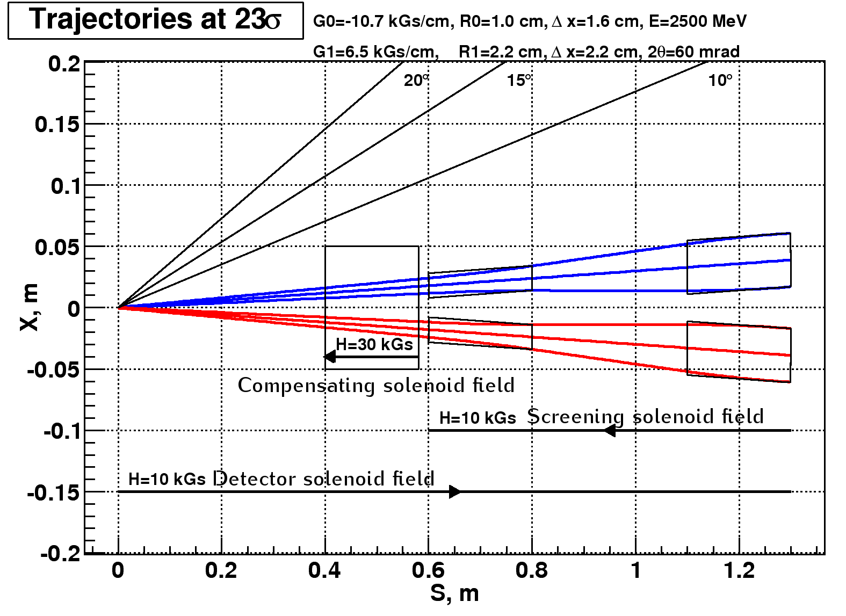
Super-c-tau: final focus

Slide 24
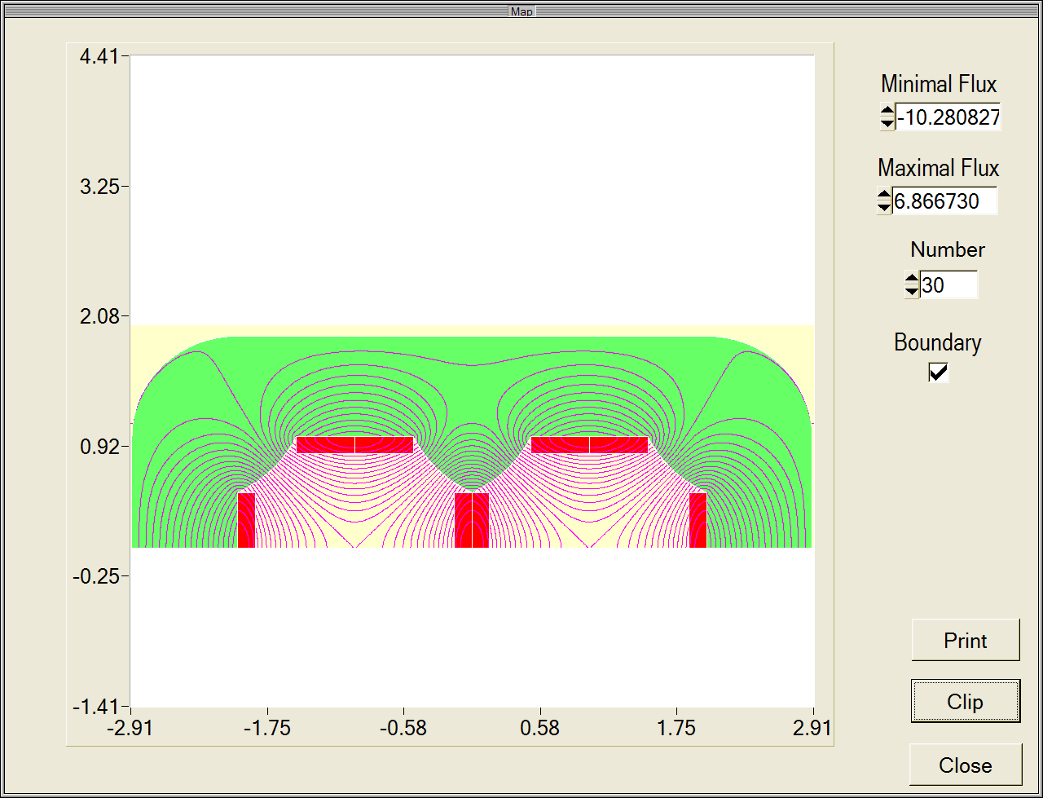
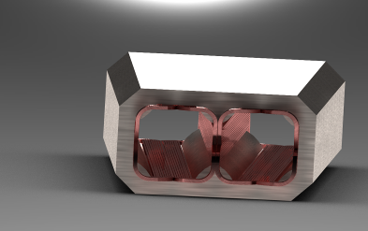
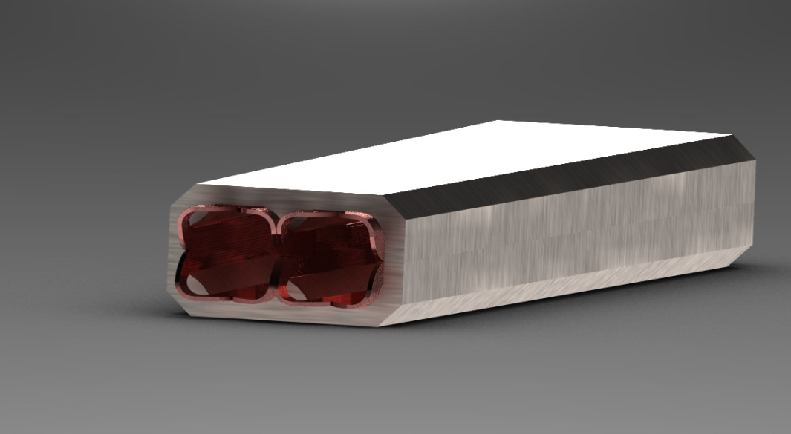
Super-c-tau: final focus
SC iron yoke twin aperture magnet
Excitation current 8.5 kA·turns
Single aperture 2 cm
Gradient 10.7 kGs/cm
Length 20 cm
Prototype is being manufactured.

Slide 25
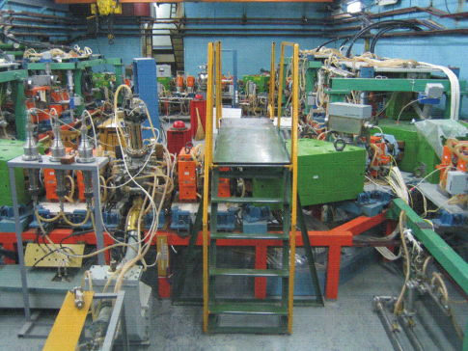
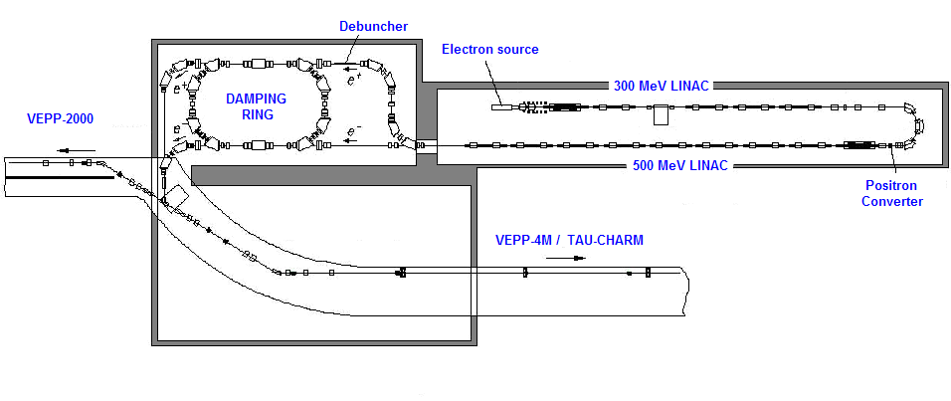
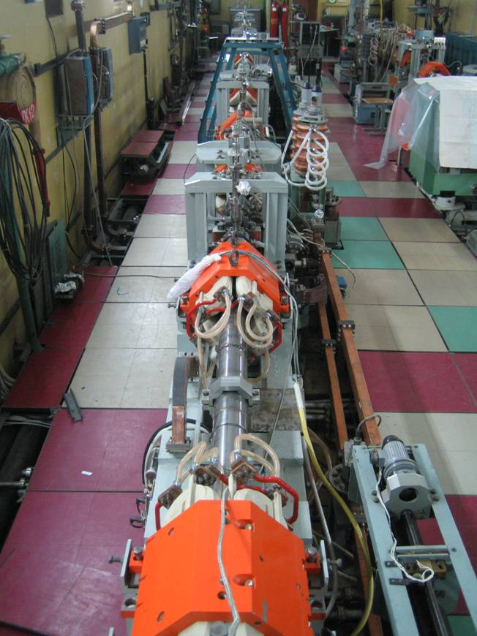
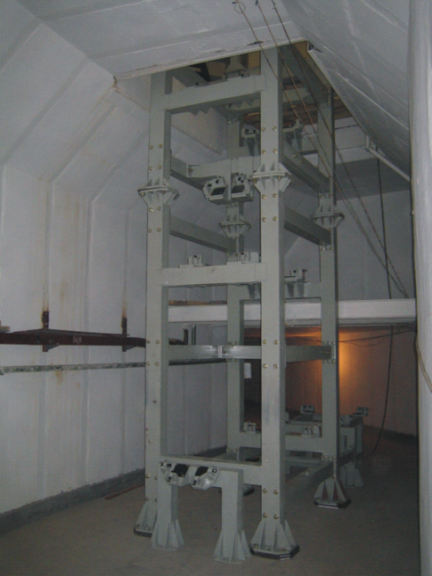
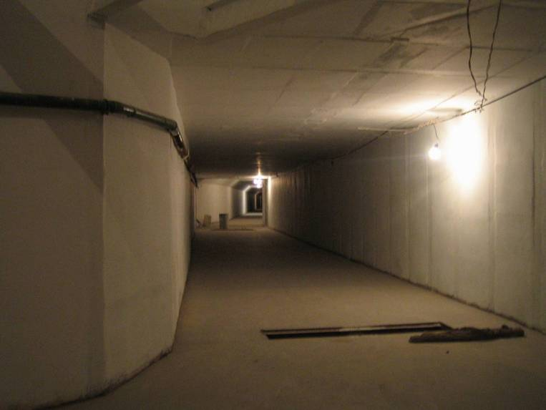
Super-c-tau: injection facility

Slide 26
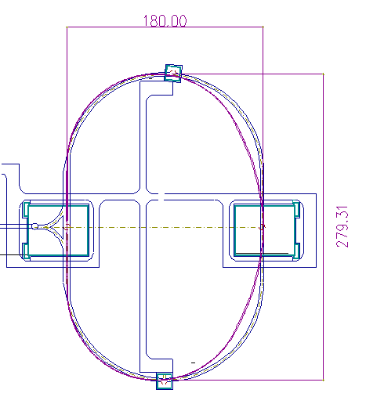
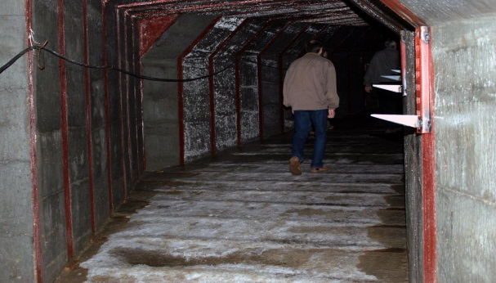
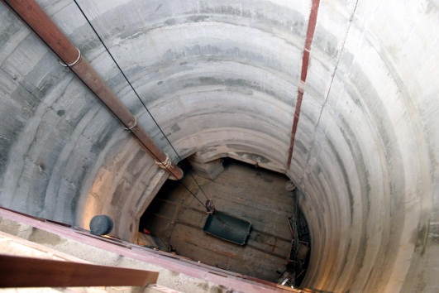
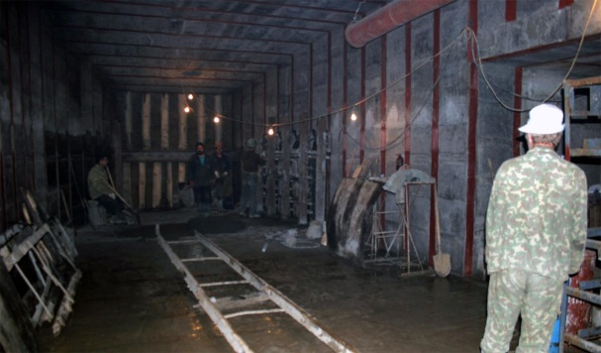
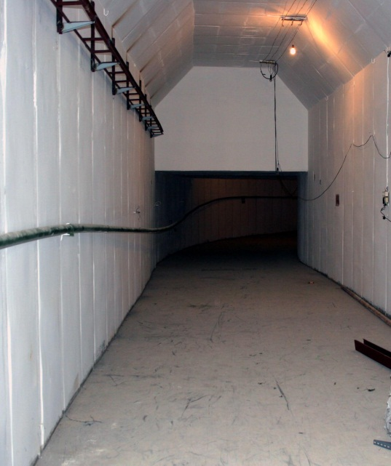
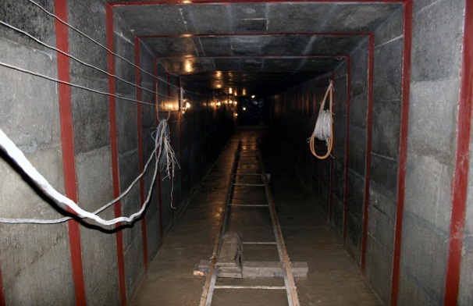
Super-c-tau: construction cite
Ready-built tunnel
FF region
Technical reg. (RF and injection)
Damping wiggler sections
A.Bogomyagkov (BINP)
26

Slide 27
Super-c-tau: conclusion
The lattice, meeting all main requirements is ready.
FF key element, twin-aperture SC quadrupole prototype is being manufactured.
Prototype of the damping wiggler is ready.
Civil construction is under way.
injection facility is under commissioning, tunnels for linac and injection lines are ready, bulk of the facility solutions are based on existing wares and technologies.
Detailed machine design and beam dynamics simulation is in progress.
Project is being considered in government committee.

