Slide 1
Welcome
University of Hawai‘i at Mānoa
Jennifer Ott
ottjenni@hawaii.edu
ML4FE, May 19-21, 2025

Slide 2
Honolulu

Slide 3
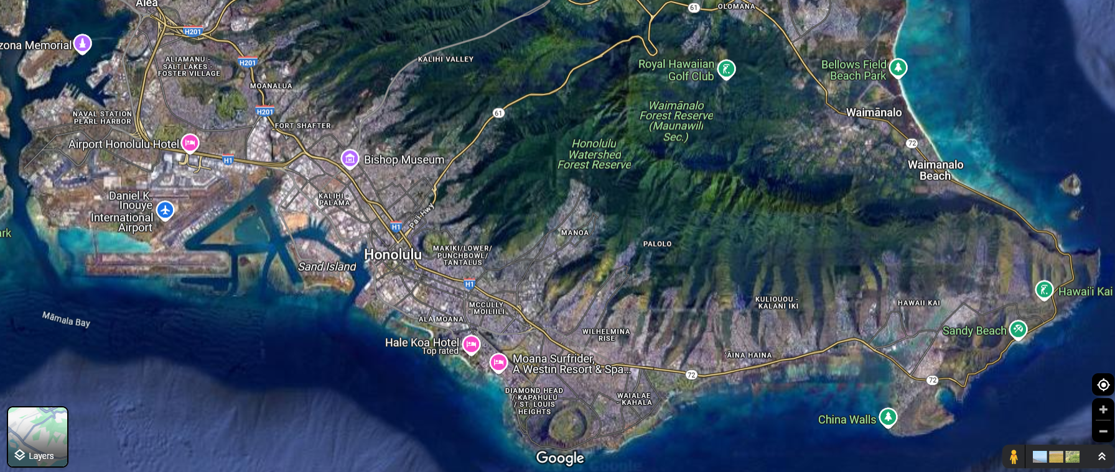

Slide 4
Land acknowledgement
UH is situated on the traditional and ancestral homelands of the Native Hawaiians - kānaka ʻōiwi
Some words you may encounter:
Aloha
Mahalo: thank you
Kōkua: collaborate, support
Makai: towards the ocean
Mauka: inland-facing

Slide 5
Background: UH
The University of Hawai‘i system encompasses several public university and community college campuses on the Hawaiian islands
Flagship campus in the Mānoa valley: the only R-1 ranked university in the state of Hawai‘i
Among the most diverse student populations in the US; Minority-Serving Institution
Passed 20,000 enrolled students for the first time in AY24/25!

Slide 6
Background
Department of Physics and Astronomy: strong presence in high-energy physics at the Belle II experiment, neutrino physics including protoDUNE and KamLAND-Zen, instrumentation in gaseous detectors and detector readout
Instrumentation Development Lab → Varner Lab
Department of Electrical and Computer Engineering: computer engineering, systems and data science, electrophysics – including microelectronics design and fabrication, ML in-ASIC
Recent collaborative hires in Physics // Electrical & Computer Engineering, with nominal emphasis on ML/AI in front-end electronics: Zepeng Li (Phys) and Jennifer Ott (ECE)
High-performance computing cluster
Hawaii AI initiative

Slide 7
ML4FE workshop
First workshop – hopefully a good opportunity for exchange and discussion!
Organizing committee:
Jennifer Ott (UH)
Keisuke Yoshihara (UH)
Julia Gonski (SLAC National Accelerator Laboratory)
Alexander Paramonov (Argonne National Laboratory)
Cristián Peña (Fermi National Accelerator Laboratory)

Slide 8
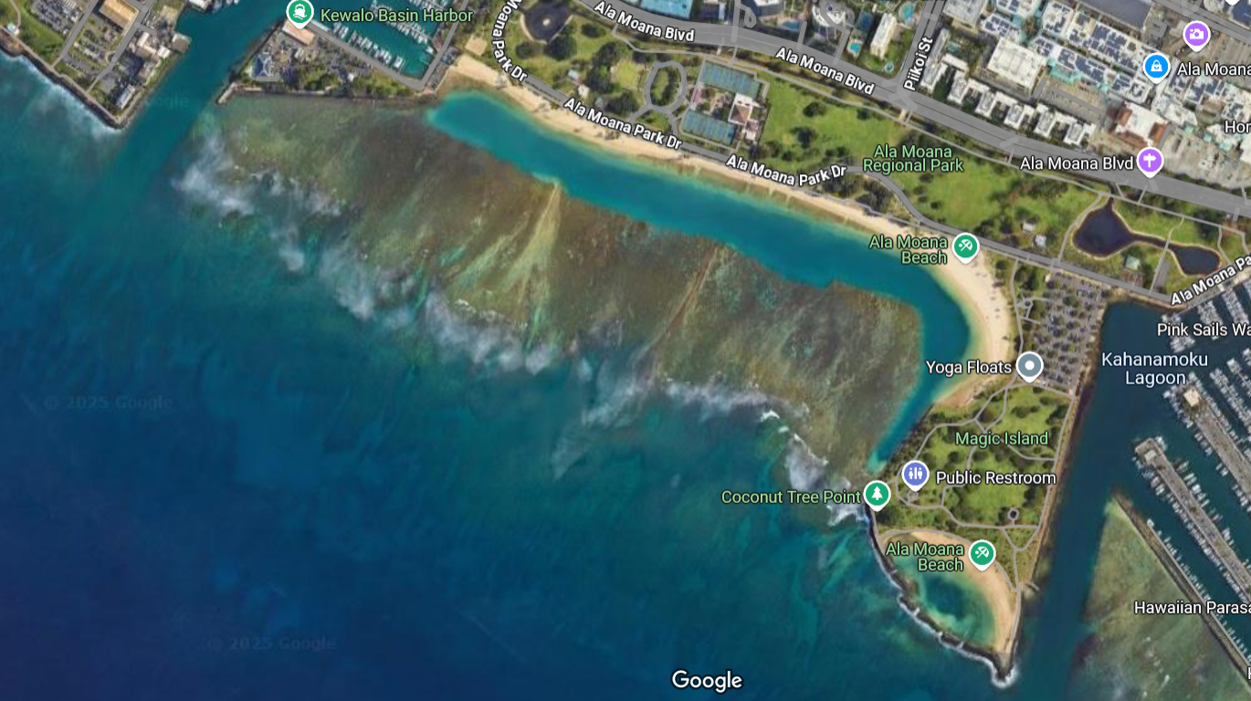
Practical information: social events
Monday
Campus tour
Evening: Ala Moana beach park
Bring drinks; towels and swimwear if you want!
Tuesday
Workshop dinner: Tiki’s Grll & Bar
https://www.tikis.com/
Please confirm by Monday noon for final headcount
Wednesday after closing and conversations: BBQ in Jenni’s backyard

Slide 9
Practical information: workshop days
Mānoa campus, Holmes Hall
Room 389: sessions
Room 244 and/or outside areas (“lanai”): coffee breaks
Lunch: Campus Center, Paradise Palms – central delivery order if needed
Indico timetable is on local time = Hawaiian Standard Time
Please help ensure both remote participation and accessibility by not speaking on top of each other, and if necessary come closer to the ceiling microphone if you have a comment or question, and your voice is not picked up at the very back (or, session chair can repeat comment/question)

Slide 10
Practical information: sessions
Monday and Tuesday:
Overviews of Technologies / Physics application cases for ML in the front-end
Contributed talks
Regular
Short ‘idea’ presentations
Wednesday:
Presentations on networks and frameworks advancing or contributing to ML in the front-end
Community discussion about potential joint efforts, funding opportunities, etc
There are indications (at least from the DoE side) that the significance of ML/AI-related funding in experimental HEP is going to increase. It may be very useful to initiate a white paper or another form of write-up of target technologies and projects by this community following this workshop

Slide 11
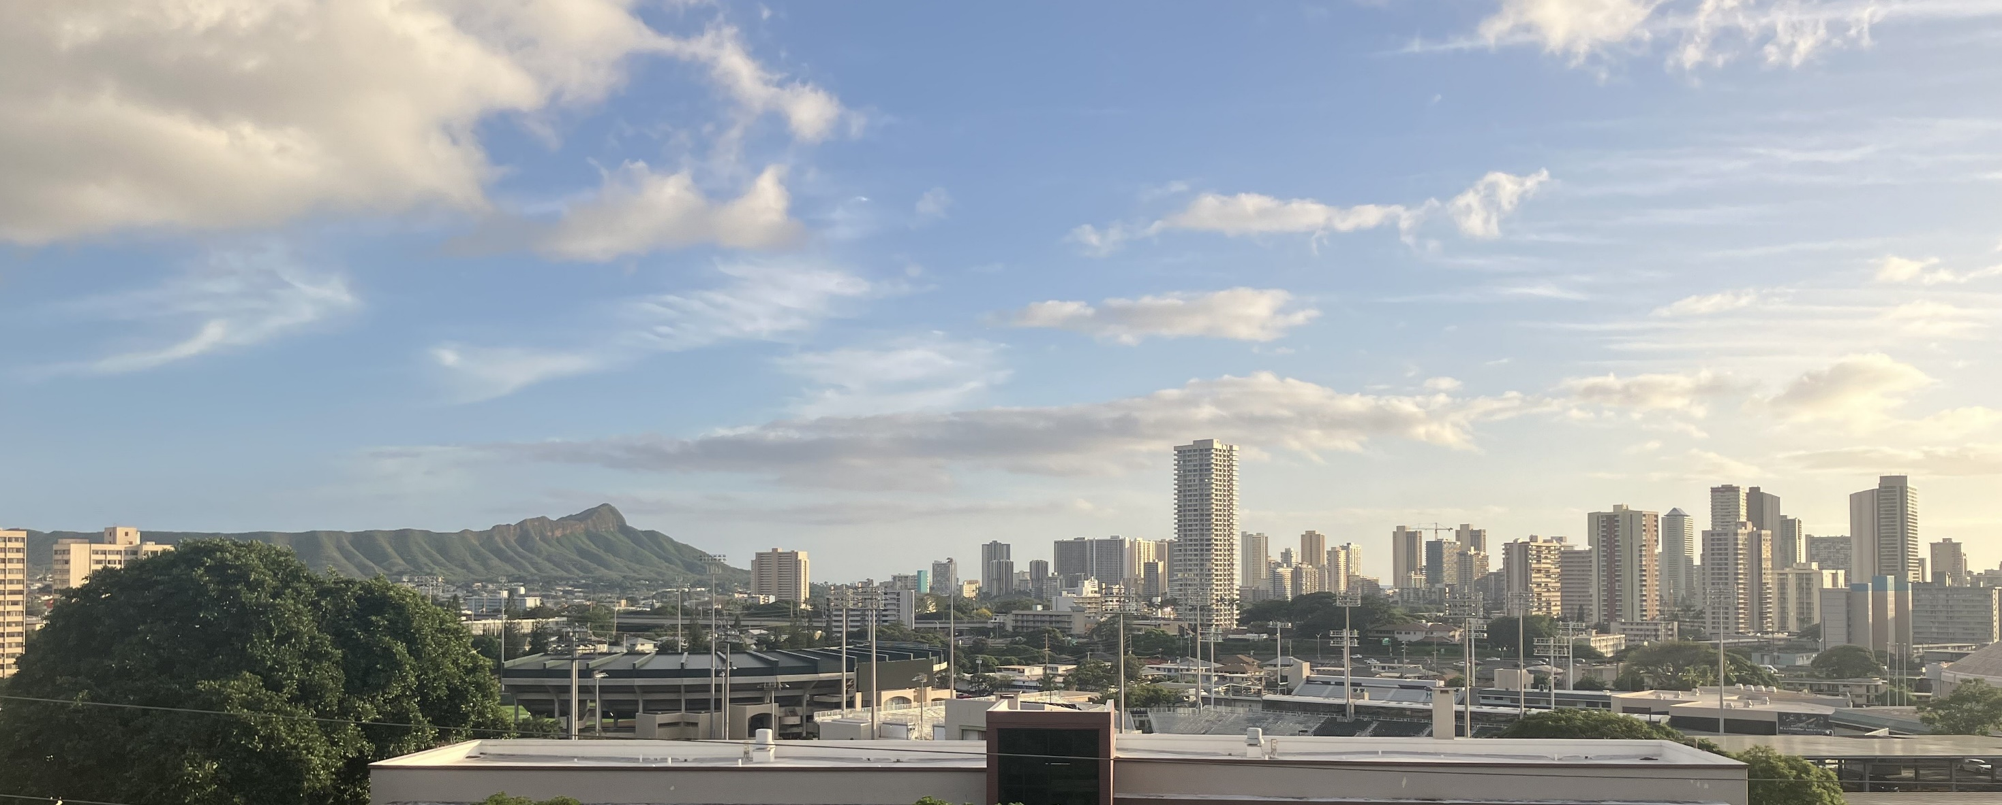
Coffee break reconvene ca. 10:15

