Slide 1
AI/ML for Beam Optimization at the UH Accelerator and FEL Facility
Siqi Li, Niels Bidault
ML4FE workshop, May 2025

Slide 2
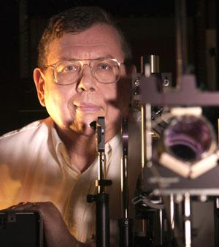
Brief Overview of the Linear Accelerator
Prof. John Madey brings FEL science to UH
MkIII transferred to UH and upgraded to MkV
First IR light observed from MkV
X-ray scattering chamber
First X-ray light detected
Restart of a group
1998 2002 2009 2012 2015 2024
Brief Overview of the Linear Accelerator
Notes:
Holes are filled with civil engineering work, technical advances, design and thinking of the linac and FEL.

Slide 3
The UH linac/FEL
Niknejadi, Pardis, et al. "Free-electron laser inverse-Compton interaction x-ray source." Physical Review Accelerators and Beams 22.4 (2019): 040704.

Slide 4
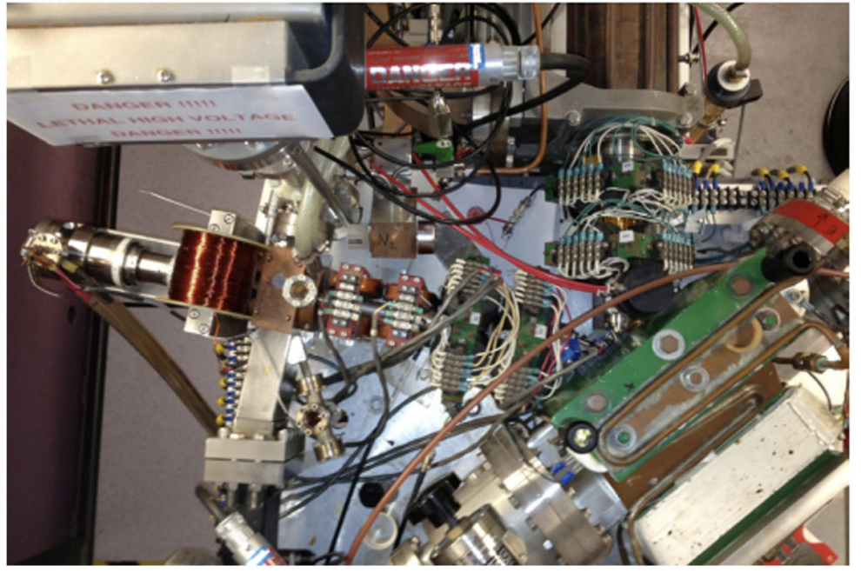
The UH linac/FEL

Slide 5
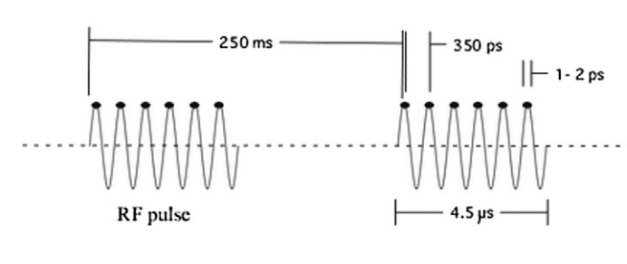
The UH linac/FEL
RF frequency 2.856GHz
Micropulse duration: 1-2ps
Macropulse duration: 4-5us
Macropulse frequency: 4-10Hz

Slide 6
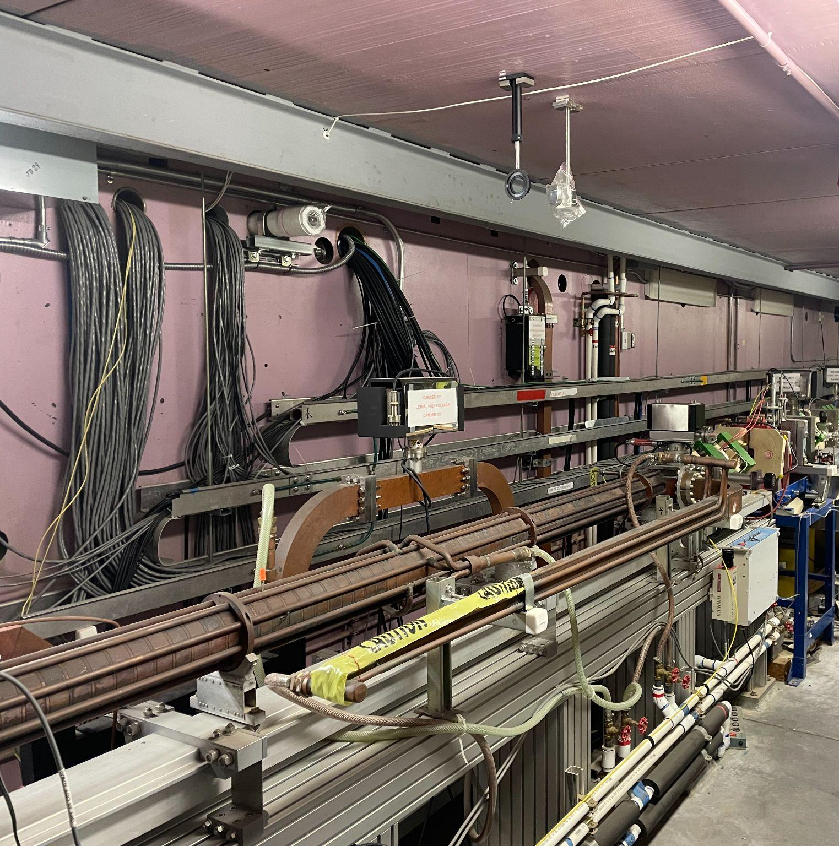
The UH linac/FEL

Slide 7
The UH linac/FEL
design
experiment

Slide 8
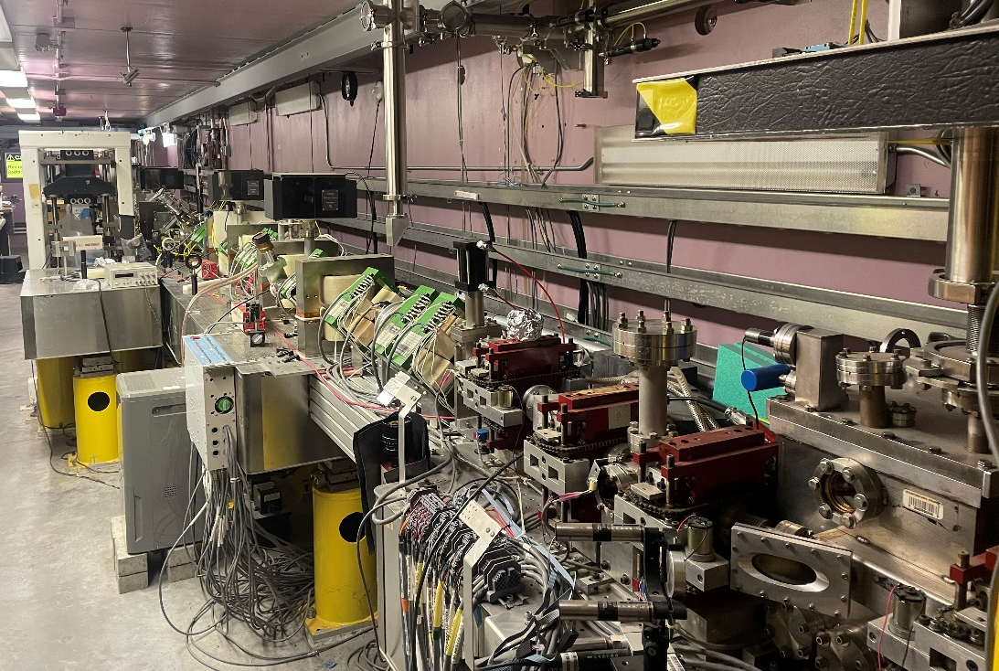
The UH linac/FEL

Slide 9
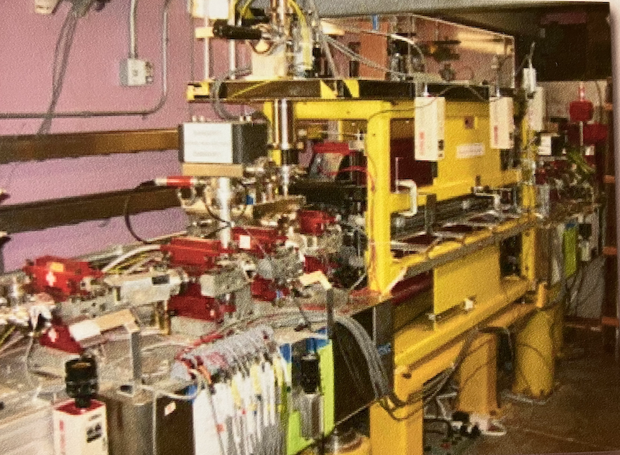
The UH linac/FEL

Slide 10
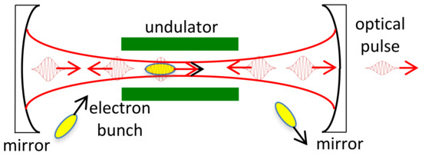
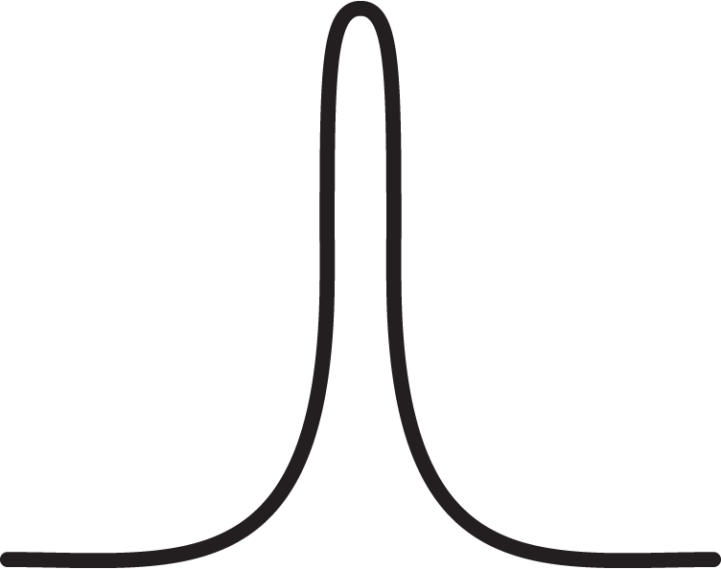
The UH linac/FEL

Slide 11
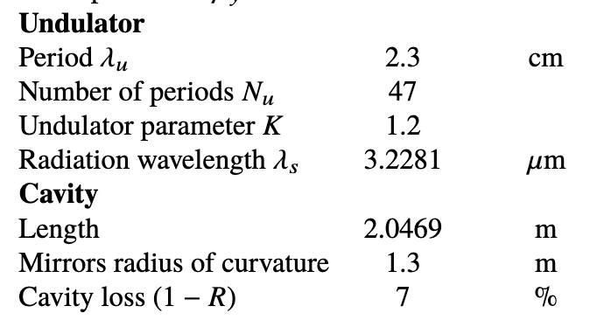
The UH linac/FEL

Slide 12
The UH linac/FEL

Slide 13
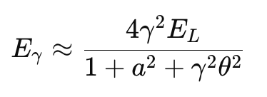
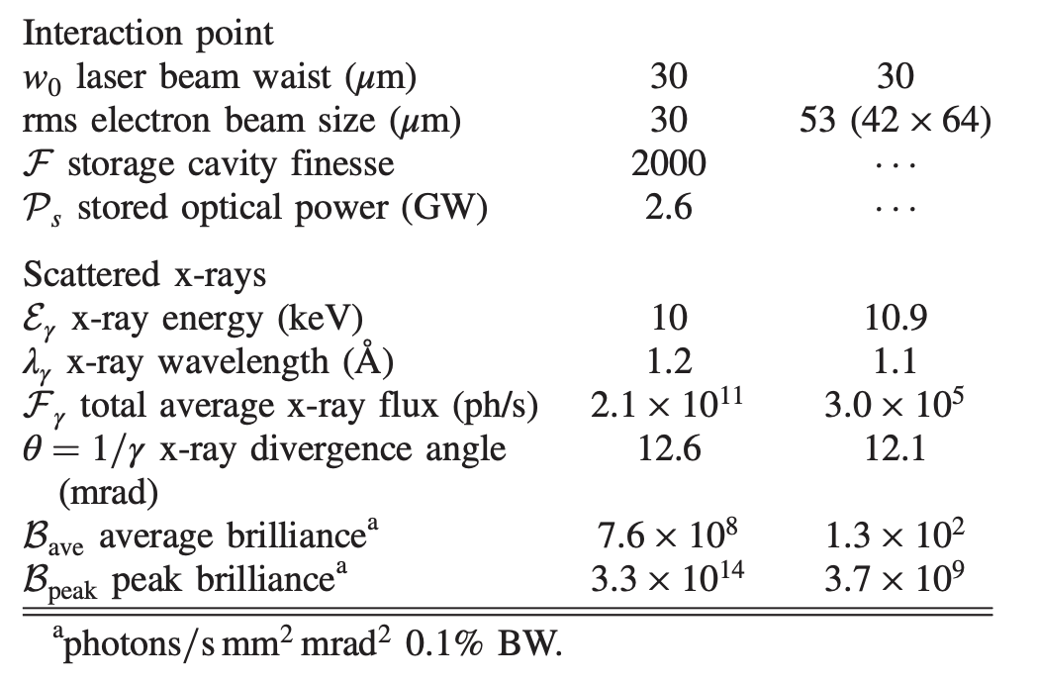
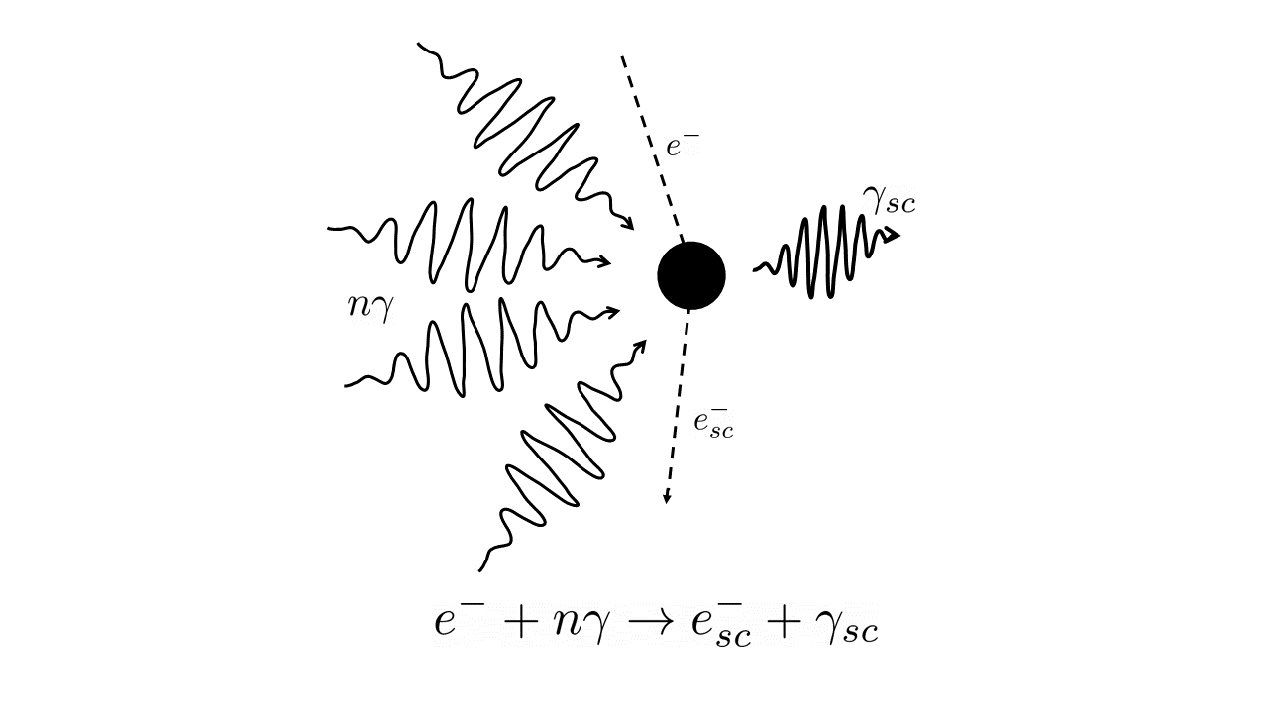
The UH linac/FEL
design
experiment
IR
x-ray

Slide 14
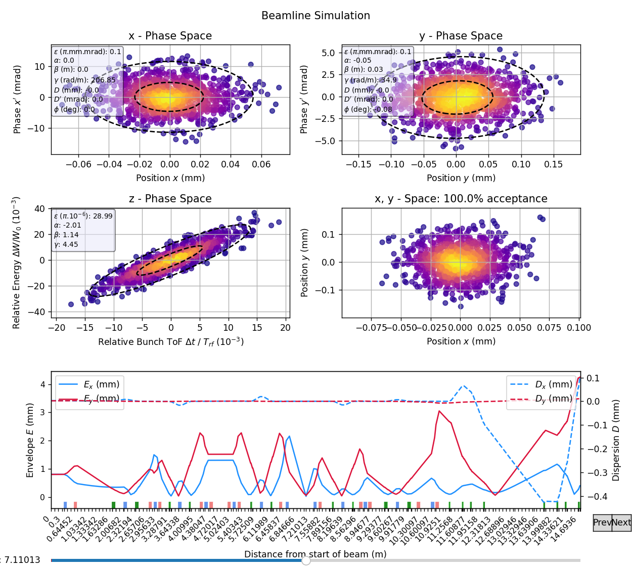
Beam dynamics simulations
Beam Properties at
Inverse Compton Scattering (ICS)
Interaction point
ICS
Interaction point
FEL undulator
Start point
Christian Komo
Notes:
Done
Provides 1st order dynamics with fringe fields
Flexible beamline integration
Flexible beam input
Provide optimization tools
Remaining
Integration of beam loading
Treatment of non-linearities
Integration of existing codes: Bmad, MADX, COSY-INFINITY

Slide 15
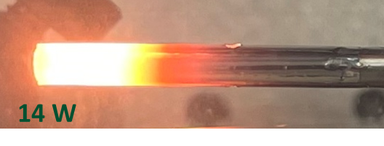
Current status of the linac
Fixed vacuum leak
Fabricated new cathode, installed to the gun
RF testing
Beam dynamics simulation from cathode to the entrance of the FEL
VacSeal curing

Slide 16
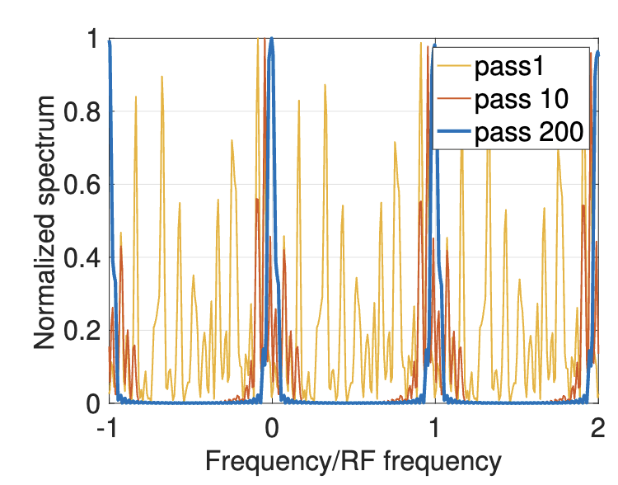
Current research with FEL
Phase coherence
wiggler
Amir Weinberg

Slide 17
Current research with FEL
Oscillator desynchronization
wiggler
Amir Weinberg

Slide 18
Potential projects for AI/ML applications
Optimization of the electron beam current, while avoiding beam loading and cathode back heating
Optimization of the electron beam phase space (energy vs time)
Optimization of the electron beam at the entrance of the FEL and at the interaction point in the ICS Chamber
Beam emittance
Energy spread
Optimization of the FEL performance
Interferometer tuning
Cavity tuning

Slide 19
Summary
There are hundreds/thousands of parameters to tune with a few objective functions, depending on the specific application of the facility.
Start-to-end simulations
Benchmark with a few different codes (ASTRA, GPT, ELEGANT, GINGER, GENESIS)
Upgraded beam-based measurements and diagnostics.
Currently we have: toroidal beam current transformer, scanning wire, OTR screens, spectrometers, and BPMs

