Slide 1
Reconfigurable Pulse-Shape Discrimination Algorithm Implementations using eFPGAs
Machine Learning for Front Ends Workshop – University of Hawaii
Carl Grace, Jyothis Johnson, & Tarun Prakash 05/19/2025
Lawrence Berkeley National Laboratory

Slide 2
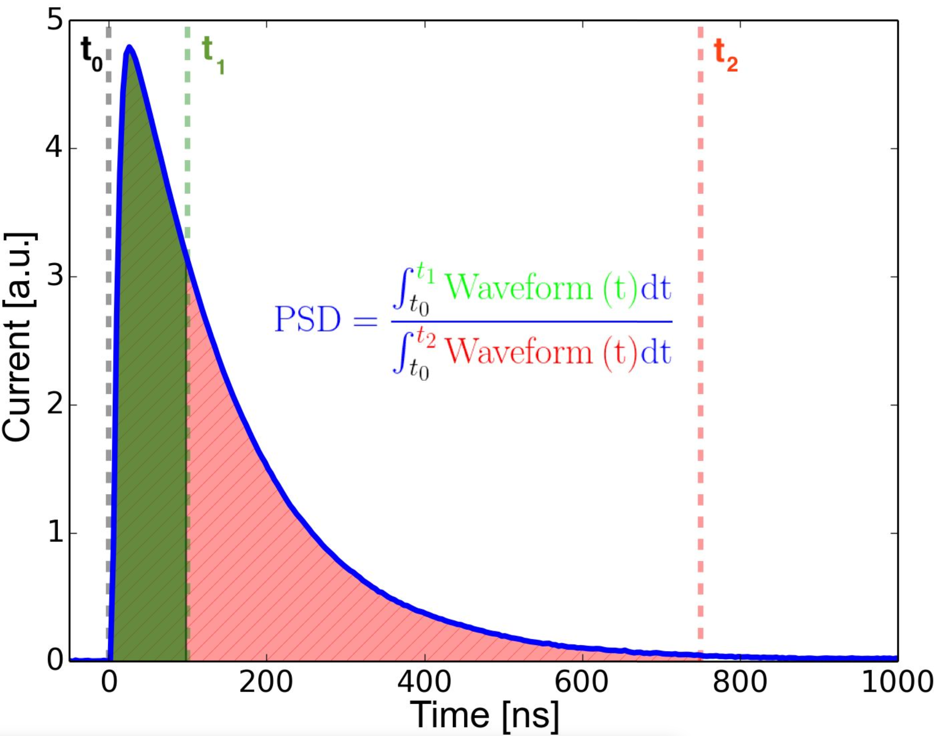
Mixed-Signal Pulse Shape Discrimination (PSD)
Emission spectra depend on the type of interacting particle
Differential excitations of excited states decay with distinct decay contents
The resultant output pulse has this characteristic encoded in its temporal profile
Widely used ”Q-ratio” approach.

Slide 3
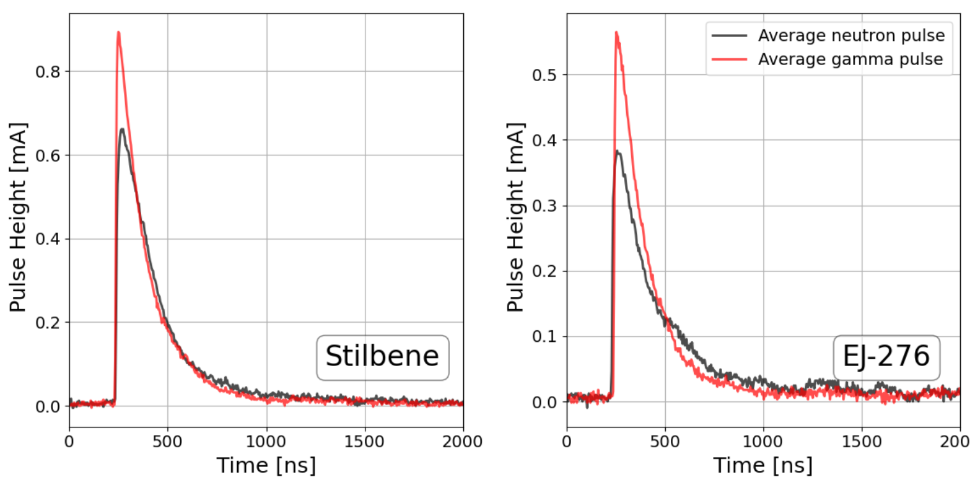
Mixed-Signal Pulse Shape Discrimination (PSD)
Data reduction is a key strategy for reducing power in emerging mobile neutron imaging systems. Gamma interactions can be 100X more common than neutrons. Need on-chip PSD.
100 keVee AmBe source

Slide 4
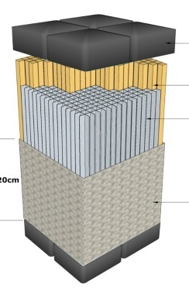
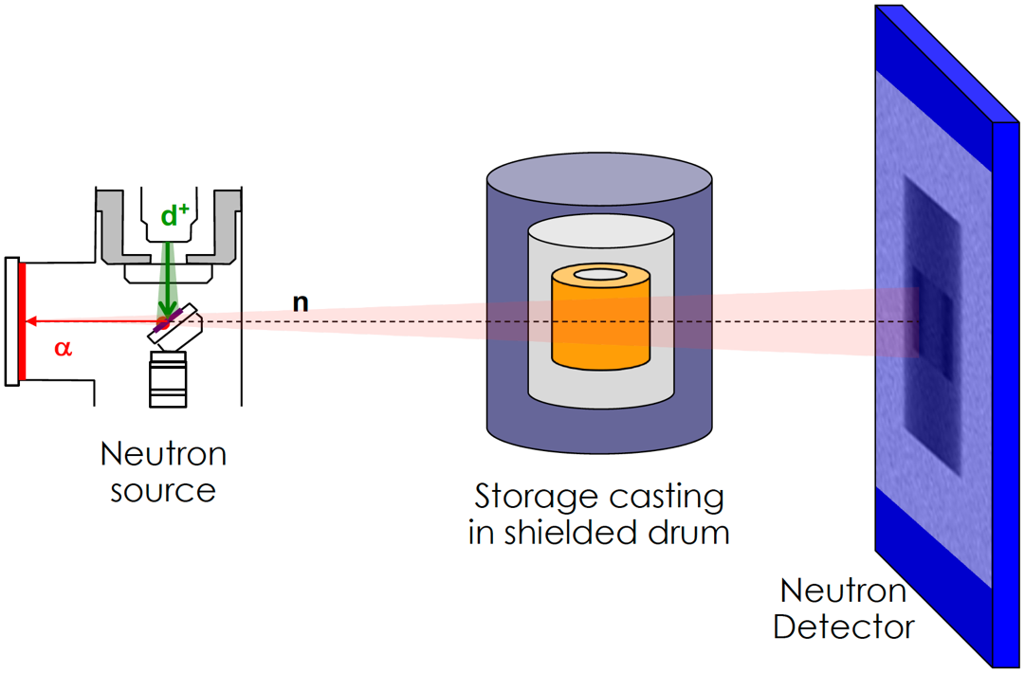
eFPGA Value Proposition
Typically, neutron imaging modalities require different triggering, filtering, and PSD settings
Providing sufficient tunability to meet needs of various scintillator / imaging systems is impractical
Emerging applications can be addressed if digital logic is reconfigurable
eFPGA provides the ability to reconfigure a chip for different scintillators and modalities
Also allows more flexible tradeoffs in ML algorithms for PSD
Neutron and Associated Particle Imaging (API)
Optically Segmented Scatter Camera (OSSC)
Single Volume Scatter Camera (SVSC)

Slide 5
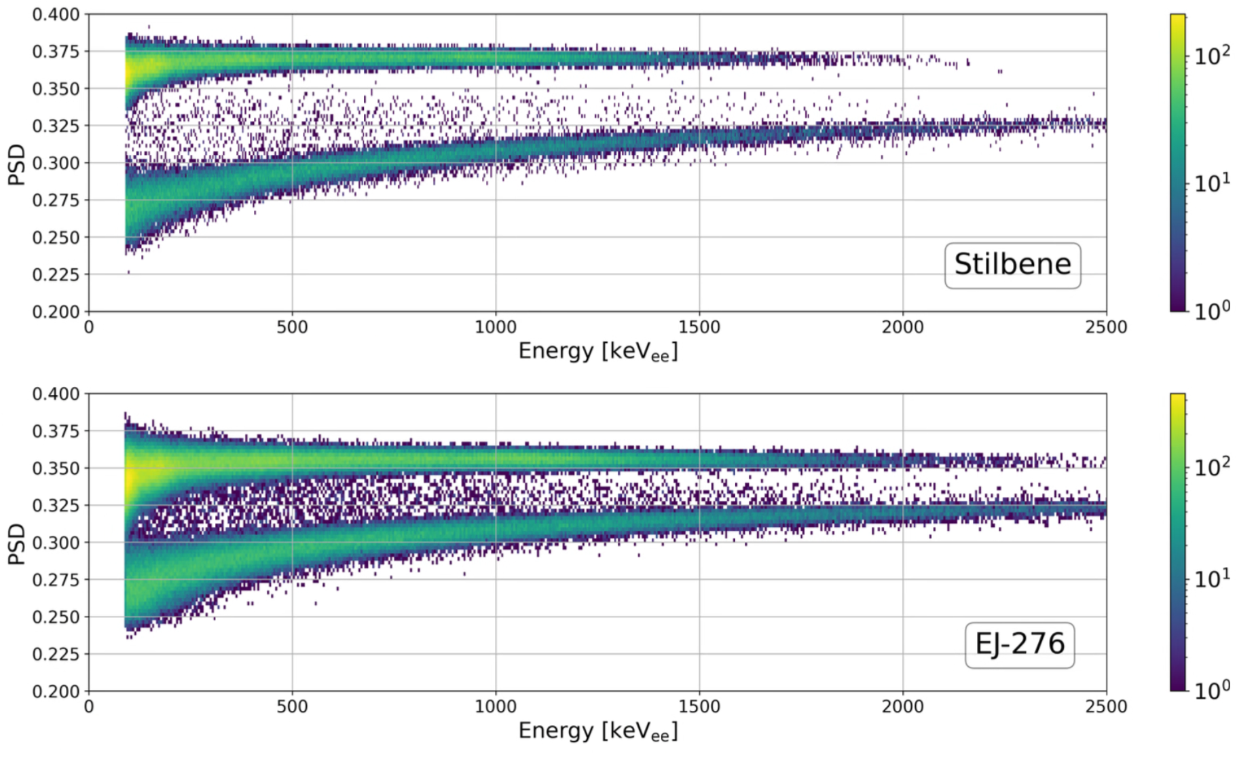
Mixed-Signal Pulse Shape Discrimination (PSD)
GAMMA
$$PSD= \frac{\int_{t_{0}}^{t_{1}}{Waveform(t) dt }}{\int_{t_{0}}^{t_{2}}{Waveform(t) dt }}$$
NEUTRON
Q-ratio works very well with waveform digitization. However, a typical waveform digitizer (DRS4) uses 240 mW per channel. Need a different approach for NeuROC.

Slide 6
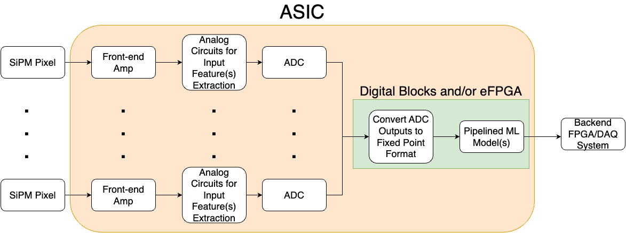
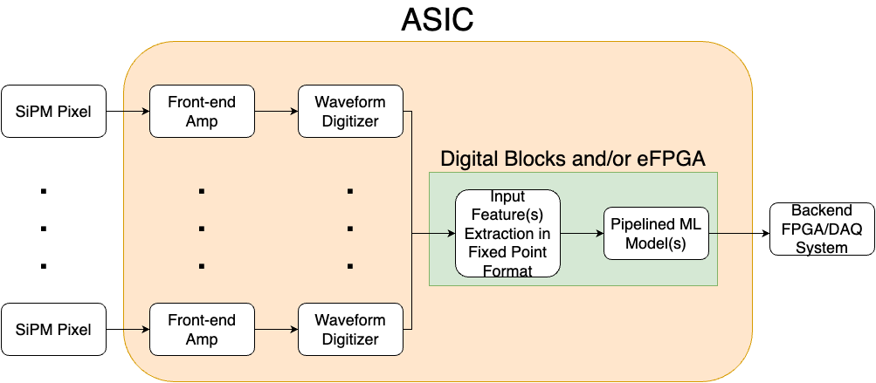
Extracting Input Features
Optimal input feature selection is one of the core limiters of final model performance!
In general, input feature choices will be limited by ability to effectively extract it in real-time
Two possibilities for real-time input feature extraction
Waveform and T0 digitization (using ADCs and TDCs) + DSP
Dedicated analog circuits to target specific features
Analog circuits + ADC signal chain
Waveform digitization signal chain

Slide 7
Extracting Input Features
In theory, can use either one or both options (depending on input feature)
Work needs to be done in defining input features that have high discrimination power/capability but can still be extracted in real-time for any target application
Input feature extraction adds to inference latency → what latency is okay depends on end use application’s expected event rate, etc
Analog circuits + ADC signal chain
Waveform digitization signal chain

Slide 8
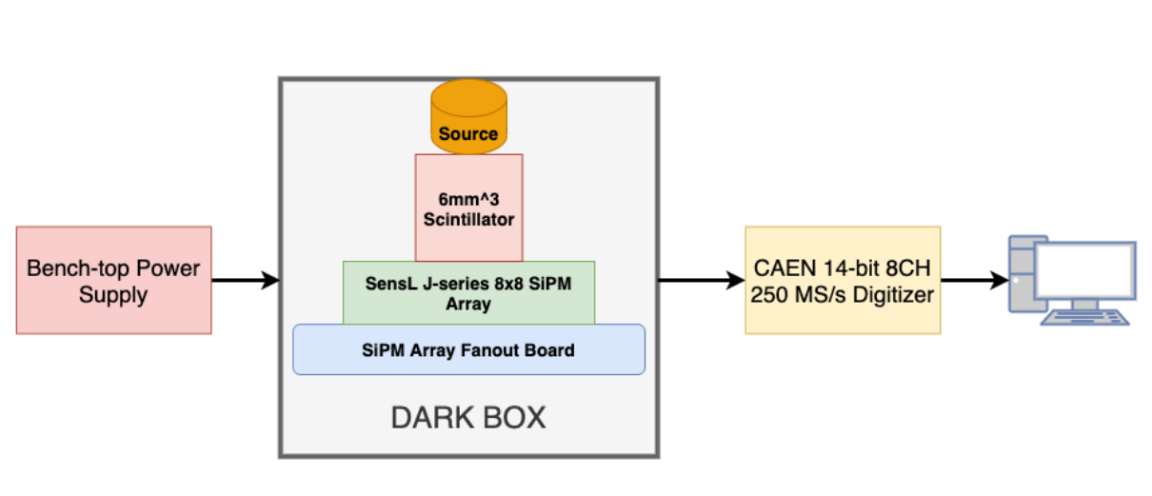
Testbed Setup
AmBe sealed source incident on an OnSemi J-Series SiPM (50um microcell size) 8x8 array with a single SiPM channel optically coupled to a cube of Stilbene scintillator
These SiPMs have two outputs: a fast, capacitively coupled output (FOUT) and the standard resistively coupled standard output (SOUT)
Custom fanout board to bring both signals to the commercial CAEN digitizer
Recorded waveforms saved on PC → 30 million AmBe waveforms recorded but most were 60 keV xrays from Am-241 decay

Slide 9
Overview of Python to Hardware Flow (hls4ml/conifer)
Full workflow requires translation of ML models across domains from programming to hardware description languages to synthesized gate-level netlists
hls4ml/conifer fills a crucial gap between domains by performing automated translation of Python ML models to synthesizable C++ using appropriate HLS libraries for various commercial HLS tools
LINK
V. Loncar (Heterogenous and Targeted Systems Seminar)

Slide 10
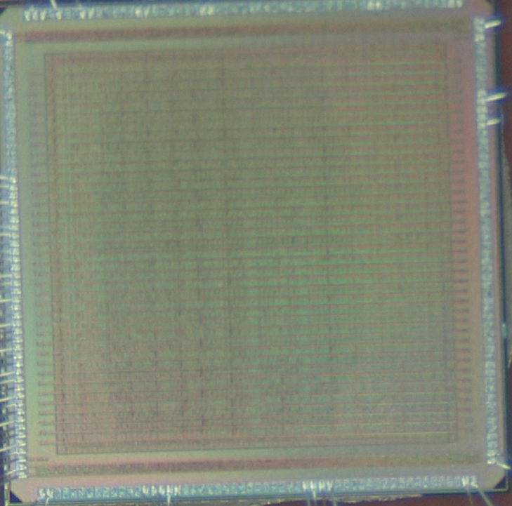
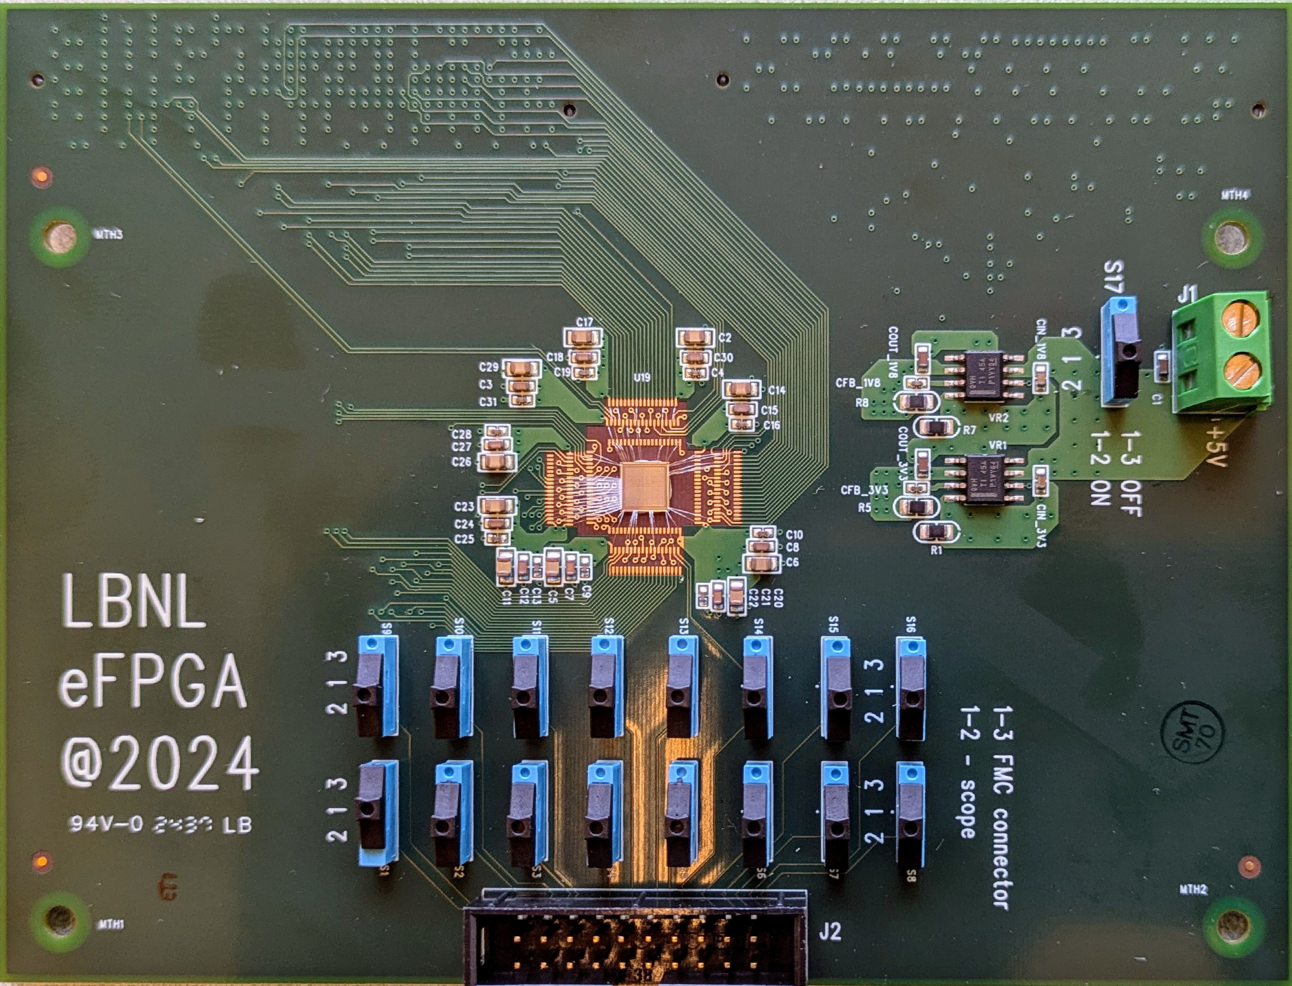
LBNL Prototype eFPGA
10x16 tiles (640 LUT blocks). 180 nm CMOS
(functionality testing underway)

Slide 11
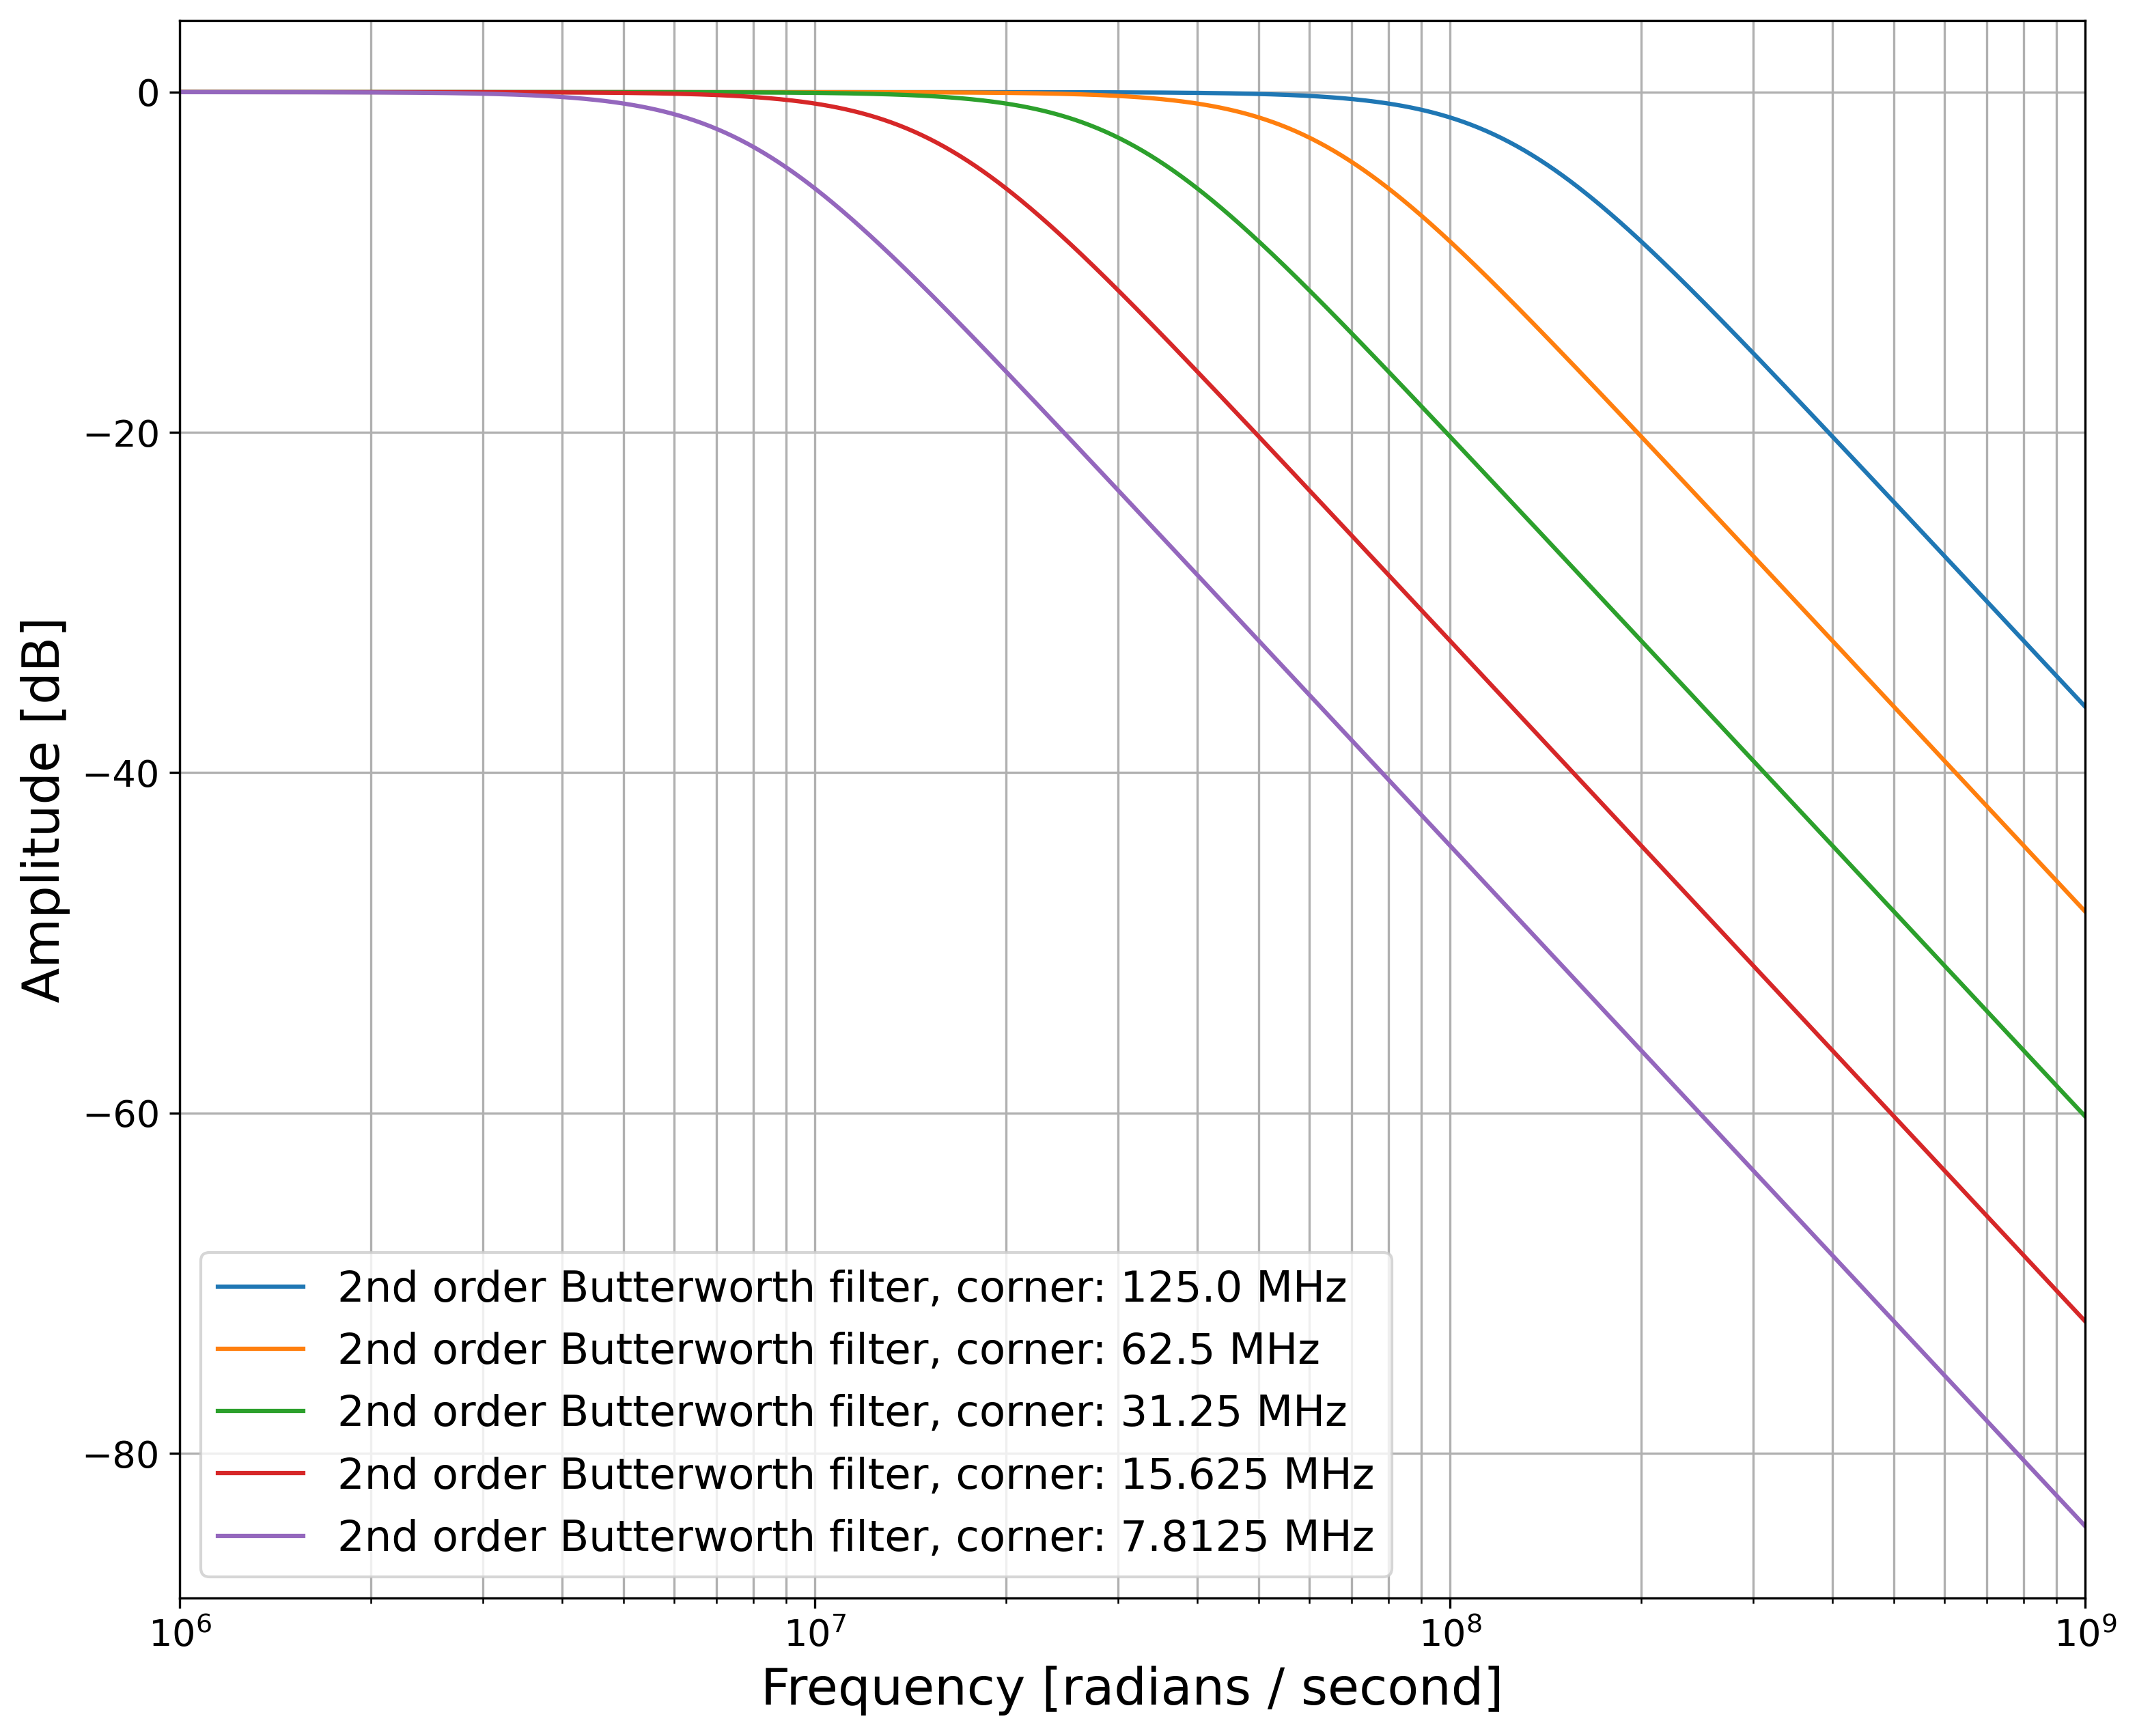
Methodology for Resource Efficient Study
Four input features used: FOUT peak amplitude, SOUT peak amplitude, SOUT total area and SOUT partial area (same for both BDT and fcNN models)
Software re-filtering and re-digitization of waveforms to take into account specifying ADC requirements for a final model (i.e. hardware aware co-design) → 35 pairs of filter corner and bit-resolution values
Used original 14-bit 250MS/s recorded waveforms to trim down on the rather large full parameter space (especially for fcNNs) and then just explore around these values when including quantization aware training and pruning
JINST 19 P07034
Bode plot of frequency response after software filtering

Slide 12
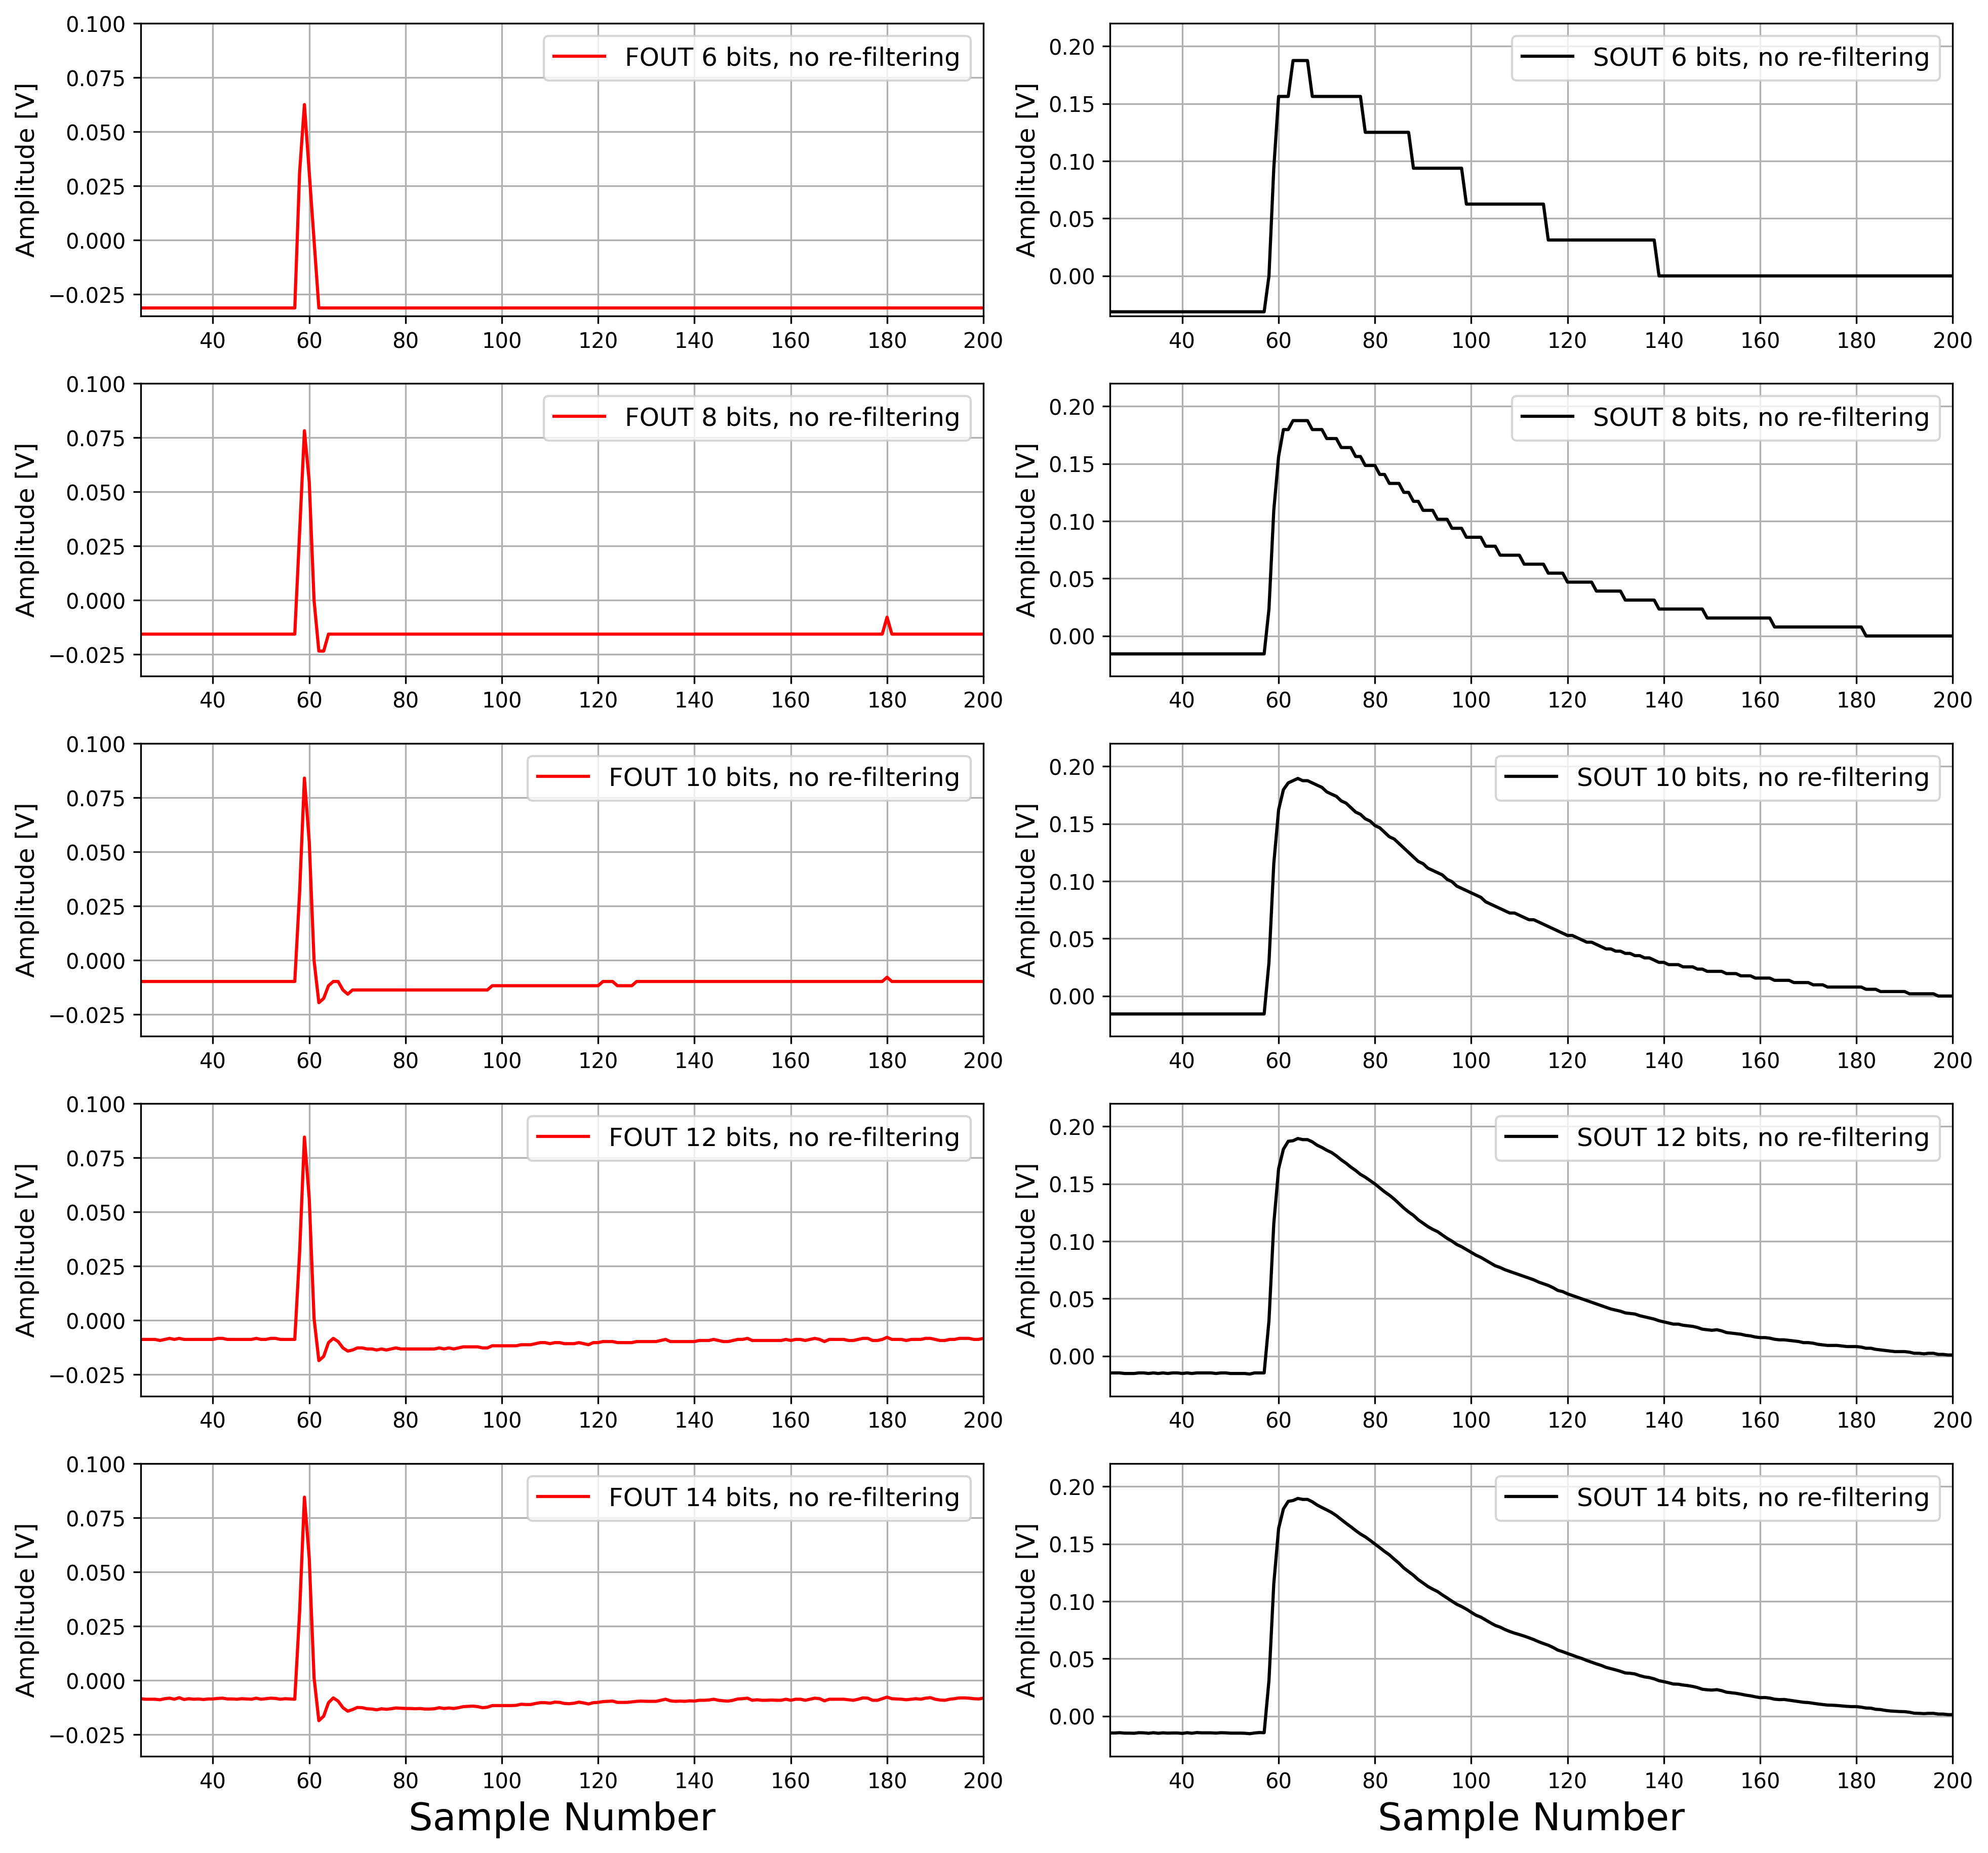
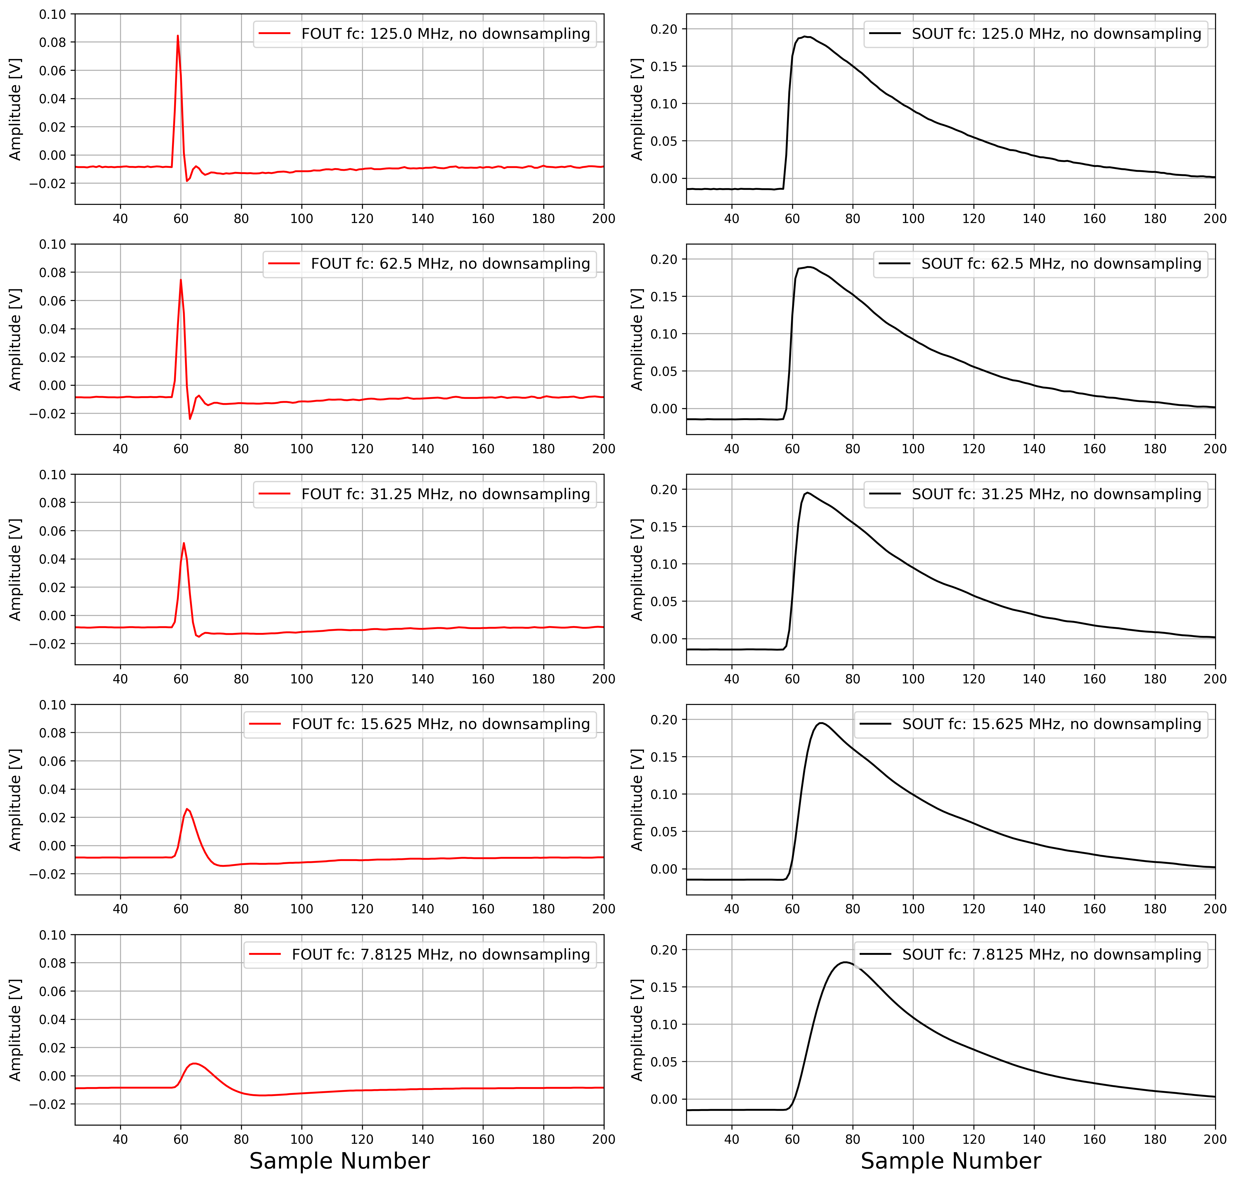
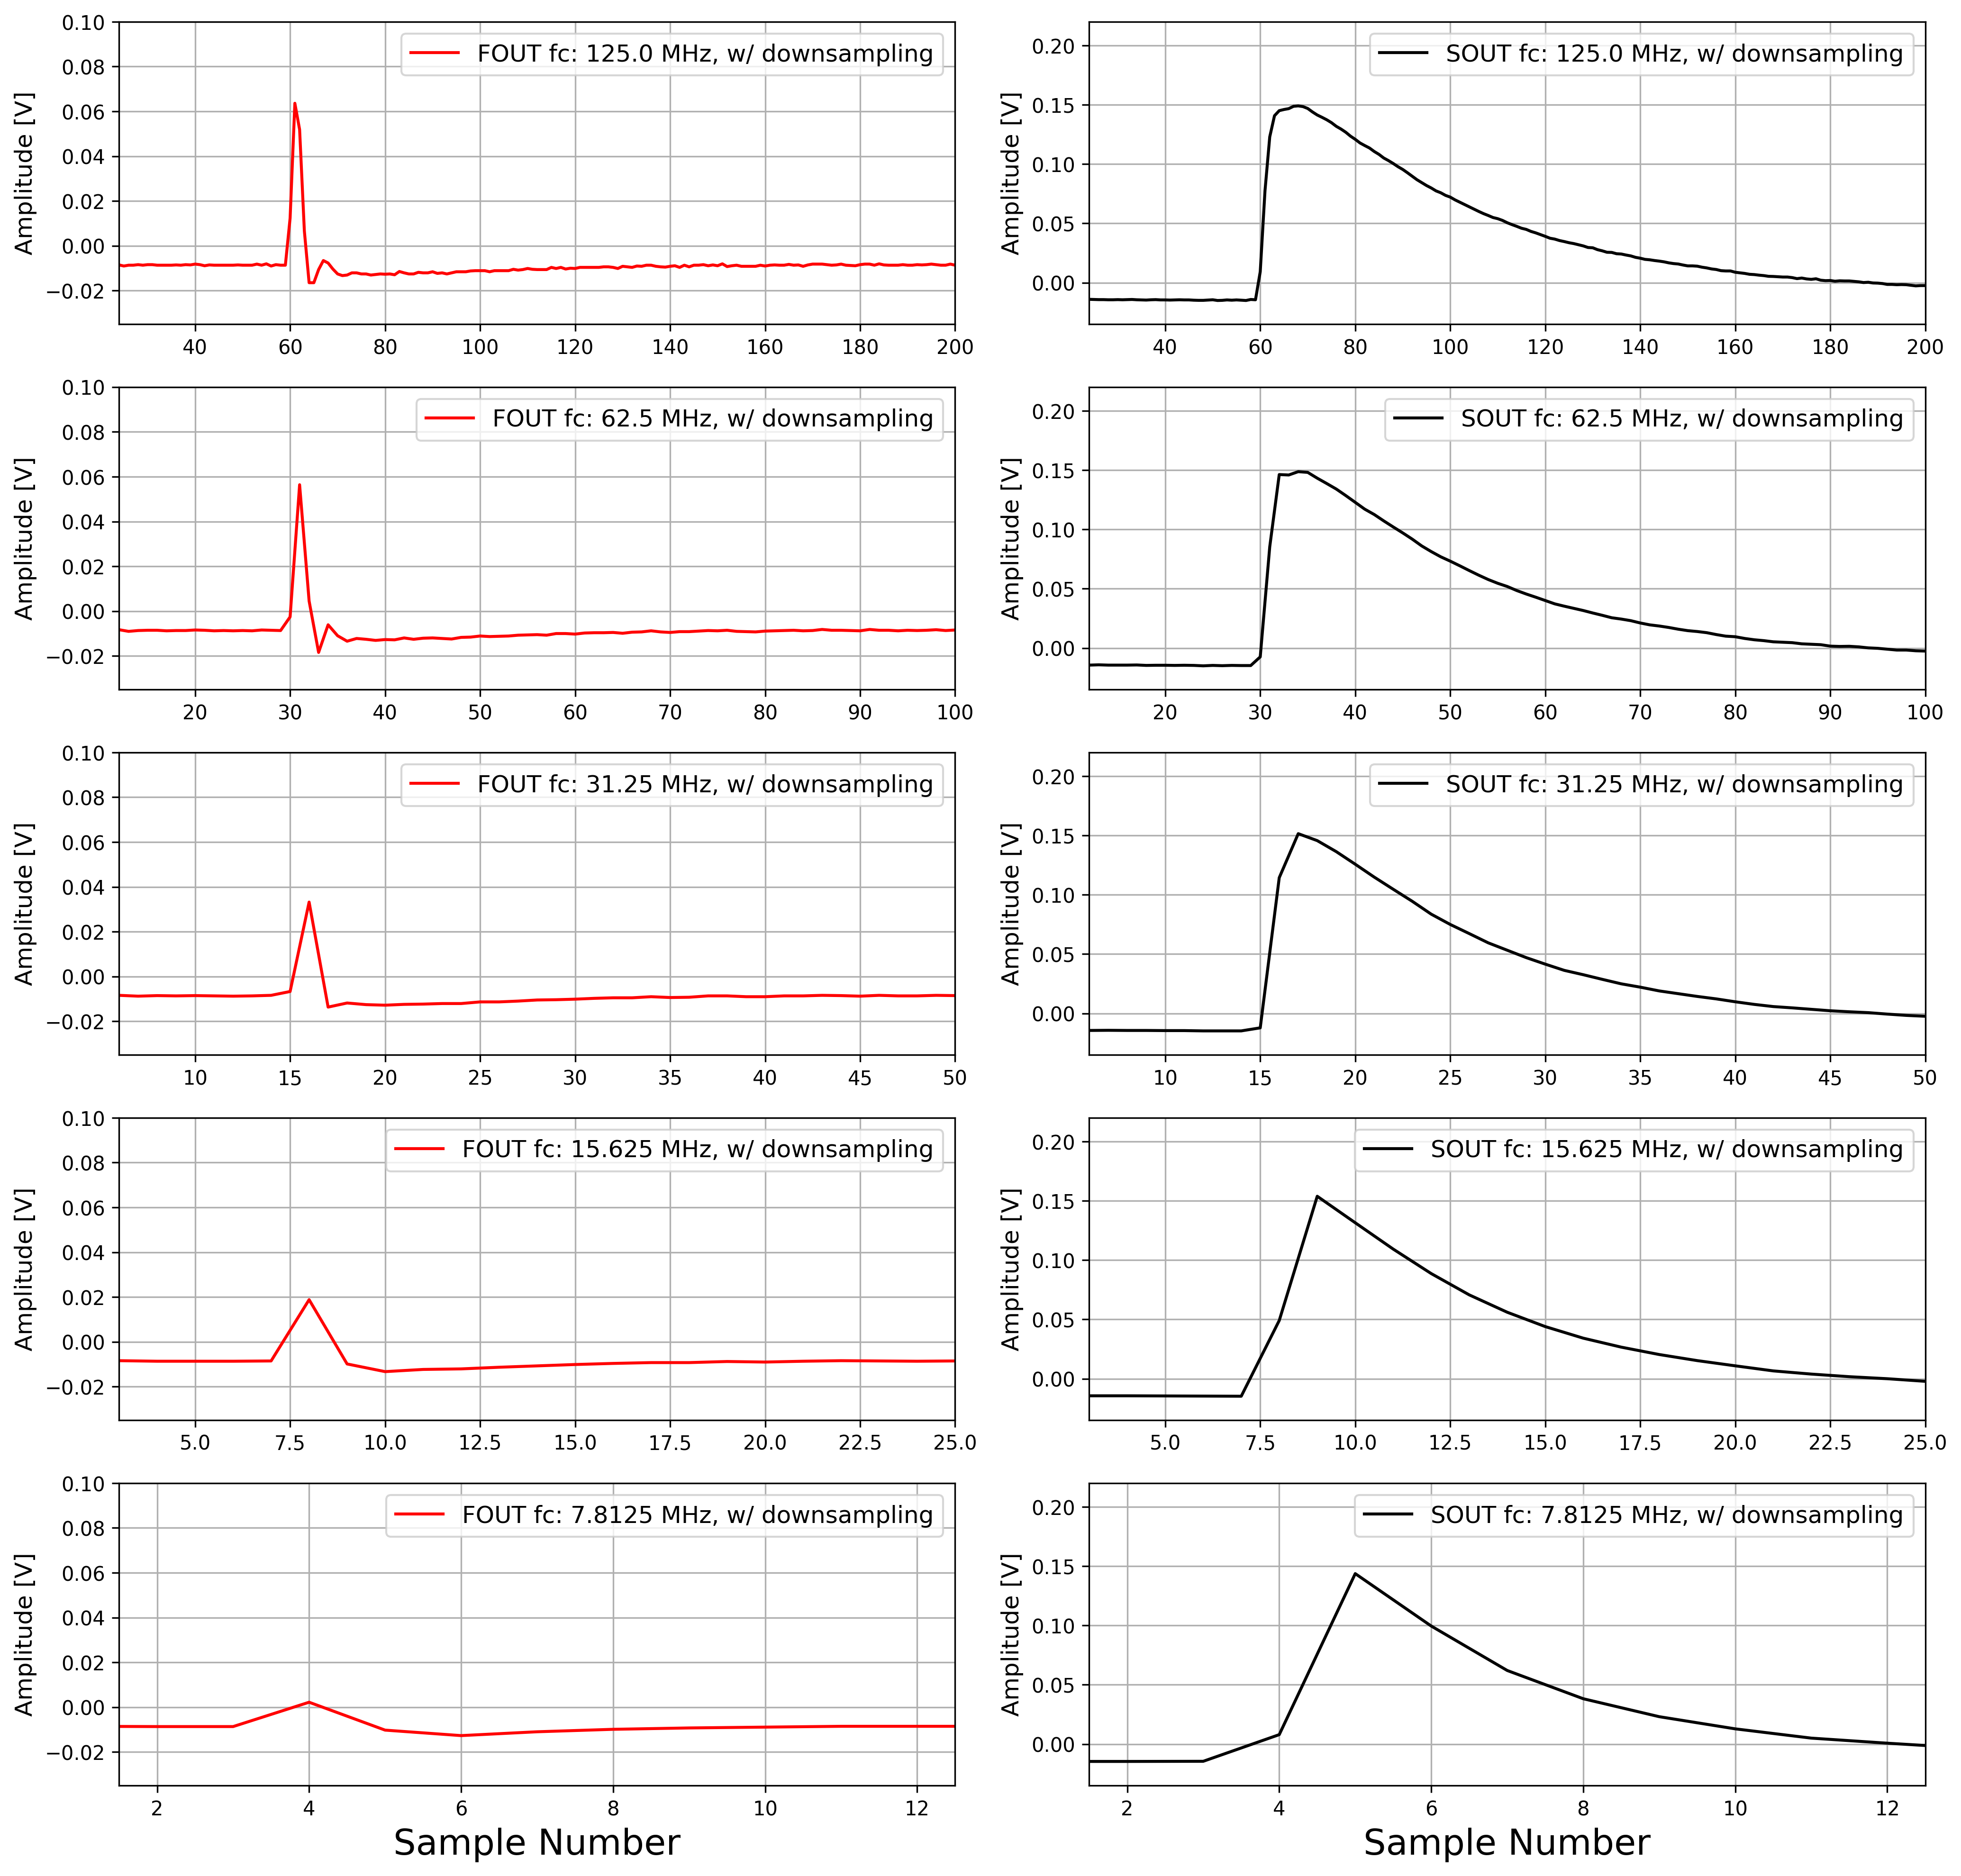
Methodology for Resource Efficient Study
Left: only re-digitizing waveforms while maintaining original bandwidth of recorded waveforms
Middle: only re-filtering waveforms while maintaining original 14-bit resolution (corresponds to analog circuits + ADC for input feature extraction)
Right: both re-digitization and re-filtering of recorded waveforms (corresponds to waveform digitization + DSP for input feature extraction)

Slide 13
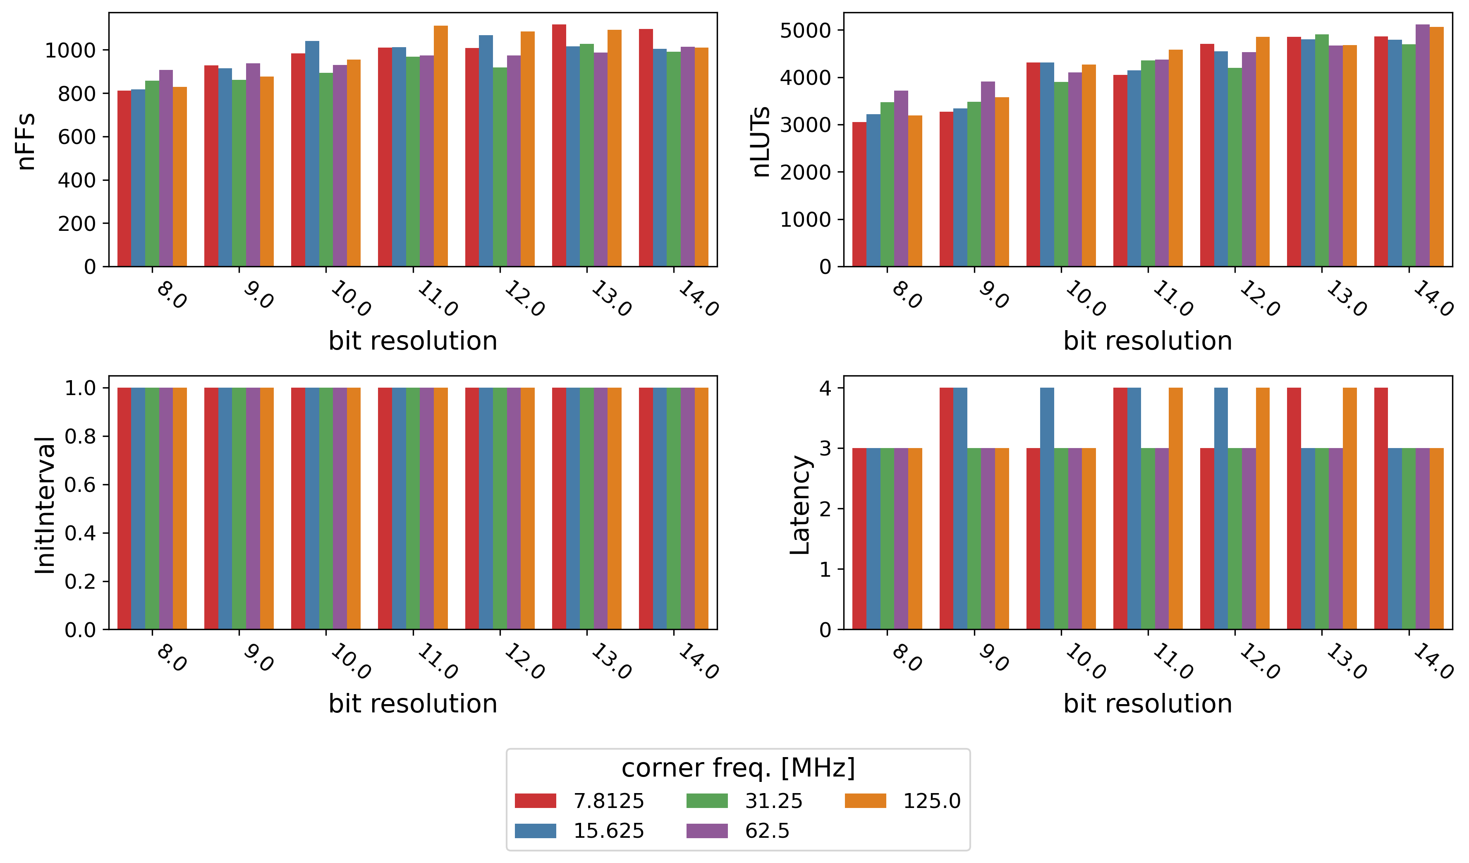
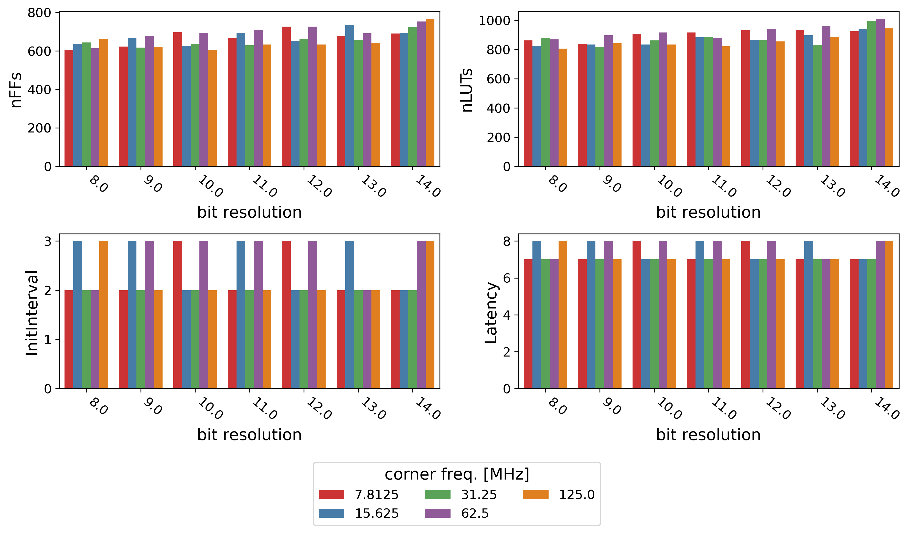
Resource Usage for Reduced Complexity ML Models
BDT model: number of boosting rounds = 50, depth of each tree = 3, binary classifier
fcNN model: 1 hidden layer, size = 16, target sparsity value = 30%, number of epochs = 120, binary classifier (plus DSPs and RAM requirement)
100 MHz target clk frequency

Slide 14
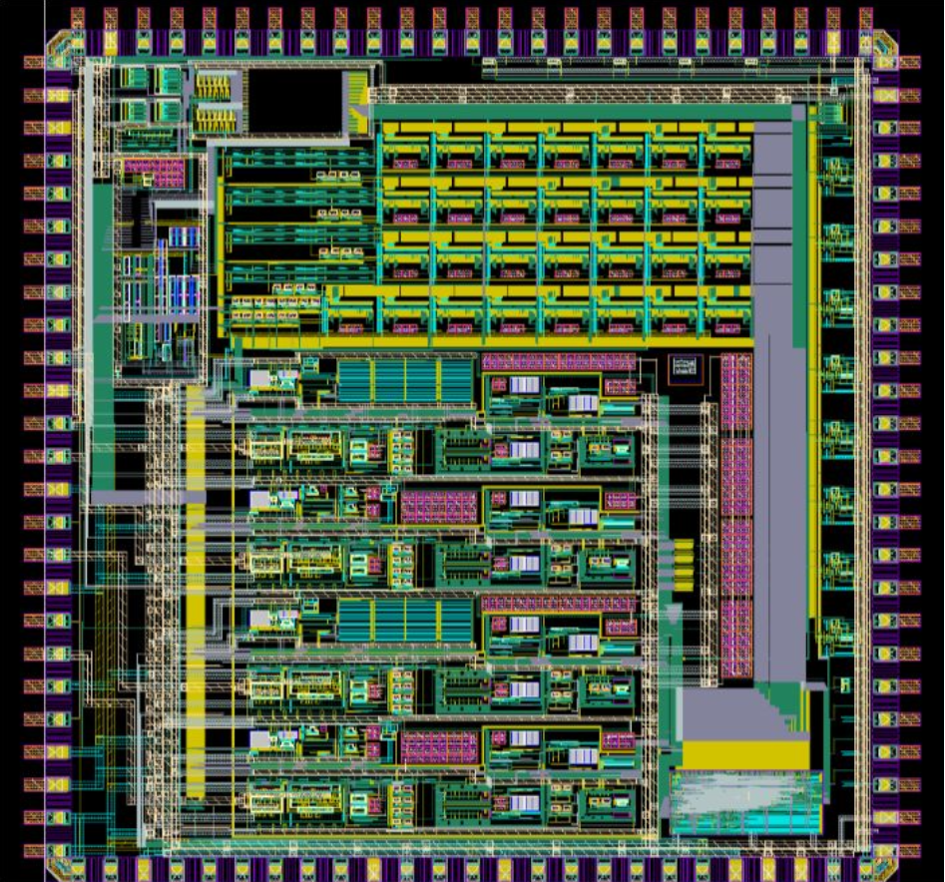
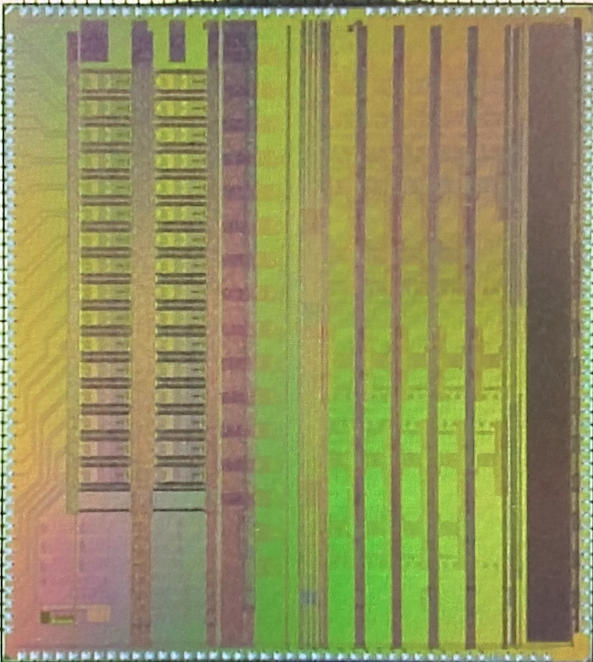
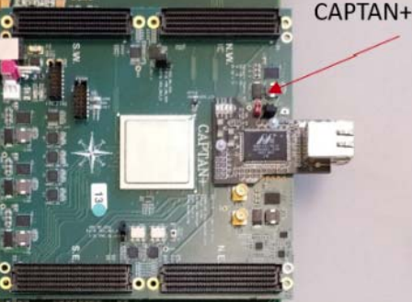
Block Diagram of Current Test Setup
ColdADC
eFPGA
NeuPIX
CAPTAN+

Slide 15
Block Diagram of Next Test Chip
Architecture generally applicable to detector readout systems. PSD is initial demonstrator.
Notes:
It’s actually a fairly complex task to translate a straight-forward concept like neutron/gamma PSD into a system that can achieve 10^-3 to 10^-4 false positives in gamma-dominant environments with a real-time implementation.

Slide 16
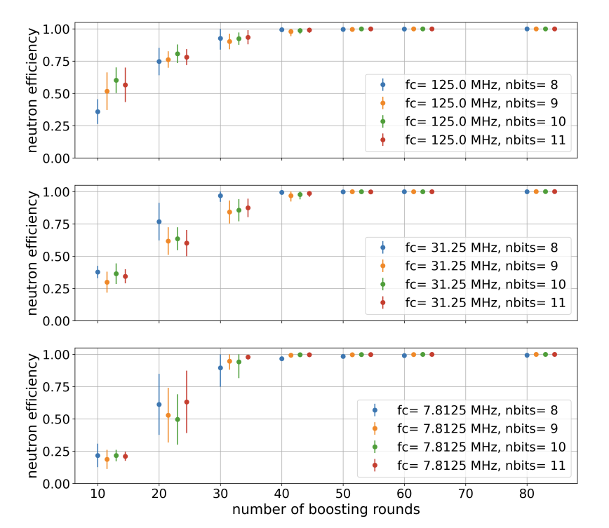
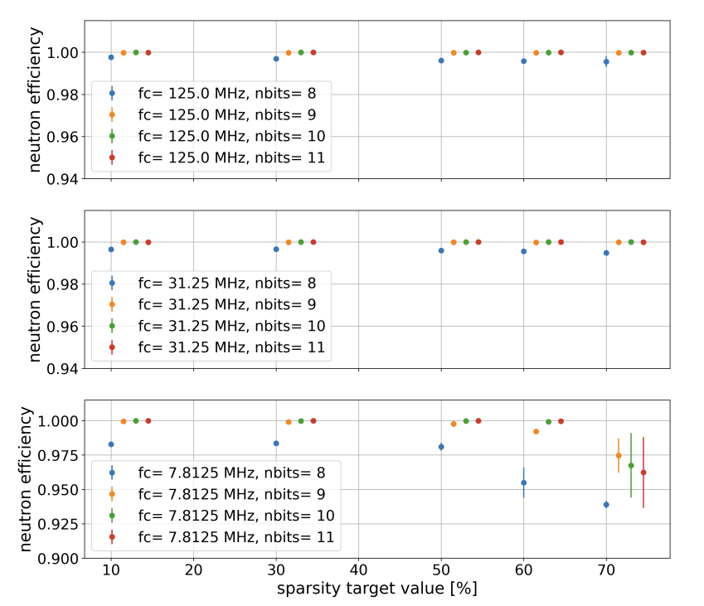
Simulated Results
Neutron Efficiency (BDTs)
Neutron Efficiency (fcNNs)
Notes:
BDT on the left, fcNN on the right. Both plots show simulated neutron efficiency across the major ML model parameter affecting performance for each type of ML algorithm. What we can likely fit on the V1 test chip is a model with 10 boosting rounds or so for the BDT. What we want to do for V2, with a 20MSPS ADC w/ 9 - 10 bits ENOB is push that up to at least 30 if not 50 (you can see a drastic improvement in achieved neutron efficiency). Also have memory and DSP blocks so we can implement fcNN models --> overall much better performance at the cost of requiring both DSP and block RAM. Compare both model types against the baseline non-ML psd+pileup engine performance.
Since DSPs and BRAM requirements aren't shown in slide 12, they should be mentioned here when explaining the results since its the hidden penalty for the higher performance with the fcNN models

Slide 17
Conclusion
eFPGA has potential to simplify ROCs for neutron imaging by enabling application specific tailoring
Different ML algorithms have different resource types that they use (fcNNs require DSP & BRAM)
eFPGA fabric optimization involves tradeoffs
To maintain ability to implement different types of algorithms means trading off how much of each resource you can put on the fabric
eFPGA fabric specification and design for on-chip AI/ML is critical
Notes:
Different algorithms have different resource types that they use. Because of this, eFPGA fabric optimization involves tradeoffs. To maintain ability to implement different types of algorithms means trading off how much of each resource you can put on the fabric. Thus, eFPGA fabric specification and design for on-chip AI/ML is also a critical part of the problem.

Slide 18
Thank You
This work was supported in part by the U.S. Department of Energy under Contract No. DE-AC02-05CH11231

