Slide 1
Machine Learning-Assisted Event Classification in Cross-Strip CZT PET Detectors Leveraging Quantum Correlations
${\text{Praveen} \text{Gurunath} \text{Bharathi}}^{1}$, ${\text{Gregory} \text{Romanchek}}^{1,2}$, ${\text{Greyson} \text{Shoop}}^{1}$, ${\text{Max} \text{Teicheira}}^{1}$, ${\text{Ryan} \text{Herbst}}^{3}$, ${\text{Chiao} \text{Huang}}^{4}$, ${\text{Sophia} \text{Pells}}^{5}$, ${\text{Clifford} \text{Lindsay}}^{5}$, ${\text{Kesava} \text{Kalluri}}^{5}$, ${\text{Michael} \text{King}}^{5}$, ${\text{Matthew} \text{Kupinski}}^{4}$, ${\text{Lars} \text{Furenlid}}^{4}$, ${\text{Shiva} \text{Abbaszadeh}}^{1}$
$$1_{\text{Dept}\text{. }\text{of} \text{Electrical} \text{and} \text{Electronics} \text{Engineering}\text{, }\text{Baskin} \text{Engineering}\text{, }\text{UC} \text{Santa} \text{Cruz}\text{, }\text{CA} }$$
$$2_{\text{Dept}\text{. }\text{of} \text{Nuclear}\text{, }\text{Plasma}\text{, }\text{and} \text{Radiological} \text{Engineering}\text{, }\text{Grainger} \text{College} \text{of} \text{Engineering}\text{, }\text{University} \text{of} \text{Illinois} \text{at} \text{Urbana}\text{−}\text{Champaign}\text{, }\text{Urbana} \text{IL} }$$
$$3_{\text{SLAC} \text{National} \text{Accelerator} \text{Laboratory}\text{, }\text{Stanford} \text{University}\text{, }\text{CA}}$$
$$4_{\text{Wyant} \text{College} \text{of} \text{Optical} \text{Sciences}\text{, }\text{The} \text{University} \text{of} \text{Arizona}\text{, }\text{AZ}}$$
$$5_{\text{Dept}\text{. }\text{of} \text{Radiology}\text{, }\text{UMass} \text{Chan} \text{Medical} \text{School}\text{, }\text{MA} }$$
ML4FE Workshop @ University of Hawaii at Manoa
May 19, 2025

Slide 2
Outline
Multimodal Imaging and Challenges
State of the Art: Edge on CZT
Quantum Entanglement in positron annihilation
Double differential Entangled Cross Section
Impact and Future Directions
1
2
3
4
5
Multiple Interaction Photon Events (MIPE)
Machine learning for event classification

Slide 3
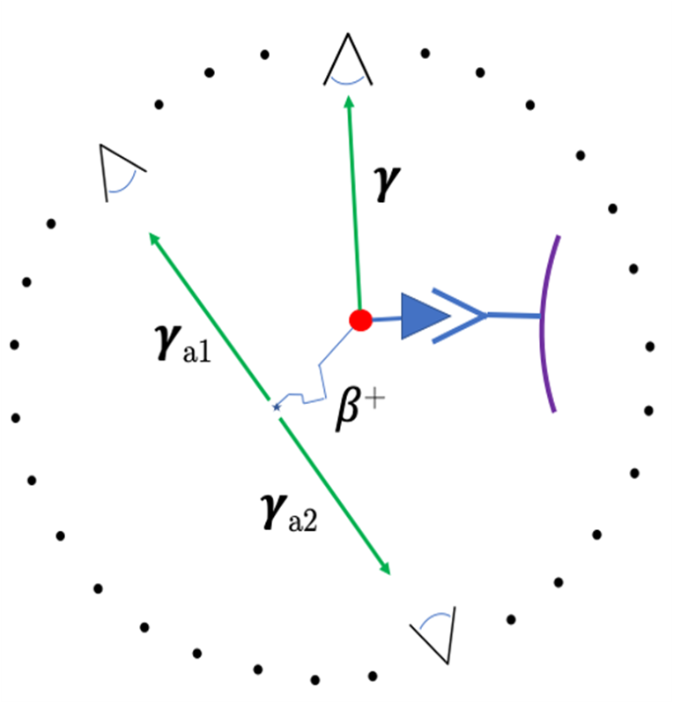
Motivation:
The emissions detected in imaging, showing the distinction between the origins of the annihilation and gamma photons.

Slide 4
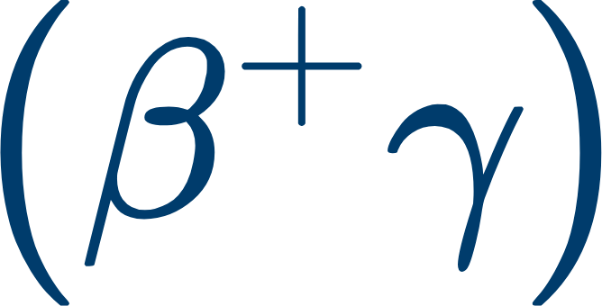
Multimodal Imaging and Challenges
Benefits:
Increase sensitivity
Additional information allows for better placement of radiotracer in reconstruction
Distinguishing between two positron-emitting isotopes
Challenges:
Need Compton Imaging to get information about prompt gamma
Third gamma invokes complication in pairing the annihilation gammas
Increased random rate, more difficult coincidence pairing due to energy window filling
Requirement of imaging
Measuring a broad energy spectrum
Good energy resolution and spatial resolution
The emissions detected in imaging, showing the distinction between the origins of the annihilation and gamma photons
[1] Conti, Maurizio, and Lars Eriksson. “Physics of pure and non-pure positron emitters for PET: a review and a discussion.” EJNMMI physics 3 (2016): 1-17.

Slide 5
Requirement of imaging
Measuring a broad energy spectrum
Good energy resolution and spatial resolution

Slide 6
State of the Art: Edge-on CZT system

Slide 7
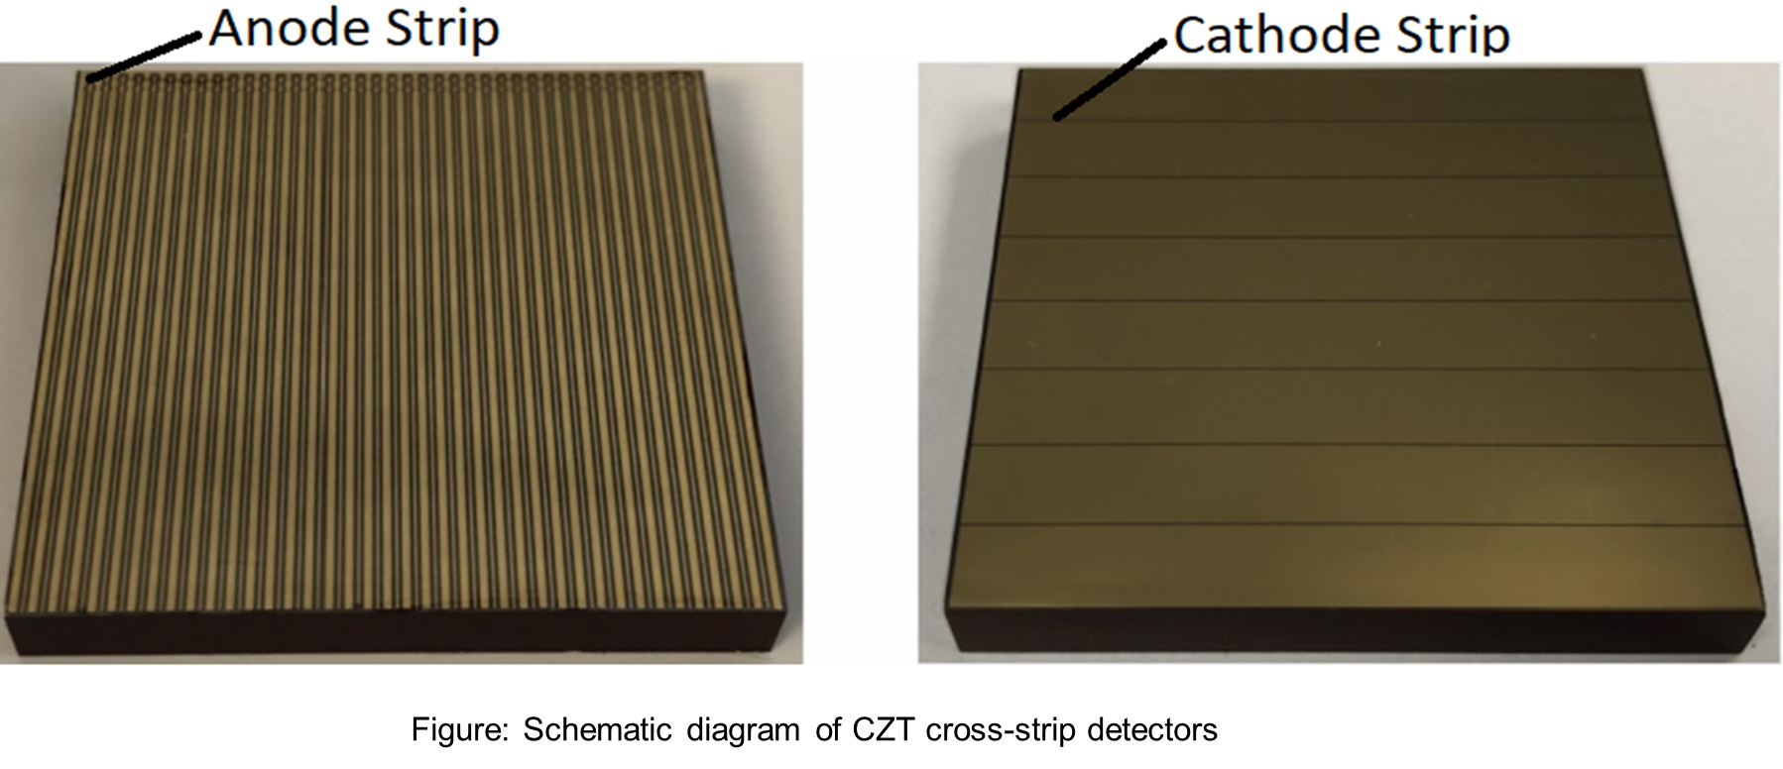
Edge-on Cadmium Zinc Telluride Detector
High cross section for Compton Scattering
Measuring a broad energy spectrum
Large volume to detect scattering events
Good energy resolution and spatial resolution
Benefits of Cross-Strip
High spatial resolution with fewer channels
Scalability and Modular Design

Slide 8
Benefits of Cross-strip
High spatial resolution with fewer channels
Scalability and Modular Design

Slide 9
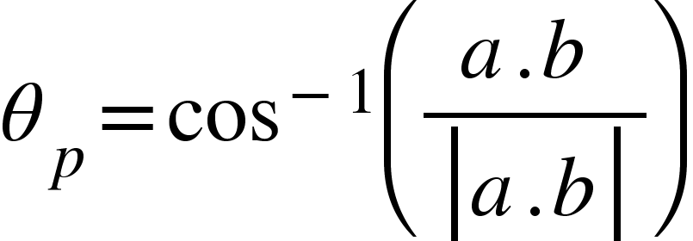
Multiple-interaction Photon Events (MIPE)
b
a
Scattered photon energy
Incident photon energy
[2] Abbaszadeh, Shiva, Garry Chinn, and Craig S. Levin. "Positioning true coincidences that undergo inter-and intra-crystal scatter for a sub-mm resolution cadmium zinc telluride-based PET system." Physics in Medicine & Biology 63, no. 2 (2018): 025012.

Slide 10
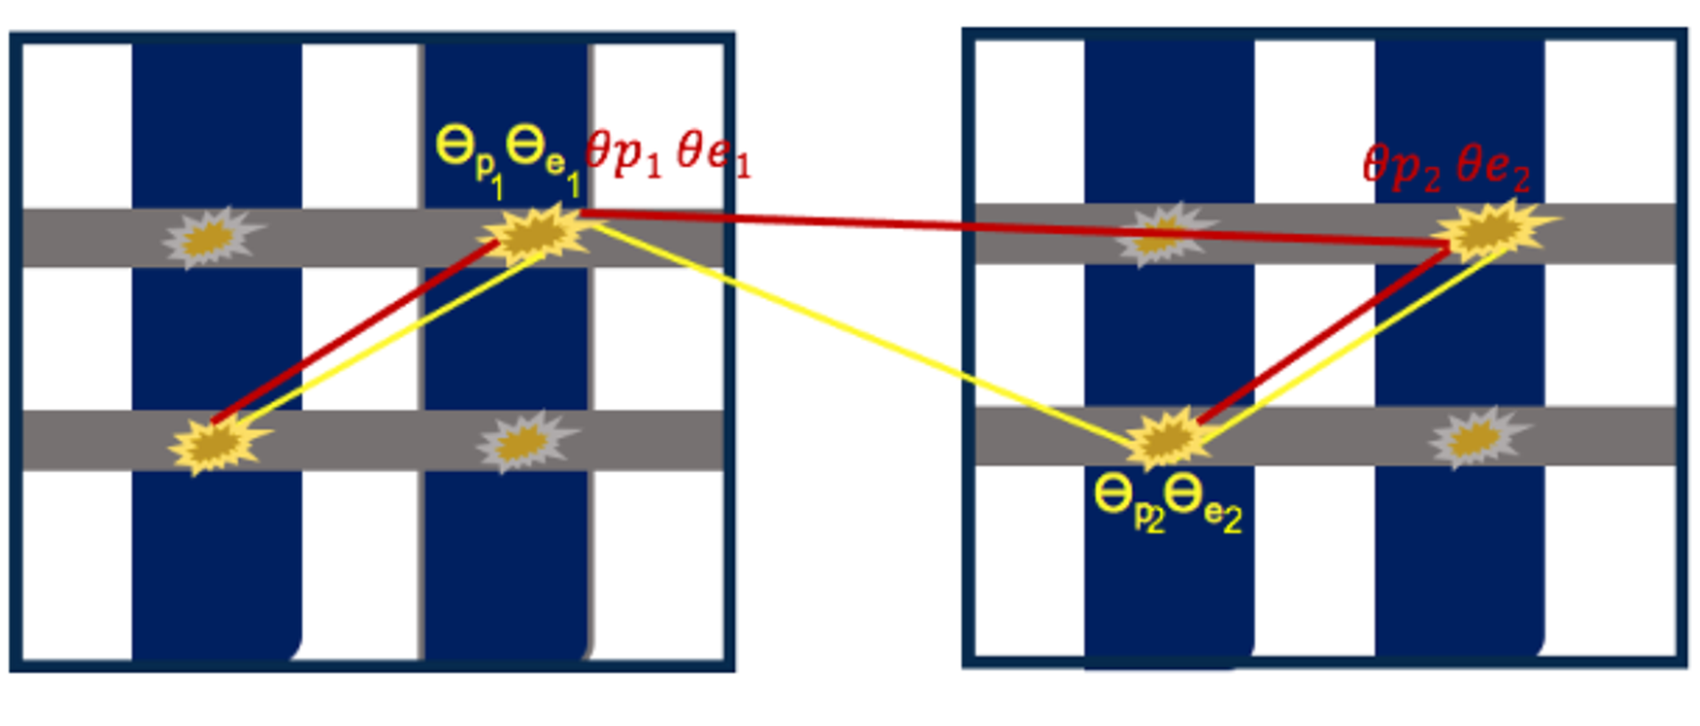
MIPE - Double Compton Scatter
Figure: Possible two sequences of events out of 16 scenarios one Compton interaction followed by Photoelectric interaction (1C, 1P) in both detectors with cross-strip configuration. This example (1C, 1P) leads to triggering two anodes and two cathodes. Anodes are shown in gray, cathode in blue. The figure is for illustration purposes only, the electrode features are not drawn to scale [3].
[3] Nasiri, Nahid, and Shiva Abbaszadeh. "A deep learning approach to correctly identify the sequence of coincidences in cross-strip CZT detectors." In Medical Imaging 2021: Physics of Medical Imaging, vol. 11595, pp. 1011-1018. SPIE, 2021.

Slide 11
QE in Positron Annihilation

Slide 12
Double Differential Entangled Cross Section

Slide 13
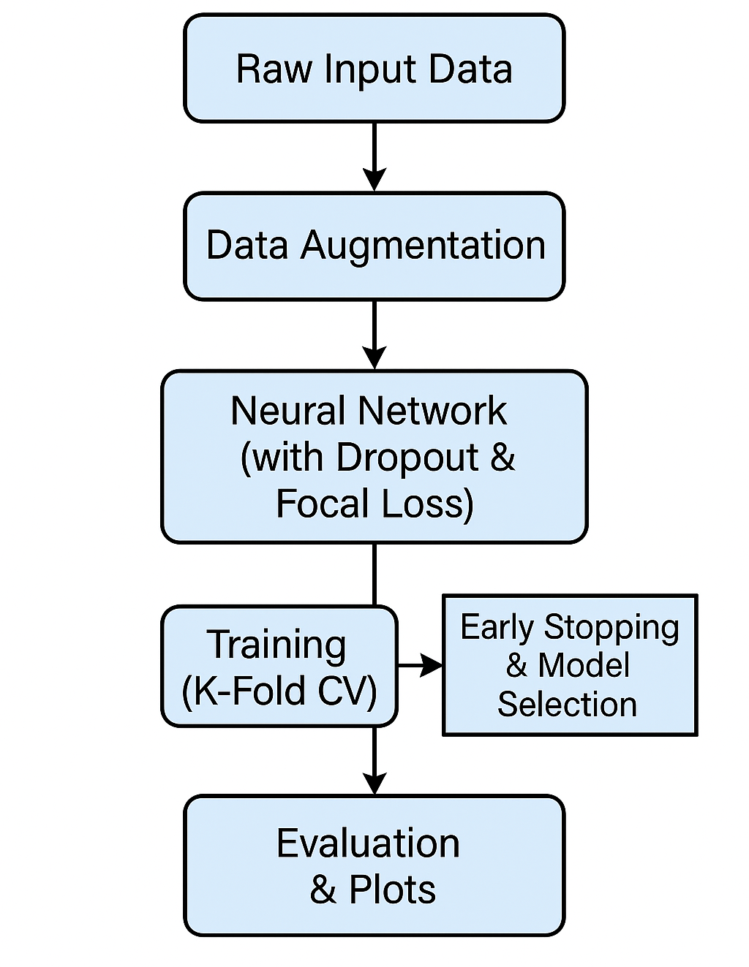
Methodology
Input layer (labeled “Input (Augmented features, 4×21)”)
Three hidden layers, each labeled underneath:
“Hidden Layer 1: 512 units, Rectified Linear Unit (ReLU), Dropout”
“Hidden Layer 2: 256 units, ReLU, Dropout”
“Hidden Layer 3: 128 units, ReLU, Dropout”
Output layer (labeled “Output (5 units, Softmax)”)

Slide 14
Machine Learning For Event Classification
Hyper Parameter | Value/Setting | Description
Number of Epochs | 100 | Total training epochs per fold
Batch size | 128 | Number of samples per training batch
Initial learning rate |  | Initial learning rate for Adam optimizer
Optimizer | Adam | Optimization algorithm for model parameters
Loss Function | FocalLoss | Used for multi-class classification
K-Folds (Cross-Val) | 5 | Number of folds for cross-validation
Scheduler | ReduceLROnPlateau | Reduce learning rate by 0.1 if validation loss doesn't improve for 5 epochs
Early stopping | 10 epochs | Halts training if validation accuracy does not improve for 10 consecutive epochs, preventing overfitting and restoring the best model weights.

Slide 15
Machine learning features
3D coordinates for Compton and photoelectric hits (gamma 1 & 2)
Energy depositions for each interaction
Position and energy derived angles (theta p and theta E)
Azimuthal angle difference (deltaPhi)

Slide 16
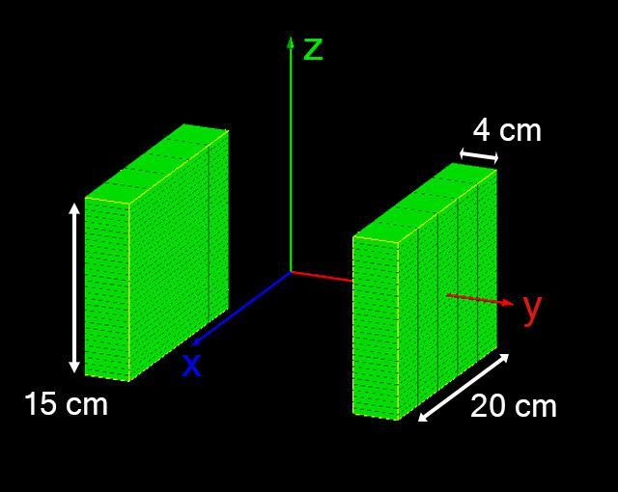
Dataset description
The data was obtained from Monte Carlo gate simulations
UCSC dual panel system was modelled
We were imaging $Scandium−44$ point source – 30μCi imaged for 60 seconds, which has 100% dual emission of positrons and prompt gamma
Looked for any 1C1P event for both annihilation and prompt gammas that fell within 50keV of 511
Correctly paired events in half and other half as randoms
Dataset has approx. 800K samples
 | $$x_{1,C}$$ | $$y_{1,C}$$ | $$z_{1,C}$$ | $$x_{1,P}$$ | $$y_{1,P}$$ | $$z_{1,P}$$ | $$x_{2,C}$$ | $$y_{2,C}$$ | $$z_{2,C}$$ | $$x_{2,P}$$ | $$y_{2,P}$$ | $$z_{2,P}$$ | $$E_{1,C}$$ | $$E_{1,P}$$ | $$E_{2,C}$$ | $$E_{2,P}$$ | $$θ_{1,pos}$$ | $$θ_{2,pos}$$ | $$θ_{1,ene}$$ | $$θ_{2,ene}$$ | $Δφ$ | Label
Config. 1 | -114.7 | 54.58 | 7.389 | -118 | 76.27 | -9.54 | 109 | -52.06 | -6.968 | 100.7 | -47.96 | -11.96 | 0.19 | 0.321 | 0.329 | 0.182 | 65.906 | 148.34 | 65.914 | 143.871 | 44.532 | 1
Config. 2 | -118 | 76.27 | -9.54 | -114.7 | 54.58 | 7.389 | 109 | -52.06 | -6.968 | 100.7 | -47.96 | -11.96 | 0.321 | 0.19 | 0.329 | 0.182 | 119.66 | 152.062 | 133.588 | 143.871 | 128.215 | 0
Config. 3 | -114.7 | 54.58 | 7.389 | -118 | 76.27 | -9.54 | 100.7 | -47.96 | -11.96 | 109 | -52.06 | -6.968 | 0.19 | 0.321 | 0.182 | 0.329 | 66.852 | 32.982 | 65.914 | 63.461 | -135.872 | 0
Config. 4 | -118 | 76.27 | -9.54 | -114.7 | 54.58 | 7.389 | 100.7 | -47.96 | -11.96 | 109 | -52.06 | -6.968 | 0.19 | 0.321 | 0.329 | 0.182 | 118.962 | 29.06 | 65.914 | 143.871 | -51.291 | 0

Slide 17
Machine learning Architecture
Regularization:
Dropout: Applied after every hidden layer (p=0.3) for robust generalization.
Loss Function:
Focal Loss:
Handles class imbalance by focusing more on difficult (misclassified) samples.
Also incorporates class weights based on label distribution.
Training Protocol:
5-fold Cross Validation
Early Stopping
Learning Rate Scheduling

Slide 18
Data Augmentation Strategy
Random 3D Rotation:
Each event is randomly rotated in 3D space by up to ±15 degrees around a random axis.
Purpose: Mimics detector orientation uncertainty; helps model learn invariance to rotation.
Positional Gaussian Noise:
Small Gaussian noise (σ = 0.3) is added to all position coordinates (x, y, z) of each interaction point.
Purpose: Simulates real-world spatial measurement noise.
Derived Features Regeneration:
After transformation, key features like angular variables (theta1_pos, theta2_pos, etc.) are recalculated to match the new geometry.

Slide 19
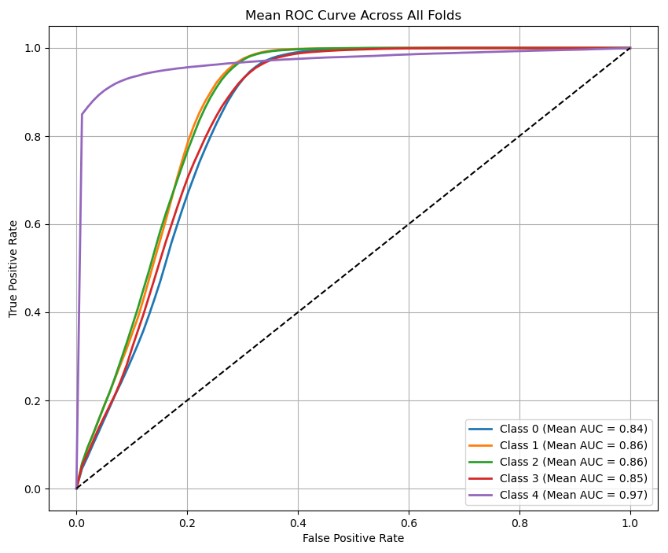
Results
Class | Config | Area under curve (AUC)
 |  | Mean | Standard Deviation
0 | 0 | 0.841 | 0.013
 | 1 | 0.864 | 0.002
 | 2 | 0.864 | 0.005
 | 3 | 0.846 | 0.012
1 | 4 | 0.971 | 0.005

Slide 20
Impact & Future Directions
The integration of ML for event classification in cross-strip CZT PET detectors enables significantly improved discrimination between complex photon interaction events
Enhanced event classification directly contributes to better image quality, more accurate radiotracer localization, and the ability to distinguish between different positron-emitting isotopes
Future work will involve a systematic verification of the feature importance and selection process.
Quantitative Assessment of Azimuthal Angle Contribution
Further development of ML models tailored for more complex event topologies, including those involving multiple scatterings and rare interaction sequences, will continue to improve event classification accuracy
Future work may also explore real-time implementation of these ML frameworks, enabling on-the-fly event classification and improved workflow in clinical and research PET systems

Slide 21
Questions?
sabbasza@ucsc.edu
pgurunat@ucsc.edu

Slide 22
Thank you!
sabbasza@ucsc.edu
pgurunat@ucsc.edu

