Slide 1
Co-design of Artificial Neural Networks for Real-Time Feature Extraction in Front-End ASICs
Soumyajit Mandal, Prashansa Mukim, Dominik Gorni, Grzegorz W. Deptuch, Jack Fried, Piotr Maj (Instrumentation)
Shubha Raj Kharel, Yihui Ren, Shinjae Yoo (Computing and Data Sciences)
Brookhaven National Laboratory
ML4FE Workshop, University of Hawai’i, May 20, 2025

Slide 2
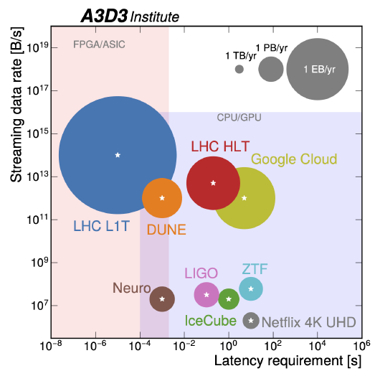
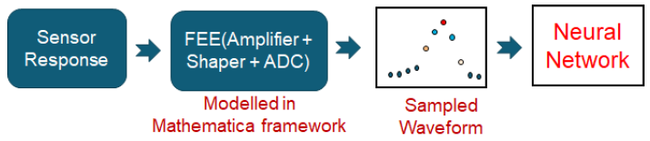
Introduction and motivation
Overall goal: Explore non-linear digital signal processing (DSP) and machine learning (ML) algorithms as an efficient yet high performance alternative to analog circuits for real-time on-chip waveform processing.
These algorithms will be implemented on highly-digital readout ASICs for a new generation of “smart” detectors with built-in amplitude estimation, pile-up detection/correction, and pulse shape classification capabilities.
These capabilities can be utilized to reduce output data rates, enable real-time adaptation of the detector, and provide distributed “edge intelligence’’ for improved physics outcomes [1].
Hardware model
[1] Carini, Gabriella, et al. "Smart sensors using artificial intelligence for on-detector electronics and ASICs.“
arXiv preprint arXiv:2204.13223 (2022).

Slide 3
AIML65P1 ASIC

Slide 4
Overview of the AIML65P1 readout ASIC
Simplified AFE design (charge-sensitive amp + anti-aliasing filter)
Per-channel 12-bit ADC generates inputs for on-chip DSP and ML
  Fully-differential, includes calibration
Per-channel DSP:
  Programmable shaping filter (FIR)
  Waveform alignment / snippeting
  Baseline removal
Per-channel machine learning (ML):
  Artificial neural network (ANN): multi-layer perceptron (MLP) with programmable weights
  Performs classification or regression
Additional blocks:
  Low-speed I²C programming and testability interface
  Output serializer
1
2
~200 μm
Digital pads
(I/O, power, bias)
Sensor
23
Analog (AFE)
Digital (ADC, DSP, ML, I/O)
Analog pads
(sensor, power)
Area: 5 x 5 mm²
Channel height: 200 μm

Slide 5
Simplified view of the channel design
8f_{s}
Clock generator
Circular Buffer
Analog front-end
f_{s}
f_{s}/4N
f_{s}/4N
8f_{s}/N
f_{s}/4
f_{s}
IN
MUX
Pulse shaping FIR filter
Decimator, series-parallel
Waveform
aligner
G
G
ADC
Baseline holder
MLP
1
Amplifier (Stage 1)
Amplifier (Stage 2)
Low-pass
anti-aliasing filter
Digital back-end
ADC driver / single-ended to differential converter
High-speed hybrid ADC
(up to 40 MS/s)
Parallel bus
MUX
The analog front-end (AFE) and ADC are based on existing designs
  The AFE includes a 3rd order shaper that acts as an anti-aliasing filter
The FIR filter, waveform aligner, and baseline holder were generated from a Simulink model using MATLAB-based high-level synthesis (HLS)
The MLP and synchronous readout were synthesized and placed/routed from hand-written Verilog code
All in-channel memory (including the MLP weights and biases) is set over a standard two-wire I²C interface
I²C Block
OUT
Serializer
SDA SCL
128f_{s}/4N
Serial port
Programming
circuitry
N = 8 in this case

Slide 6
DSP implementation: High-level synthesis (HLS)
MATLAB code
MATLAB code
Simulink blocks
Design goals (rate and area) for the MLP block could not be met with MATLAB HDL coder → optimized RTL was written for the MLP network
Simulink model
Custom HDL code
HDL coder
Auto-generated HDL code
Verilog import
Analog blocks
System-level functional model (Virtuoso)
Verilog export
Arbitrary stimuli
Design verification (AMS)
Logic synthesis (Genus)
Netlist export
Automated place & route (Innovus)
Schematic and layout views

Slide 7
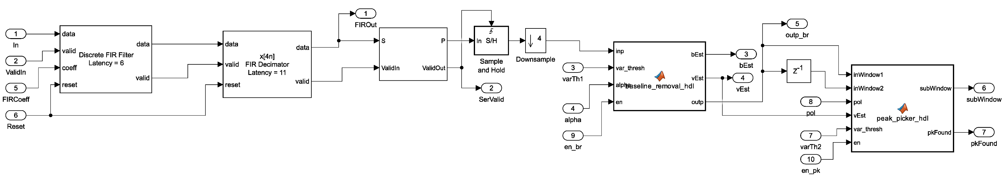
Simulink model of the DSP
Network architecture exploration of the MLP suggests that a window size = 9 is sufficient.
Input and output bit widths fixed to 12 (same as ADC outputs)
  Internal bit widths are optimized by the Fixed-Point Designer tool.
  FIR coefficients and baseline restorer parameters are programmable.
  Design process uncovered an HDL Coder bug (related to triggering of MATLAB function blocks).
FIR filter
Decimator (4x)
Parallelizer (8x)
Baseline restorer
Waveform aligner

Slide 8
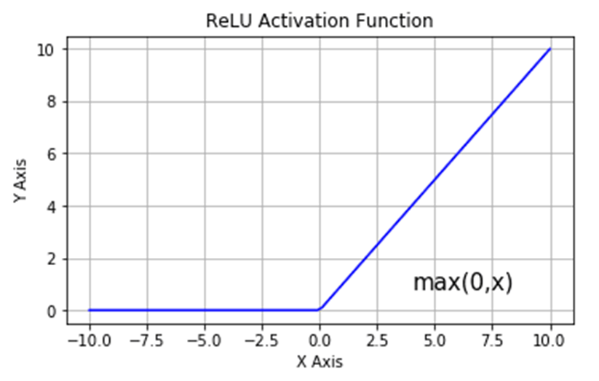
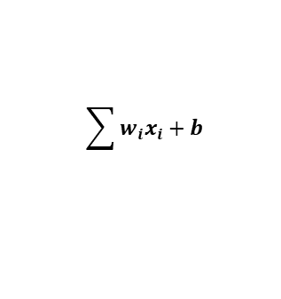
Multi-layer perceptron (MLP) network
Composed of two fully connected layers of perceptrons (16 neurons in hidden layer, 2 neurons in output layer)
Will be used for:
  Regression: Amplitude and/or pulse decay time estimation
  Classification: Pulse shape detection (for particle ID or pileup detection)
Each perceptron involves:
  Multiplication of input vectors (12-bit) with weights (8-bit)
  Addition of a bias (8-bit)
  Application of a non-linear activation function (ReLU) for hidden layer neurons only
  Stochastic rounding of the MAC result to a 12-bit vector
MLP Block
Analog Front End
DSP Channel
H1
OUT1
OUT2
H2
O1
OUT3
.
.
.
.
.
.
O2
OUT9
H16
x₀
w₀
x₁
w₁
$$\sum{w_{i}x_{i}+b}$$
ReLU
Activation
Stochastic
Rounding
Output
w₂
x₂
perceptron
Neural network architecture determined by an automated co-design strategy
(Part II of the talk!)

Slide 9
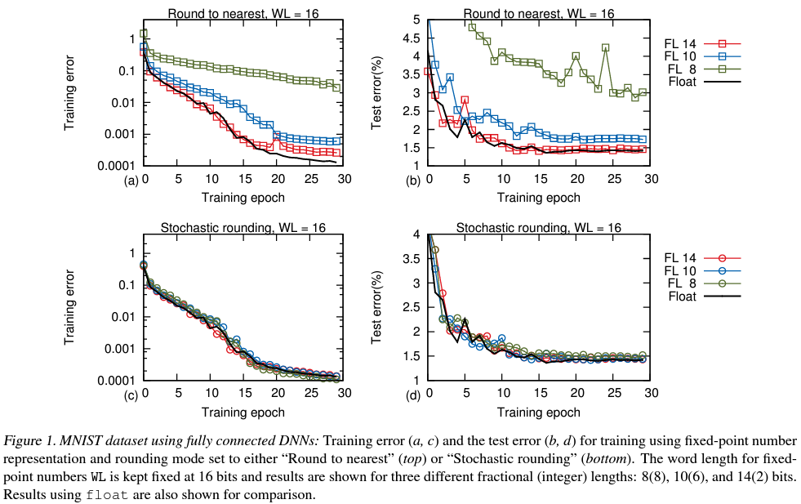
Stochastic rounding
Random numbers are generated a 31-bit LFSR clocked at a rate = f_{s}
The input/output rate is f_{s}/4N (= f_{s}/32) and the LFSR needs to generate 18 random values for the 18 perceptrons for every new computation
18 LFSR outputs are stored to be used by the 18 perceptrons (rand_val = lfsr_out[5:0])
Why implement stochastic rounding?
  Useful for hardware-aware training with quantized inputs, outputs, weights and biases [2]
  During training, if the back-propagation gradient is smaller than the LSB, no updates are made to the weights and training doesn’t work
  With stochastic rounding, the average round-off error becomes zero, which allows stochastic gradient descent (SGD) to eventually converge
[2] Gupta, Suyog, et al. "Deep learning with limited numerical precision." International Conference on Machine Learning. PMLR, 2015.

Slide 10
Working of perceptron (hidden layer)
x₀
w₀
If MAC result out_val_prev < 0 : out = 0
Else stochastic rounding is performed as follows (rand_val is generated by an LSFR):
Basically, probability of rounding up is proportional to the fractional part. Mean rounding error will be 0
x₁
w₁
$$\sum{w_{i}x_{i}+b}$$
ReLU
Activation
Stochastic
Rounding
Output
w₂
x₂
perceptron
out_val_prev[5:0] > rand_val
Inputs (x_{i}) are 12-bit signed integers
Weights (w_{i}) and bias (b) are signed 8-bit (1 sign bit, 1 integer bit, 6 fractional bits)
sign _ . _ _ _ _ _ _
Multiplication result stored in a 21-bit vector and MAC result (out_val_prev) stored in a 25-bit vector to prevent overflow problems
Hidden layer perceptron has a pipelining factor of 12, is clocked at 8f_{s}/N and is triggered with new inputs at a rate = f_{s}/4N (the rate at which the DSP channel generates outputs)
Is activated when pkFound goes high
Yes
No
out_val_prev[24:6] > 2¹¹ - 2
out_val_prev[24:6] > 2¹¹ - 1
Yes
No
Yes
No
out = 2¹¹ -1
out = out_val_prev[17:6] + 1
out = 2¹¹ -1
out = out_val_prev[17:6]

Slide 11
Working of perceptron (output layer)
x₀
w₀
If MAC result out_val_prev < 0 : out = -out, is_neg = 1
Stochastic rounding is performed as follows (rand_val is generated by an LSFR):
If is_neg == 1, out = -out
x₁
w₁
$$\sum{w_{i}x_{i}+b}$$
ReLU
Activation
Stochastic
Rounding
Output
w₂
x₂
perceptron
out_val_prev[5:0] > rand_val
Output layer perceptron has a pipelining factor of 20, is clocked at 8f_{s}/N and is triggered with new inputs at a rate = f_{s}/4N (the rate at which DSP channel generates outputs)
Similar to hidden layer perceptron except:
Is activated when out_valid from hidden neuron goes high
Does not contain ReLu activation, outputs can be positive or negative
Yes
No
out_val_prev[24:6] > 2¹¹ - 2
out_val_prev[24:6] > 2¹¹ - 1
Yes
No
Yes
No
out = 2¹¹ -1
out = out_val_prev[17:6] + 1
out = 2¹¹ -1
out = out_val_prev[17:6]

Slide 12
Programming bits
Used for programming | Name | # of bits
AFE | afe | 33
SEDC | sedc | 5
ADC | adc | 130
DSP | dsp | 160
Input and output sources | sel_in_src, sel_out_src | 3
Circular buffer | data_cir_buf | 768
LFSR | lfsr_seed, en_MLP_lfsr | 32
MLP block | weights_L1, weights_L2, bias_L1, bias_L2 | 1552

Slide 13
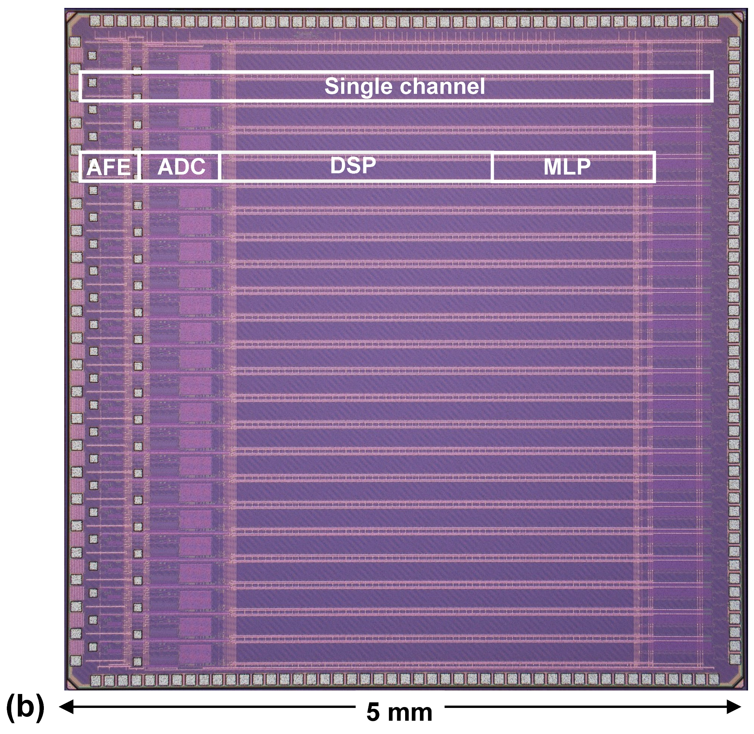
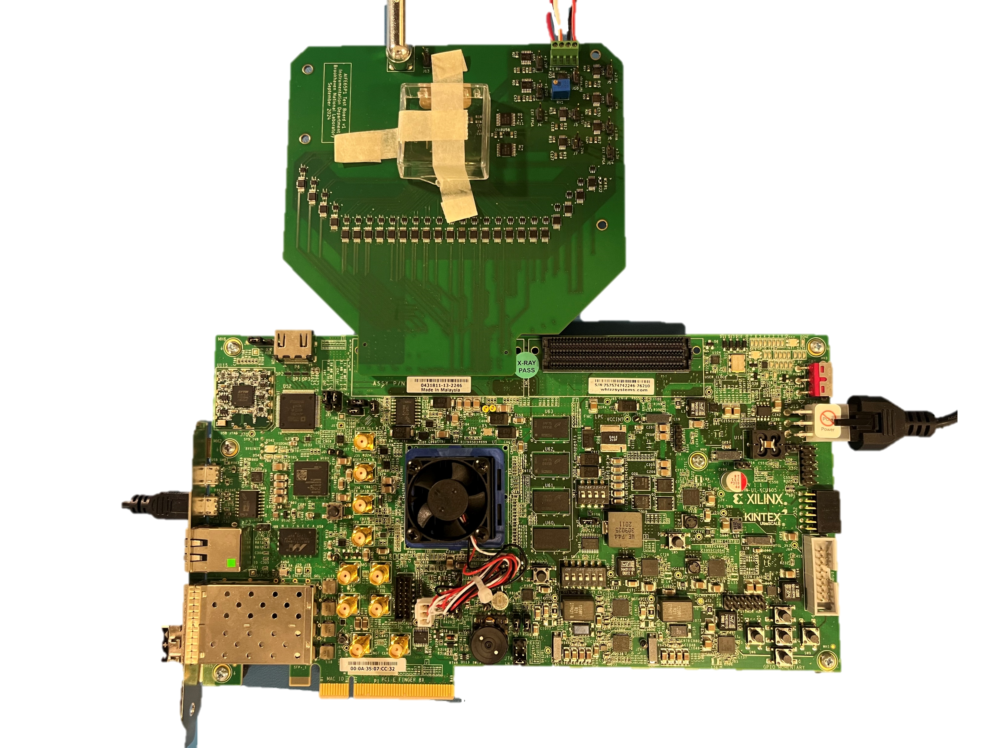
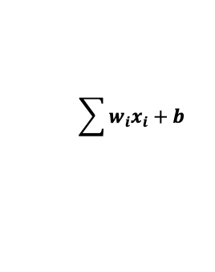
Die photograph and test platform
FPGA development board
H1
H2
O1
.
.
.
O2
ASIC test board
H16
ReLU
Activation
Stochastic
Rounding
The test board contains the ASIC, voltage regulators, logic level translators single-ended to differential converters, and LVDS buffers
The FPGA streams multi-channel data to the PC over Gigabit Ethernet
$$\sum{w_{i}x_{i}+b}$$
perceptron
Chip currently being tested

Slide 14
Co-design Strategy

Slide 15
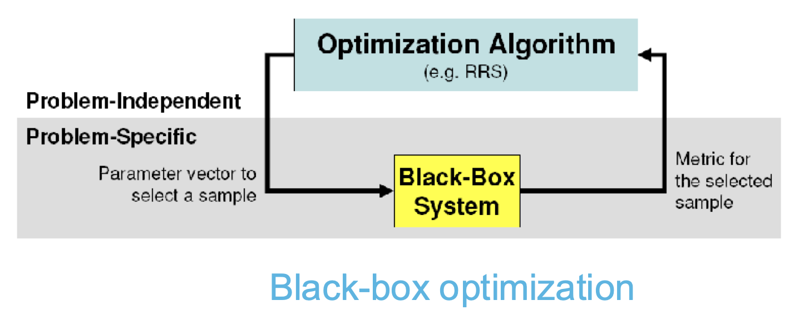
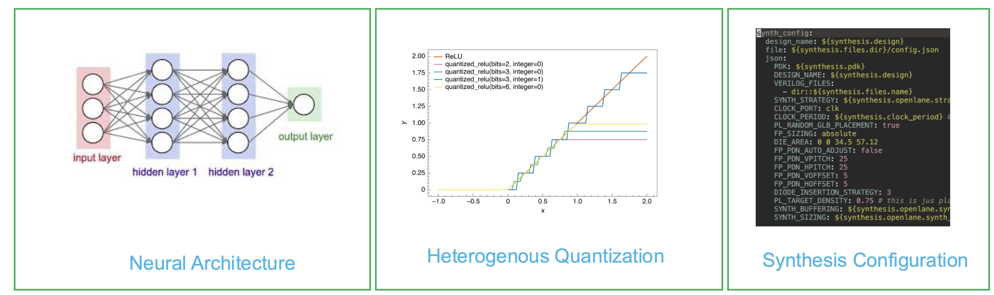
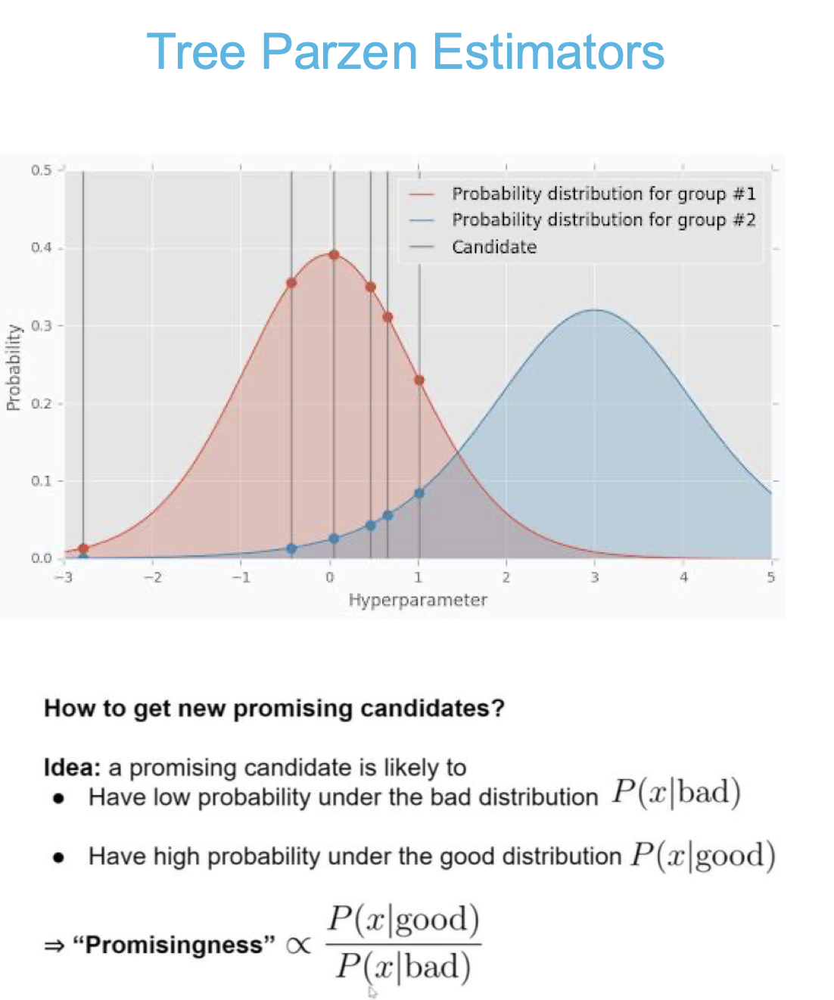
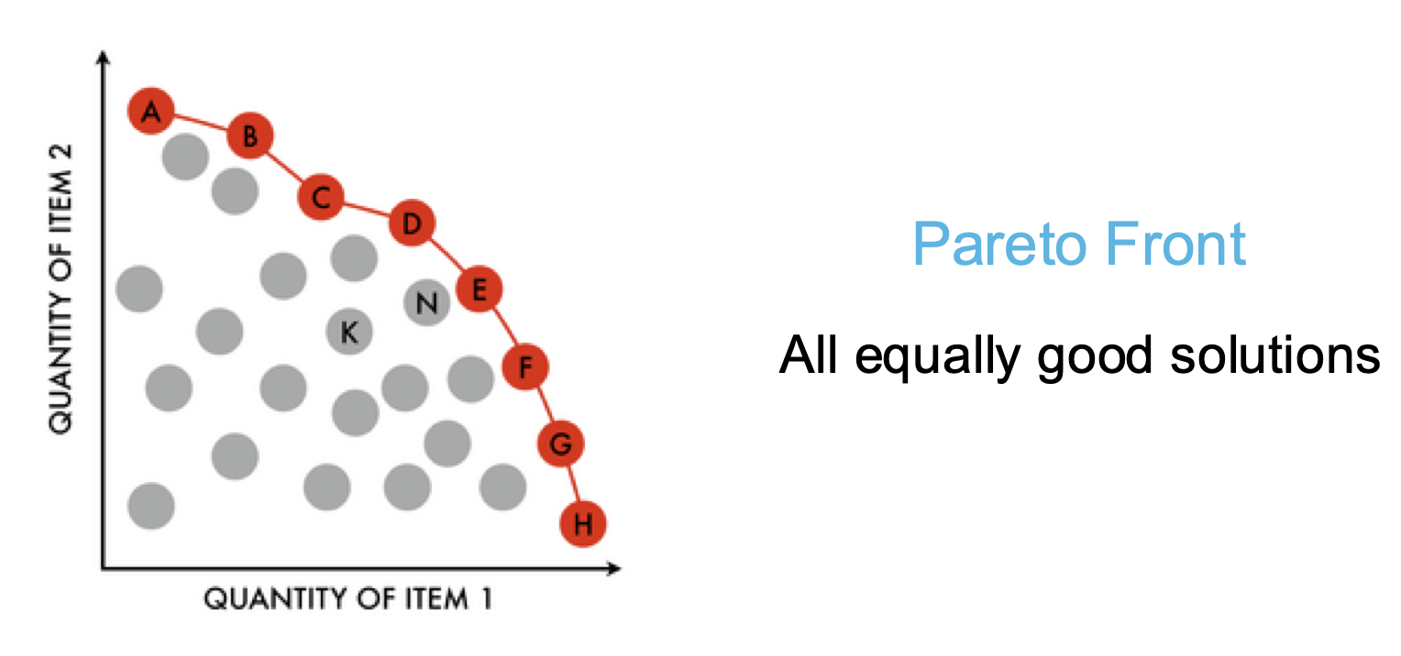
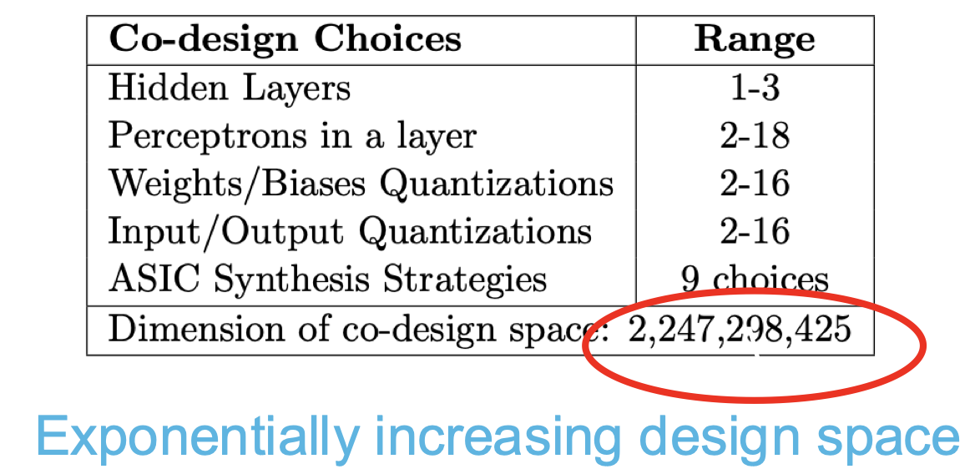
Automated and holistic co-design methodology
Motivation: optimizing the neural network design - given accuracy, area, power and speed goals, while keeping the computing costs realistic
Design synthesis included in the analysis pipeline to obtain more accurate estimates
Utilizes multi-objective Bayesian optimization

Slide 16
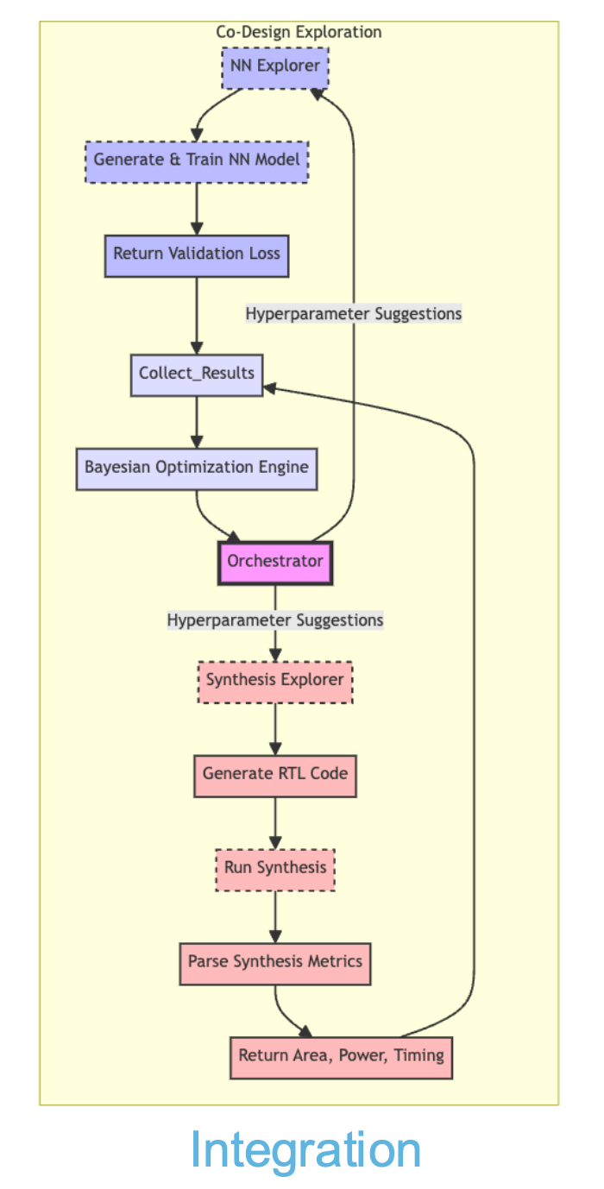
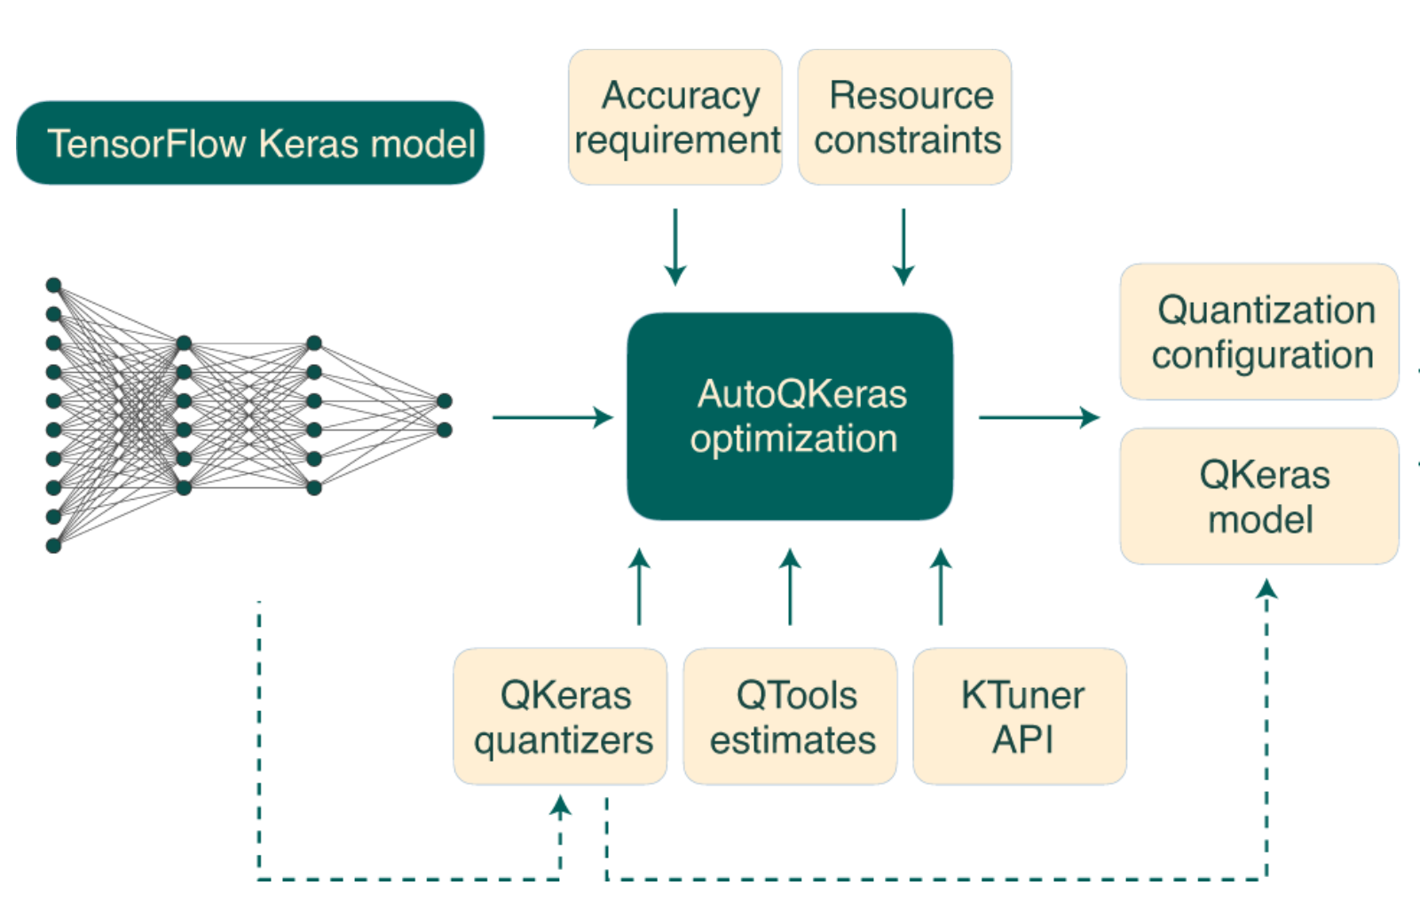

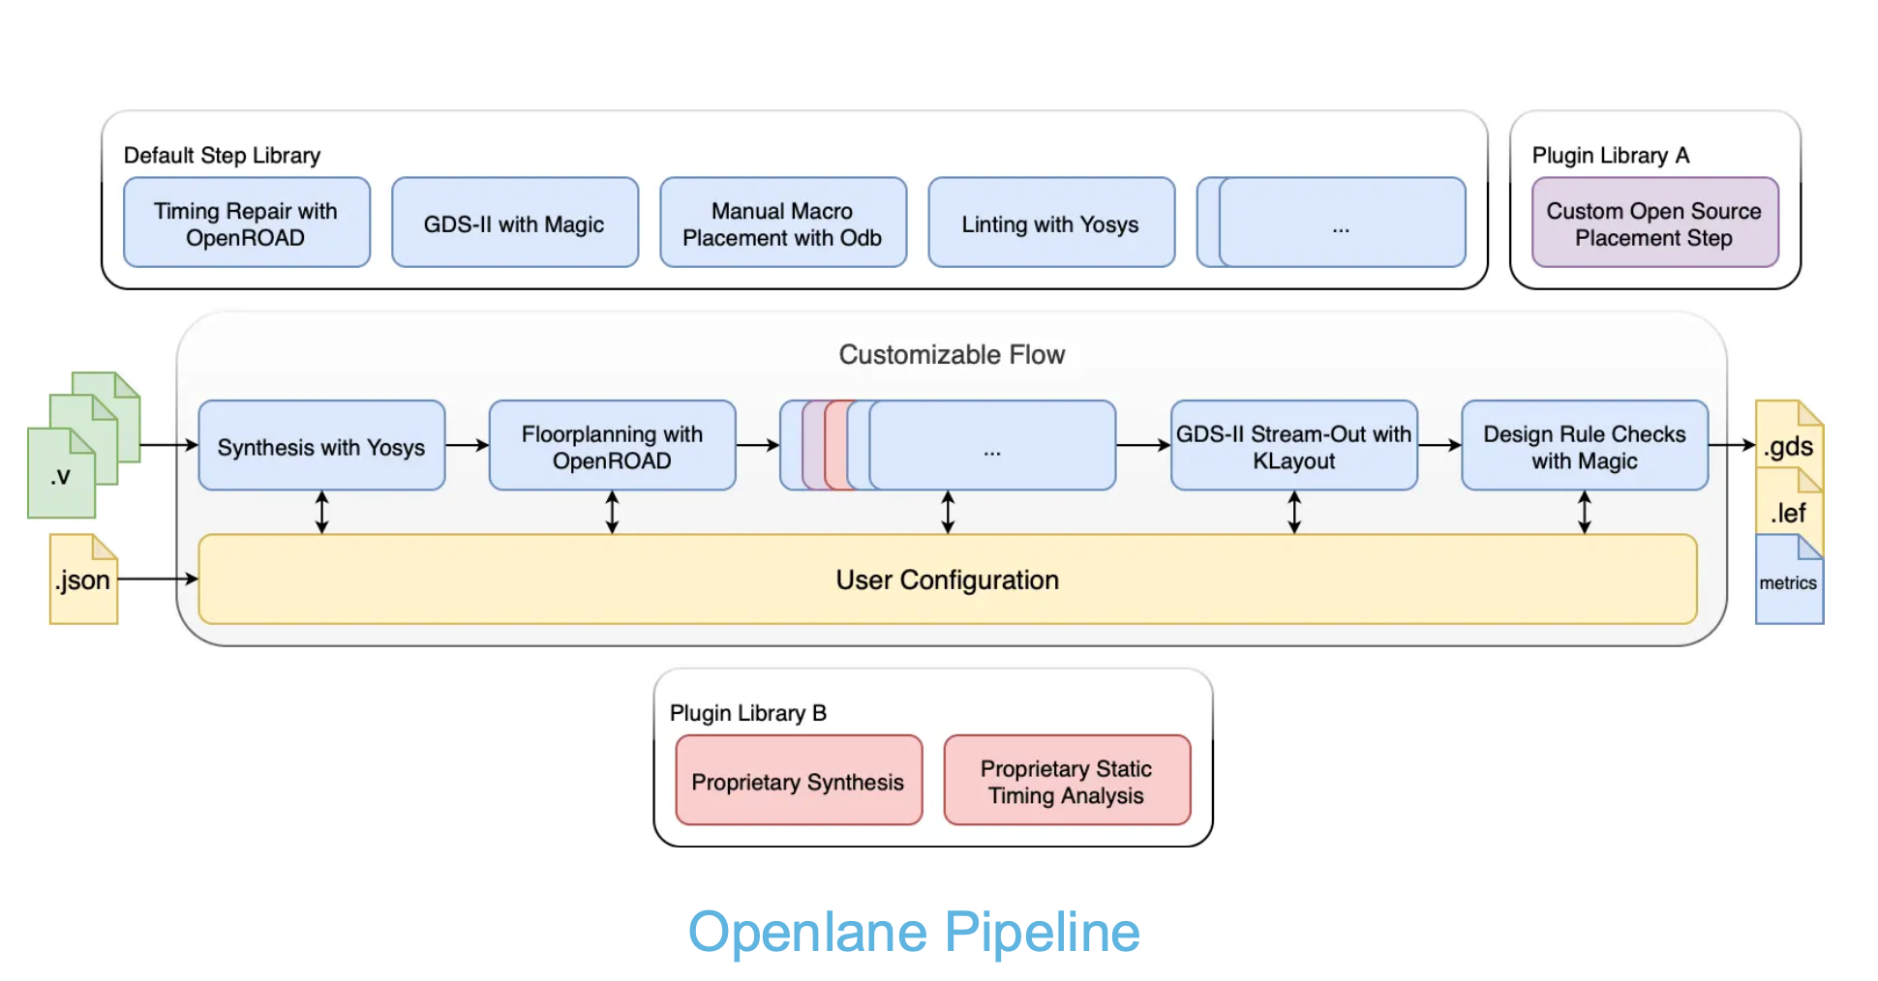
Tools, integration and automation
Fully automated design-pipeline utilizing open source tools and PDKs
Custom compiler for RTL generation of fully connected layers with programmable number of layers, number of neurons and quantization for every layer
Qkeras
(For NN simulations)
(For synthesis)

Slide 17
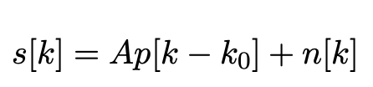
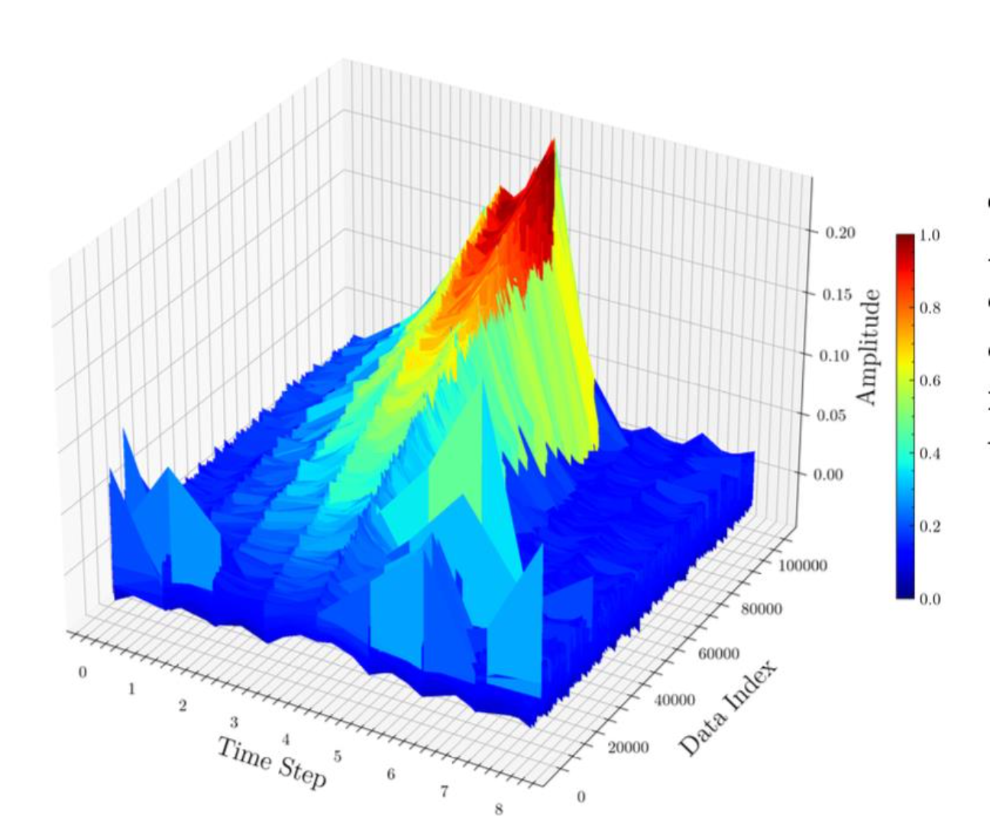
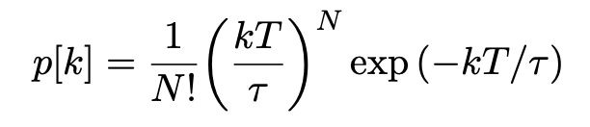
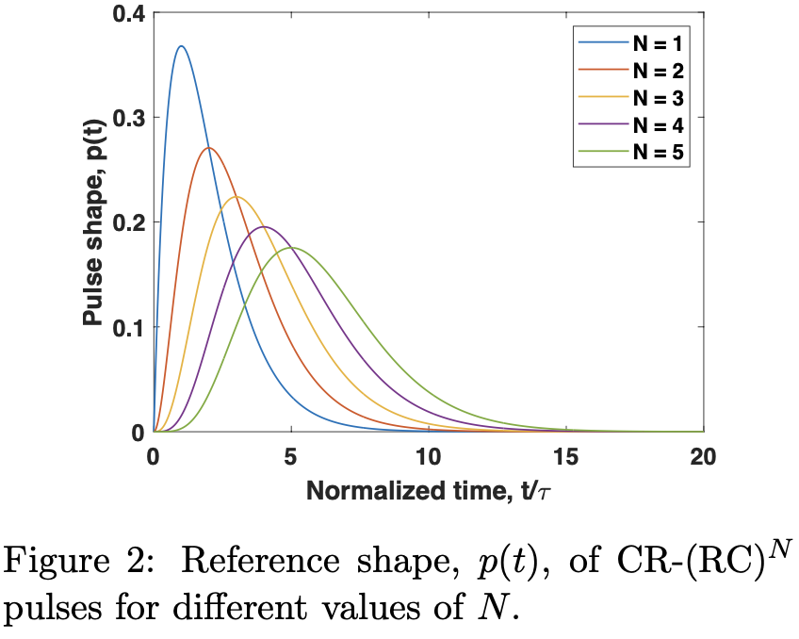
Experiment
Sampled noisy pulses used as inputs to the neural network
A: pulse amplitude, p: pulse shape, k₀: time of arrival, n: additive white Gaussian noise
Pulse shape produced by CR-(RC)^{N} shaping filter
N: order of the shaping filter, T: sampling period, 𝜏: decay time constant (varied between T and 2T)
Neural network trained for performing regression and estimating two parameters (A and 𝜏)
Validation loss, area, power and delay used as optimization metrics
Simulated waveforms data (98,583 pulses)
Down-sampled to just 9 data points

Slide 18
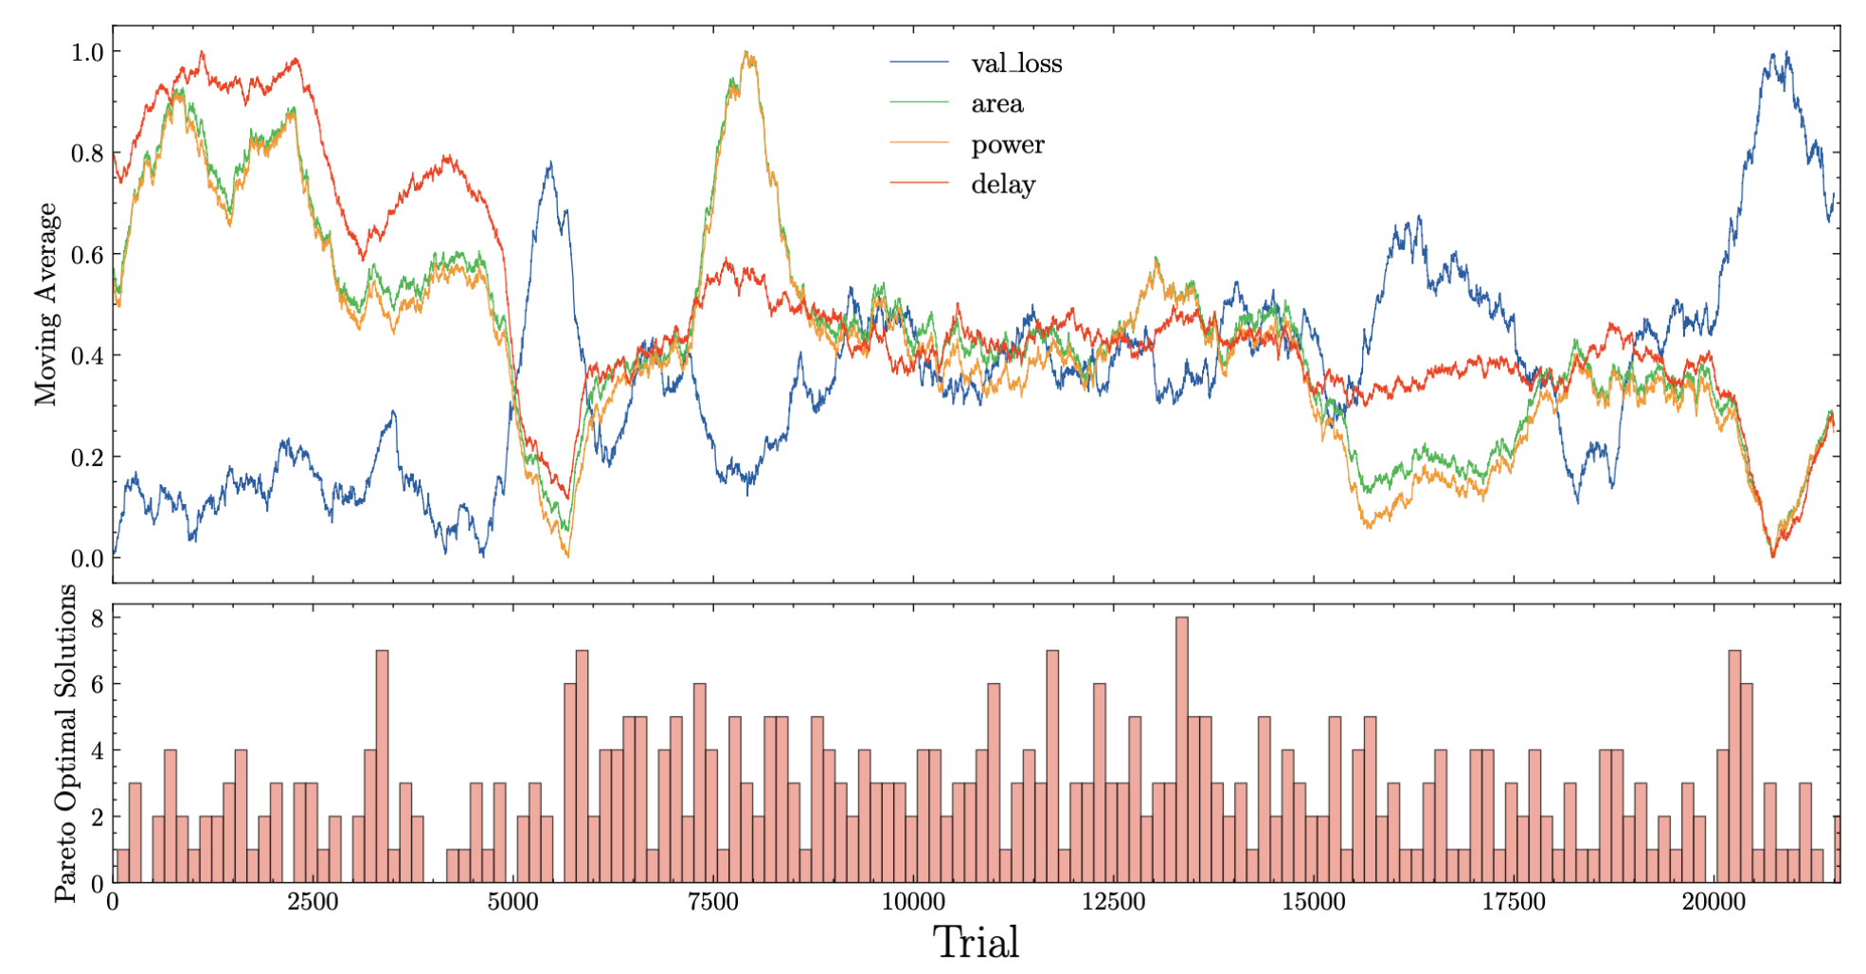
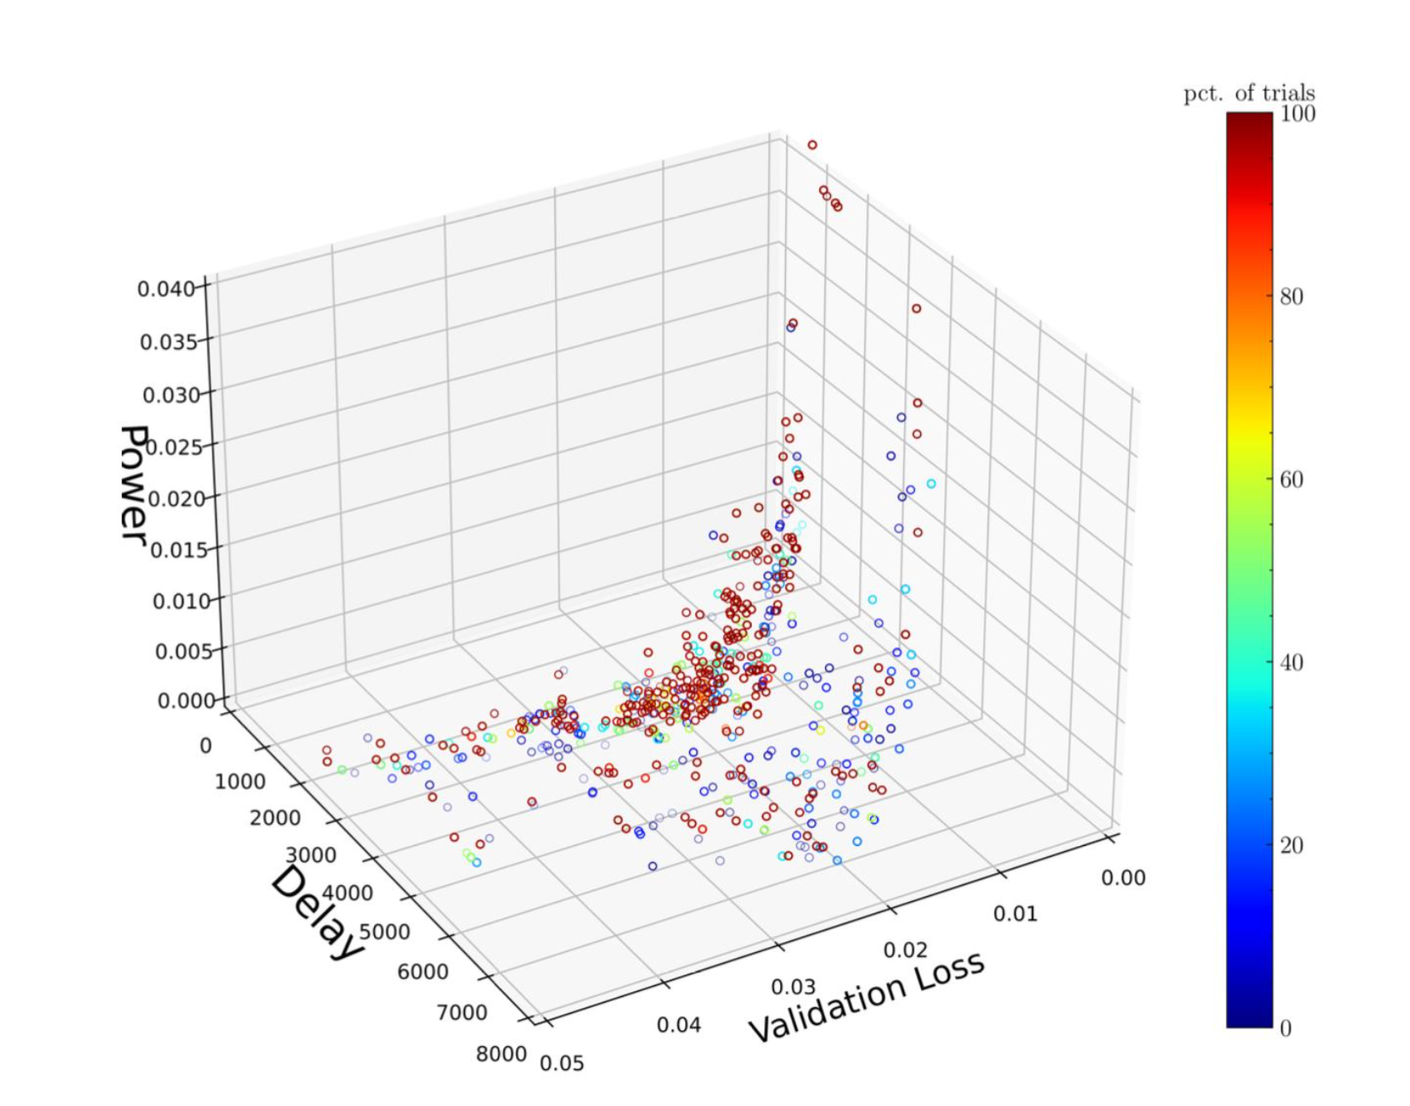
Architecture search results
~22,000 different neural networks trained and synthesized
(W)
(ps)

Slide 19
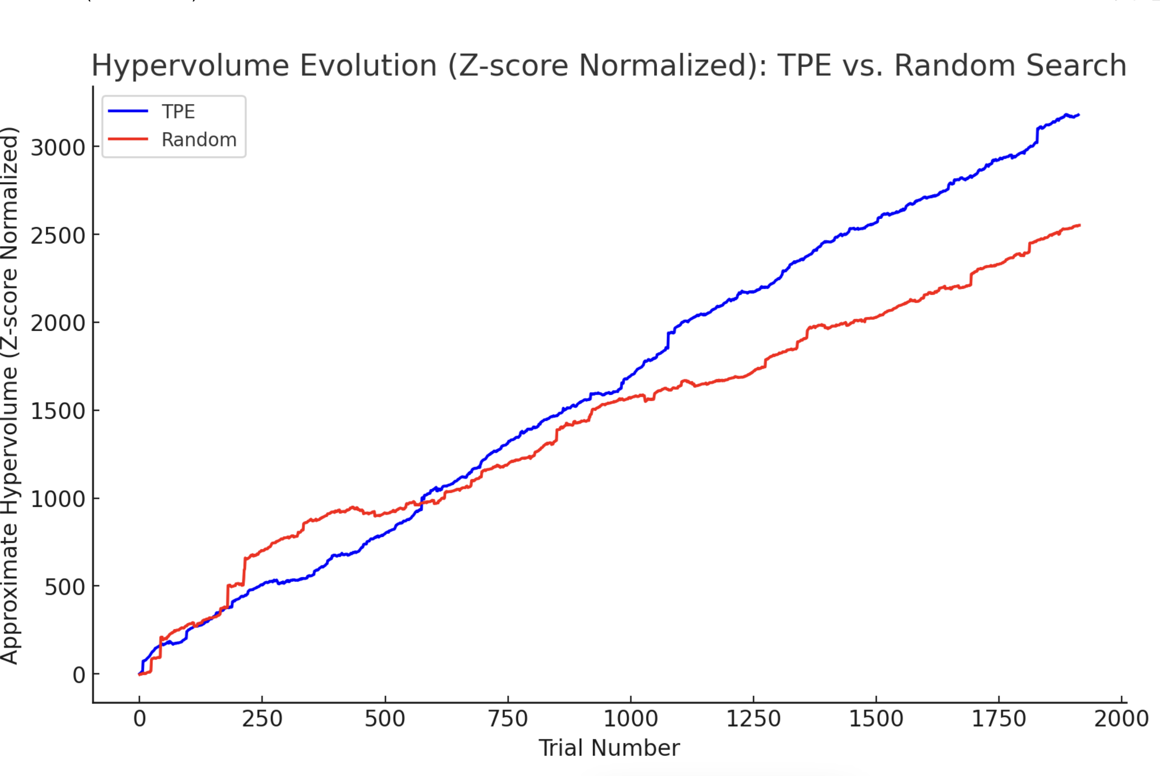
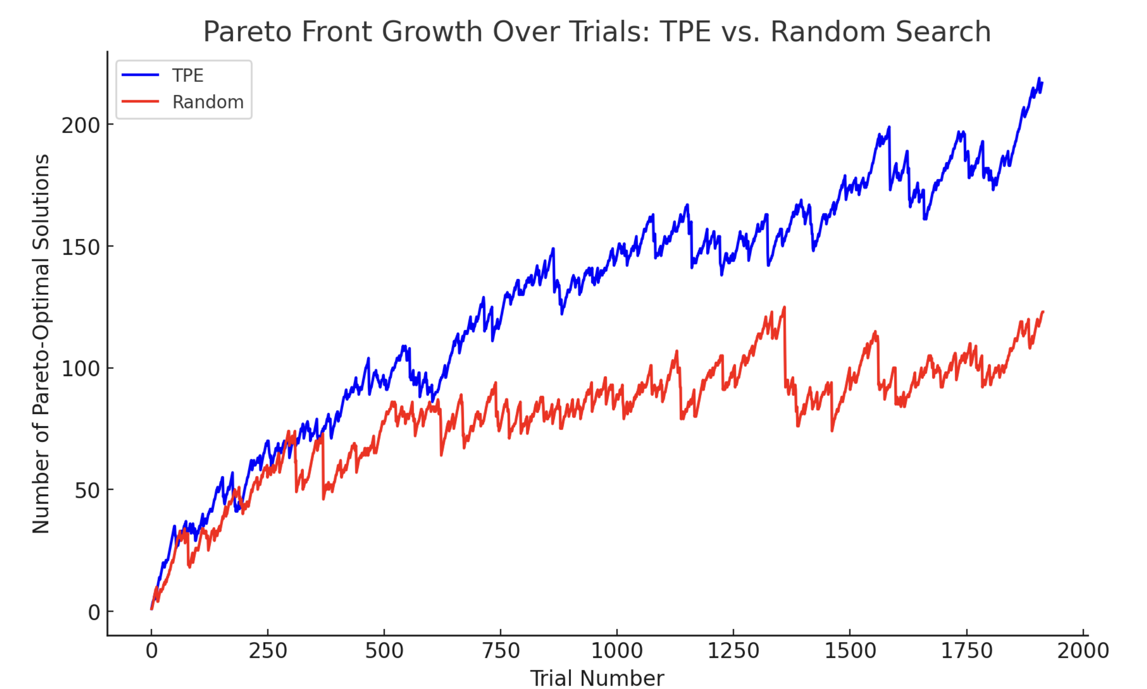
Pareto-front dynamics

Slide 20
Optimization metrics vs. total bits

Slide 21
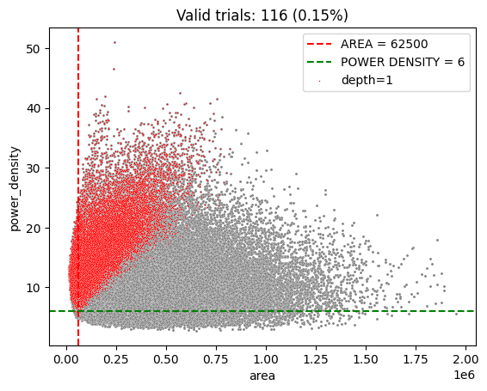
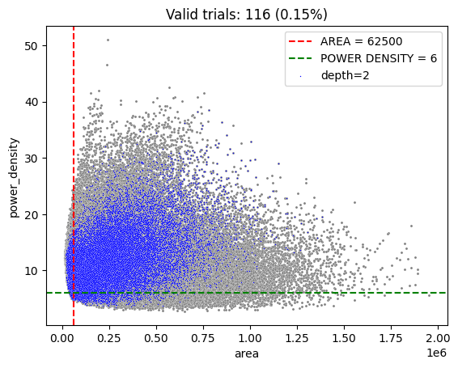
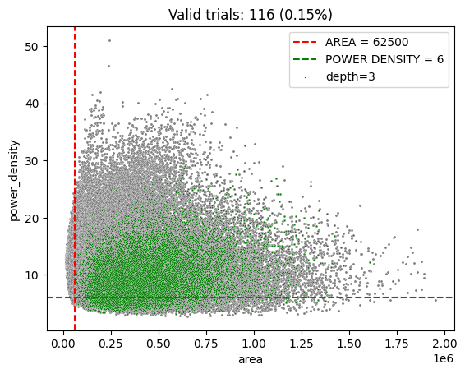
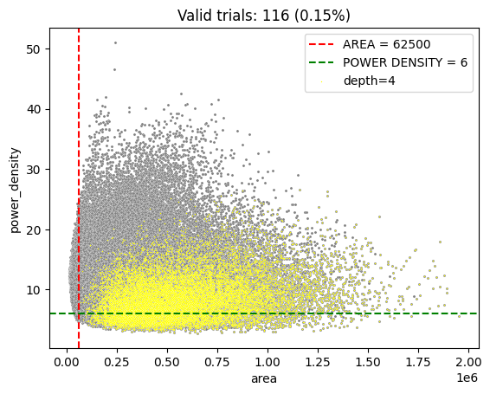
Design insights

Slide 22
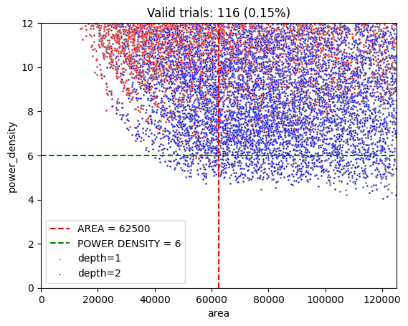
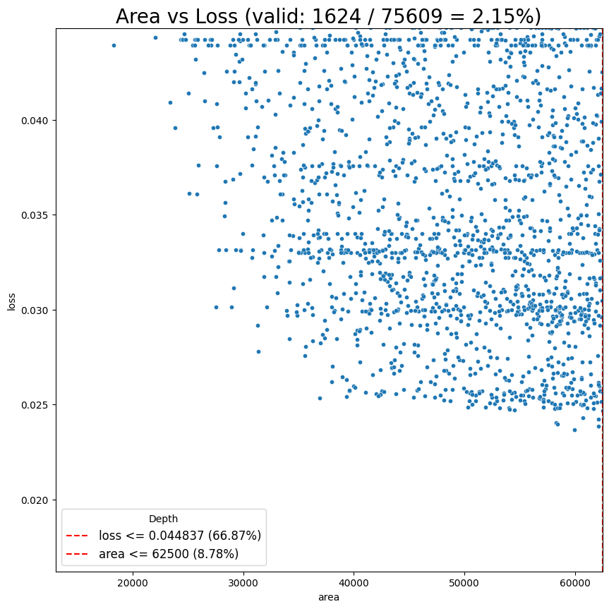
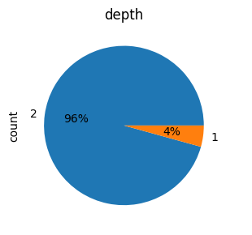
Design insights
Depth = 2 is the best design choice for in-pixel implementation

Slide 23
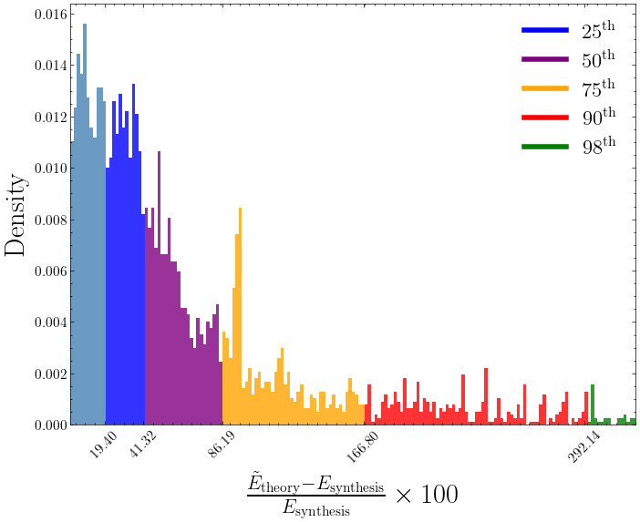
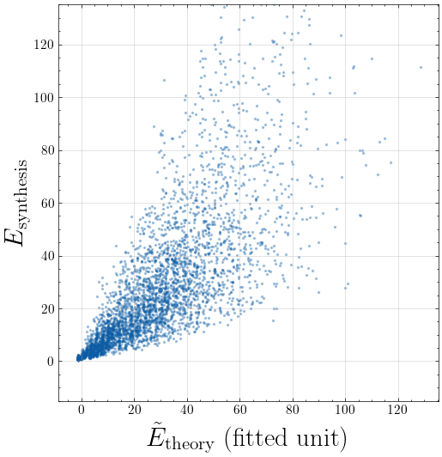
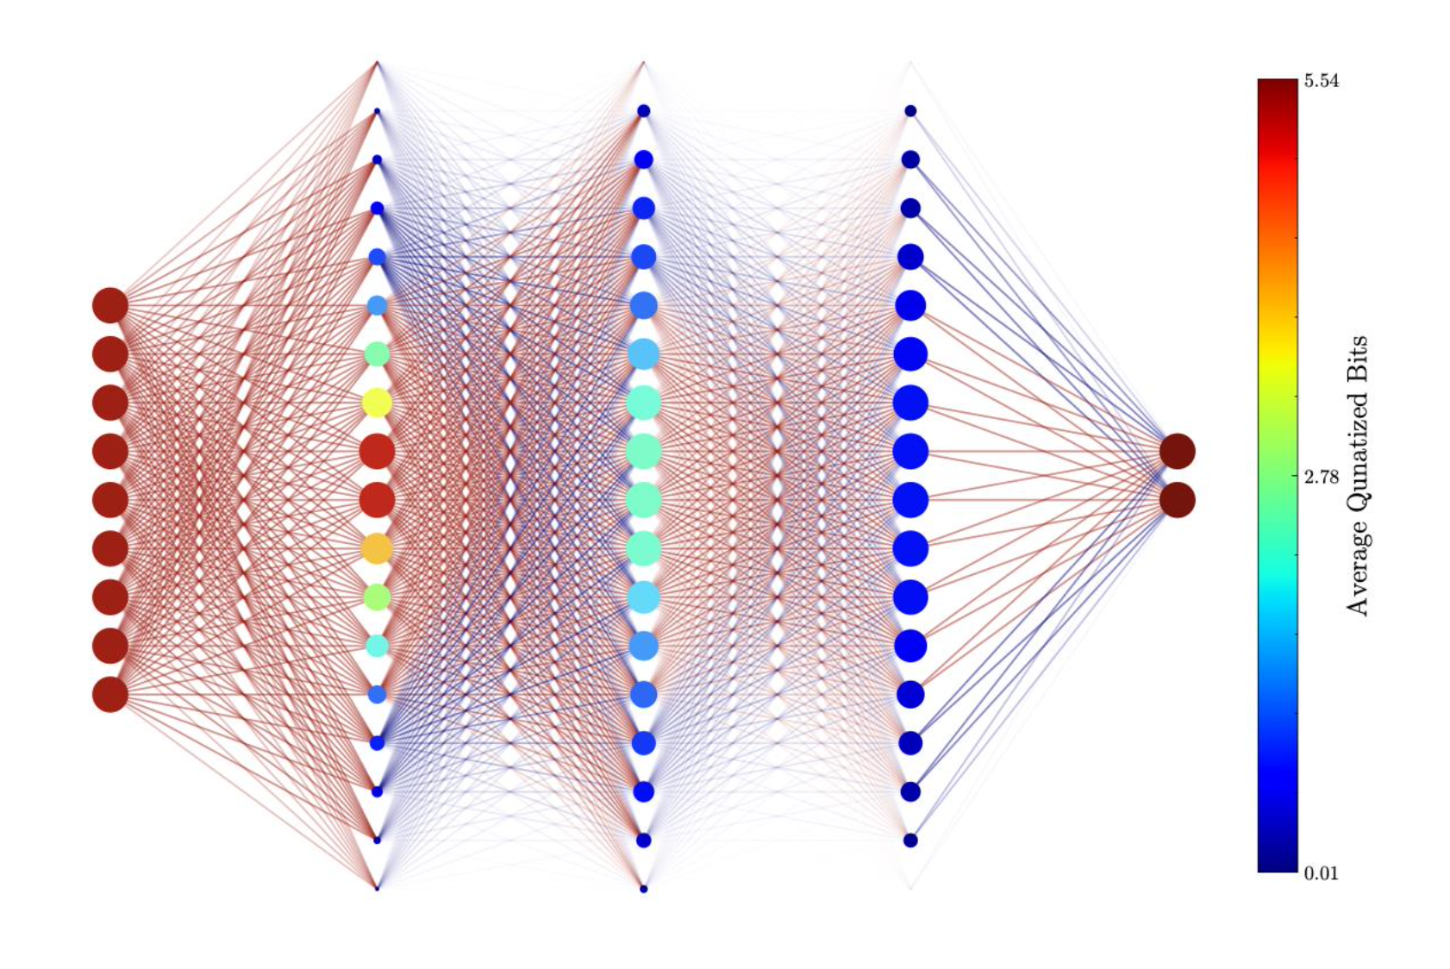
Comparisons with theoretical estimates
Pareto-optimal neural networks
Weighted view of neural network architectures

Slide 24


Conclusions and future work
A multi-channel “smart” readout ASIC for linear strip sensors has been developed in 65 nm CMOS technology.
The chip focuses on early digitization of the acquired signal followed by nonlinear DSP and ML for further processing.
Future work will focus on further characterization and testing of the ASIC, including tests with silicon sensors.
Co-design framework utilizing open source tools and PDKs developed for synthesis informed neural network architecture search and optimization.

Slide 25
Backup slides

Slide 26
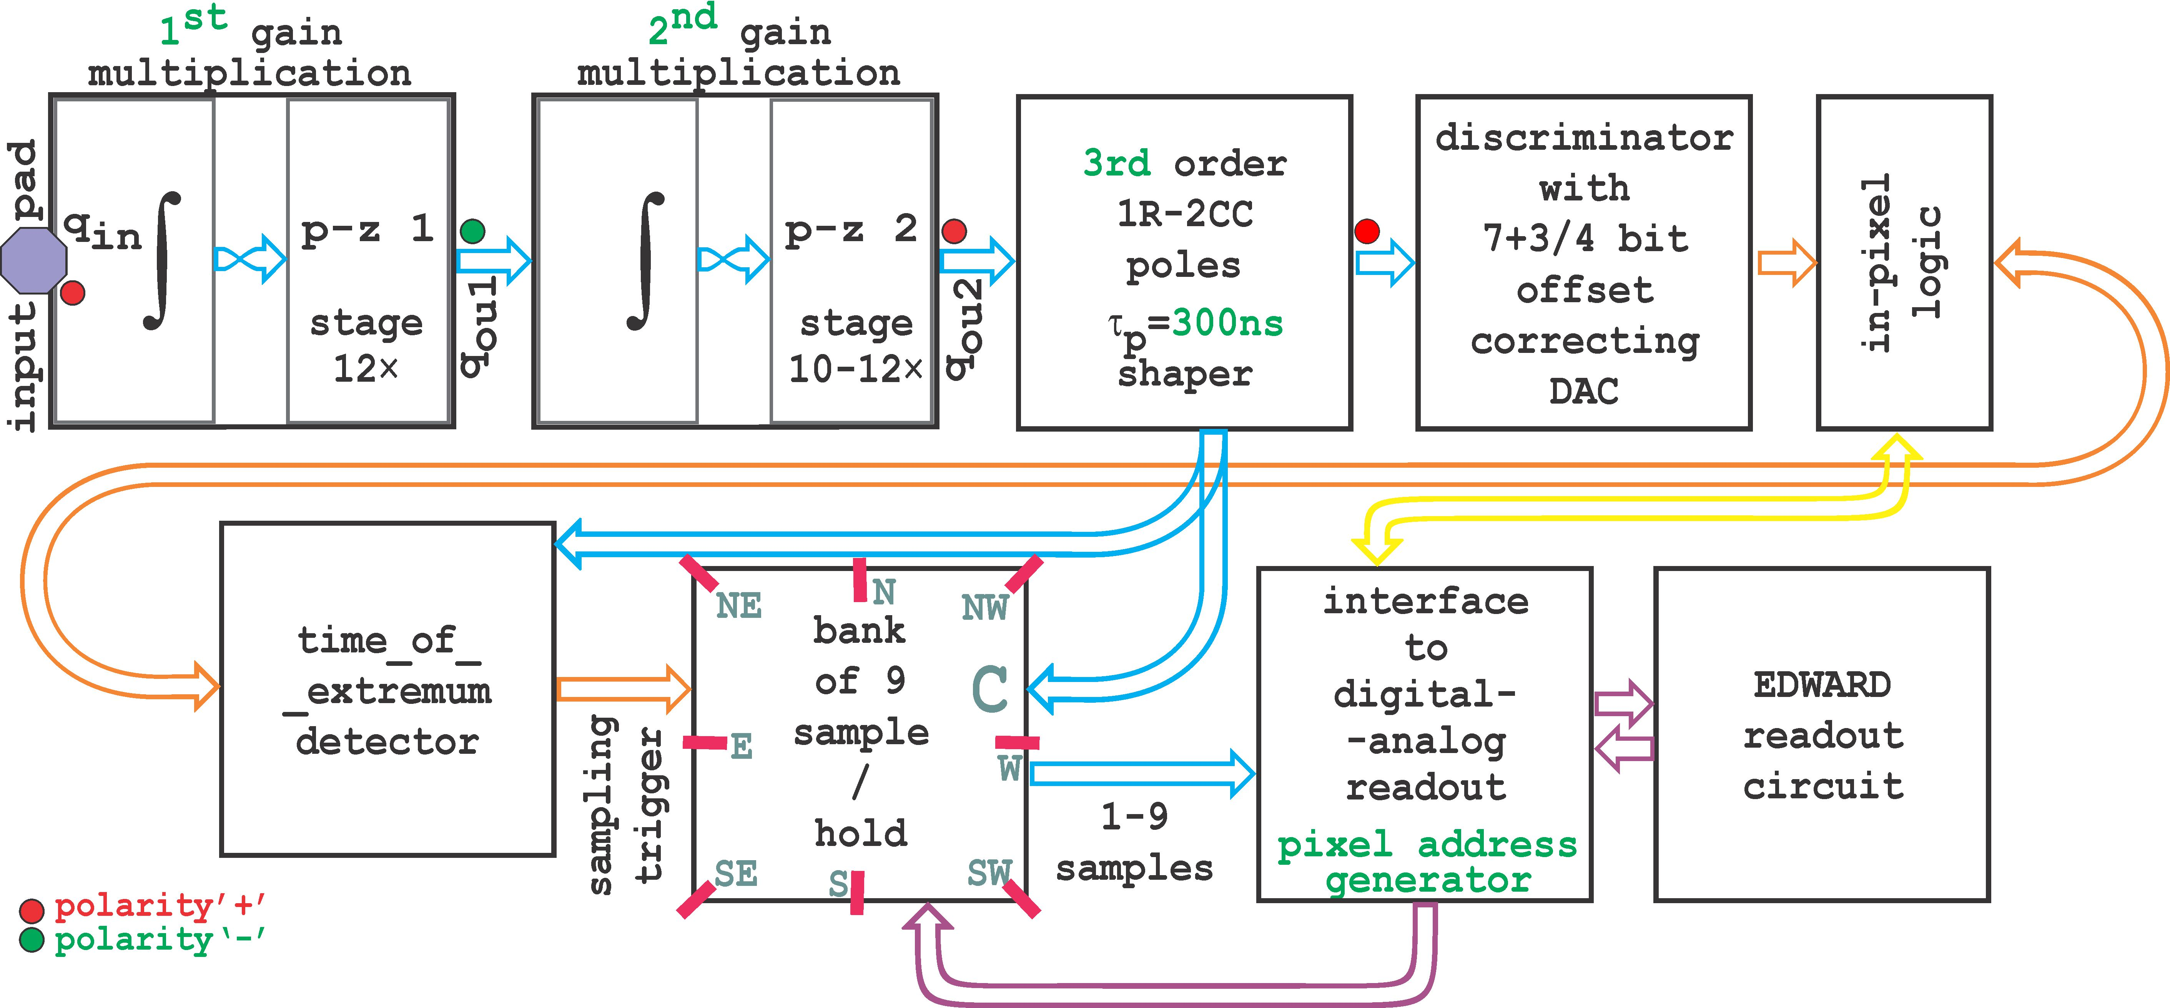
Analog front-end (AFE)
Modified from an existing AFE for X-ray amplitude spectroscopy [1], with the following changes:
  Shaping time reduced to ~100 ns to serve purely as an anti-aliasing filter (AAF).
  All bias currents generated by built-in DACs to eliminate analog bias distribution.
  Minor layout improvements.
Charge injector
100ns
Two-stage CSA
Anti-alias filter
For a detector capacitance of C_{DET} = 50 fF, the simulated ENC = 7.3 e- to 16.5 e- for CSA feedback currents of 0-50 pA and a final shaping time of 300 ns.
The baseline can be adjusted for positive and negative polarity signals to maximize dynamic rage (DR)
Useful DR value of ~10 bits (1:1000)
[1] Deptuch, G. W., et al. "Pixel detectors with built-in signal processing and bandwidth-efficient data transmission." 10th International Workshop on Semiconductor Pixel Detectors for Particles and Imaging. 2023.

Slide 27
Charge-sensitive amplifier (CSA)
Network shown for holes
Switched feedback network to handle both electrons and holes
Inverter-type OTA amplifiers with bias current reuse and active cascode gain boosting
  ~90 dB open loop DC gain, single-stage and thus intrinsically stable
Self-cascaded FET (SCFET) feedback network with pole-zero cancellation [2]
[2] G. W. Deptuch, P. Otfinowski, “Charge Sensitive Amplifier with Pole-Zero Cancellation”, provisional patent application USPTO Serial No. 63/379,887

Slide 28
Anti-aliasing filter (AAF)
Initial plans assumed the use of a first-order AAF, which is simply a lossy integrator.
However, the slow roll-off of the integrator results in unacceptable levels of aliasing unless very high oversampling ratios are used.
The amount of aliasing was reduced by adding a second-order (biquad) stage after the integrator, thus realizing a third-order LPF.
LPF coefficients were tuned to obtain a semi-Gaussian response [3], but this is not critical since the final pulse shape will be determined by the digital FIR filter within the in-channel DSP.
DAC current for baseline shifting is injected into node ‘d’ for noise performance.
Lossy integrator
Biquad
C_{c} is the coupling capacitance for the last stage of the CSA
[3] G. De Geronimo and S. Li, "Shaper Design in CMOS for High Dynamic Range," in IEEE Transactions on Nuclear Science, vol. 58, no. 5, pp. 2382-2390, Oct. 2011

Slide 29
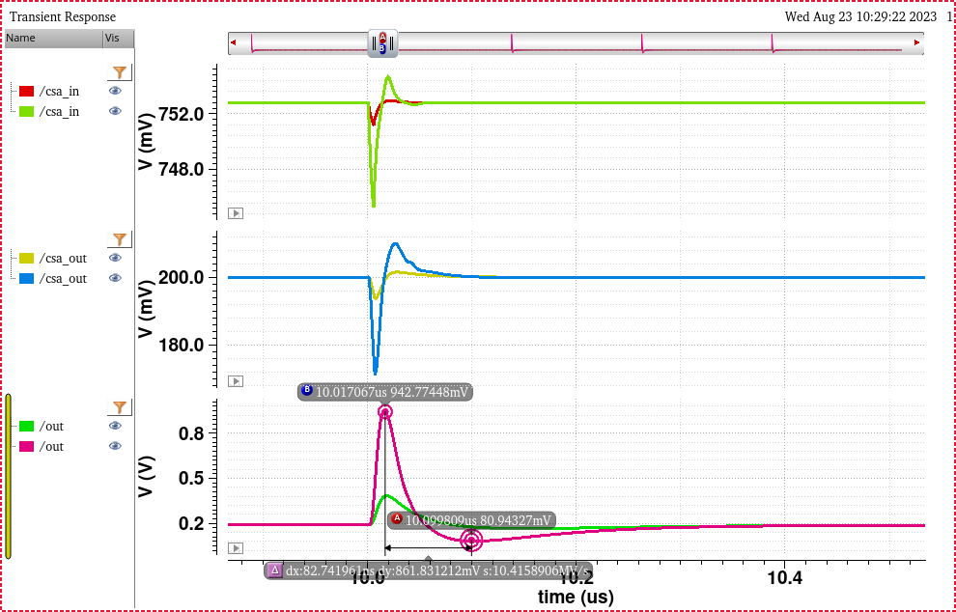
Transient response (negative polarity)

Slide 30
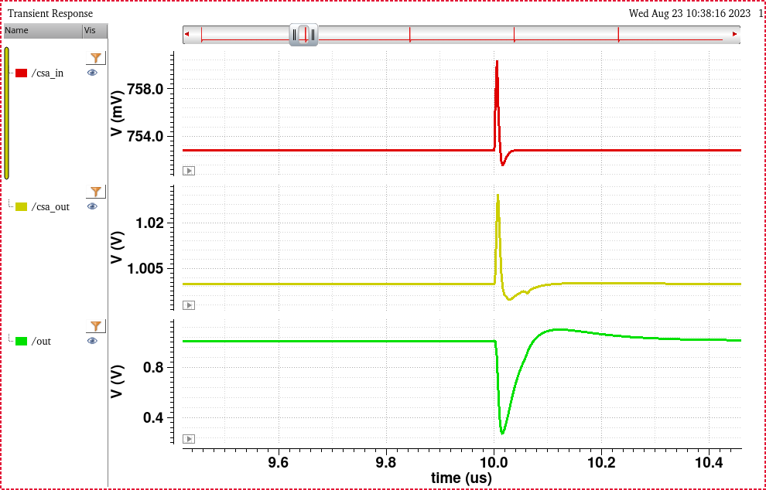
Transient response (positive polarity)

Slide 31
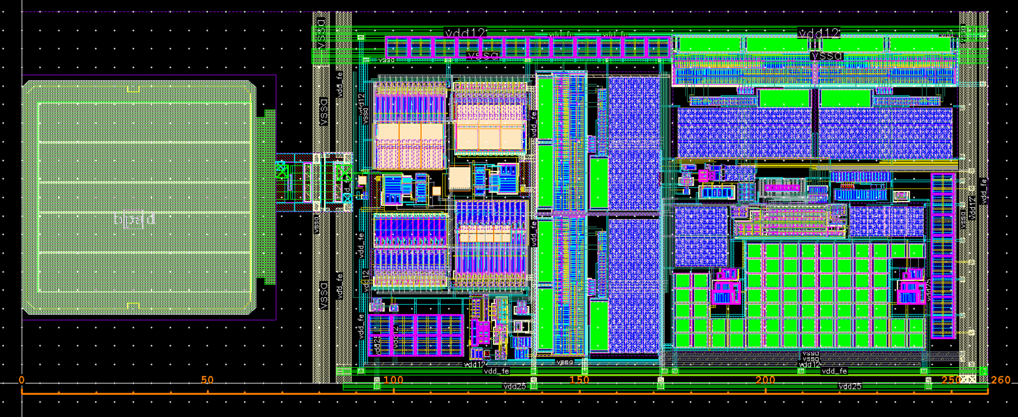
AFE layout
Designed to have a vertical pitch of 100 μm to simplify reuse in other designs.

Slide 32
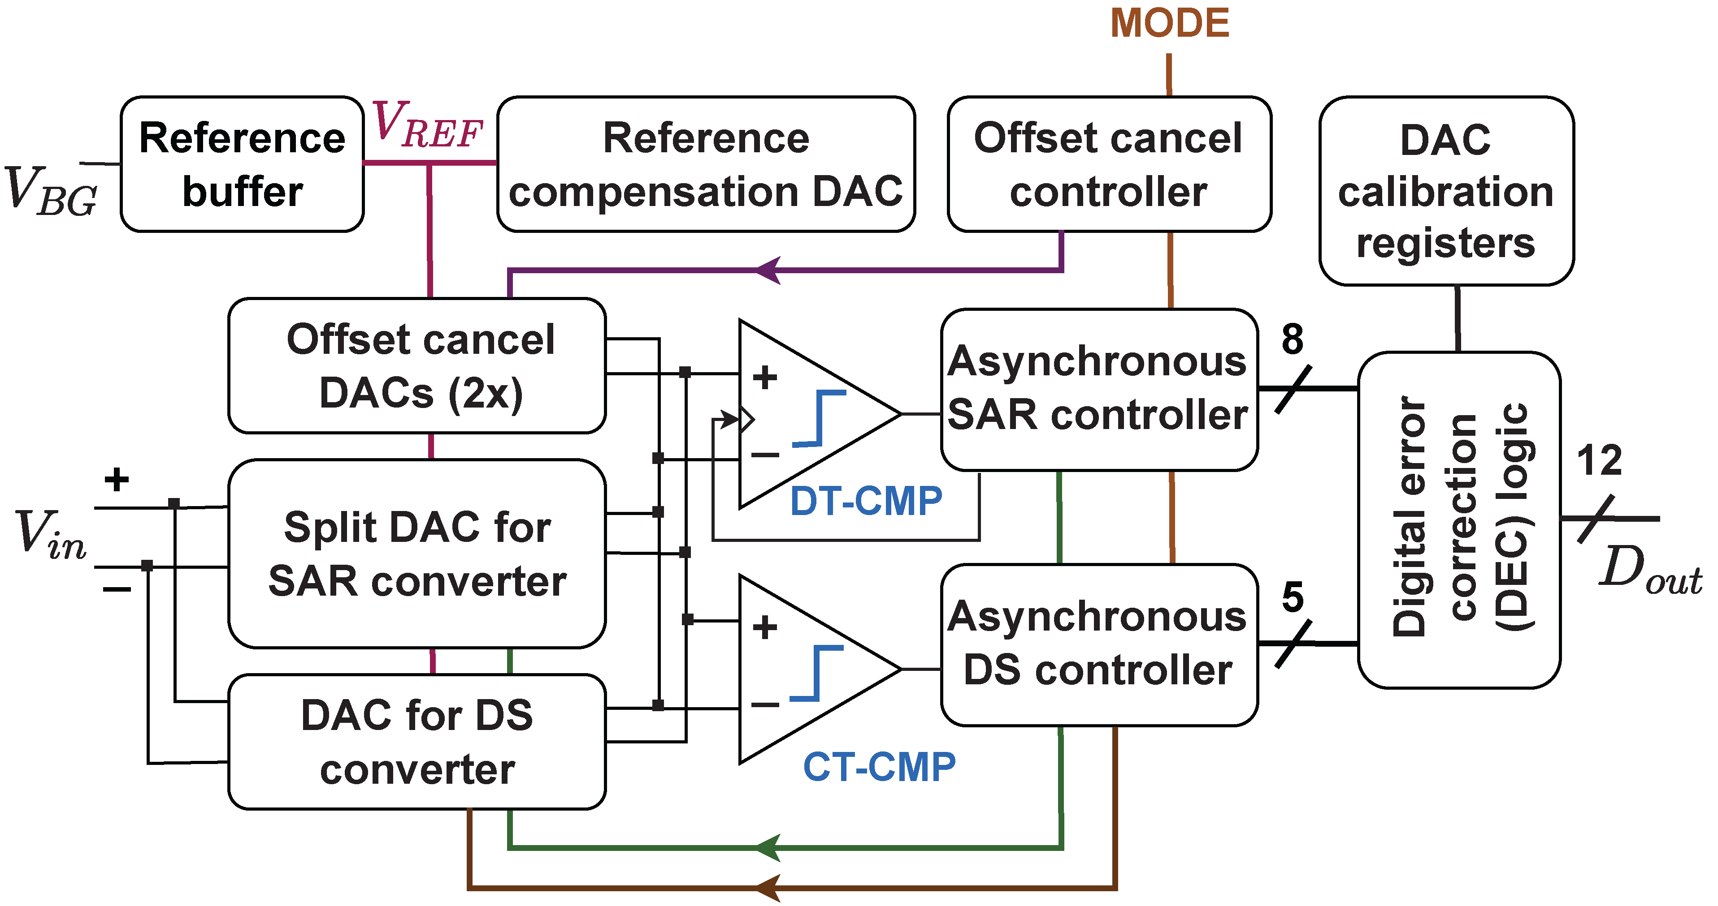
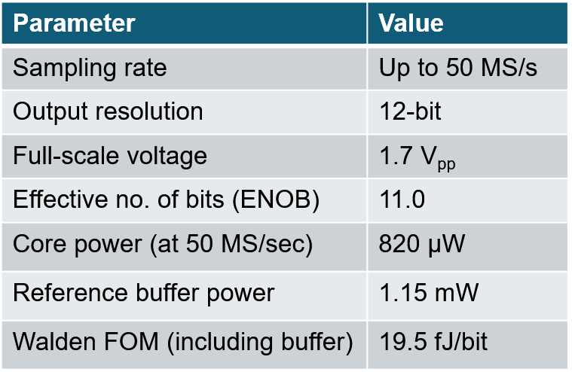
Low-power hybrid ADC
Low-power 12-bit hybrid ADC design in 65 nm CMOS:
  Overall: 8-bit SAR (MSB) + 5-bit digital slope (LSB) [4].
  SAR/digital slope boundary uses 1 redundant bit for robustness, thus resulting in 12-bit resolution.
  Asynchronous successive approximation (SAR) converter:
  Fully-differential charge redistribution architecture.
  Split capacitor DAC (C_{unit} = 20 fF) using an energy-efficient merge-and-split (MS) switching scheme.
  Uses one redundant conversion cycle (9 cycles for 8 bits) to obtain robustness to comparator noise and V_{REF} settling error.
  Asynchronous digital slope (DS) converter:
  Asynchronous (self-timed) delay line-based architecture to ensure low power and robustness to PVT variations.
  DS capacitors (C₀ = C_{unit}/8 = 2.5 fF) are laid out within the SAR DAC to minimize SAR-DS gain mismatch and simplify calibration.
Additional features:
  On-chip reference buffer w/ cancellation of switching transients.
  On-chip digital calibration of comparator offset; supports off-chip calibration of DAC capacitor mismatch.
Performance specifications
[4] Mandal, Soumyajit, et al. "A 12-bit 50 MS/s Hybrid ADC for Waveform Sampling, Data Streaming, and Sparse Readout." 2022 IEEE NSS/MIC.
Both core and buffer power scale with sampling rate

Slide 33
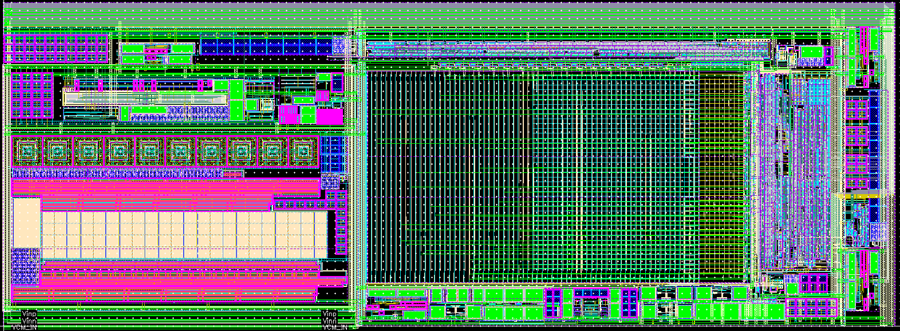
Revised ADC design
Several performance improvements, including
  Built-in low-power input driver using ring amplifiers
  High-linearity single-ended to differential converter (SEDC).
  Built-in current references and DACs to eliminate external bias sources.
Numerous layout improvements, including
  Reduced series resistance for power supplies and reference voltages.
  Reduced substrate coupling by using guard rings.
  Isolation of high-current auxiliary circuits (CML receivers and transmitters) within deep n-wells.
Revised layout (size = 550 μm x 200 μm)

Slide 34
Differential SAR driver
Track-and-hold amplifier (THA) with continuous-time correlated double sampling (CDS) for amplifier gain and offset compensation.
  Input switches are bootstrapped to improve linearity.
  Grounded switches use a single NMOS to reduce nonlinear capacitance and improve linearity.
Input capacitance of SAR DAC = 3.5 pF (single-ended).
Driver input capacitance = 300 fF (12x smaller, much easier to drive).
Total power consumption at I_{B} = 10 μA and f_{s} = 50 MHz is ~240 μA.

Slide 35
Ring amplifier (RA) design
The SAR driver uses a self-biased fully-differential ring amplifier (RA) for power efficiency.
Input stage with neutralization of input capacitance
Adaptive dead zone for stabilization
Replica circuit for self-biasing
First stage is differential to ensure better CMRR and PSRR than a pseudo-differential implementation.
Use of CMOS inverters ensures low input-referred noise, rail-to-rail output swing.
Switched-capacitor common-mode feedback (CMFB)

Slide 36
Simulated performance of the SAR driver
Adequate linearity and noise for 11-bit conversion
  Linearity estimated from simulated signal to noise plus distortion (SINAD) ratio for sinusoidal inputs.
  Simulated output noise (BW = 15 MHz) of 510 μV_{rms} (= 0.7 x LSB), can be reduced by increasing I_{B}.
Schematic netlist, full-scale input, f_{s} = 50 MHz
Parasitic extracted netlist, full-scale input, f_{s} = 40 MHz

Slide 37
Single-ended to differential converter (SEDC)
Simple op-amp based circuit.
High input impedance, easy to drive.
Transfer functions to the positive and negative outputs are well-matched (both in terms of gain and bandwidth).
Op-amp gain-bandwidth (GBW) must be at least 20x higher than the largest operating frequency to ensure adequate linearity.
Requires a stable and low-noise V_{CM}.

Slide 38
High-speed op-amp design
High-speed op-amp with rail-to-rail inputs and outputs for the SEDC.
  Uses V_{DD} = 1.8V to ensure rail-to-range input range for the 1.2V domain
Indirect feedback compensation to improve GBW
Folded-cascode PMOS input stage
Class-AB output stage for rail-to-rail swing
Simulated GBW = 550 MHz at I_{B} = 60 μA

Slide 39
Simulated performance of the SEDC
Linearity increases with op-amp bias current, I_{B} (trade-off versus power consumption).
Linearity degrades with frequency (trade-off versus bandwidth).
Adequate (11-bit) linearity and noise for a signal bandwidth of 15 MHz and V_{FS} = 1.6V_{pp} obtained at I_{B} = 80 μA
  Total power consumption = 1.2 mA, total output noise = 200 μV_{rms} (= 0.28 x LSB)
Input frequency = 10 MHz, output swing = 1.6 V_{pp}
Input frequency = 15 MHz, output swing = 1.6 V_{pp}

Slide 40
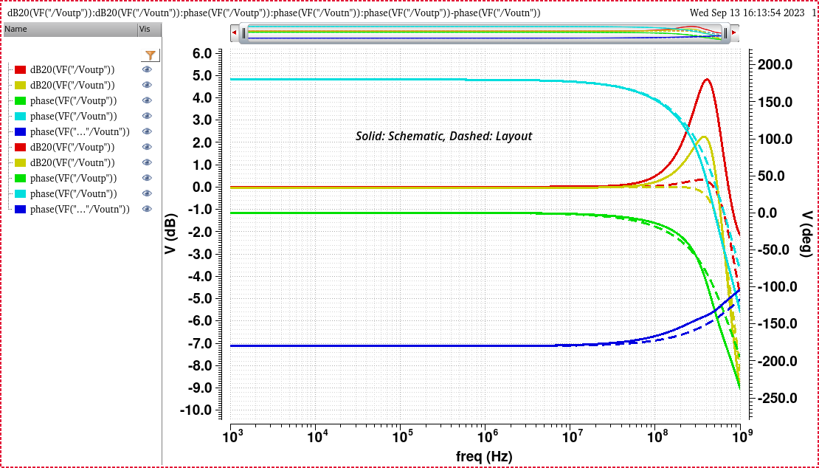
Effects of layout parasitics
Phase margin decreases due to parasitic high-frequency poles (mainly from current mirrors).
Dashed: Schematic, Solid: Layout

Slide 41
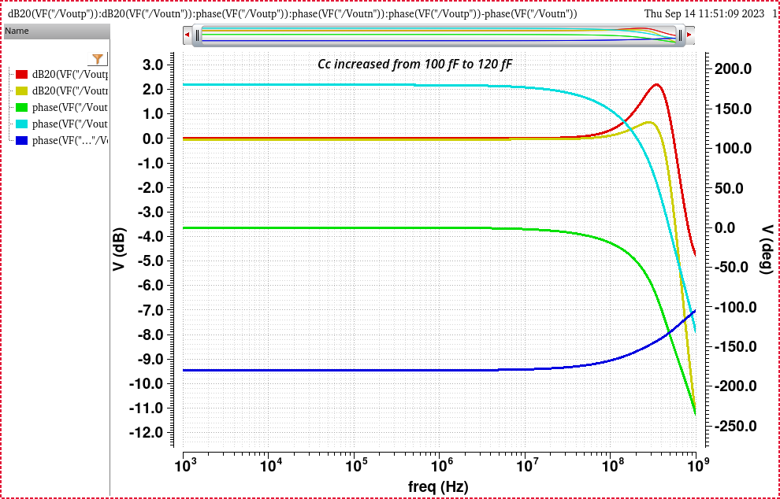
Compensating for layout parasitics

Slide 42
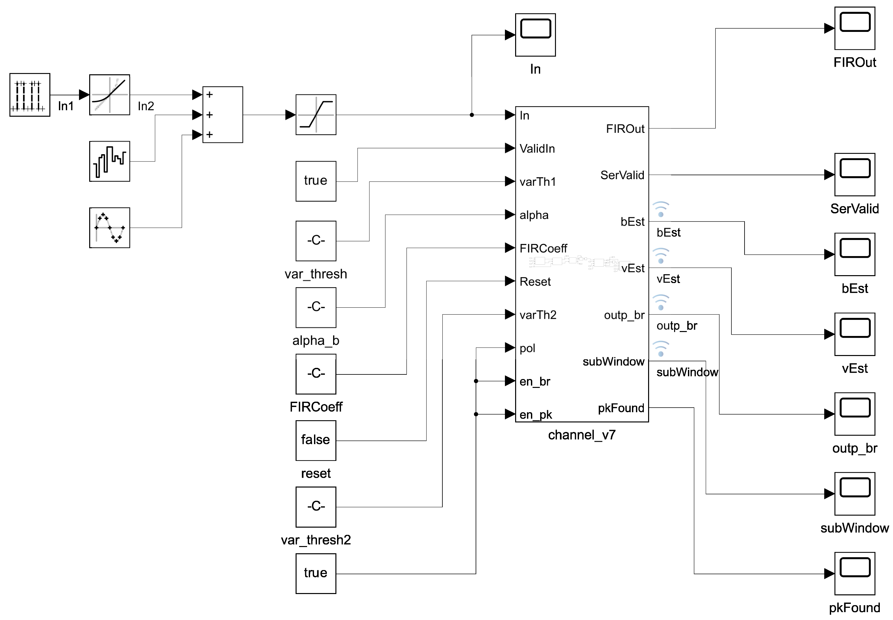
Simulink test bench for the DSP
Full-scale pulses are fed into the model to ensure proper scaling during fixed-point conversion.
Block outputs
  FIR filter
  Serializer valid
  Baseline estimate (bEst)
  Variance estimate (vEst)
  Aligned window (subWindow)
  Peak found flag (pkFound)

Slide 43
Programmable FIR filter
FIR filter chosen to ensure stability, allow creation of linear phase responses.
Arbitrary coefficients to allow generation of a wide range of shaping filters.
Example: Gaussian, M = 17 points
Impulse response (12-bit coefficients)
Error due to coefficient quantization

Slide 44
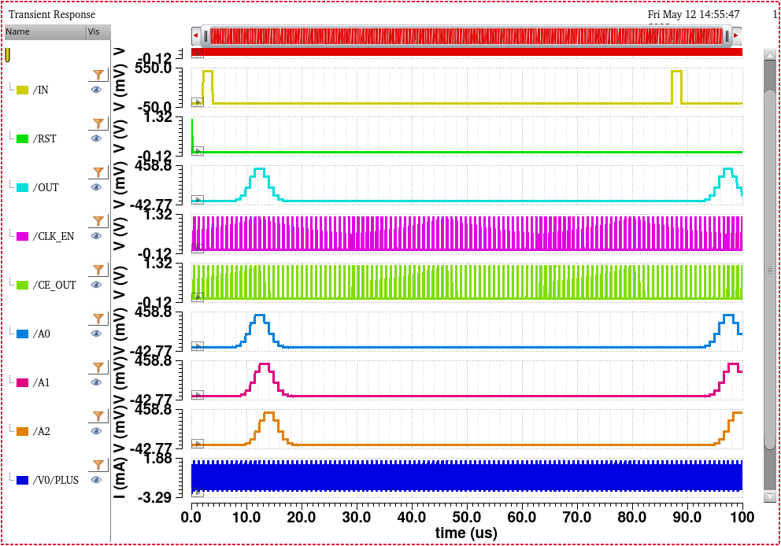
Programmable FIR filter: Cadence simulation
Transient simulation of MATLAB-generated Verilog to check the impulse response.
Filter output
Some buffer outputs

Slide 45
Decimation filter
Trade-off between filter length, stopband rejection, and roll-off slope.
Coefficients are fixed for a given decimation rate. Obtained using the MATLAB multi-rate FIR filter design function (designMultirateFIR).
Decimation rate: R = 4
Half-polyphase length: P = 4
Stopband attenuation > 40 dB
Filter length = 2PR = 32

Slide 46
Baseline holder (BLH)
% inp = Signal window
% var_thresh = Signal rejection threshold (pp, sigma^2 units)
% alpha = Estimate update rate [baseline, variance]
% rst = Reset; en = Enable
% ------------------------
% Modifications for HDL coder:
% Avoid use of "std" function for calculating standard deviation
function [bEst,vEst,outp] = baseline_removal_hdl(inp,var_thresh,alpha,en)
persistent var_est var_estf b_est;
if isempty(var_est) % Initialize estimates
var_est = 0; var_estf = 0; b_est = 0;
end
N = length(inp);
mu_curr = sum(inp)/N; % Sample mean
% This formula for calculating variance is numerically unstable due to
% cancellation of two large numbers! It can even go negative.
%var_curr = sum(inp.*inp)/N-(mu_curr.*mu_curr); % Sample variance
var_curr = sum((inp-mu_curr).*(inp-mu_curr))/N; % This formula is numerically stable
var_est = (1-alpha(2))*var_est + alpha(2)*var_curr; % Update raw noise estimate
var_pp = (max(inp)-min(inp))*(max(inp)-min(inp)); % Find (Peak-peak value)^2
sig_present = var_pp > var_thresh*var_est; % Assume a signal is present
if ~sig_present % No signal present
b_est = (1-alpha(1))*b_est + alpha(1)*mu_curr; % Update baseline estimate
var_estf = (1-alpha(2))*var_estf + alpha(2)*var_curr; % Update corrected noise estimate
end
bEst = b_est; % Baseline estimate
vEst = var_estf; % Variance estimate
if en
outp = inp - b_est; % Baseline-subtracted output (if enabled)
else
outp = inp; % Baseline subtraction disabled
end
Feedforward design to ensure stability.
Operates on sub-windows generated by the waveform aligner.
Algorithm
  Compare the range of values with variance to check if the present sub-window contains a pulse (or is just noise)
  If no pulse is present, calculate the mean and variance of the sub-window points
  Use these values to update the estimates of mean and variance.
  Subtract the updated mean from the acquired sub-window points.

Slide 47
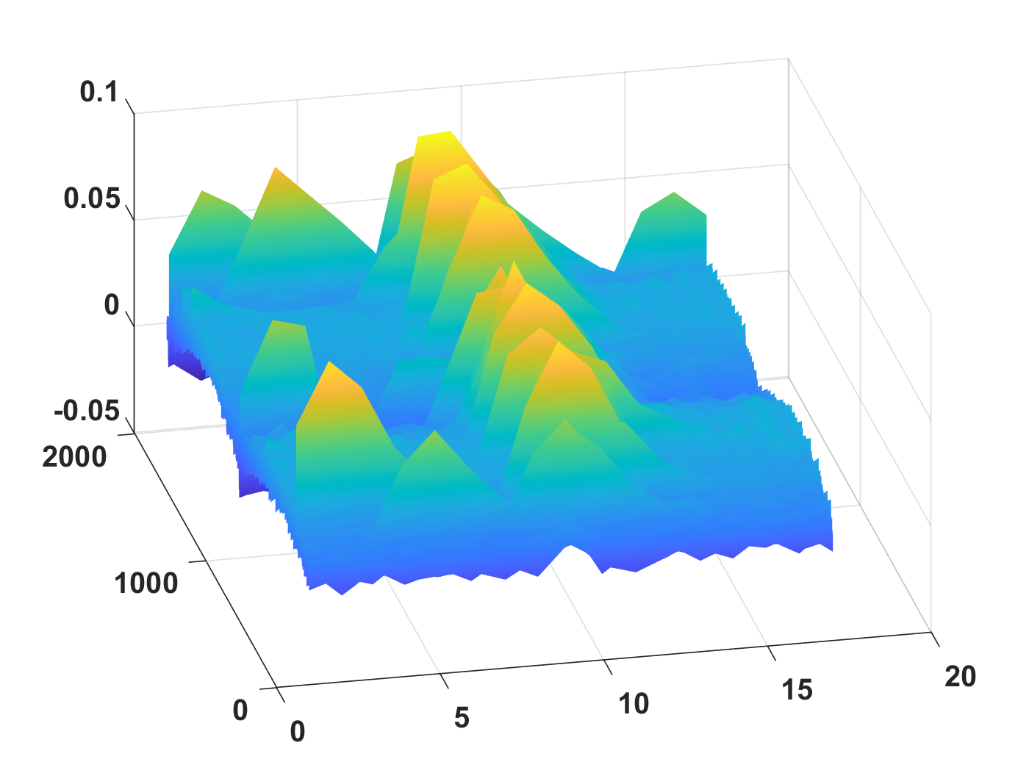
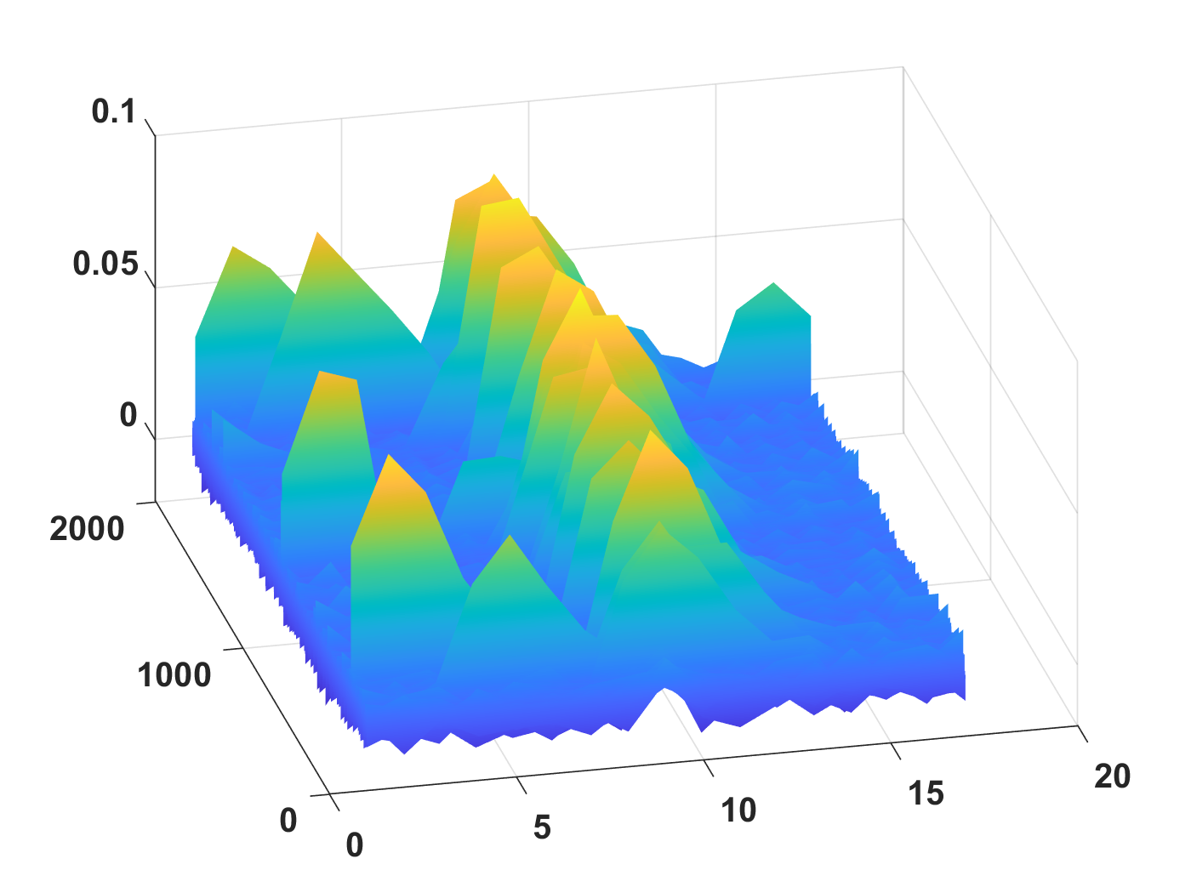
Baseline holder (BLH)
Transient simulations in MATLAB
Algorithm has been synthesized to Verilog.
Random input sequence with a sinusoidal baseline
Original waveform snippets (before the BLH)
Corrected waveform snippets (after the BLH)

Slide 48
Waveform aligner
Goal: Extract waveform “snippets” in real time that are centered around amplitude peaks.
Advantages:
  Reduces the number of variables that must be estimated by the ML algorithm (by removing the unknown time of arrival of the pulses).
  Prevents loss of signal energy and shape information due to pulse arrival near edges of sample buffer.
Implementation:
  Incoming samples fill up a sample buffers. Buffer length = 2N.
  The central 50% (length = N) of the buffer is searched for peaks.
  If a peak is found, the desired waveform snippet (a sub-window of length = N centered around the peak location) is extracted.
Performance:
  For pulses with uniformly-distributed peak SNR (1-20), ~90% of pulses are properly detected and centered for N = 16.
  Remaining 10% are either too close to another pulse (resulting in multiple pulses within one snippet) or have an SNR that is too low to correctly trigger the peak detector.

Slide 49
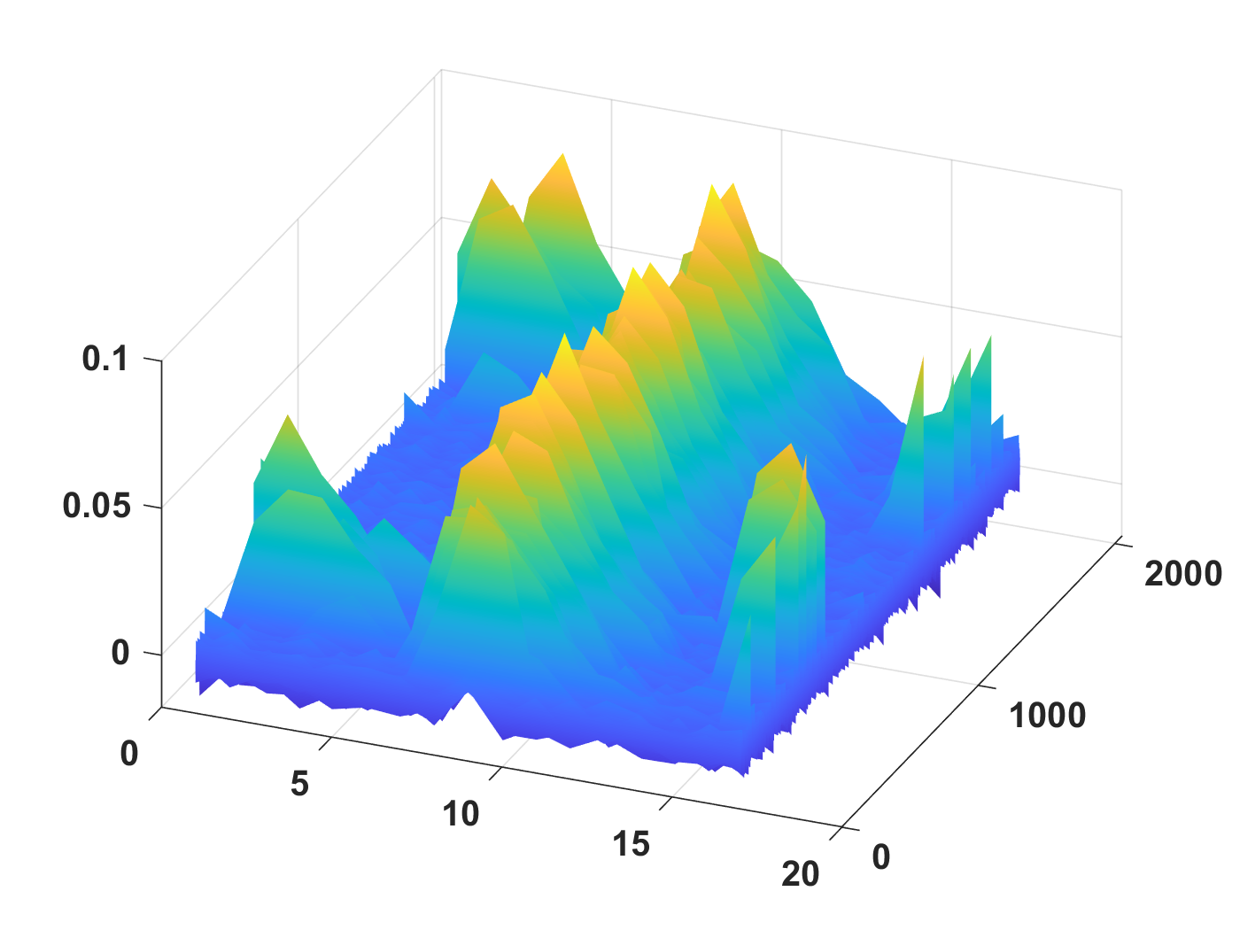
Waveform aligner
Transient simulation in MATLAB
Algorithm was synthesized to Verilog.
Random input sequence
Aligned waveform snippets

Slide 50
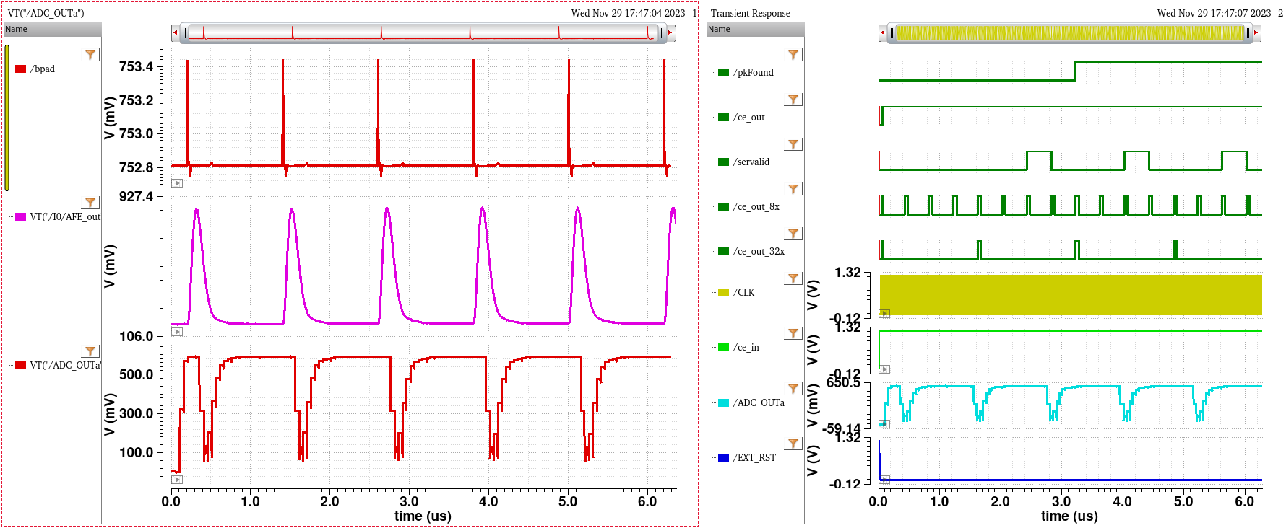
AMS simulation results of the ADC + DSP

Slide 51
Channel input multiplexer
The input to the channel can come either from the outputs of the ADC or a circular buffer of depth 64 (with 12-bit values stored by each unit)
Circular buffer is clocked at a rate = f_{s} (= the rate at which ADC values are produced)
ADC output
1
Channel input
12
Circular Buffer
12
0
12
sel_in_src

Slide 52

MLP simulation results (functional)
LSB fluctuations due to stochastic rounding
MLP block has a total pipelining factor of 32
Latency from ce_out_32x → out_valid : 32 f_{s} clock cycles
Verilog simulation output matches with software simulation

Slide 53

MLP simulation results (synthesized)
LSB fluctuations due to stochastic rounding
MLP block has a total pipelining factor of 32
Latency from ce_out_32x → out_valid : 32 f_{s} clock cycles
Verilog simulation output (functional and synthesized) matches with software simulation

Slide 54
Output readout
Output is read out through a 4-way multiplexer
Channel and MLP block outputs are produced at a rate = f_{s}/32.
A maximum of 12 x 9 = 108 bits need to be outputted
A 128-bit serializer triggered at 128 x f_{s}/32 = 4 x f_{s} reads out the results
Along with the serial_out, an out_valid pulse is transmitted on a separate wire to indicate start of the serial stream
Baseline restorer input
0
serial_out
Baseline restorer output
1
Serializer
Channel output
out_valid
2
128
{vest, best, MLP block output}
3
sel_out_src

Slide 55

Simulation results of all digital blocks (functional)
Channel outputs
ML block outputs
Serial output stream

Slide 56

Simulation results of all digital blocks (synthesized)
Channel outputs
ML block outputs
Serial output stream

Slide 57

Simulation results with all digital blocks + memory (after implementation)
Simulation results with default memory values for configuration – simulations match those obtained with the functional and synthesized versions
00000000_00000000_07763BB80_A5FF0FFC
00000FFC_FFAFFFFF_F3B41D50_6E1F8599
00000599_95DC83B4_17733B50_B30F02CA
PkFound goes high at ~3.3 µs
Deserializer added to check serial stream values

Slide 58

Final chip layout
Channel
Includes CML receiver for high-frequency input clock (8f_{s} = 160 MHz).
Channel 23 is instrumented (additional outputs brought out to pads).
Expected DSP power consumption ~10 mW/channel (clock = f_{s} = 20 MHz).
AFE
ADC
DSP
MLP
5 mm
(b)

Slide 59

Analog front-end (AFE)
Modified from an existing AFE designed for X-ray amplitude spectroscopy [1], with the following changes:
  Shaping time reduced to ~100 ns to serve purely as an anti-aliasing filter.
  All bias currents generated by built-in DACs to eliminate analog bias distribution.
  Minor layout improvements.
Bias DAC
CSA
Shaper
Charge injector
[1] Deptuch, G. W., et al. "Pixel detectors with built-in signal processing and bandwidth-efficient data transmission." 10th International Workshop on Semiconductor Pixel Detectors for Particles and Imaging. 2023.
Bias DACs

Slide 60

Bias DAC (5-bit)
Current DAC
Constant-g_{m} reference

Slide 61

Top-level schematic of the ADC
Combines the ADC core with the driver.
Clock generator
Driver
ADC core

Slide 62

Test bench for the complete channel
Ideal DACs
Total number of programming bits:
  AFE: 33
  SEDC: 5
  ADC: 130
  DSP: 160
  MLP: 1552
Channel
Programming bits (ideal ADCs)

Slide 63

Full channel schematic
Clock divider
ADC
All digital blocks
SEDC
AFE

Slide 64

AMS model of the complete channel
Analog front-end and ADC: transistor-level
Channel DSP: functional
SEDC
ADC
DSP
AFE

Slide 65
Synthesis report for the DSP
=======================================================================
Metric initial generic map syn_opt final
=======================================================================
Slack (ps): 11,564 18,092 947 0 0
R2R (ps): 11,564 18,092 947 0 0
I2R (ps): no_value no_value no_value no_value no_value
R2O (ps): no_value no_value no_value no_value no_value
I2O (ps): no_value no_value no_value no_value no_value
CG (ps): no_value no_value no_value no_value no_value
TNS (ps): 0 0 0 0 0
R2R (ps): 0 0 0 0 0
I2R (ps): no_value no_value no_value no_value no_value
R2O (ps): no_value no_value no_value no_value no_value
I2O (ps): no_value no_value no_value no_value no_value
CG (ps): no_value no_value no_value no_value no_value
Failing Paths: 0 0 0 0 0
Leakage Power (nW): 429 198 287 276 276
Cell Area: 457,367 413,548 275,179 270,195 270,195
Total Cell Area: 457,367 413,548 275,179 270,195 270,195
Leaf Instances: 120,834 116,420 32,111 30,825 30,825
Total Instances: 120,834 116,420 32,111 30,825 30,825
Utilization (%): 0.00 0.00 0.00 0.00 0.00
Tot. Net Length (um): no_value no_value no_value no_value no_value
Avg. Net Length (um): no_value no_value no_value no_value no_value
Route Overflow H (%): no_value no_value no_value no_value no_value
Route Overflow V (%): no_value no_value no_value no_value no_value
MBCI(%) (bits/gate) : 0.00 0.00 0.00 0.00 0.00
Norm Cong Hotspot Area:
Max Cong: no_value no_value no_value no_value no_value
Tot Cong: no_value no_value no_value no_value no_value
=========================================================================
ADC sampling frequency = 25 MHz
Total cell area: 1.35 mm x 200 μm

Slide 66

Transient simulation results (lower pulse rate)

Slide 67
Clocks used by digital blocks
Name | Rate
CLK_RDOUT | 4 x fs = 80 MHz
CLK_DSPb | fs = 20 MHz
CLK_MLP | fs = 20 MHz

Slide 68



Evaluation software and initial results
Test GUI written in LabVIEW
Initial tests show that the chip is alive and generating outputs
Stay tuned for more results!
Recorded waveform panel
I²C programming panel
Global ASIC control panel

