Slide 1
How IceCube got its Digital Mojo working Or, the story of the Little Chip that Could
David Nygren
University of Texas at Arlington

Slide 2
How IceCube got its Digital Mojo working Or, the story of the Little Chip that Could
David Nygren
University of Texas at Arlington

Slide 3
Once upon a time...
... I was visited by a Greek friend of mine, Leonidas Resvanis, who invited me to help him realize his dream of neutrino astronomy in the Mediterranean...

Slide 4
The challenges he faced were very tall
To demonstrate NESTOR, Leo was planning the deployment of one “floor” at the excellent site near Pylos, Greece.
Twelve PMT waveforms must be captured with high sampling frequency and dynamic range and very low power.

Slide 5
The challenges were very tall.
ADCs at the time (1990’s) for this purpose were very power hungry...
Instead, maybe a UCB student project I had by chance seen at LBL might be of interest...
This was an ASIC designed by Stuart Kleinfelder for his MS degree.

Slide 6
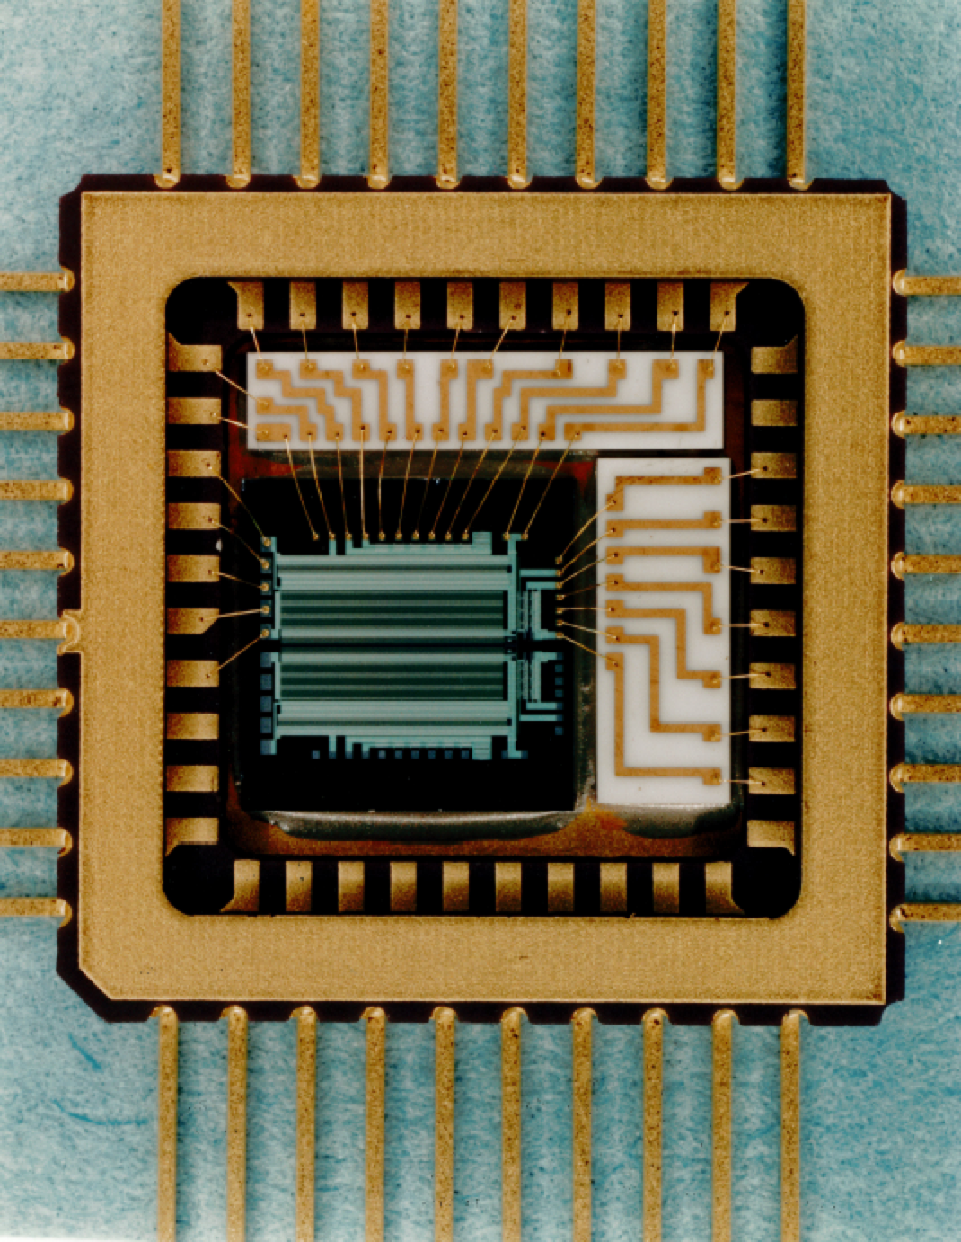
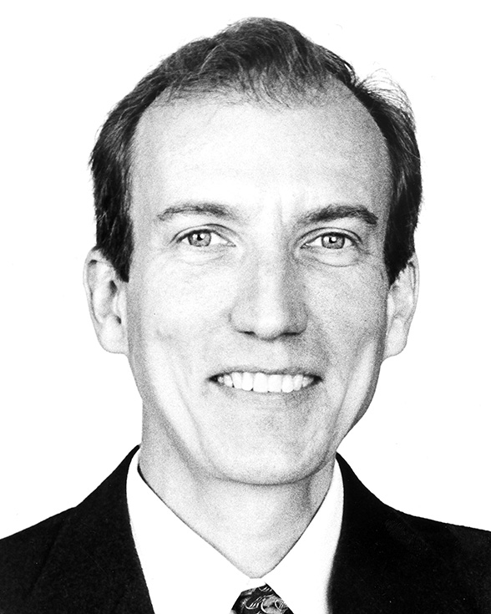
(1996): A switched capacitor array we called the
Analog Transient Wave Recorder! (ATWR)
Designer: Stuart Kleinfelder, LBL, now Professor in EE, UC Irvine

Slide 7
(1996): A switched capacitor array we called the
Analog Transient Wave Recorder! (ATWR)
Stuart’s Master’s thesis, UCB
***
Switched-capacitors: low power
Three input channels
256 samples per channel
synchronous sampling: variable from 200 - 1000 MHz
2.5 µm double-poly technology!
10 bit S/N, but:
No internal ADC: Slow readout!

Slide 8
We used this ASIC for NESTOR
Joshua Sopher of LBL did the overall design for deployment at the NESTOR site near Pylos.
I had somehow gotten money from NSF ($150K ?) for this... (Or maybe it was for something else...)
It all worked; data sent back to shore allowed full reconstruction of downward going muons.

Slide 9
AMANDA → IceCube
It was around this time that I had become somewhat involved with AMANDA and the IceCube transition
AMANDA very successful... but:
PMT pulses after 2 km cable - not so good
Optical fiber: PMT pulses much better, but...
Dynamic range still not so good
Optical cables: not so robust (or cheap) either...
Optical calibration: not so stable...
Not so pleasant to deploy two down-hole cables

Slide 10
“What does IceCube really need?”
High dynamic range:
deposited energy may vary by ~10⁶
Lowest possible power dissipation
Incompatible with waveform capture?
Complex waveform information:
Ice: absorption small, scattering large
Let’s find out – use the ATWR
two pre-prototype Digital Optical Modules!

Slide 11
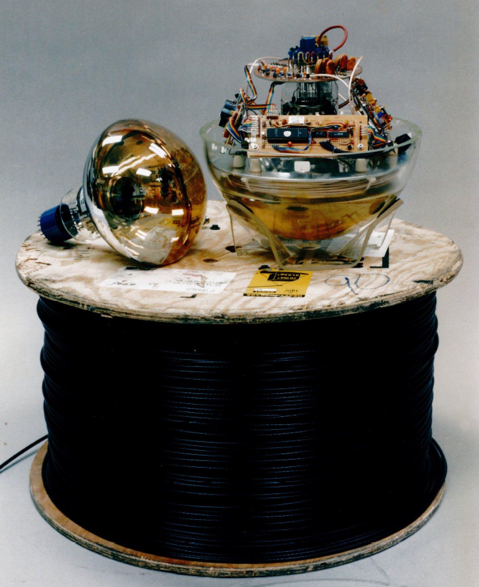
What’s this?

Slide 12
What’s this?
This is one of
two primitive
DOMs made
at JPL!

Slide 13
What’s this?
This is one of
two primitive
DOMs made
at JPL!
Why JPL?

Slide 14
What’s this?
This is one of
two primitive
DOMs made
at JPL!
Why JPL?
“Because that’s where the money is!”*
* Willie Sutton

Slide 15
Seed Money
In addition to JPL’s support (~$100K) Buford Price and Francis Halzen also contributed to the construction of these two proto-DOMs at JPL.
And they worked!

Slide 16
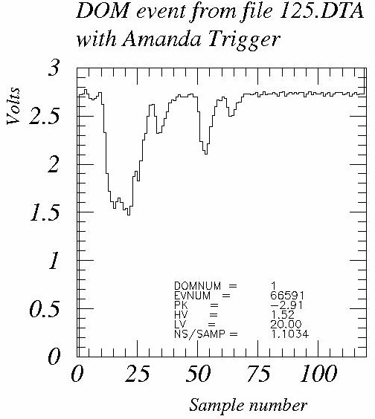
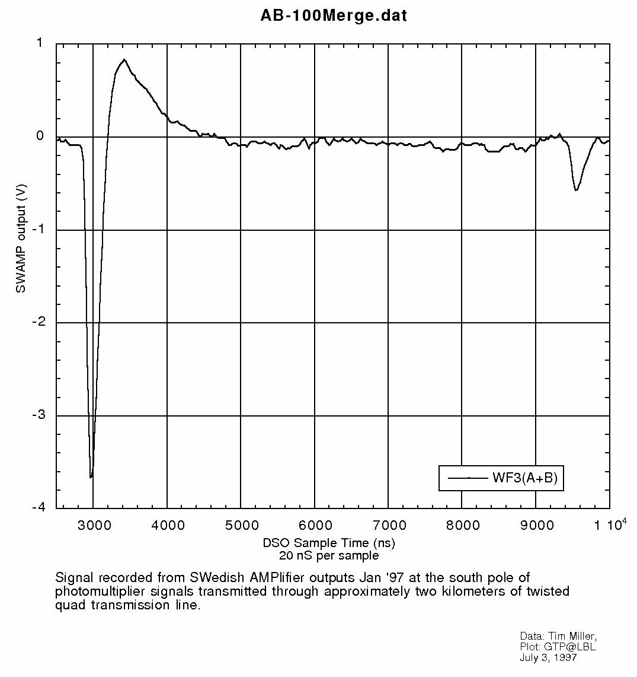
AMANDA J-B-W DOM
7.5us
132ns
Thanks to
Tim Miller and Doug Lowder

Slide 17
Suddenly, there was KamLAND!
Stuart Freedman (LBL/UCB) came to me and asked how “we” might usefully get involved with KamLAND.
“Why not use Stuart’s ASIC to do the electronics and DAQ for KamLAND?” This became a $6M project...
I came to Hawaii and made a pitch for that showing that we used the ATWR successfully for NESTOR.
We were accepted for this task, but I have the impression that our KamLAND friends were wary.
Stuart implemented an internal Wilkinson ADC and the ATWR became the ATWD. Much better!

Slide 18
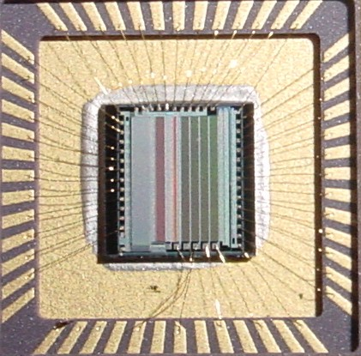
ATW “R” → ATW “D”
A 128-channel common-ramp Wilkinson ADC was added by Stuart K.
This sped up the readout greatly.

Slide 19
All that worked too.
The electronics for KamLAND was completed by Thorsten Stezelberger and another LBL engineer.
Delivery was hampered by bad production quality, but the system was used by KamLAND for many years.
On the basis of success in KamLAND, we could propose to use the ATWD as the enabling element...

Slide 20
...For IceCube
Analog to Digital conversion of IceCube
Each optical module must become a complete semi-autonomous data acquisition platform, linked in an all-digital network with asynchronous DAQ.
A complete departure from the AMANDA framework.
A complete systemic transformation!

Slide 21
Scary things
“Let’s make 5000 complex tethered satellites and bury them forever in ice”
“Will the cold keep them from working?”
“Nothing like this has ever been done”
“What if we make a mistake we can’t fix?”

Slide 22
Waveforms are useful!
Get to work on realizing a digital string
but how?
NSF: $325K for AMANDA string 18
grant to George Smoot, UCB
Start: meeting at LBL, November 1998
tremendous motivation to do this
Karle: “Let’s make string 18 a hybrid”
what’s one more back-breaking feature?

Slide 23
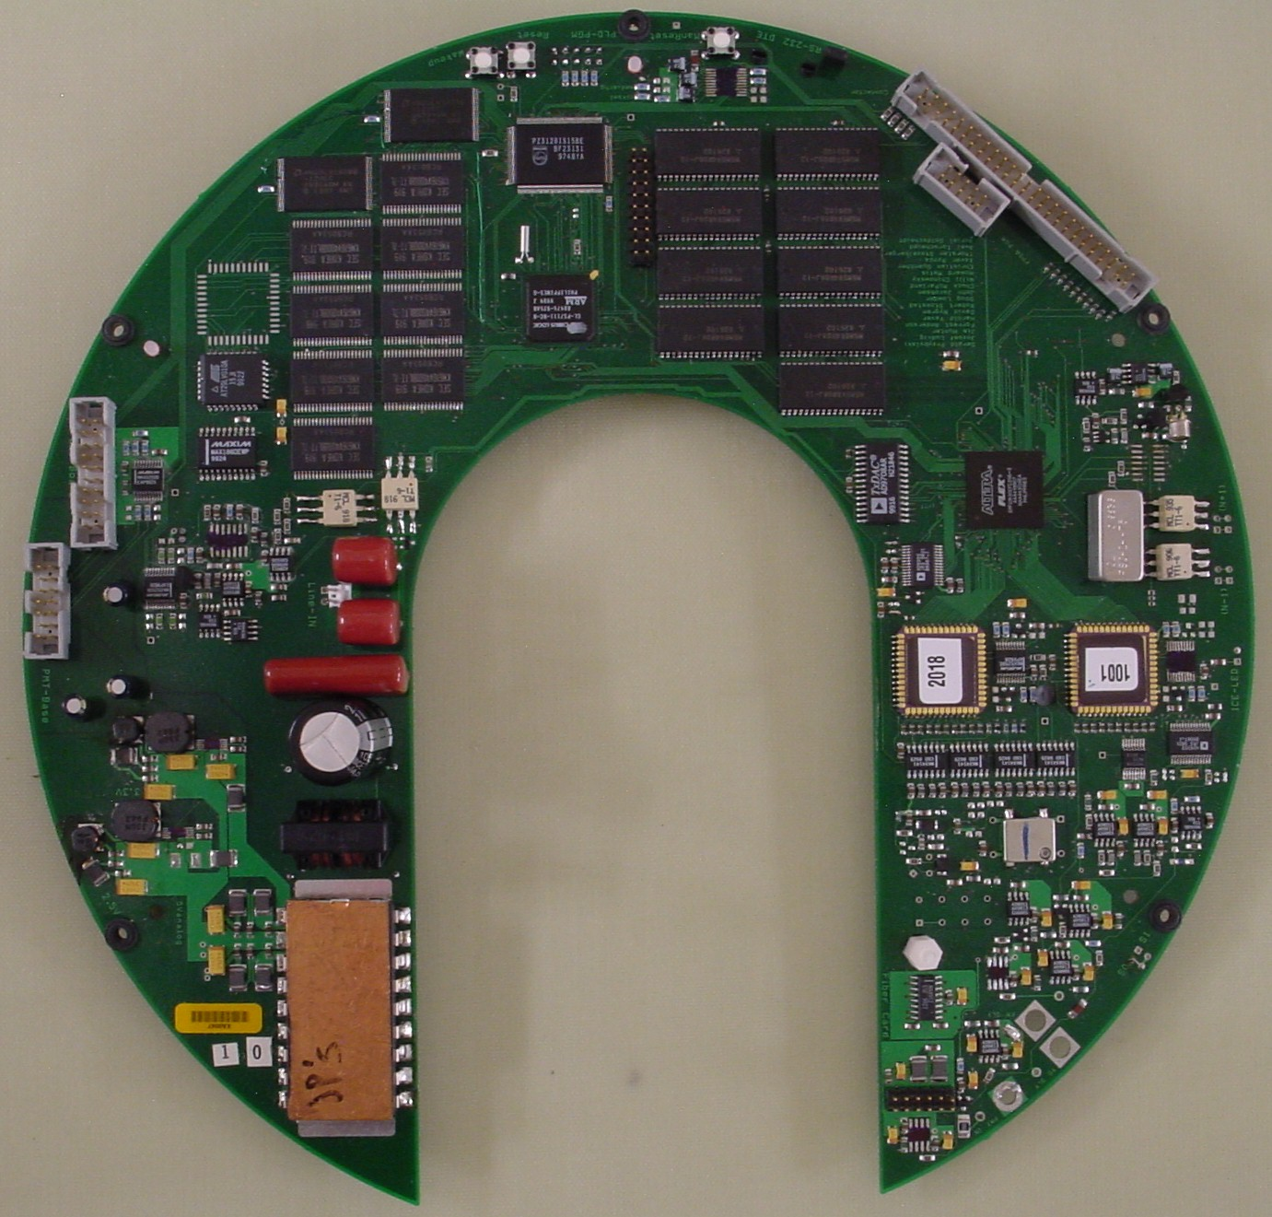
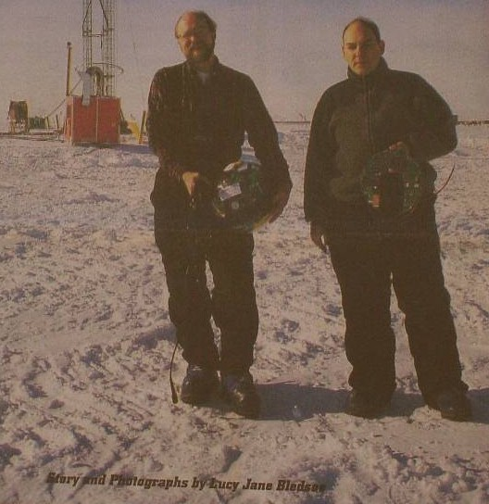
“Main board” for AMANDA String 18 40 Optical Modules, January 15, 2000
String 18: Jerry Przybylski
Jozsef Ludvig

Slide 24
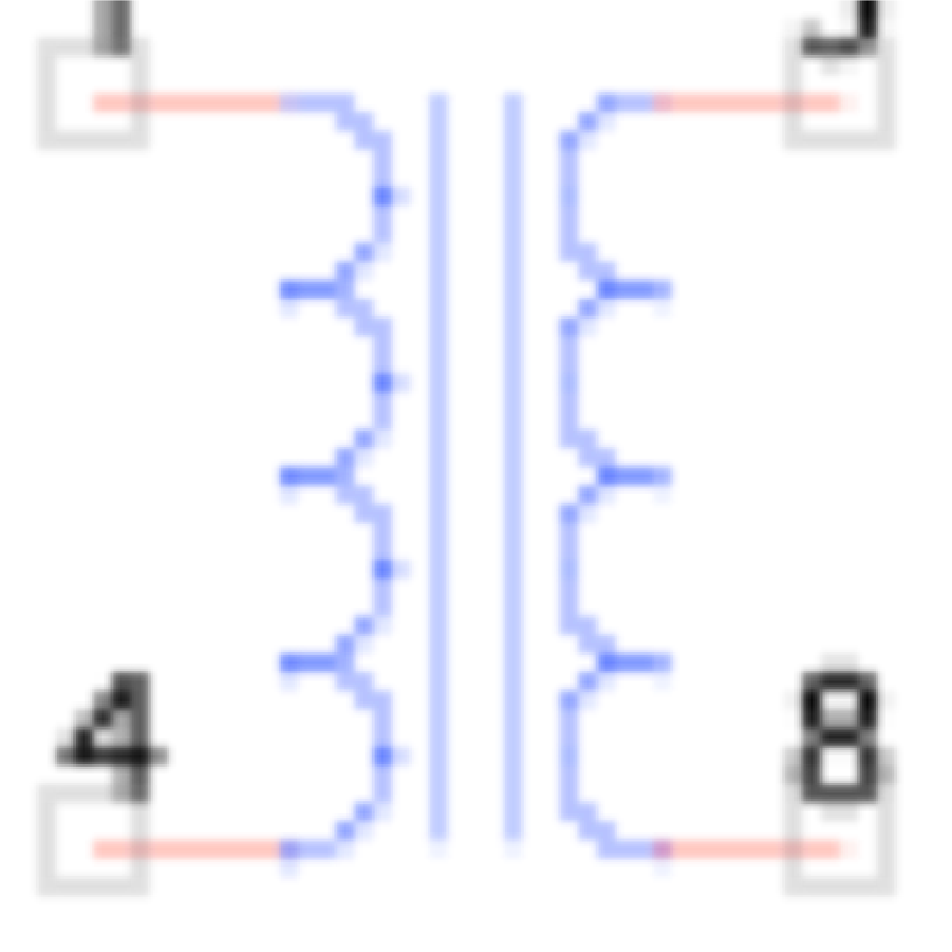
Digital Optical Module Block Diagram
Trigger (2)
10b
FPGA
ADC
Pulser
1 megabaud
DOR
Delay
x16
8b
DAC
ATWD
10b
LPF
x2
x0.25
CPU
+/-5V, 3.3V, 2.5V, 1.8V
DC-DC
ATWD
10b
x 2.6
x 9
fADC
10b
Configuration
Device
8Mbit
MUX
OB-LED
40 MHz
DP Ram
32b
SDRAM
16Mb
16Mb
(n+1)
LC
SDRAM
(n–1)
20 MHz
Flash
Flash
CPLD
16b
Monitor
& Control
Oscillator
4Mb 4Mb
Corning Frequency Ctl (was Toyocom)
8b
Flasher
Board
DACs & ADCs
PMT Power
64 Bytes
GTP, LBNL, 26 Mar, 2004
8b, 10b, 12b

Slide 25
Digital Optical Module Block Diagram
Trigger (2)
10b
FPGA
ADC
Pulser
1 megabaud
DOR
Delay
x16
8b
DAC
ATWD
10b
LPF
x2
x0.25
CPU
+/-5V, 3.3V, 2.5V, 1.8V
DC-DC
ATWD
10b
x 2.6
x 9
fADC
10b
Configuration
Device
8Mbit
MUX
OB-LED
40 MHz
DP Ram
32b
SDRAM
16Mb
16Mb
(n+1)
LC
SDRAM
(n–1)
20 MHz
Flash
Flash
CPLD
16b
Monitor
& Control
Oscillator
4Mb 4Mb
Corning Frequency Ctl (was Toyocom)
8b
Flasher
Board
DACs & ADCs
PMT Power
64 Bytes
GTP, LBNL, 26 Mar, 2004
8b, 10b, 12b

Slide 26
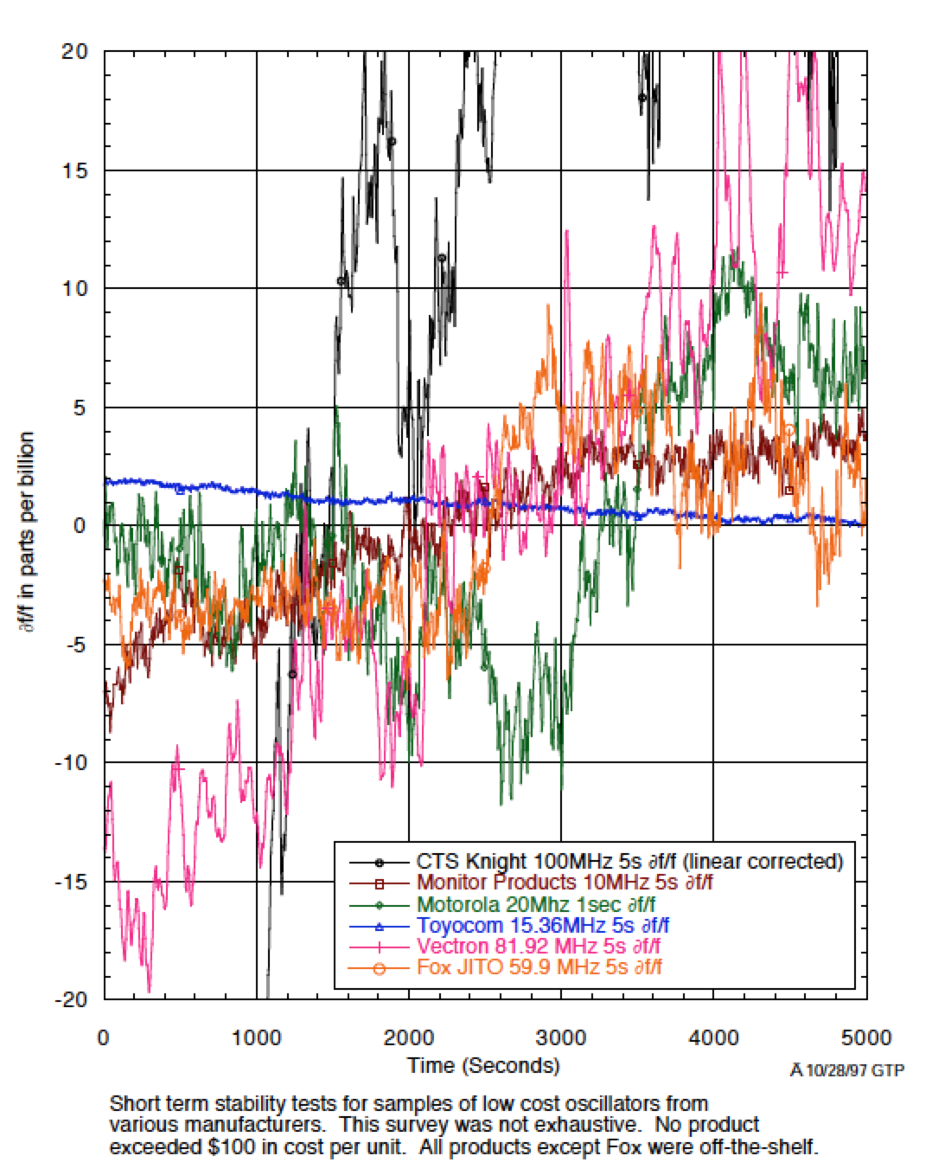
Jerry P set up a test bench for oscillators so we could measure the stability of various products
The winner:
Toyocom
incredible performance!

Slide 27
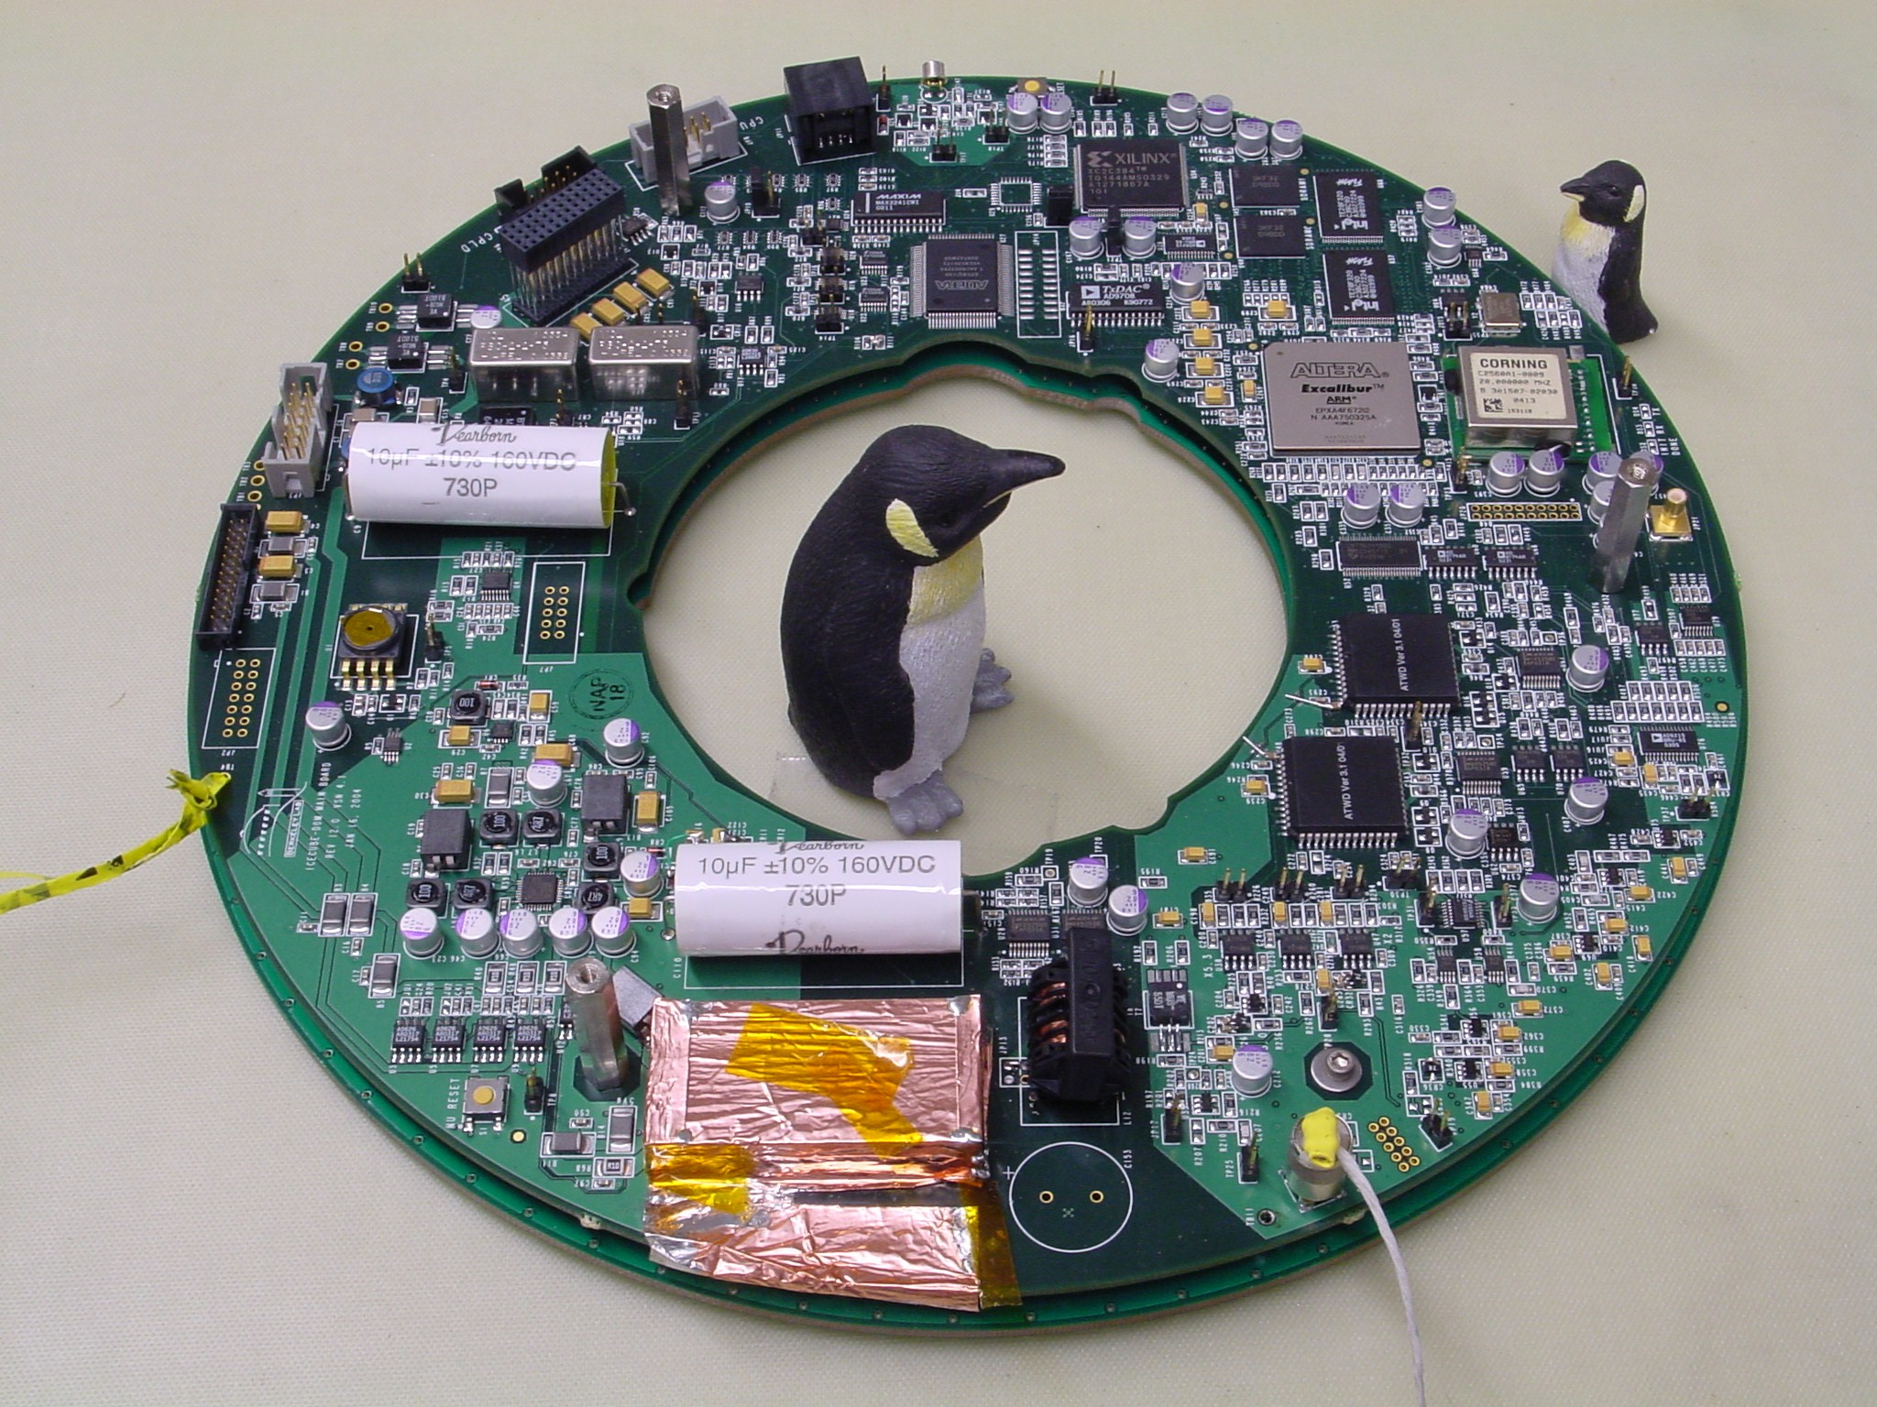
Rev 4.2

Slide 28
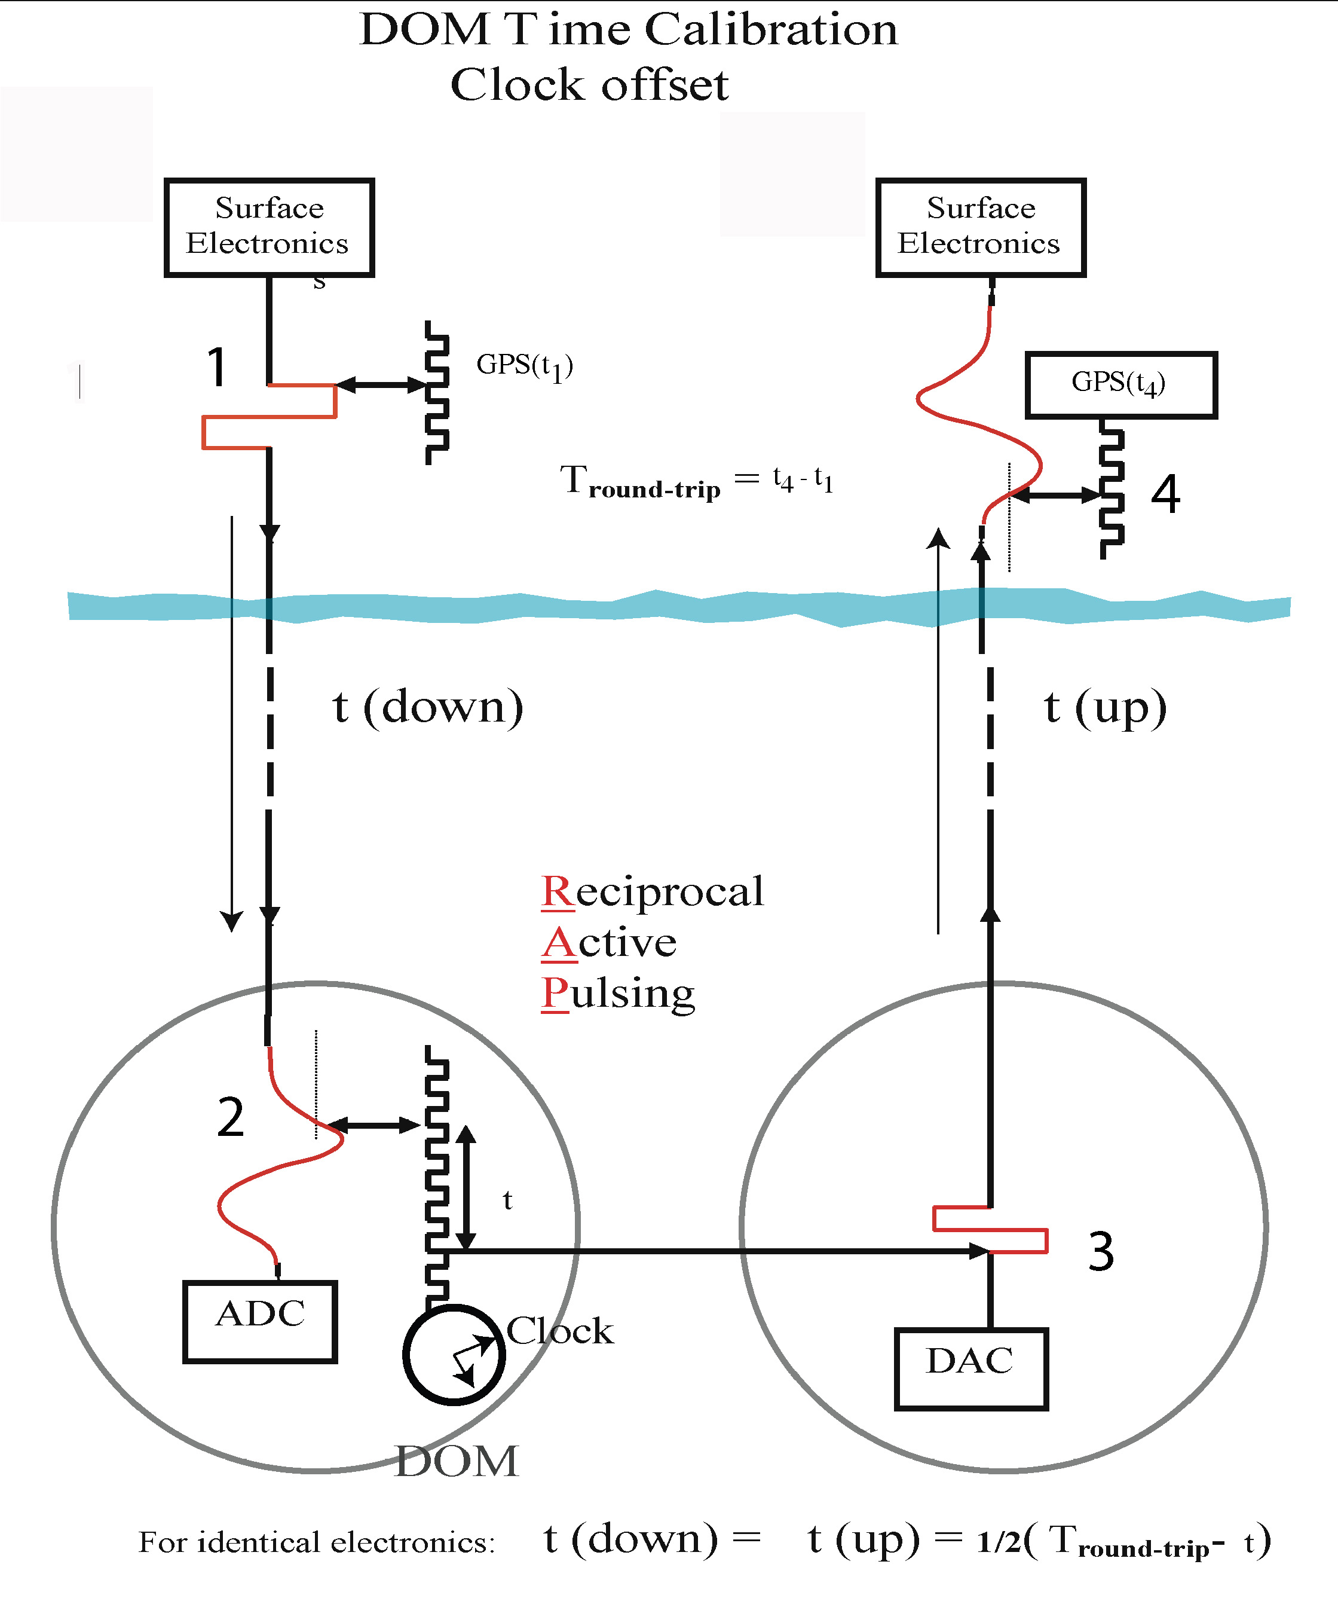
Reciprocal
Active
Pulsing
Calibration
“RAPCal”
- Bob Stokstad
A few times a second, each DOM receives and sends a special pulse to measure the cable length and phase of the local quartz oscillator

Slide 29
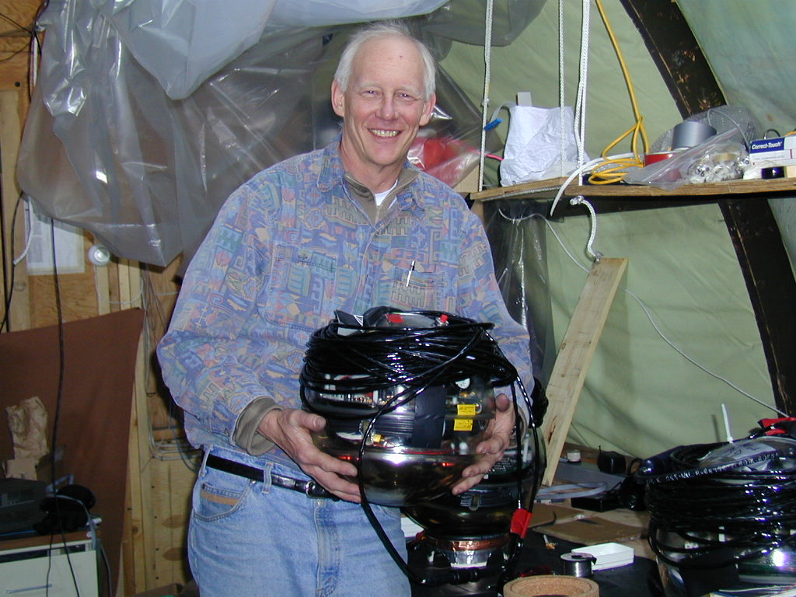
Bob Stokstad - with string 18 module

Slide 30
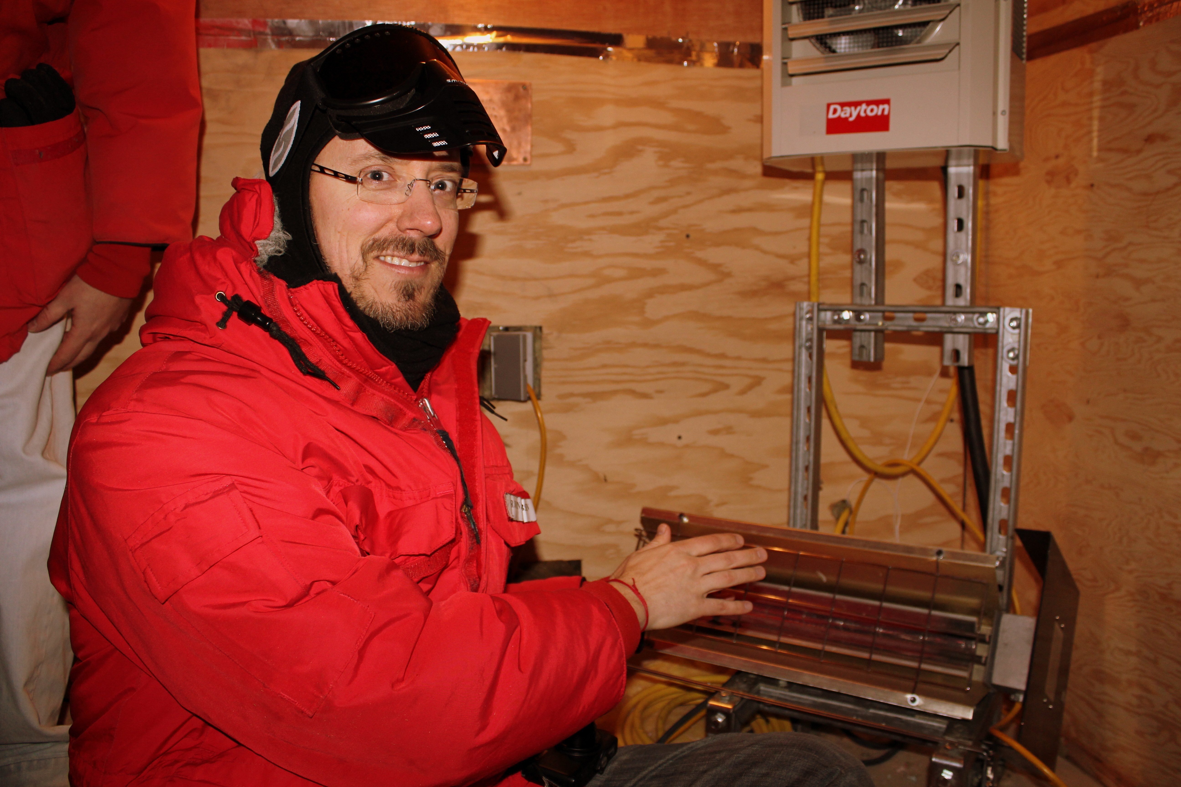

Slide 31
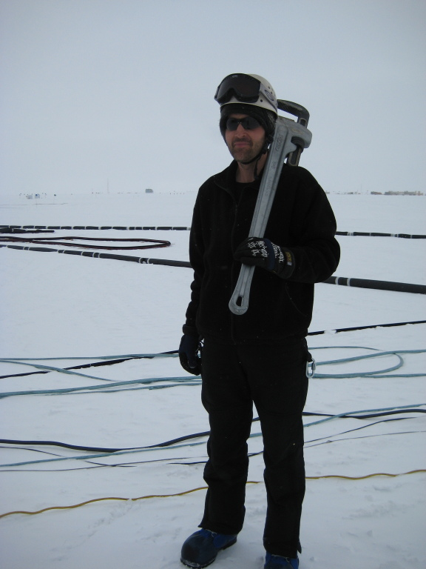
Thorsten Stezelberger,
on his way to make some on-site hardware calibrations

Slide 32
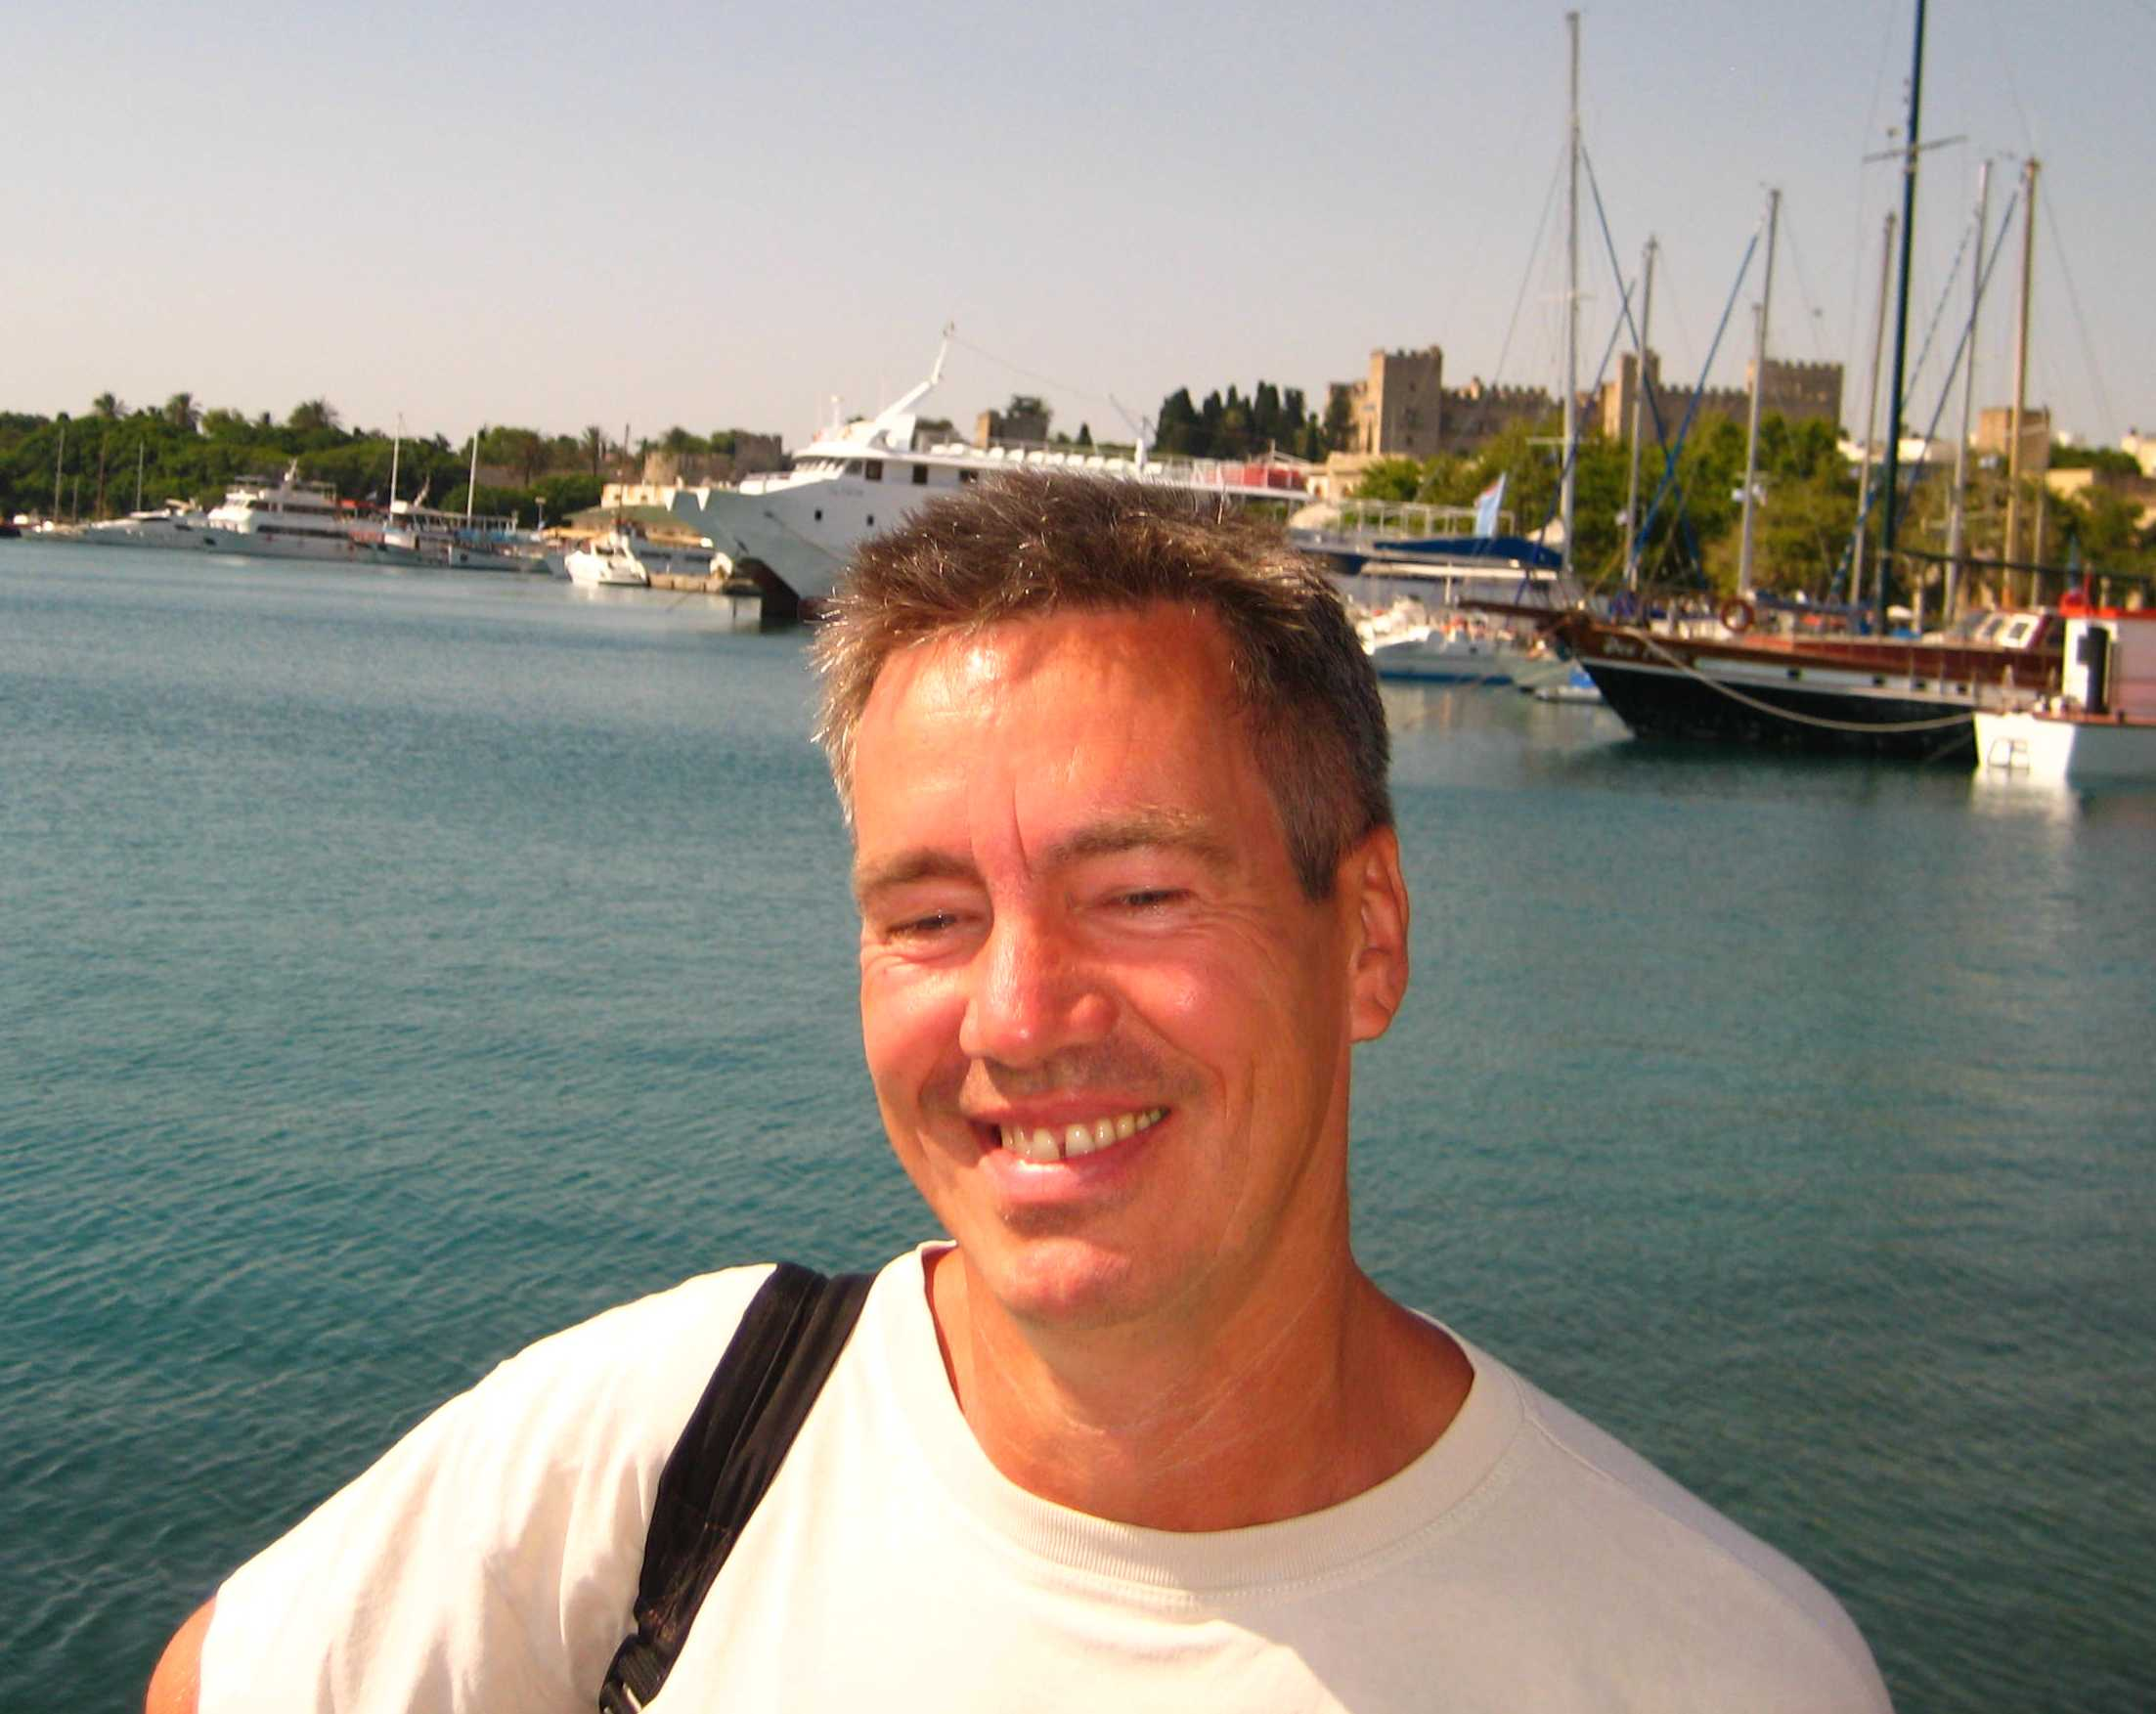
Kalle Sulanke (McMurdo?)

Slide 33
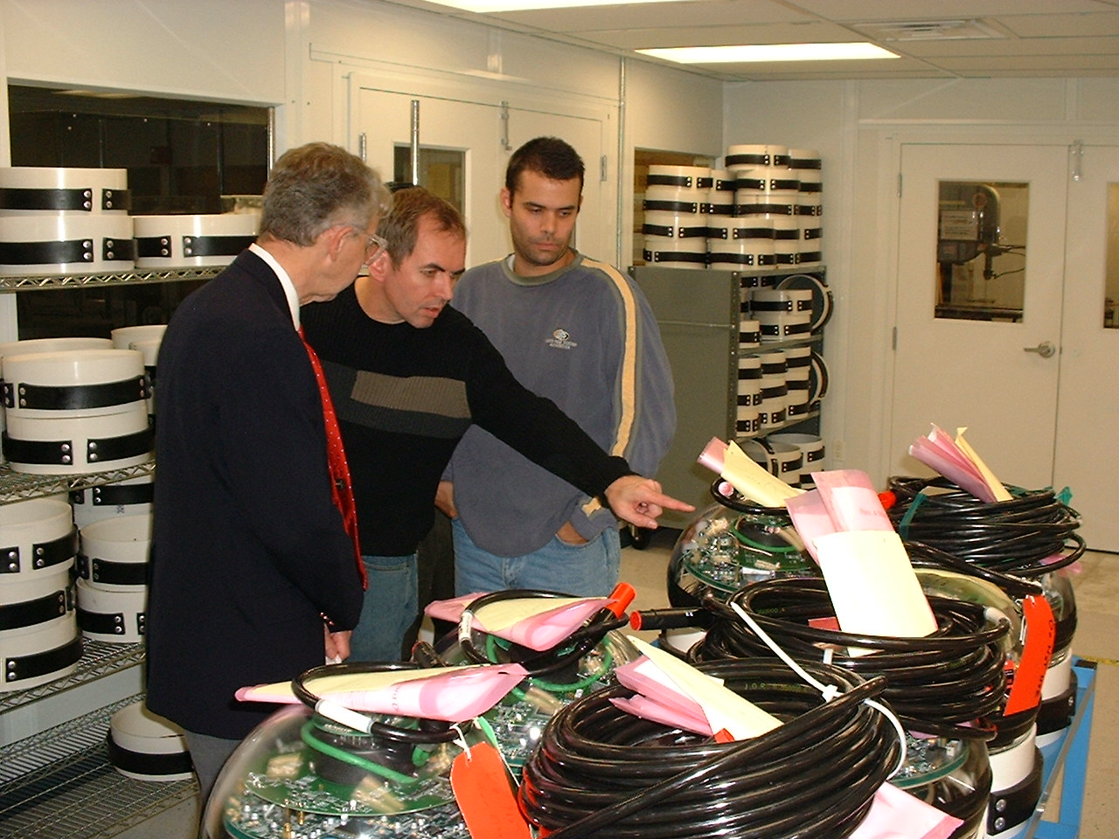
Don Hartill
Albrecht Karle
Kael Hanson

Slide 34
We Won!
We, somehow, survived countless reviews.
IceCube DAQ systems continue to work well
Stop that $#& ¥≠ power-cycling!

Slide 35
We Won!
We, somehow, survived countless reviews.
IceCube DAQ systems continue to work well
The Little Chip that Could, and Did is a great story, made possible by many people.
Stop that $#& ¥≠ power-cycling!

Slide 36
We Won!
We, somehow, survived countless reviews.
IceCube DAQ systems continue to work well
The Little Chip that Could, and Did is a great story, made possible by many people.
NESTOR → KamLAND → IceCube was not a planned sequence, but it all worked out !
Stop that $#& ¥≠ power-cycling!

Slide 37
We recall that this experimental field was started by
John Learned, with DUMAND
Thank you

