Slide 1

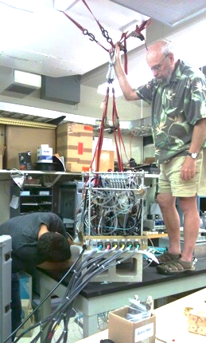
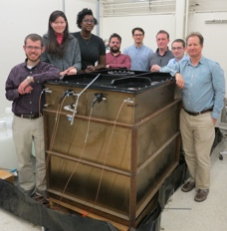
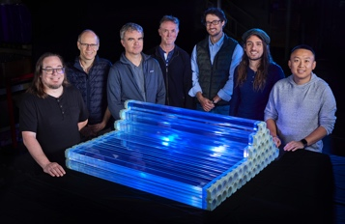
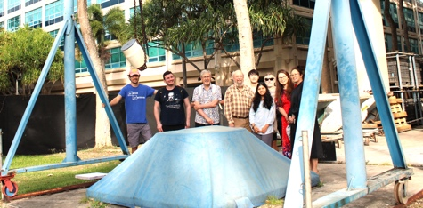
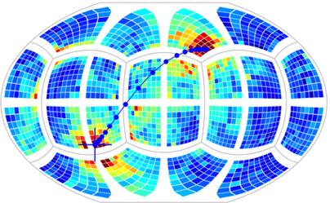
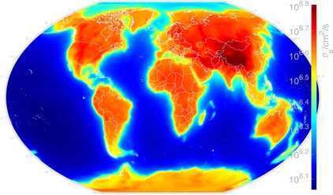
Neutrinos in Action: from miniTimeCube to Shaping the
World Nonproliferation Landscape
Workshop on Ghost Particle Hunting:
Neutrino Physics and its Applications to World Peace
University of Hawai`i
April 28 – May 3, 2025
Viacheslav A. Li
Rare Event Detection group
Lawrence Livermore National Laboratory
neutrinos.llnl.gov
La__

Slide 2
My first interaction with John
From: John G. Learned
Date: Fri, Dec 17, 2010
...
I have a small project building a very nice
2 liter neutrino detector for use near reactors....
it hopefully opens the door to a new type of anti-electron neutrino detection (including directionality).

Slide 3
My first interaction with John
From: John G. Learned
Date: Fri, Dec 17, 2010
...
I have a small project building a very nice
2 liter neutrino detector for use near reactors....
it hopefully opens the door to a new type of anti-electron neutrino detection (including directionality).

Slide 4
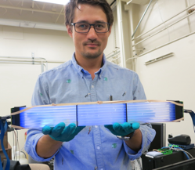
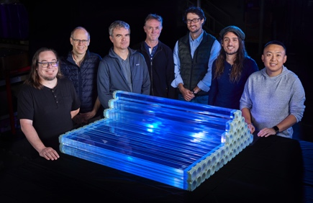
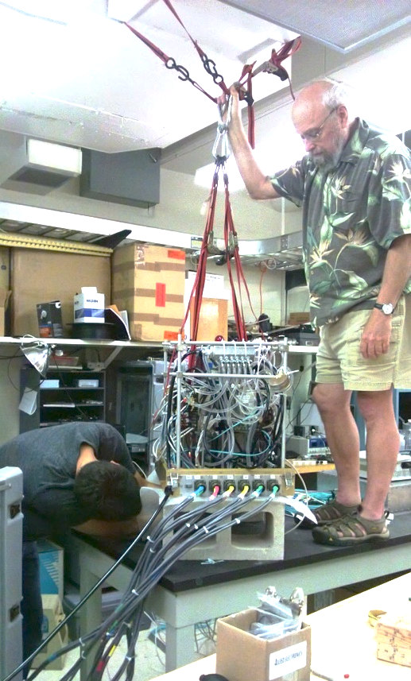

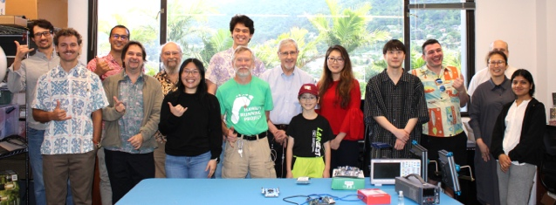
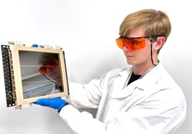
Time
LLNL aboveground detector R & D:
segmentation + ⁶Li + PSD + plastics
SANDD
ROADSTR
MAD
Call me John.
2025
Lawrence Livermore National Laboratory
CASC-NN*
Directionality (MTV consortium)
Water-based detection
AIT/WATCHMAN (see A. Bernstein’s talk)
BUTTON (see J. Coleman’s talk)
LAPPD/electronics
2018
University of Hawai`i — grad school
miniTimeCube
Neutron Time Camera
NuLat (see B. Crow’s talk)
2011

Slide 5
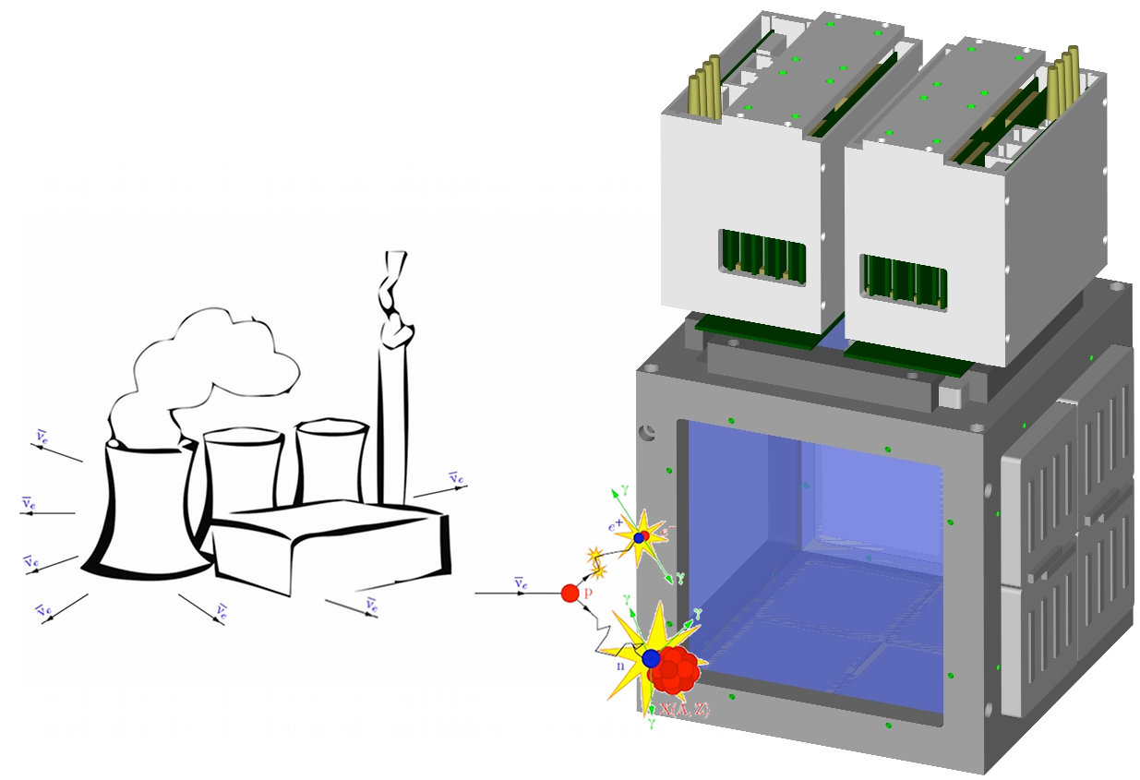
Nuclear reactors emit enormous amounts of ν_{e}
Inverse β decay since the 50s
Idea to use fast photosensors and fast electronics to detect first-photon arrivals: particle ID / imaging
miniTimeCube = 1536 pixels looking into 2-liter scintillator

Slide 6
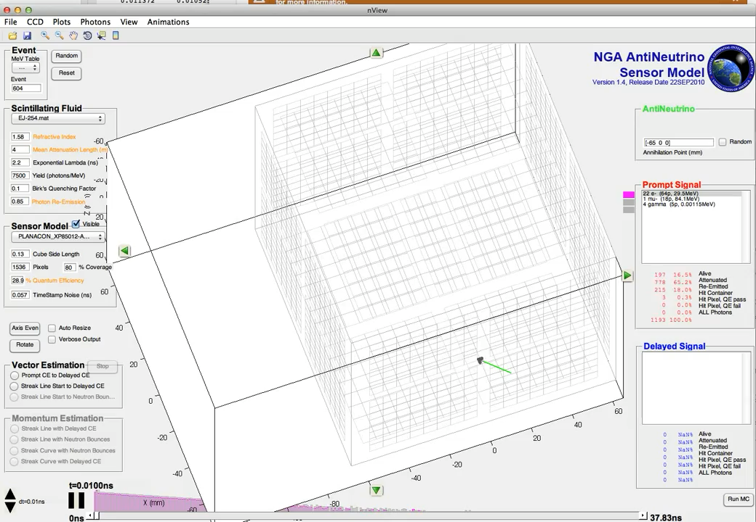
Idea and simulations

Slide 7
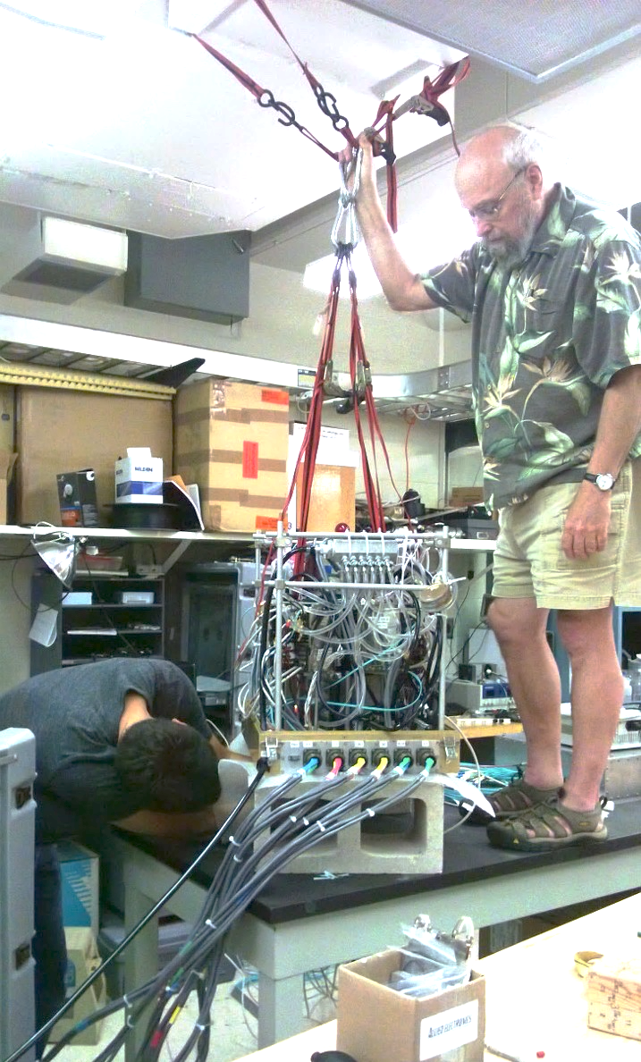
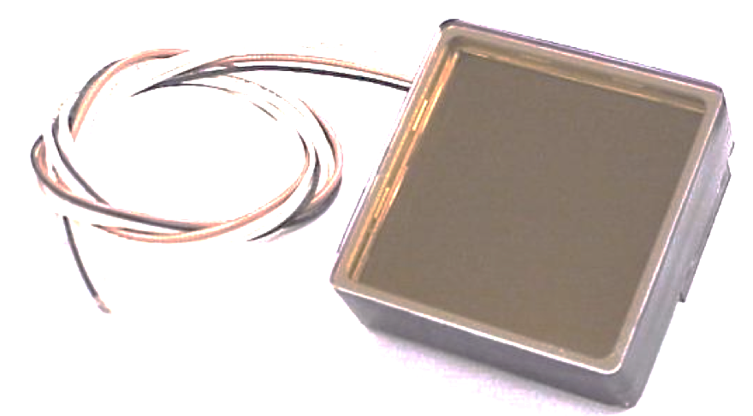
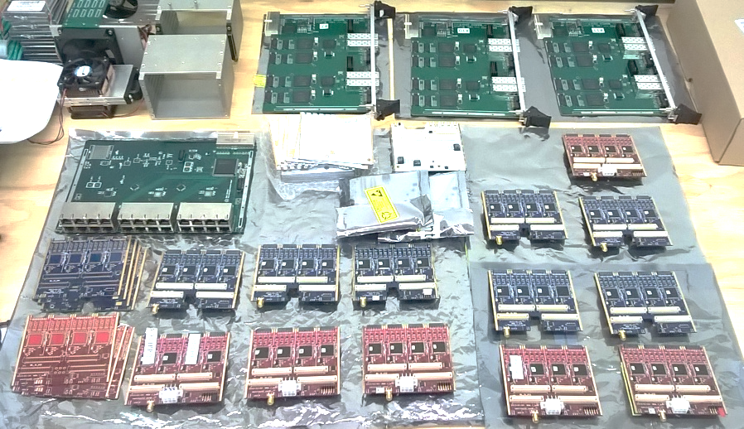
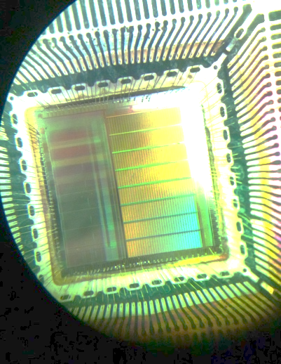
Construction and calibration
Using air duct to raise mTC.
Do not do it in your lab.
Use Gary Varner’s Belle electronics
Couple it with Photonis MA MCP-PMTs
Reality is not that simple
me

Slide 8
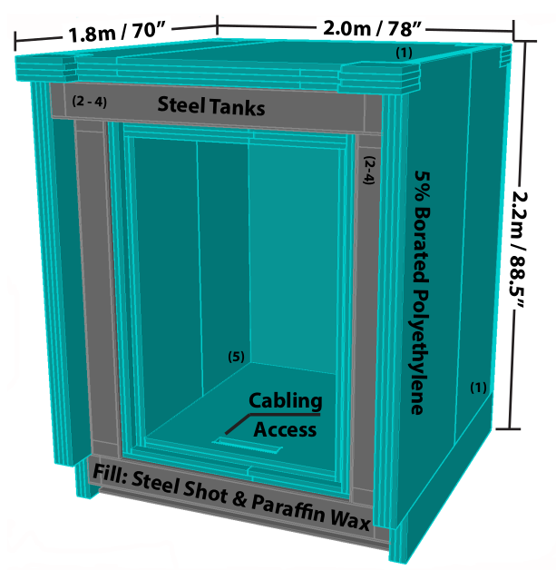
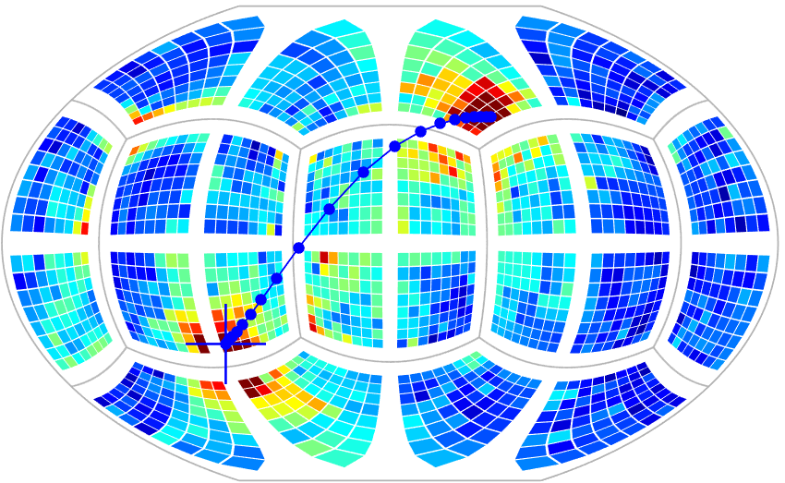
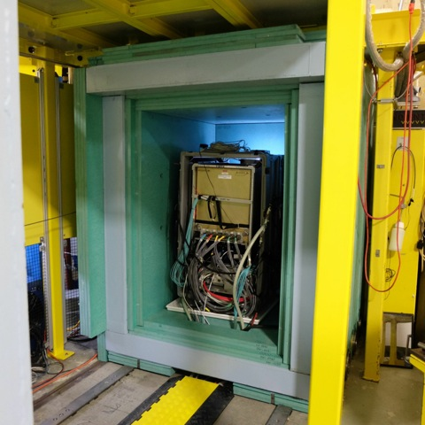
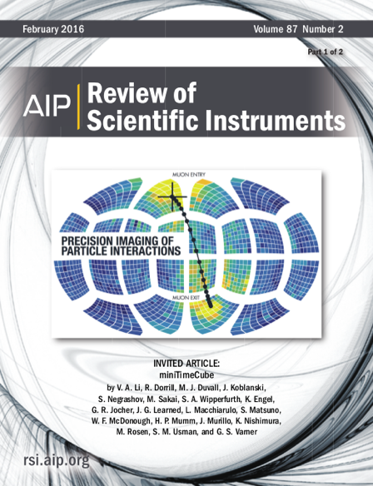
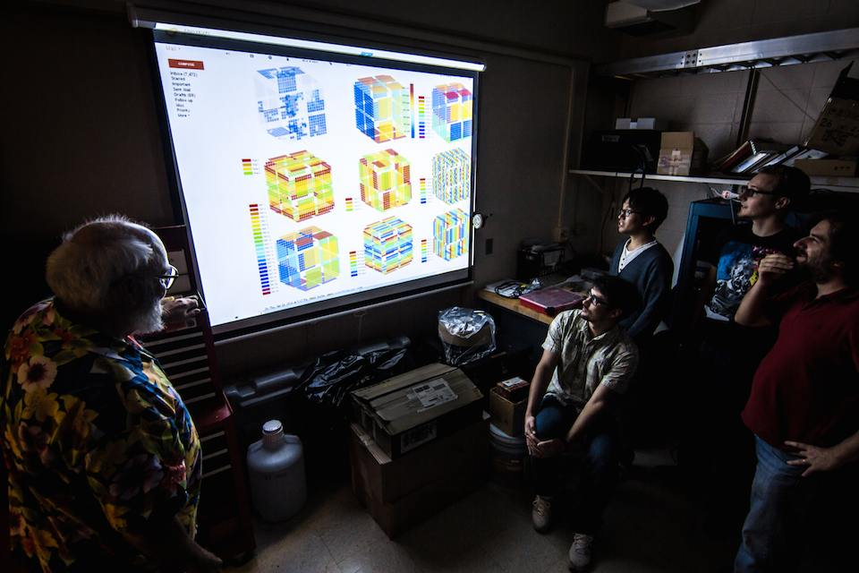
miniTimeCube — ahead of its time
Real data and deployment at NIST research reactor
Muon going through mTC
Distance 5 m to the core
Compact 20 MW core
While the project did not succeed in detecting neutrinos
in its first outing, many important lessons were learned.
Group meeting circa 2014
Rev.Sci.Instrum. 87 (2016) 2, 021301
AIP Adv. 8 (2018) 9, 095003
AIP Adv. 9 (2019) 3, 035301

Slide 9
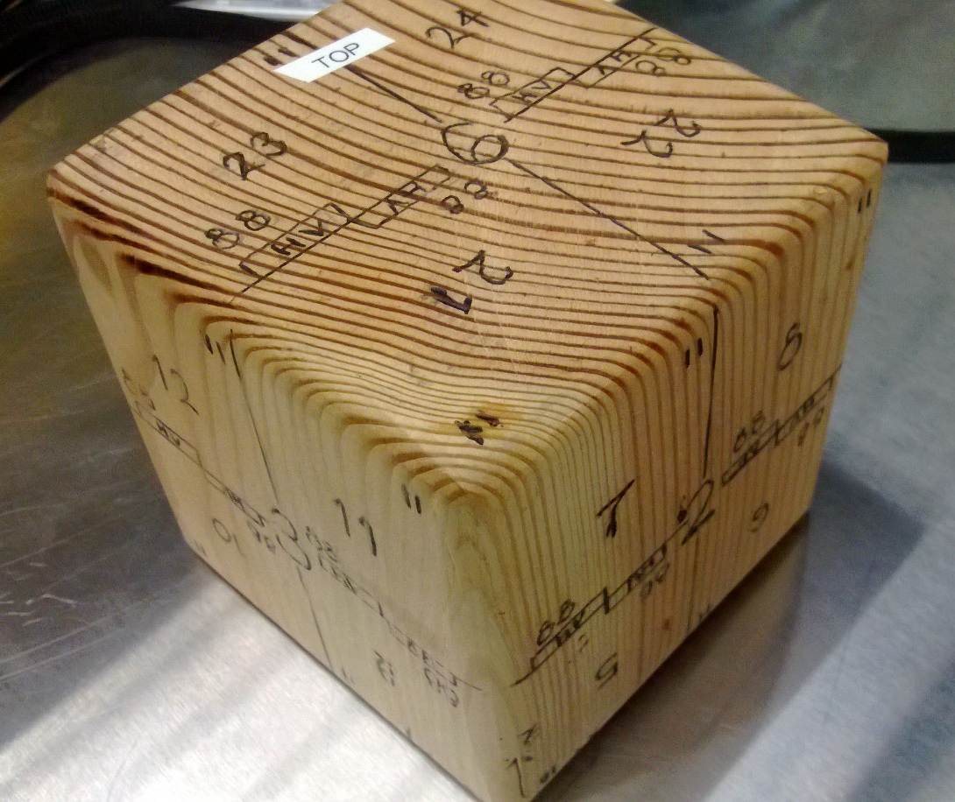

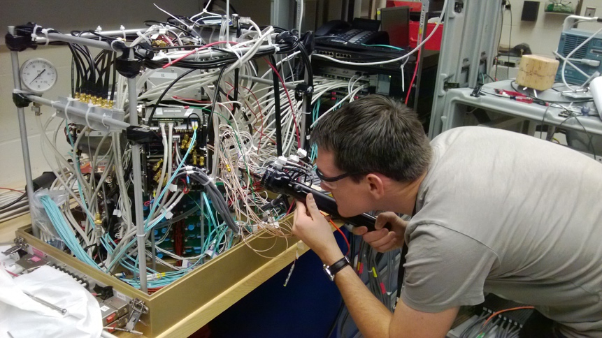
Cube made by John
This was the most used tool in the mTC era.
https://www.phys.hawaii.edu/~mtc

Slide 10
Joining LLNL
LLNL is now home to the world’s largest supercomputer El Capitan
The only place on Earth that can achieve ignition repeatedly
Nuclear nonproliferation and strategic deterrence — key missions
Visit LLNL.gov to learn more

Slide 11
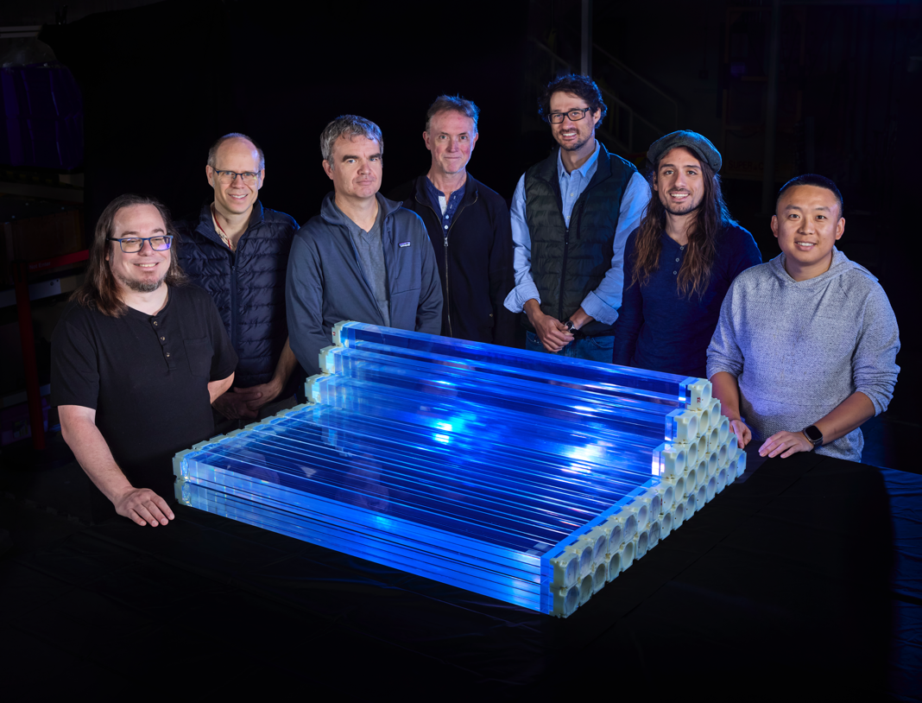
⁶Li and PSD in plastic scintillator and its advantages
Invented at LLNL in 2010s by N. Zaitseva
Material scale-up by Eljen to multi-kg pieces
Basis for multiple neutron and neutrino systems at LLNL
Main advantages:
⁶Li — localized capture location
PSD — background rejection based on particle ID
Plastic — ease of handling and deploying
This part of the talk will focus on the path towards realization of a reactor antineutrino detector.

Slide 12
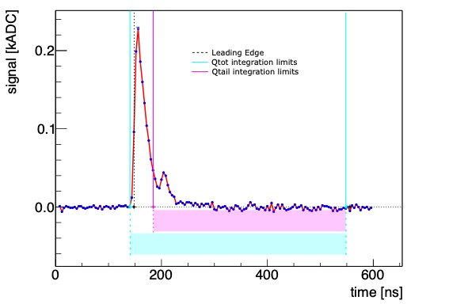
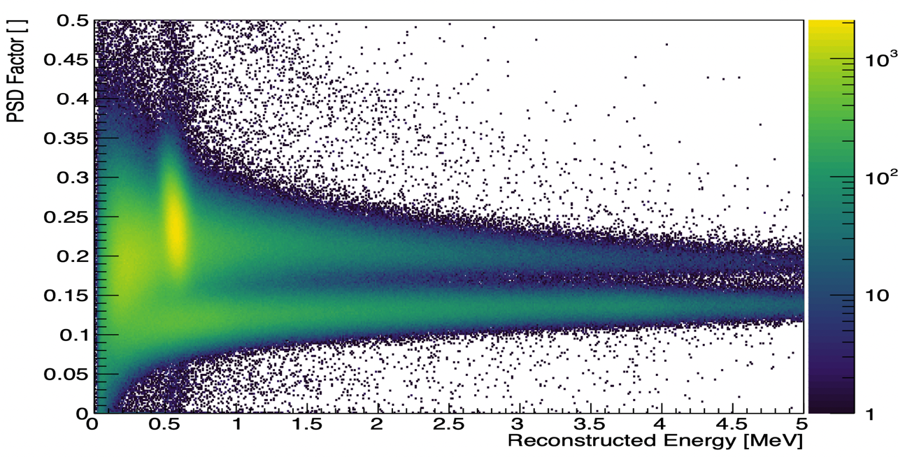
Essence of Pulse-shape sensitivity and lithium-6
ν_{e}
γ
Tail and Total time windows
define PSD factor
¹H
511 keV
e–
e⁺
γ
Data obtained with a ²⁵²Cf fission source
511 keV
Prompt Light
[Electronic Recoil for PSD]
⁶Li
Thermal-Neutron Captures
n
⁶Li concentration
0.1% by weight:
~88% captures on ⁶Li
~12% captures on ¹H
Nuclear recoils
³H
Electronic recoils
⁴He
2.73 MeV
2.05 MeV
Delayed Light
[Nuclear Recoil for PSD]
PMT
PMT
Quenched energy ~0.5 MeV electron equivalent
Scintillator

Slide 13






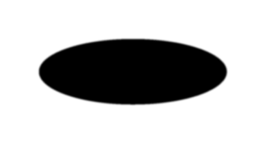
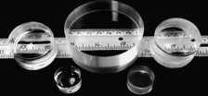
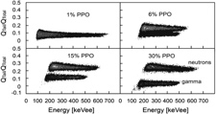

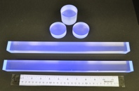
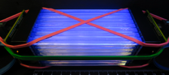
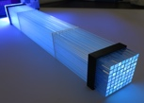
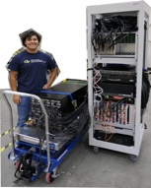
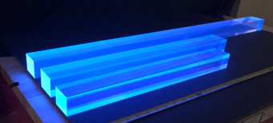
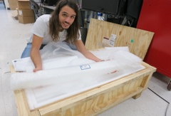



Scintillator Formulation
Decade of R&D
Monomer
for matrix
Co-monomer
for solubility
Co-monomer for crosslinking
Secondary dye
Monomer – styrene or vinyl toluene
  [Building block for a scintillating polymer]
PPO – primary dye, also provides PSD
Secondary dye – shifts light to deep blue (425nm)
⁶Li salt – provides ⁶Li
Co-monomer – methacrylic acid organic compound to dissolve ⁶Li salt
Cross-linker – helps polymerization achieve hard structure
Antioxidant – prevents degradation from air exposure
Exacting temperature control during curing in glass molds
Primary dye
⁶Li salt
Add initiator for curing
Control:
• temperature ramp
• curing time
• oxygen content
Add components
Control:
predissolution
weight percentage
temperature
2012
2013
2016
2019
2021
2023
2024-present
Plastic scintillators with efficient neutron/gamma pulse shape discrimination.
Zaitseva et al. NIM A668.
First stable ⁶Li-doped PSD scintillators developed at LLNL.
Zaitseva et al. NIM A729.
R&D: stability, formulation, doping level, PPO level, etc.
Mabe et al. NIM A806.
1st successful casting of ⁶Li PSD at ~1-liter scale.
Mabe et al. AAP 2018.
SANDD: SiPM-array readout and PSD
Li et al. NIM A942.
SANDD: LLNL Exploratory Research to study feasibility of 10-liter detector and PSD with SiPM-array readout
Sutanto et al. NIM A1006.
Ford et al. NIM A1050.
Material scaling at Eljen: EJ-299-50.
Roca et al. arxiv:2405.19573.
Arrival of new material for MAD 2D

Slide 14

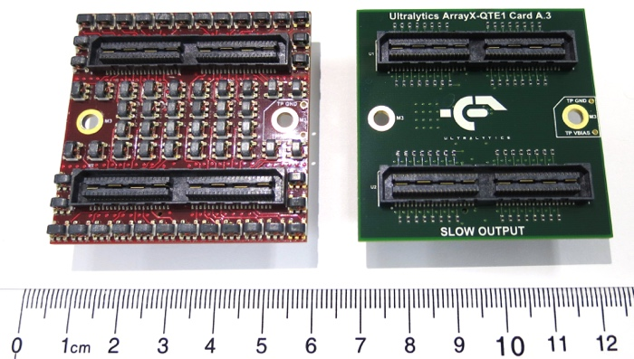
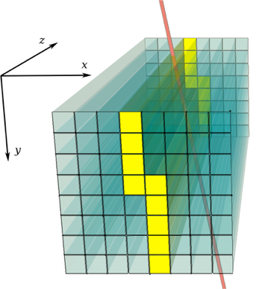
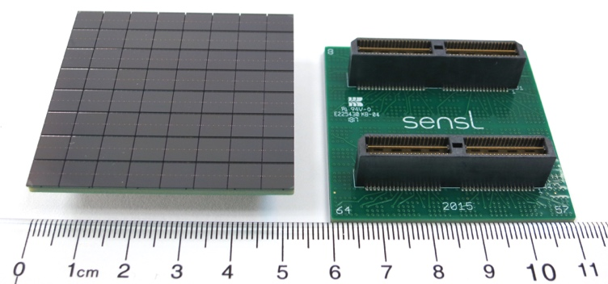
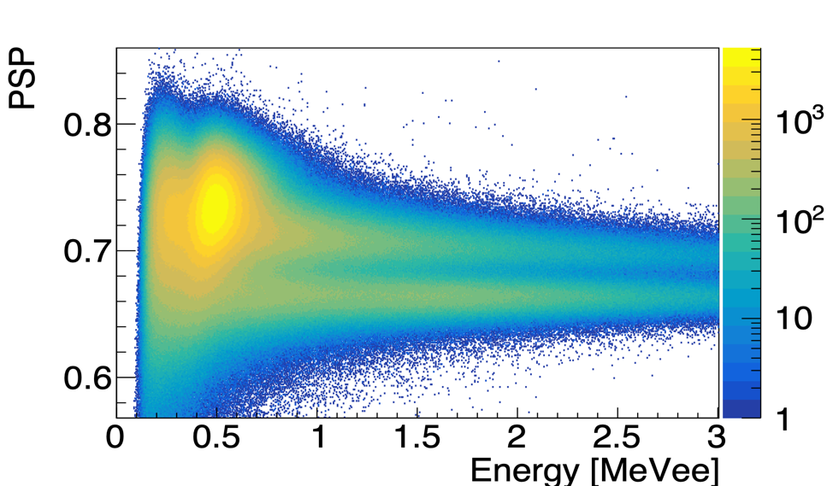
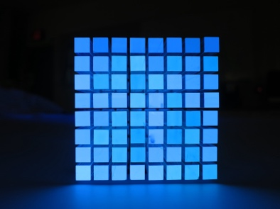
Starting small: Feasibility of using SiPM arrays
SANDD/iSANDD
Central module of SANDD
64 bars with SiPM arrays
[data with ²⁵²Cf source]
thermal neutrons
fast neutrons
gamma-rays
First system to show PSD in segmented fully instrumented detector with SiPM arrays (128 channels)
Nucl.Instrum.Meth.A 942 (2019) 162334
Nucl.Instrum.Meth.A 1006 (2021) 165409

Slide 15
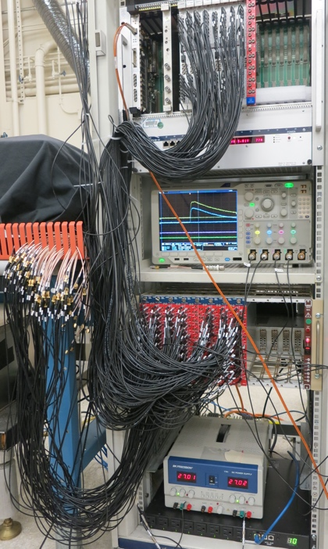
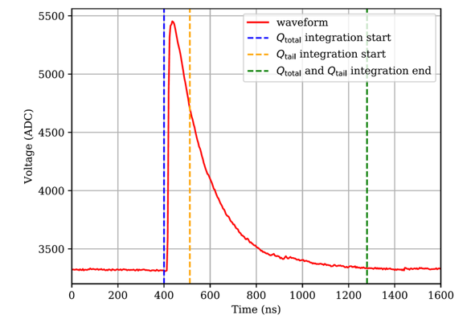
Adding compact electronics
PSD determination using split signals — Head and Total
TOTAL
HEAD
Q_{tail} = Q_{total} – Q_{head}
Future multi-channel detectors would require low-power, low-cost, fast-timing electronics
PET-scanner 256-channel SiPM-readout electronics (expandable beyond 1,000 channels)
Neutron imaging shows promise but the PSD in QT extraction readout is inferior to full-waveform readouts.
Nucl.Instrum.Meth.A 1046 (2023) 167624
Nucl.Instrum.Meth.A 1057 (2023) 168699

Slide 16
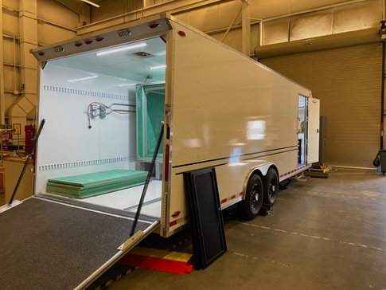
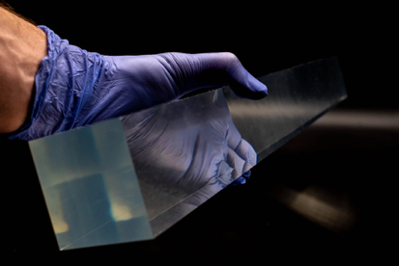
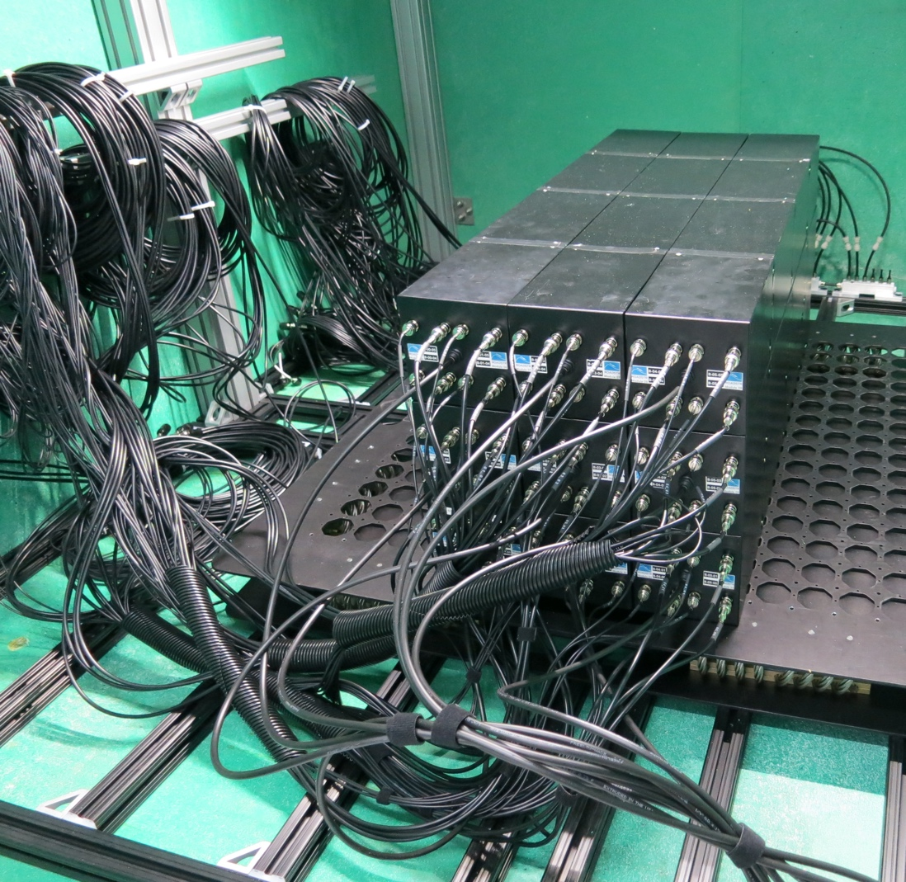
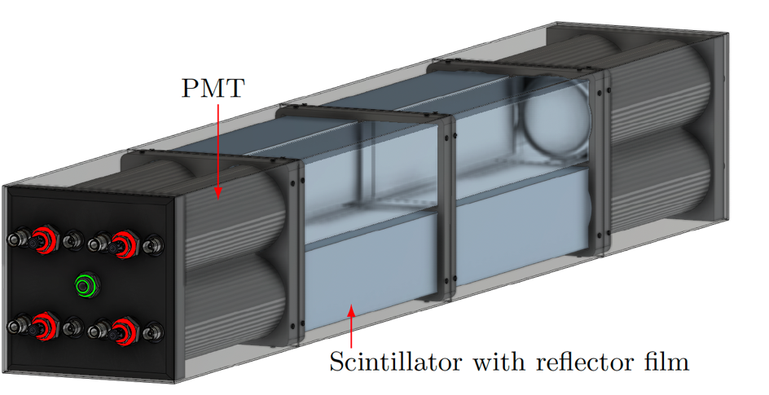
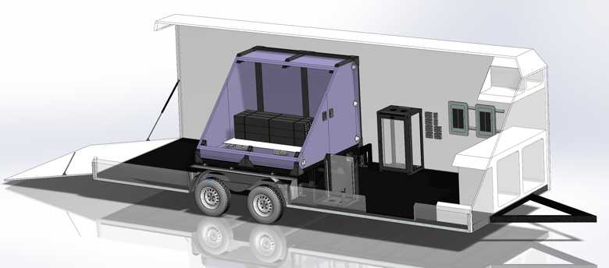
Advancing towards practical aboveground systems — ROADSTR
PROSPECT-style 6 x 6 array realized in ⁶Li PSD plastic
60-kg prototype using scaled-up Eljen EJ-299-50
Characterizing scintillator properties & performance
Understanding
backgrounds
Each module has 4 scintillator segments.
Each scintillator segment: EJ-299-50 bar
55mm X 55mm X 50 cm
with dual-ended 2” PMT readout
(H11284-100 assembly, optical grease EJ-550)
Nucl.Instrum.Meth.A 1050 (2023) 168093
Nucl.Instrum.Meth.A 1069 (2024) 169916

Slide 17
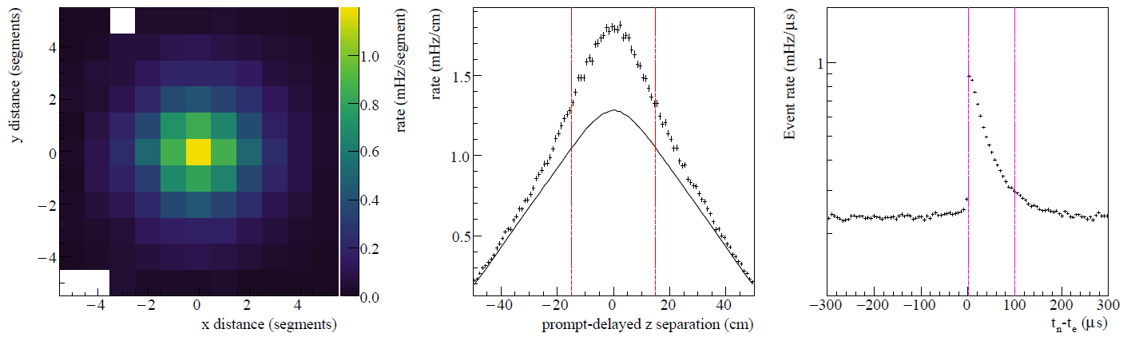
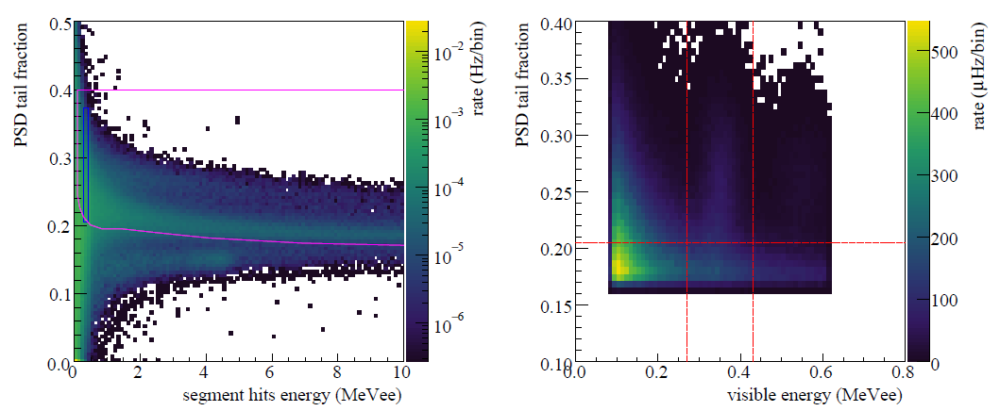
PROSPECT-style IBD-like event selection: position, timing, and PSD
PROMPT-DELAYED position and timing:
XY: same or in adjacent 8 segments
Z: 15 cm in Z
T: (1.2, 100) us
PSD
PROMPT:
E: (1, 7.5) MeV
PSP: outside magenta region
PSD
DELAYED:
E: ±3 sigma energy mean
PSP: ±2 sigma PSP mean

Slide 18


Projected performance if deployed at 25 m, ~3GWt
⁴⁰K: 1.4 MeV
²⁰⁸Tl: 2.6 MeV
¹²C* 4.4 MeV
Encouraging results for a 60-kg detector!

Slide 19





ROADSTR background studies in different configurations
— bare
Multiplicity of thermal-neutron-capture
candidates within a 100-us window
IBD-like correlated backgrounds
— lead bricks
— basement
no shield + O(10) mwe
— poly stack
— lead+bpoly
— lead bricks: naturally increase correlated neutron background (muon-induced spallation)
— lead+bpoly: adding bpoly reduces both neutron multiplicity and correlated component
— bare: inside the main borated-polyethylene (bpoly) shield
— poly stack: neutron capture multiplicity similar to bare, while prompt backgrounds slightly reduced
— basement: significantly lower backgrounds, while neutron component is increased
ROADSTR is able to measure neutron-capture correlations — detailed background study is under preparation.

Slide 20



CASC-NN* — Test site transparency
Ensuring that there are no neutrinos (no fissions)
Connection to the original proposal by Reines et al.
* Comprehensive Antineutrino Solutions for Contemporary Nonproliferation Needs
ROADSTR is currently taking data at the Nevada Test Site to better understand backgrounds.
CONFLUX software: arXiv:2503.18966

Slide 21
ROADSTR summary
60-kg system constructed and operational, taking data since 2022
Technology cooperation with Eljen (scaled-up EJ-299-50 material)
Capable of measuring neutron-capture correlated events
Shows useful sensitivity despite small volume (paved the way to a larger detector)
Only using naturally occurring backgrounds for calibration (cosmogenic muons, neutrons, BiPo, ¹²B beta)
Currently deployed in P-tunnel (test site transparency)
Important lessons learned to proceed to the larger detector!

Slide 22




Going to ton-scale. Meet:
Mobile Antineutrino Demonstrator
2D: ⁶Li+PSD
8x8 bars (EJ-299-50)
Each 6 x 6 x 100 cm³
128 PMTs
0.2 m³
3D: LiZnS+WLS
16x16x25 half cubes (EJ-260)
832 PMTs
0.6 m³
Hybrid 2D + 3D approach in a shipping container

Slide 23


MAD-2D scintillator encapsulation
In ROADSTR, minor PPO leaching was observed, leading to crystal formation on the surface and degradation of TIR. As a mitigation, in MAD, we encapsulate the bar.
Lots of work: encapsulating scintillator in 1-mil tape and reflector
reflector
air
film
adhesive
Scintillator
Acrylic light guide
PMT locating collar

Slide 24



MAD-2D status and plans
Finish construction this summer
Integrate in the full MAD
Deploy the full system by the nuclear reactor
Above-ground near-field measurement campaigns
World’s largest ⁶Li PSD plastic scintillator stockpile
MAD is a multi-institutional project. Stay tuned for more exciting updates.

Slide 25


Modern Neutrino Detectors and recent advances by our LLNL group
Detection medium:
  Plastic PSD Scintillator (Performance of large-scale 6Li-doped pulse-shape discriminating plastic scintillators NIMA 1069 (2024) 169916)
  Liquid PSD (6Li-loaded liquid scintillators produced by direct dissolution of compounds in diisopropylnaphthalene NIMA 1054 (2023) 168389)
  Water (A long path-length optical property measurement device for highly transparent detector media JINST 18 (2023) 09, P09004, Exclusion and Verification of Remote Nuclear Reactors with a 1-kiloton Gd-Doped Water Detector Phys.Rev.Applied 19 (2023) 3, 034060)
  WbLS (Pulse-shape discrimination in water-based scintillators NIMA 1036 (2022) )
Photosensor:
  PMT (Improvement in light collection of a photomultiplier tube using a wavelength-shifting plate NIMA 1040 (2022) 167207)
  MA MCP-PMT (Studies of MCP-PMTs in the miniTimeCube neutrino detector, AIP Adv. 8 (2018) 9, 095003)
  MA MCP-PMT (LAPPD) (next in this talk)
  SiPM (A prototype for SANDD: A highly-segmented pulse-shape-sensitive plastic scintillator detector incorporating silicon photomultiplier arrays NIMA 942 (2019))
Electronics:
  Feature-extraction (Q/T) (Calibration of a compact ASIC-based data acquisition system for neutron/γ discrimination and spectroscopy with organic scintillators NIMA 1057 (2023) 168699)
  Full-waveform (next in this talk)
Data analysis / simulations / ML:
  GEANT4 / RAT-PAC (Scalability of Gadolinium-Doped-Water Cherenkov Detectors for Nuclear Nonproliferation Phys. Rev. Applied 18, 034059 , Physics-informed machine learning approaches to reactor antineutrino detection, Directional response of several geometries for reactor-neutrino detectors Phys.Rev.Applied 22 (2024) 5, 054030, Ratpac-Two v1.0.0 https://doi.org/10.11578/dc.20240620.8 )
LLNL triple-PSD in water
And others outside of this talk. Visit NEUTRINOS.LLNL.GOV → to learn more.

Slide 26


Water-based detection
1-ton prototype
AIT-WATCHMAN LLNL group (circa 2019)
Key to scaling to O(1 kt) detectors
Factor of a 1,000 less photons compared to scintillators
Can we used Gd-doped water for far-range reactor monitoring?
New instrumentation (WbLS/LAPPD/electronics)
20 km
60 km
Map to show scale.
This part of the talk will focus on the water-Cherenkov detection and instrumentation.

Slide 27

A 50-MW reactor in different geographical locations
Three locations selected — range largely dominates by the world’s background.
Phys. Rev. Applied 18 (2022) 034059.

Slide 28
Sensitivity to detect a 50-MW reactor
Detecting a small 50-MWt reactor at a large distance depends primarily on the world reactor background at that location.
Phys. Rev. Applied 18 (2022) 034059.

Slide 29




Instrumentation with LAPPDs
LAPPD gen 1 and gen 2 — main difference
64 SMA connectors at the back and 5 SHV connectors.
Strips → Pads
Cross → Ribs
Intern James Foot holding LAPPD gen 2 #133
The new design allows for custom size and shape of anodes (pixelization) but how to read them?

Slide 30


Fast-timing: miniTimeCube era and why we need fast timing
Fast-timing allows better track reconstruction
Cherenkov and Scintillation light separation
Trade-offs: pixel size, photocoverage, and cost
Cherenkov light in mTC (MA MCP-PMTs)
For pure liquid scintillator we likely don’t worry (scintillation dominant), but for WbLS it is valuable.

Slide 31




Electronics
Can we reach the $10/channel?
How many channels?
Readout in situ?
Track&Hold principle
8-channel IceRingSampler
4-channel AARDVARC eval board (SN 000!)
Connection to UH: Prof. Gary Varner’s dream of “oscilloscope on a chip”.

Slide 32




Test stand for LAPPD gen 2 at LLNL
Picosecond laser
Collimators
1:1 splitter
XY stepper motor
Automated scans
LED and laser
laser
from idea to implementation:
Laser fiber
The setup is robust and allows for X-Y alignment of the laser beam.

Slide 33
SPE data with fast Tektronix scope and picosecond laser
Scope traces
Time delay with respect to laser controller
Time delay between two pixels
Gain: 10⁶ – 10⁷. Jitter: sub-100 ps (single pad), ~100 ps (multipad).

Slide 34

SPE data with NaluScope (AARDVARC 000 SOC)
Waveforms (AARDVARC)
Nalu electronics tour
Time delay between two pixels
This is the first time LAPPD gen 2 has been readout with AARDVARC SoC.

Slide 35
Current work on LAPPD and fast-timing readout
First Readout of LAPPD Gen 2: Successful integration with AARDVARC and HDSoC.
Initial Test Results: Promising performance of new photosensors and electronics.
Future Development: Significant R&D efforts anticipated for a full-scale detector.
Ongoing Tests at LLNL: Cross-talk evaluation.
Looking ahead:
Exploration of New Ideas: Focus on cost-effective underwater and ground detectors.
Development of Test Stands: For photosensors, electronics, and detection media.
R&D Initiatives: Investigating novel techniques, materials, and engineering solutions.
Utilization of Simulation and High-Performance Computing: To enhance detector design and performance.
Photosensors and fast-timing electronics are advancing.

Slide 36

Applied Antineutrino Physics workshops
# | Year | Venue | Website | Materials
1 | 2004 | Hawai’i | https://www.phys.hawaii.edu/~jgl/nacw.html | Presentations
2 | 2005 | Hawai’i | https://inspirehep.net/literature/1644476
3 | 2006 | Livermore | https://neutrinos.llnl.gov/workshops/aap2006 | Presentations
4 | 2007 | Paris | https://inis.iaea.org/collection/NCLCollectionStore/_Public/39/107/39107638.pdf | AAP2007
5 | 2009 | Angra | https://www.cbpf.br/~angra/files/AAP2009/ | Presentations
6 | 2010 | Sendai | https://www.awa.tohoku.ac.jp/AAP2010/ | Presentations
7 | 2011 | Vienna | https://apc.u-paris.fr/APC_CS/Conferences/AAP2011/Program.html | Presentations
8 | 2012 | Hawai’i | https://www.phys.hawaii.edu/~jgl/AAP/AAP_2012_Agenda.htm | Presentations
9 | 2013 | Seoul | https://indico.cern.ch/event/245969/ | Presentations
10 | 2014 | Paris | http://aap2014.in2p3.fr/ | Presentations
11 | 2015 | Virginia | http://aap2015.phys.vt.edu/ Timetable at Virginia Tech Indico | Presentations
12 | 2016 | Liverpool | https://hep.ph.liv.ac.uk/aap2016/ | Presentations
13 | 2017 | Mumbai
14 | 2018 | Livermore | https://neutrinos.llnl.gov/workshops/aap2018 https://arxiv.org/abs/1911.06834 | Presentations
15 | 2019 | Guangzhou | https://spe.sysu.edu.cn/aap2019/ Timetable at CERN Indico | Presentations
16 | 2023 | York | https://indico.ph.liv.ac.uk/event/1195/ | Presentations
17 | 2024 | Aachen | https://aap2024.physik.rwth-aachen.de/
Repository of 20+ years of material.
https://www.phys.hawaii.edu/aap/
https://arxiv.org/abs/2411.13461

Slide 37




IBD directionality — MTV consortium
Stay tuned (more interesting work is coming up)
Phys. Rev. Applied 22 (2024) 054030

Slide 38


Conclusion
The field of Applied Antineutrino Physics is advancing.
Strong connection to Hawai`i
⁶Li PSD plastic scintillators and fast compact high-channel-density electronics offer unique capabilities for reactor antineutrino monitoring.
Mahalo nui loa, John!

Slide 39
Back-up

Slide 40


CANS-NN
Test Site Transparency
Multiple technologies are currently being evaluated for test site transparency and maritime reactors.

