Slide 1
Cooperative monitoring of reactors using antineutrinos
Niche but important applications in nuclear arms control and nonproliferation
– which, who knows, might one day lead to World Peace
Adam Bernstein, Vienna Center for Nonproliferation and Disarmament
Festschrift für Professor John G. Learned 2025

Slide 2
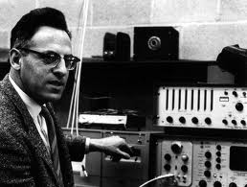
Foreshadowing
“I don’t say that the neutrino is going to be a practical thing, but it has been a time-honored pattern that science leads, and then technology comes along, and then, put together, these things make an enormous difference in how we live.”
Fredrick Reines, winner of the Nobel Prize and co-discoverer of the neutrino
NYT interview, 1997
http://library.lanl.gov/cgi-bin/getfile?00326606.pdf

Slide 3
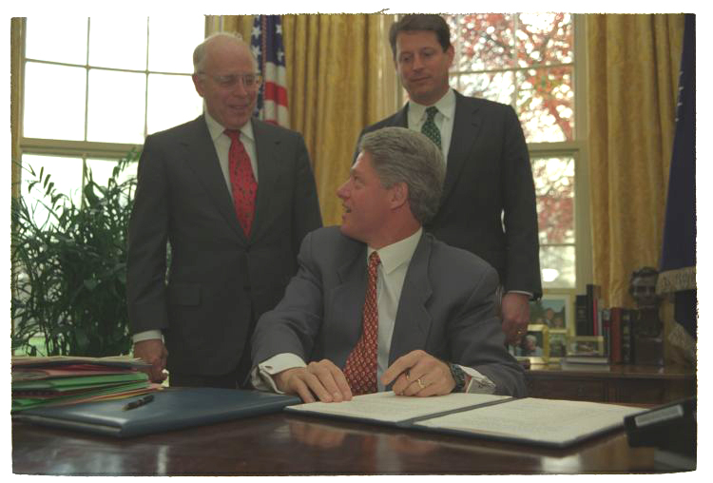
The obstacle to making neutrinos a practical thing for nuclear security
“This is one of the most challenging policy problems I've come across, weaving together issues of technology, security, environment, energy, and international politics.
John H. Gibbons, Clinton head of Office and Science and Technology Policy, discussing how to deal with U.S. and Russian plutonium declared surplus to military needs, 1994
Policy problems can’t be solved by physicists, engineers or technology alone

Slide 4
Cooperative monitoring concepts sorted by distance
power/burnup monitoring
exclusion for >50 MWt reactors
exclusion only
for >50 MWt reactors
Mid-field
Far-field
depth: 10-100 m
detector mass: 5- 3000 tons
dwell times: weeks to months
applicable worldwide
depth: 100-1000 m
detector mass: 1 kiloton – 500 kilotons
dwell times: months to 1 year
applicable in low-to-medium background regions only
100 m
10 km
100 km
detector distance from reactor
Near-field
onsite reactor monitoring
depth: surface/a few meters
detector mass 1-10 tons
dwell times: hours to months
applicable worldwide

Slide 5
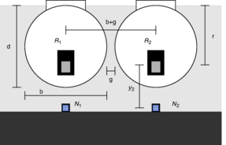
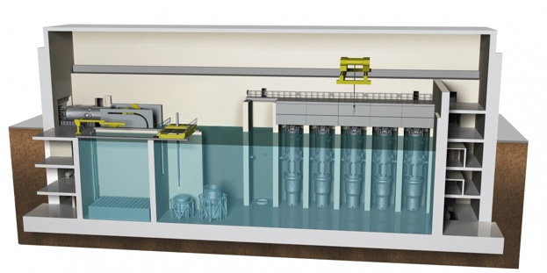
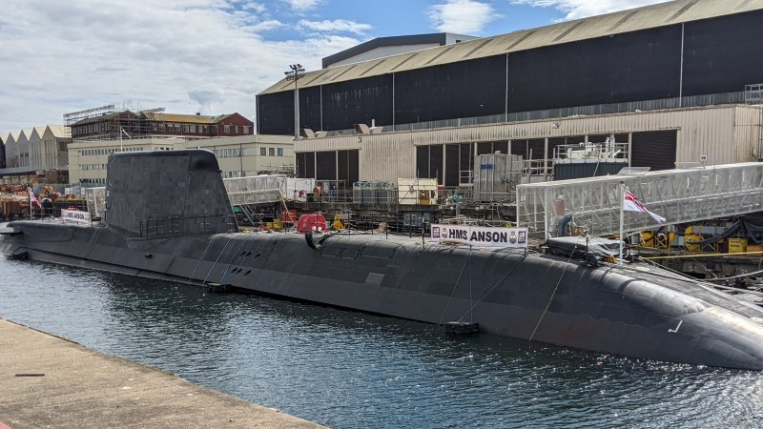
Possible uses for antineutrino-based monitoring
near to mid-field applications
mid and far-field application
Advanced Reactor Fuel Safeguards
Monitor reactors with e.g. bulk fuel or opaque coolants
Monitor multiple small modular reactors on a site
NPT and Confidence
Cooperatively verify a reactor shutdown or absence of reactors from outside a site (NPT AP)
Check status of surplus plutonium burning in civil reactors (Pu disposition)
Naval Reactor Verification
Verify reactor core presence/enrichment in a non-nuclear weapon state submarine
Cogswell & Huber, PRL 128 241803 (2022)
Carr, et al, Science & Global Security (2019)
https://arxiv.org/abs/2308.01306
Non-intrusive, persistent, unattended, quantitative estimates of key reactor properties
See https://neutrinos.llnl.gov/sites/neutrinos/files/AAP2018-IAEA-Anzelon.pdf for existing IAEA reactor safeguards methods

Slide 6
Near-field cooperative monitoring

Slide 7
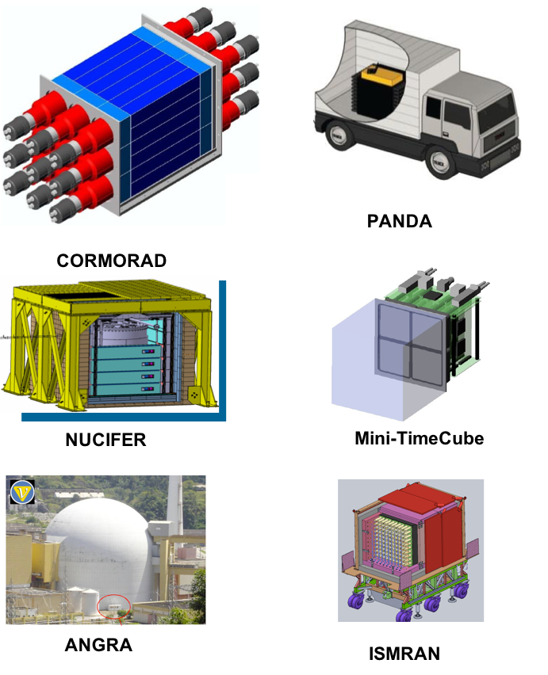
R&D Timeline for Near-field Monitoring
2004:Early (the first ?) US workshop on
Neutrinos and Arms control,
J. Learned, UH
2006 onward Applied Antineutrino Physics workshops France, Japan, US, Brazil, India, UK,
IAEA safeguards applications
Bernstein JAP. 91, 4672–4676 (2002)
IAEA workshops on antineutrino-based monitoring
coherent-scatter based reactor monitoring (Hagmann TNS 51, 5, 2004)
Theoretical case studies (Huber, others)
1980
1990
2000
🏈
2010
🏈
🏈
2020
The Rovno era
SONGS
PROSPECT CHANDLER
surface-level detection
Conus+
coherent scatter
measurement
All basic ideas explored
with IBD detectors
basic ideas re-explored
- some simplifications and
attention of the IAEA
Country
USA
Japan
UK
Italy
France
Japan
CA/US
Brazil
Japan
USA
India
Russia
Birth of the idea:
Neutrino ’77, Baksan
(maybe ’75 ?)
Gd-scintillator
donated by
F. Boehm/Gratta from Palo Verde experiment
‘Cambrian
explosion’ for
monitoring
detectors

Slide 8
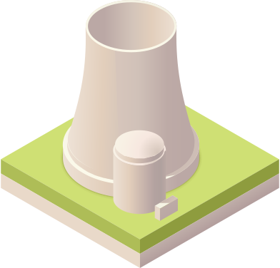

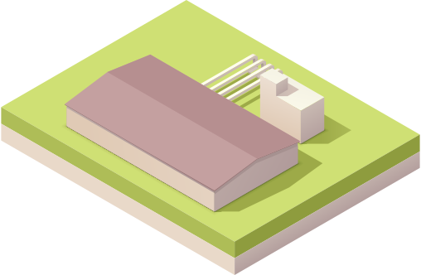

Current IAEA safeguards practice at reactors (220 worldwide)
Reactor
Onsite Fuel Storage
Reprocessing
Waste Repository
(1–1.5 years)
(months to years)
(months)
(forever)
Gross defect detection
Item accountancy
Containment and surveillance
U Pu Radwaste
Check declarations
Item accountancy
Containment and
surveillance
Check declarations
Bulk accountancy
Japan only
Operators only declare fuel burn up and power history
No direct Pu inventory measurement is made unless the fuel is reprocessed
Can antineutrino detectors provide real-time inventory estimates?

Slide 9
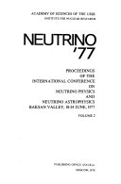
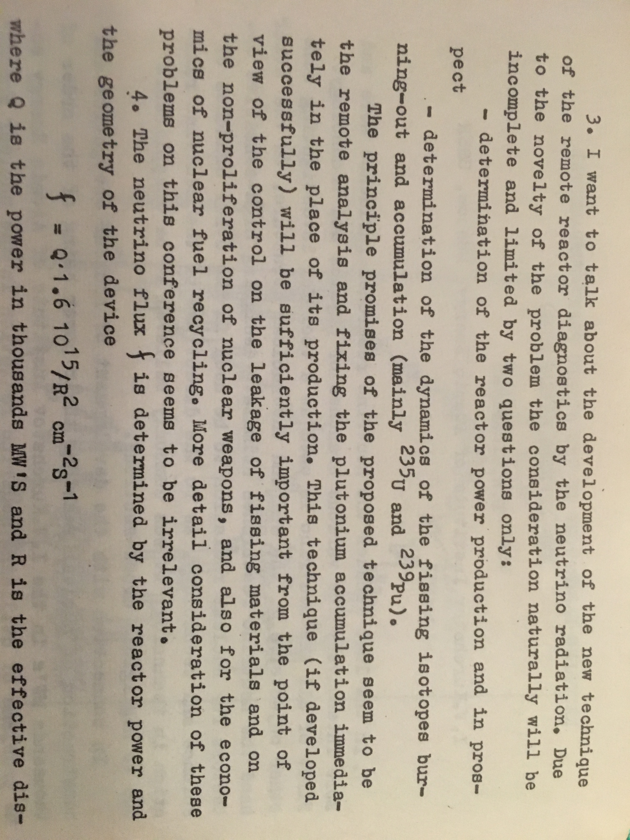
An early description of near-field reactor monitoring - Neutrino ‘77 conference, Baksan
Borovoi, A.A., Mikaélyan, L.A. Possibilities of the practical use of neutrinos. At Energy 44, 589–592 (1978). https://doi.org/10.1007/BF01117861

Slide 10
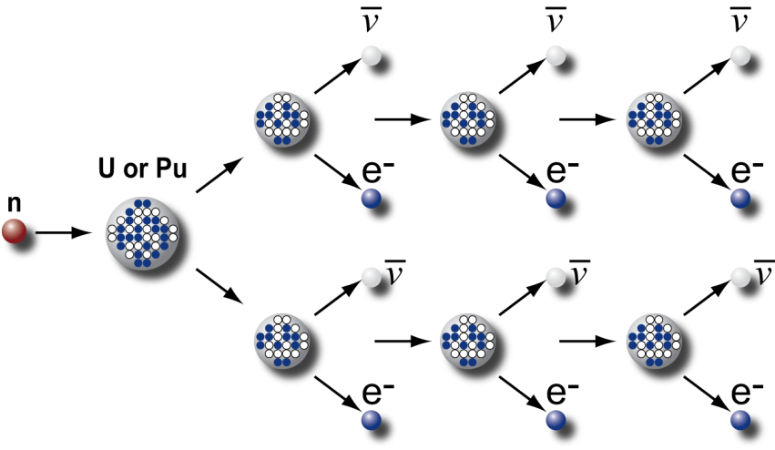
Large reactor flux overcomes the small cross-section giving tractable rates
Reactors emit huge numbers
of antineutrinos
Detected rates are reasonable
6 antineutrinos per fission from beta decay of neutron-rich daughters
10²¹ fissions per second in a 3 GWt reactor
About 10²² antineutrinos are emitted per second from a typical PWR
unattenuated and in all directions
10¹⁷ antineutrinos per square meter per second at 25-m standoff
6,000 events per ton per day with a perfect detector
Modern detectors (e.g. NEOS) 2000 or more per ton per day

Slide 11
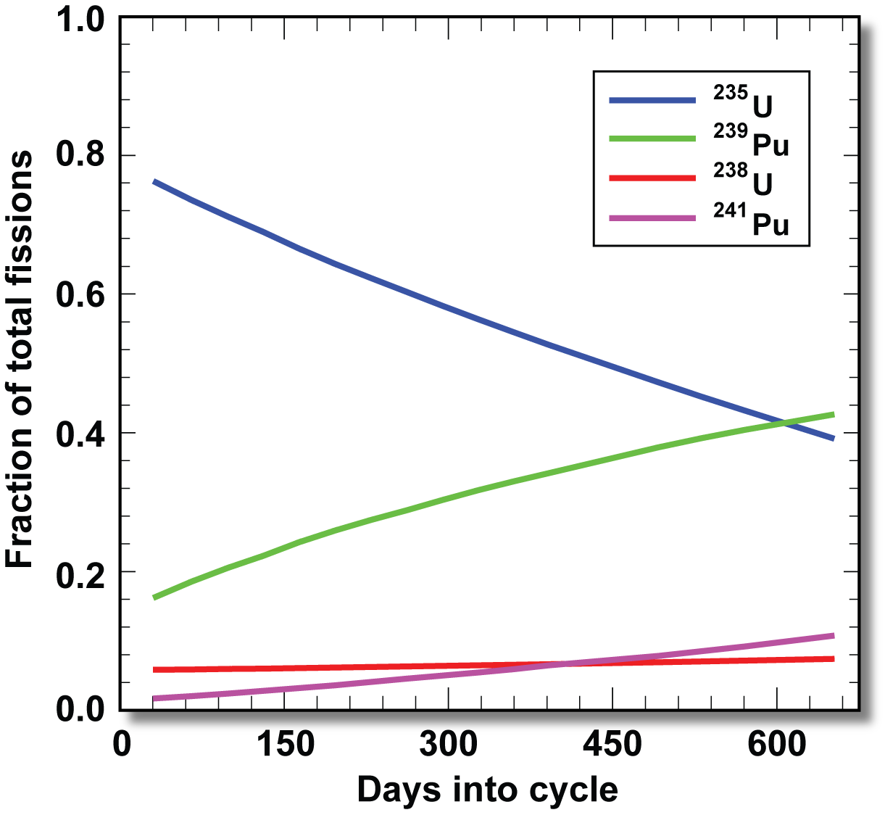
Reactor antineutrino energy spectra, convolved with changing fission fractions, produce the “burnup effect”
For each isotope, fission rates vary with time
Energy spectra vary with isotope
Events/MeV/fission
(relative frequency)
²³⁵U
²³⁹Pu
Zeroth order:
reactor power
First order: ~10%
Varying contributions from Pu/U isotopes

Slide 12
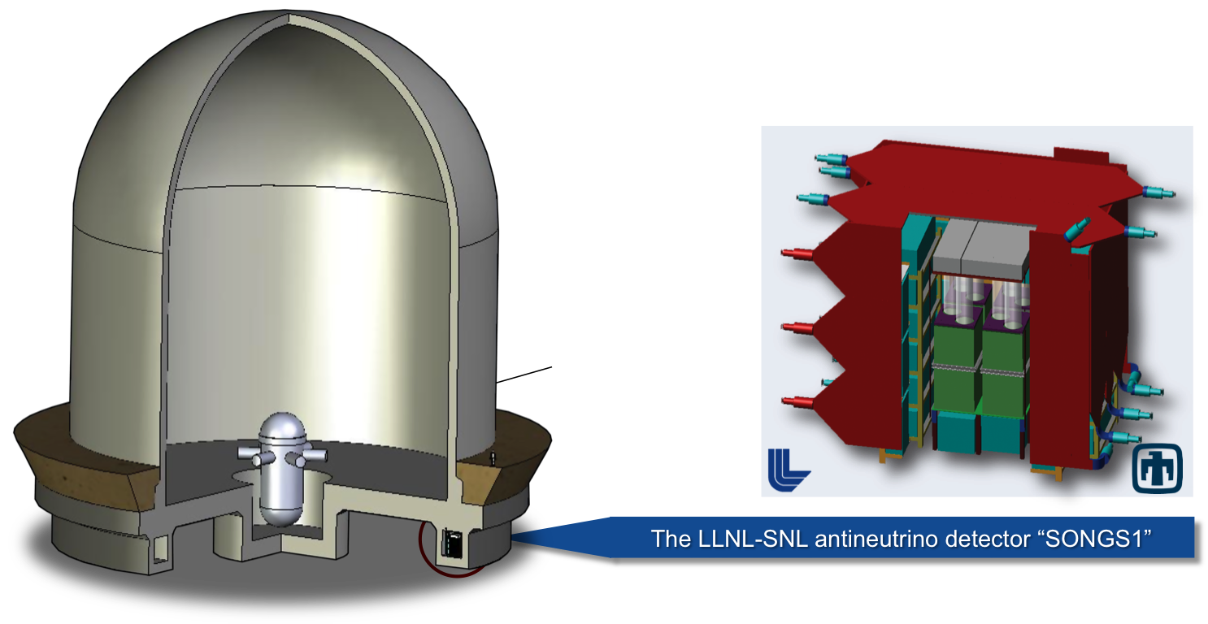
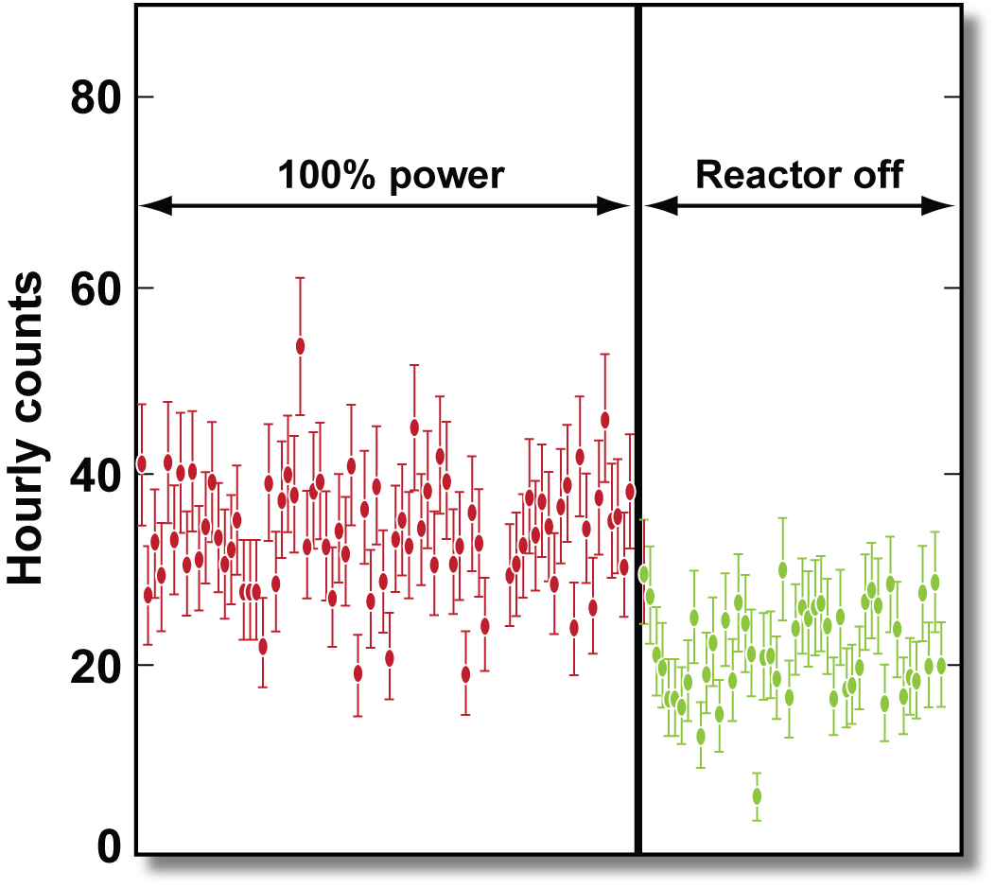
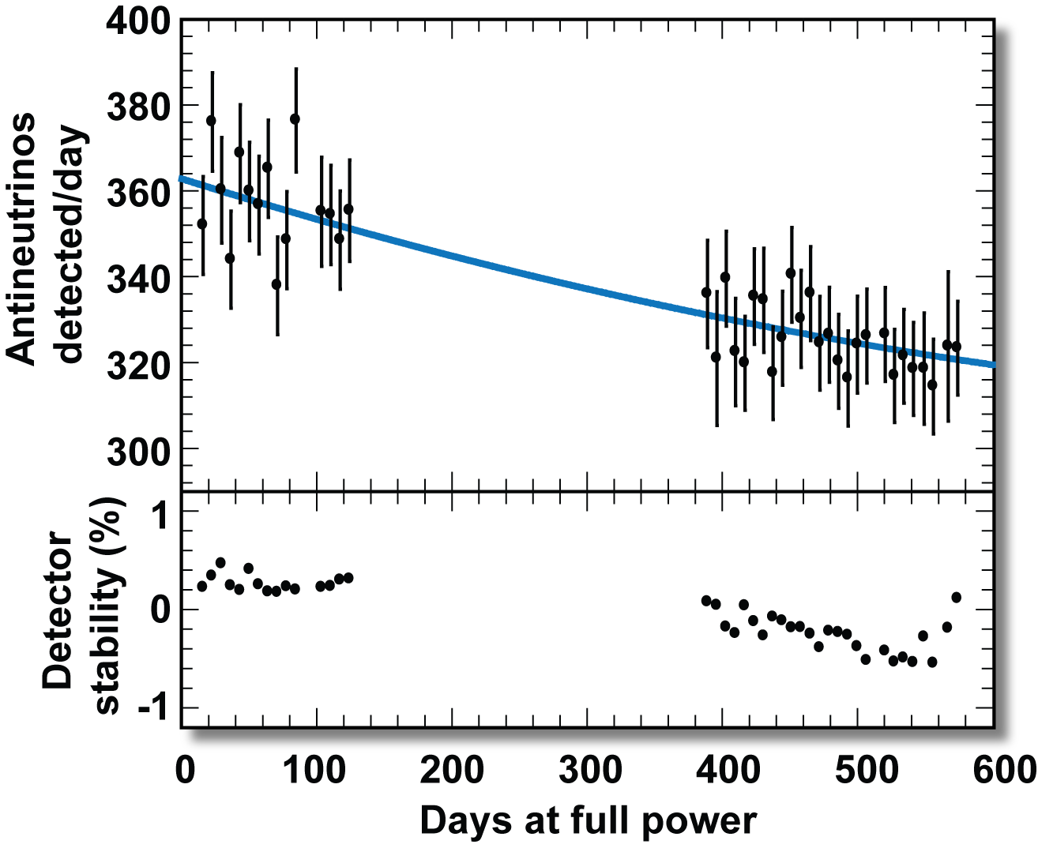
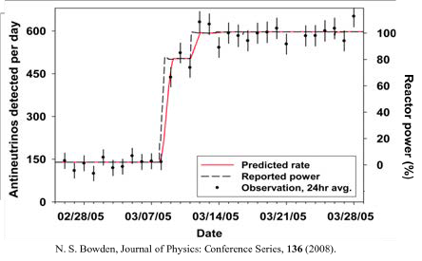
Results from a nonproliferation demonstration in San Onofre California
0.6 ton liquid scintillator detector
Total footprint ~ 3x3x3 meter
25 electronics channels
NIM A 572, 2, (2007)
J Appl. Phys., 109 11, Jun 2011
Determine reactor on/off status
within 5 hours with 99.9% C.L.
Measure thermal
power to 3% in one week
Detect switch of 70 kg Pu with equivalent amount
of ²³⁵U in three months
J. Appl. Phys. 103, 074905 (2008)
J. Appl. Phys. 105, 064902 (2009)

Slide 13
Antineutrino rate and shape measurements reveal properties of the core
Comparison of relative nubar rates versus time for different core types
Comparison of two spectra with midpoints on cycle day 45 and day 315
5 ton detector
3 GWt core
25 m standoff
Sensitive to an 8% change in MOX composition in 150 days
5 ton detector
40 MWt core
17.5 m standoff
Sensitive to a change of 7 kg of Pu at > 5 sigma
(Plutonium disposition)
(North Korean Reactor monitoring)
arxiv:1612.00540
arxiv:1403.7065

Slide 14
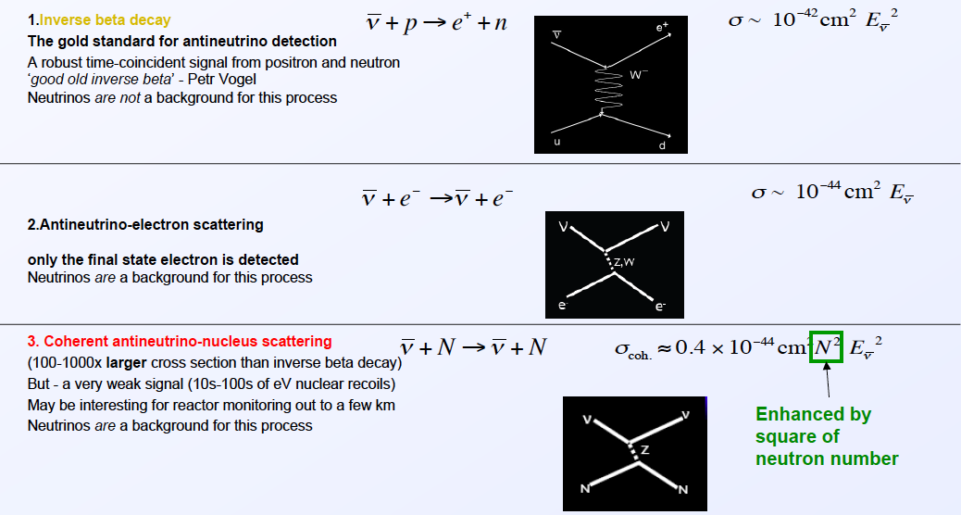
What about coherent scatter to shrink detector size or increase rates ?
C. Hagmann and A. Bernstein, Two-phase emission detector for measuring
coherent neutrino nucleus scattering, IEEE TNS 51, 2151 (2004)

Slide 15
Near-field monitoring summary
In the near-field (<100 m or so) it has been proven since Rovno/1980’s that antineutrino detectors can be used to determine fissile inventories and power levels at reactors
Reliable long-lasting detectors are deployable now
Further steps, such as mobile detectors and better S/B above-ground are useful technical R&D
Policy analyses are essential to gain the interest of the user community
Political will and the attention of the policy community are the main missing ingredients

Slide 16
Mid and Far Field cooperative monitoring

Slide 17
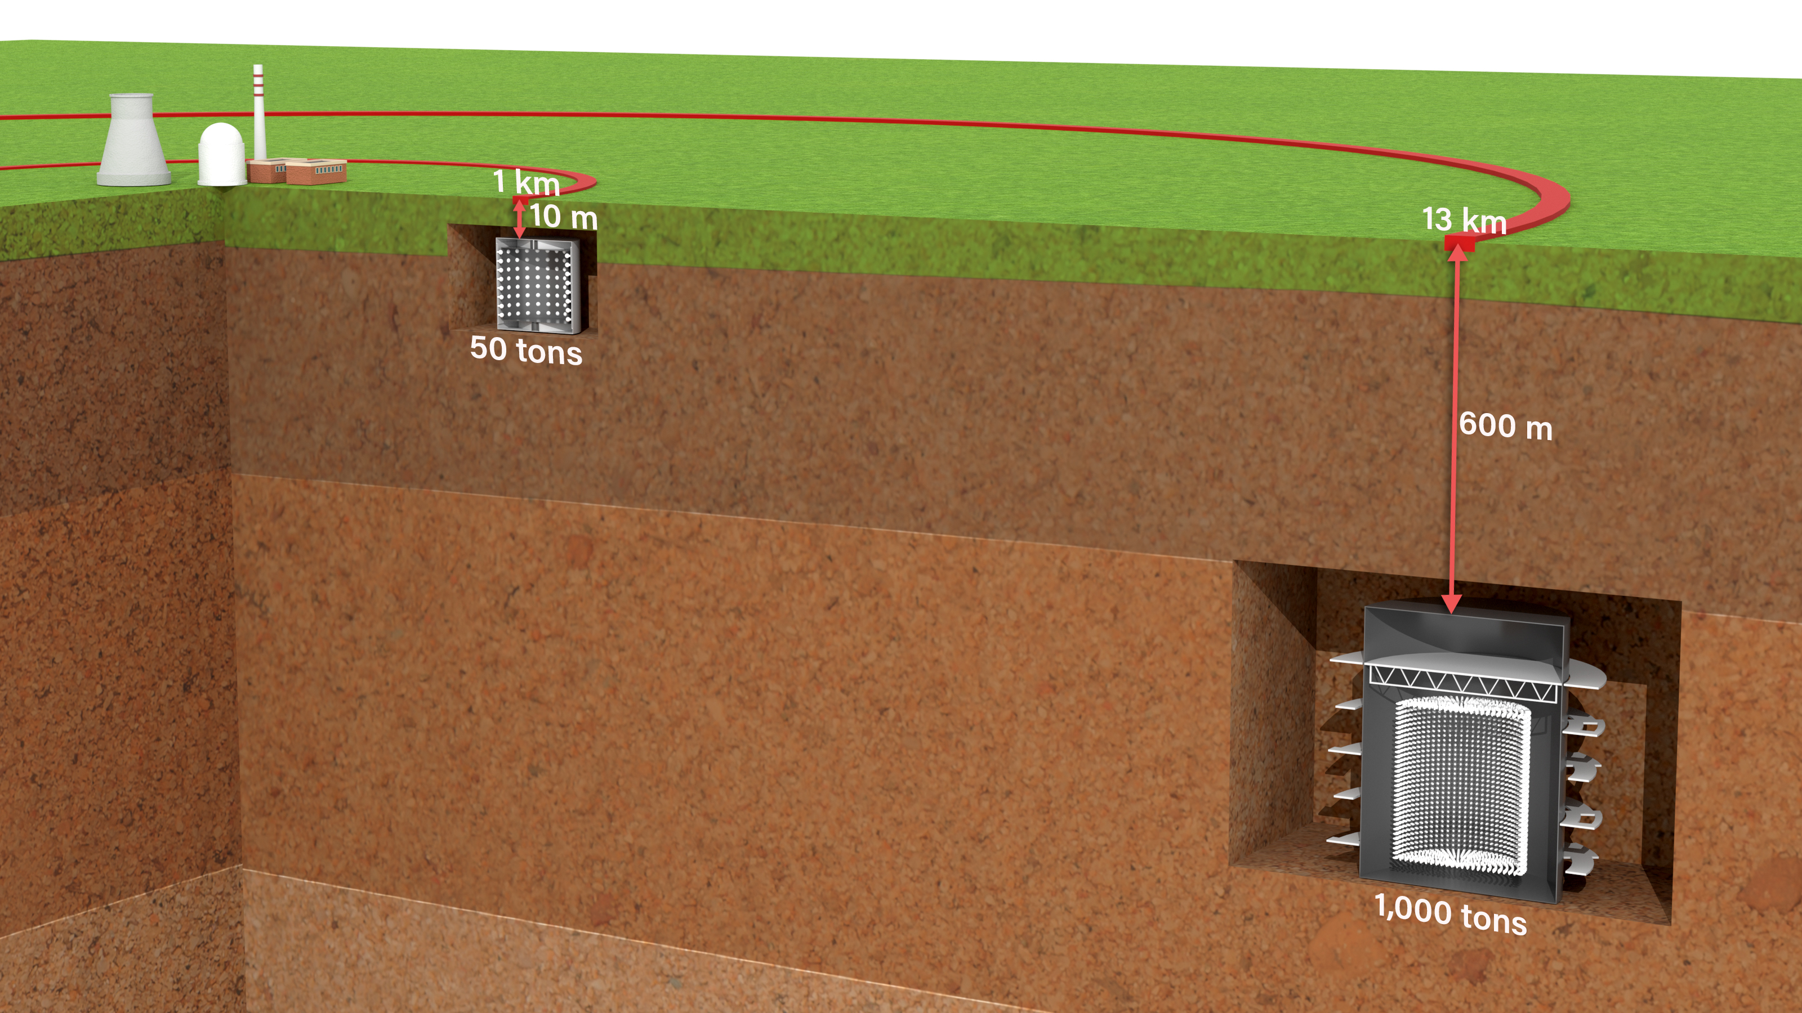

Mid-to-far-field - cooperative discovery, exclusion and monitoring of reactors
  Site-wide exclusion of > 50 MWt reactors
    Independent information about presence or absence of small reactors
    Confidence-building measures to support and complement NPT and future treaties
    Threat of discovery helps deter undeclared reactor construction and operation
  Monitoring of advanced reactors
    Fill known safeguards gaps
      Small modular, Pebble bed, and Molten salt reactors
    Provide non-intrusive and independent site-wide power and burnup information out to several kilometer standoff
Examples of possible mid-to-far-field deployments
Greater standoff or lower reactor power → Reduced flux → larger detectors and less detailed information

Slide 18
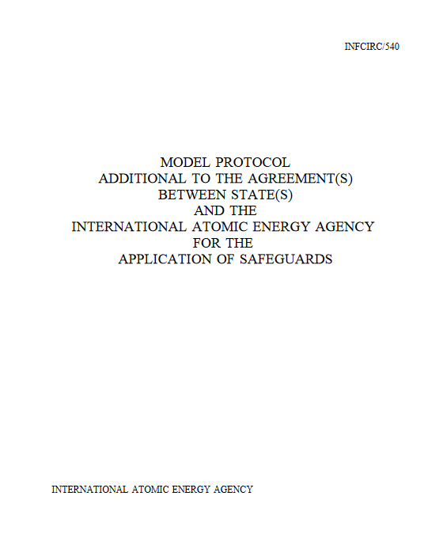
Mid-to-far-field antineutrino-based monitoring systems offer unique capabilities
  Less intrusive than near-field deployments or onsite inspections
  Potential for wide-area coverage
    Sensitivity ranges from 100 m to a maximum of 100 km
  Persistent
  Definitive confirmation of absence of reactor activity
  Antineutrino emissions can’t be shielded
  Opportunities for scientific collaboration with inspected party
    e.g., Confidence-building measures
NPT Additional Protocols emphasize minimizing intrusiveness and burden to the state
“take every precaution to protect commercial and industrial secrets and other confidential information coming to its knowledge and implementation of the Agreement”
“avoid hampering economic and technological development”
”avoid undue interference”
No other reactor monitoring/exclusion technology – radionuclide detection, satellite imagery, onsite inspections - enjoys this unique set of features

Slide 19
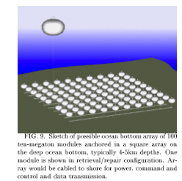
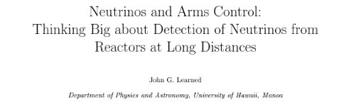
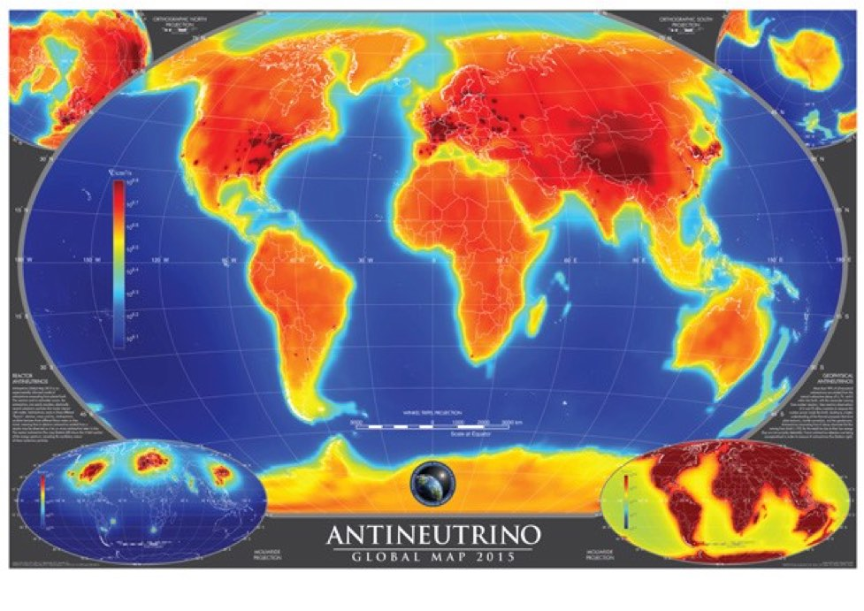
Timeline for Mid/Far-field Monitoring concepts
KamLAND
‘09-10 - LLNL/SK/EGADS
Physics and
engineering
Gd-H2O demonstrators
(1-200 tons)
WATCHMAN:
1 kT Gd-doped water
devoted to reactor monitoring
X
relevant
experiments
‘03 - reactor measurement
at 200 km
JUNO:
20 kT scintillator
Palo Verde
‘98 - reactor measurement at
~1 km
Super-K_Gd:
50 kT Gd-doped water
2000 2005 2010 2015 2020
’03: Dreaming big: John Learned considers the benefits of a gigaton array of monitoring detectors
‘17: Carr et. al – PR Appl. 10
‘Seismically cued antineutrino detectors’
Modest improvement on ‘01 results
relevant
analyses
‘01: Bernstein et. al.
Gd-doped water
for CTBT monitoring applications
Conclusion: not worth it
for the 1 G$ price of entry
‘10: Lasserre et. al – PRC
‘Secret Neutrino Interaction Finder’
marvelously detailed treatment of
reactor and non-reactor backgrounds
AGM 2015 Usman/Learned
geoneutrino.org/reactors S. Dye

Slide 20
The world’s reactors form a limiting and essentially irreducible background for far-field exclusion and discovery applications
Due to the variability in backgrounds, the minimum dwell time and detector size changes substantially across the globe Sensitivity is highest in the low and medium background regions of the world
results from https://reactors.geoneutrinos.org/, S. Dye, A. Barna
https://arxiv.org/pdf/1510.05633.pdf
This is an enormously
useful and convenient tool !

Slide 21
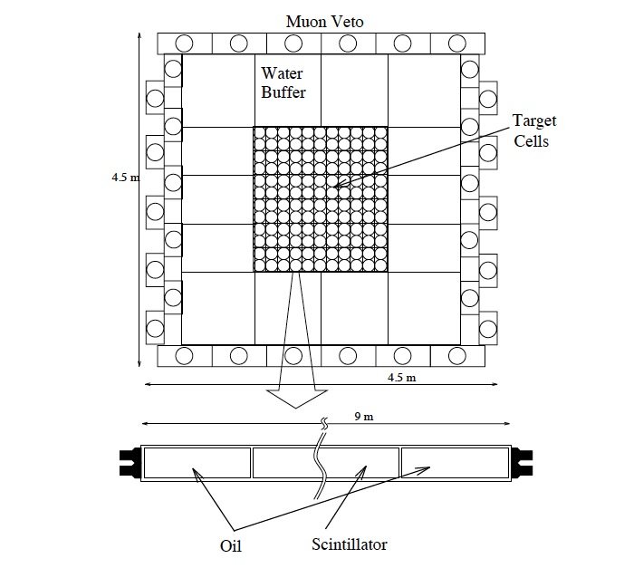
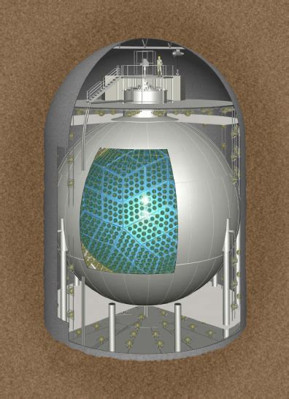
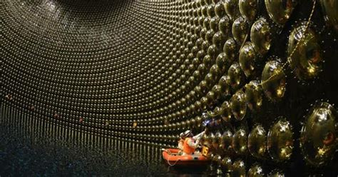
Liquid media in homogenous or modestly segmented volumes are most relevant for mid-to-large scale antineutrino detectors
The Palo Verde Gadolinium-doped Scintillator detector
(180 ton mass)
Medium | Advantages | Disadvantages
Liquid scintillator | Proven design Fewer light sensors compared to alternatives Best for monitoring applications requiring good energy resolution | Combustible Must be transported or manufactured onsite
Gadolinium- doped water | Nontoxic Readily available Large detectors possible due to high light transmissivity Attractive for discovery/exclusion applications | Inferior background rejection Poor energy resolution More light sensors than alternatives
Gadolinium, water, and scintillator mixtures (water-based liquid scintillator) | Reduced environmental impact compared to pure scintillator Possibly improved background rejection compared to water Mixture adjustment provides performance flexibility | Least mature technology
The KamLAND
Liquid Scintillator Detector
(1000 ton mass)
The Super-Kamiokande Gadolinium-doped
water Cherenkov Detector (~50,000 ton mass)

Slide 22
The ideal and the real – current and future limitations on far-field detection of 50 MWt reactors in < 1 year
Ideal detector, simple model
Plausible detector, detailed model
Liquid scintillator
Only reactor and geoneutrino backgrounds
A 3.3 MeV energy cut is applied to remove geoneutrinos – detector records all reactor antineutrinos above this energy
(Gd-H2O detector, 40% PMT coverage)
Detailed background model: ambient radioactivity; muogenic neutrons/pions/gammas , other reactors, geoantineutrinos
Full Monte Carlo including photon tracking and individual event reconstruction
Detector fiducial mass and dwell time results
Ideal detector
State-of-the-art detector
Low
background
regions
10 km
20 km
50 km
100 km
10 km
20 km
35 km
100 km
1 kt
1 month
1 kt
5 month
10 kt
1 year
100 kt
1 year
Not analyzed
1.4 kt
1 year
60 kt
1 year
Not possible with
this design in 1 year
High
background
regions
1.4 kt
1 year
25 kt
1 year
Not possible with
this design in 1 year
Not possible with
this design in 1 year
1 kt
4 month
5 kt
1 year
1000 kt
1 year
Not possible with
this design in 1 year
See Slava Li paper - https://arxiv.org/abs/1907.08891

Slide 23
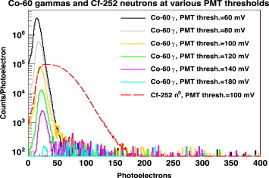
The gadolinium solution permits the use of the (possibly) more scalable water-based detector
    v_{e} + p = e⁺ + n
    Gadolinium nucleus captures neutrons with high efficiency and creates an intense flash of Cherenkov light
    The signal is two flashes of Cherenkov light, close in time (~100 μsec)
    and location (~5 cm)―the “antineutrino heartbeat”
    Method reduces backgrounds by several orders of magnitude
    Gadolinium-doped Water Cherenkov technology
    offers path to 100–1000 kiloton
    antineutrino detectors
    First proposed by Bernstein in 2001
    Science & Global Security 9, 235 (2001)
    Experimental verification in 2009
    LLNL: NIMA 607 (3), 21 (August 2009)
    Super-K: Astroparticle Physics 31(4), 320–328 (May 2009)
Neutron signal in
LLNL Gd–H₂O detector
10.1016/j.nima.2014.10.028
Notes:
2.2 MeV gamma just form proton neutrino scattering
Measurement of the positron energy determines the neutrino energy since
E_{𝜈} = E_{E} + 1.3 MeV
Gd cross section for thermal neutrons 49,000 barns compared to .33 barns for Hydrogen. At .2%, 90% of captures are on Gd (.2% on Chlorine, rest on Hydrogen). Capture occurs in about 3 microseconds and about 4cm.
In SK, at energies below 3 MeV, background singles rates (i.e. a capture of a single neutron or emission of a gamma) are much too high to detect neutron captures in isolation, however by using this reaction and by requiring a very tight time and position coincidence between the positron and follow-on neutron, nearly all captures on Gd can be detected.
Reactor neutrinos at SK: total rate from inverse beta decay scaled from KAMLAND is about 30/day. With a coincidence signal, it would be possible to identify real events as low as E_{E} = 2.5 MeV covering most of the reactor spectrum. Precision measurements of the
neutrinos from all of
Japan’s power reactors
(~5,000 events per year)
Solar antineutrino flux is < than 1% of predicted electron neutrino flux. Requiring a neutron coincidence would greatly reduce backgrounds giving a sensitivity of about .01%
23

Slide 24
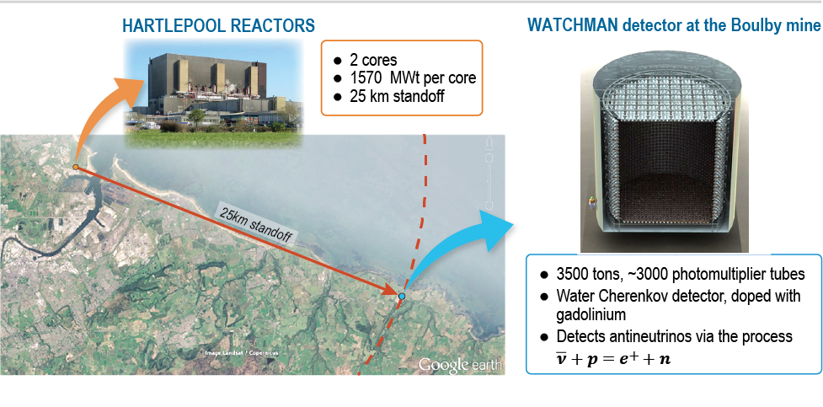
The WATCHMAN demonstration
Main Project Objective:
WATCHMAN: A WAter CHerenkov Monitor of Antineutrinos
Detect the ON/OFF power cycle of a single reactor:
at 10-25 km standoff
with a kiloton-scale Gd-H2O detector
at 3 sigma confidence level
Choose water based on cost and scalability
Doping the water with gadolinium greatly increases sensitivity to inverse beta interactions of antineutrinos

Slide 25













The WATCHMAN collaboration, ~2014 (ish)
32 collaborators
9 Universities
4 National Laboratories
Co-spokespersons:
Adam Bernstein, LLNL
Mark Vagins, UC Irvine/Tokyo University
Water attenuation
measurements
Neutron spectrometry
at multiple depths
(MARS spectrometer)
Tagged muogenic
neutron multiplicity measurements
(WATCHBOY)
Gd-water materials testing
WbLS development
LAPPD studies
PMT purchase and
testing
The
WATCHMAN
Collaboration
AWE
J.Burns
LLNL
A. Bernstein
M. Bergevin
S. Dazeley
BNL
M. Yeh
STFC–Boulby
S. Paling
Penn State U.
D. Cowen
Iowa State U.
M. Wetstein
UC Berkeley
G. Orebi Gann
U. Hawaii
S. Dye
J. Learned
U. Michigan
I. Jovanovic
U. Pennsylvania
C. Mauger
UC Davis
R. Svoboda
UC Irvine
M. Vagins
U. of Sheffield
M. Malek
N. Spooner
L. Thompson

Slide 26
After several reversals, WATCHMAN transmuted into a long-term R&D program
Hartlepool reactor announced its shutdown for 2024 (prematurely)
Cost estimates in the UK where raised substantially against original $40 M pricetag
Fairport/IMB site purchased by venture capital group with no interest in nonproliferation demonstration
Sponsor decided that an R&D program was preferable to a demonstration
An enduring neutrino-related set of activities continues – advanced PMTs, better way to measure attenuation, WbLS etc. – see Slava’s talk

Slide 27
My prescription for an achievable next step
A demonstration involving a Non-Nuclear and Nuclear Weapons state
  Historical precedent – UK-Norway initiative on warhead disarmament monitoring
Propose near and mid-field antineutrino deployments as a demonstration
De-emphasize R&D until the deployment is complete
Finally, propose to Iran, North Korea or other adversary as a scientific diplomacy initiative – this I consider to be the ultimate success for this technology

Slide 28
Monitoring Nuclear Tests
2001 and 2019 studies – not competitive in sensitivity or cost against existing CTBT methods
Very limited utility for ton-scale test exclusion
No utility for differentiating sub-critical from critical tests
May have utility for diagnostics of kiloton-scale tests (a proliferant activity in violation of the CTBT)

Slide 29
Coincidences in Nature
…the (Up-Down Cosmic Ray) asymmetry is indeed maximal, which makes it appear that we are very lucky that the earth size and cosmic ray energies are “just so” to produce this dramatic effect. This appears to this author to fall in the category of lucky co- incidences, such as the angular diameter of the moon and sun being the same from earth. .. The phase space for “coincidences” is very large, and we humans are great recognizers of such patterns.
‘Introduction to Neutrino Astronomy’, John Learned, 1999

Slide 30
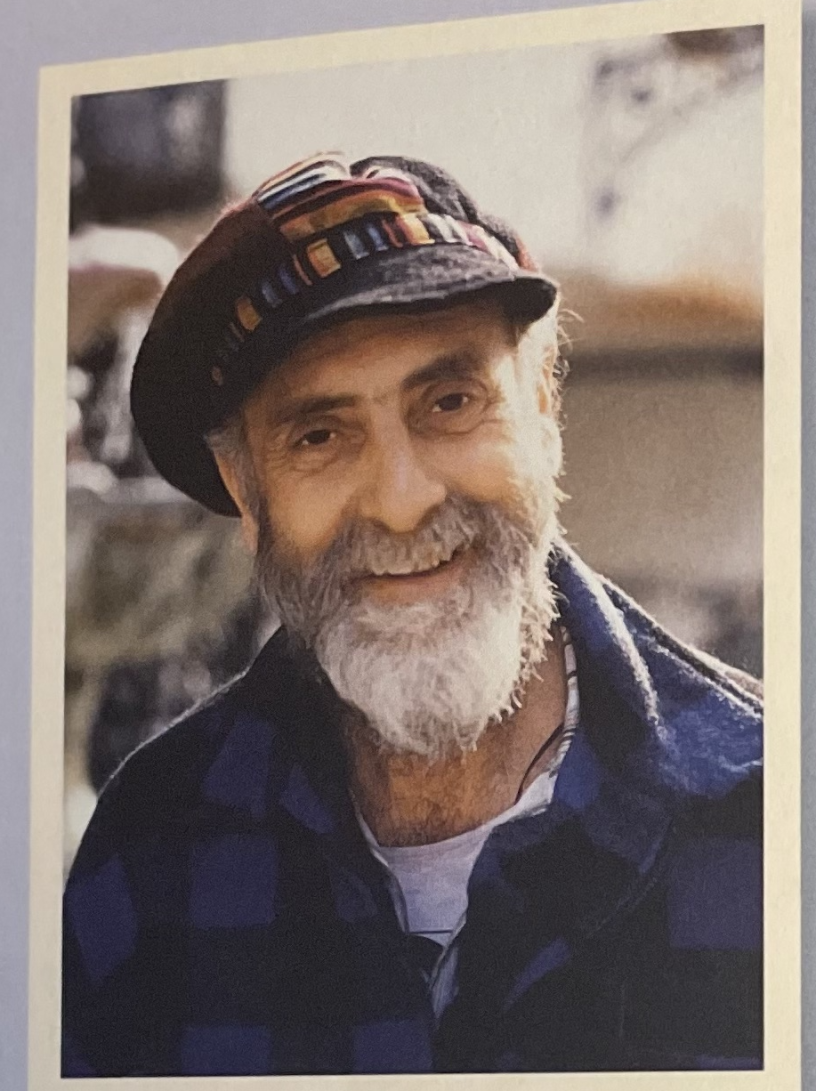
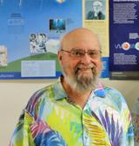
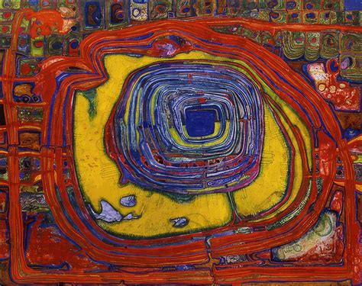
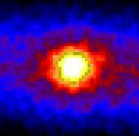
Coincidences in Nature
Friedrich Hundertwasser
Austrian painter
architect
freethinker
John Learned
American Physicist
woodworker
freethinker
Hundertwasser rendering of the sun in oil
Learned-inspired rendering of the sun in neutrinos

Slide 31
Backup slides

Slide 32
An Historical Artifact: J. Learned vision for remote monitoring applications, circa 2007

Slide 33
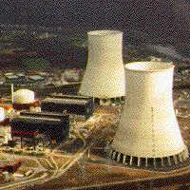
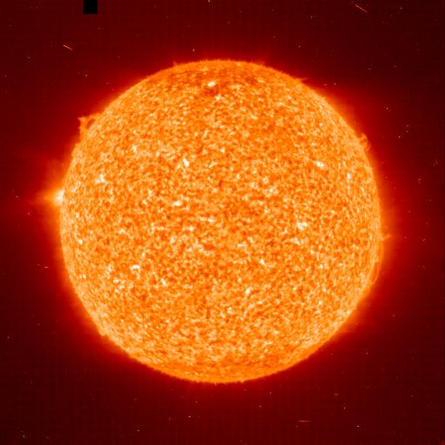
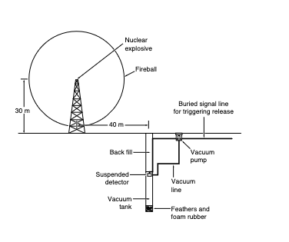
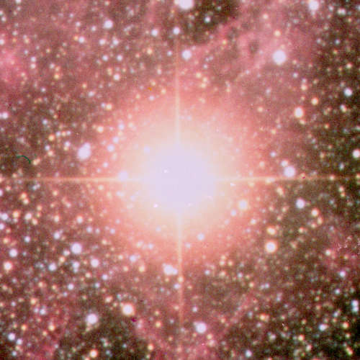
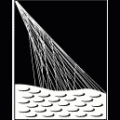
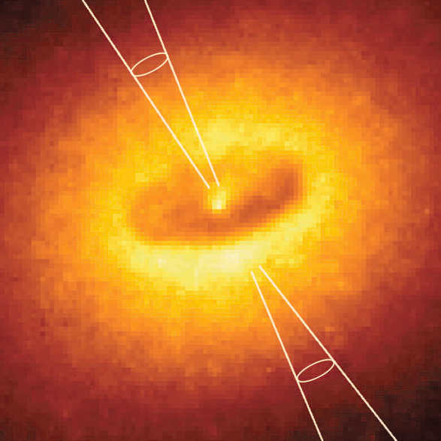

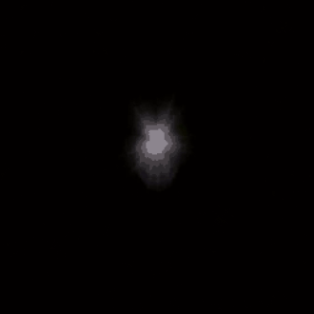
Practicality can mean many things
Nuclear Reactors
Sun
Nuclear Explosions
Supernovae
Earth’s Atmosphere
Astrophysical
Accelerators
Earth’s Crust and
Mantle
Big Bang
Slide adapted from JGL
Notes:
These other studies also count as applications – neutrinos are effective probes of the universe
To pursue neutrino solar studies or geophysics, you have to learn about the general properties of the sun or Earth
To pursue nonproliferation and disarmament, you need to learn about nuclear security

Slide 34
The Problem for CNS: ‘Good-ol’ inverse beta’* actually works pretty well
Detector feature | IBD Demonstrated | IBD plausible | Argon | Germanium | Phonon-counter
Footprint with shield | 3 m | 1.5 m | 2 m | 1.5 m (CONUS+) | 0.5-1 m ?
Mass for 100 cpd at 25 m from 3.4 GWt | 16 kg | 16 kg | 15 kg | 5 kg | 50 gram
Energy threshold | 1.8 MeV (nubar) |  | > 2 e-, ~200 eV threshold | 50 eV (CONUS+ threshold is 160 eV) | ~meV scale
Achievable thresholds for CNS detectors prevent realization of the advantage
of the higher cross-sections
*Petr Vogel, CalTech

Slide 35
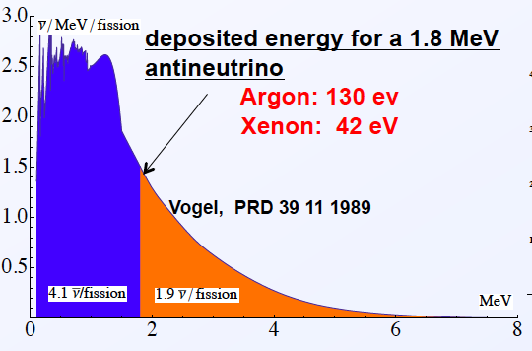
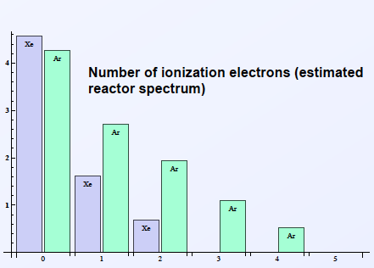

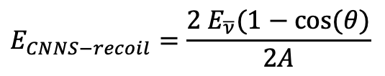
Spectroscopy with (ionization-based) CNNS is underwhelming
No-threshold property doesn’t help much
Few ionizations –
~10x worse energy resolution than IBD
detector
CNNS Spectrum must be unfolded, IBD spectrum is directly proportional to nubar energy
$$E_{CNNS−recoil}=\frac{2 E_{\overline{ν}}(1−cos⁡(θ)}{2A}$$
$$E_{IBD}=E_{\overline{ν}}−1.8MeV+2∙m_{e}$$

Slide 36
A somewhat less practical thing: ‘mid-to-far-field’ reactor monitoring
Discover, or exclude the existence of, operating reactors
Mid/‘Far’: more than 1 km, out to perhaps 100 km – varying degrees of access
‘low’ statistics: a few events per week month, year
Reactor power ~50 MWt – roughly generating 8 kg/one Significant Quantity per year
Technology: Variations on KamLAND, Super-Kamiokande, Borexino and other large detectors

Slide 37
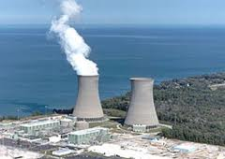
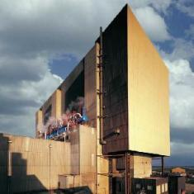
Site and configuration choices
 | Option 1 | Option 2
Reactor Location | Perry, Ohio, United States | Hartlepool, England, United Kingdom
Thermal Power (MWt) | 1 x 3875 | 2 x 1500
Detector Location | Morton Salt/IMB mine Painesville, Ohio | Boulby underground science lab, Boulby, England
Standoff | ~13 km | ~25 km
Overburden (mwe) | ~1500 | ~3000
Signal Events | 110 per month | 11 per month
Background Events | 50 per month | 20 per month

Slide 38
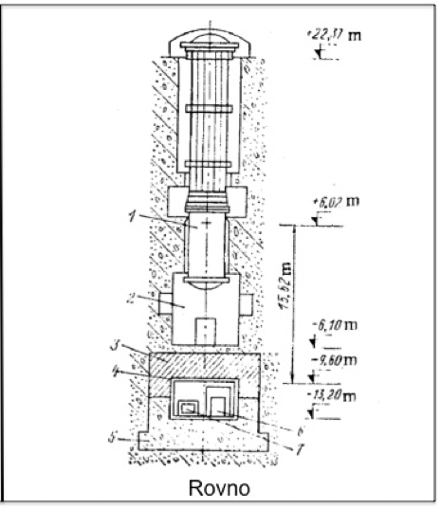
1980s - the remarkable deployment at Rovno
1400 MWt reactor (VVER 440)
18 m from core
18 m of overburden
500 l liquid scintillator (Gd-doped)
84 PMTs
core center
The ideal monitoring
experiment !
Reactor and Earth shield
cosmics
Detector is close to the
core but in a relatively low radiation environment
18 m
detector center

Slide 39
Other challenges and mitigations
Challenge | Mitigation
Excavation costs | Improve background rejection to reduce depth
Detector costs | Reduce the number and/or increase performance of the dominant cost item – light sensors Increase the usable fraction of the detector volume
Time to deploy | Use pre-built modules and existing excavation
Public, political and nonproliferation community acceptance | Host country: explain to its citizens the scientific and diplomatic benefit of the deployment All: use internationally accepted techniques to validate data All: Perform a field demonstration to provide a real-world example to the policy and technical communities (e.g. UK/Norway Initiative, Black Sea Experiment, others)
https://www.gov.uk/government/publications/uk-norway-initiative-on-nuclear-warhead-dismantlement-verification--2
https://scienceandglobalsecurity.org/archive/sgs17belyaev.pdf

Slide 40
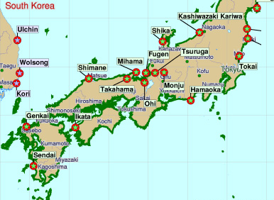
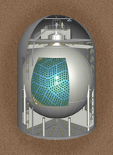
Long-range reactor antineutrino detection is feasible now with liquid scintillator
South Korea
~3% of signal from South Korean reactors
@ 400 km standoff
The KamLAND detector
Per month:
16 reactor antineutrinos
1 background event
From 130 GWt of reactors
1000 tonnes scintillator
1000 m depth

Slide 41
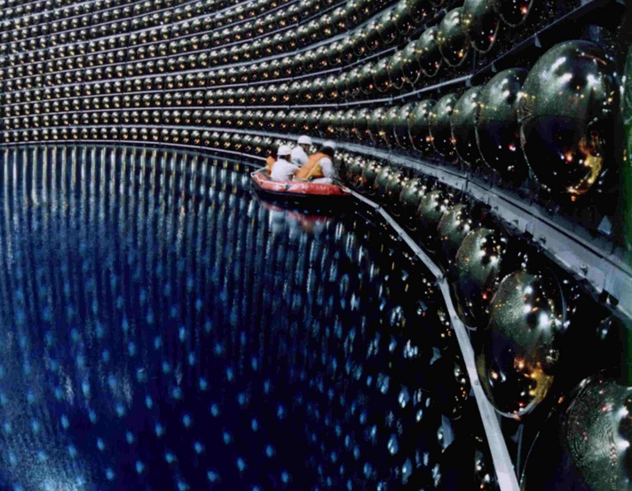
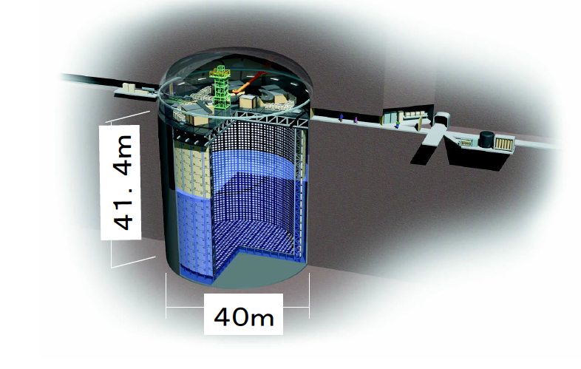
Today’s Water Cherenkov detectors are 50x larger than scintillator detectors, but can’t distinguish neutrino from antineutrino
    v_{e} + p = e⁺ + n
Identical signals from
both processes:
a single flash of
Cerenkov light
    v_{e} + e⁻= v_{e} + e⁻
Inverse beta decay
from reactor
Elastic scatter
(solar neutrinos, reactors)
    v_{e}
The Super-Kamiokande water Cherenkov detector

Slide 42
Possible users
The International Atomic Energy Agency – responsible for monitoring nuclear facilities in all Non-Nuclear Weapons States (as defined by the NonproliferationTreaty)
  Not relevant for current crop of reactors
  Potentially useful for some new reactor types/special cases
  Fixed IAEA standards for time to discover, material mass, confidence level (95%)
Pairs/groups of States interested in “Confidence-Building Measures”
  “Confidence-building Measures” are non-treaty-based, joint activities meant to lessen tensions between states
  The Iran deal, monitoring North Korea’s nuclear program, others
  Scientific diplomacy and technical engagement are key features
  No fixed performance standard
Signators to the Comprehensive Test-ban Treaty (most countries)

Slide 43
A comparison of reactor exclusion and discovery techniques
 | Non-cooperative methods |  | Cooperative methods | Cooperative methods
 | Satellite imaging | Radionuclide detection | Onsite inspections | Antineutrino detection
Advantages | effective at seeing plumes/heat signature/evidence of industrial activity repeat visits possible assets already fielded | Can qualitatively confirm the existence of reactor Cross-border detection possible | Direct observations of activity/non-activity Quantitative estimates possible (with suitable equipment) | Exclusion, thermal power and/or fissile material measurement or constraint possible with known confidence Unaffected by weather or geography does not depend on accidental release of radiation absence of evidence is evidence of absence
Limitations | absence of evidence not conclusive Cueing often required Continuous or accurate power measurement not practical May be obscured by weather Burial/heat removal can hide reactor operations | absence of evidence not conclusive Localization is difficult Depends on accidental release of activity from reactor Quantitative estimate of reactor power is difficult Detection complicated or frustrated by weather conditions | absence of evidence not conclusive Search is limited to agreed access areas during limited time periods (c.f. Iraqi inspections*) | Maximum geographical coverage of ~10,000 sq kilometers possible only with ~500 kton detectors Overburden requirements increase with distance Expense increases with distance Siting options highly case-dependent
*https://www.armscontrol.org/act/2002-10/features/iraq-chronology-un-inspections

