Slide 1
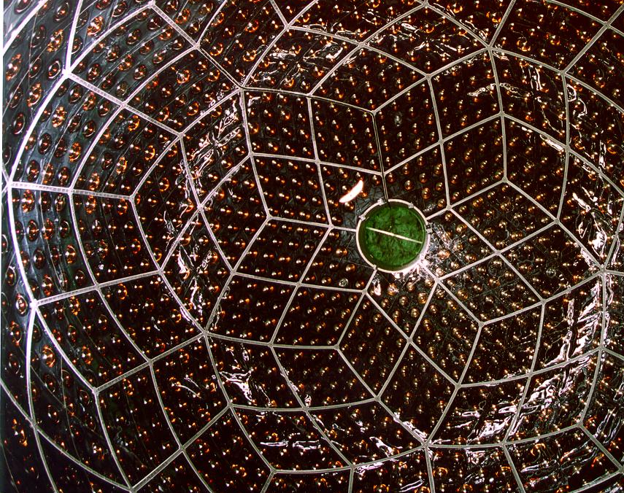
Reactor Neutrino Oscillations
Discovery with KamLAND, Status, and Future Outlook
Jason Detwiler, University of Washington
LearnedFest ‘25, Honolulu HI, May 2, 2025

Slide 2
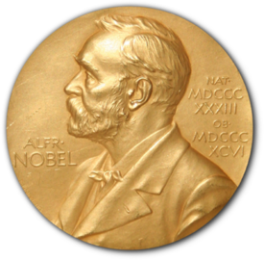
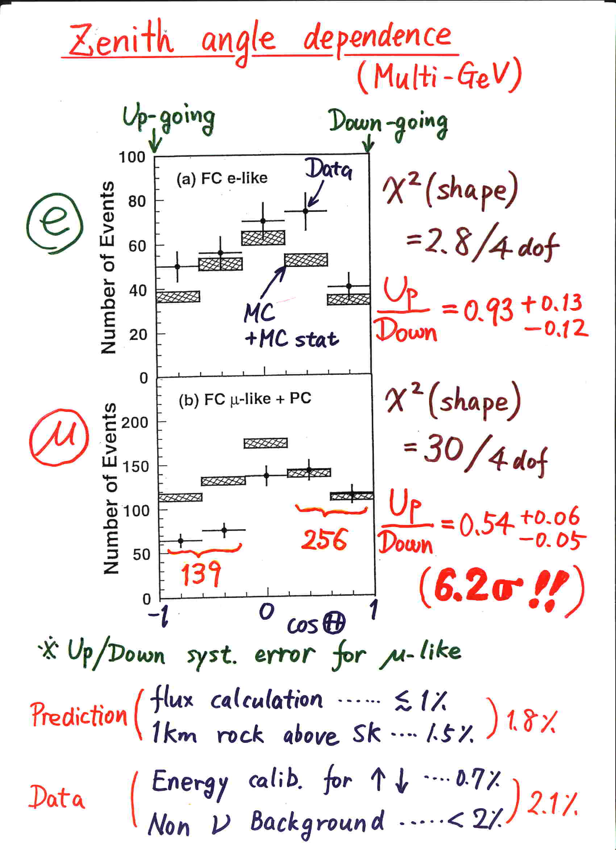
Neutrino ‘98: SuperKamiokande!
Kajita, Nu ‘98
Kajita-sensei announced the first evidence of neutrino oscillation on June 5 at the Neutrino conference in Takayama.
I was still an undergrad and was working at LANL that summer in condensed matter experiment. I remember this being the most exciting science news of that summer.
I believe it was in 1999 I was presenting at the APS meeting in Atlanta and attended a session on neutrino oscillation where a young Giorgio Gratta mentioned this new reactor neutrino experiment in Japan during his presentation…

Slide 3
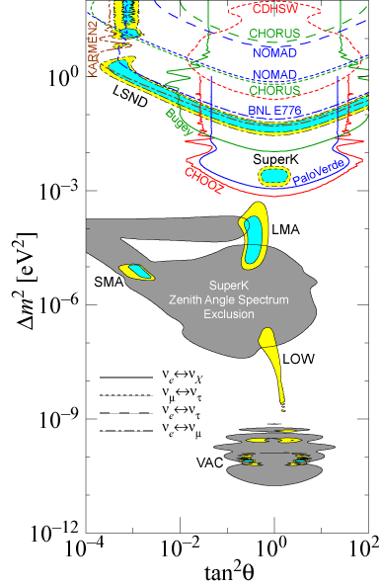
Neutrino Oscillation
Pre-KamLAND
SuperK oscillations at Δm² ~ 10⁻³
LSND hints at higher Δm²
Solar neutrino problem solutions:
  MSW flavor transformation
    Small mixing angle
    Large mixing angle
    Low Δm²
  Vacuum oscillations

Slide 4
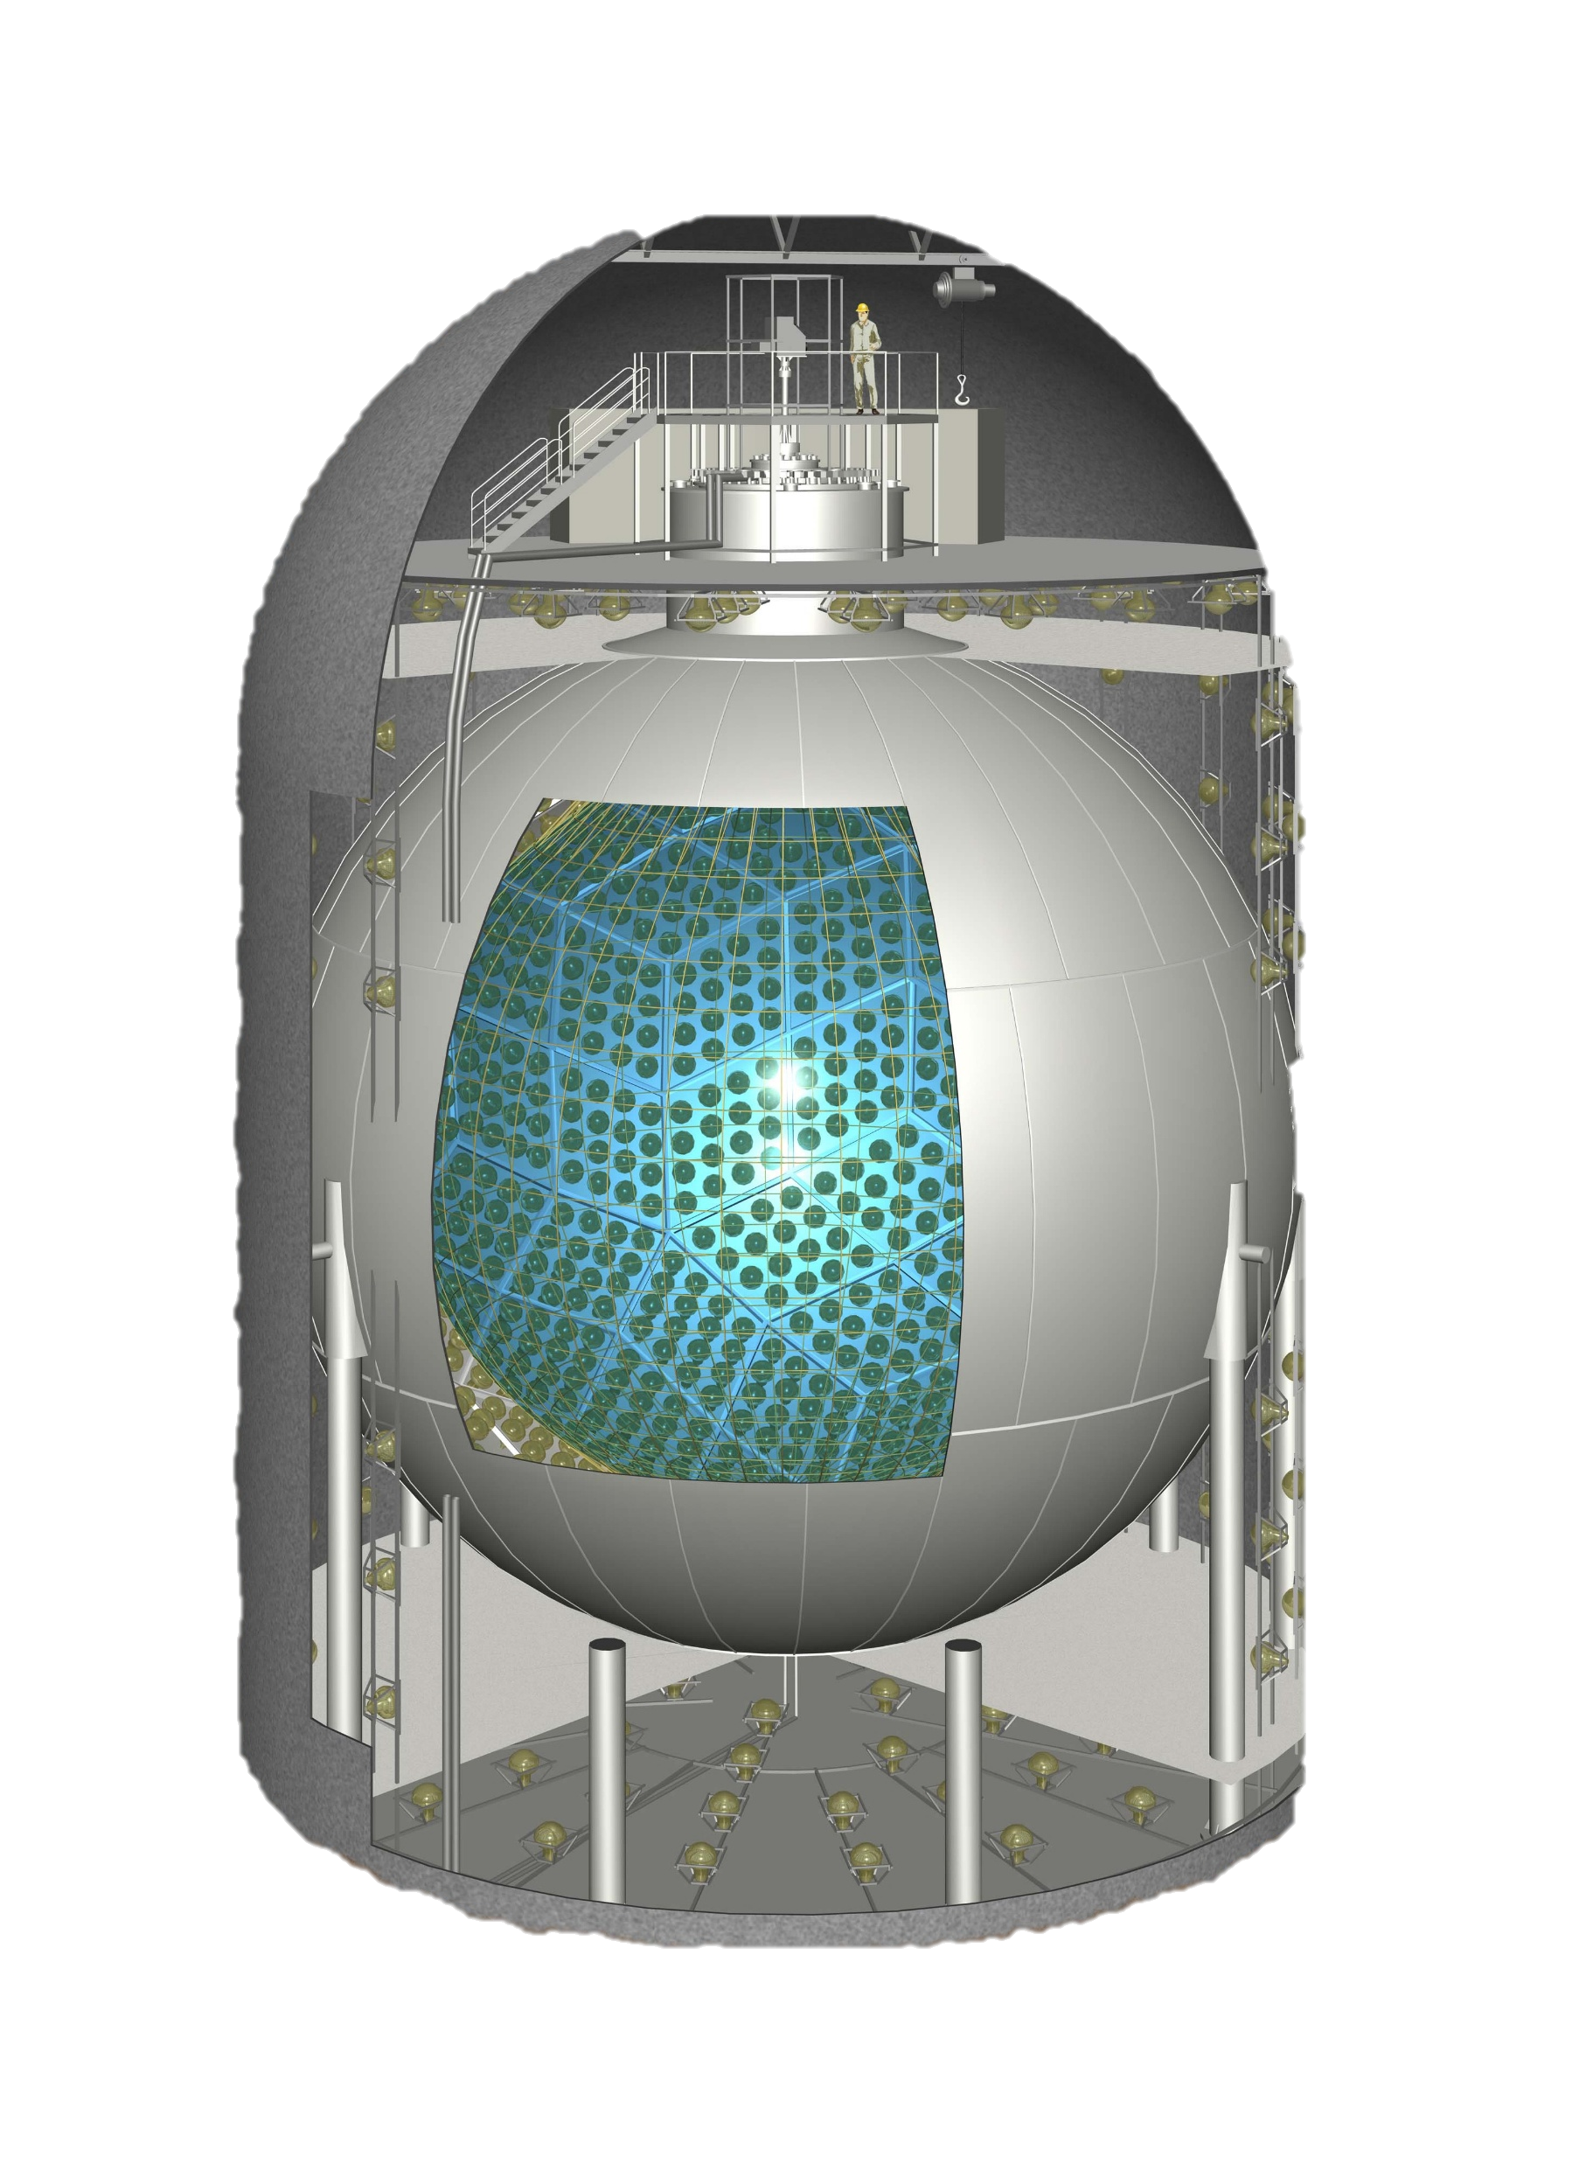
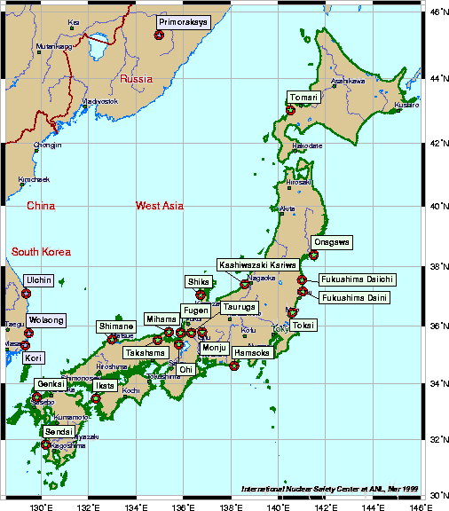
KamLAND Strategy
Atsuto Suzuki: “let’s build a
1 kton LS detector in the old Kamiokande cavern”
“Free beam” from the Japanese nuclear power industry, with convenient distribution
Sensitive to LMA solution
  Early ‘90’s theorists: “Don’t waste your time, it’s obviously SMA like the quarks…”

Slide 5

KamLAND Strategy
Atsuto Suzuki: “let’s build a
1 kton LS detector in the Kamiokande cavern”
“Free beam” from the Japanese nuclear power industry, with convenient distribution
Sensitive to LMA solution
  Early ‘90’s theorists: “Don’t waste your time, it’s obviously SMA like the quarks…”
KamLAND $\left\langle L\right\rangle$

Slide 6
KamLAND History
Suzuki, Nu ‘98
‘94: KamLAND proposal in Japanese
’97: funded in Japan
‘98: Kamiokande dismantling/ PMT production
US physicists express interest
’99: major infrastructure construction
DOE funding approval
‘00: PMT / balloon installation
’01: filling, commissioning
‘02: start of data taking

Slide 7
KamLAND History
‘94: KamLAND proposal in Japanese
’97: funded in Japan
‘98: Kamiokande dismantling/ PMT production
US physicists express interest
’99: major infrastructure construction
DOE funding approval
‘00: PMT / balloon installation
’01: filling, commissioning
‘02: start of data taking

Slide 8
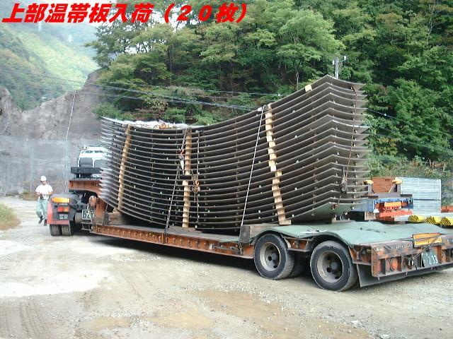
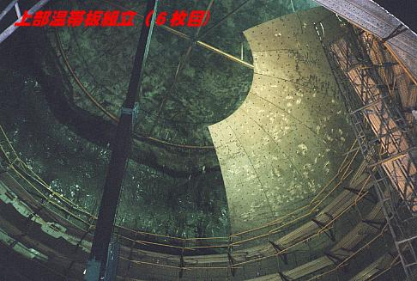
KamLAND History
‘94: KamLAND proposal in Japanese
’97: funded in Japan
‘98: Kamiokande dismantling/ PMT production
US physicists express interest
’99: major infrastructure construction
DOE funding approval
‘00: PMT / balloon installation
’01: filling, commissioning
‘02: start of data taking

Slide 9
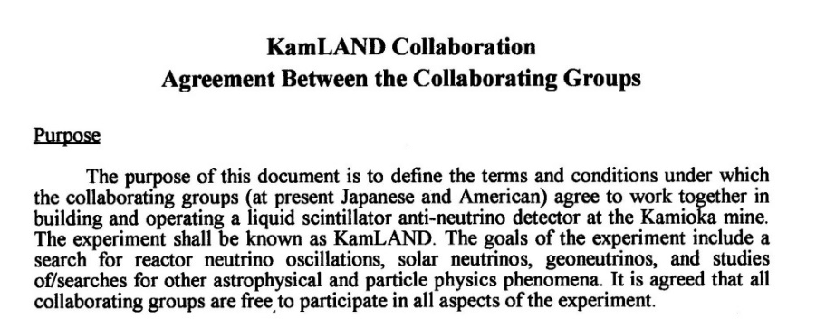
KamLAND History
‘94: KamLAND proposal in Japanese
’97: funded in Japan
‘98: Kamiokande dismantling/ PMT production
US physicists express interest
’99: major infrastructure construction
DOE funding approval
‘00: PMT / balloon installation
’01: filling, commissioning
‘02: start of data taking
UH contribution: optical calibration system

Slide 10
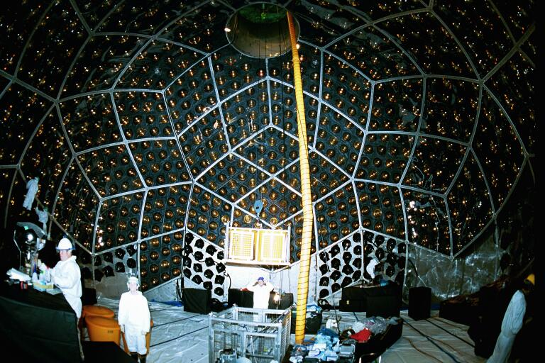
KamLAND History
‘94: KamLAND proposal in Japanese
’97: funded in Japan
‘98: Kamiokande dismantling/ PMT production
US physicists express interest
’99: major infrastructure construction
DOE funding approval
‘00: PMT / balloon installation
’01: filling, commissioning
‘02: start of data taking
yours truly
NASA Astro Pic of the Day, June 23 2023

Slide 11
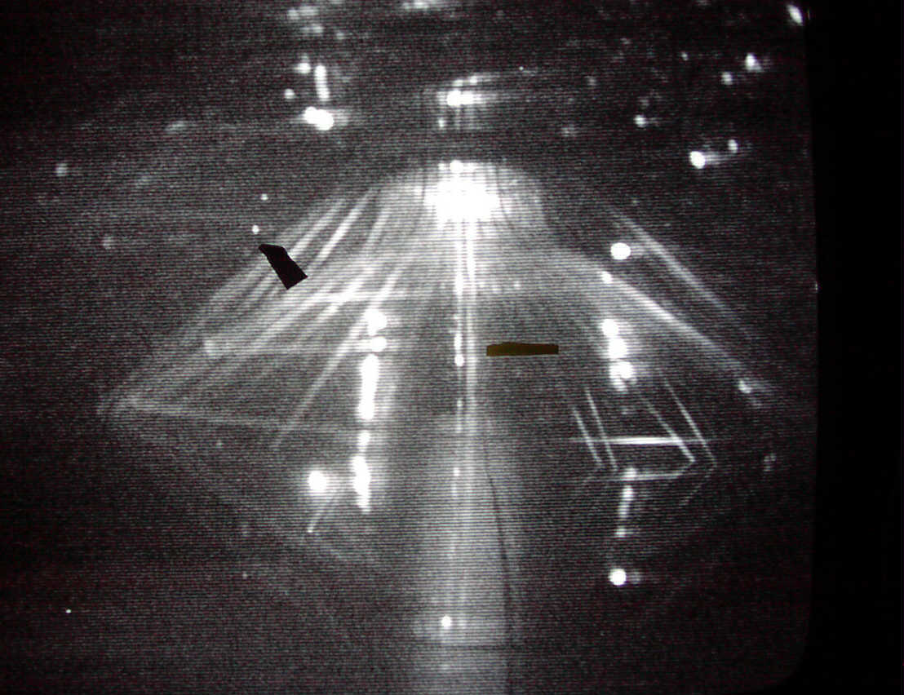
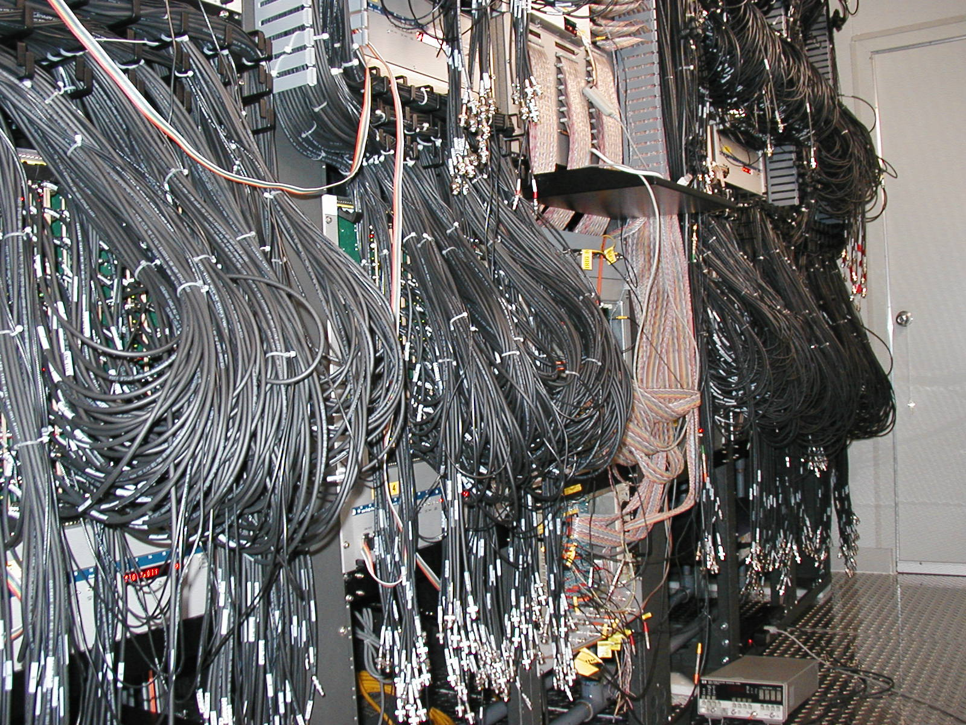
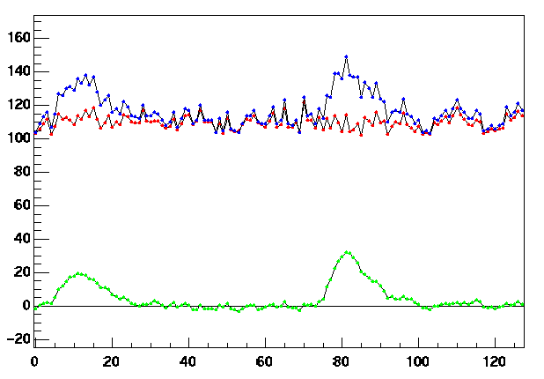
KamLAND History
‘94: KamLAND proposal in Japanese
’97: funded in Japan
‘98: Kamiokande dismantling/ PMT production
US physicists express interest
’99: major infrastructure construction
DOE funding approval
‘00: PMT / balloon installation
’01: filling, commissioning
‘02: start of data taking
adc [~120 μV]
– raw
– pedestal
– subtracted
samples [~1.5 ns]

Slide 12
KamLAND History
Jan ‘02
‘94: KamLAND proposal in Japanese
’97: funded in Japan
‘98: Kamiokande dismantling/ PMT production
US physicists express interest
’99: major infrastructure construction
DOE funding approval
‘00: PMT / balloon installation
’01: filling, commissioning
‘02: start of data taking!

Slide 13
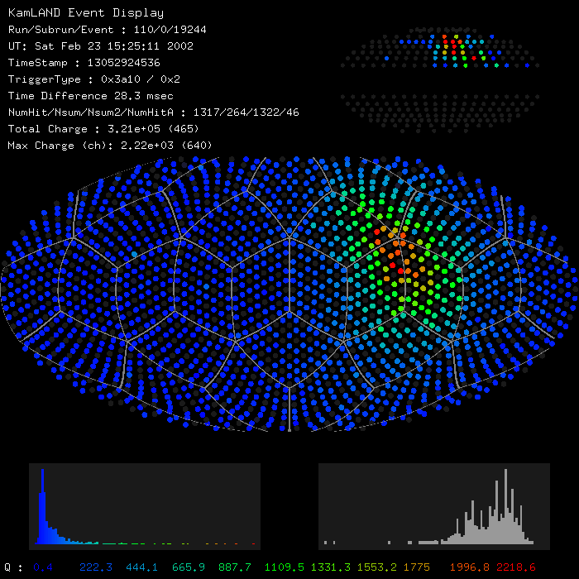
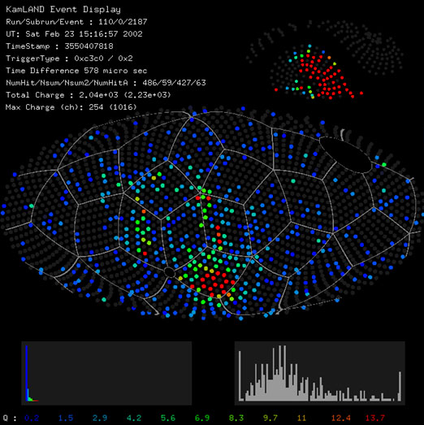
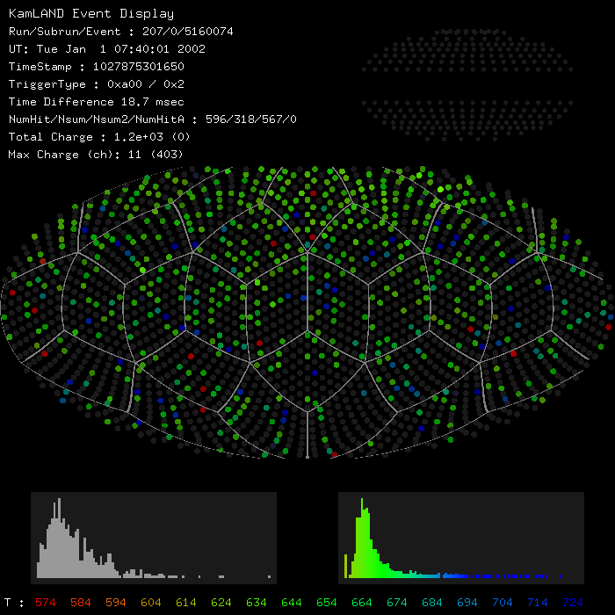
First Data
stopping μ
buffer oil muon
with Cherenkov ring
first antineutrino candidate

Slide 14
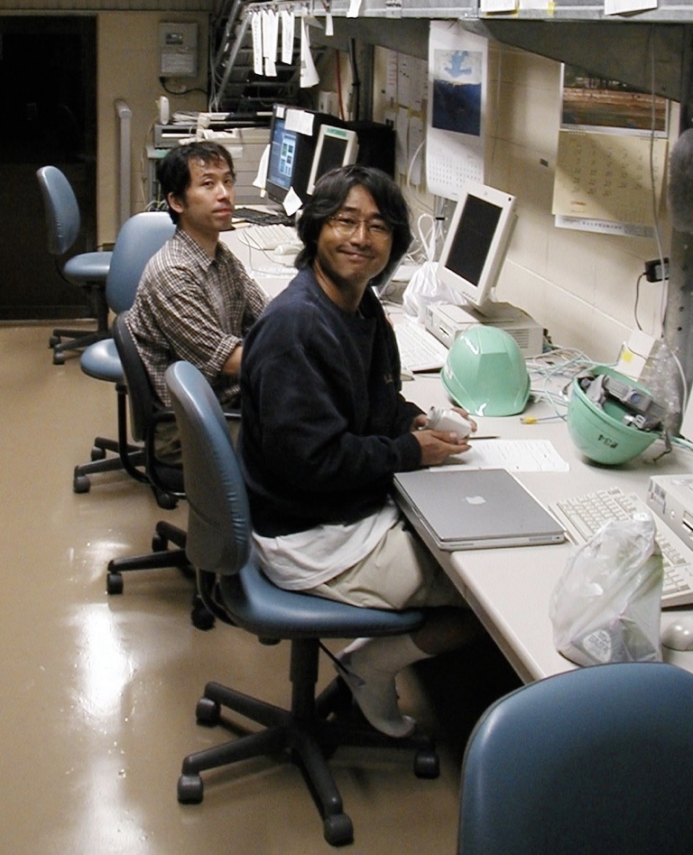
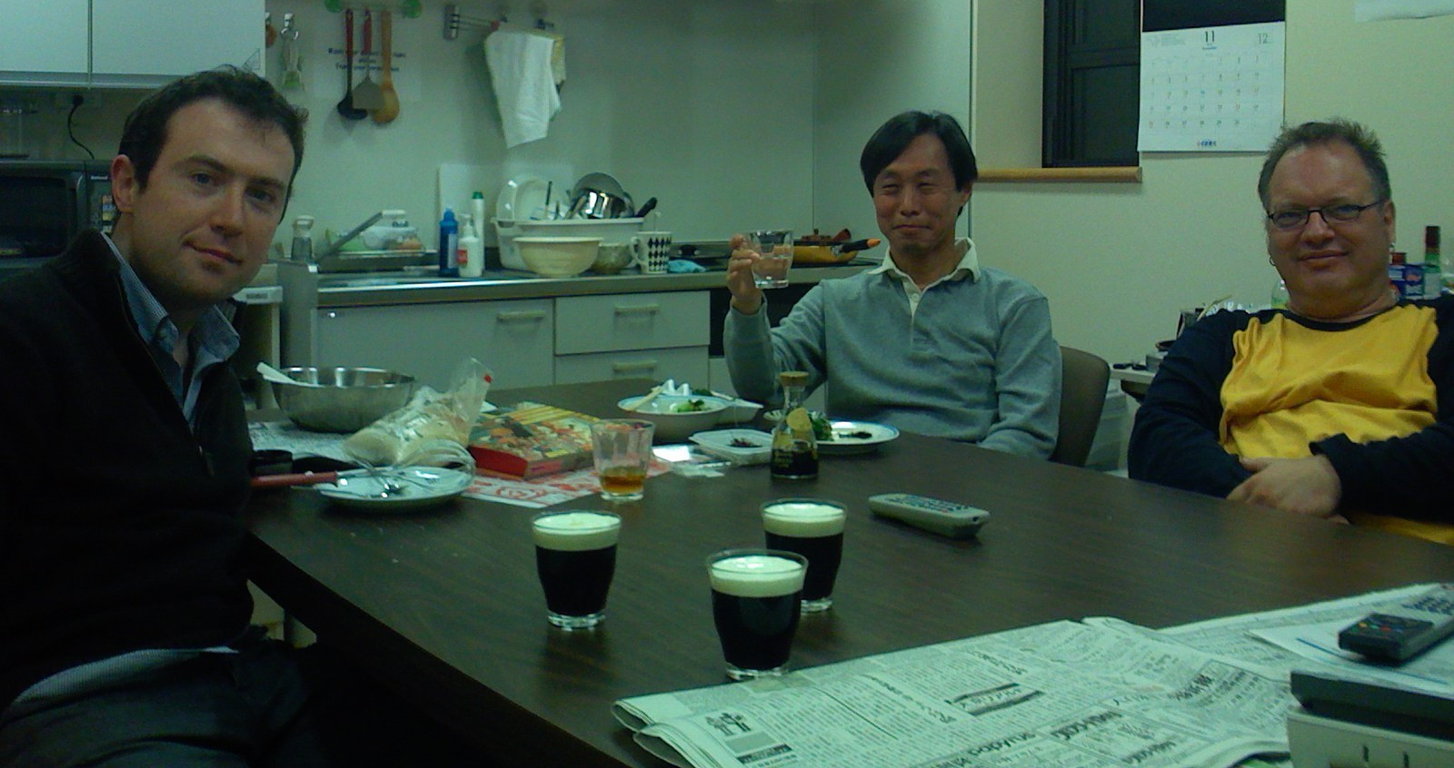
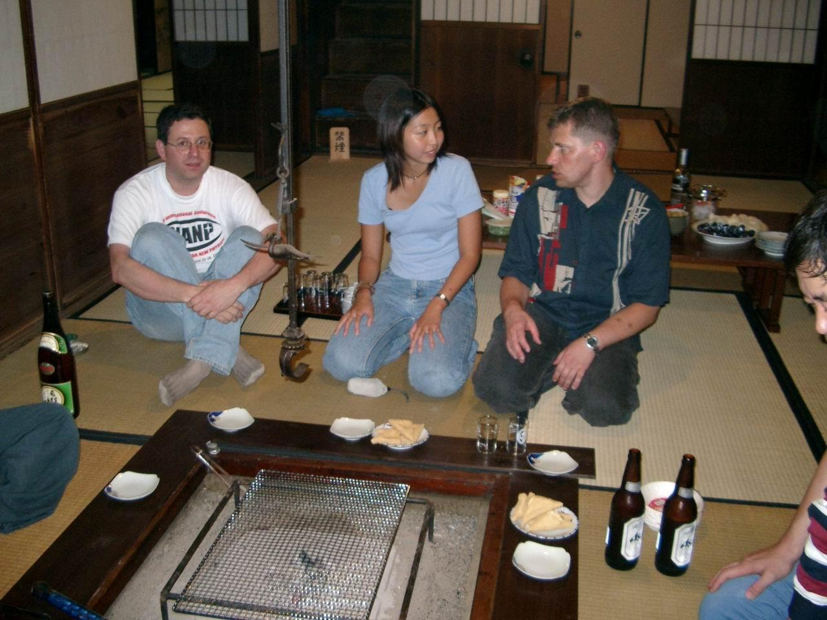
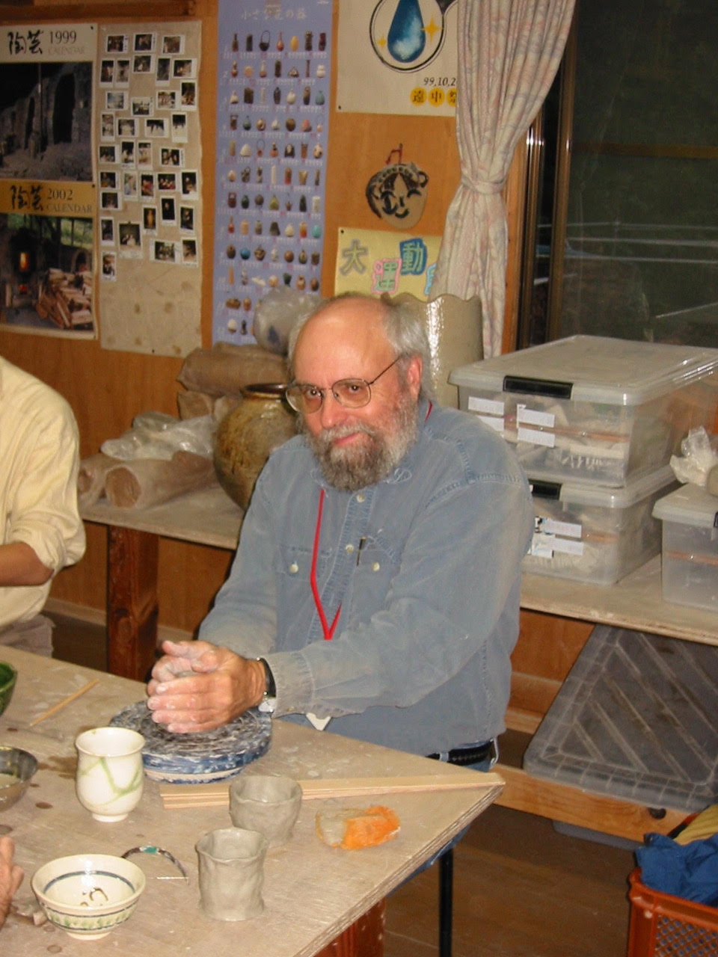
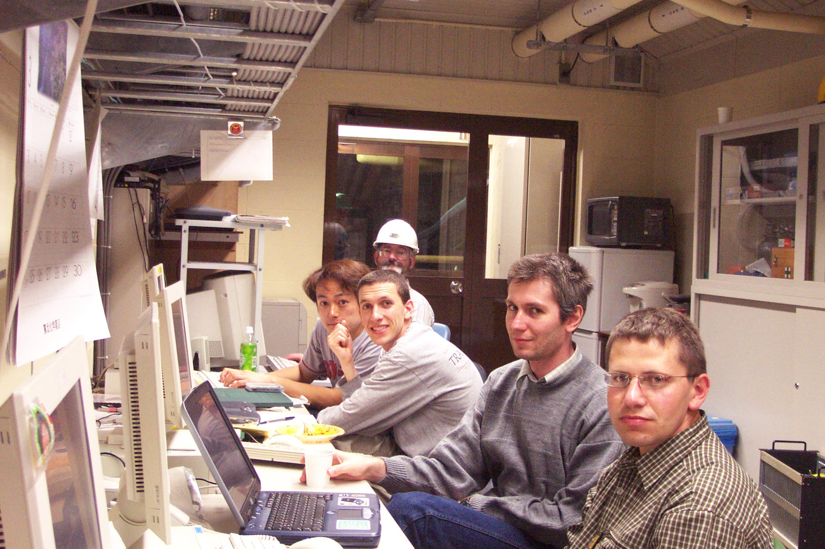
Working in Japan

Slide 15
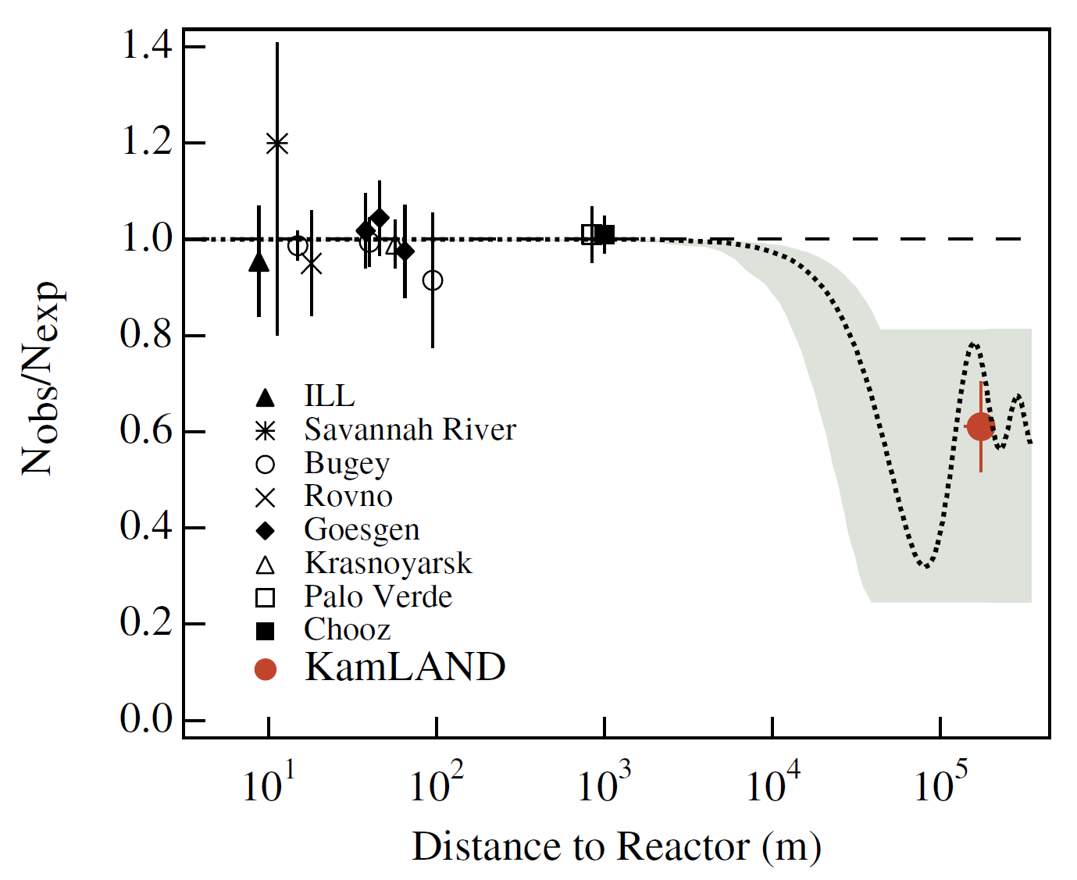
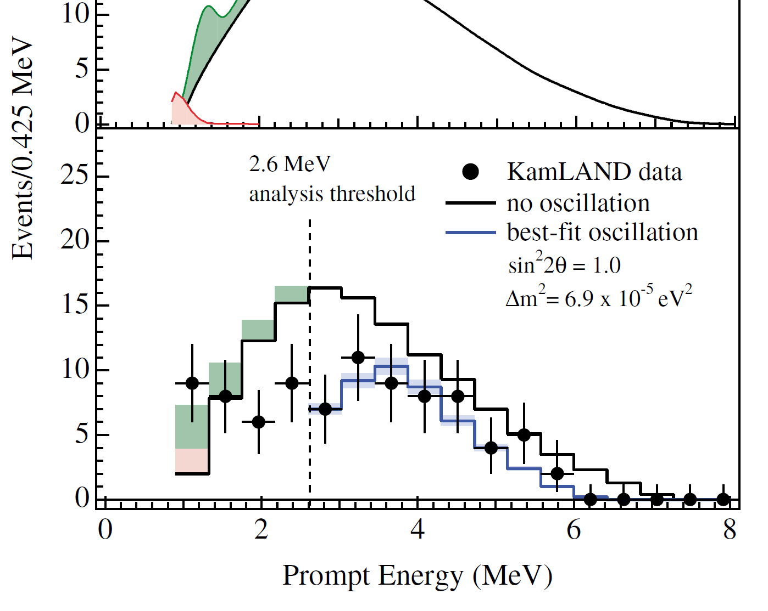
First results: reactor neutrino disappearance
PRL 90, 021802 (2003)

Slide 16
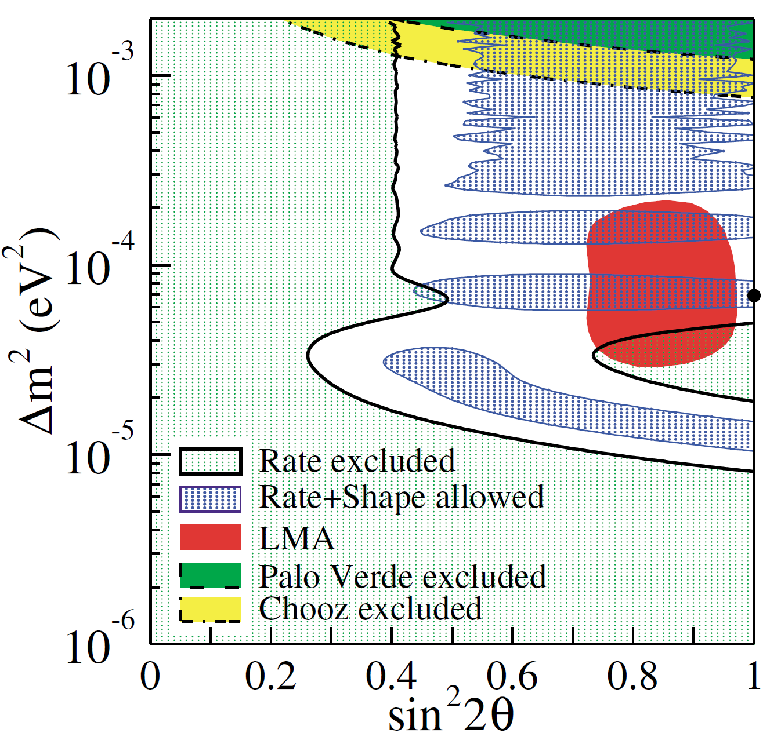
First results: reactor neutrino disappearance
PRL 90, 021802 (2003)

Slide 17
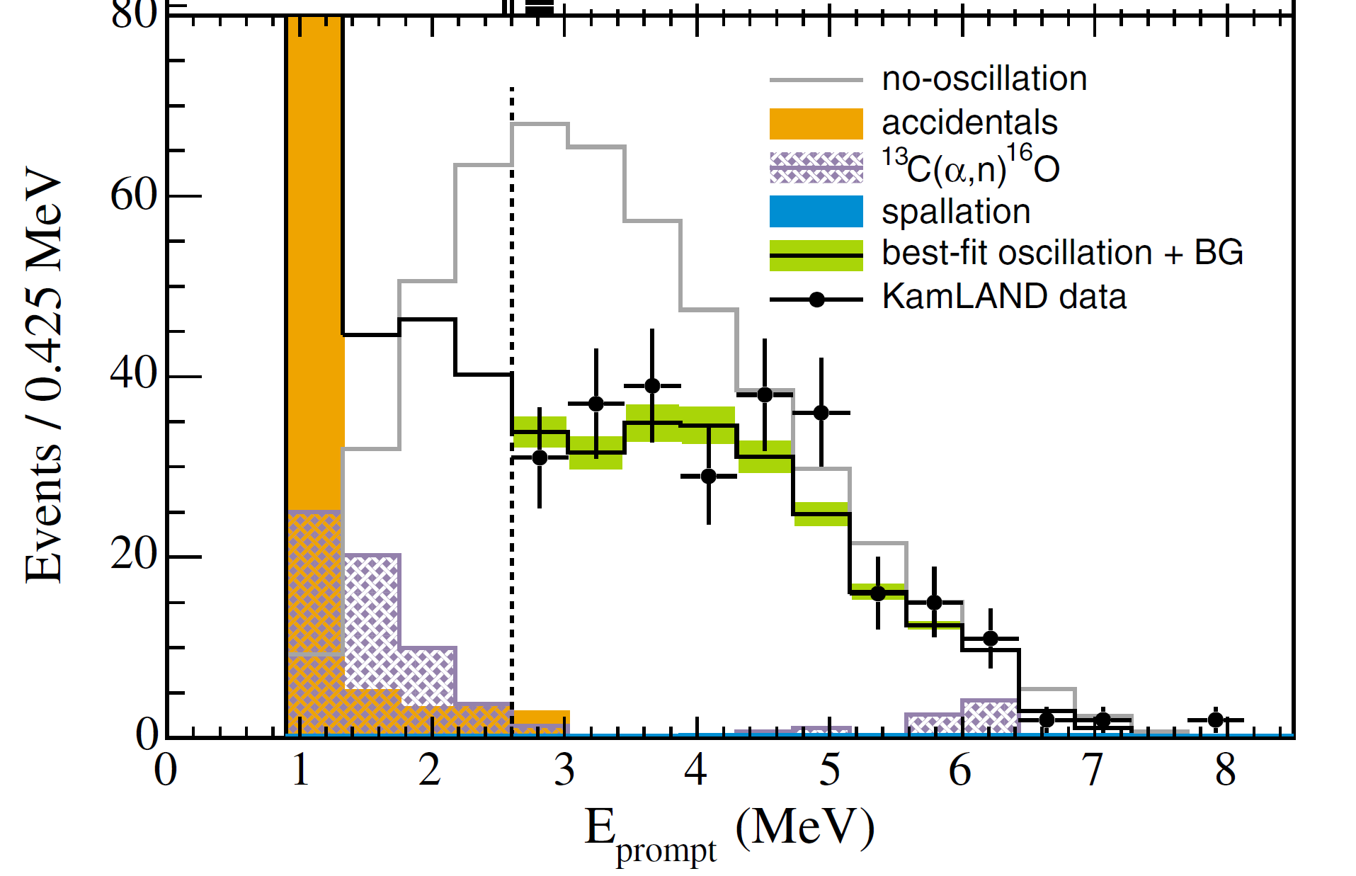
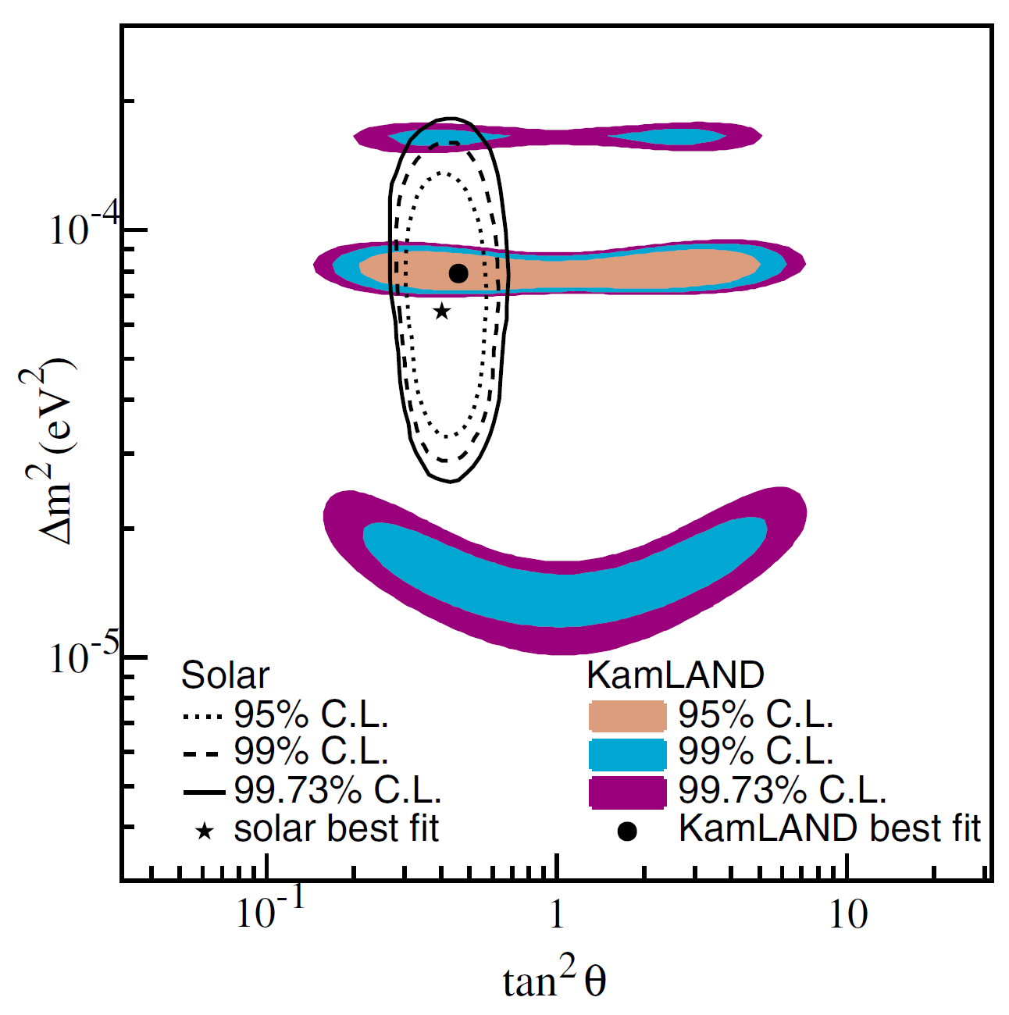
Second Result: spectral distortion
PRL 94, 081801 (2005)

Slide 18
Second Result: spectral distortion
PRL 94, 081801 (2005)

Slide 19
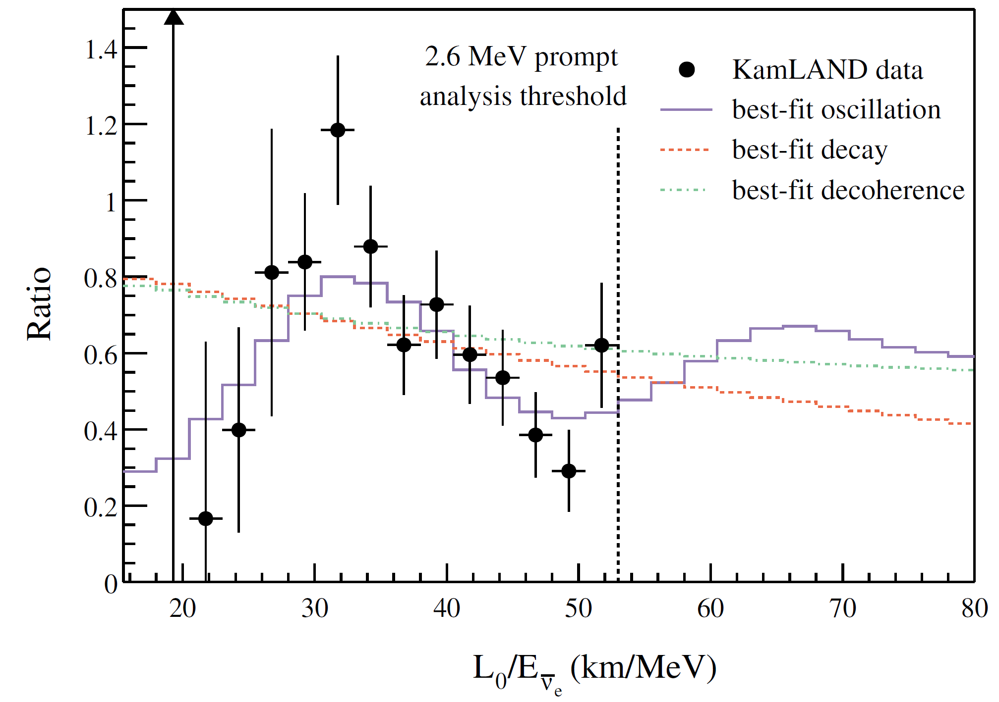
Second Result: spectral distortion
(JGL)
PRL 94, 081801 (2005)

Slide 20
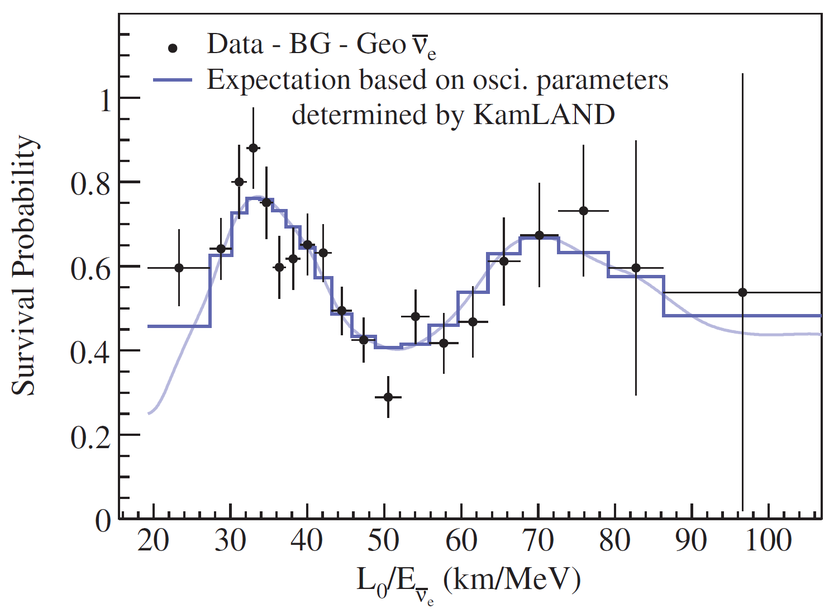
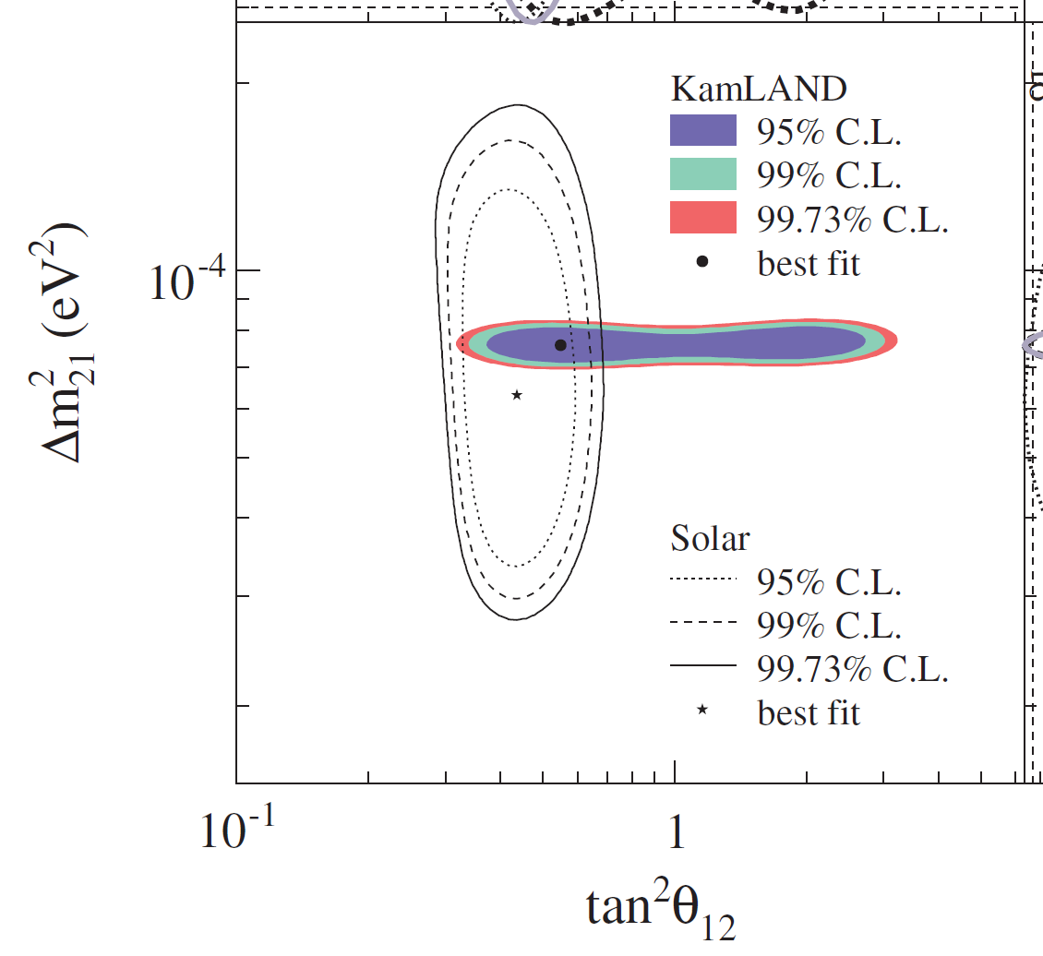
Third Result: precision oscillation
PRL 100, 221803 (2008)

Slide 21
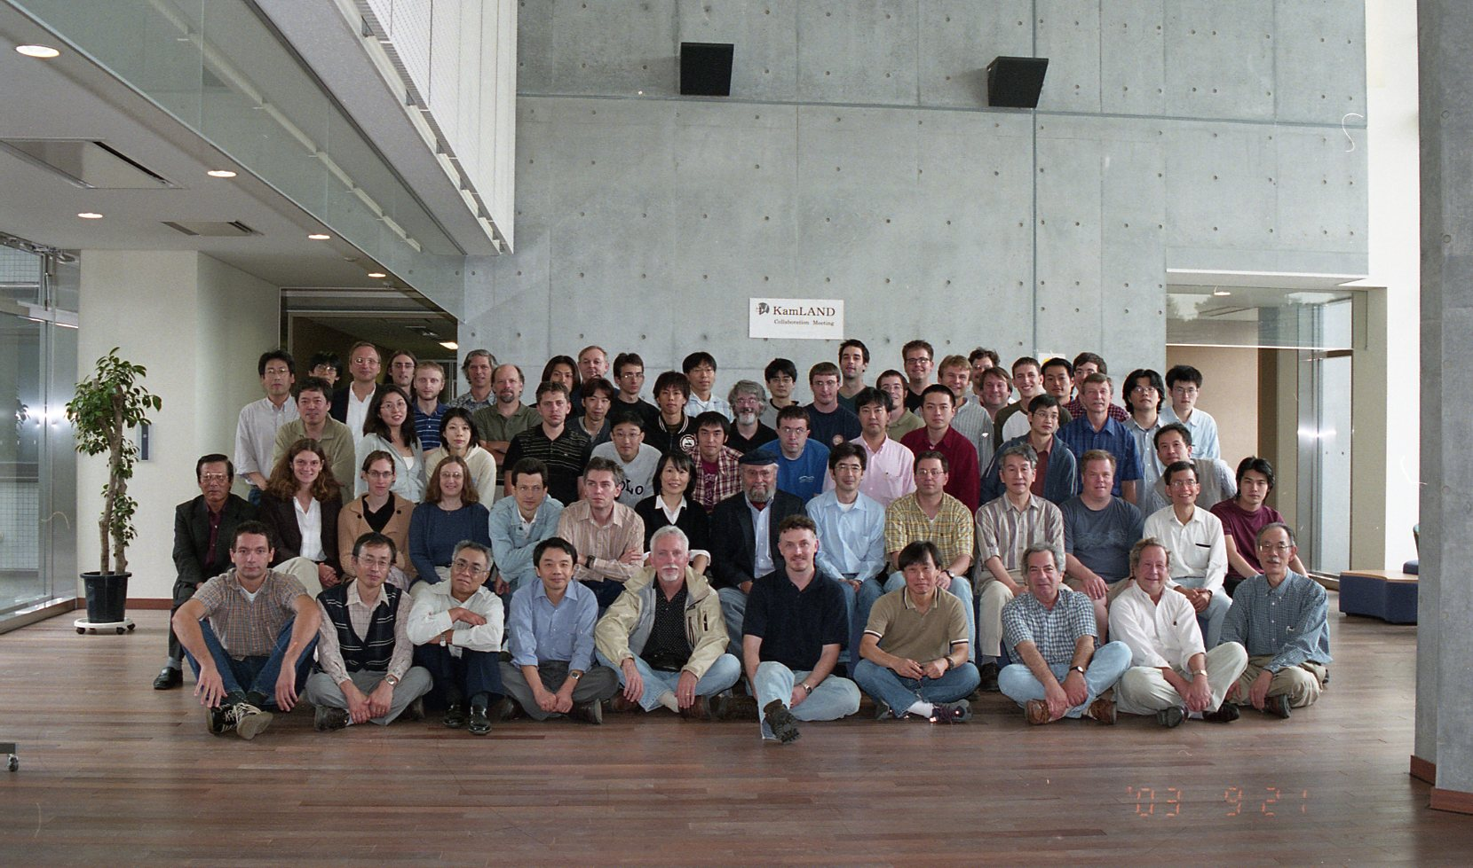
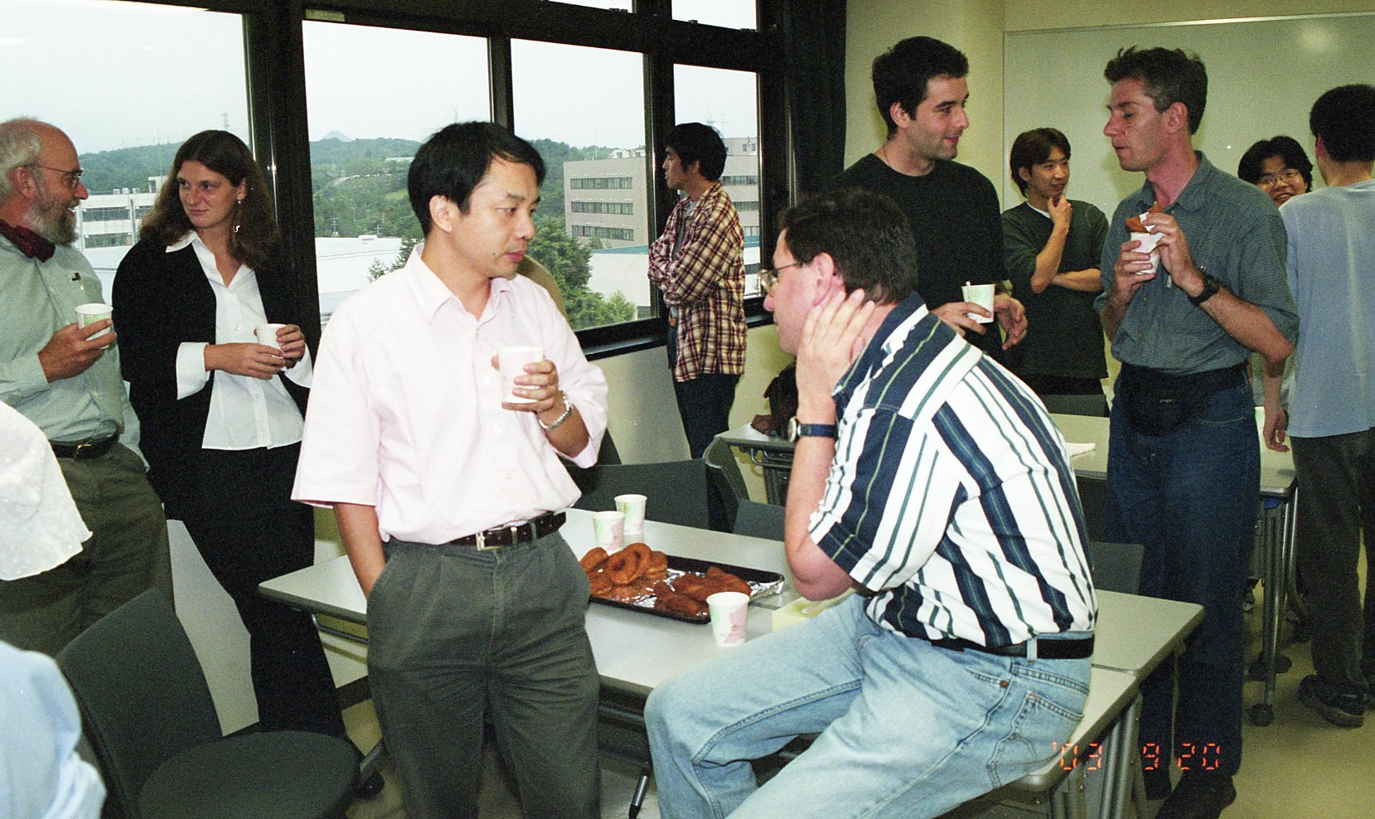
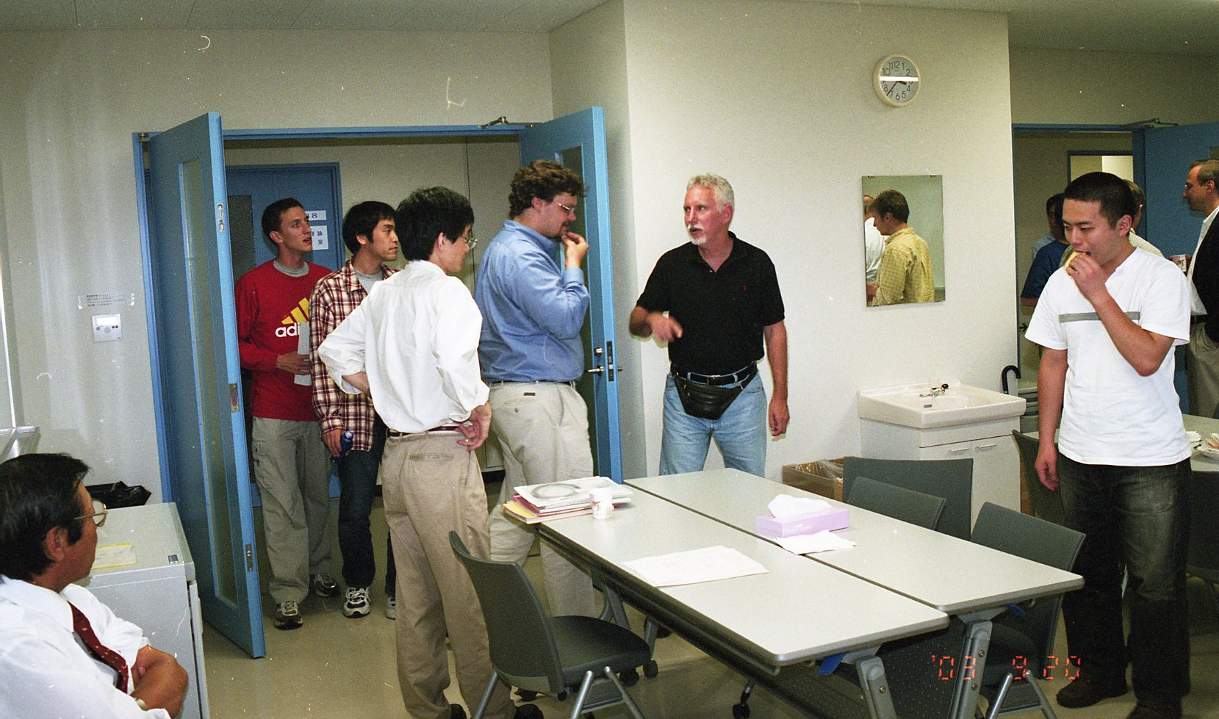
Key Contributions

Slide 22
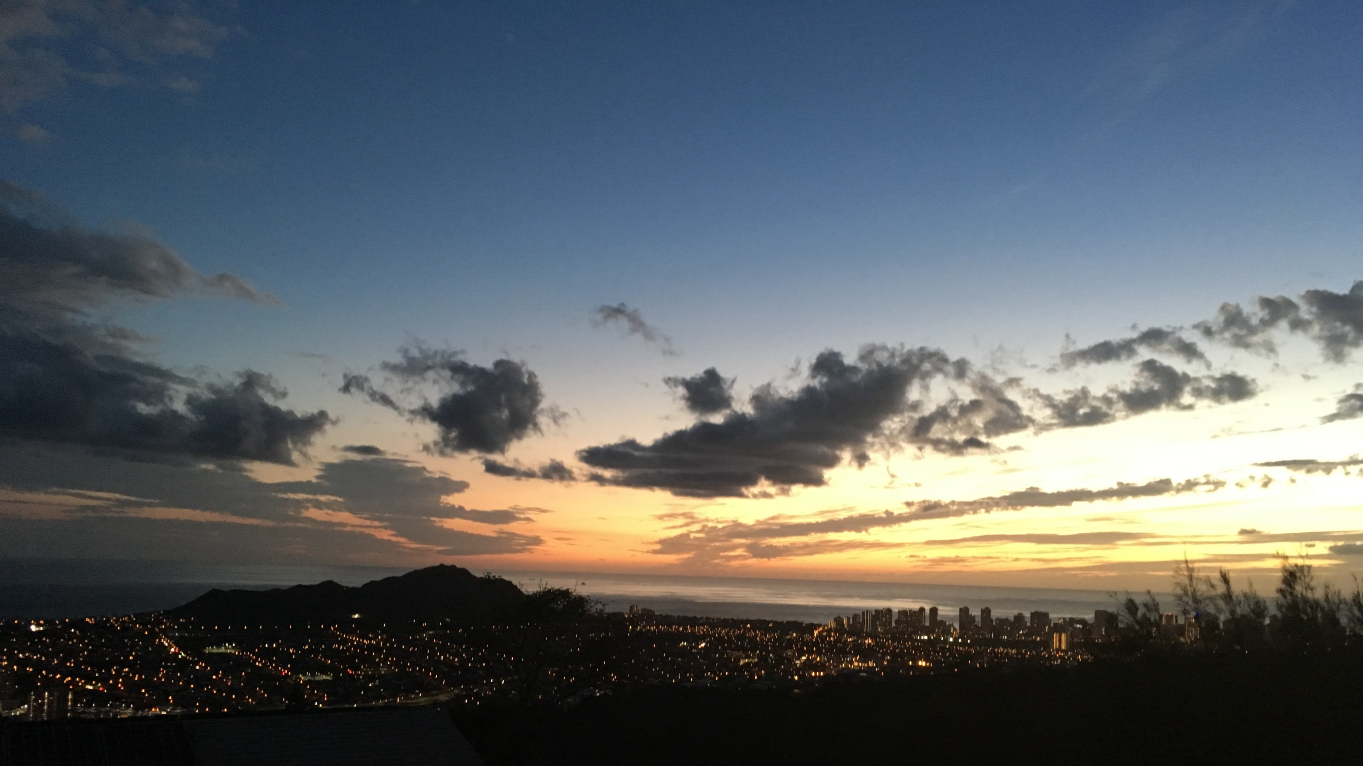
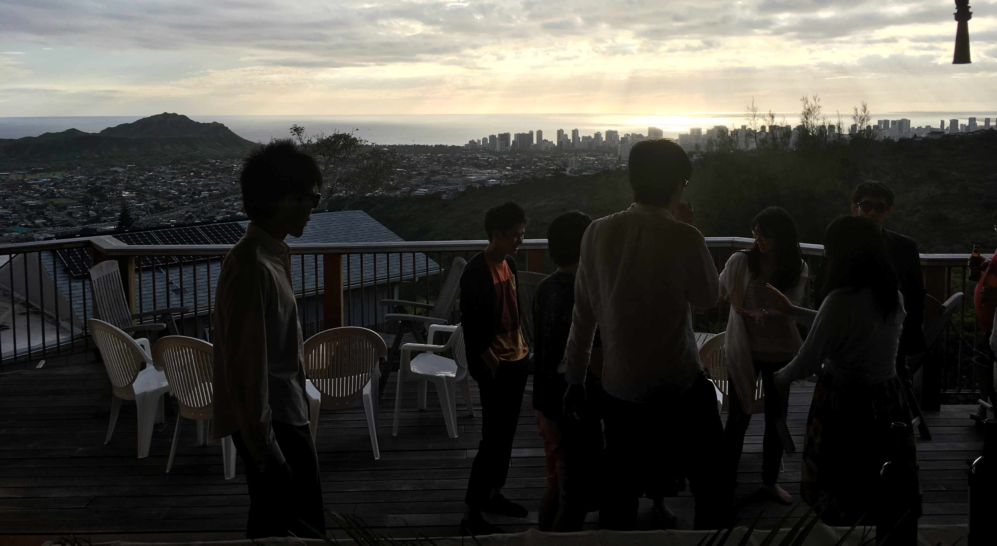
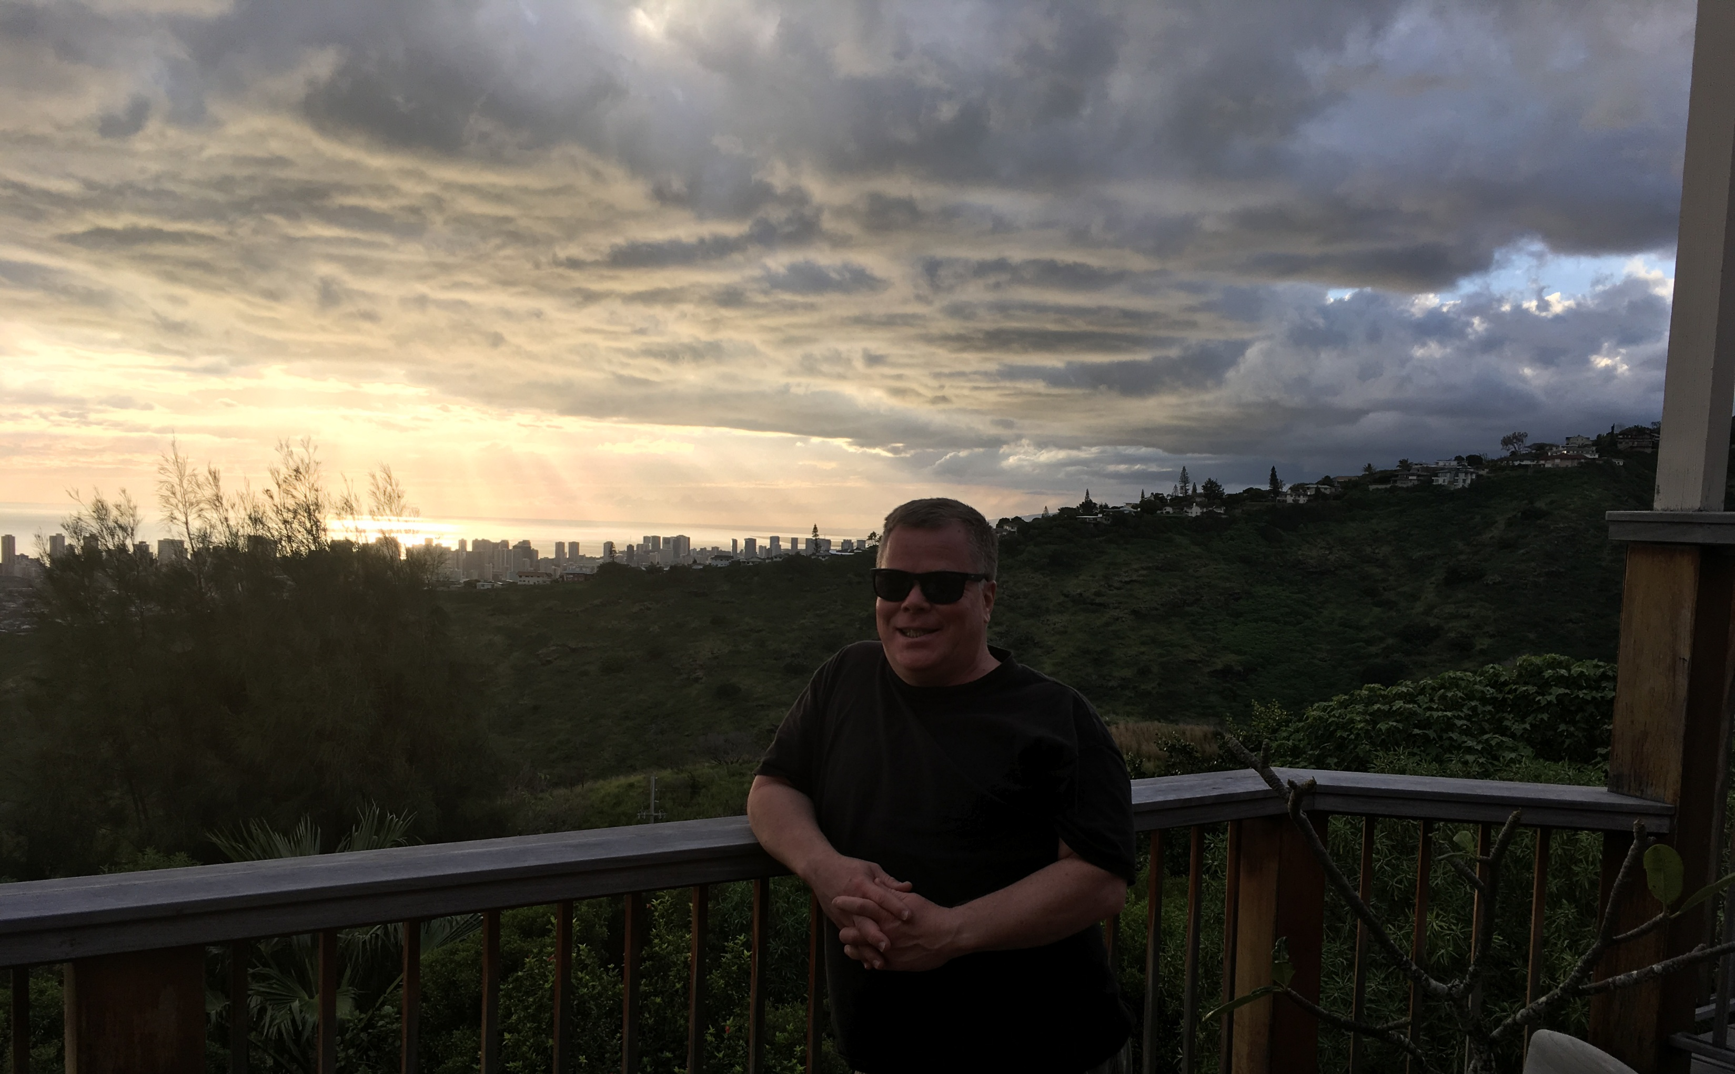
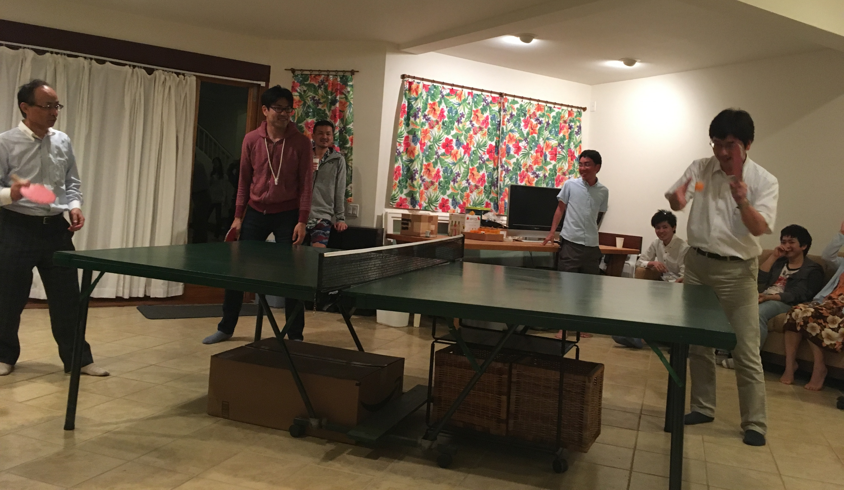
Key Contributions

Slide 23
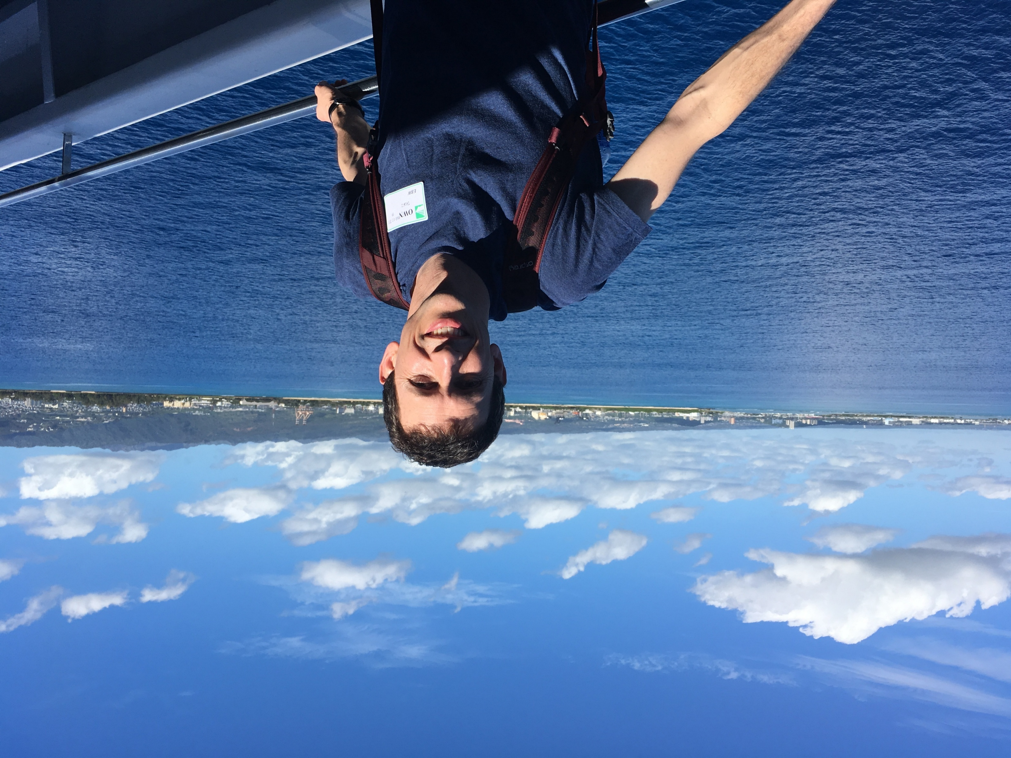
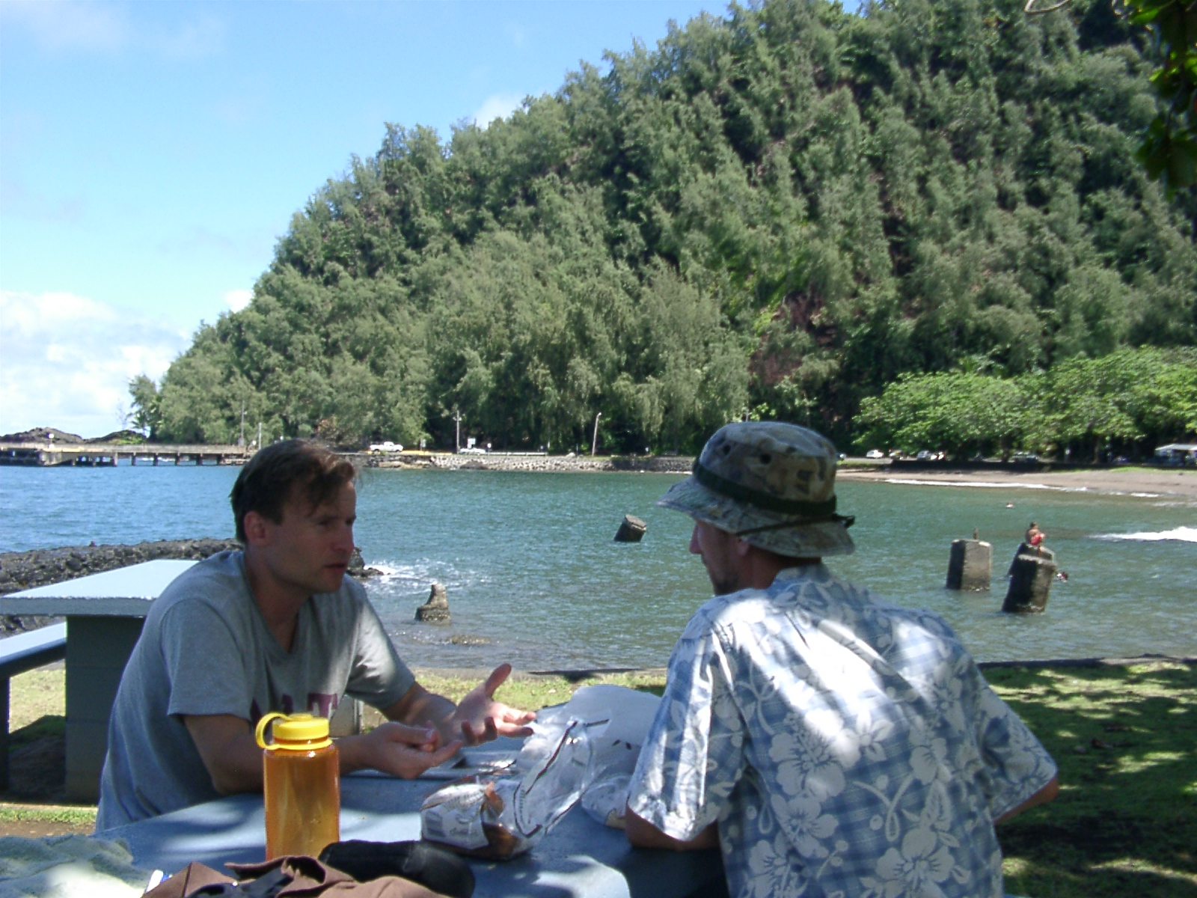
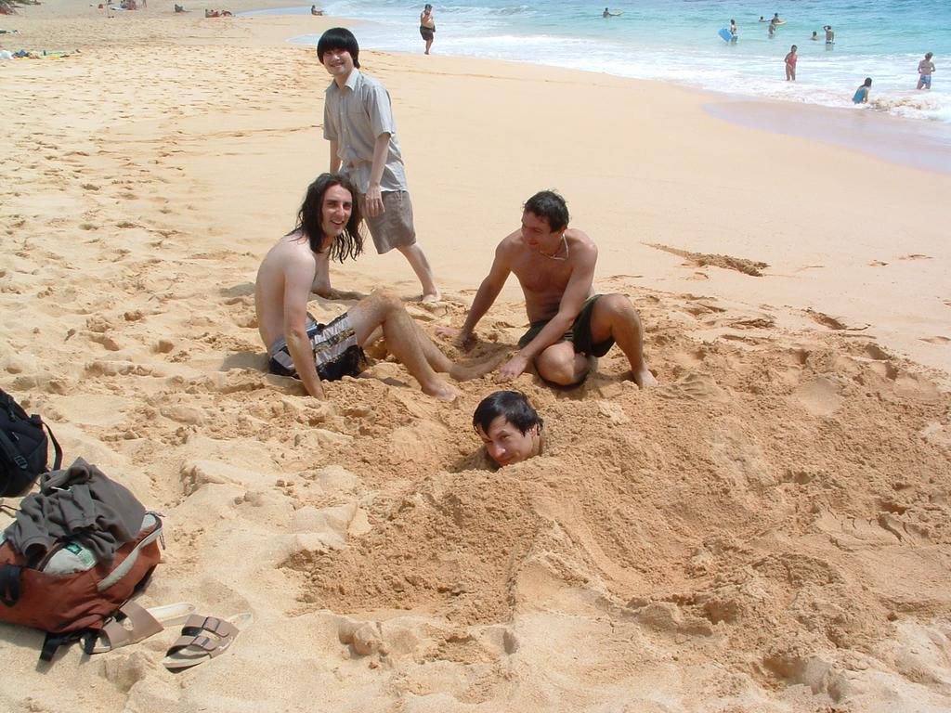
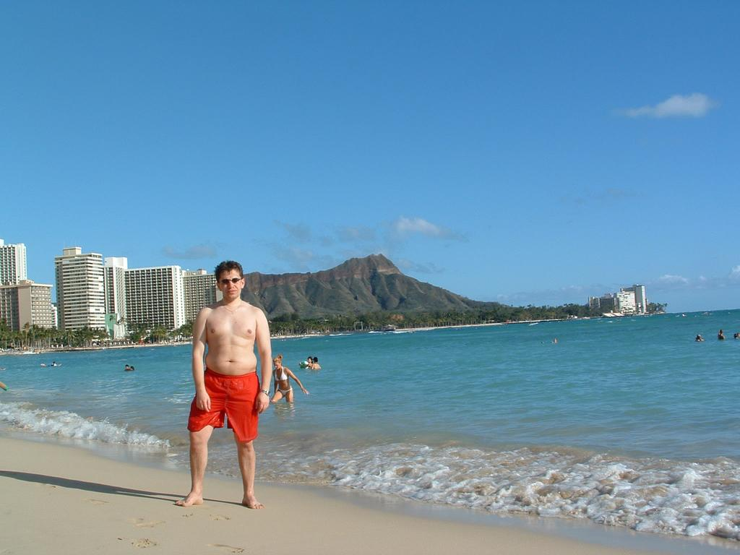
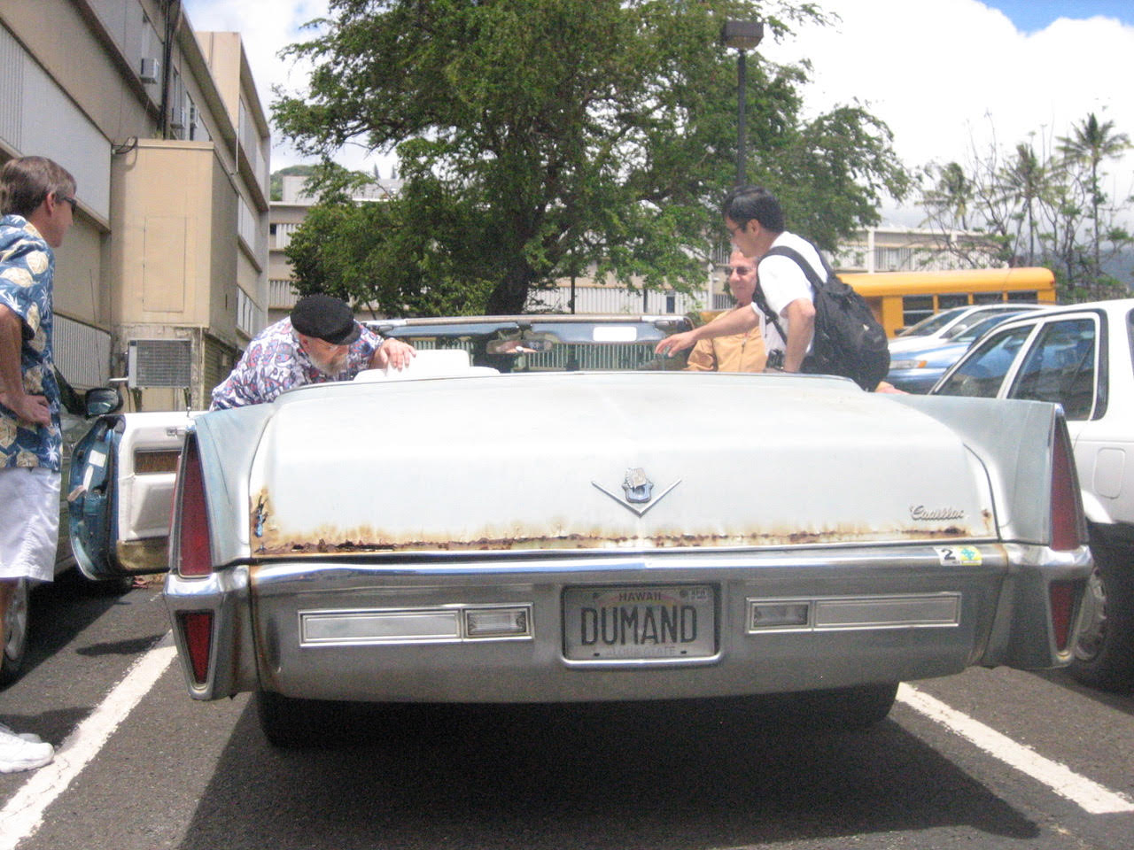
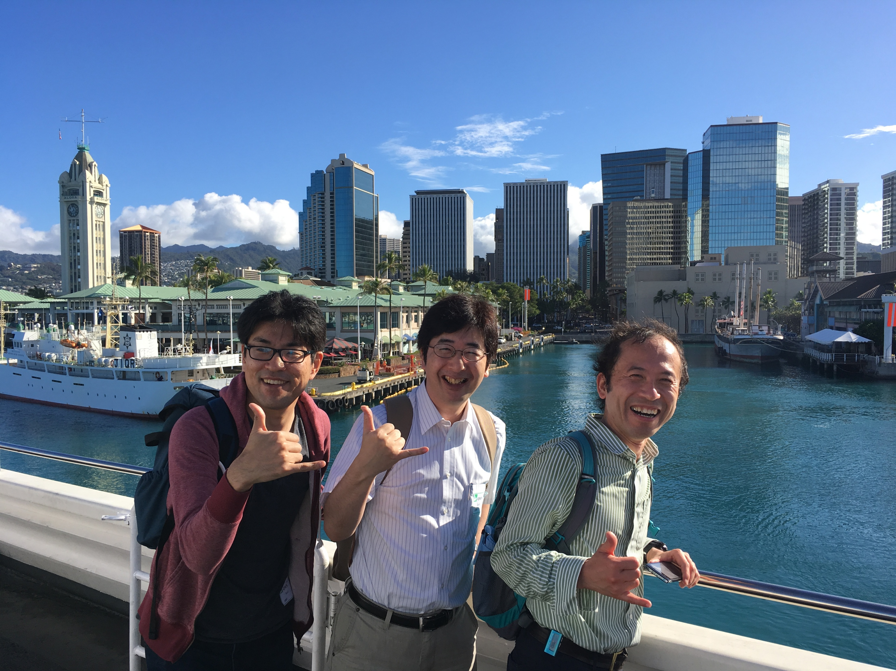

Key Contributions

Slide 24
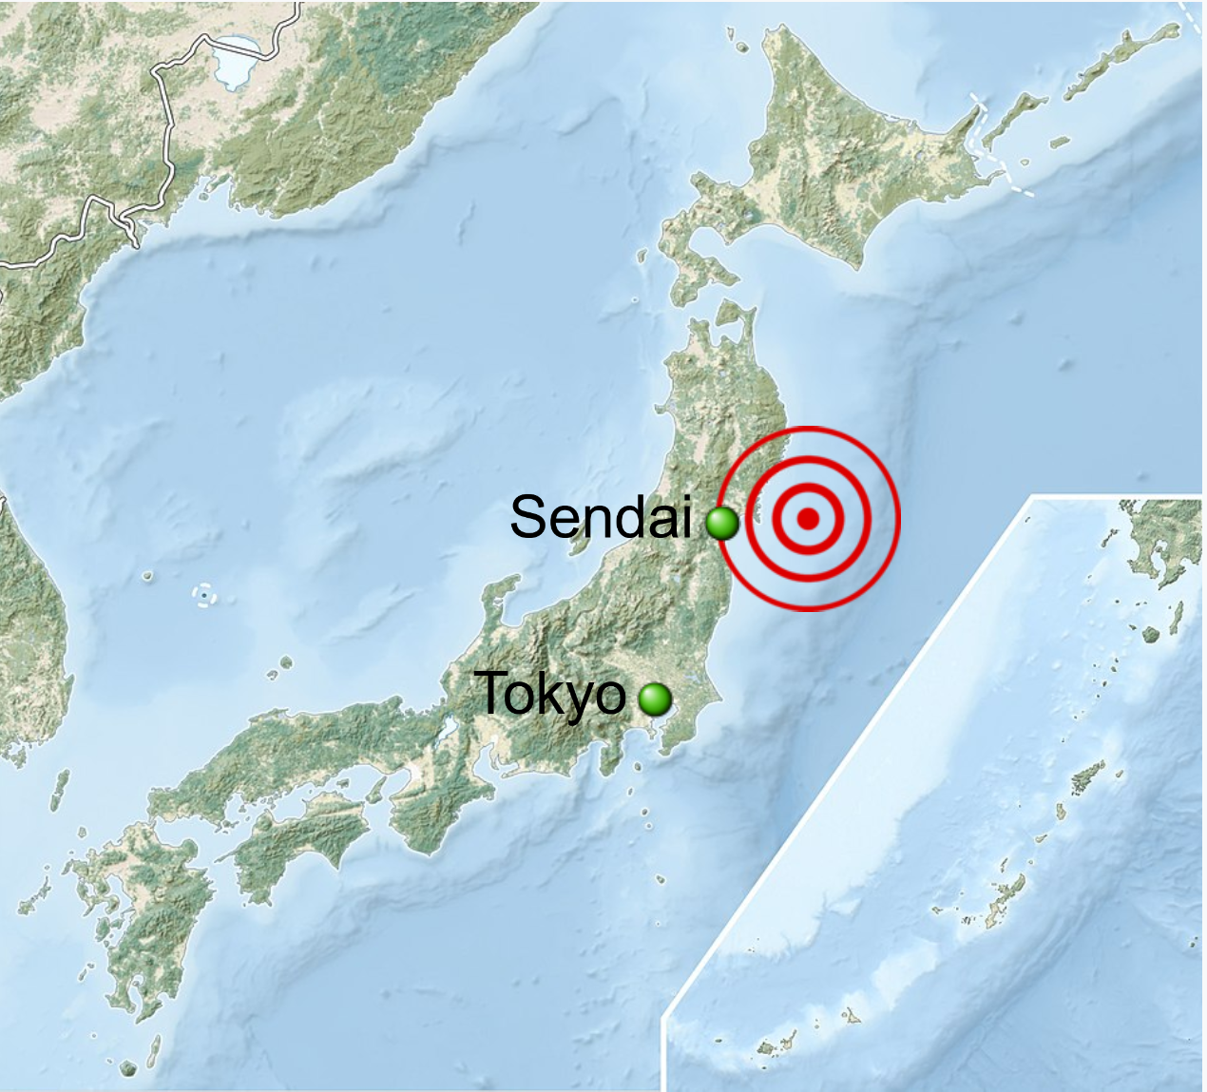
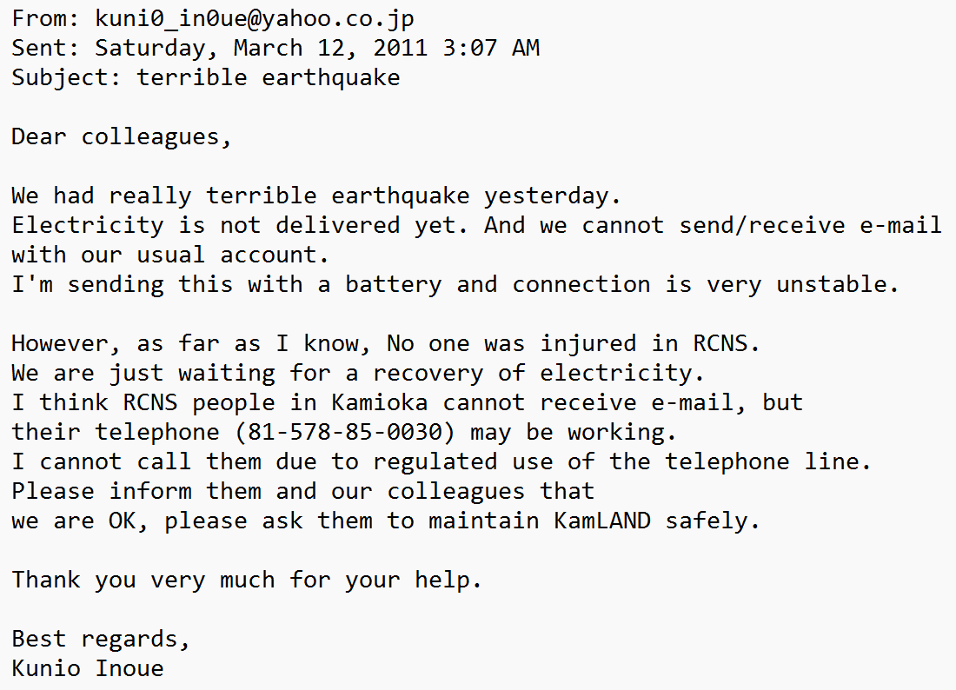
Disaster Strikes…
a

Slide 25
Disaster Strikes…
a
My memory: John was one of the most active on the collaboration in monitoring and communicating the situation, and in working to find ways to help!

Slide 26
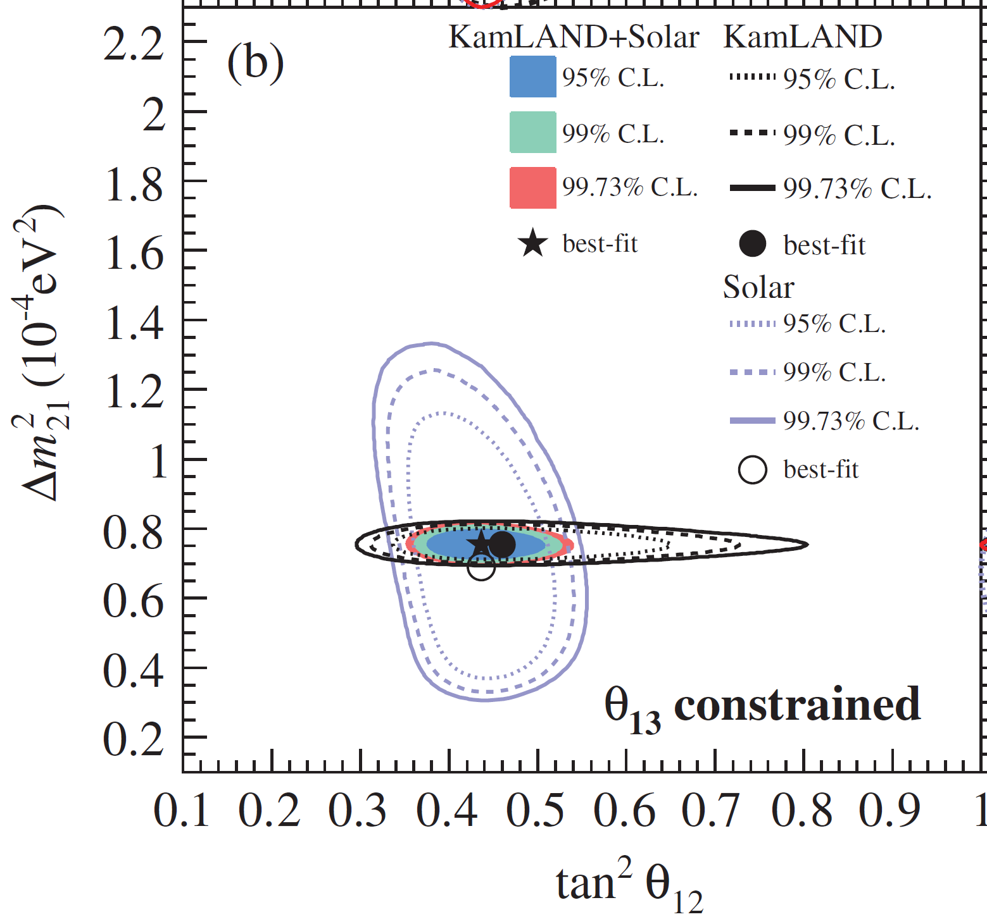
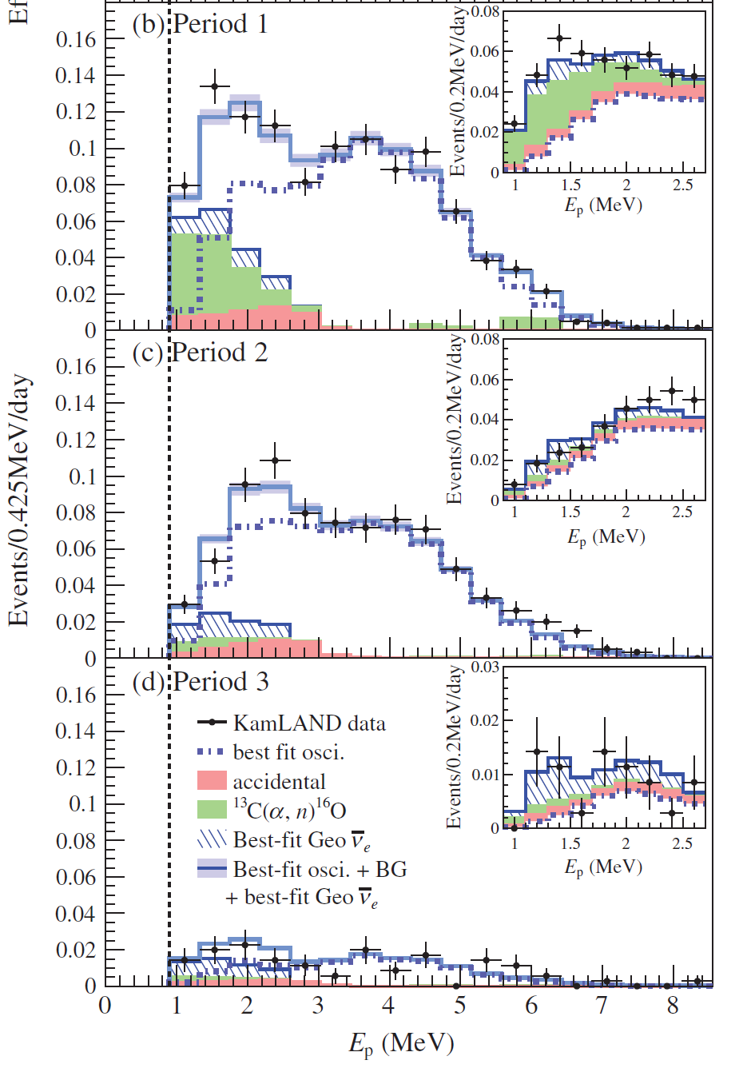
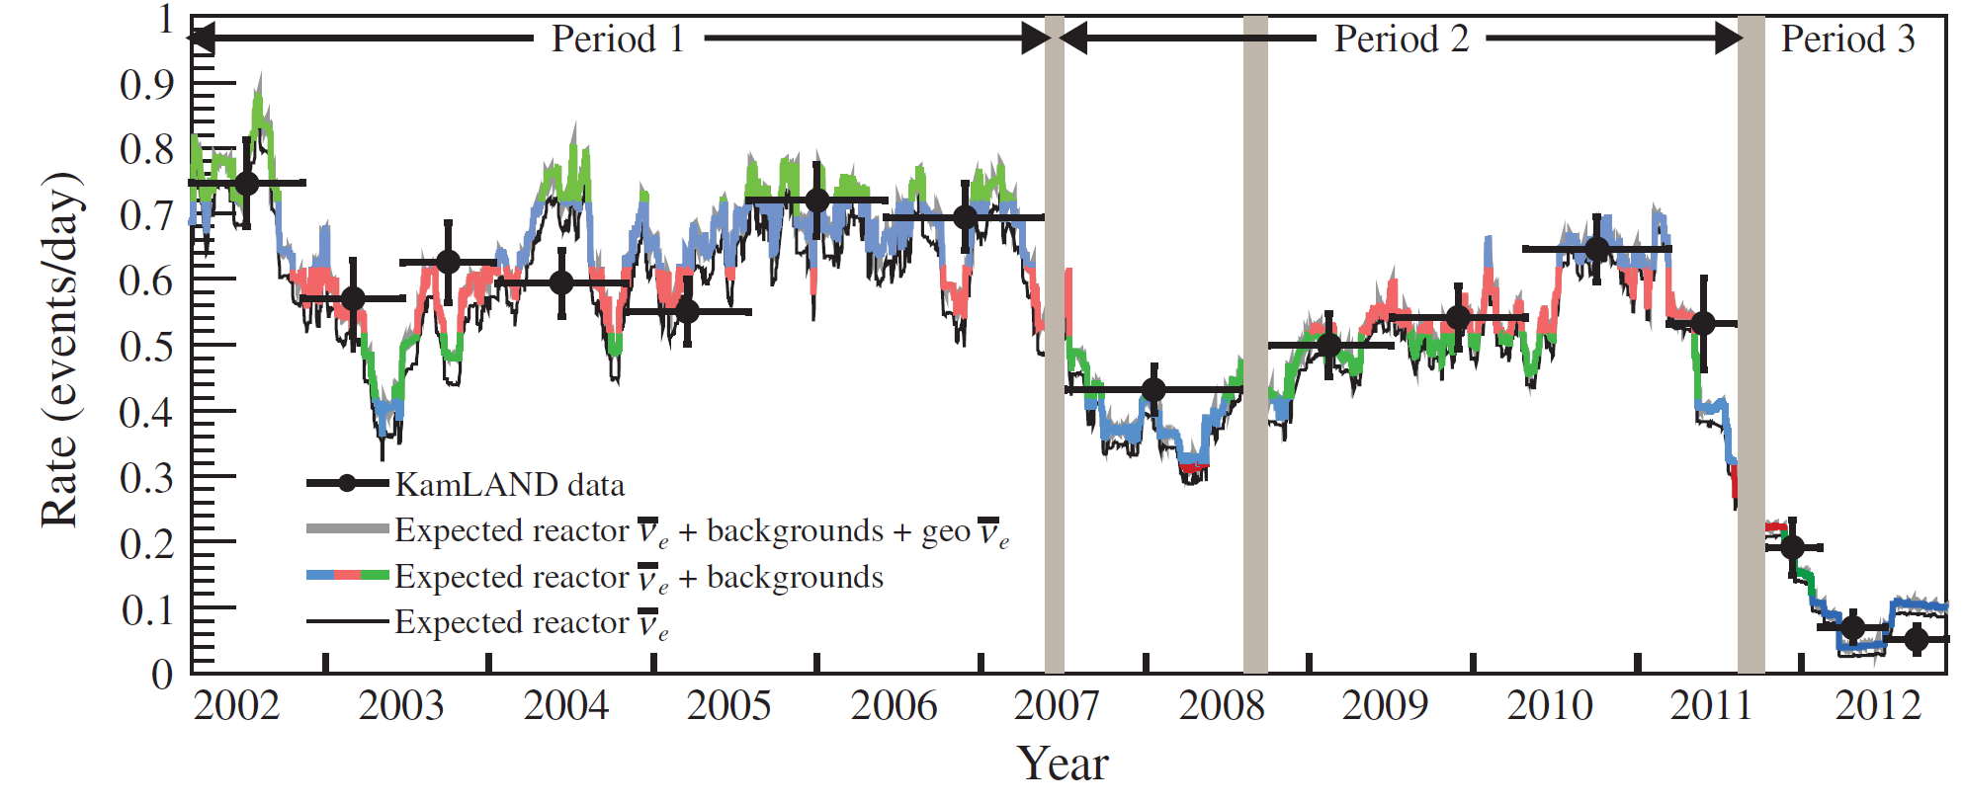
Purification and
Reactor-Off
Data
PDG
new!
new!
new!
new!
PRD 88, 033001 (2013)

Slide 27
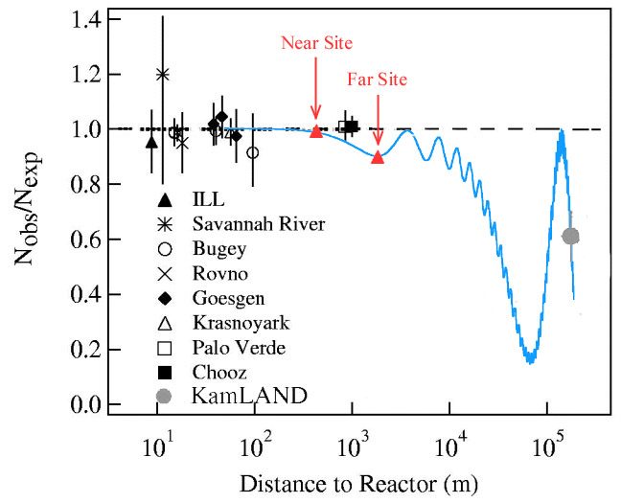
The quest to measure θ₁₃
Stringent CHOOZ limit: is θ₁₃ too small for CPV to be measured?
Non-zero θ₁₃ relieved tension between KamLAND & solar θ₁₂
Daya Bay, RENO, and Double-Chooz performed definitive measurements

Slide 28
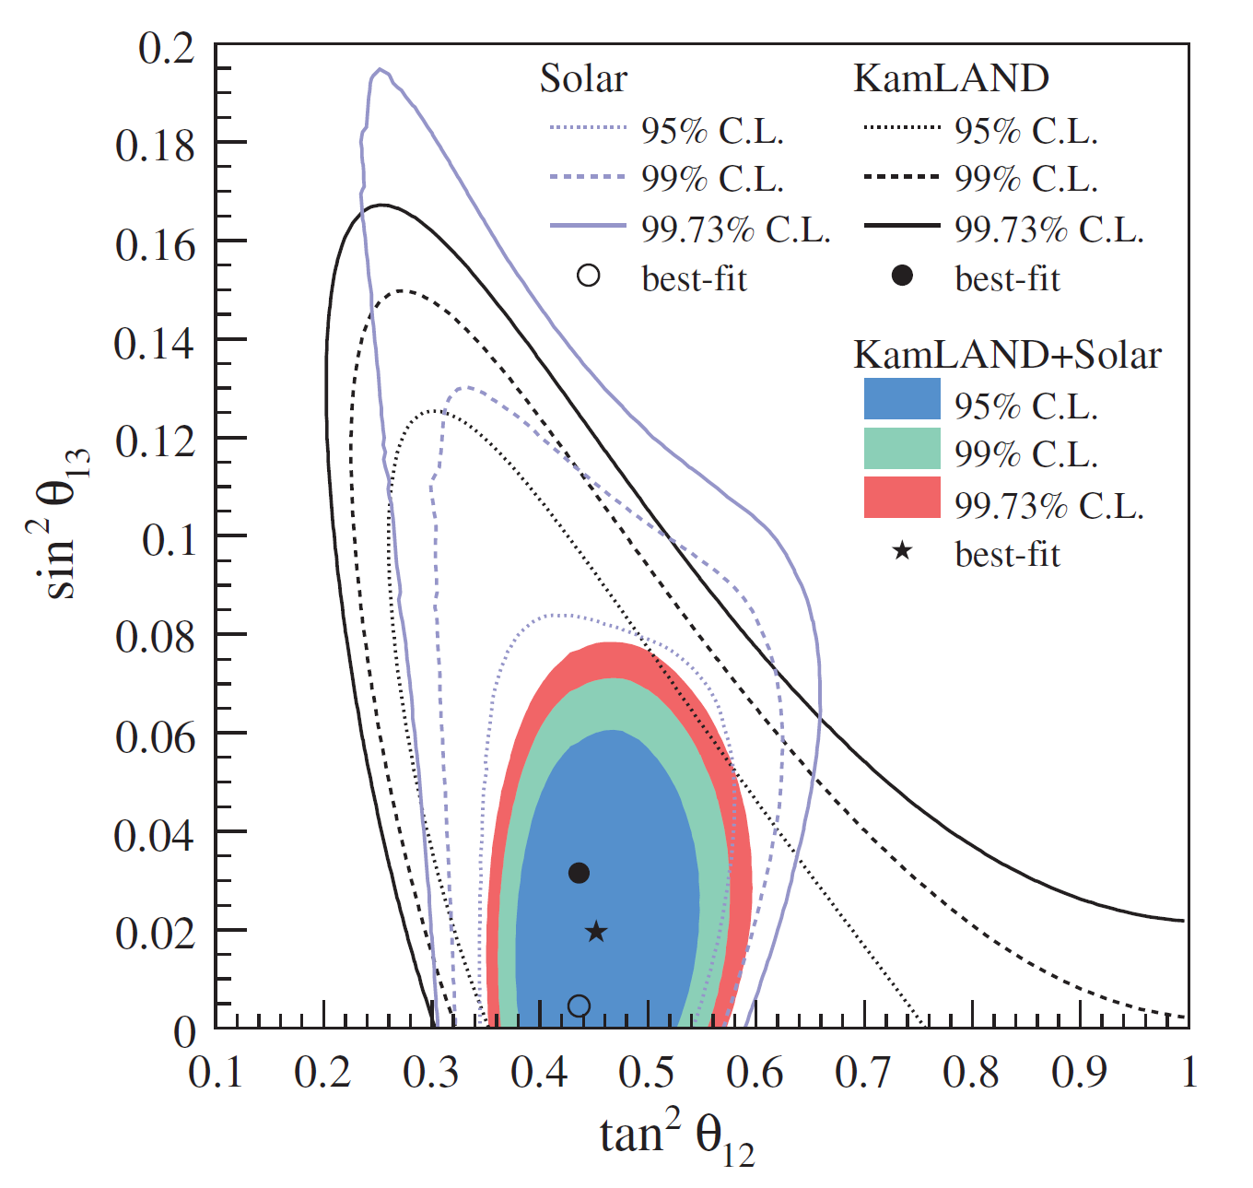
The quest to measure θ₁₃
Stringent CHOOZ limit: is θ₁₃ too small for CPV to be measured?
Non-zero θ₁₃ relieved tension between KamLAND & solar θ₁₂
Daya Bay, RENO, and Double-Chooz performed definitive measurements
PRD 83, 052002 (2011)

Slide 29
The quest to measure θ₁₃
Stringent CHOOZ limit: is θ₁₃ too small for CPV to be measured?
Non-zero θ₁₃ relieved tension between KamLAND & solar θ₁₂
Daya Bay, RENO, and Double-Chooz performed definitive measurements
PRD 83, 052002 (2011)

Slide 30
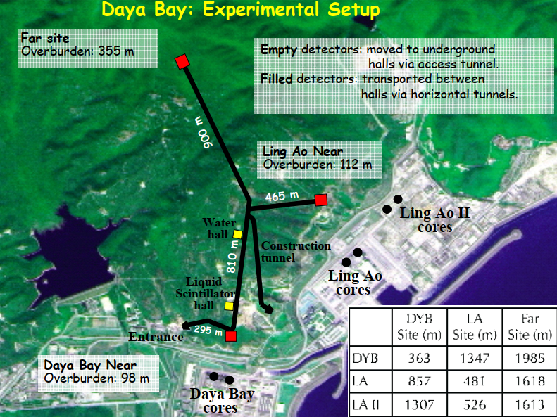


The quest to measure θ₁₃
Daya Bay
RENO
Double Chooz
Neutrino 2008

Slide 31



The quest to measure θ₁₃
Daya Bay
PRL 108, 171803 (2012)
RENO
PRL 108, 191802 (2012)
Double Chooz
PRL 108, 131801 (2012)

Slide 32


The quest to measure θ₁₃
Credit: H. Yu
Daya Bay
PRL 130, 161802 (2023)

Slide 33


Neutrino Mass Hierarchy with Reactors
Daya Bay + RENO gives a weak preference for the normal ordering when combined with accelerator and atmospheric measurements
JUNO is mounting a definitive test with reactor neutrinos using a 20 kton (!) LS detector
→ requires x2 improvement in E scale systematic uncertainty over KamLAND
JUNO will also make precision measurements of all oscillation parameters
Currently in commissioning!
Credit: H. Yu

Slide 34


Neutrino Mass Hierarchy with Reactors
Daya Bay + RENO gives a weak preference for the normal ordering when combined with accelerator and atmospheric measurements
JUNO is mounting a definitive test with reactor neutrinos using a 20 kton (!) LS detector
→ requires x2 improvement in E scale systematic uncertainty over KamLAND
JUNO will also make precision measurements of all oscillation parameters
Currently in commissioning!
Malyshkin, Nu ‘24

Slide 35


The Reactor Antineutrino Anomaly
Re-evaluation of reactor antineutrino spectra combining global nuclear data with fission beta spectral measurements revealed a global suppression relative to expectations
– re-evaluation
– $\sin^{2}{2θ_{new}}=0.12$
PRD 83, 073006 (2011)

Slide 36
The Reactor Antineutrino Anomaly
Re-evaluation of reactor antineutrino spectra combining global nuclear data with fission beta spectral measurements revealed a global suppression relative to expectations
Reactor antineutrino measurements?
Nuclear data / nuclear theory?
Beta spectrum measurements?
Sterile neutrinos??

Slide 37

The Reactor Antineutrino Anomaly
Reactor antineutrino measurements
Nuclear data / nuclear theory?
Beta spectrum measurements?
Sterile neutrinos??
All reactor data is consistent with a global
average with 0.5% uncertainty!
Prog Part Nucl Phys 136, 104016 (2024)

Slide 38

The Reactor Antineutrino Anomaly
Reactor antineutrino measurements
Nuclear data / nuclear theory?
Beta spectrum measurements?
Sterile neutrinos??
Reactor experiments also consistently show
a “6 MeV bump” not in the model, agreeing
with each other within uncertainties
Prog Part Nucl Phys 136, 104016 (2024)

Slide 39

The Reactor Antineutrino Anomaly
Reactor antineutrino measurements
Nuclear data / nuclear theory?
Beta spectrum measurements?
Sterile neutrinos??
Theory uncertainties also appear to have
been underestimated
PRL 112, 202501 (2014)

Slide 40


The Reactor Antineutrino Anomaly
Daya Bay + PROSPECT, PRL 128, 081801 (2022)
Reactor antineutrino measurements
Nuclear data / nuclear theory?
Beta spectrum measurements?
Sterile neutrinos??
The beta spectra also appear to be
questionable, especially for ²³⁵U
Phys. Atom. Nucl. 84, 1 (2021)

Slide 41

The Reactor Antineutrino Anomaly
Reactor antineutrino measurements
Nuclear data / nuclear theory?
Beta spectrum measurements?
Sterile neutrinos??
Vigorous efforts to search for a neutrino-
based solution remain inconclusive
arXiv:2503.18667

Slide 42
My biased list of other exciting reactor measurements in progress:

Slide 43





My biased list of other exciting reactor measurements in progress:
SNO+: first qualitative test of $∆m_{21}^{2}$
KamLAND $∆m_{21}^{2}$
EPJC 85, 17 (2025)

Slide 44





My biased list of other exciting reactor measurements in progress:
$\left\langle L\right\rangle \sim 200$ km
$\left\langle L\right\rangle \sim 800$ km
$\left\langle L\right\rangle \sim 350$ km
SNO+
KamLAND
full-dataset:
measure
$∆m_{21}^{2}$ at 3
effective
baselines

Slide 45


My biased list of other exciting reactor measurements in progress:
Izumiyama, Nu ‘24
SNO+
KamLAND full-dataset
GADZOOKS! (SK-Gd)
Nucl Part Phys Proc 273-275, 353 (2016)

Slide 46

My biased list of other exciting reactor measurements in progress:
SNO+
KamLAND full-dataset
GADZOOKS! (SK-Gd)
KamLAND2
x2 resolution, lower bg,
improved calibration (UH!)
→ qualitatively better Δm²
measurement!
Data taking start in 2027

Slide 47




My biased list of other exciting reactor measurements in progress:
SNO+
KamLAND full-dataset
GADZOOKS! (SK-Gd)
KamLAND2
x2 resolution, lower bg,
improved calibration (UH!)
→ qualitatively better Δm²
measurement!
Data taking start in 2027

Slide 48

My biased list of other exciting reactor measurements in progress:
SNO+
KamLAND full-dataset
GADZOOKS! (SK-Gd)
KamLAND2
And of course: JUNO!
(see Wei’s and Benda’s
talks!)
Malyshkin, Nu ‘24

Slide 49

Summary
Reactors continue to reveal to us new secrets about the neutrino!
A new generation of reactor experiments is poised to determine the mass ordering, measure neutrino oscillation with unprecedented precision, and reveal the source of the RAA
Reactor neutrino measurement in general, and KamLAND in particular, rely on the techniques pioneered by John, and greatly benefitted from his contributions (including the non-technical ones!)

Slide 50

Special message to John from Atsuto Suzuki, speaking for all of us on KamLAND!

