Slide 1
John’s early career:
Physics at Two Lakes
Lake Chelan, WA
Echo Lake, CO
Jeffrey Wilkes
Dept of Physics (emeritus)
University of Washington, Seattle

Slide 2
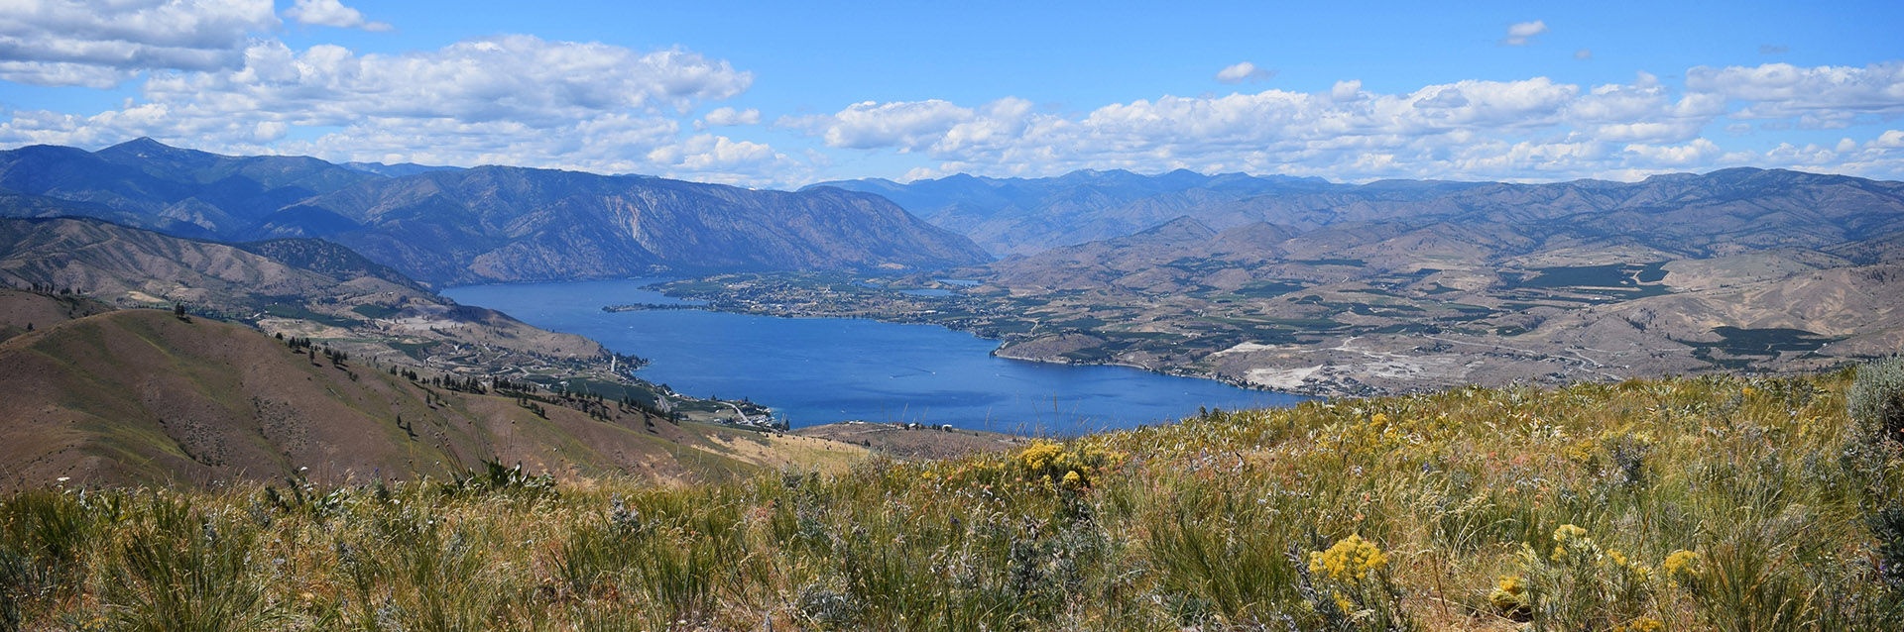
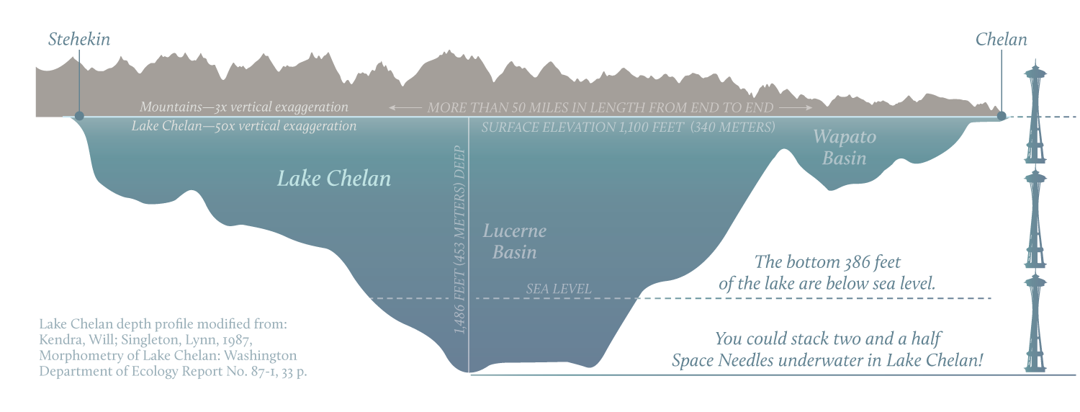
1. Lake Chelan experiment, 1966-67
JGL’s thesis project: underwater muons in Lake Chelan, WA
450m deep glacial lake east of Cascade range, 170 miles E of Seattle
Lake Chelan
Data taking site

Slide 3
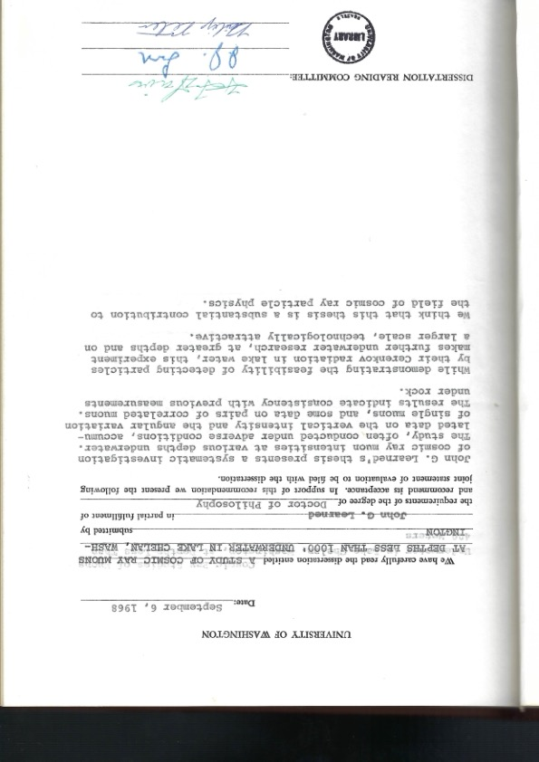
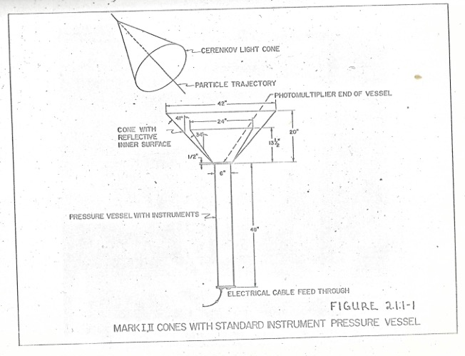
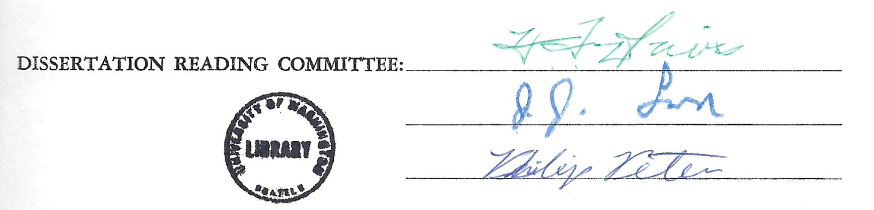
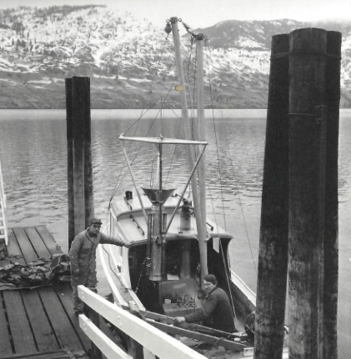
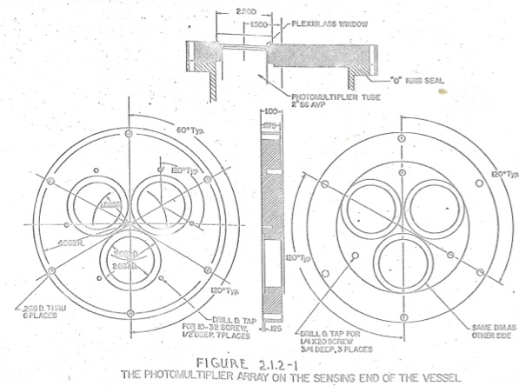
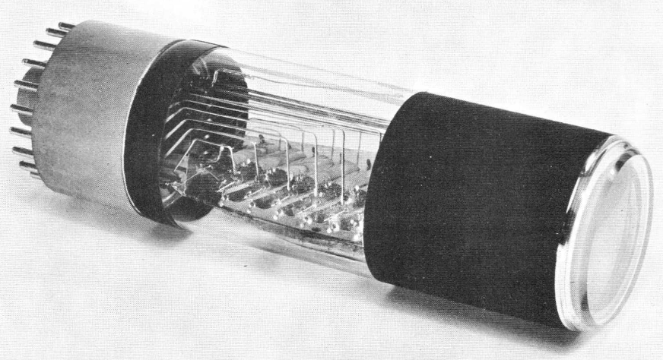
Goal: measure muon depth-intensity curve with a water Cherenkov detector -- Paleo-DUMAND !
"For many decades, measurements of muons have been conducted underwater and underground to study the energy spectrum and composition of primary cosmic rays..."
Mark I detector: single optical module (OM) with 3 small PMTs
Committee:
Howard Davis
Jere Lord
Phil Peters
56AVP 42mm PMTs

Slide 4
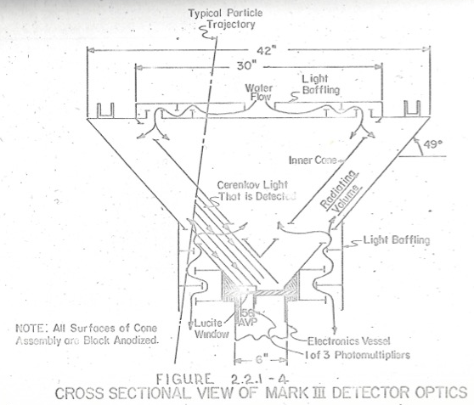
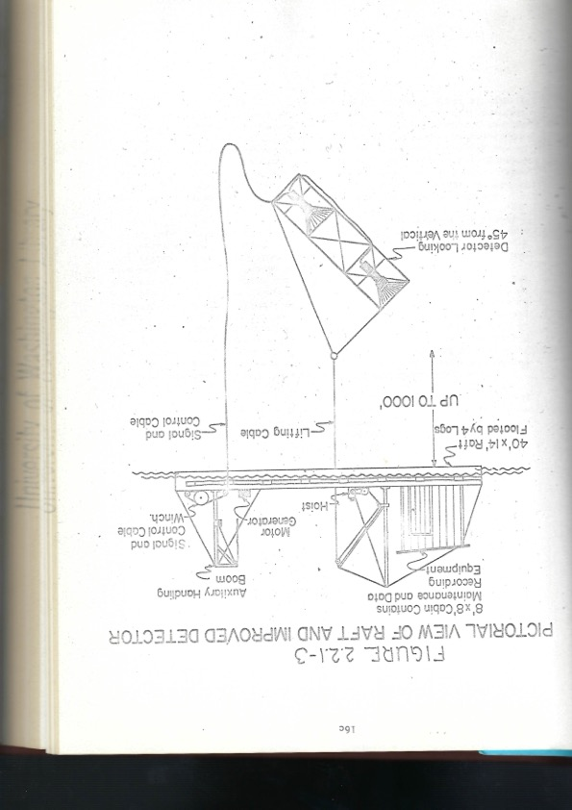
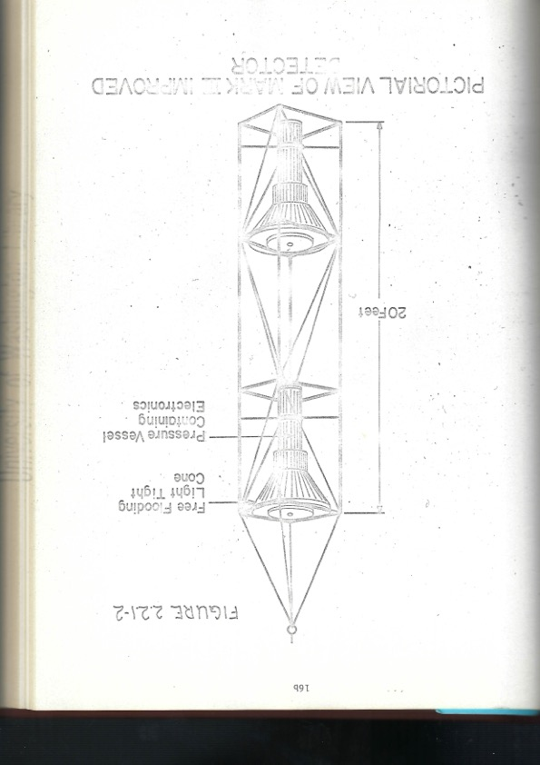
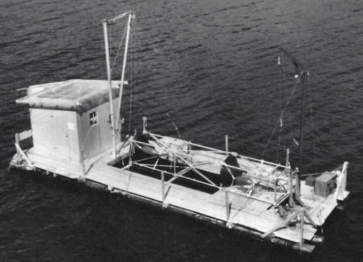
Mark II: improved instrument (1967)
Now 2 OMs in improved reflectors, lowered from raft towed by the boat

Slide 5
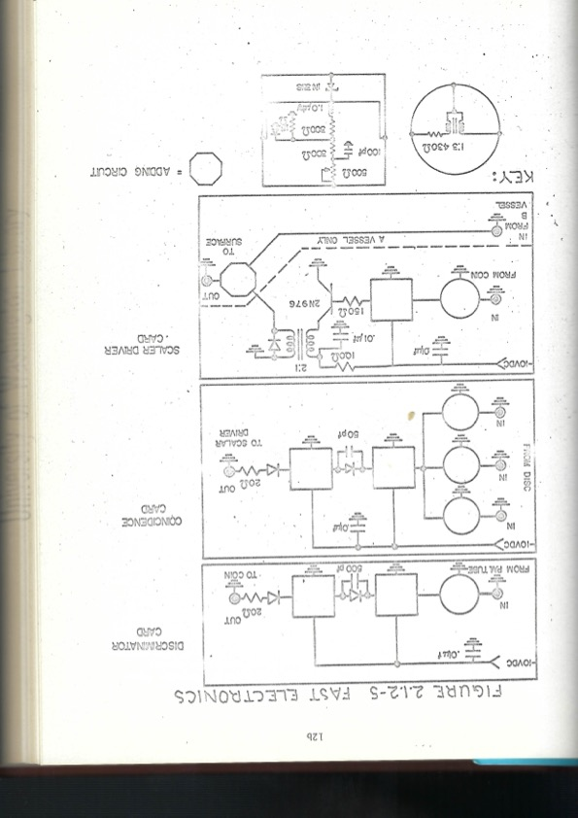
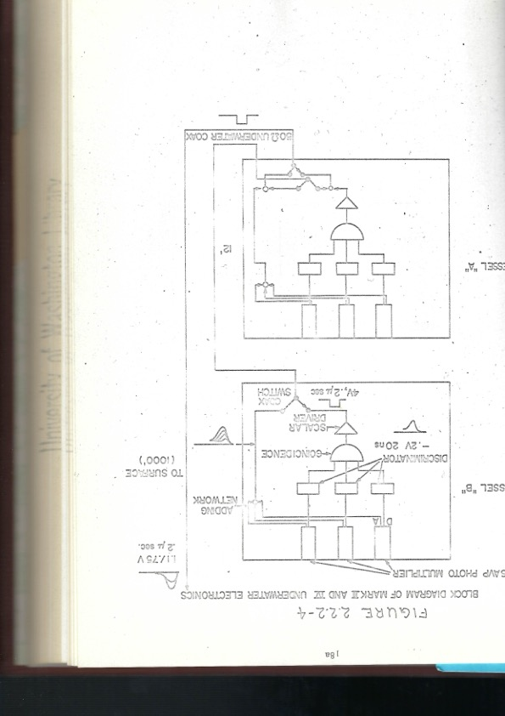
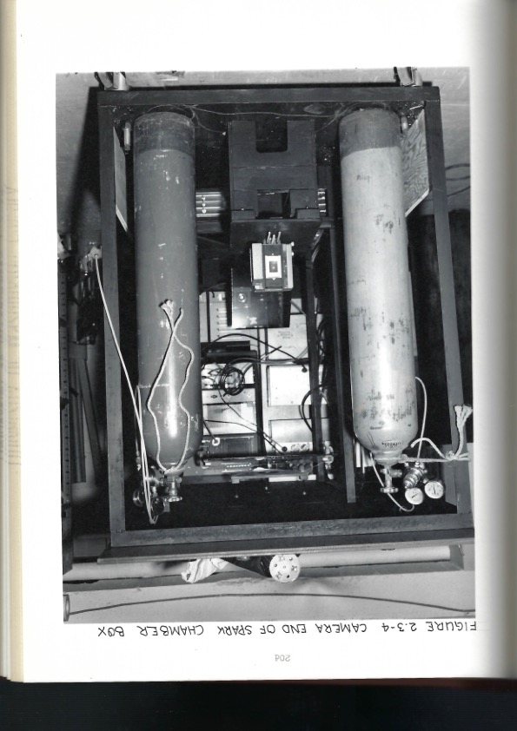
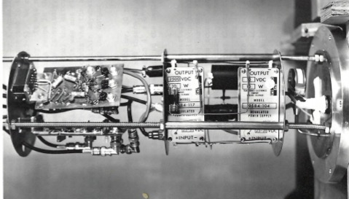
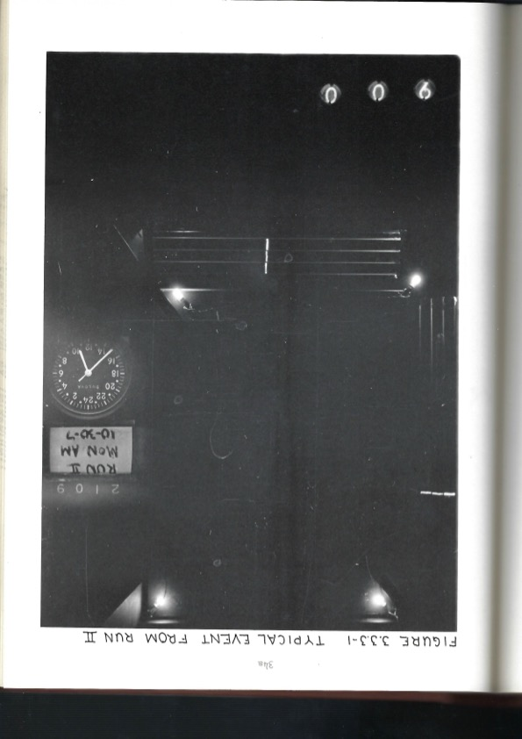
Look Ma, no chips! Hand-made DAQ with diodes
Remember “microseconds”?
Used spark chambers on raft to check OM effective area vs θ – Photos scanned and measured by hand
Nixie tubes for event numbers...
Front end DAQ

Slide 6
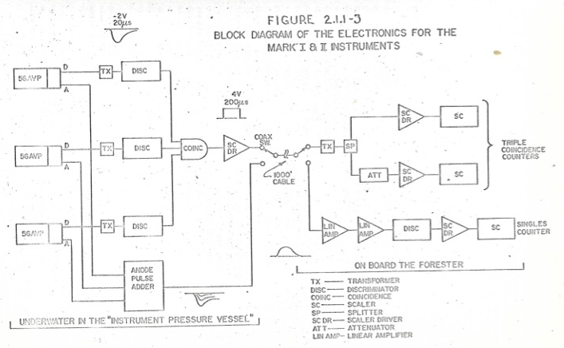
Choose: count 3-PMT coincidences, or summed pulse heights above a threshold
1000 ft cable softens pulse shapes...
Example of data file:
counts from scalers,
hand-written in logbook:

Slide 7
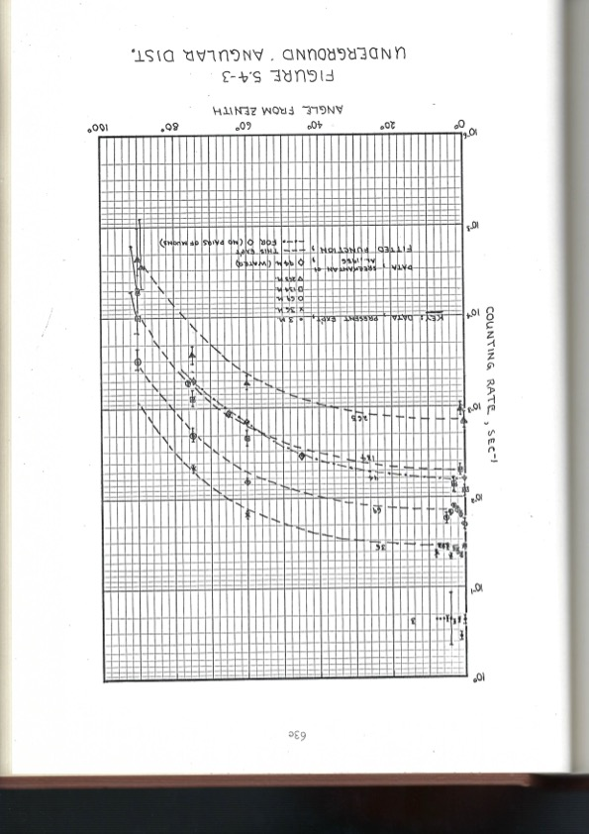
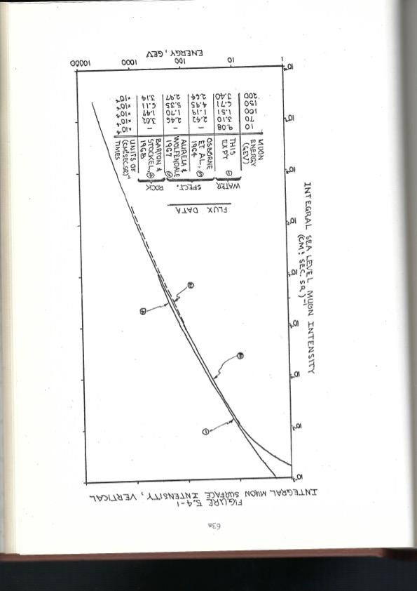
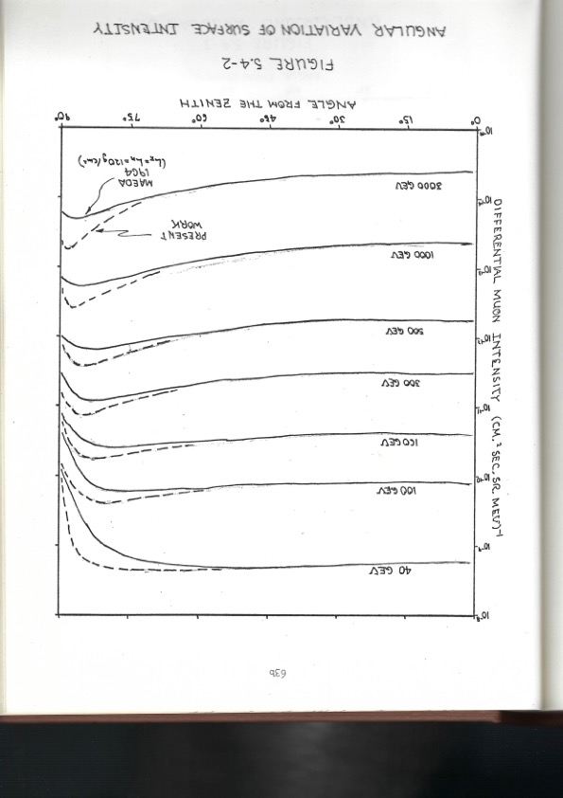
Results: comparable to other underground muon measurements

Slide 8
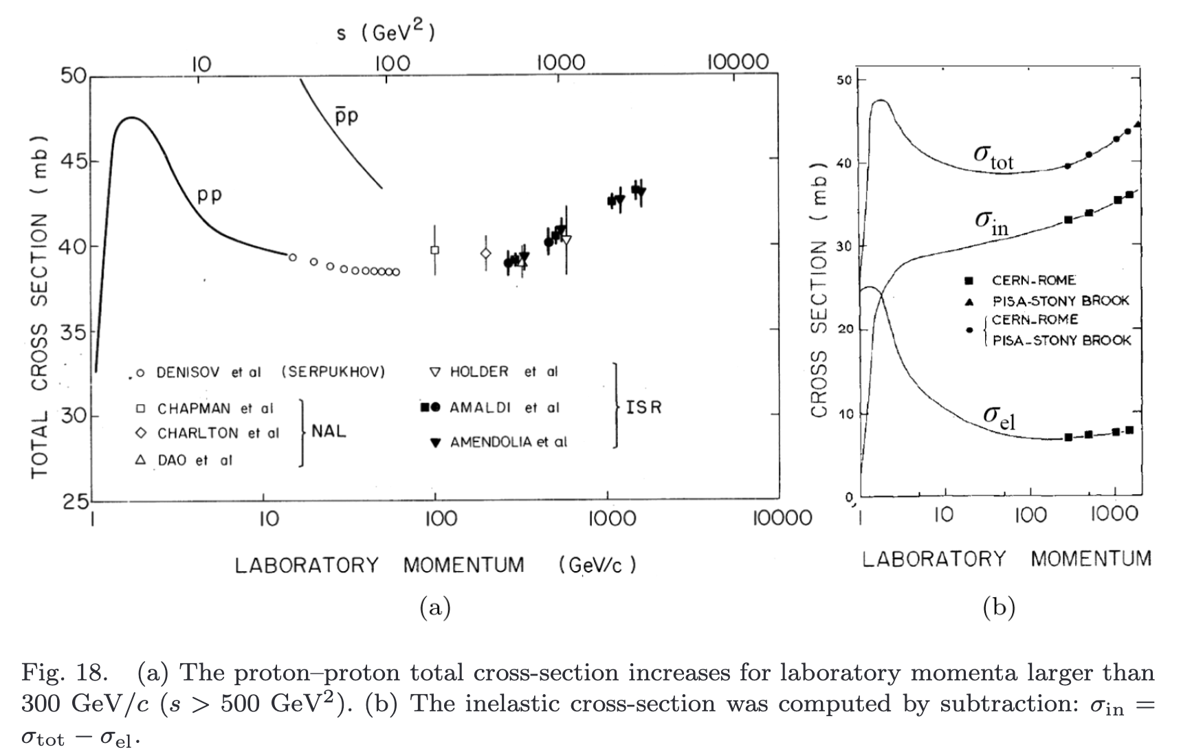
2. Echo Lake experiment, 1968-72
  Key question in mid-60s: does the p-p cross section in the 100-1000 GeV range rise, stay flat, or fall?
    Important theory implications
    Well-measured at lower energies at CERN, BNL, Serpukhov
    Fermilab under construction – not expected until 70s
    Larry Jones et al: use cosmic rays to get an early view
      At mountain altitudes a (very) few primary protons survive
      Accessible mountain lab exists in Colorado: Echo Lake on Mt. Evans
Before Echo Lake
U. Amaldi, 60 Years of CERN Experiments and Discoveries (2015) in worldscientific.com/worldscibooks/10.1142/9441

Slide 9
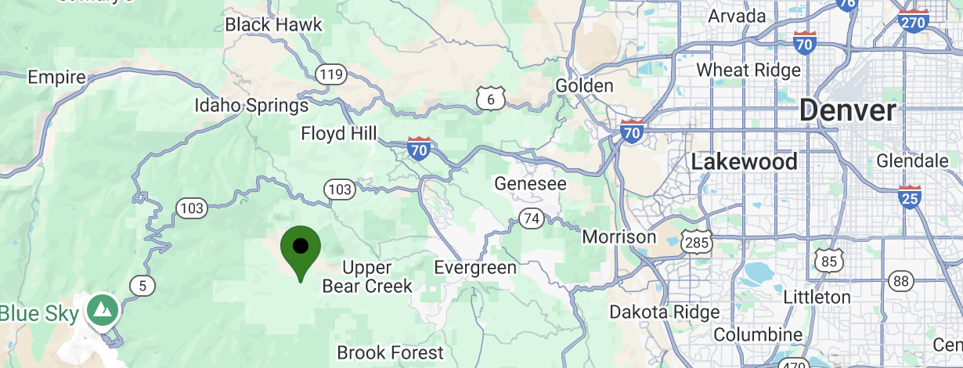
Echo Lake experiment, 1968-72
  Echo Lake Laboratory
    11,000 ft (3230 m) altitude, atmospheric depth 715 g/cm2
    Used for cosmic ray research since 1930s
    Year-round accessible by plowed highway
      Mt Evans summit (14,000 ft) is impractical
  Idaho Springs, CO — nearby small town with basic amenities (supported by gold and molybdenum mines nearby!)
    40 miles W of Denver, 1 hour by freeway from (Stapleton) airport
    13 miles (30 min) to Echo Lake lab by state highway kept open year-round
      (but 4WD vehicle useful in winter)
  1 hr to Idaho Springs from Denver Airport
  Echo Lake Laboratory
  30 min from Idaho Springs to lab
Road to summit @ 14,000 ft
(Mt Evans is now officially Mt Blue Sky)

Slide 10
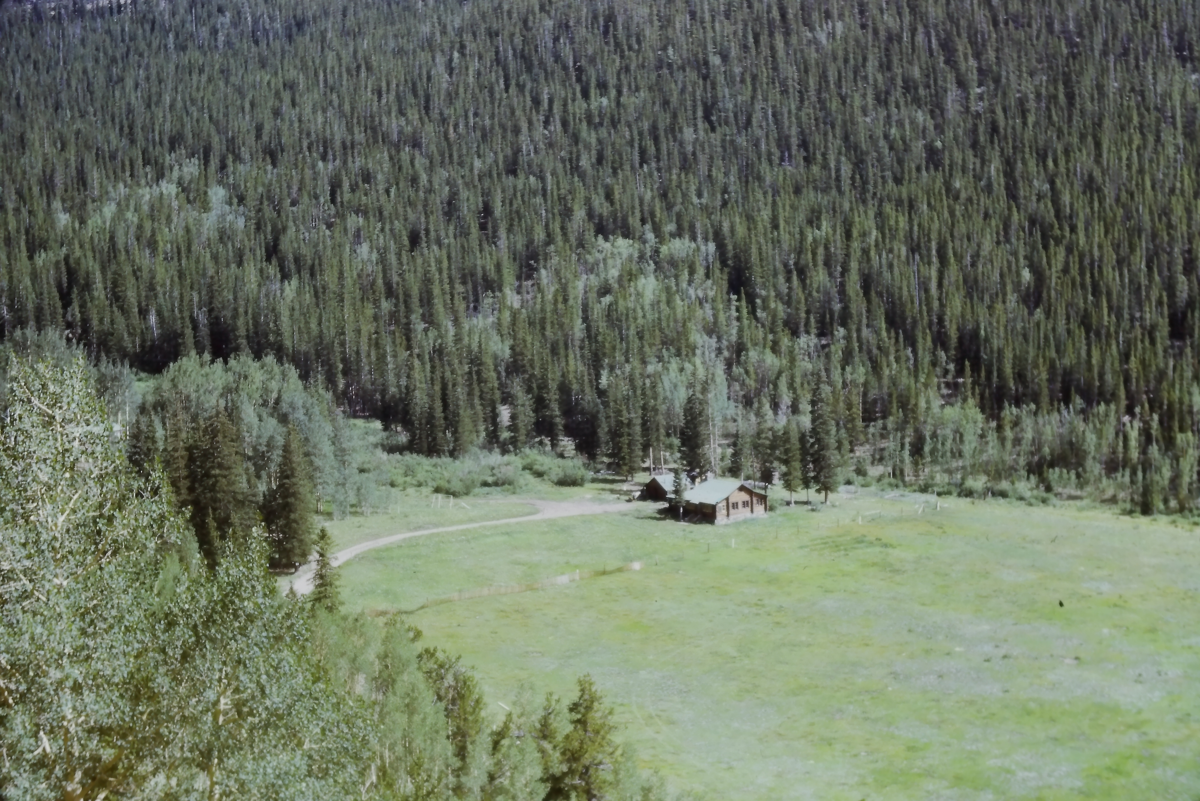
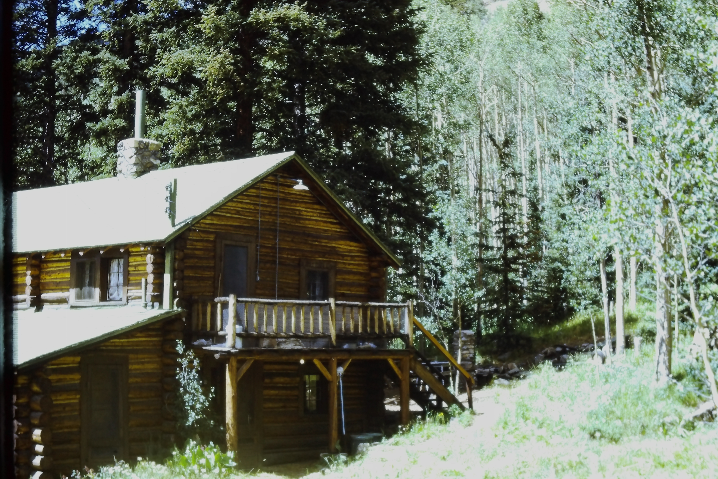
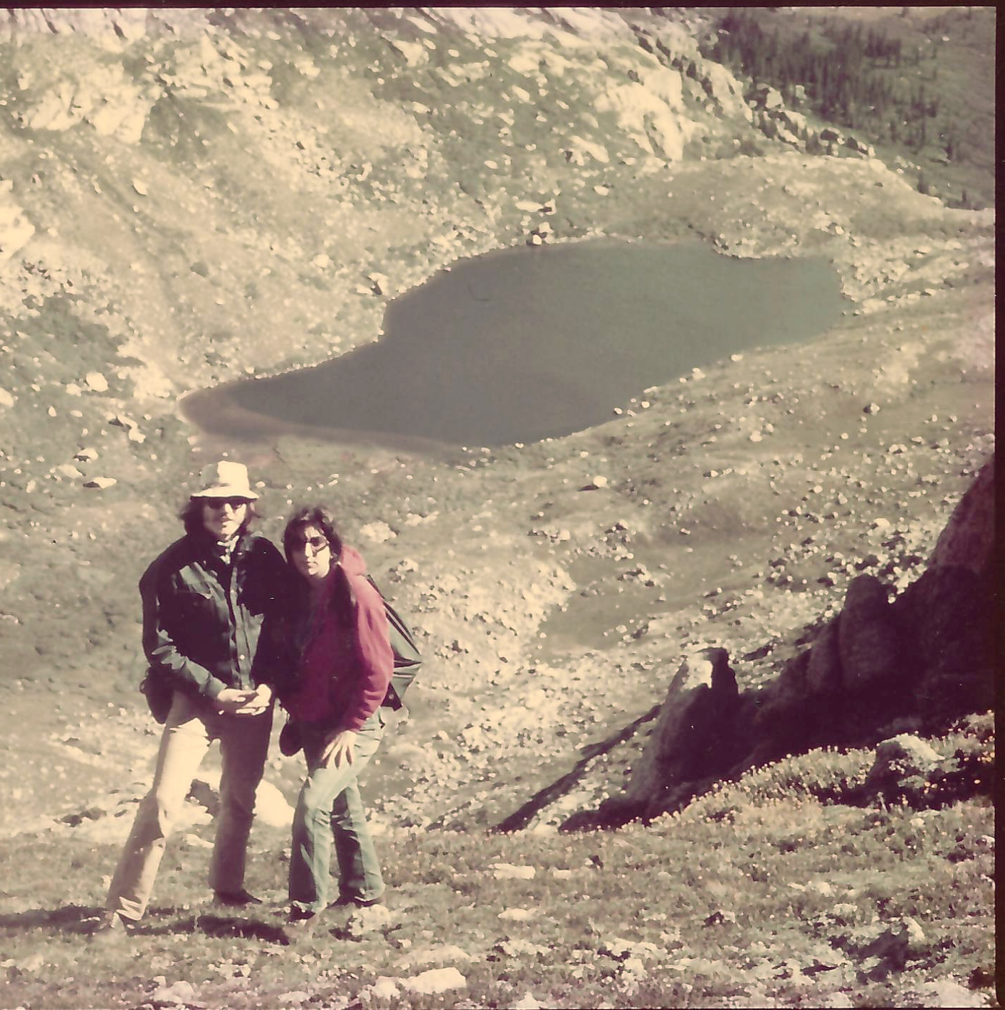
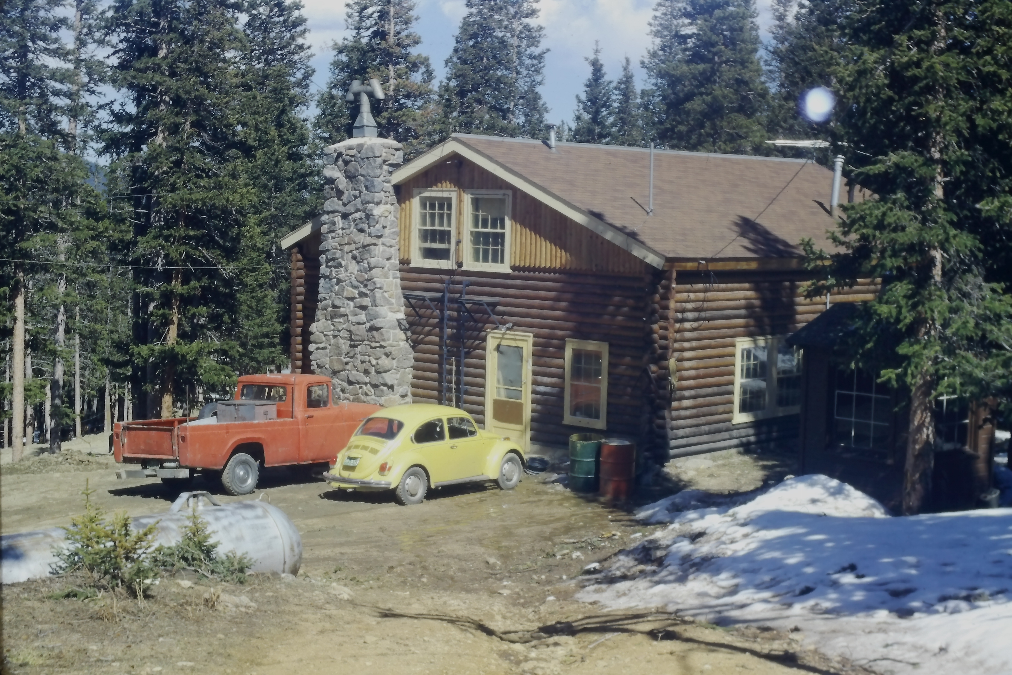
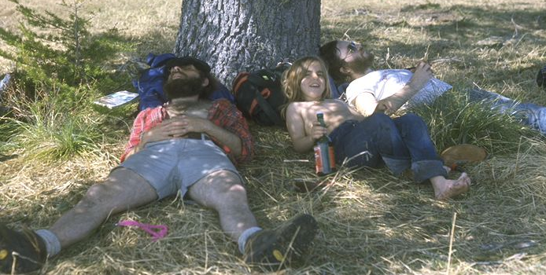
Life on the mountain: Ranch and dorm, natural beauty...
Family housing at “the Ranch”, 10 min drive below lab
Jeff & Roberta Wilkes at Summit Lake
“Two-story”
Ranch house
JGL and JW napping on the trail, with Alison Learned
Bachelor housing: dormitory at lab

Slide 11
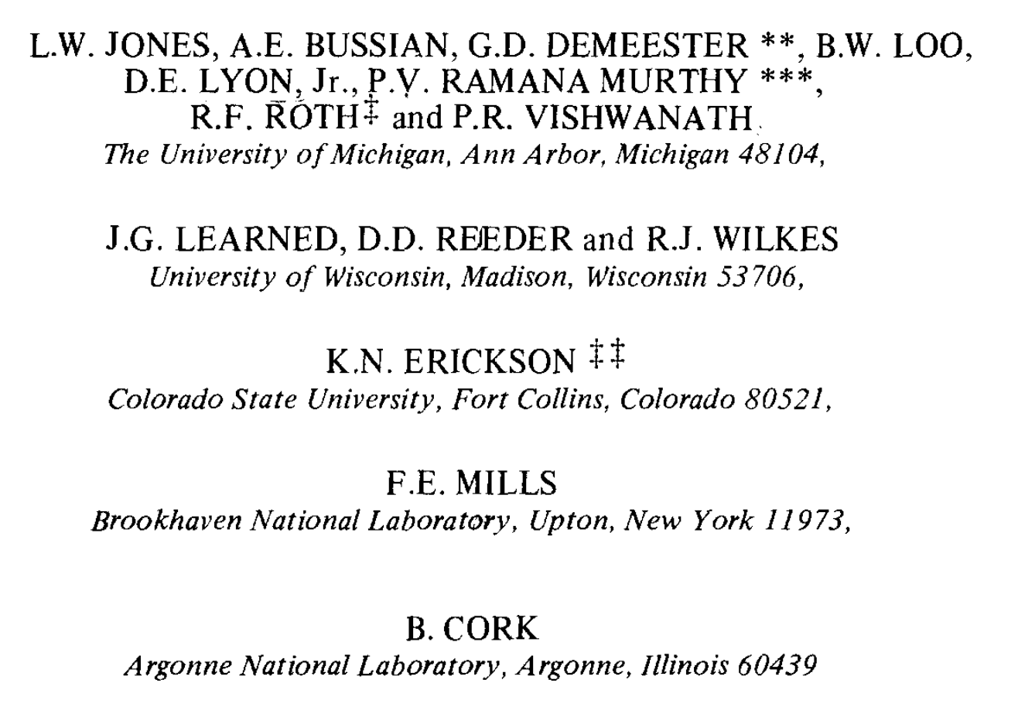
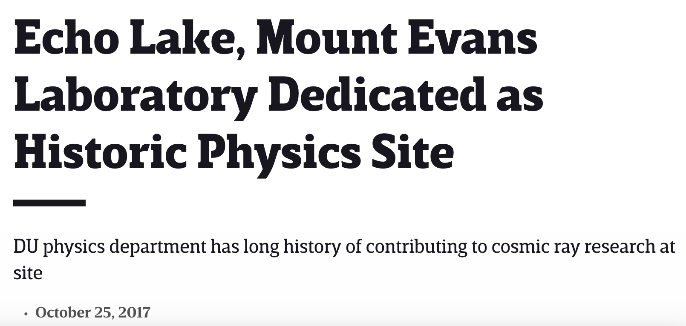
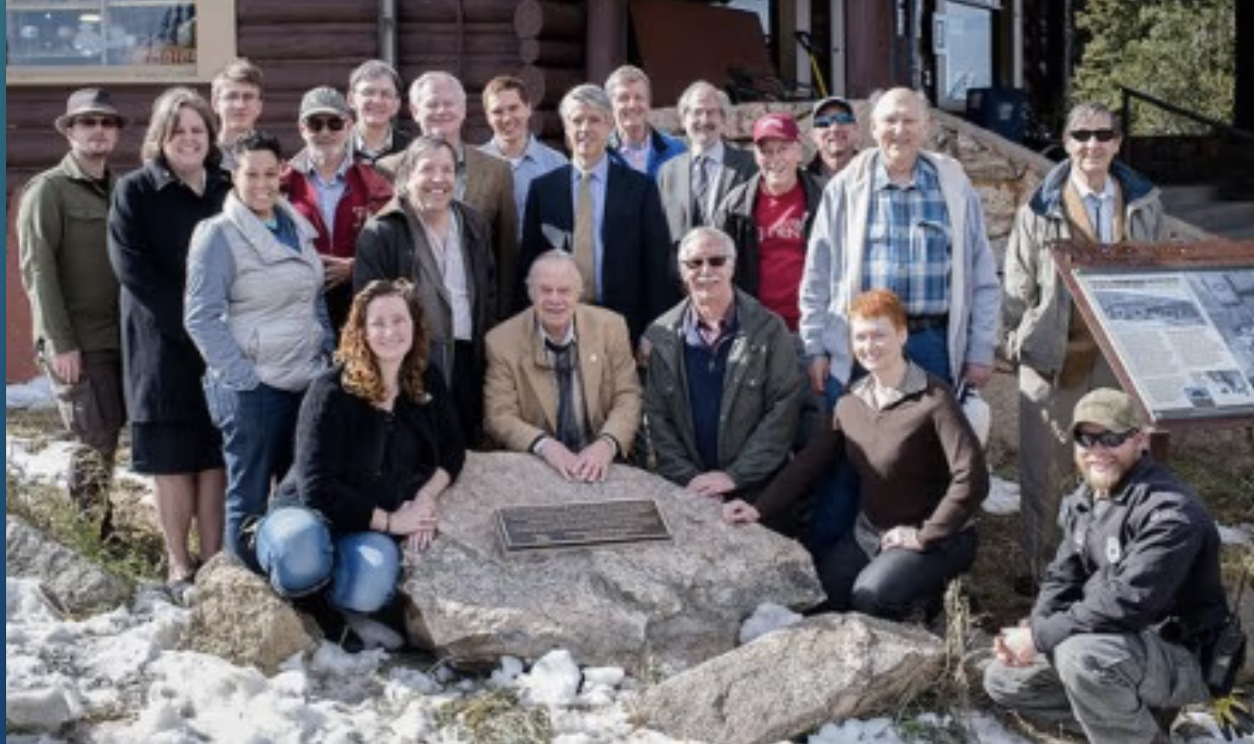
Collaboration members:
Lab is now an official APS historic site:

Slide 12
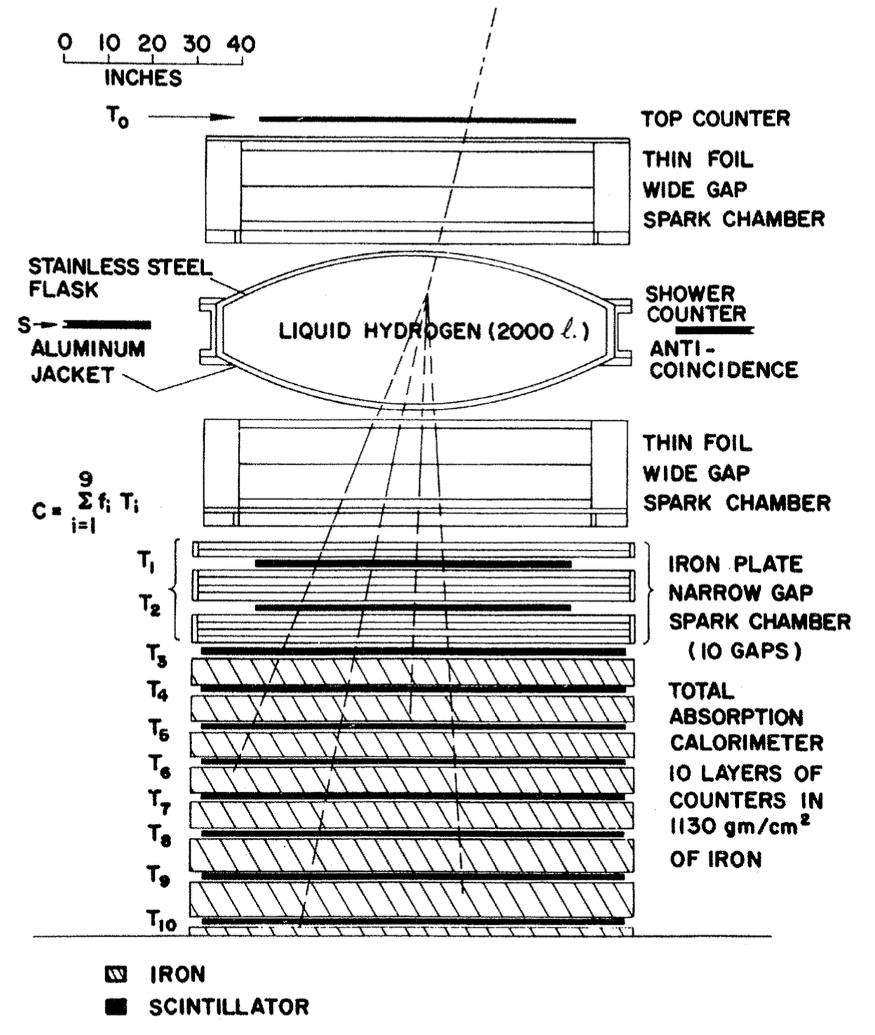
Echo Lake experiment, 1968-72
Hydrogen target: 10/68 - 5/69
  LH2 topped off every 7~10 days (by Nitro drivers from Boulder)
  Wide-gap chambers: 2.0 m × 2.0 m, with two 20 cm gaps
    Beautiful chambers made by Billy Loo at U. Michigan — excellent multi-track efficiency
  Narrow-gap chambers (E-M calorimeter): ten-layer spark chamber with 20 g-cm² Fe between gaps.
  Hadronic calorimeter: 10 layers of iron with graduated thickness from 40 ~ 160 g-cm², total 1130 g-cm², scintillators with 8 PMTs per layer
  Trigger = Top counter + sum of nine calorimeter layers (dynodes) + side counters in anticoincidence
    Hadron trigger rate ~ 20/hr, with 90 GeV (nominal) threshold.
  Recorded summed anode signals for each of the 10 layers with 7 bit (127 channel!) logarithmic ADCs

Slide 13
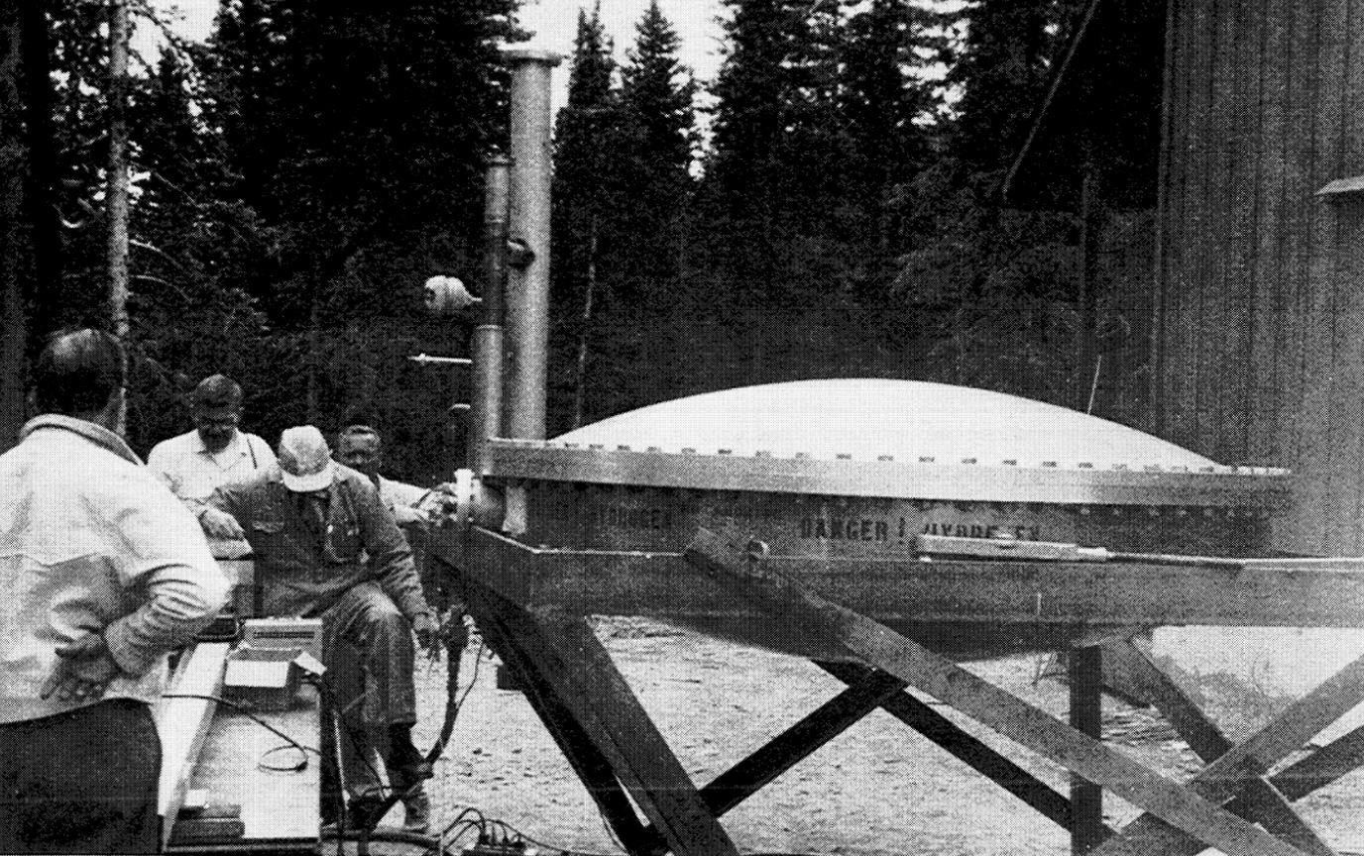
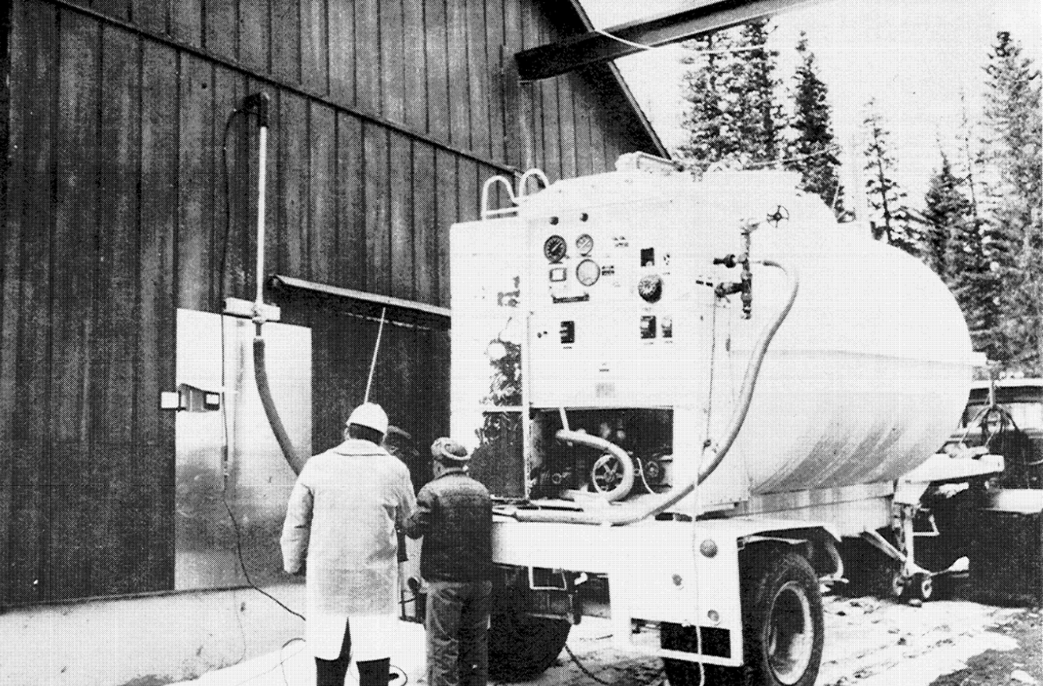
Hydrogen target
Fred Mills supervising...
Installation
LH2 truck filling target
BW Photos from Larry Jones history of ELL

Slide 14
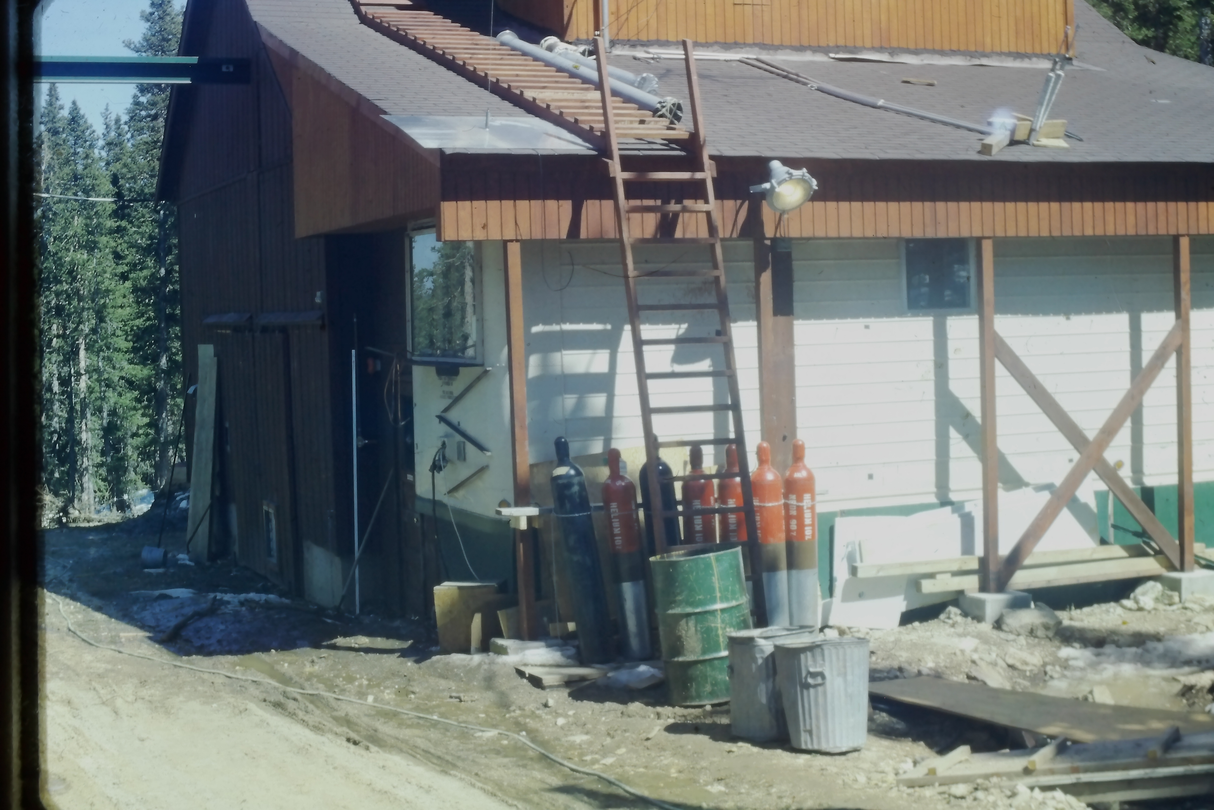
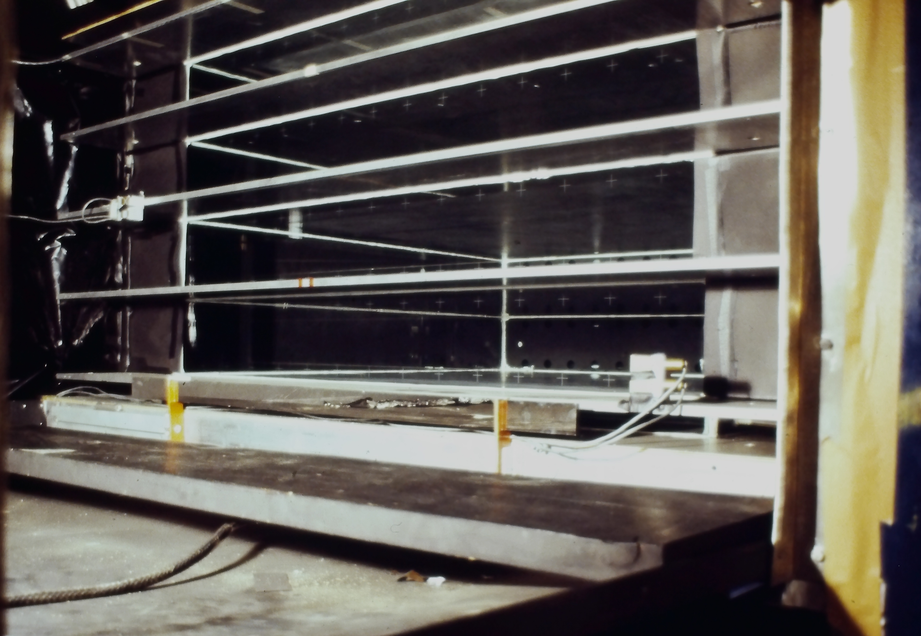
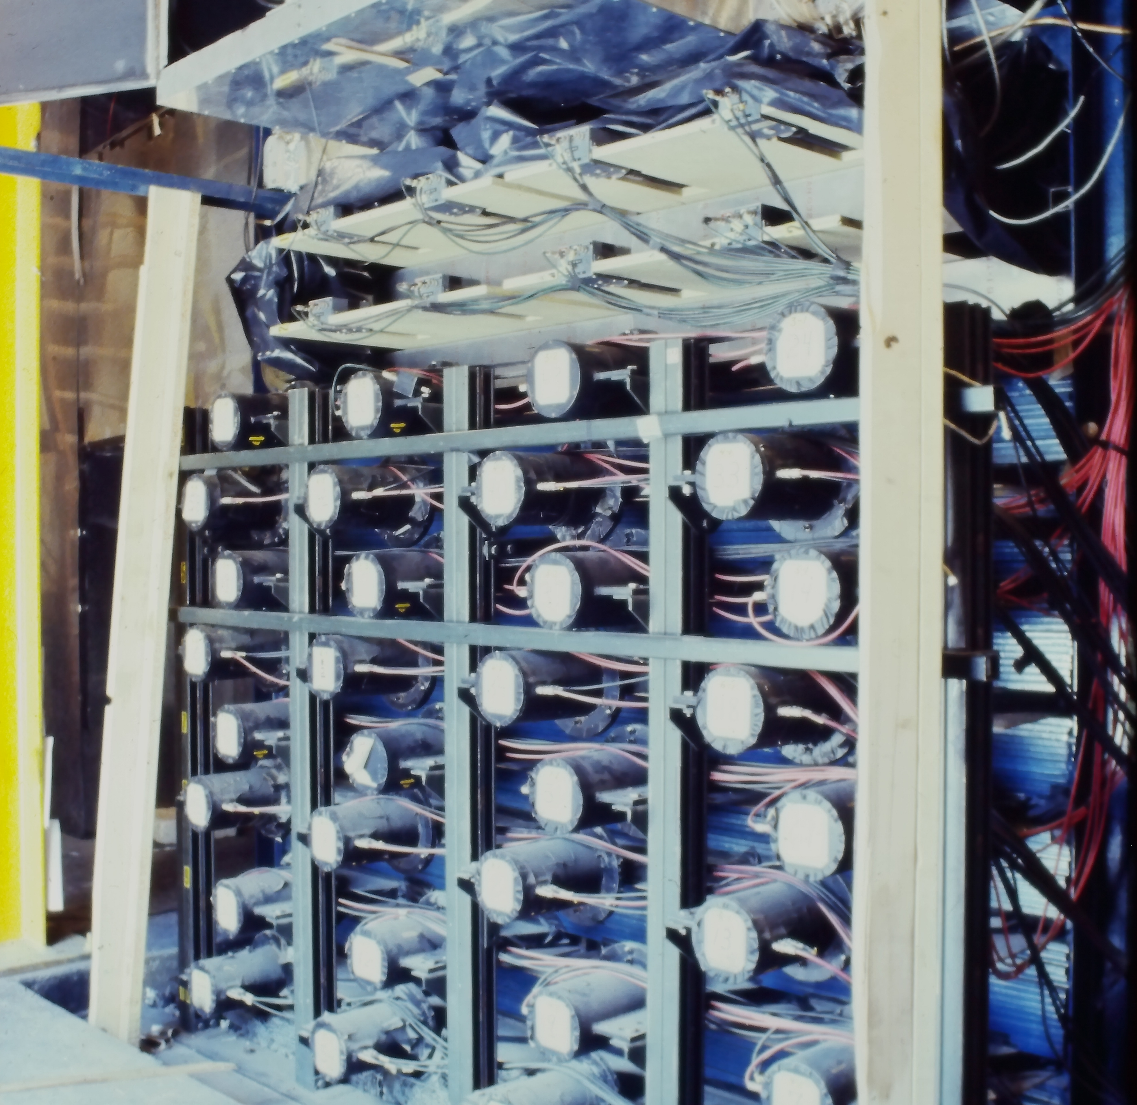
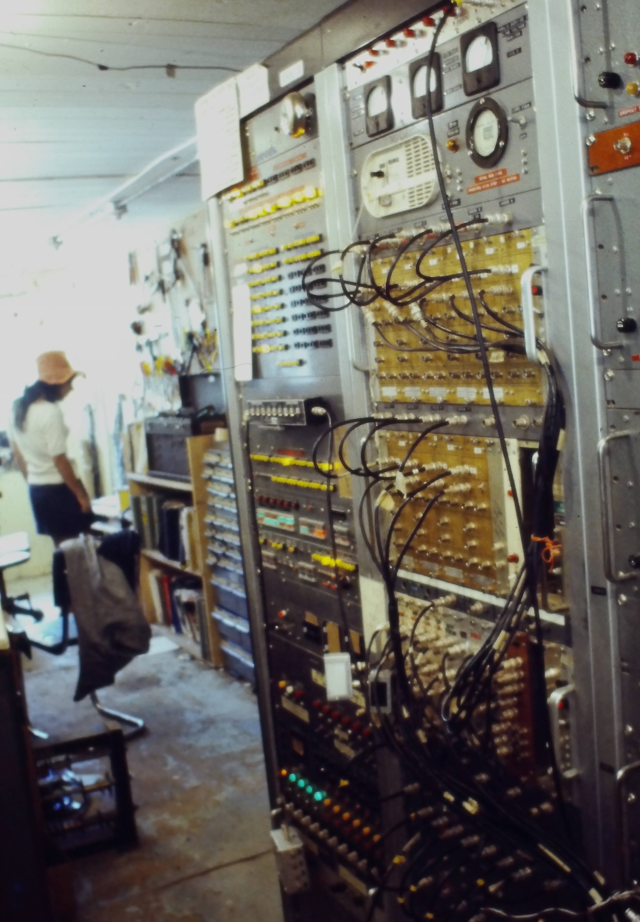
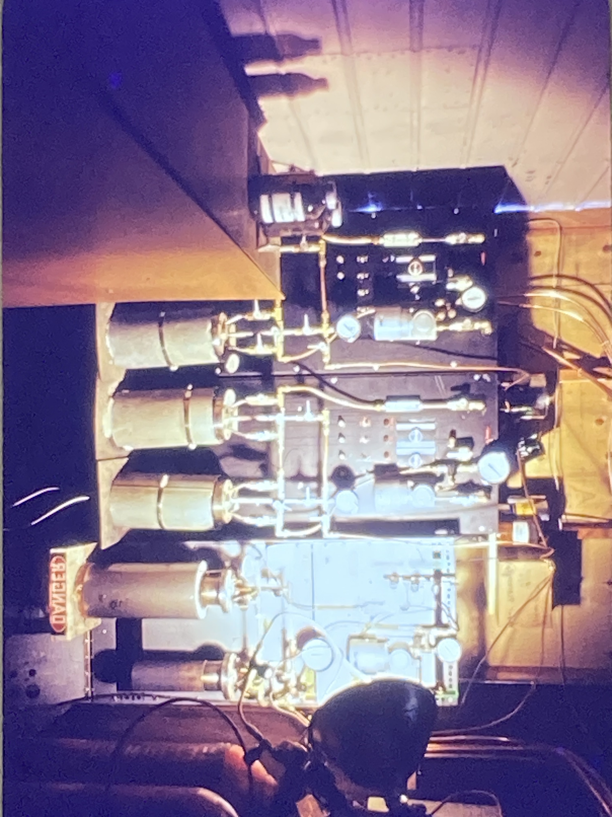
Lab building with electronics trailer in front
Wide-gap spark chambers
a
EM and hadronic calorimeters
Spark chamber gas system
Electronics trailer interior

Slide 15
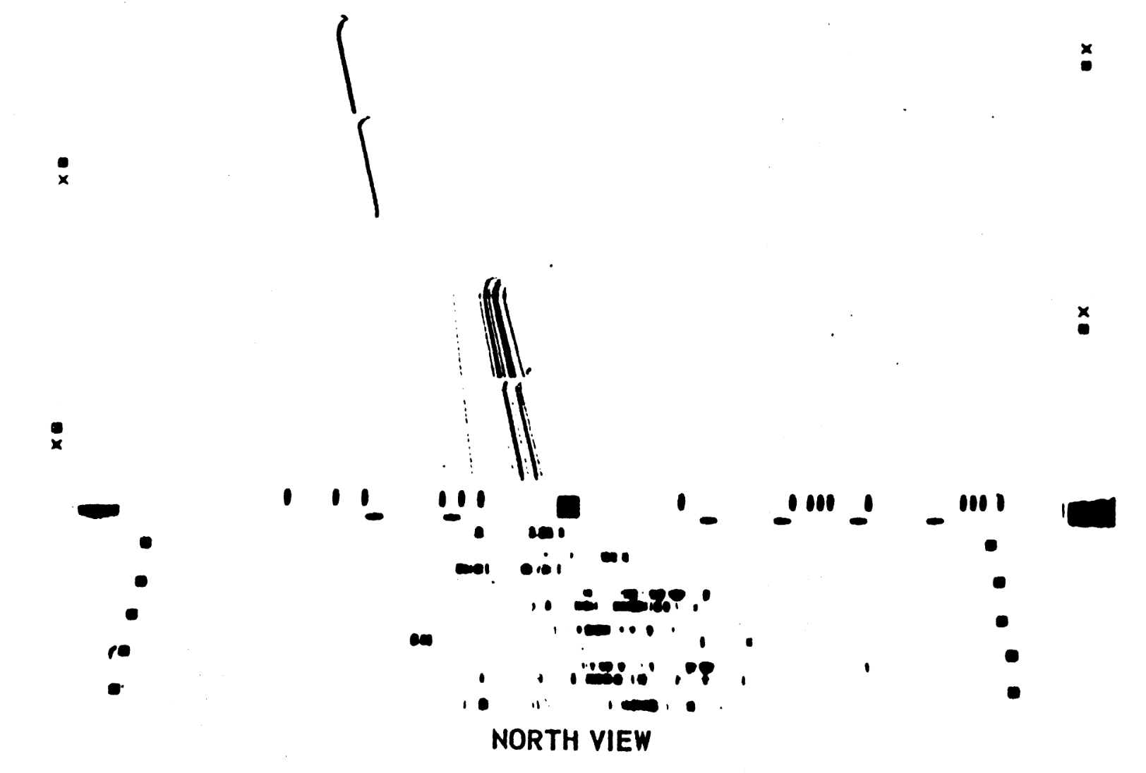
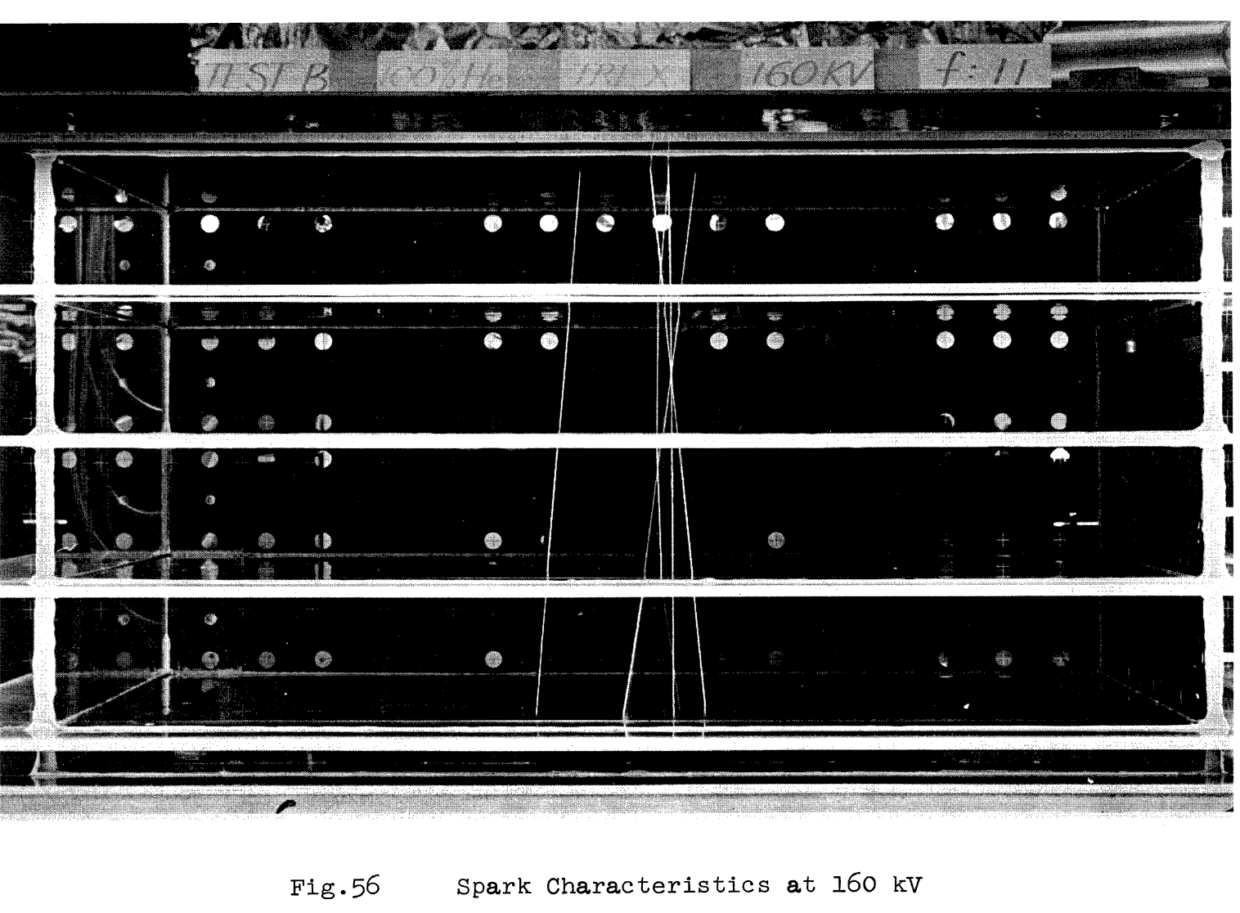
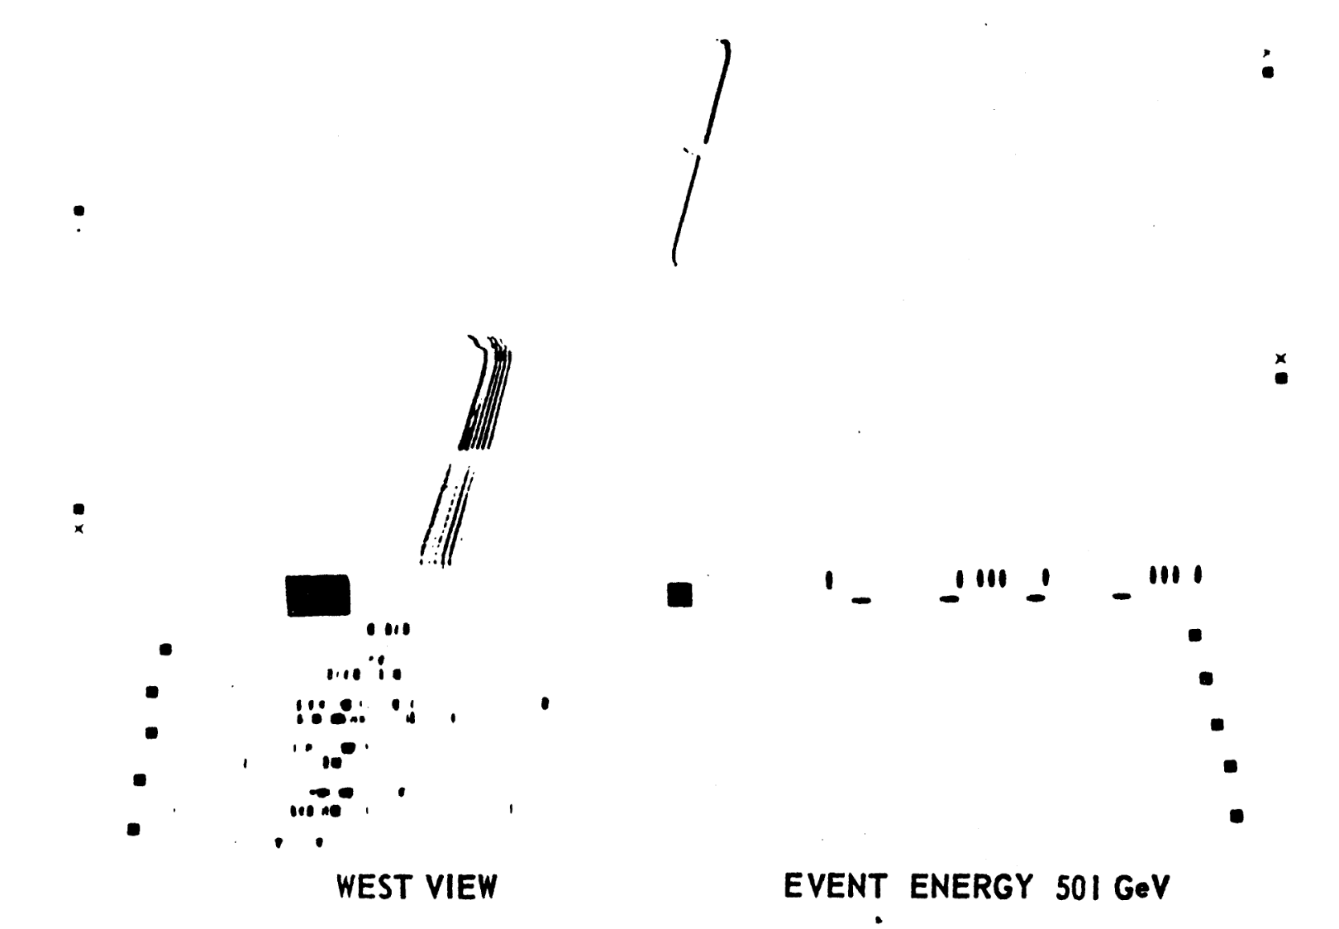
Wide-gap spark chambers
"Typical" multiparticle production interaction in H target, seen in 90º stereo
Narrow-gap iron plate spark chambers
(E-M calorimeter)
from Billy Loo U.M. PhD thesis
from Gordon DeMeester U.M. PhD thesis

Slide 16
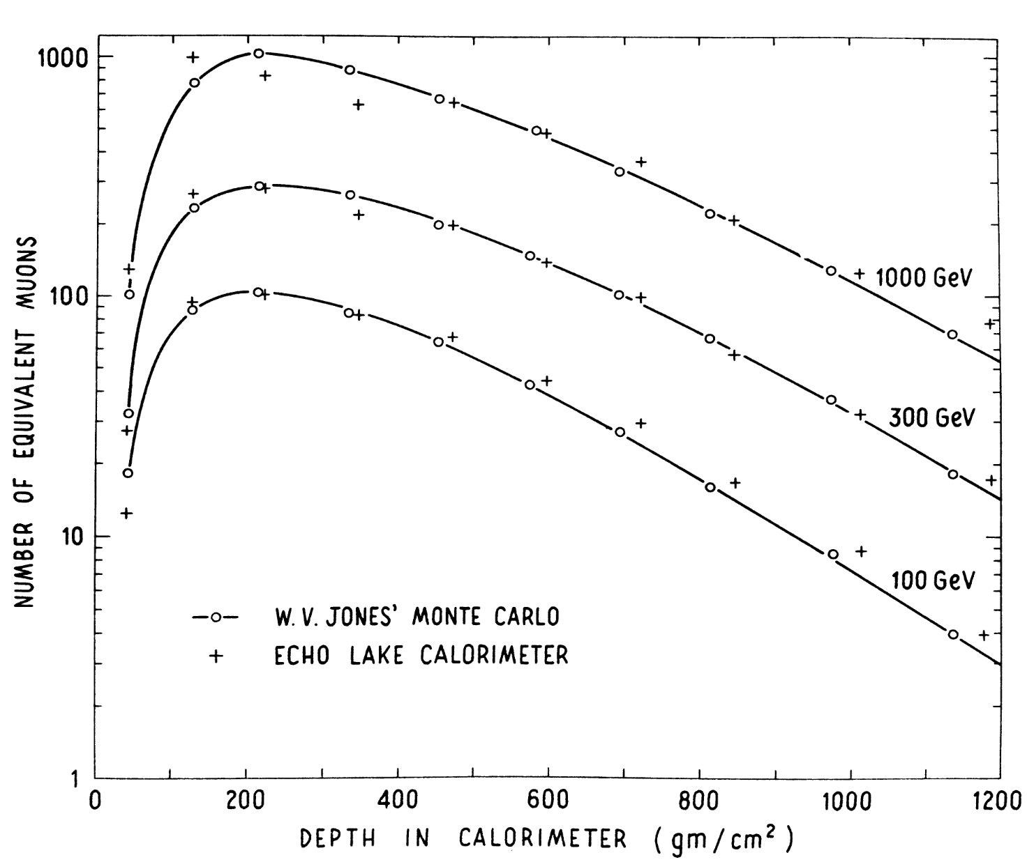
Calorimeter data for energy estimation
W. V. Jones, Phys. Rev. 187, 1868 (1969)
from Gordon DeMeester U.M. PhD thesis

Slide 17
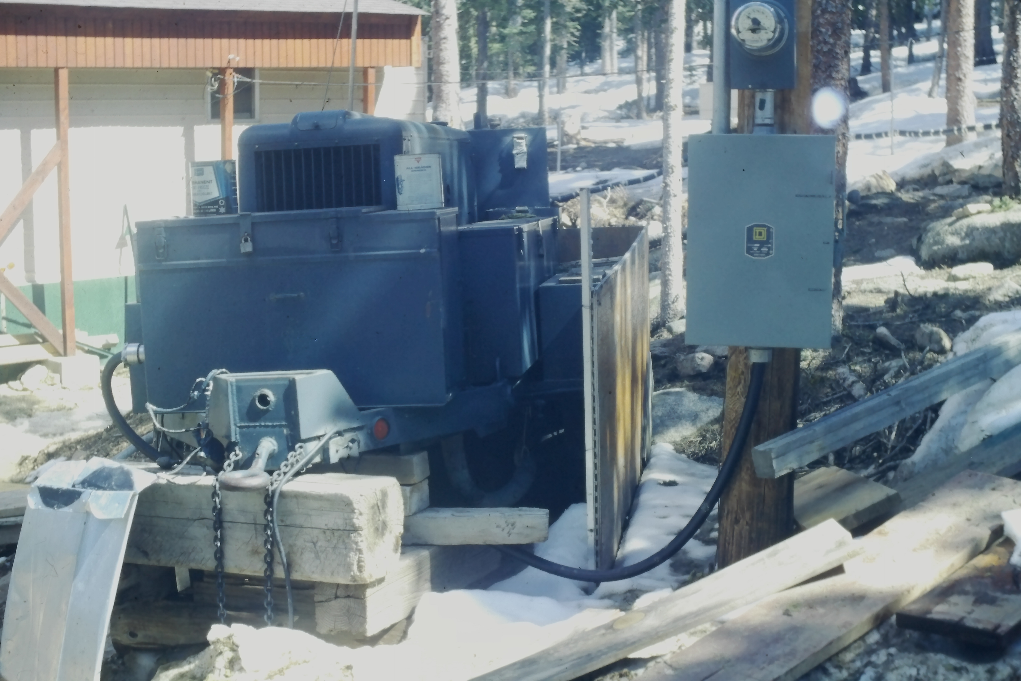
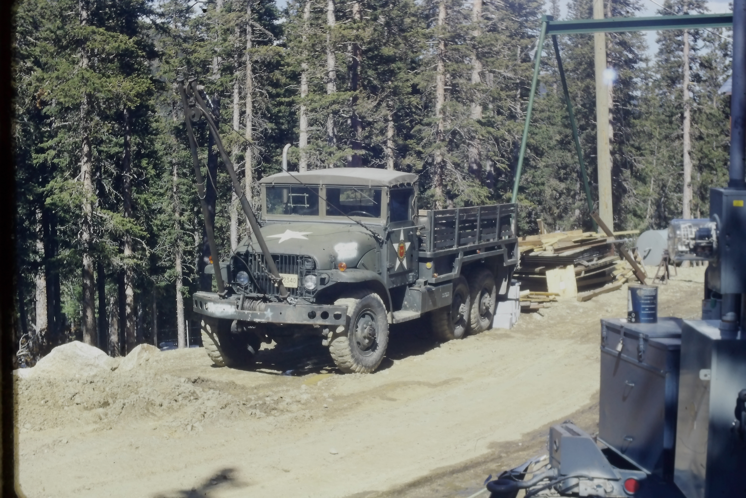
Additional equipment needed (or just wanted)
Backup generator – allowed 95% up-time, even when heavy snowfall brought down utility lines
Step 1: dig out of dorm and put on snowshoes to go start it
JGL's hobby: scanning US government surplus lists for free goodies
Project supported by AEC (remember that?), so we qualified for federal surplus...
One great find: ex-Army "6x6" truck
  Could go anywhere!
After this photo, painted Michigan Maize & Blue by UM Motor Pool

Slide 18
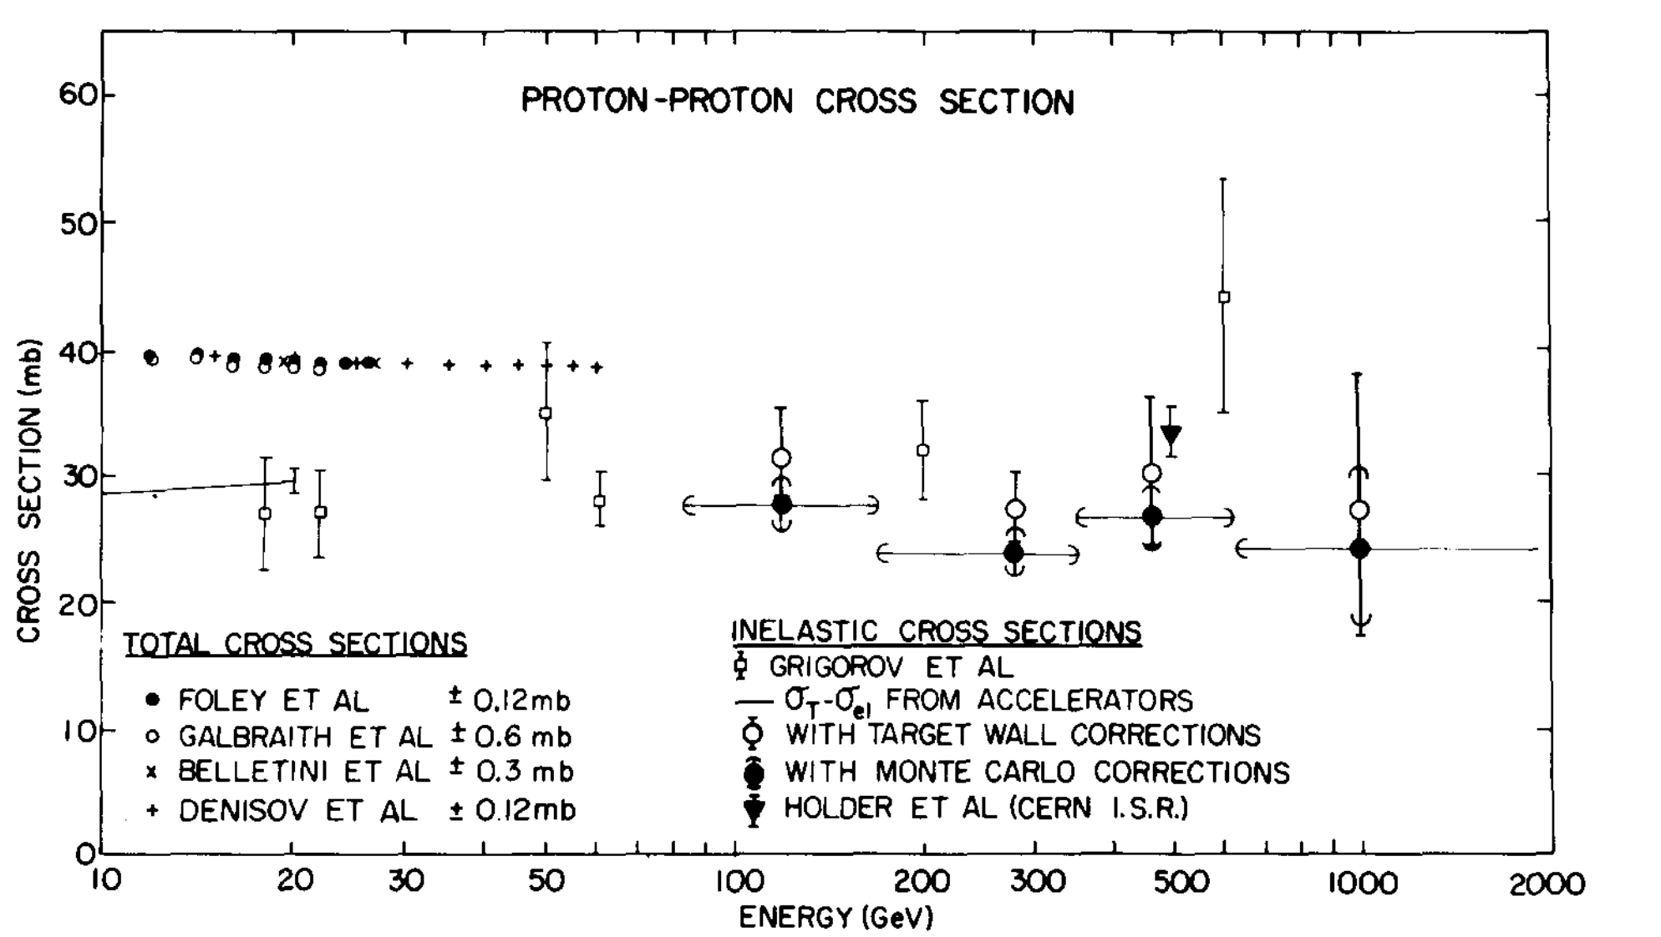
Echo Lake: Results from hydrogen target runs
p-p inelastic cross section 100 – 1000 GeV
    Corrections from Vern Jones monte carlo W. V. Jones, Phys. Rev. 187, 1868 (1969)

Slide 19
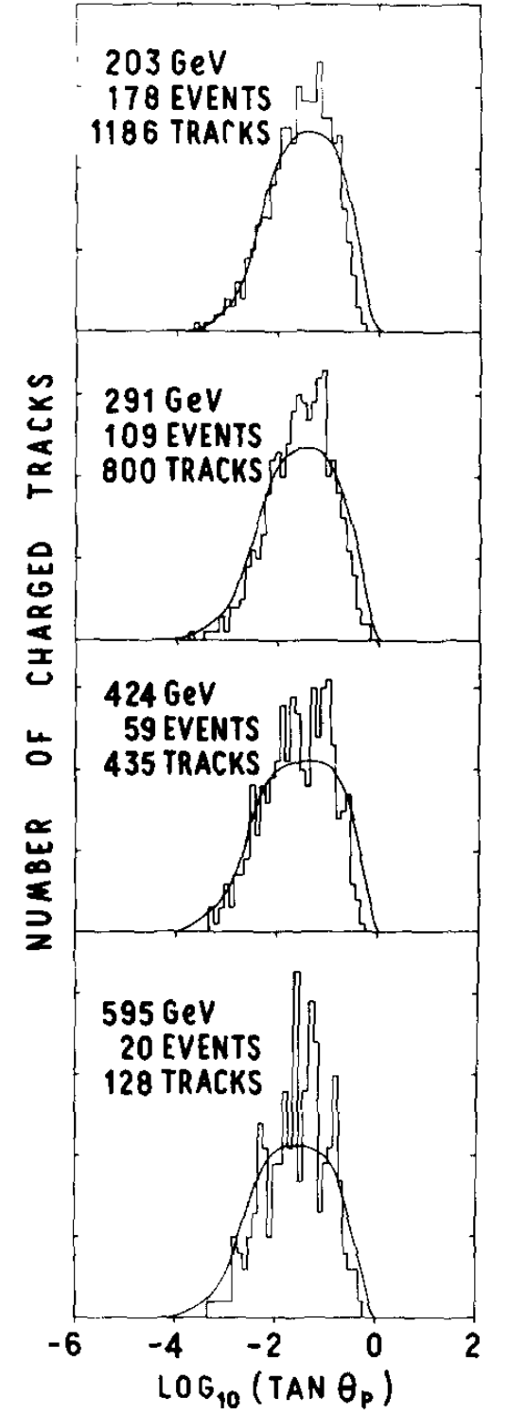
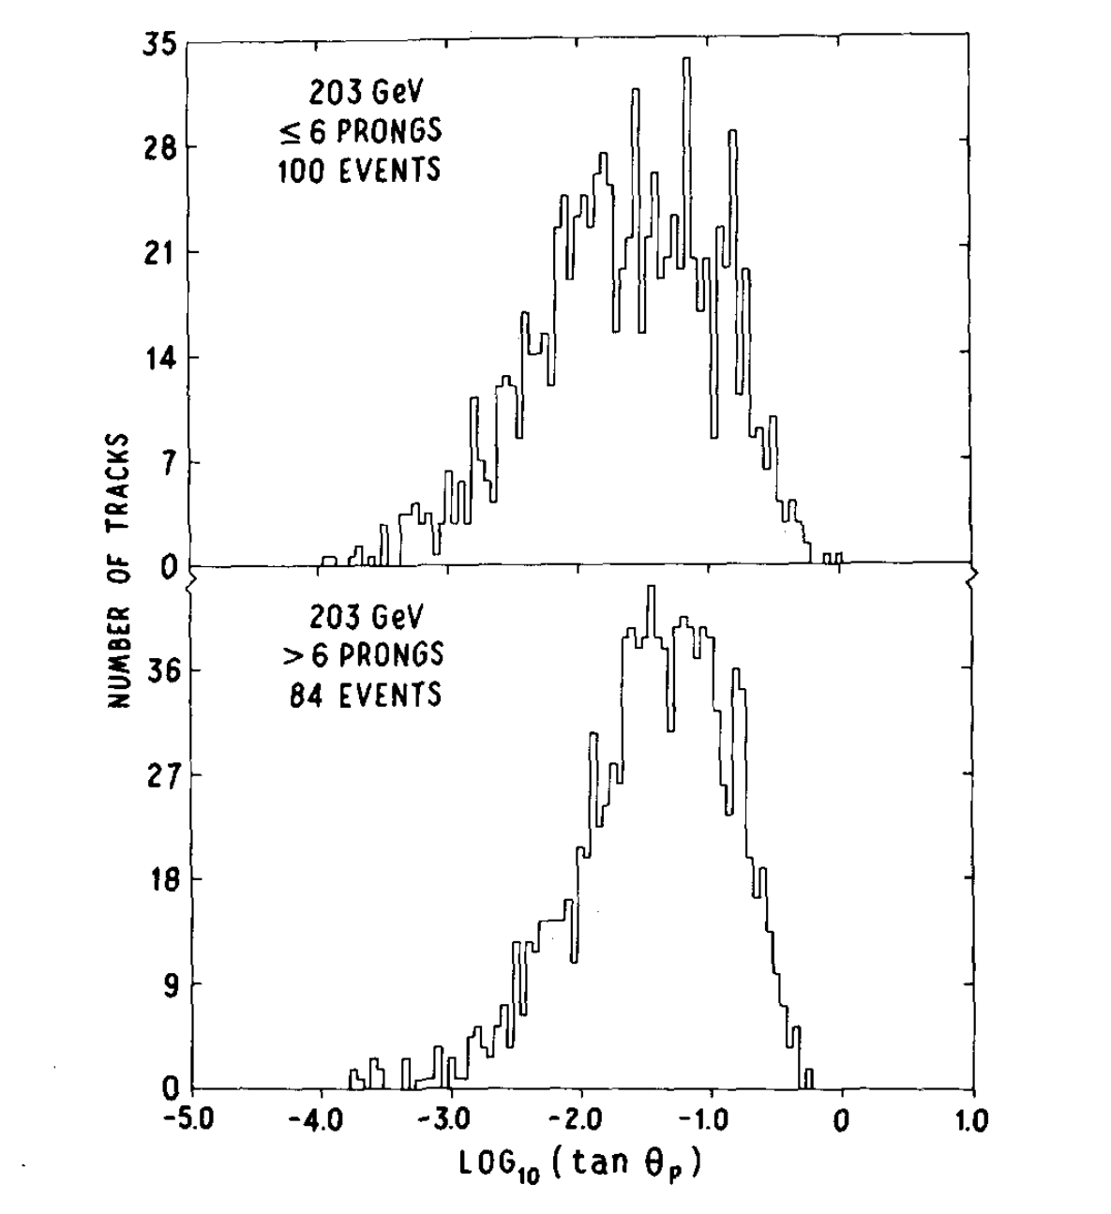
Echo Lake: Results from hydrogen target runs
p-p angular distributions (log₁₀ tan θ )
  For low and high multiplicity events @ 200 GeV
  For all n >3 events vs energy

Slide 20
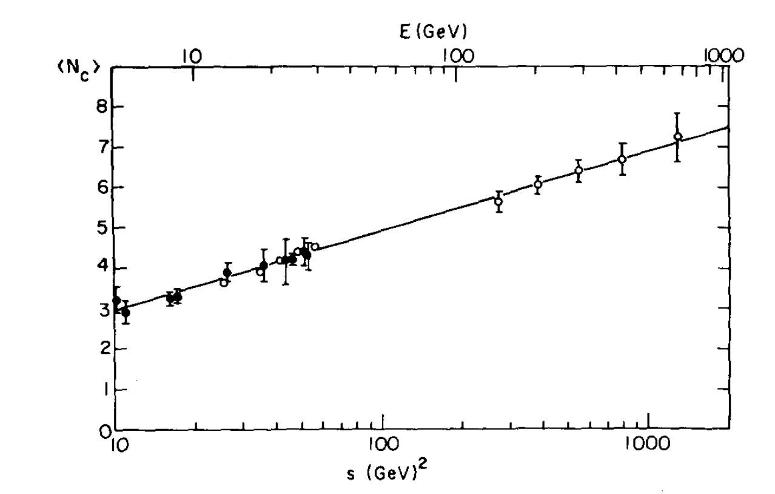
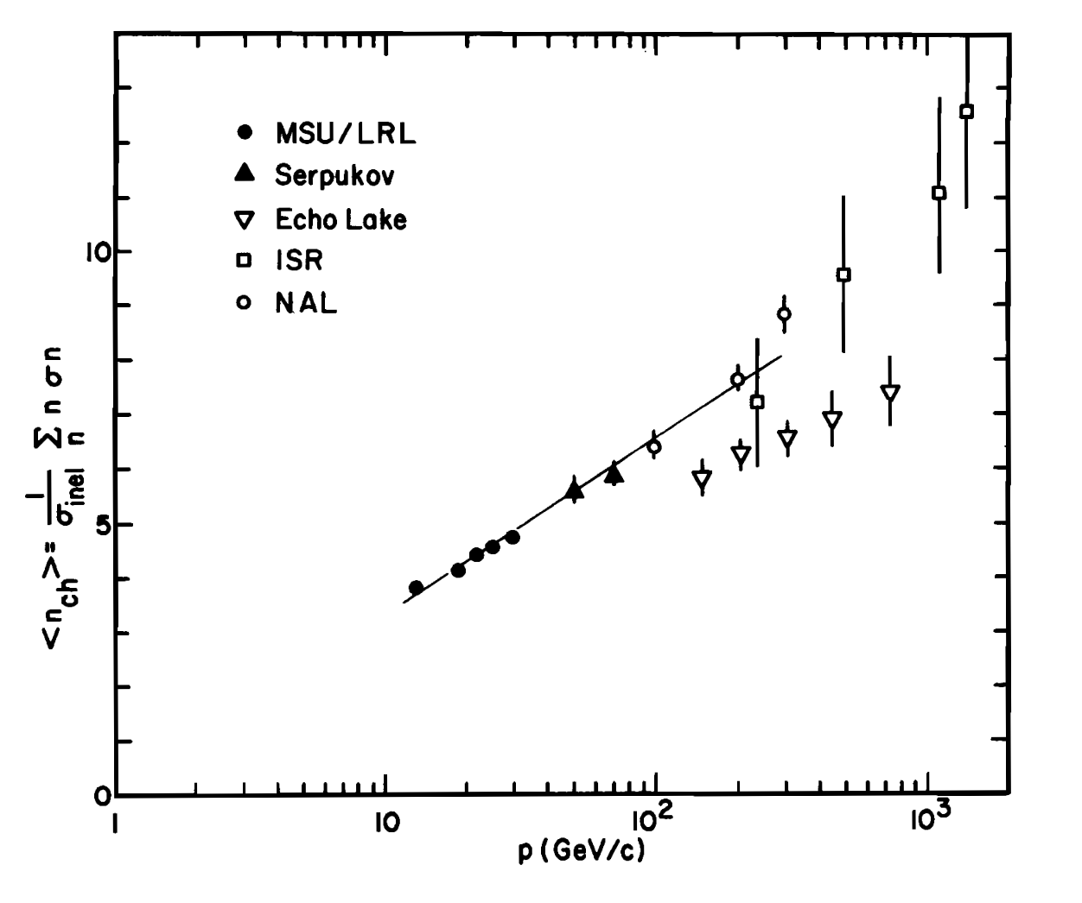
Echo Lake: Results from hydrogen target runs
p-p inelastic average charged multiplicity <n_{CH} >
    M. Jacob review, ICHEP 1972
    Echo Lake Nucl. Phys. B 1972
    Systematic undercounting...

Slide 21




The Alvarez Magnet adventure
UCB Alvarez group built large-gap superconducting magnet, for emulsion balloon flights
  High Altitude Particle Physics Experiment (HAPPE), 1 m bore,2m long, 1 T field
  Crashed in attempted flight, abandoned for experiment with smaller SC magnet
Available as surplus... put it above our target and we have a magnetic spectrometer! But
  Nobody had made a helium liquefier work at such high altitude before
  Magnet design focused on light weight...
  Superconductor was 1960s alloy, none too stable
Lab building roof was raised
Magnet arrived
He liquefier shed
He gas tank looming in the background

Slide 22

Echo Lake: Superconducting magnetic spectrometer layout
New, larger wide-gap spark chambers for tracking
Air-core magnet! Significant B field outside magnet shell
from Larry Jones history of ELL

Slide 23

The first time I blew up an experiment with JGL
Brilliant technician from CTI (refrigerator company) made his machine produce LHe, albeit slowly
Intense effort recommissioned detector, put magnet system in place, and filled it with Lhe
  Successfully charged magnet, mapped field, ran for a week
  Magnet went normal, relief valve worked, no damage
One snowy night on Mt Evans, we charged the magnet for data-taking successfully, then...
  I dropped a large (non-ferrous) wrench, and a moment later the magnet went normal
    (John bugs me to this day...)
  Relief valve failed, rupture disk failed, magnet's end cap blew off from sudden gas pressure
  Lab filled with cold He vapor, superinsulation shreds, and fog
  Team bailed from 2nd story – a technician followed me to the ladder but beat me to ground
  JGL heroically kept his thumb on the "recover gas" button until his voice went Donald Duck, slid out roof door onto a snowbank
CTI 1400 helium refrigerator
(Not ours! Buy it on ebay for $3500)

Slide 24

After the Happe-ness
Results from magnet installation
  CON: Two extra years to get data for my thesis...
  PRO: Francis Halzen joins UWis faculty – and my committee!
The first paper I wrote on the subject was with John Learned, because he knew all the detection techniques, so in fact if you look at the ICE CUBE optical module it looks very much like one of DUMAND... Luckily I was quite naive and had not read all the books that I had to read before making the proposal. For example, should I have read the standard textbook of the time, called “The optics of water and ice”, I would have never started the experiment… In fact, ever since I always advise, specially to High Schools and undergraduates, “don’t read too many books, do things!”
from
www.jotdown.es/2014/05/francis-halzen-i-always-advise-to-my-students-dont-read-too-many-books-do-things/

Slide 25

Echo Lake experiment, 1968-72
Metal plate targets: 1969 - 1970
  Same basic configuration, with LH2 target replaced by sheets of various metals side-by-side, spaced 15 cm
    Preliminary run with carbon slab
    Run 1: Al and Fe
    Run 2: Pb and SN
  Total target thickness ~0.2 λ_{mfp}
  Wide-gap chambers allowed reconstruction of event vertex accurate enough to identify which metal plate was target
  Provided thesis data for P.R. Vishwanath and J. Wilkes

Slide 26


Echo Lake: p-A data
p-Fe inelastic cross section vs E from interactions in Fe plate narrow-gap spark chambers, H target runs
η' = log₁₀ tan(θ) plots for p-A data:
<E> = 200 GeV
"Leading particle" = most negative η' in each event
Low multiplicity = n_{CH} < 6
High multiplicity = n_{CH} > 6

Slide 27
Value of our metal-target results was recently cited
(Thanks to P.R. Vishwanath for pointing me to this recent paper)
“… It was in this context that pseudorapidity * , now ubiquitous in the field, was introduced as a variable of necessity....A major advance in these studies was made by Jones and collaborators in a cosmic ray experiment at Echo Lake which solved one of the problems, resolving for each collision the nature of the target [16]...“
From The Early History of the Quark-Gluon Plasma, W. Busza and W.A. Zajc, Contribution to "Quark Gluon Plasma at Fifty - A Commemorative Journey", Springer Nature Switzerland AG, Eds: Tapan Nayak, et al, arXiv:2504.08720 [nucl-th]
[16] P. R. Vishwanath, A. E. Bussian, L. W. Jones, D. E. Lyon, Jr., J. G. Learned, D. D. Reeder, and R. J. Wilkes, Cosmic Ray Results on the A-Dependence of Multiplicity and Angular Distributions in Proton Nuclear Interactions Above 100-GeV, Phys. Lett. B 53 (1975) 479–483.
* Initially we used η' = log₁₀ tan(θ), familiar from emulsion experiments; later η = ln tan(θ/2)

Slide 28


...and then we did DUMAND
Loyal UWa tribe delivering traditional Spam® tribute to our Chief
UWa team led by our late dear friend and colleague Ken Young (joined UW HEP faculty and met JGL in 1966)

Slide 29
Thanks for the ride, John!
JGL taught me every practical thing I know about doing physics
Taught me to choose what's interesting, potentially very important, and fun – instead of what's safe
All the best for this year, and let's do this again when your odometer rolls over in 5 years...
And thanks to Jelena and friends for organizing this wonderful event and letting me babble !

