Slide 1
DUMAND contributions to the field of Neutrino Astronomy and the NESTOR PROJECT L.K. RESVANIS, University of Athens
http://km3net.phys.uoa.gr/NESTORreport/NESTOR%20PROJECT.pdf
LearnedFest “NESTOR PROJECT”, 2025

Slide 2
" οἱ γοῦν ἐκ τῶν ὀρυγμάτων καὶ φρεάτων ἐνίοτε καὶ ἀστέρας ὁρῶσιν“
Αριστοτέλης, Περί ζώων γενέσεως, Ε, 1, 24
i.e.
“… in fact, men in pits or wells sometimes see the stars. …"
Aristotle, Generation of Animals, V, 1 ,24
“There are some crazy people who go inside mines to study the stars”
Gaius Plinius Secundus, “Naturalis Historia
LearnedFest “NESTOR PROJECT”, 2025

Slide 3
IN OTHER WORDS
When, as is this case, ZEUS controls the signal, common wisdom dictates that the only thing that the experimental physicist can do is to minimize the noise.
This means: locate the telescope as deep as possible (to absorb and thus minimize the noise generated by the down coming cosmic rays) in a medium that maximizes the telescope’s sensitive volume (like water with long transmission lengths for the wavelengths, a bialkali photocathode is sensitive at).
LearnedFest “NESTOR PROJECT”, 2025

Slide 4
PREAMBULUM
Discussions for the construction of a deep sea neutrino telescope started in 1975 with DUMAND (Deep Underwater Muon and Neutrino Detector), in the USA, in order to build and establish a neutrino observatory/telescope deep in the Pacific Ocean near the Big Island of Hawaii and in the, then USSR, lake Baikal in Siberia.
LearnedFest “NESTOR PROJECT”, 2025

Slide 5
PREAMBULUM
Discussions for the construction of a deep sea neutrino telescope started in 1975 with DUMAND (Deep Underwater Muon and Neutrino Detector), in the USA, in order to build and establish a neutrino observatory/telescope deep in the Pacific Ocean near the Big Island of Hawaii and in the, then USSR, lake Baikal in Siberia.
Later and parallel to the DUMAND activity in the Pacific, L. K. Resvanis and his colleagues of the Physics Laboratory, University of Athens and the INR Institute and the Shirshov Institute of Oceanology of the USSR Academy of Sciences, started investigations about similar research activities in Europe and particular in the benign (compared to the Atlantic) Mediterranean Sea. Looking for suitable sites they located a number of deep abyssal plateaus in the region of the Southern Ionian Sea near Pylos of Trojan War fame.
LearnedFest “NESTOR PROJECT”, 2025

Slide 6
PREAMBULUM
Discussions for the construction of a deep sea neutrino telescope started in 1975 with DUMAND (Deep Underwater Muon and Neutrino Detector), in the USA, in order to build and establish a neutrino observatory/telescope deep in the Pacific Ocean near the Big Island of Hawaii and in the, then USSR, lake Baikal in Siberia.
Later and parallel to the DUMAND activity in the Pacific, L. K. Resvanis and his colleagues of the Physics Laboratory, University of Athens and the INR Institute and the Shirshov Institute of Oceanology of the USSR Academy of Sciences, started investigations about similar research activities in Europe and particular in the benign (compared to the Atlantic) Mediterranean Sea. Looking for suitable sites they located a number of deep abyssal plateaus in the region of the Southern Ionian Sea near Pylos of Trojan War fame.
This was the beginning of the Neutrino Extended Submarine Telescope with Oceanographic Research or NESTOR, a very appropriate acronym for a project centered in Pylos (http://km3net.phys.uoa.gr/NESTORreport/NESTOR%20PROJECT.pdf).
LearnedFest “NESTOR PROJECT”, 2025

Slide 7
Two sites, both in Greece were suitably deep.
I emphasize again, that depth is a critical parameter in order to minimize the down coming cosmic ray muon flux and also maximize the near the horizon telescope sensitivity.
LearnedFest “NESTOR PROJECT”, 2025

Slide 8
Two sites, both in Greece were suitably deep.
I emphasize again, that depth is a critical parameter in order to minimize the down coming cosmic ray muon flux and also maximize the near the horizon telescope sensitivity.
One with a depth of 4500 m, later called the NESTOR basin, which is 7.5 nautical miles SW from the island of Sapienza, and
The second, at a 5200 m depth (the deepest in the Mediterranean), known as the Oinousai pit or Vavilov or Calypso Deep.
LearnedFest “NESTOR PROJECT”, 2025

Slide 9
Two sites, both in Greece were suitably deep.
I emphasize again, that depth is a critical parameter in order to minimize the down coming cosmic ray muon flux and also maximize the near the horizon telescope sensitivity.
One with a depth of 4500 m, later called the NESTOR basin, which is 7.5 nautical miles SW from the island of Sapienza, and
The second, at a 5200 m depth (the deepest in the Mediterranean), known as the Oinousai pit or Vavilov or Calypso Deep.
Both are, at the most south-western tip of the Peloponnese, Greece, and about 17 nautical miles from the Bay of Navarino, one of the world’s best natural harbours, where the town of Pylos is located (Fig.1).
LearnedFest “NESTOR PROJECT”, 2025

Slide 10
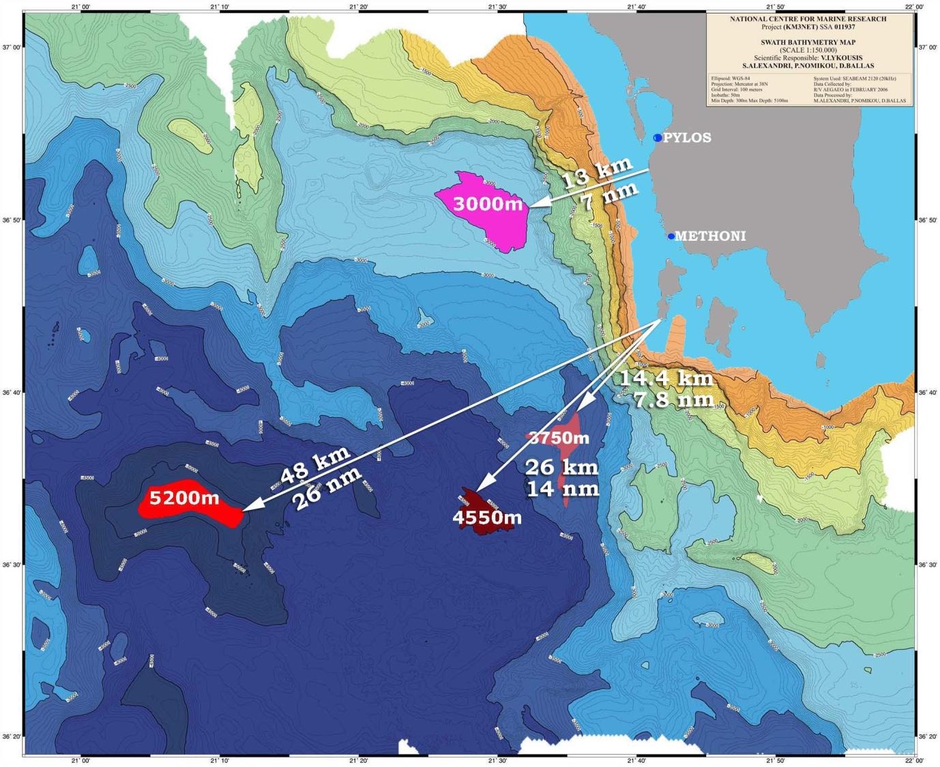
Figure 1.The NESTOR sites (Co-ordinates at 4550 m depth: 36° 33’N, 21°30’E). Detailed map produced by HCMR (Hellenic Centre for Marine Research).
LearnedFest “NESTOR PROJECT”, 2025

Slide 11
Resvanis is an early convert to NEUTRINO ASTRONOMY due to his long association and collaboration with John Learned and had participated in the 1980 DUMAND Workshop in Hawaii.
At that time the West European HEP community was not aware of this exciting new field of HEP/ASTROPHYSICS and Resvanis started to tour many countries preaching the gospel of Neutrino Astronomy.
Resvanis hit the seminar circuit in Europe trying to proselytize new converts to Neutrino Astronomy
LearnedFest “NESTOR PROJECT”, 2025

Slide 12
BUT allow me to concentrate on NESTOR……. An experiment which was inspired by DUMAND and was helped by “a technology knowhow umbilical” connected to DUMAND.
LearnedFest “NESTOR PROJECT”, 2025

Slide 13
BUT allow me to concentrate on NESTOR……. An experiment which was inspired by DUMAND and was helped by “a technology knowhow umbilical” connected to DUMAND.
A Collaboration was set up between the Physics Laboratory of the University of Athens and the M.Markov - I.Zheleznykh group of the Institute for Nuclear Physics of the USSR Academy.
Markov is credited for first proposing, in the 1960s, the construction of a deep sea/lake neutrino telescope and use Cherenkov radiation to detect the muons produced by the interacting neutrinos. Upcoming muons would be the signature of particles that interacted after having traversed the Earth (from the host of known elementary particles only neutrinos can do this).
LearnedFest “NESTOR PROJECT”, 2025

Slide 14
BUT allow me to concentrate on NESTOR……. An experiment which was inspired by DUMAND and was helped by “a technology knowhow umbilical” connected to DUMAND.
A Collaboration was set up between the Physics Laboratory of the University of Athens and the M.Markov - I.Zheleznykh group of the Institute for Nuclear Physics of the USSR Academy.
Markov is credited for first proposing, in the 1960s, the construction of a deep sea/lake neutrino telescope and use Cherenkov radiation to detect the muons produced by the interacting neutrinos. Upcoming muons would be the signature of particles that interacted after having traversed the Earth (from the host of known elementary particles only neutrinos can do this).
This activity was supported also by the Shirshov Institute of Oceanology of the Academy with its extensive deep sea expertise and infrastructure which included a fleet of well-equipped large oceanographic vessels including bathyscaphs like the MIRs, the world’s best, capable of operating at water depths down to 6000 m.
LearnedFest “NESTOR PROJECT”, 2025

Slide 15
A Russian made autonomous titanium star of 7 m radius equipped with 15 inch HAMAMATSU upward looking photomultiplier tubes in glass pressure housing was suspended from the "VITYAZ", at depths of 3300, 3700 and 4100 m and then, in the following year, a linear string of five 15 inch photomultiplier tubes in glass pressure housing to depths of 3700 and 3900 m suspended from the "AKADEMIK MSTISLAV KELDYSH".
The down coming rate of cosmic ray muons and the angular distribution were measured, at depths of 3300, 3700, 3900 and 4100 m.
LearnedFest “NESTOR PROJECT”, 2025

Slide 16
A Russian made autonomous titanium star of 7 m radius equipped with 15 inch HAMAMATSU upward looking photomultiplier tubes in glass pressure housing was suspended from the "VITYAZ", at depths of 3300, 3700 and 4100 m and then, in the following year, a linear string of five 15 inch photomultiplier tubes in glass pressure housing to depths of 3700 and 3900 m suspended from the "AKADEMIK MSTISLAV KELDYSH".
The down coming rate of cosmic ray muons and the angular distribution were measured, at depths of 3300, 3700, 3900 and 4100 m.
For the first time ever there was a demonstration that Markov’s idea worked. Though only down coming atmospheric muons were detected in short deployments of autonomous structures suspended from ships. Thus, the proof of concept was demonstrated in July 1991 (VITYAZ) and, again in November 1992 (KELDYSH) by the collaboration of the Institute for Nuclear Research and the Institute of Oceanology of the USSR Academy of Sciences and the University of Athens.
LearnedFest “NESTOR PROJECT”, 2025

Slide 17
All the surveys as well as the cosmic rate measurements were reported in workshops in Pylos in October 1992 and October 1993 respectively (see articles in the "Proceedings of the 2nd NESTOR International Workshop in Pylos Greece, 19 -21 October 1992”, in the "Proceedings of the 3rd NESTOR International Workshop in Pylos Greece, 19 -21 October 1993”).
LearnedFest “NESTOR PROJECT”, 2025

Slide 18
However, the concurrent demise of the USSR meant that the Academy had no longer the resources to support the costly parts of this endeavor, especially the deep sea operations.
So, with the help of John, we turned to DUMAND for technology transfer. This is something that our DUMAND colleagues generously shared with us.
A steady flow of Engineers and Technicians was established between Honolulu and Pylos.
LearnedFest “NESTOR PROJECT”, 2025

Slide 19
However, the concurrent demise of the USSR meant that the Academy had no longer the resources to support the costly parts of this endeavor, especially the deep sea operations.
So, with the help of John, we turned to DUMAND for technology transfer. This is something that our DUMAND colleagues generously shared with us.
A steady flow of Engineers and Technicians was established between Honolulu and Pylos.
We all feel grateful to our DUMAND colleagues for this.
LearnedFest “NESTOR PROJECT”, 2025

Slide 20
The lack of technical support from the USSR had profound implications in the telescope design, because the MIRs were no longer available for the required deep sea wet-mate connections between the telescope elements and a shore cable supplying electrical power and transporting data and commands.
LearnedFest “NESTOR PROJECT”, 2025

Slide 21
The lack of technical support from the USSR had profound implications in the telescope design, because the MIRs were no longer available for the required deep sea wet-mate connections between the telescope elements and a shore cable supplying electrical power and transporting data and commands.
Consequently in October 1994, Resvanis organized the first European Deep Sea Neutrino meeting in Greece (Athens and Cape Sounion) with participants from several European countries in order to establish a European collaboration, Project NESTOR (Neutrino Extended Submarine Telescope with Oceanographic Research). Besides scientists from Greece, scientists from Italy, Germany, Switzerland, France, Russia and the USA joined the project.
LearnedFest “NESTOR PROJECT”, 2025

Slide 22
The central aim of this endeavor was the joint development of concepts, components and infrastructure resources, needed for constructing, installing and operating a very large telescope unit for high energy neutrinos in the deepest part of the Mediterranean Sea. Due to its vicinity to the intended test and deployment site, the town of Pylos became the operational centre for the ongoing inter-European collaboration with personnel and material contributions from Greece, Italy, Germany, and Russia. Several annual NESTOR Workshops in Pylos provided the basic platform for the exchange of progress and results.
LearnedFest “NESTOR PROJECT”, 2025

Slide 23
MILESTONE
LAERTIS= Laboratory in the Abyss of Europe with Real TIme data Transfer to Shore for Interdisciplinary Studies was deployed at the end of a 35km electro-optical cable. Data were transmitted to shore on January 15, 2002.
LAERTIS is the first, ever, deep sea laboratory with real time data and command transfer, thus enabling researchers to do dynamic studies. It was built in parallel to and for the needs of the NESTOR telescope and its main purpose was to study the NESTOR site deep sea environment and establish, in situ, a paradigm of deep sea sites study methodology [Aggouras et al:NIM A,567 (2006)pp468-473], with instrumentation to measure interactively in Real Time: water temperature, pressure, conductivity, light transmissivity, currents, Ocean Bottom Seismometer etc.
LearnedFest “NESTOR PROJECT”, 2025

Slide 24
MILESTONE
LAERTIS operated for many months before it was recovered to play the role of the anchor/platform of a NESTOR floor.
NOTE: Chronologically, EMSO the European Multidisciplinary Seafloor and water column Observatory was launched much later.
LearnedFest “NESTOR PROJECT”, 2025

Slide 25
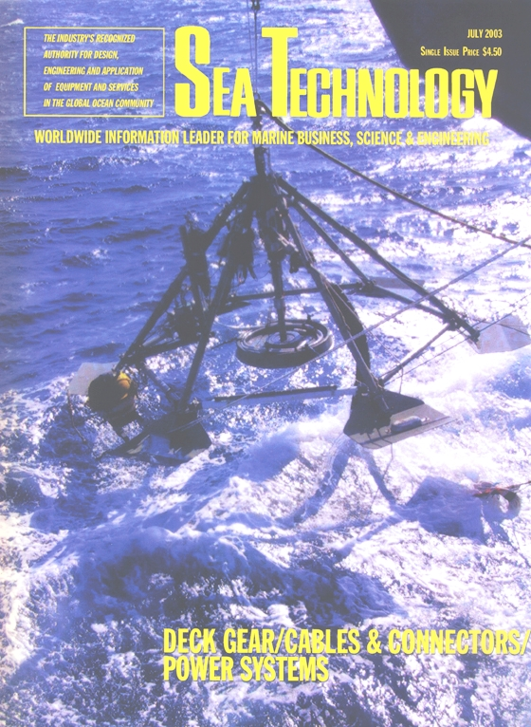
LAERTIS. The cover of "Sea Technology, Vol. 44, No 7, 2003" where the article concerning LAERTIS, “Deep sea Station Connected with Cable to Shore” (E.G. Anassontzis, P. Koske, Sea Technology, Vol. 44), was published.

Slide 26
The first version of the NESTOR telescope electronics were made by the Milano firm LABEN (LABoratori Elettronici e Nucleari), proved to be unreliable and thus was not incorporated in the telescope.
This caused a delay of a few years because the Collaboration did not have the expertise to design and build a new set of electronics.
LearnedFest “NESTOR PROJECT”, 2025

Slide 27
The first version of the NESTOR telescope electronics were made by the Milano firm LABEN (LABoratori Elettronici e Nucleari), proved to be unreliable and thus was not incorporated in the telescope.
This caused a delay of a few years because the Collaboration did not have the expertise to design and build a new set of electronics.
Lucky for us, the David Nygren group (LBL) was developing at the time an Analogue Transient Waveform Digitizer. David and his colleagues came to our rescue and this chip literally became the heart of the Nygren electronics for NESTOR.
Enough electronics to instrument 12 Optical Modules were produced, sufficient for a prototype hexagonal floor with six pairs of up and down looking Optical Modules.
LearnedFest “NESTOR PROJECT”, 2025

Slide 28
MILESTONE-proof of concept
This NESTOR test detector, a fully equipped NESTOR floor, was deployed at about 4000m, connected to shore and operated in 2003.
This is the first ever in-situ demonstration that the concept of the neutrino deep sea telescope is realistic.
LearnedFest “NESTOR PROJECT”, 2025

Slide 29
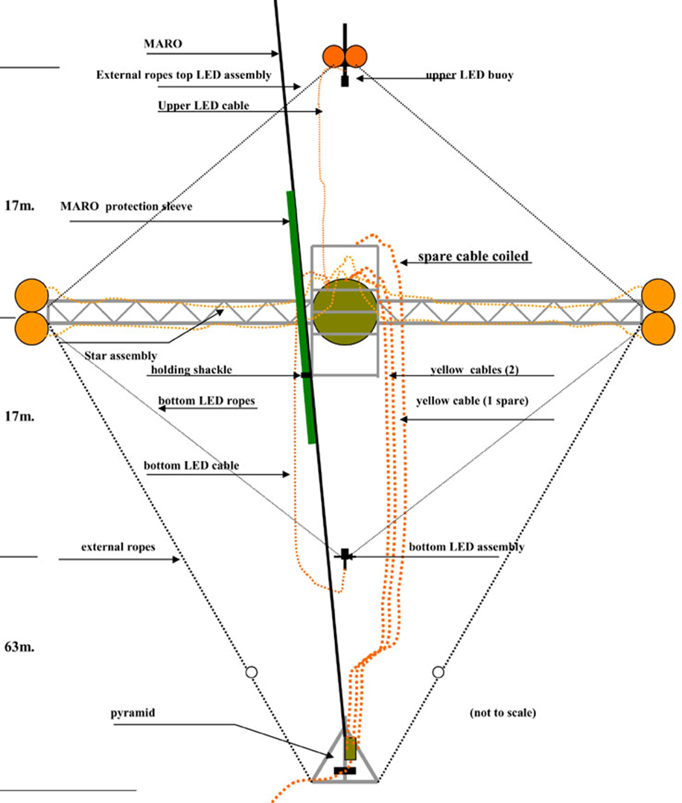
NESTOR FLOOR SCHEMATIC, NESTOR test detector deployed in 2003.
anchor/LAERTIS
LearnedFest “NESTOR PROJECT”, 2025

Slide 30
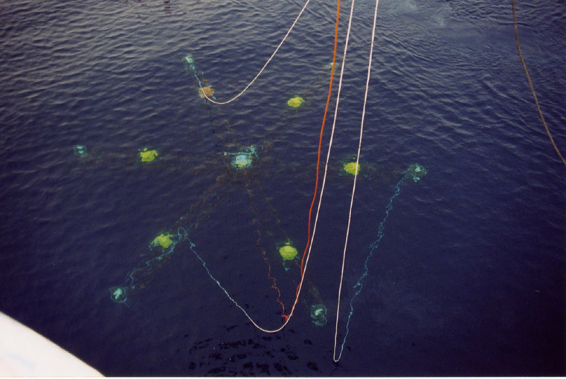
NESTOR FLOOR DURING DEPLOYMENT

Slide 31
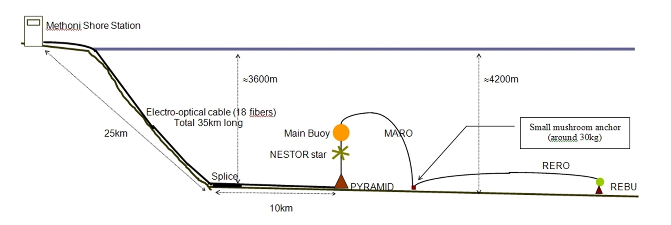
NESTOR floor
Anchor/LAERTIS
NESTOR LAYOUT DIAGRAM, as deployed in 2003
LearnedFest “NESTOR PROJECT”, 2025

Slide 32
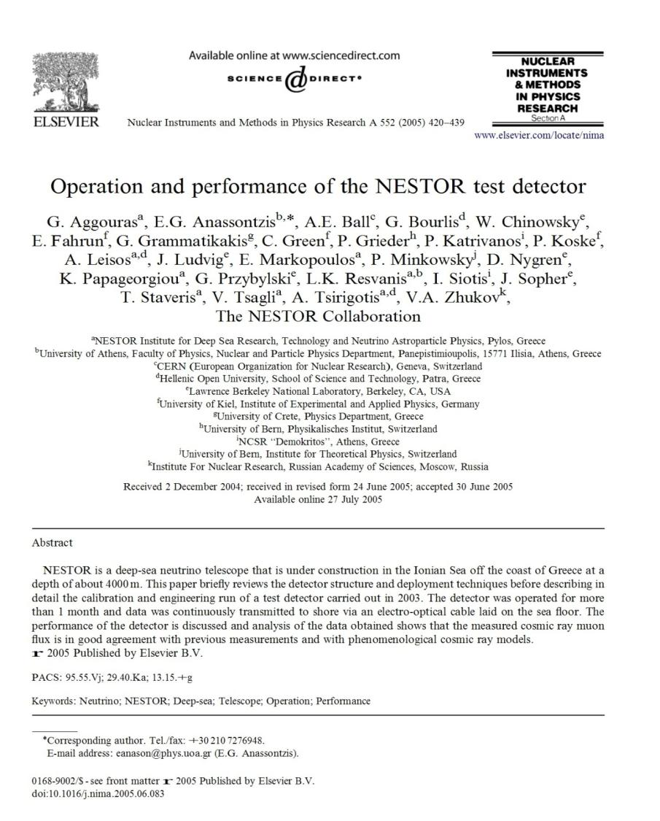
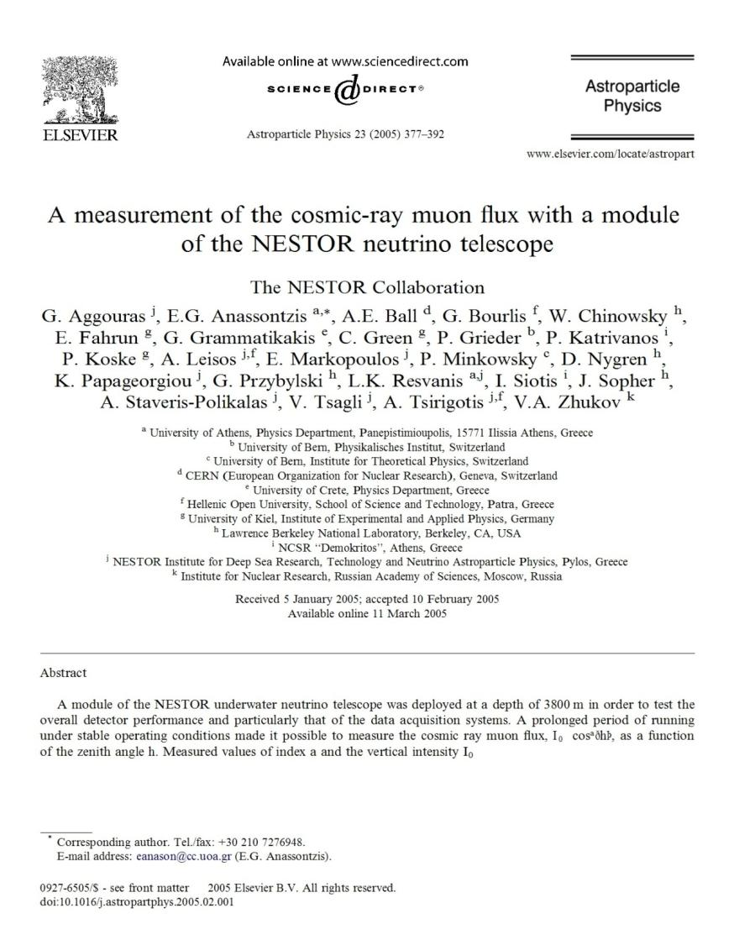
NIM in Physics Research A 552 (2005) 420–439
Astroparticle Physics 23 (2005) 377–392

Slide 33
OVERVIEW
Later, based on the pioneering work done by NESTOR, the project became part of the High Priority List of the first ESFRI, the European Strategy Forum for Large Research Infrastructures, a fact that underlined the importance of the endeavor.
Due to a multitude of reasons and also in order to take advantage of the Regional EU and National funding, two similar experiments branched out of NESTOR. So “ANTARES”, and later “NEMO”, were established in the south of France and east of Sicily respectively.
LearnedFest “NESTOR PROJECT”, 2025

Slide 34
OVERVIEW
Later, based on the pioneering work done by NESTOR, the project became part of the High Priority List of the first ESFRI, the European Strategy Forum for Large Research Infrastructures, a fact that underlined the importance of the endeavor.
Due to a multitude of reasons and also in order to take advantage of the Regional EU and National funding, two similar experiments branched out of NESTOR. So “ANTARES”, and later “NEMO”, were established in the south of France and east of Sicily respectively.
Eventually, the three experiments “converged”, expanded and evolved with further funding at a European level to the European project "KM3NeT", a Kilometre Cube Neutrino Telescope that is pursued by the participating countries; initially Greece, Italy, France, Netherlands and Germany and later many more (the KM3NeT collaboration is quite larger now).
LearnedFest “NESTOR PROJECT”, 2025

Slide 35
Ε Π Ι Λ Ο Γ Ο Σ
John and his DUMAND colleagues started with the idea of M. Markov and laid the foundations of High Energy Neutrino Telescopes in water/ice.
They made a multitude of original multidisciplinary contributions/innovations essential for building deep sea neutrino telescopes.
LearnedFest “NESTOR PROJECT”, 2025

Slide 36
Ε Π Ι Λ Ο Γ Ο Σ
John and his DUMAND colleagues started with the idea of M. Markov and laid the foundations of High Energy Neutrino Telescopes in water/ice.
They made a multitude of original multidisciplinary contributions/innovations essential for building deep sea neutrino telescopes.
To mention some of the seminal:
The use of pressure resistant glass housing for the photomultiplier tubes, including how to encase them in a high magnetic permeability cage with minimal shadowing.
The use of optical fibers to transmit data to shore.
The use of “chirped sonar” to continuously locate accurately the detection elements, extremely important for reconstructing track direction
LearnedFest “NESTOR PROJECT”, 2025

Slide 37
Ε Π Ι Λ Ο Γ Ο Σ
ALL THIS IS THE DIRECT RESULT OF DUMAND
We have all used these, at the time, pioneering techniques
LearnedFest “NESTOR PROJECT”, 2025

Slide 38
In many ways John, and his DUMAND colleagues, laid the foundations of High Energy Neutrino Telescopes.
Thus, John become the Godfather and Patron Saint of High Energy Neutrino Telescopes in water and ice.
LearnedFest “NESTOR PROJECT”, 2025

Slide 39
In many ways John, and his DUMAND colleagues, laid the foundations of High Energy Neutrino Telescopes.
Thus, John become the Godfather and Patron Saint of High Energy Neutrino Telescopes in water and ice.
MAHALO GIOVANNI
LearnedFest “NESTOR PROJECT”, 2025

