Slide 1
Radio Detection of
High Energy Particles
Peter Gorham (U. Hawai'i)
With many thanks to David Saltzberg (UCLA)

Slide 2
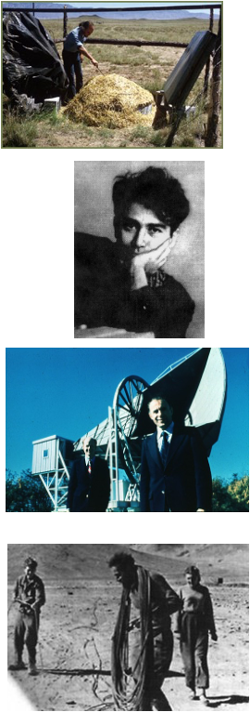
The 60’s
1961: First 10²⁰ eV cosmic ray air shower observed
– John Linsley, Volcano Ranch, near Albuquerque, NM
1962: G. Askaryan predicts coherent radio Cherenkov from showers
– His applications? Ultra-high energy cosmic particles
1965: Penzias & Wilson discover 3K echo of the Big Bang
– (thermal noise from bird dung in their dish?)
1966: Cosmic ray spectral cutoff at 10^{19.5} eV predicted
– K. Greisen (US) & Zatsepin & Kuzmin (Russia), independently
Cosmic ray spectrum must end close to ~10²⁰ eV
Berezinsky & Zatsepin drew the important conclusion: there must be cosmogenic UHE neutrinos

Slide 3
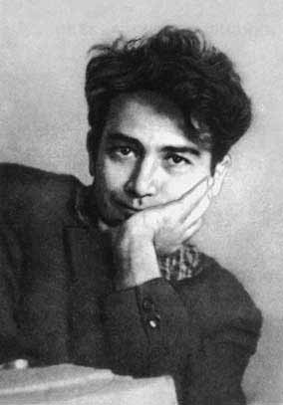
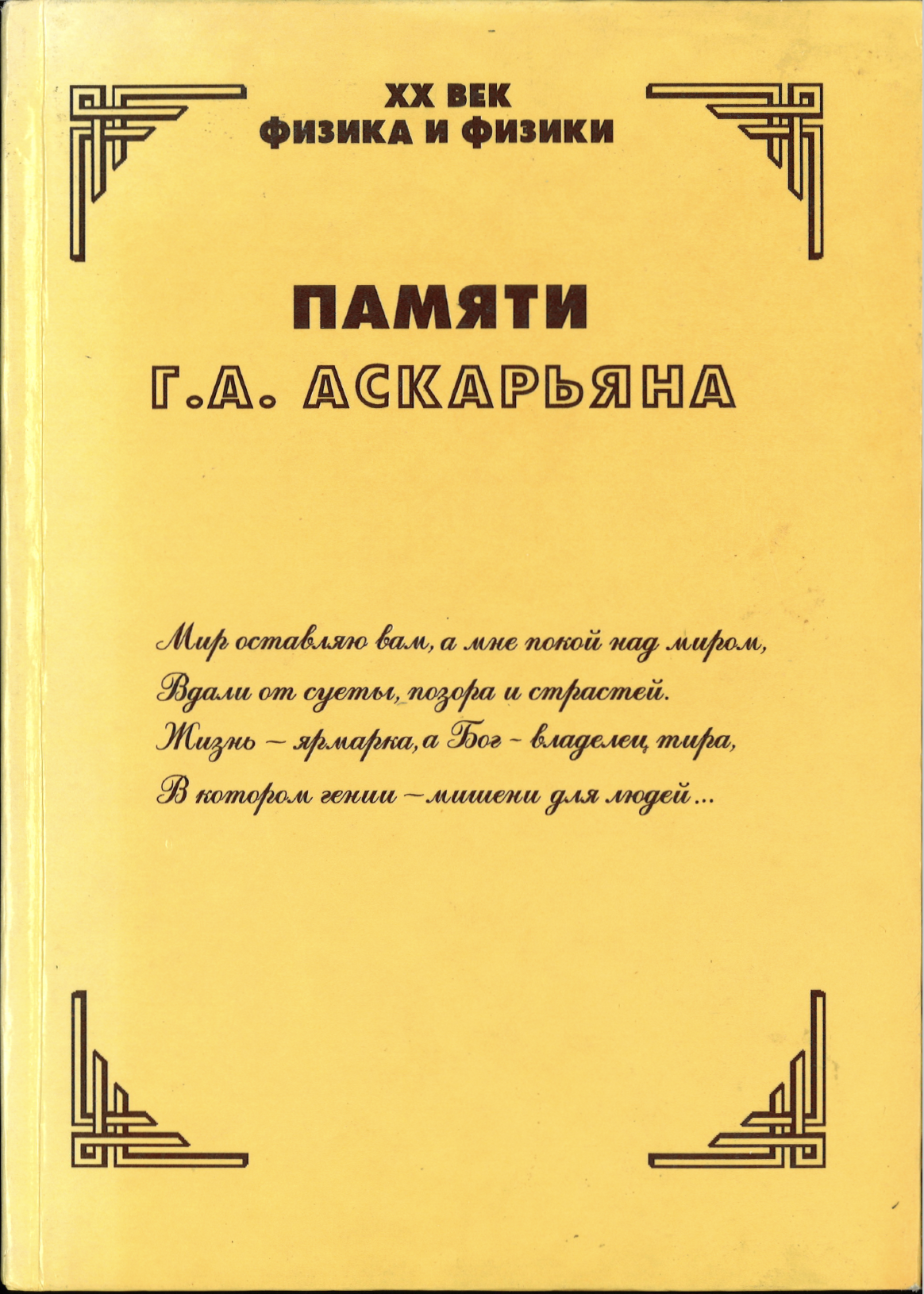
Askaryan’s application: Use Large Natural Media,
Transparent to Radio
Mapped it out in the 1960s:
Lunar Regolith
combines two Greek words: rhegos (ῥῆγος), 'blanket', and lithos (λίθος), 'rock'.
Antarctic Ice
Up to 4km deep
Salt domes
Uplifted & purified ancient Sea Beds
G. Askaryan biography: Boris Bolotovskii
Gurgen Askaryan (1928-1997): prominent Soviet-Armenian physicist, discoverer of self-focusing of light, pioneer in light-matter interactions, and visionary in interaction of high energy particles with matter (and a Nobel contender…)
G. A. Askaryan, 1962, JETP 14, 441; 1965, JETP 21, 658, ...

Slide 4
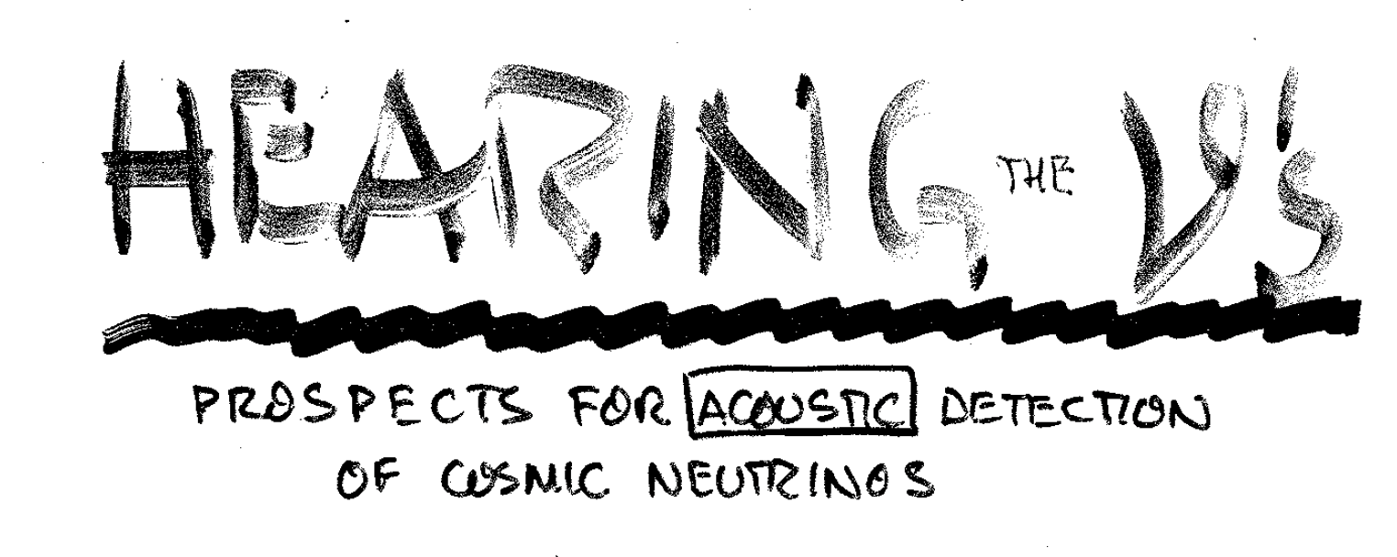
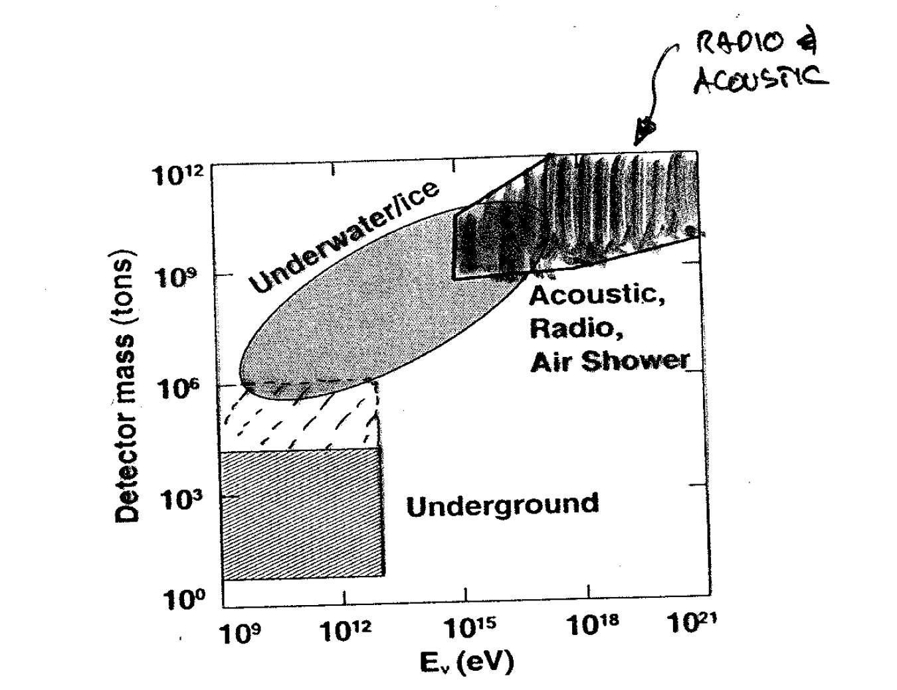
Askaryan’s missed Nobel
While a PhD student in the late 1940’s, Askaryan came up with the idea to measure HE particles via supercritical fluids – the bubble chamber!
He did not get much support from his institute, got discouraged and never published the idea
A few years later Donald Glaser published the bubble chamber paper, resulting in a Nobel prize in 1960
After that Askaryan published everything! Including: acoustic detection of HEP
→ JGL took this and ran with it in a wonderful series of accelerator experiments that inspired a similar set of radio tests
JGL 1990’s
transparencies!

Slide 5
The Askaryan Effect
High Energy showers create radio.
Assuming
There is a charge excess of 10-30%
Coherence factor among 10¹⁰ charges
No “plasma shielding”
No unknown unknowns (haha).
Had to convince the field
Modern simulations
first by Francis Halzen, Enrique Zas, Todor Stanev further established effect, George Frichter & John Ralston at KU
FH: "I stake my career on it!"
Much subsequent theory work by Jaime Alvarez-Muñiz, Enrique Zas, Dave Seckel, many others
As is well known to this audience:
P_{Cherenkov} ∝ ν Δν (includes radio!)
Pioneering work by Dave Besson with antennas on Amanda strings
and pioneering ideas by Dagkesamanskii, Gusev, & Zheleznykh, incl. at Russian Antarctic base, Vostok

Slide 6
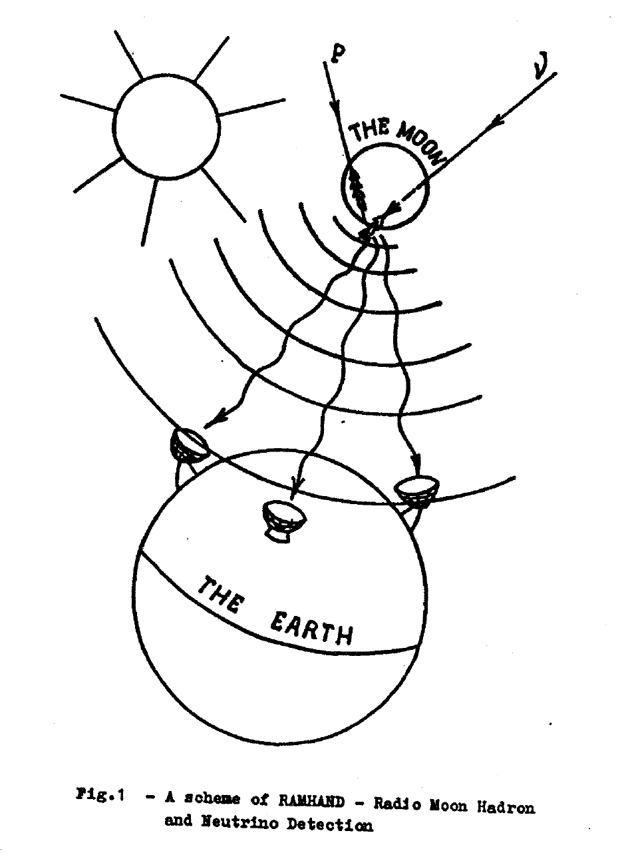
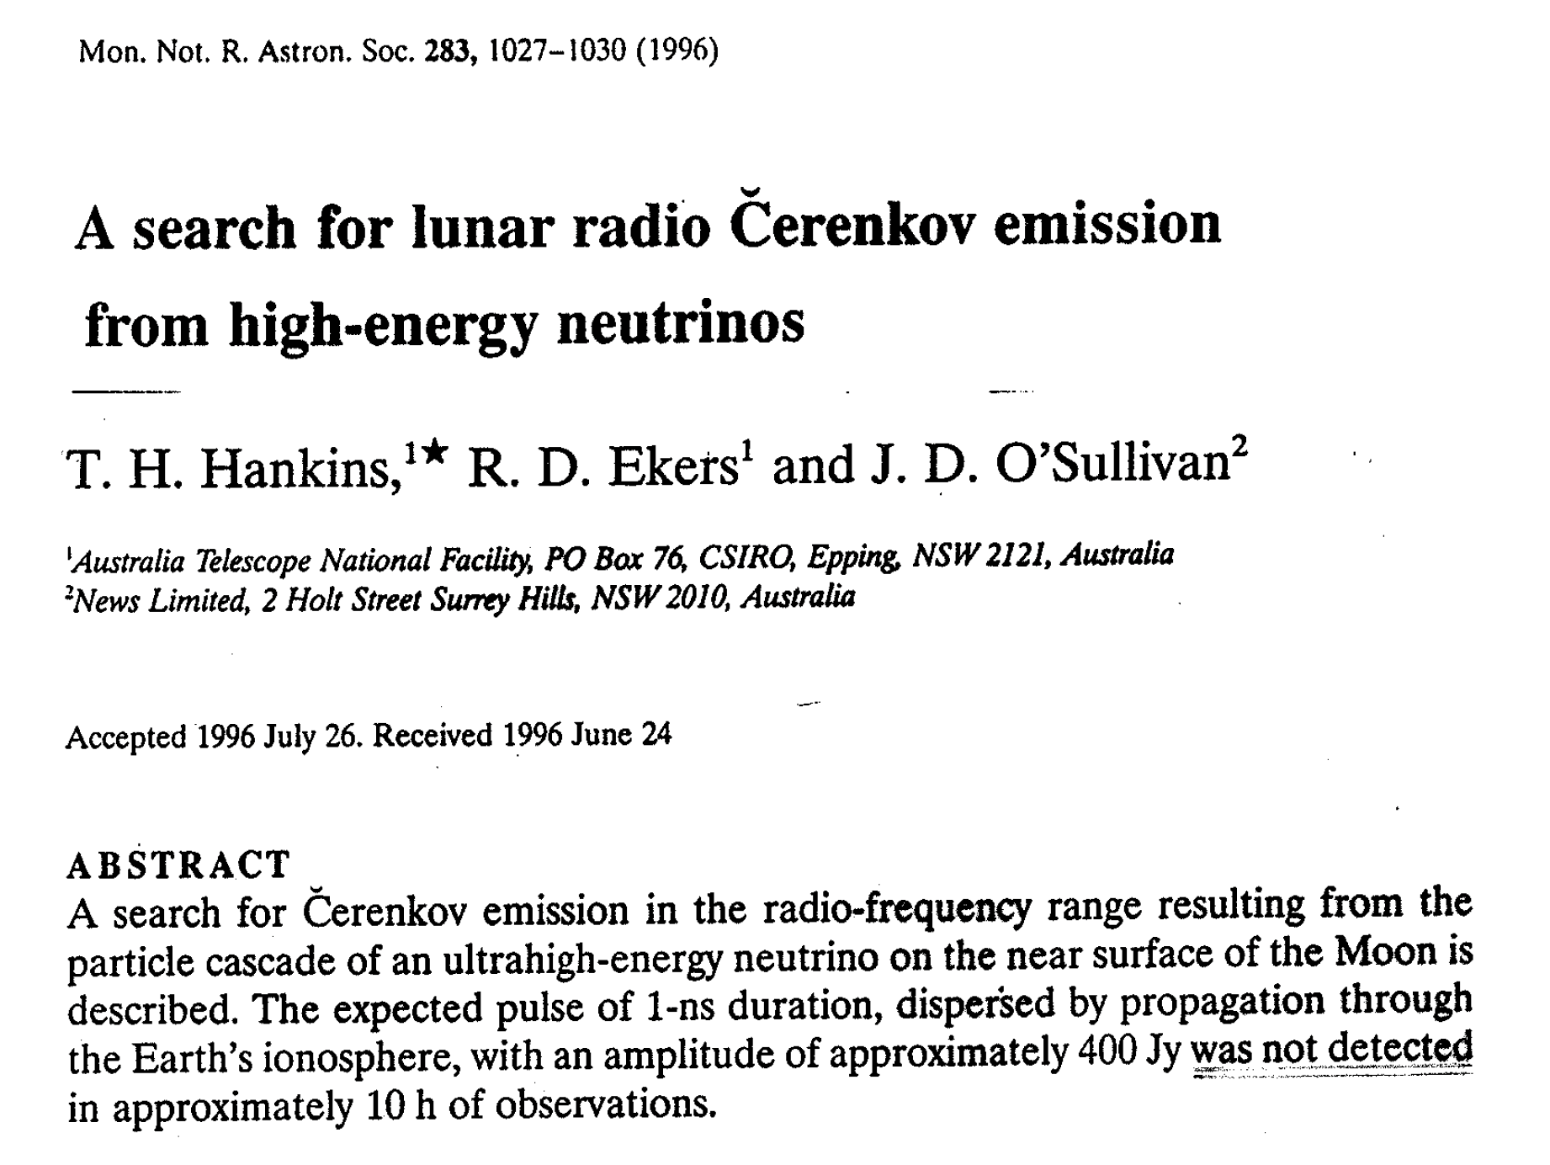
R. Dagkesamanski & I Zheleznykh 1980’s
Inspired work on how to observe EHE CRs & neutrinos using ground based radio telescopes
Two very good radio astronomers, Tim Hankins and Ron Ekers, took them seriously and did the (single-dish) experiment!
PG* was at JPL, doing VLBI observations at Goldstone, and Chuck Naudet had discretionary research time…
* I first heard about the D&Z paper from Dan O’Connor!

Slide 7
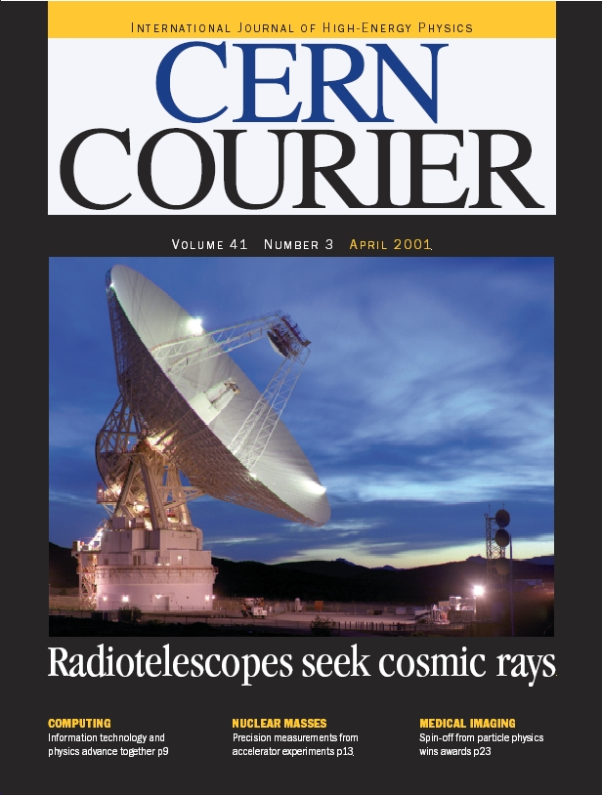
The Goldstone Lunar ultra-high energy Neutrino Experiment (GLUE)
Chuck Naudet, Kurt Liewer, and PG then of JPL. Access to the amazing 70m Deep-Space Network (NASA/JPL/Caltech) Goldstone radio telescope and its partners
Gorham came to UCLA, invited Saltzberg to join (with grad student Dawn Williams)

Slide 8
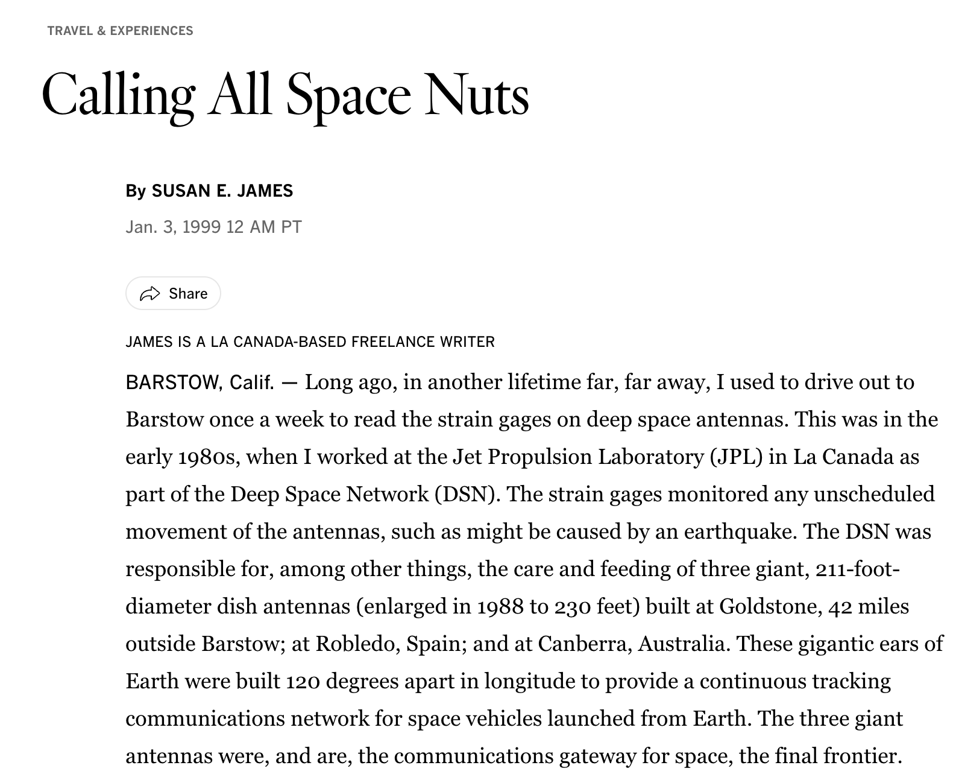
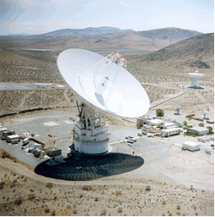
Goldstone 70m tourism

Slide 9
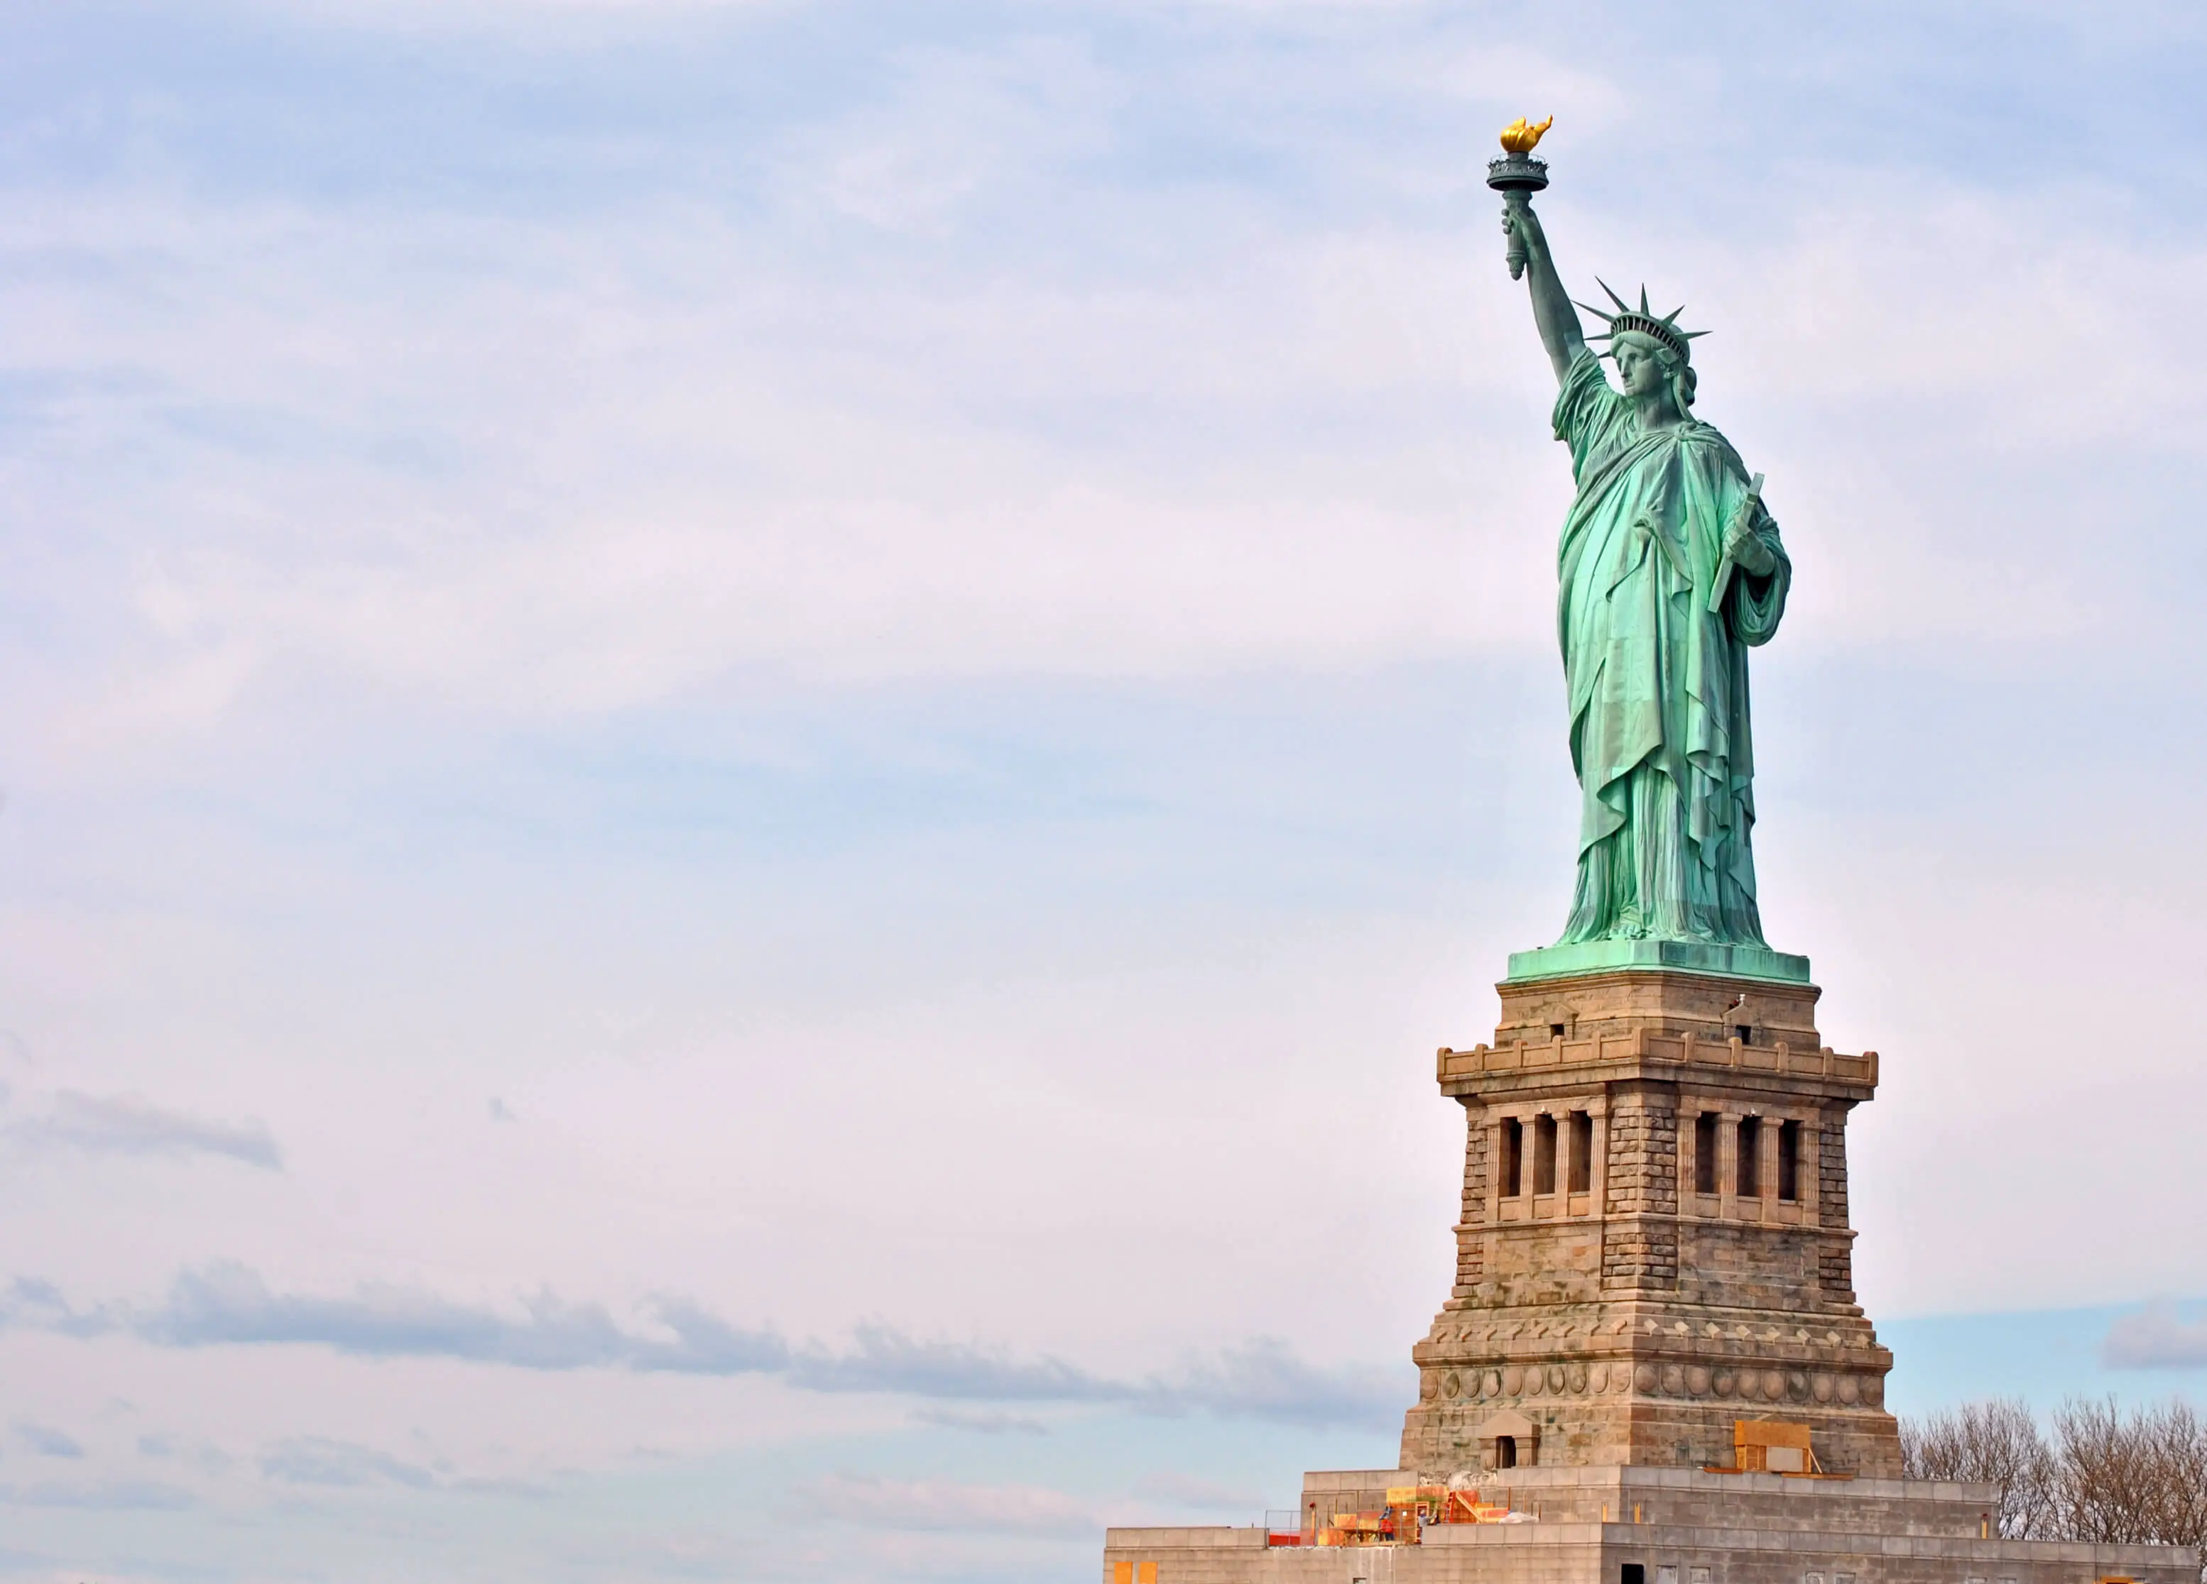
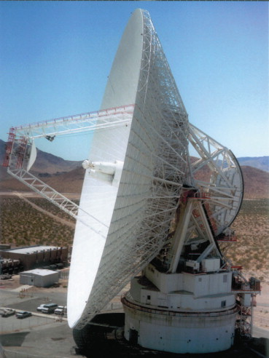

Slide 10
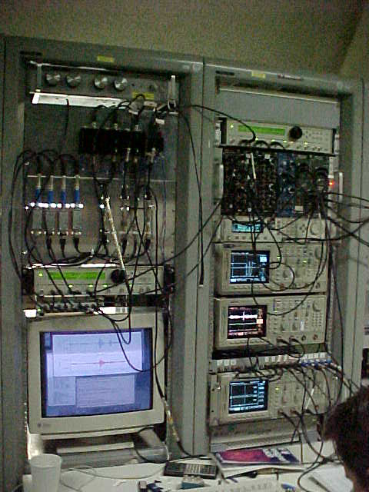
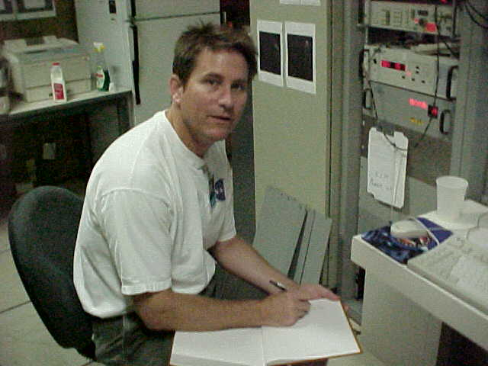
The GLUE control room
(1998-2003)
Peter: "David, you are an accelerator-based guy. Can we show we are not wasting our time?

Slide 11
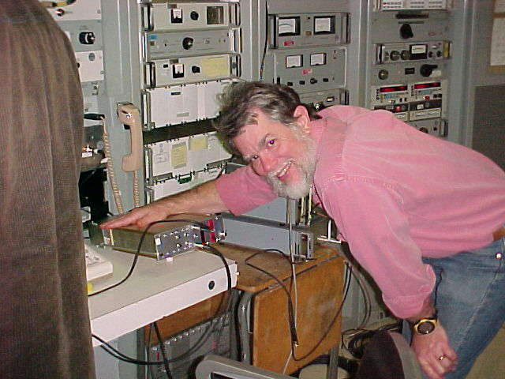
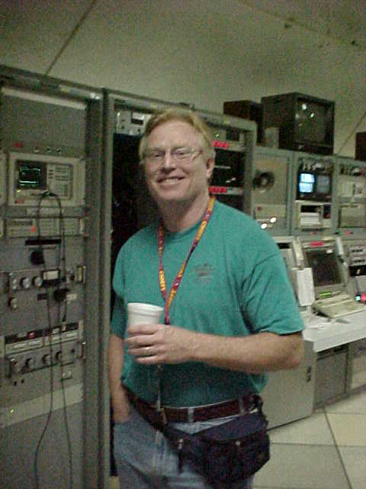
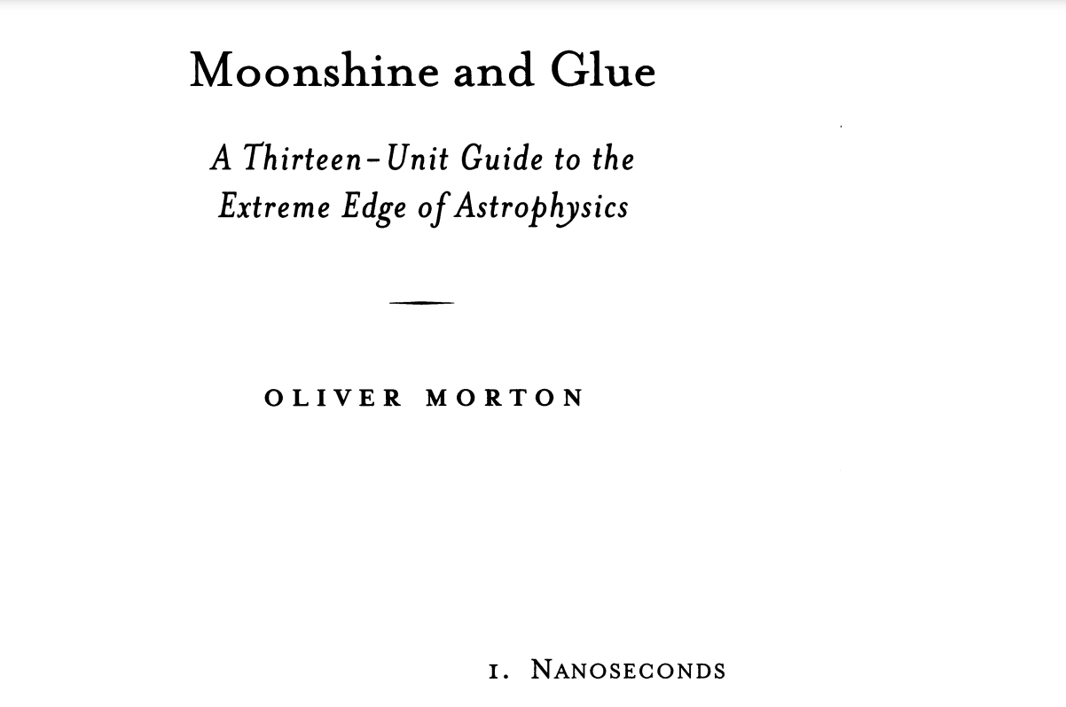
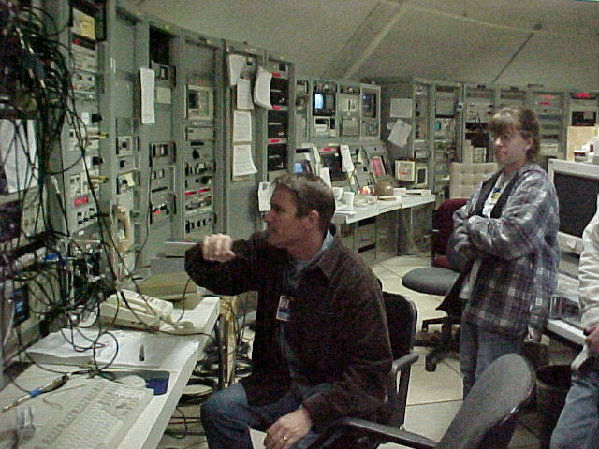
More GLUE Folks
+an article in "American Scholar"
Kurt Liewer
Chuck Naudet
Dawn Williams

Slide 12
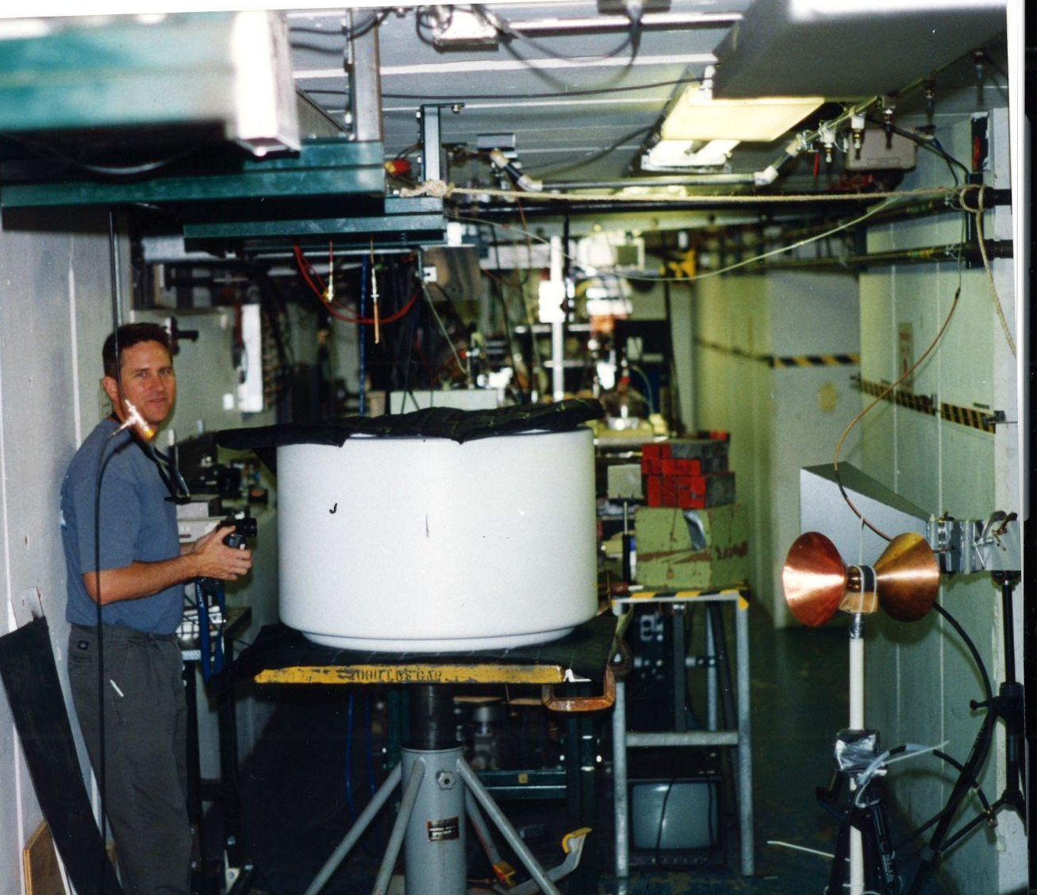
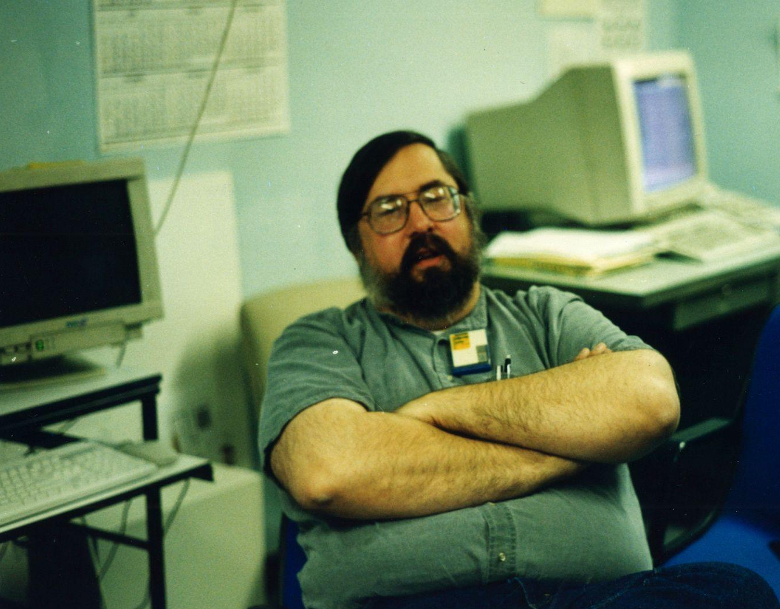
The Argonne Wakefield Accelerator (AWA)
Dick Konecny
6 ✕ 100lb. bags of silica sand
Ordering the target:
-- "What kind of gas station do you operate?"
+ Wei Gai, John Power, Manuel Conde
Paul Schoessow

Slide 13
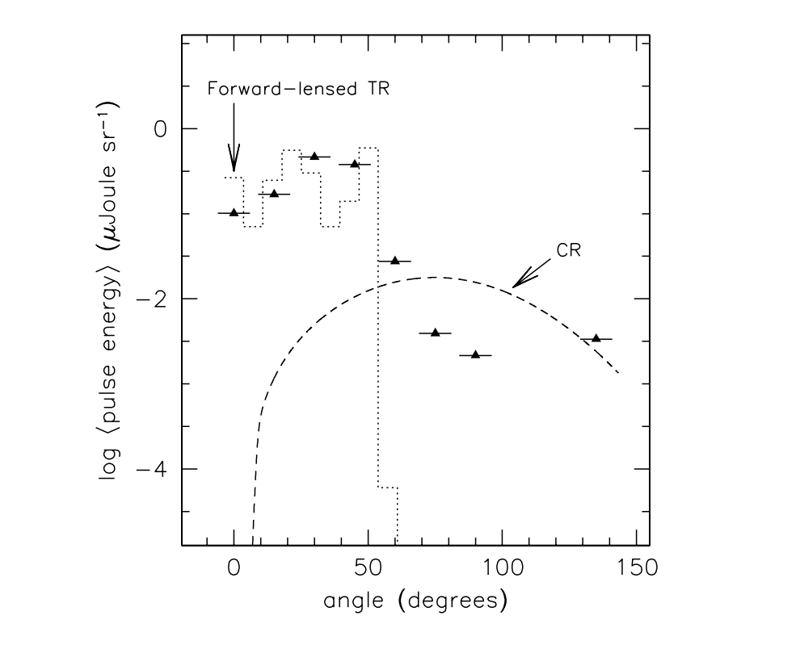
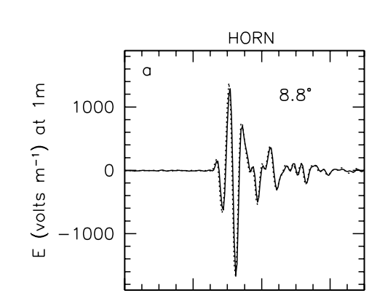
AWA results
Phys.Rev.E 62 (2000) 8590-8605
Coherent transition radiation – check!
Cherenkov?
Hmm…doubtful
Sort of suggestive but not yet the "slam dunk" to the community.
Hard to separate Cherenkov Radiation from Transition Radiation
(Generally a pretty awful first attempt, but we learned a lot.)

Slide 14
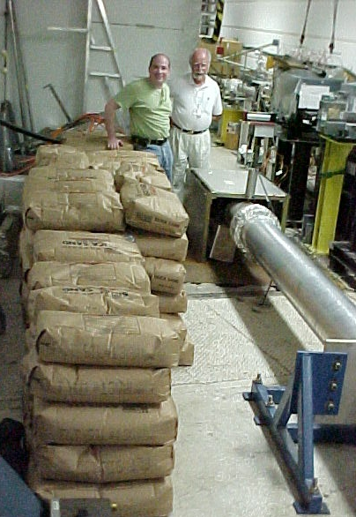
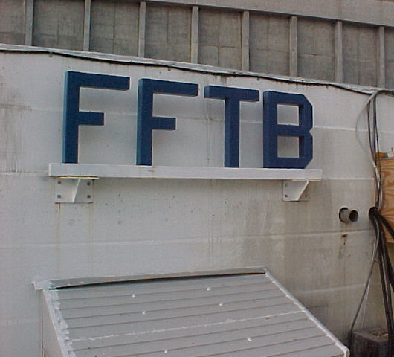
PG: "Always publish” (eg. Askaryan)
AWA paper → invitation to SLAC by Al Odian
15 GeV electron beam, converted to ~ 2 GeV photon beam at SLAC's Final Focus Testbeam
Photons → no charged particles to begin with, showers were not “biased”
Now 4 tons of sand

Slide 15
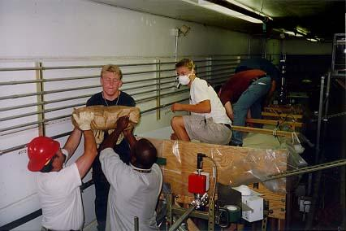
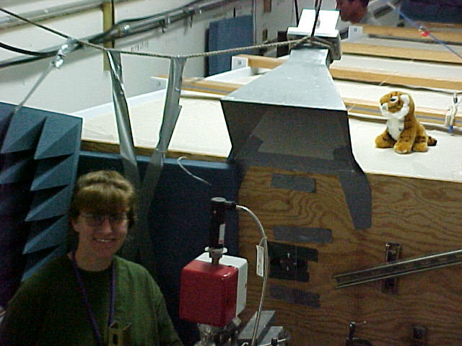
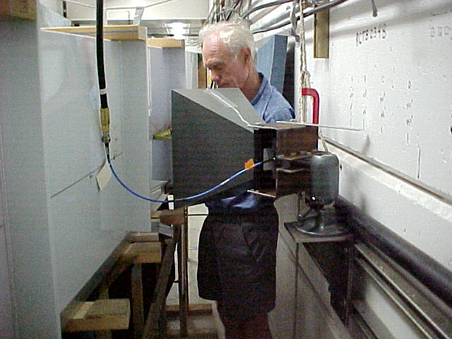
"The Kitty Litter Experiment” 2000
Lots of volunteer help
The amazing Dieter Walz!
"There's a cat in your target!"

Slide 16
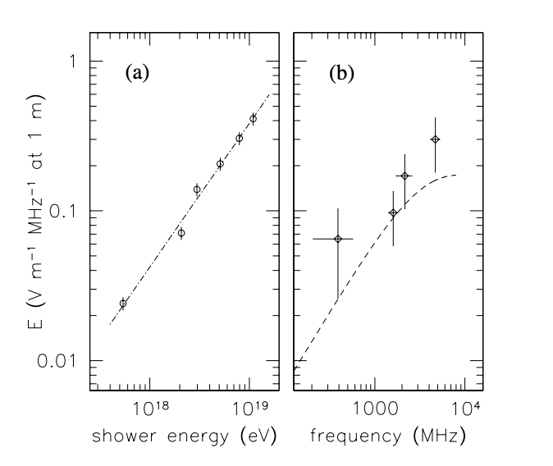
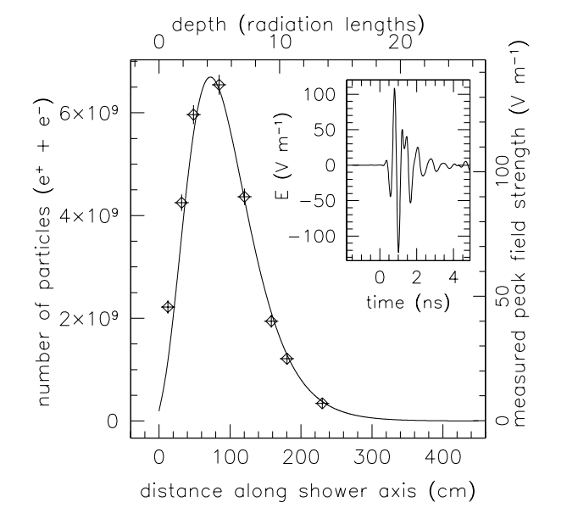
Very clear results
Phys.Rev.Lett. 86 (2001) 2802-2805
Curves: coherent Cherenkov prediction
Data: calibrated RF signal
Curve: EGS sim
Data: Scaled RF power

Slide 17
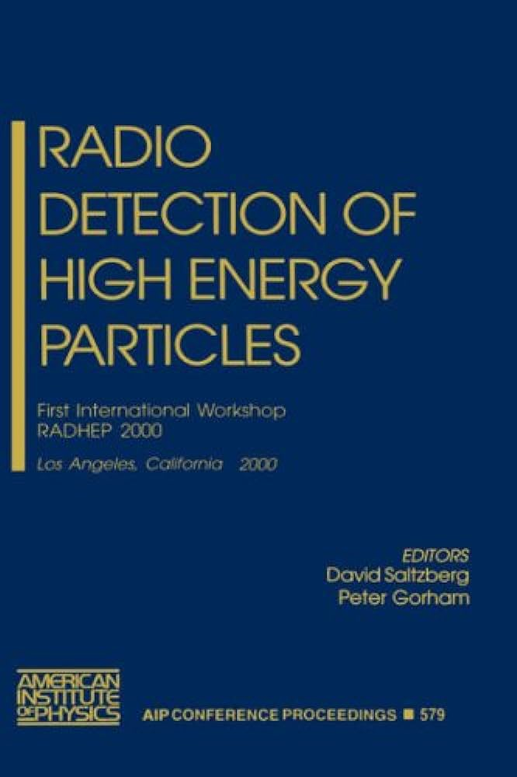
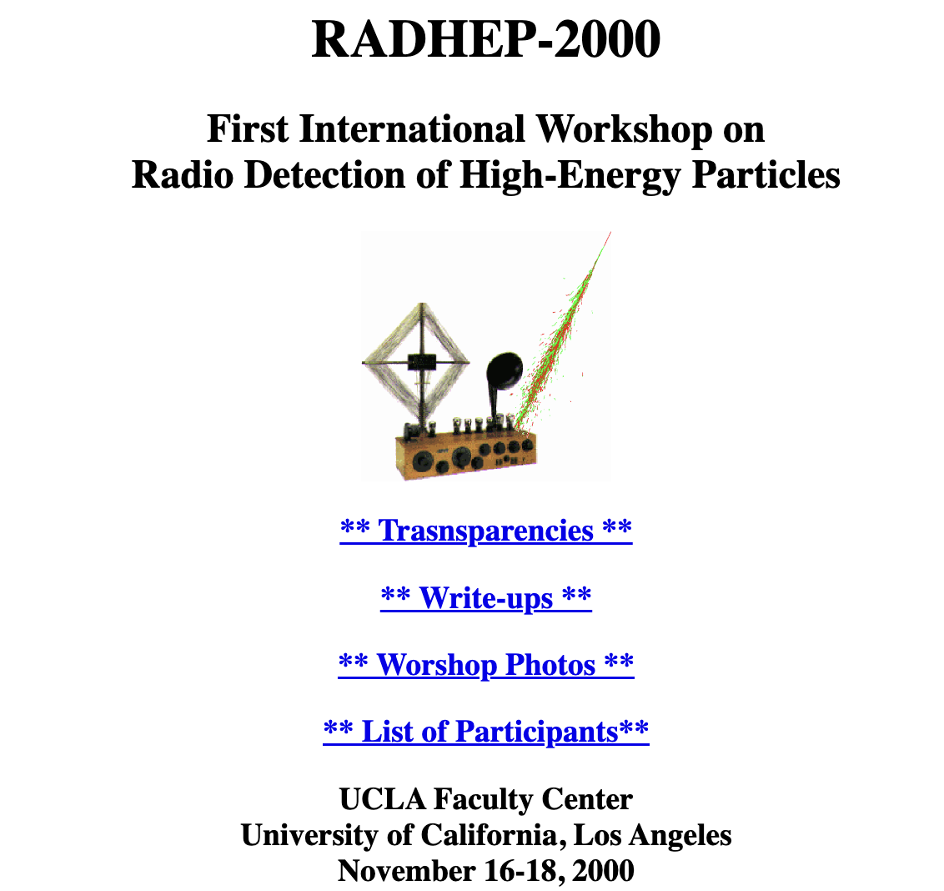
The field of Radio Detection of High Energy Particles had a renaissance

Slide 18
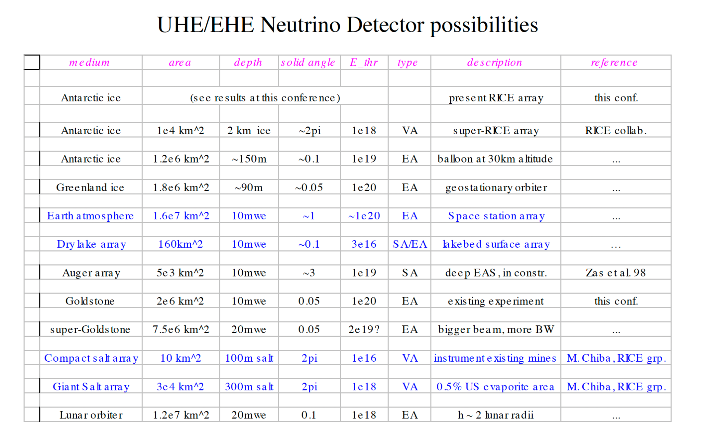
From RADHEP2K, future possibilities?
Balloon-borne neutrino detector?
Seemed a bit wild at the time, but would NASA try it?

Slide 19
Antarctic Impulsive Transient Antenna (ANITA)
Balloon payload over ice sheets – best “figure of merit” for cosmogenic neutrinos, so we decided to explore in more detail
Went to Berkeley: George Smoot (who had himself done radio experiments in Antarctica): “This is a nice idea, but NASA will NEVER fund it!”
Fortunately he was wrong! In 2003, NASA did fund it for an Antarctic flight
“ANITA-lite” flew in late 2003, with two antennas to test EMI environment
ANITA flew in late 2006, after completing its pre-launch “hang test” at SLAC End Station A, where the payload was calibrated with 8 tons of ice blocks – verifying the Askaryan effect for ice

Slide 20
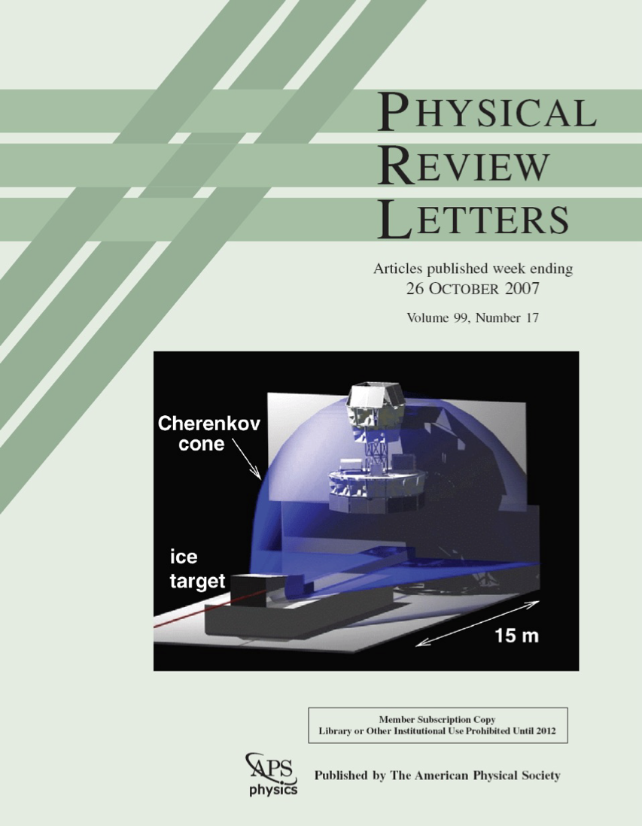
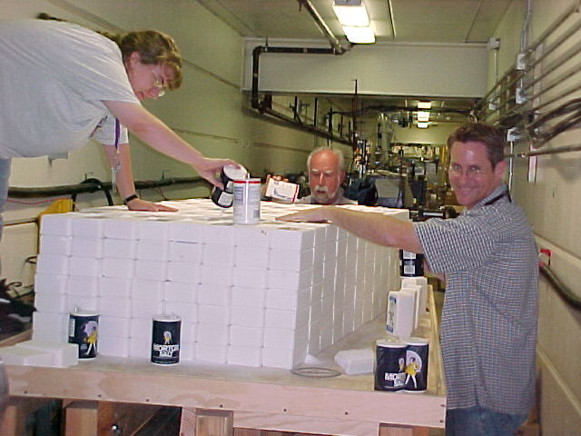
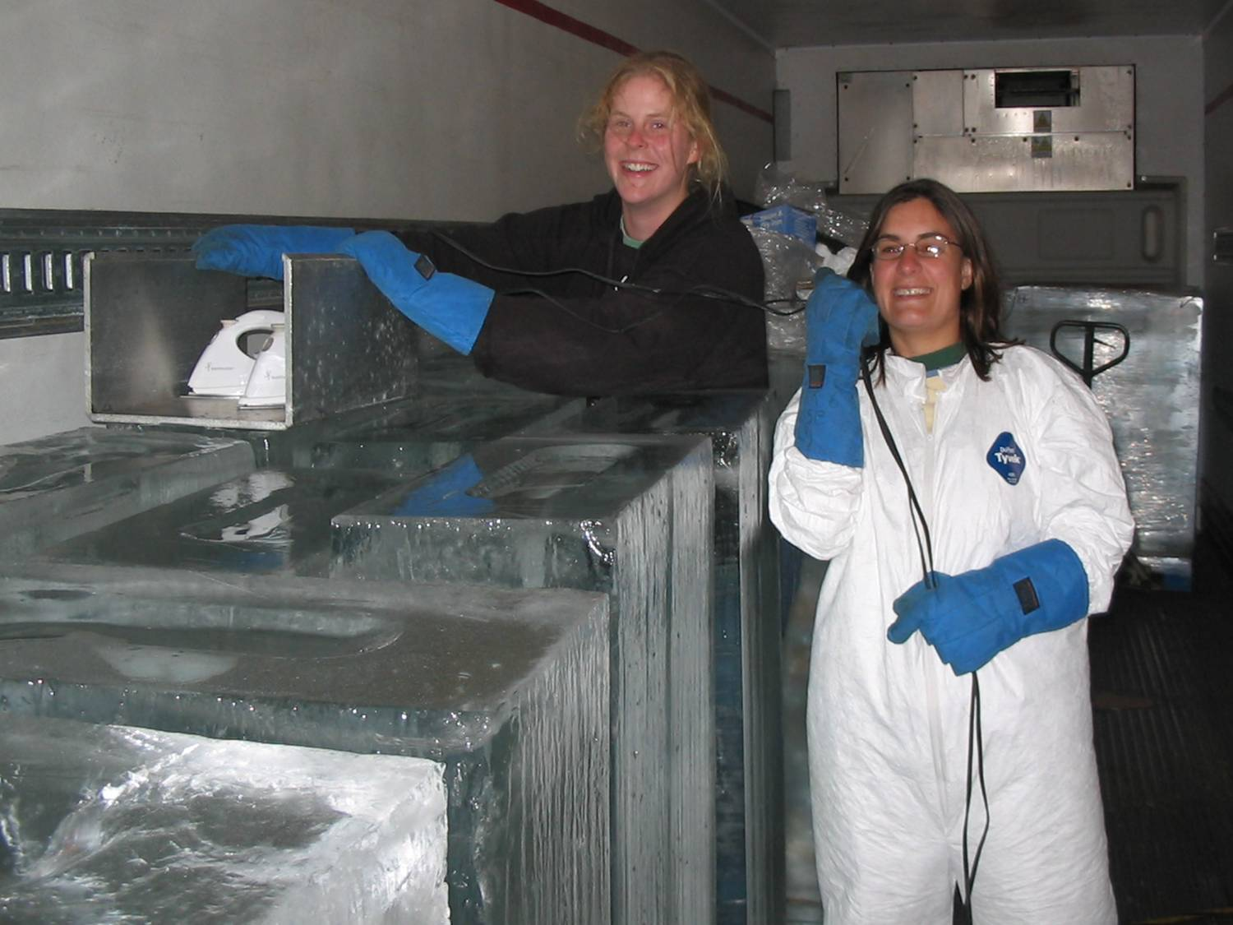
Several Askaryan Experiments at SLAC,
including ANITA calibration
"Yes, you can iron ice."
---Abby Vieregg & Amy Connolly
4 tons of "salt licks"
+ a year's supply of Morton's salt from Menlo Park Safeway
Thank you, Carsten Hast!
(No power cords were daisy chained, we promise)

Slide 21
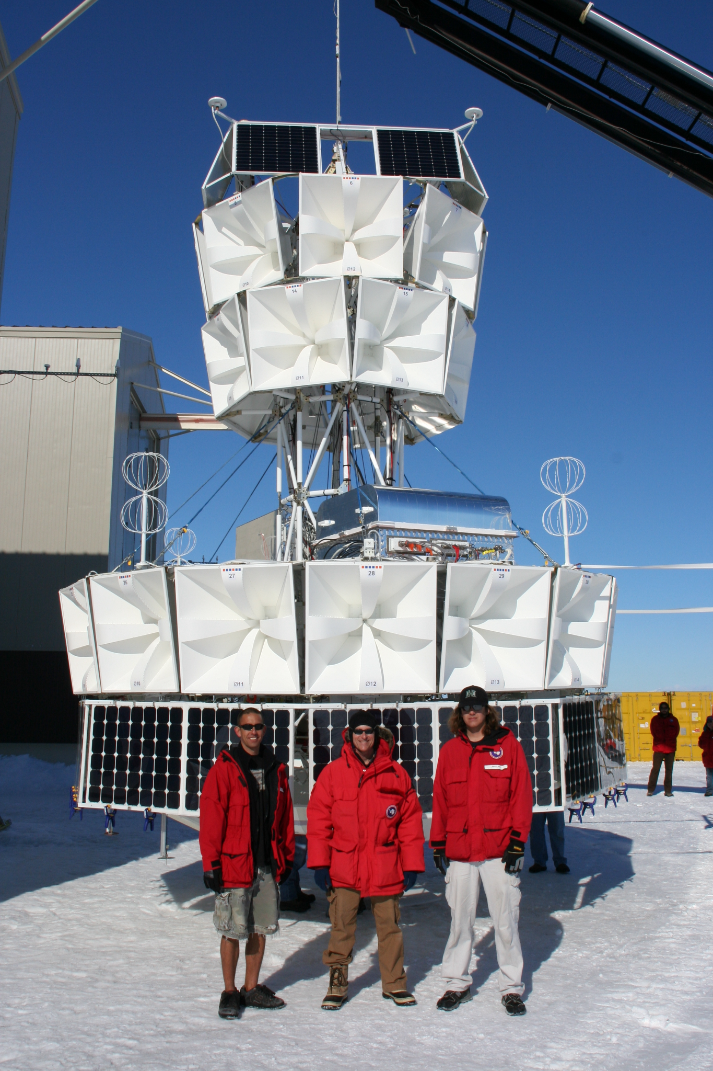
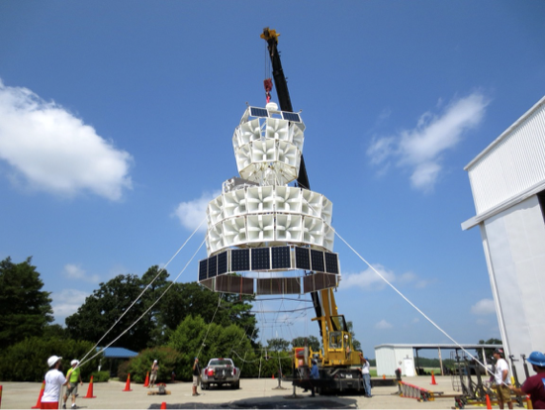
ANITA-1 at left, ANITA-3&4 at right.
Four flights complete by 2017, nearly 100 days at float, around 70 ultra-high energy cosmic rays, no clear-cut neutrinos, but some other strange stuff

Slide 22
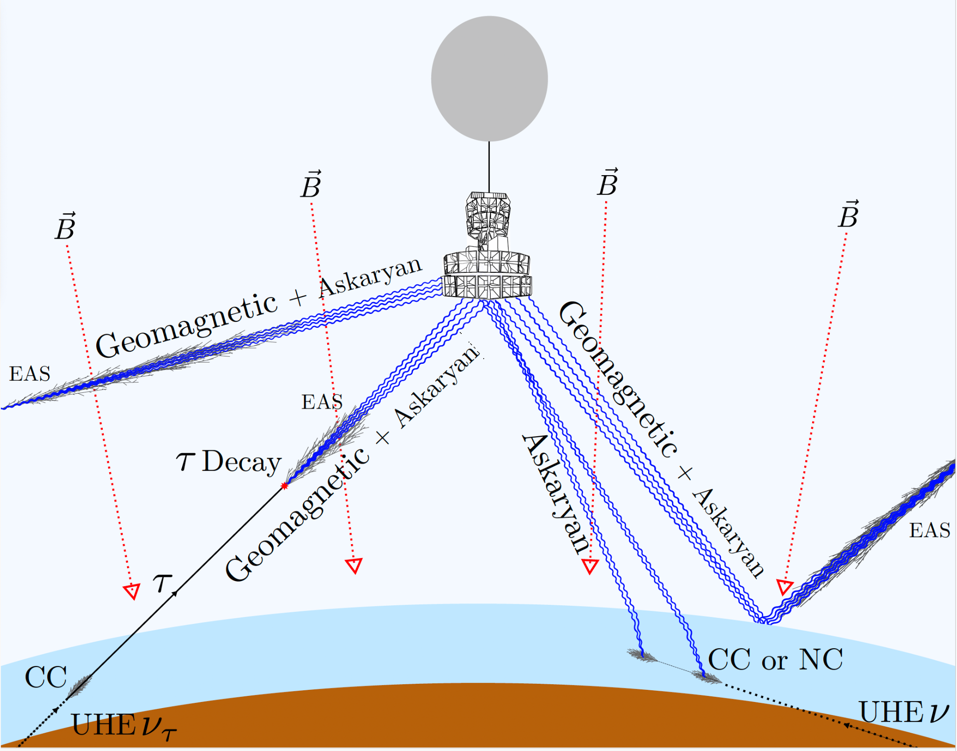
Seeing neutrinos/CRs with ANITA
Cosmic rays are 10:1 reflected vs. direct
Reflections always flip pulse polarity
Neutrinos seen by subsurface cascades
OR above-surface tau decay (eg. as a cosmic-ray event)
CRs: horizontally polarized (vertical B)
Neutrinos: Vpol due to transmission Fresnel
Non-inverted Hpol
Inverted Hpol
Non-inverted Hpol
Non-inverted Vpol

Slide 23
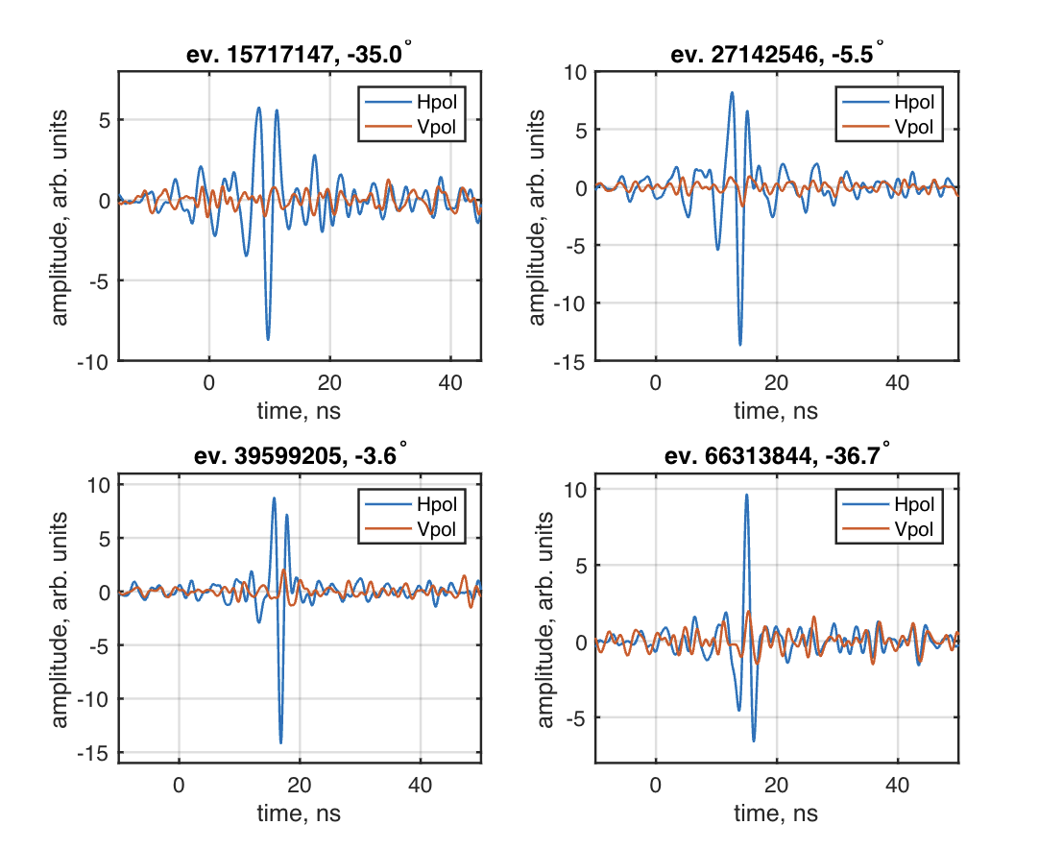
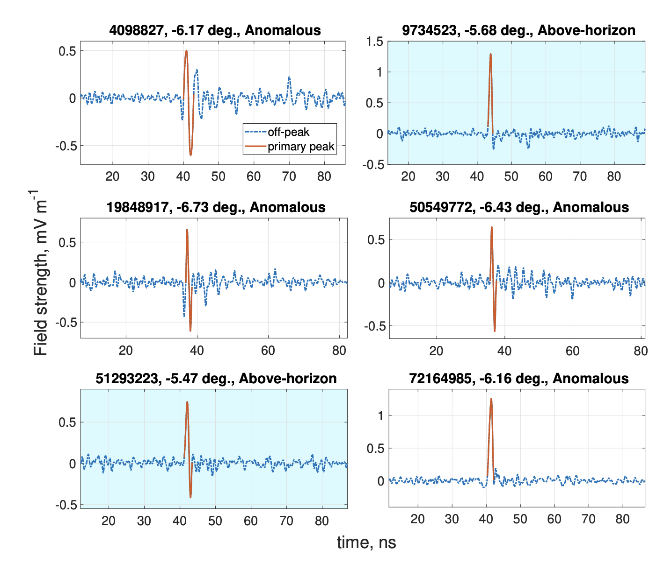
5 unexpected CR events from ANITA 3(left) & 4(right)
A3: Phase convention negative non-inv A4: phase convention positive non-inv
-6.2º
non-inv
anomaly
Non-inv.
(direct)
non-inv
anomaly
Non-inv.
(direct)
-35º
-6.7º
-6.4º
non-inv
anomaly
non-inv
anomaly
Non-inv
(direct)
non-inv
anomaly
-6.2º
Non-inv
(direct)
Inverted (reflected)
Events not yet explained, but are problematic if interpreted as tau neutrino decay showers – implied flux is in tension with Auger and IceCube

Slide 24
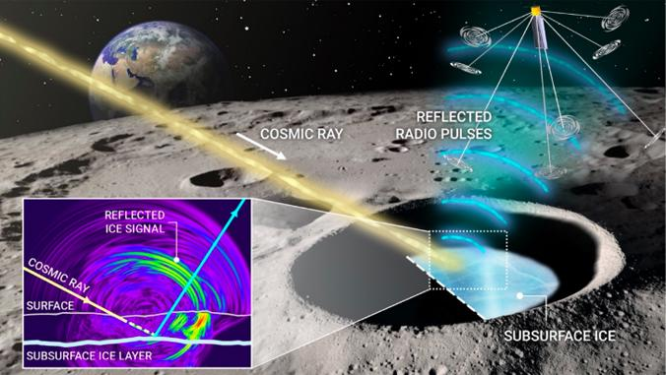
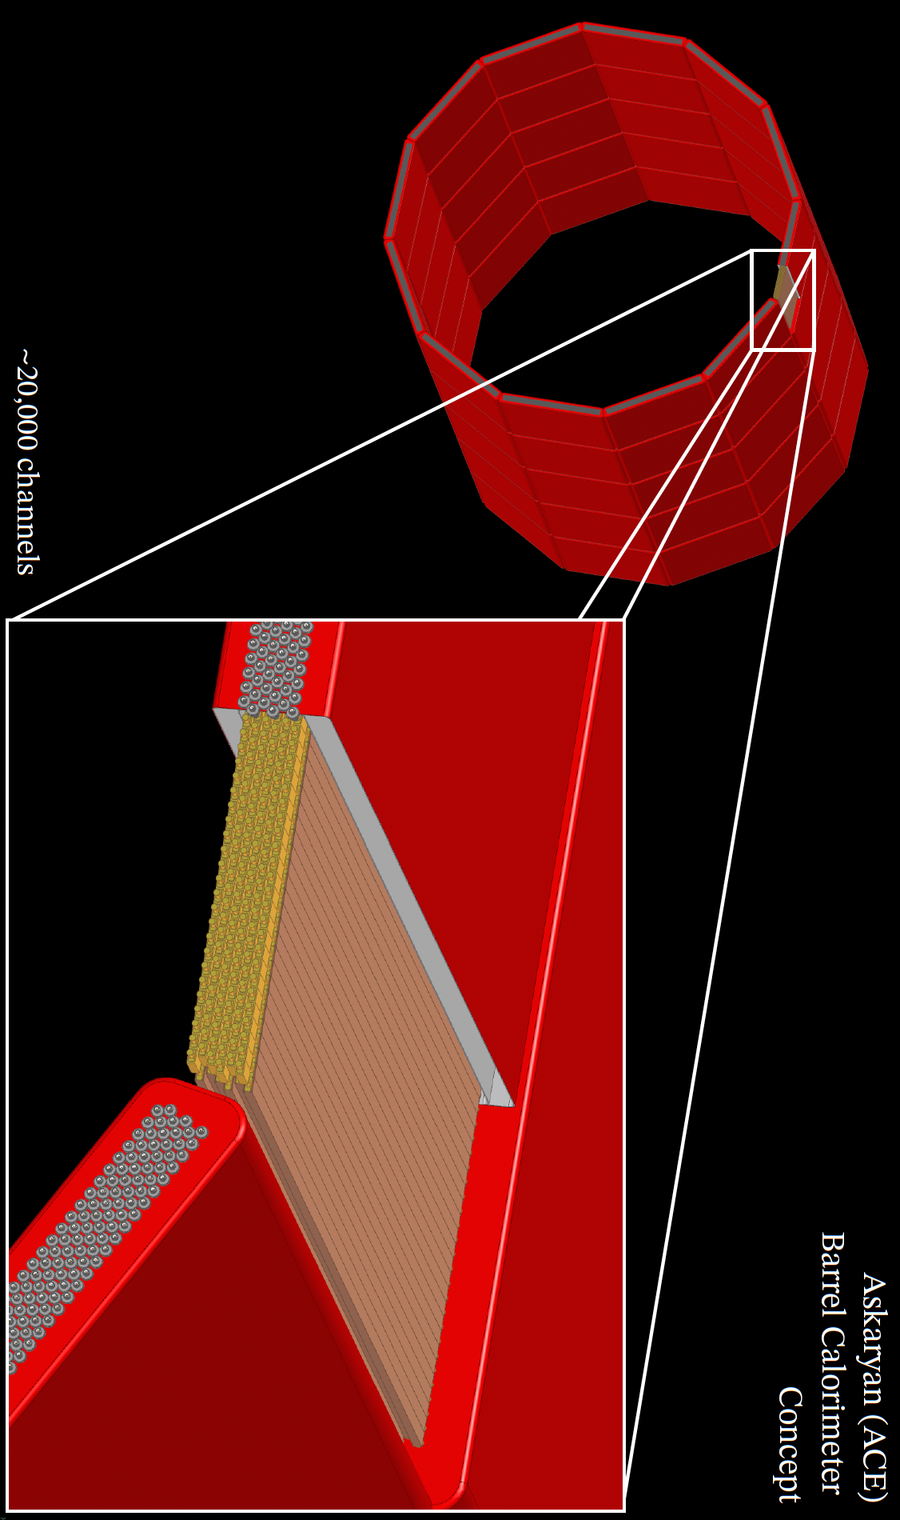
Current and future applications
NASA Planetary: Cosmic Ray Lunar Sounder (CoRaLS)
NASA Pioneers: Payload for Ultra-high Energy Observations (PUEO)
DOE HEP detectors: Askaryan
Calorimeter
Experiment
(ACE)

Slide 25
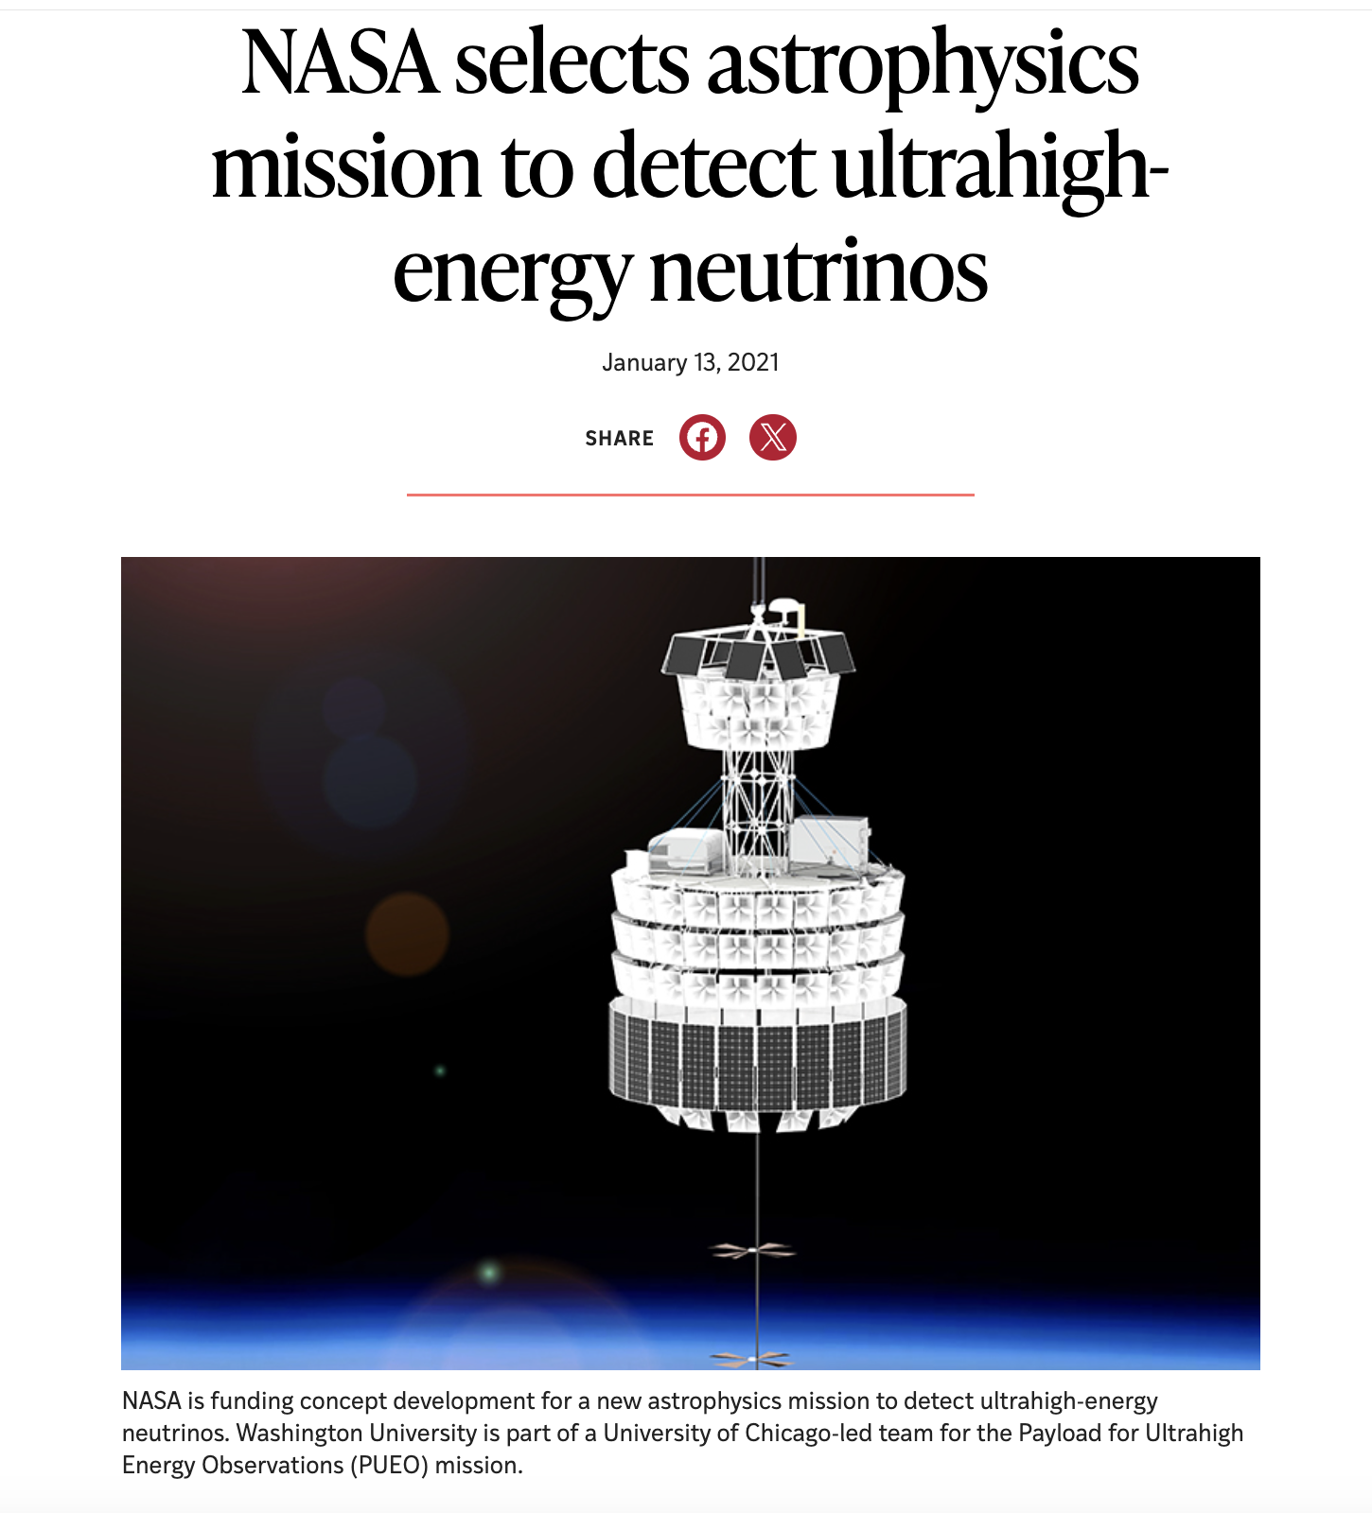
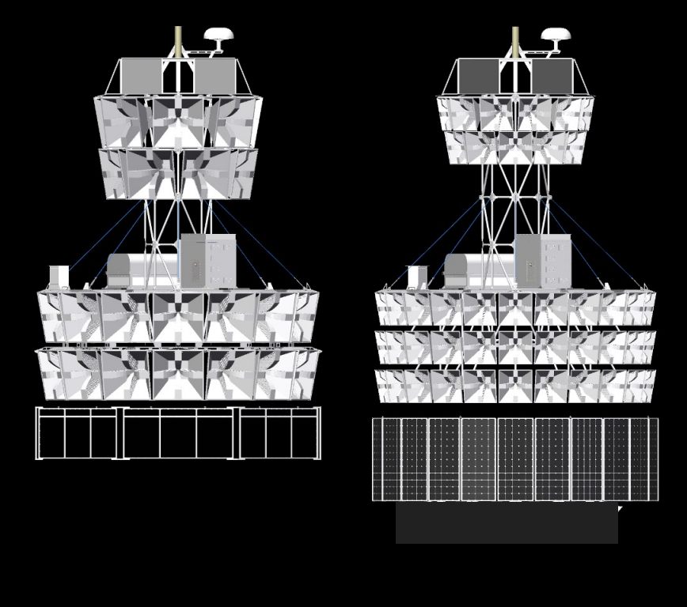
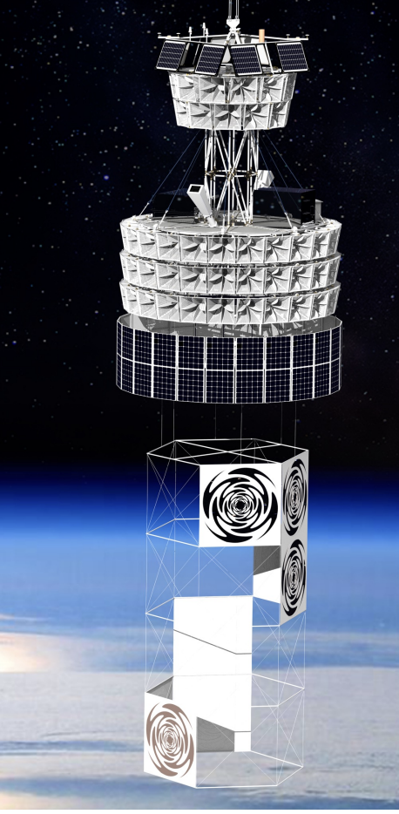
Payload for Ultra-high energy Observations (PUEO)
Successor to ANITA, led by former Saltzberg student, Abby Vieregg (U. Chicago, P5 member)
Payload funded by NASA Astrophysics Pioneers program, a new payload class
Should exceed ANITA sensitivity by > 1 order of magnitude
Due to launch this December!
ANITA PUEO
Low-frequency
Antenna array
Deploys after
launch

Slide 26
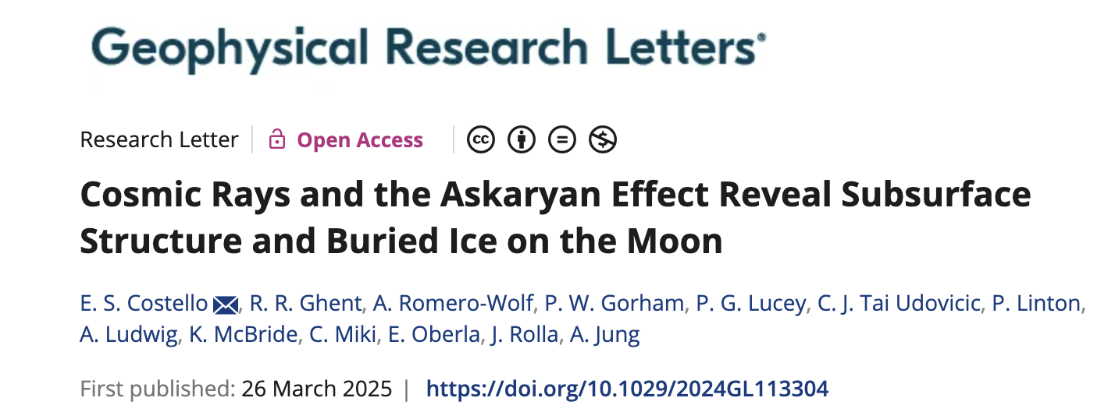
Cosmic Ray Lunar Sounder (CoRaLS)
Cosmic rays impact the lunar regolith continuously, creating subsurface RF pulses
These will reflect off buried ice layers if they are within ~20m of the surface in permanently shadowed polar regions, can be detected by lunar orbiter
CoRaLS was awarded $3M for TRL advancement in NASA’s Planetary science division
Also a possible surface instrument for Artemis Lunar lander!
https://www.phys.hawaii.edu/~gorham/Post/iceSignal_ideal.gif

Slide 27
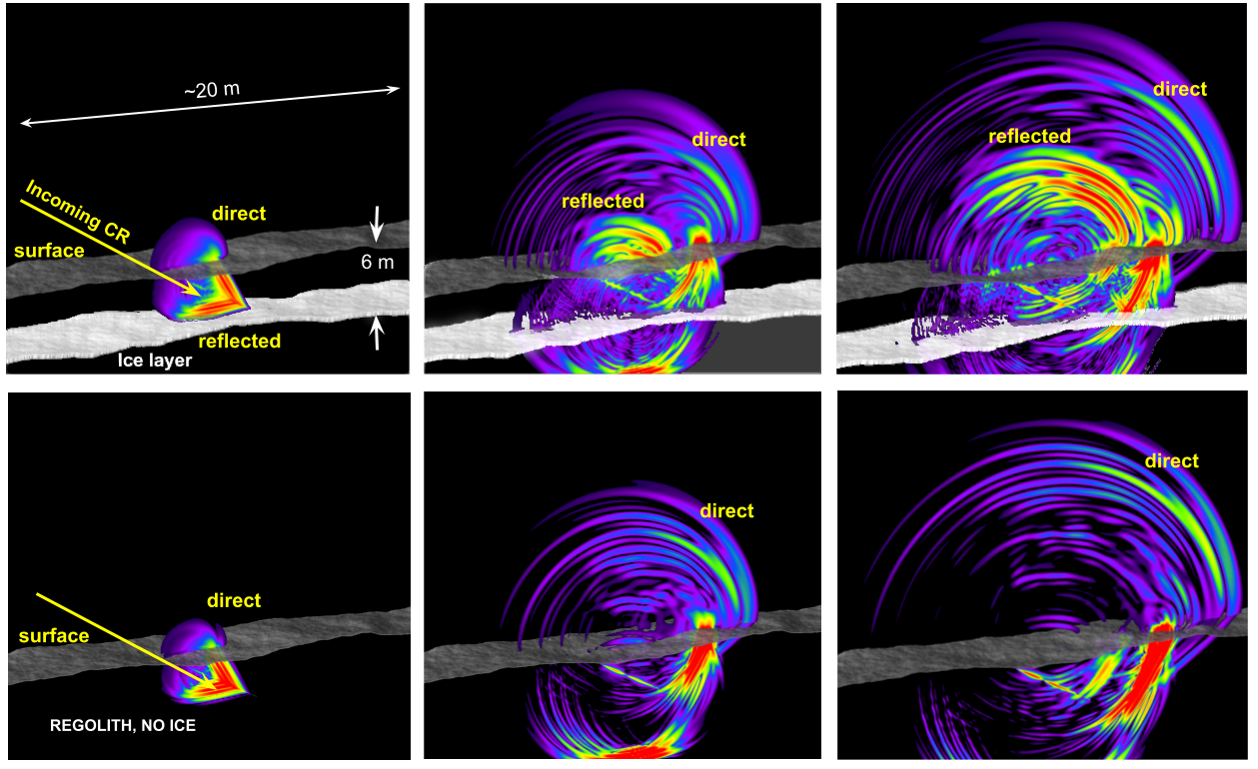
CoRaLS: realistic subsurface bistatic sims
Huge ice deposits seen on Mercury in permanent shadows
Why not the Moon? Buried?!
LCross impactor excavated ~5m, saw water vapor
Need subsurface radar to probe 3-30 meters for potential large ice deposits

Slide 28
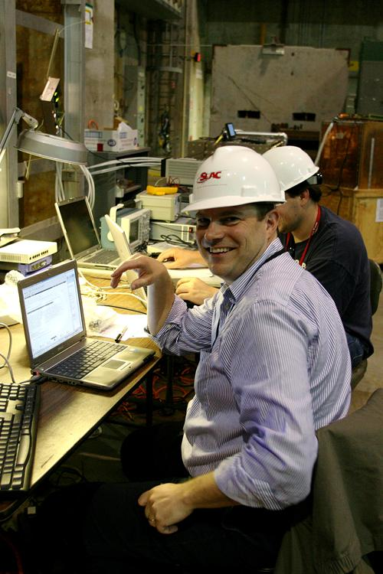
Much debt to Gary Varner
Gary's help and companionship through these years was essential, and a highly treasured memory.
Without Gary’s marvelous instrumentation, none of this would have been possible

Slide 29
Conclusion:
Accelerator confirmation of Askaryan effect has had wide-ranging consequences
Coherent Radio Cherenkov is essential to EeV neutrino astronomy
Many projects completed, current, and planned, with world-beating constraints in place
ANITA helped fuel a renaissance in radio detection of UHE cosmic rays
Coherent radio Cherenkov from cosmic rays showering in airless solar system bodies may provide probes that no other method can rival!

