Slide 1

Disruption of Axion Miniclusters by Successive Stellar Encounters
Chris Gordon
University of Canterbury
Collaboration with Ian DSouza and John Forbes
PHYSICAL REVIEW D 109, 123035 (2024)
arXiv:2411.16166

Slide 2

Dark Matter
Image Credit: Chandra X-Ray Observatory
Notes:
Alpha Centauri

Slide 3
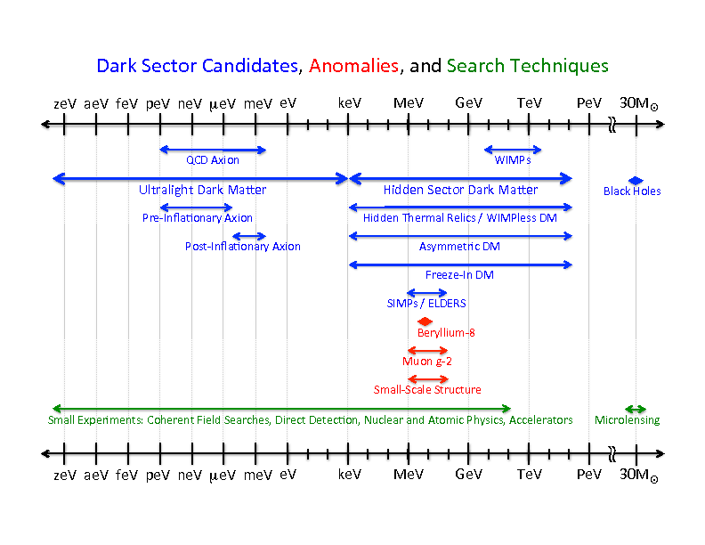
Image credit: US Cosmic Visions: New Ideas in Dark Matter 2017: Community Report

Slide 4
Strong CP problem
The Lagrangian of QCD includes the following term which allows for CP violation:
Measurements of the neutron’s electric dipole moment imply that

Slide 5
Peccei-Quinn Solution
In the Peccei-Quinn solution (1977), the quantity 𝜃_{QCD} is taken to be a dynamical variable instead of a constant.
They accomplished this by introducing a new global U(1) symmetry that is broken by a complex scalar field.
Weinberg and Wilczek each independently pointed out that the broken U(1) Peccei-Quinn symmetry implies the existence of a new pseudoscalar particle known as the axion.

Slide 6
Axion properties
Pseudo-Goldstone boson of a new global U(1) spontaneously broken at scale f_{a} .
Also couples to the photon and fermions:

Slide 8
Image credit: US Cosmic Visions: New Ideas in Dark Matter 2017: Community Report

Slide 9
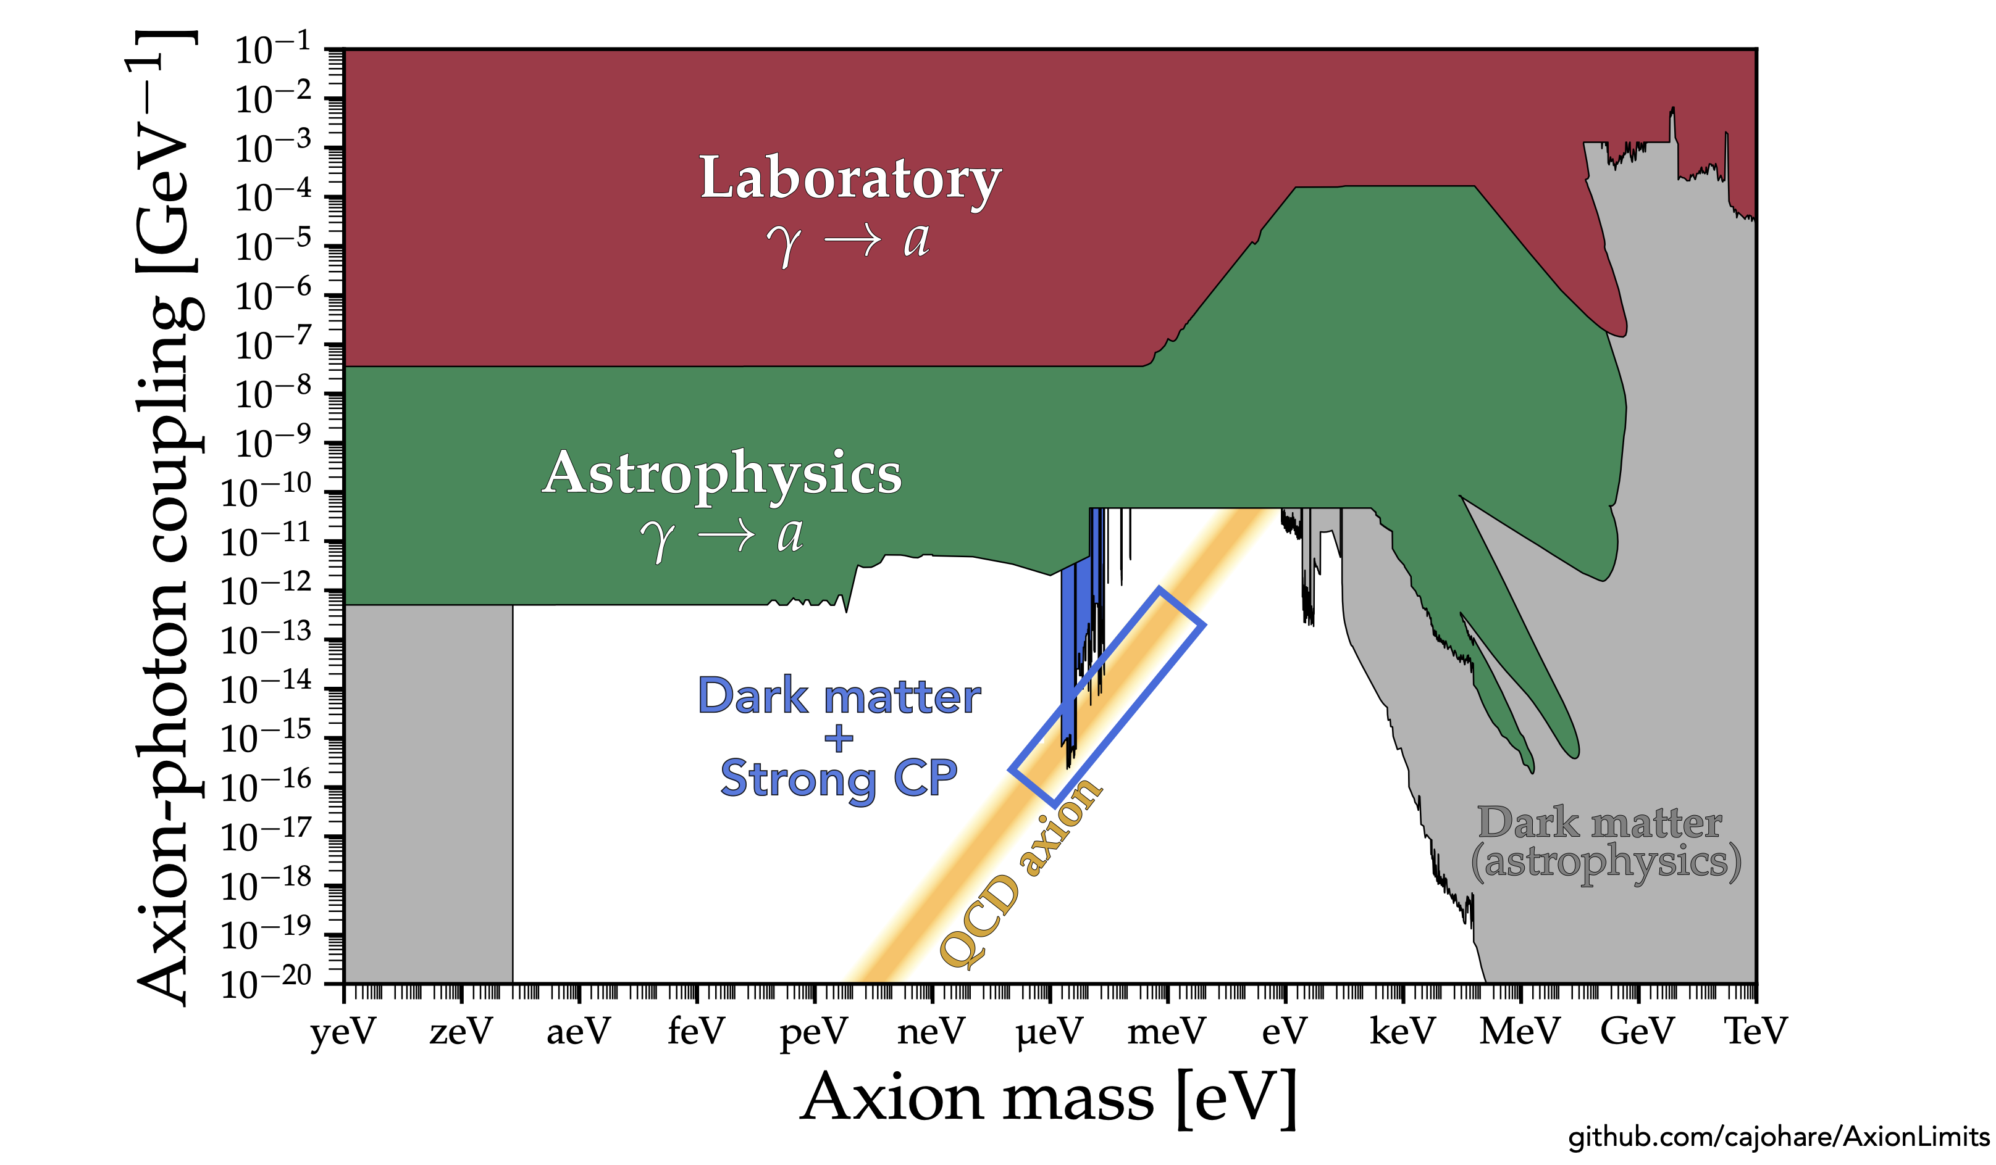

Slide 10
Slide credit: Ciaran O’Hare

Slide 11
Slide credit: Ciaran O’Hare

Slide 12
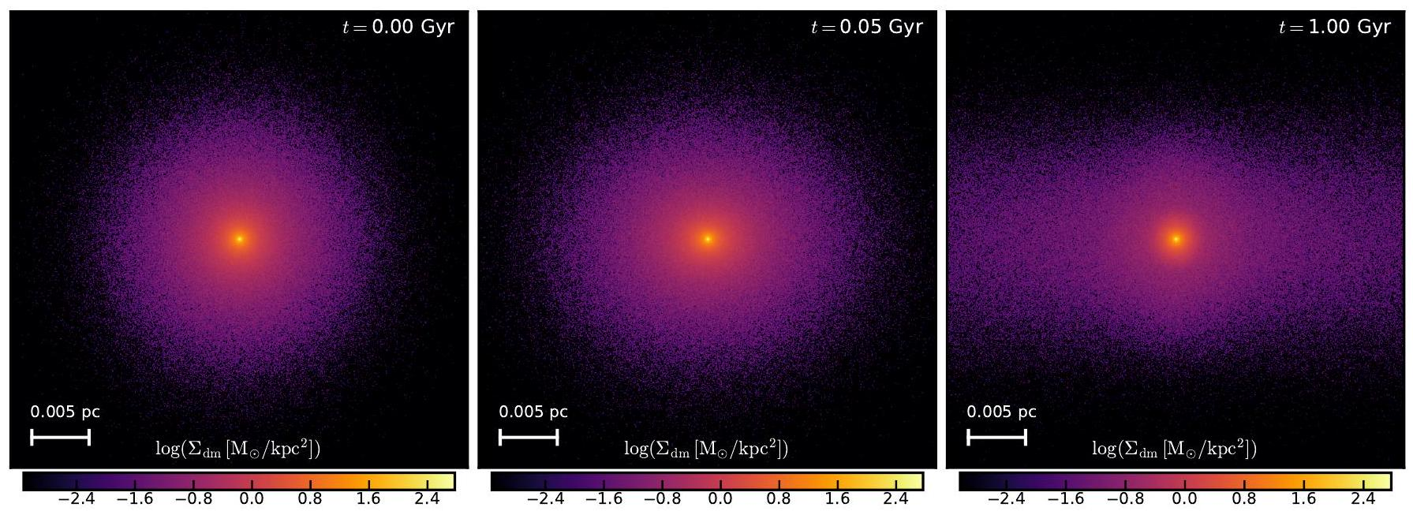
SIMULATIONS FOR STELLAR ENCOUNTERS (Shen et al. (2024))

Slide 13
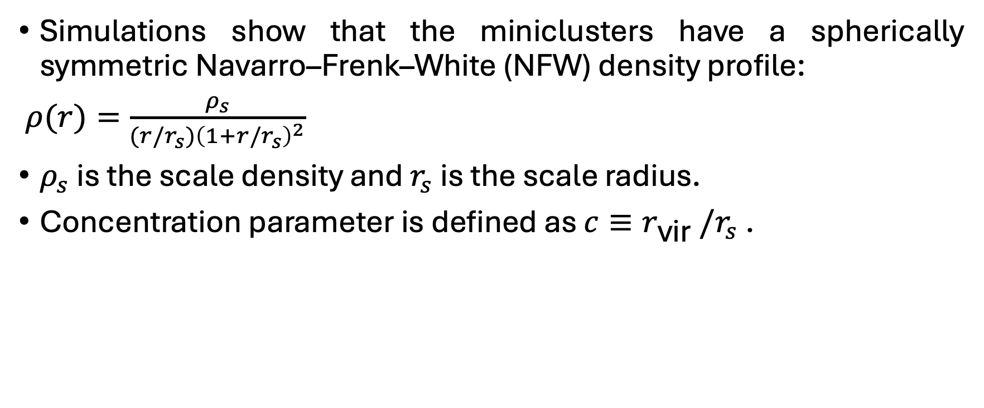
Axion miniclusters – NFW Profile
Simulations show that the miniclusters have a spherically symmetric Navarro–Frenk–White (NFW) density profile:
$ρ(r)=\frac{ρ_{s}}{(r/r_{s}{)\left(1+r/r_{s}\right)}^{2}}$
$ρ_{s}$ is the scale density and $r_{s}$ is the scale radius.
Concentration parameter is defined as $c≡r_{\text{vir} }/r_{s}$ .

Slide 14
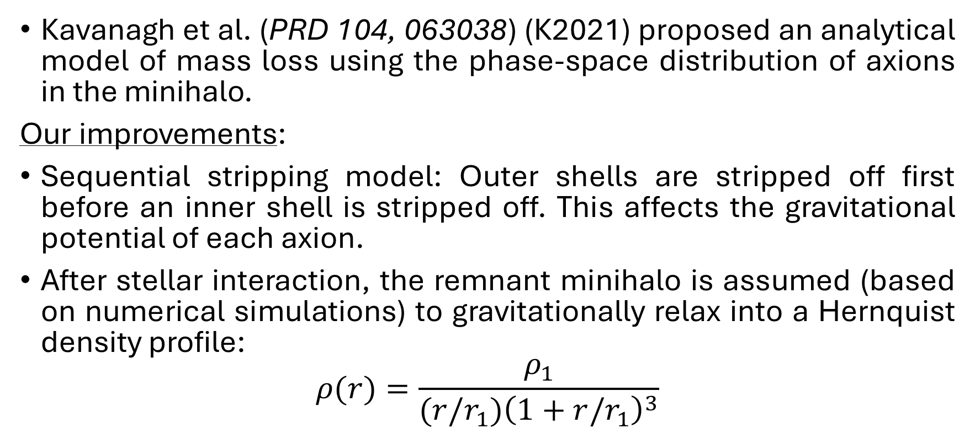
Model of mass disruption due to stellar encounters
Kavanagh et al. (PRD 104, 063038) (K2021) proposed an analytical model of mass loss using the phase-space distribution of axions in the minihalo.
Our improvements:
Sequential stripping model: Outer shells are stripped off first before an inner shell is stripped off. This affects the gravitational potential of each axion.
After stellar interaction, the remnant minihalo is assumed (based on numerical simulations) to gravitationally relax into a Hernquist density profile:
$$ρ(r)=\frac{ρ_{1}}{(r/r_{1}){\left(1+r/r_{1}\right)}^{3}}$$

Slide 15
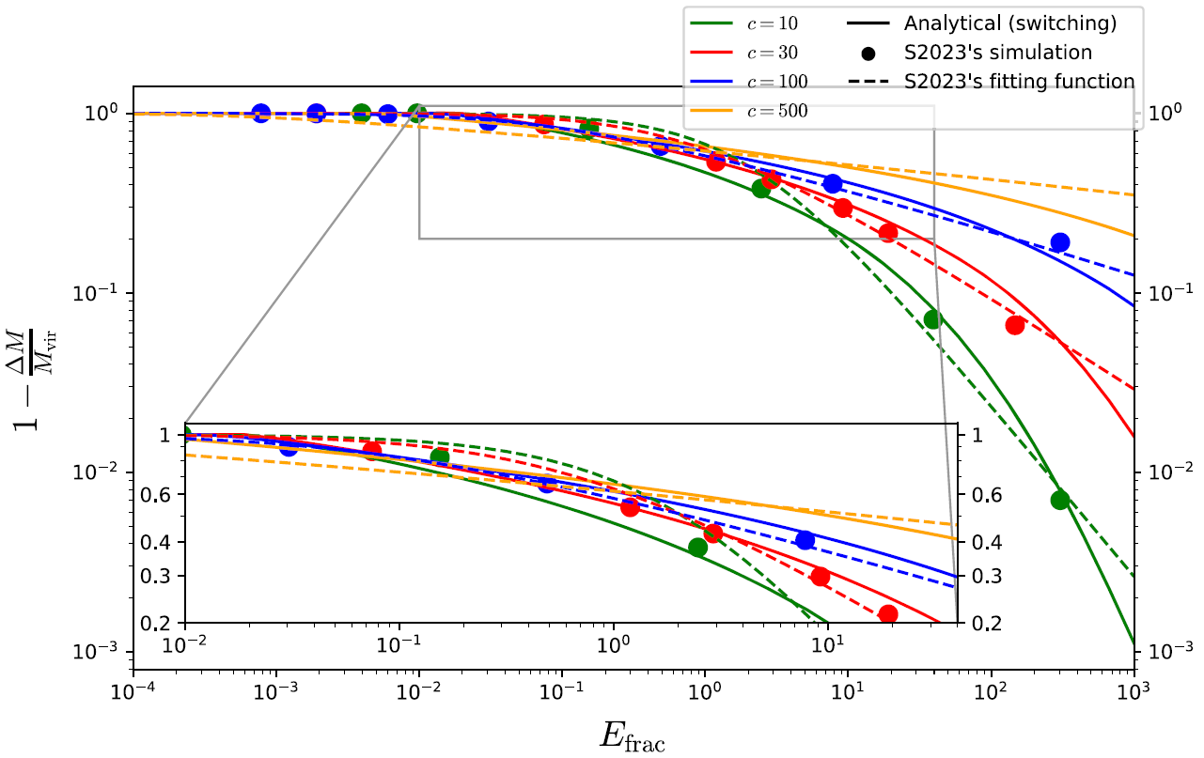
Compare to S2024

Slide 16
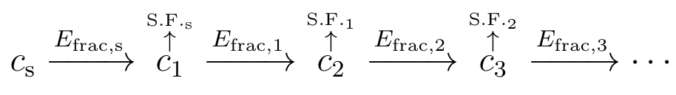
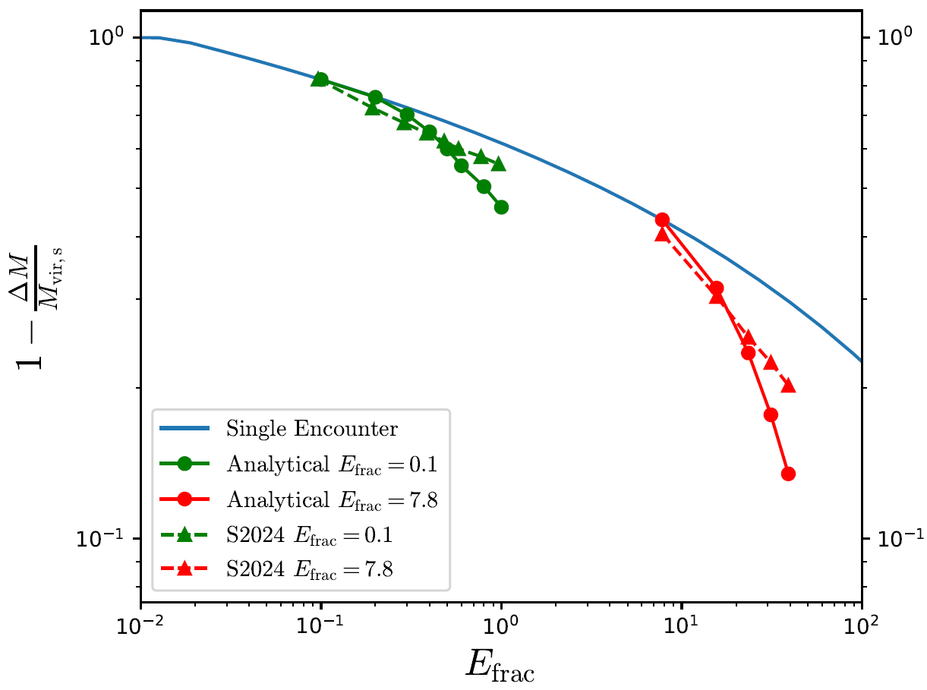
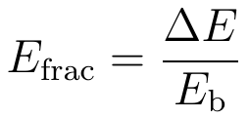
Successive Stellar Encounters
Shen et al - APJ 962:9 (25pp) – (S2024)

Slide 17
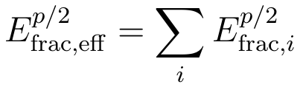
Effective energy injection
Stücker et al. (2023) proposed a formula for effective energy injection in the multiple encounters:
S2024 assumed p=2. They did not take into account the density profile changes in between disk passes.
Given enough time for relaxation in between disk passes, we found that p~1. Thus, multiple disk passes incur more mass loss (higher E_{frac,eff}) than simply adding the energy injection parameters. A qualitatively similar result was reported by Delos (2019).

Slide 18

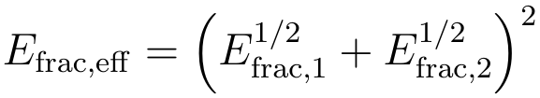
Summing energy injection for multiple disk passes
Time scale of relaxation (post-encounter) for a minihalo is called the dynamical time and depends on the infall redshift z_{i}:
If time between consecutive stellar encounters < dynamical time, energy injection parameters are added up linearly (p=2):
If time between consecutive stellar encounters > dynamical time, energy injection parameters are added non-linearly (p=1):

Slide 19
Slide credit: Ciaran O’Hare

Slide 20
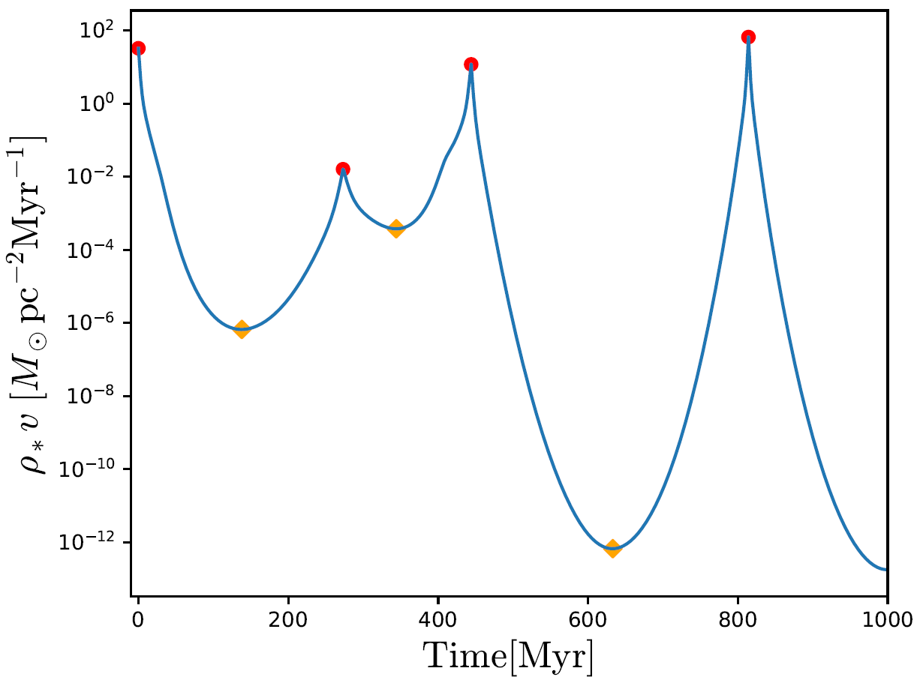
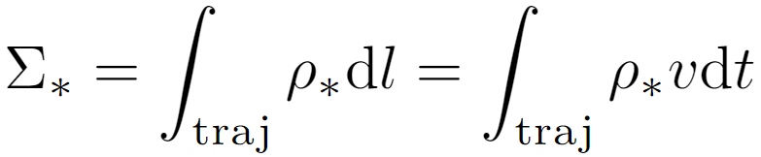
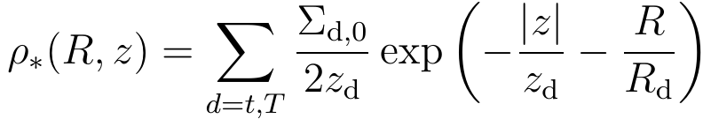




Energy injection during a disk pass
- stellar volume density
- central surface density
- scale height
- scale length
McMillan (2011) – MNRAS 414, 2446–2457

Slide 21
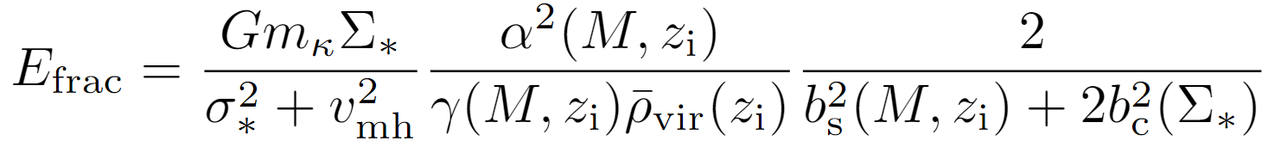

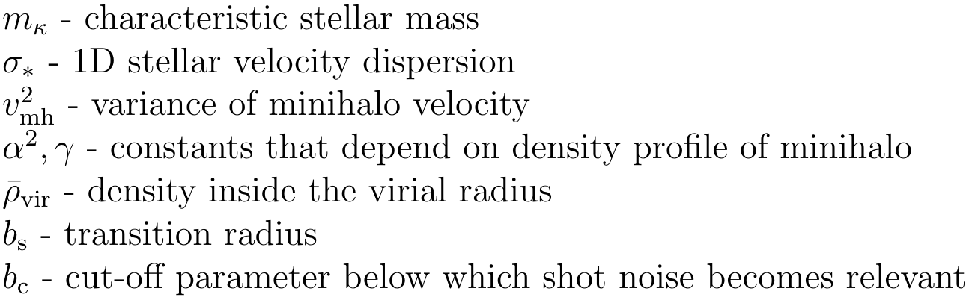
Energy injection during a disk pass
For a single disk pass, the energy injection parameter is (S2024):
is the stellar surface density for one disk pass.

Slide 22

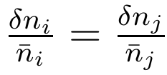
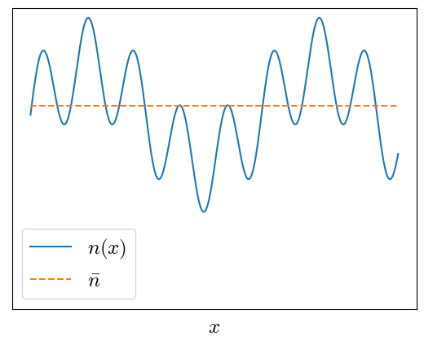
Adiabatic vs Isocurvature Perturbations
Adiabatic Perturbations:

Slide 23
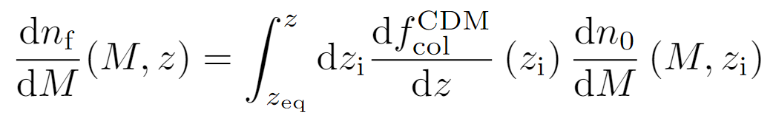
Mass Function of miniclusters
Primordial adiabatic perturbations of axion collapse to form large adiabatic halos which become hosts to galaxies.
For a population of miniclusters, the mass function tells us the number density of miniclusters in a unit mass interval (S2024, Xiao et al - PRD 104, 023515).
adiabatic
isocurvature

Slide 24
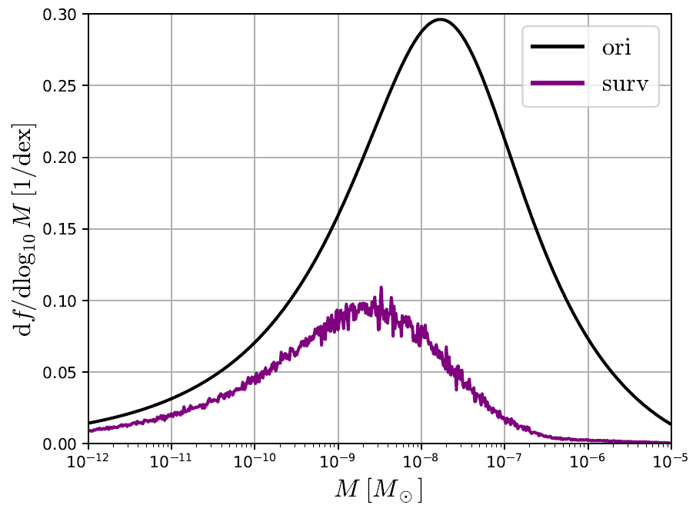
Computing the stellar disrupted mass function

Slide 25

Mass today after stellar disruption
To find the mass contained in miniclusters in the Milky Way galaxy:
We compute the mass in miniclusters both in the presence of stellar disruption (M_{surv}) and separately without considering stellar disruption (M_{ori}). We compute the percentage of minihalo mass that survives today as:
S2024 finds this value ~ 58%
Our result ~ 30%

Slide 26
Conclusion
We explored successive encounters and found the mass loss is more severe than simply adding up the energy injection parameters, given enough time for minicluster relaxation.
We developed a new code to evolve the minihalo orbit.
We compared the time between consecutive stellar disk passes to the dynamical time, to more accurately add energy injection parameters.
We found that the percentage of minihalo mass that survives today is around 30%.

Slide 27
