Slide 1
Simulation Study of Ocean Bottom Detector
Simran Chauhan
Tohoku University

Slide 2
17kt Detector Simulation
Why 17 kt ?
It would take more than 10 years to sort BSE models using a 1.5kt detector
A detector that can do it in about a year is needed
Calculations show a 17kt liquid scintillator detector can do it in a year

Slide 3
Evaluation Process
Design a 17kt detector geometry in Geant4
Estimate the number of background events
Estimate the number of geoneutrino events
Determine Fiducial cut using Figure of Merit
Statistical analysis of the number of geoneutrino and background events, taking into account 4

Slide 4
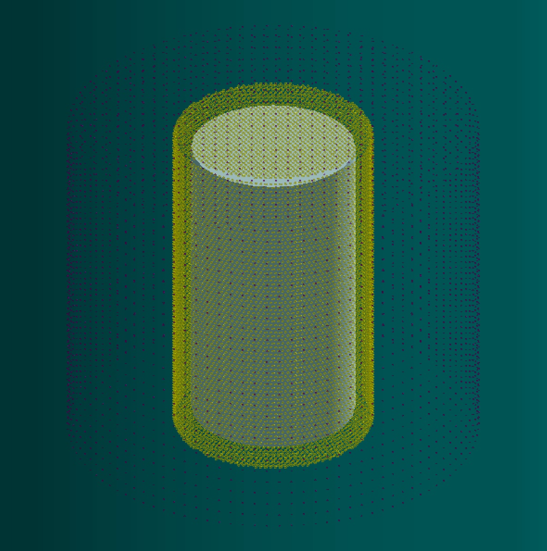
Detector Geometry in Geant4
component | Shape | Radius | Height | Density (g/cm³) | material
Stainless steel tank | Cylinder | Outer diameter = 15.016m Inner diameter = 15m | External height = 50.032 m Internal height = 50m | 7.938 | Stainless steel:99% Carbon: 1%
PMT | Hemisphere | Outer diameter = 25.037cm Inner diameter = 24.537cm | - | 2.4 | glass
PMT shield | Sphere | Outer diameter = 36cm Inner diameter = 35cm | - | 2.4 | Glass
Buffer layer | Cylinder | Outer diameter = 15m Inner diameter = 12.05m | External height = 50m Internal height = 44.1m | 0.76 | C₂₅H₅₂
Acrylic | Cylinder | Outer diameter = 12.05m Inner diameter = 12m | External height = 44.1m Internal height = 44m | 1.18 | C₅H₈O₂
LS (liquid scintillator) | Cylinder | Radius = 12m | Height = 44m | 0.87 1.00 | LAB PPO(3g/L)
12,505 pmts

Slide 5
Background evaluation
Main background sources
Accidental :
random coincidences in the detector
Evaluated using G4
From natural radioactive materials inside the detector
G4 simulations of 1.5kt detector produced 4.20 events/year
For 17kt detector, we scaled the results of 1.5kt
(α, n) Reactions:
From spallation reactions induced by cosmic-ray muons
Calculated for 1.5kt detector using FLUKA simulations
8He: 19 events/year , 9Li: 180 events/year
Can be removed with 5-seconds veto
Scaled for 17kt
He-Li
Reactor neutrinos :
From geoneutrinos.org

Slide 6
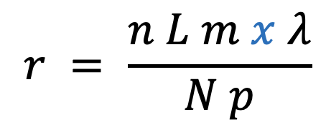
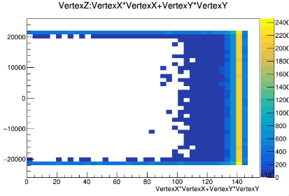
Accidental background
Generate events caused by radioactive materials (²³⁸U, ²³²Th, ⁴⁰K) in the detector structure
Reaction in the LS during Tl decay using acrylic
reaction rate
N: Number of simulations (250,000)
L : Avogadro's number
m: Mass of radioactive material
x : amount of radioactive material
λ: Decay constant
p : Atomic weight of radioactive material
n: Number of reactions in LS
Acrylic | LS | PMT | Shield | total
43.52 [Hz] | 5.36×${10}^{−3}$ [Hz] | 6.03 [Hz] | 1.22 [Hz] | 50.77 [Hz]

Slide 7
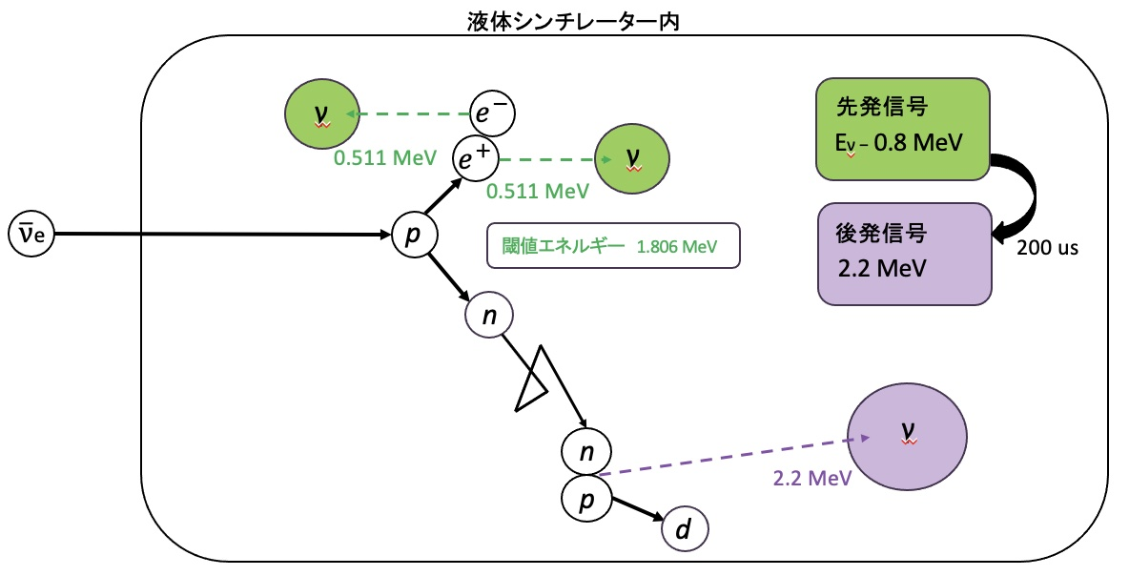
2. Using the reaction rate r, reproduce the exp(−rt) distribution
3. Create event lists using info about reaction location, time and energy
4. After creating the event list, select the events using the delayed coincidence measurement

Slide 8
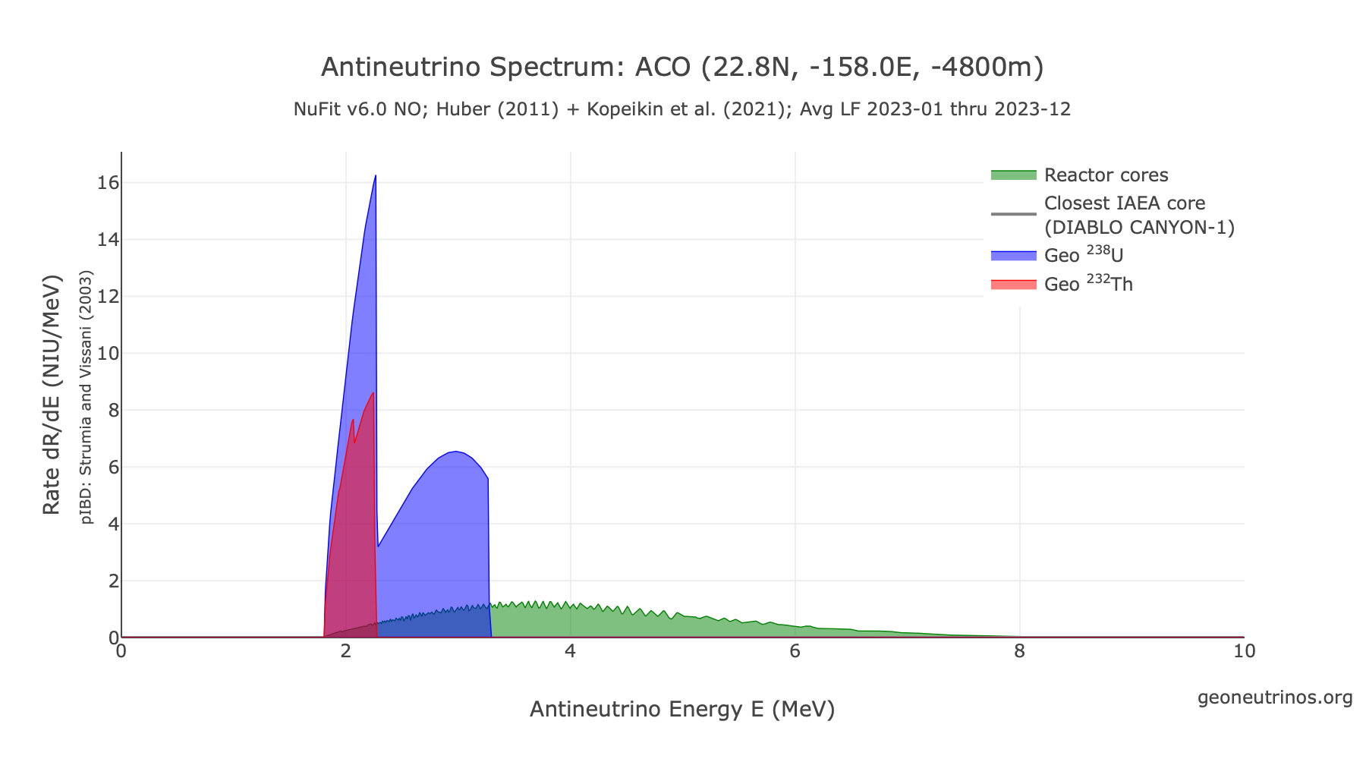
Number of geoneutrinos
Aloha Cabled Observatory (ACO), 22.8N, -158.oE, -4800m
Data from geoneutrinos.org
Provided by O. Šrámek
Background from reactor neutrinos is also estimated from this data

Slide 9
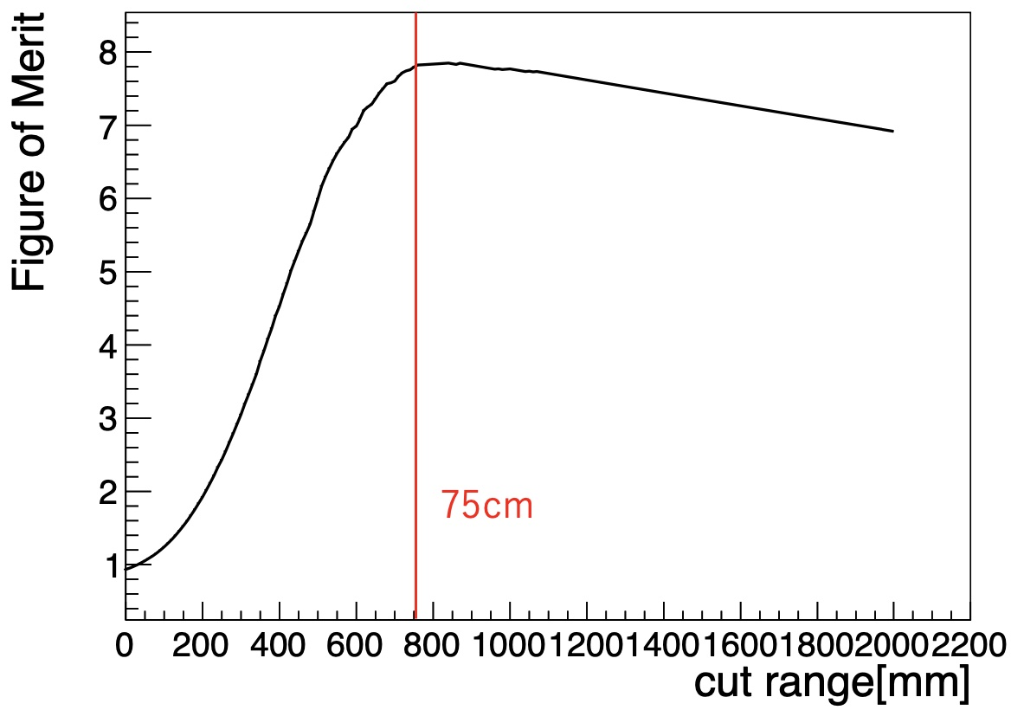
Fiducial cut using Figure of Merit
S : number of geoneutrino signal events
B : all background signal events
The optimal distance from the wall (fiducial cut) was found to be 75 cm, as it maximized the FOM.

Slide 10
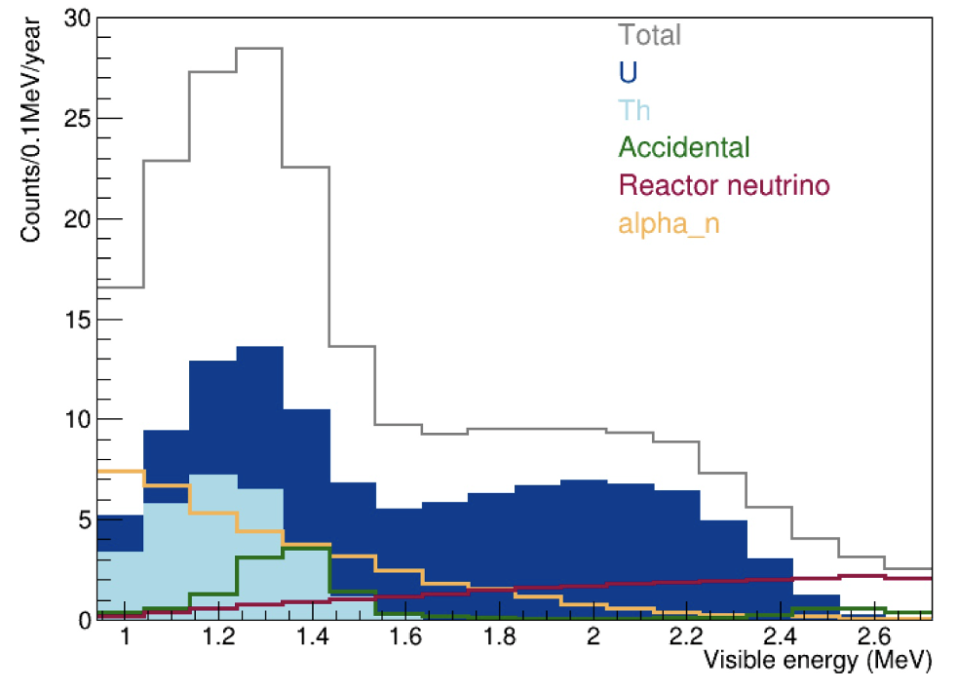
Energy Spectrum
Same as KamLAND
Efficiency %
Energy (MeV)
Number of predicted events [/year]
 | U | Th | Total | Reactor | Accidental | (α, n) | He-Li | total
All energy region | 112.45 | 28.05 | 140.50 | 67.84 | 14.29 | 55.47 | 0 | 137.6
Geoneutrino energy region
 |  |  |  | 23.08 | 12.61 | 40.27 | 0 | 75.96
Mantle geoneutrinos | 78.72 | 19.64 | 98.36

Slide 11
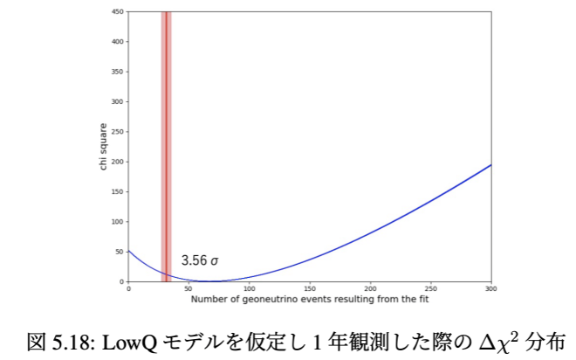
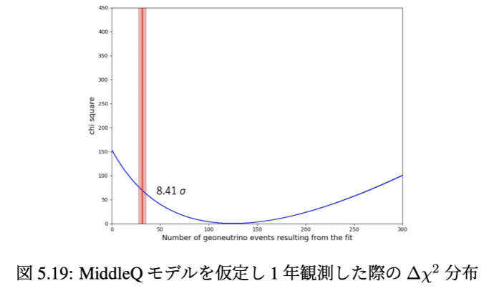
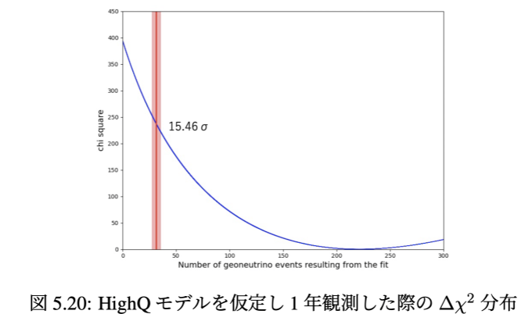
Extent to which mantle 0 signals are eliminated in BSE models
1 Create dummy data using the predicted energy spectrum from the Poisson distribution
2 Fit the obtained dummy data so that the following values are minimised
Geoneutrino in crust
3.05 ± 0.37 TNU
×volume
×１year
×live time ratio
Red label
Blue curve
Chi-square distribution when assuming lowQ
Chi-square distribution when assuming middleQ
Chi-square distribution when assuming highQ

Slide 12
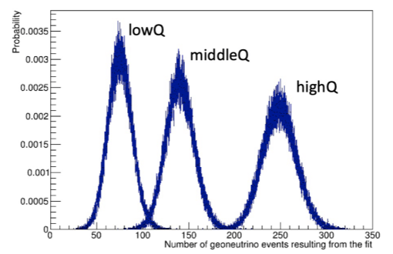
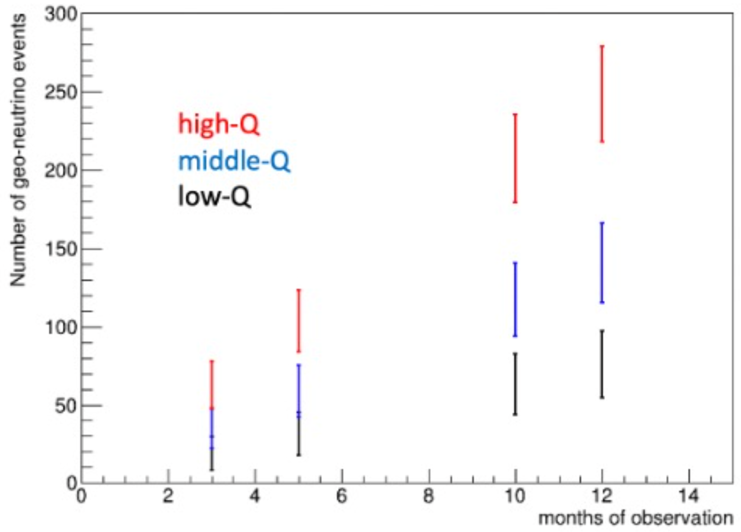
Exclusion rate for each model in BSE model
Number of observations predicted for one year of observation
Choose a range of 90%
Probability (%) of rejection of Earth’s heat model
i , j : bin
P : probability
N : max of bin
Assume model

Slide 13
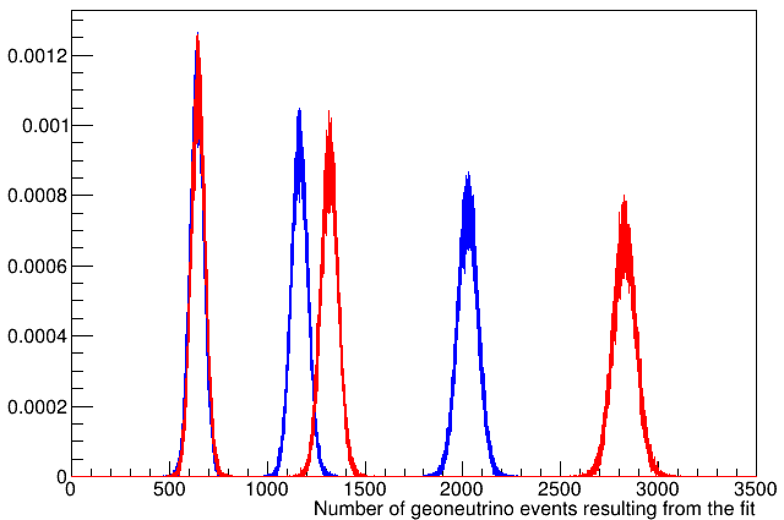
Comparing geoneutrino flux at two locations
# Site1 W161,N9
# Site2 W161,N60
Pacific Ocean, near Marshall Islands
North Pacific Ocean (Bering sea), western cost of Alaska
Low 7.52%
Middle 92.0%
High 100%
If We observe for 10 years, we can see the difference in the mantle with
MiddleQ at 92.0% and HighQ at 100%.
It is difficult to see the difference with LowQ.

Slide 14
Optical Simulation for prototype detector
pmt
pmt
Optical transport in prototype through different components:
LS
Can pass through or get absorbed, depending upon the absorption length of LS
multiple reflections from stainless steel wall
Depending upon the reflectivity
Acrylic windows
Difference in refractive indices of LS and acrylic can cause total internal reflection in some cases
thickness of the acrylic window is smaller than the absorption length of acrylic
Seawater : scattering
Pmt shield : Difference in refractive indices

Slide 15
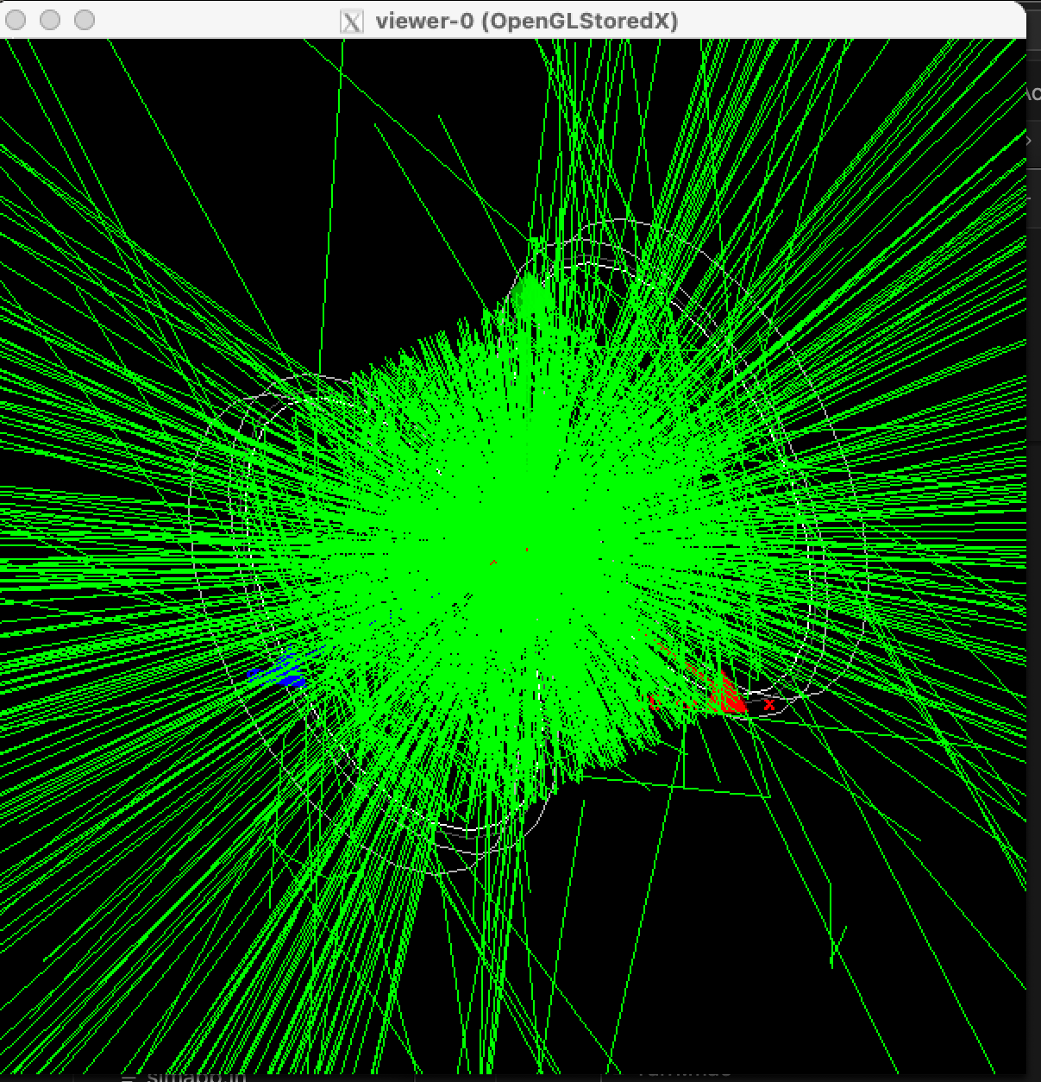
Optical Simulation in Geant4
Geant4 photon simulation

Slide 16
Geometry setup in G4
LS properties
component | Shape | Dimensions/ Diameter(cm) | Height/thickness (cm) | Density (g/cm³) | material
Stainless steel tank | box | 132.6 x 66.6 x 66.6 | Thickness = 2.5 | 7.938 | G4_STAINLESS_STEEL
Seawater | box | 127.6 x 61.6 x 61.6 | - | 1.025 | G4_WATER
Stainless steel vessel | cylinder | diameter = 28 | Height = 20 Thickness = 1 | 7.938 | G4_STAINLESS_STEEL
LS (liquid scintillator) | Cylinder | diameter = 27 | Height = 20 | 0.87 1.00 | LAB PPO(3.5g/L)
Acrylic window | Cylinder | diameter = 30 | Thickness = 3 | 1.19 | G4_PLEXIGLASS
PMT shield | Spherical shell | Diameter = 43.2 | Thickness = 1.4 | 2.23 | Borosilicate glass (G4_Pyrex_Glass)
PMT cathode | Hemispherical shell | Diameter = 43.1 | Thickness = 0.1 | 2.4 | Aluminium G4_Al
 | material | ratio
Organic solvent | LAB - Linear alkylbenzene C₂₁H₃₆ | 80 %
 | PC – pseudocumene C₉H₁₂ | 20 %
fluor | PPO – (2,5-Diphenyloxazole) (DPO) | 3.5 g/l
Wavelength dependent properties
Wavelength (nm) | Refractive Index | Absorption Length (mm)
519.92 | 1.497 | 21630
500.00 | 1.499 | 15965
449.93 | 1.504 | 15965
400.00 | 1.508 | 12875
370.04 | 1.514 | 6180
360.05 | 1.517 | 3562
349.99 | 1.520 | 2060
320.00 | 1.526 | 824
20cm
Wavelength independent properties
Light yield | 500 photons/MEV (for scaling purpose)
Rise time constant | 5.991 ns
Decay time constant | 33.12 ns
30 cm
CAD design of LS vessel in prototype detector

Slide 17
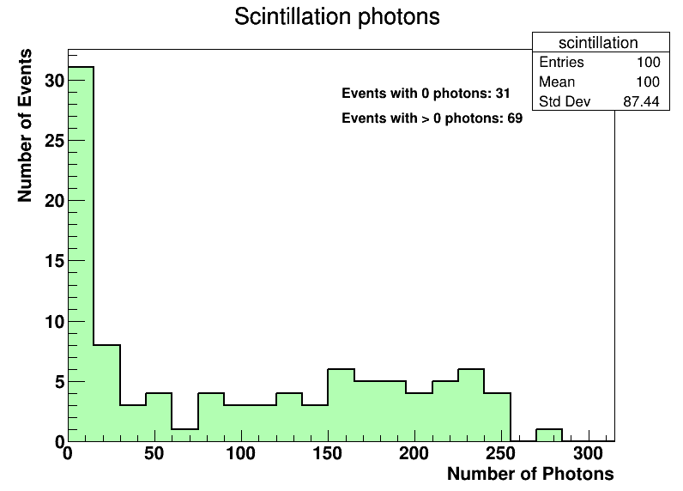
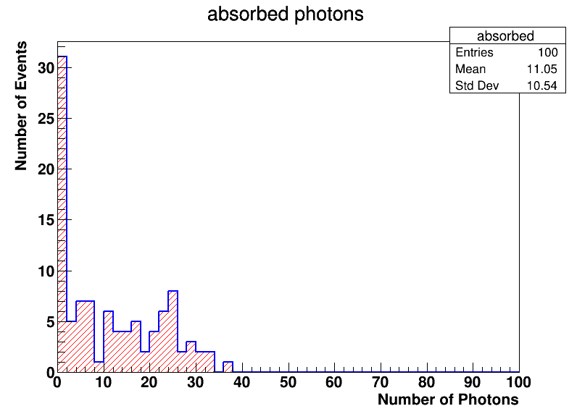
Event simulations
Source particle : 511keV gamma (100 events)
Vertex : center of geometry
Scintillation light is produced by Compton scattered electrons in LS by gamma rays.
Average of 100 scintillation photons are produced in each event

Slide 18
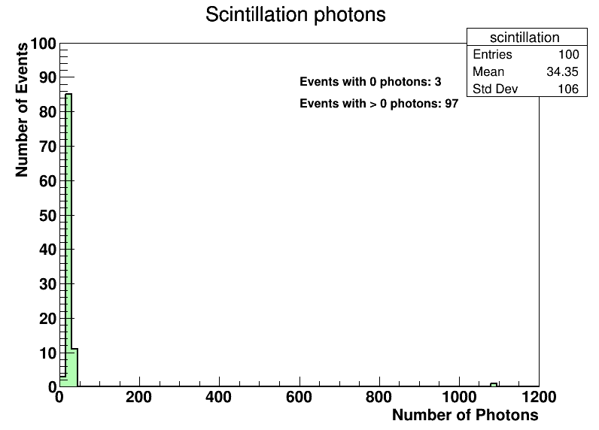
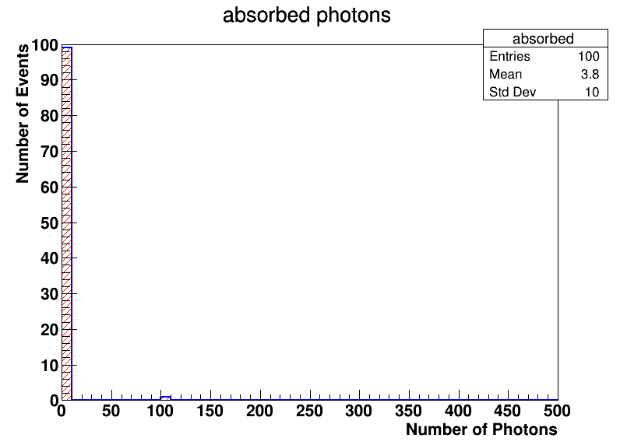
Source particle : 50 keV neutron (100 randomized events)
Vertex : center of geometry
High luminosity due to neutron capture

Slide 19
ROBAST Ray Tracing to evaluate collection efficiency
Geometry and optical parameters
Wavelength of light used = 400 nm
Stainless steel reflectivity ~ 0.4
LS refractive index = 1.508
from Watanabe san’s M thesis
LS absorption length = 12875 mm
from Watanabe san’s M thesis
Acrylic refractive index = 1.508
from refractiveindex.info
Acrylic absorption length = 136 mm
from refractiveindex.info
Radius of PMT = radius of acrylic plate

Slide 20
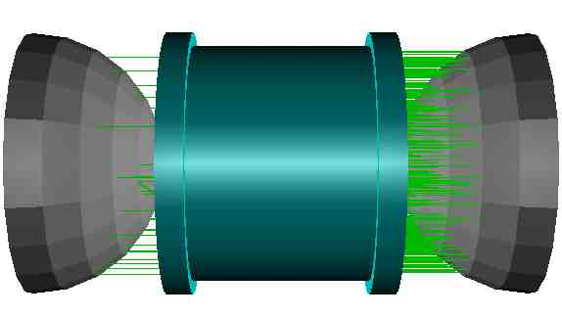
Total number of rays traced = 500
Direction = (1,0,0)
No of rays absorbed in medium = 108 (21.6%)
No of rays collected by right pmt = 358
No of rays collected by left pmt = 33
Collection efficiency = 78.2%
Similar setup in Geant4 gave absorption in the medium as ~ 23%. (for 186 GeV muon)

