Slide 1
ALPHA ASIC Evaluation Board
Makiko Kuwahara
PHYS475 Fall 2021
Professor: Dr. Gary Varner

Slide 2
ALPHA ASIC
Advanced Low Power Hybrid Acquisition [ALPHA] ASIC
Project Title: The Antarctic Demonstrator for the Advanced Particle-astrophysics Telescope (APT)
ALPHA_v1 ASIC designed in our IDLab and manufactured by TSMC
Multiple ASICs are daisy chained with one FPGA to lower power consumption
CT5TEA sends trigger to ALPHA for capturing samples of interest
There are two paths for data and token so that the chain can detour defective ASIC

Slide 3
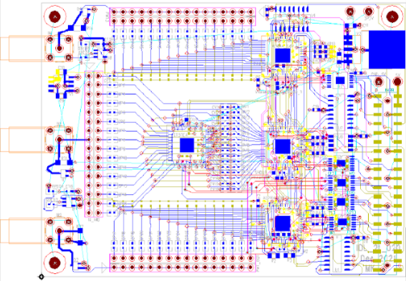
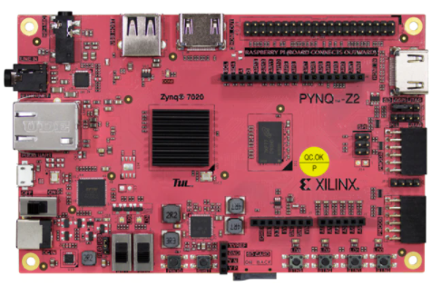
Evaluation Board Features
Evaluation board PCB on PYNQ
Test with one ALPHA to characterize chip by itself
Test with 2 other ALPHAs (total 3) to test the communication
1 CT5TEA to emulate the performance
Power 1.8V(ALPHA) 2.5V(CT5TEA) 3.3V(PYNQ)
Schematic and Layout creation using Mentor PADS software
PCB size 3 x 4 inches

Slide 4
PADS Logic (Wiring Documentation)

Slide 5
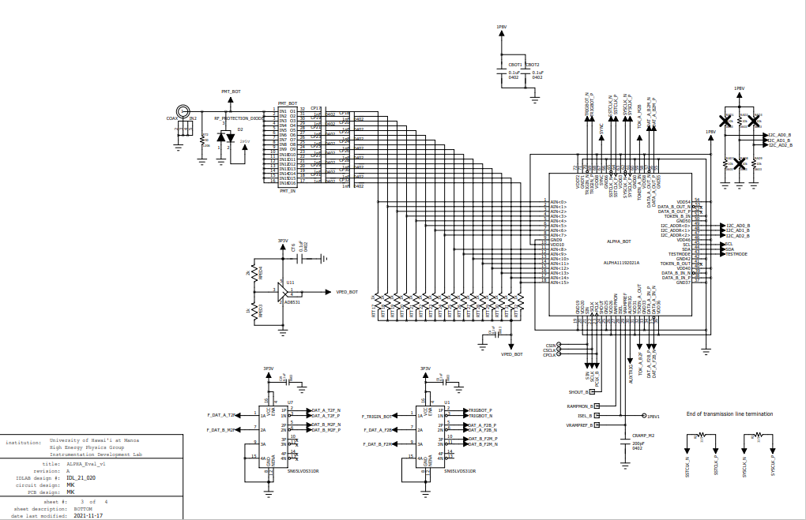
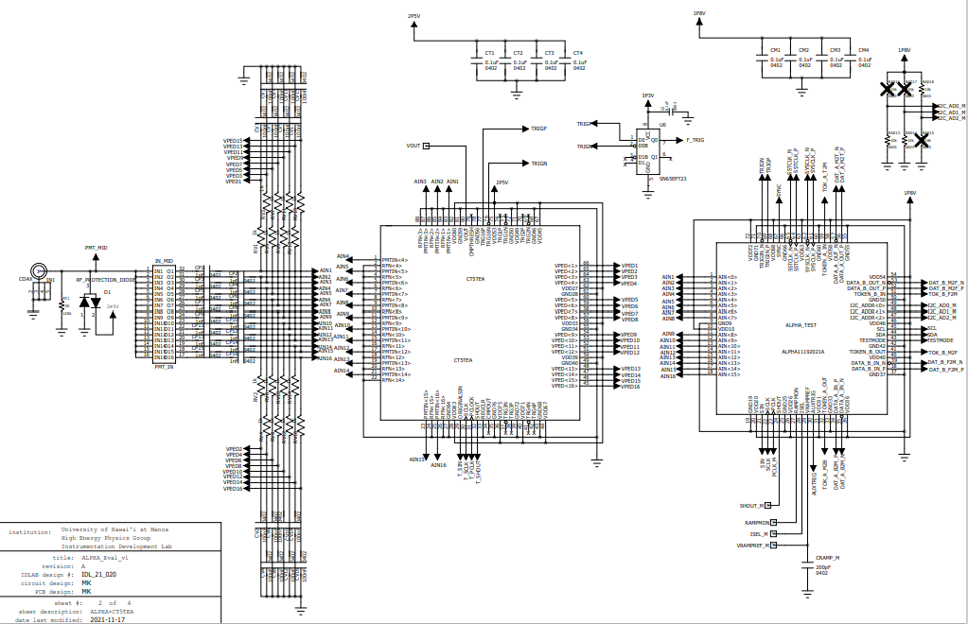
PADS Logic Schematic
Blueprint of the parts and connections.

Slide 6
PADS Layout

Slide 7
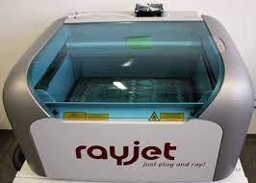
Evaluation board production process flow diagram
Mentor PADS
Symbol Creation
Decal
Creation
Wiring
Documentation
Schematic
Creation
PCB
Layout
Artwork
Generation
PADS Logic
PADS Layout
PADS Logic
PADS Logic
PADS Layout
PADS Layout
Future Work
PCB Design Submit for Manufacturing
Stencil
Making for
Assembling
Soldering
Parts on PCB
Testing
ALPHA_v1
ALPHA_v2
Completed on
Dec 08, 2021
Estimated delivery on
Dec 20, 2021
rayjet
Laser Engraver
PYNQ

Slide 8
Questions?

