Slide 1
Time-to-Amplitude Converter
Presented by: Jon Itokazu December 10th, 2021
PHYS 475

Slide 2
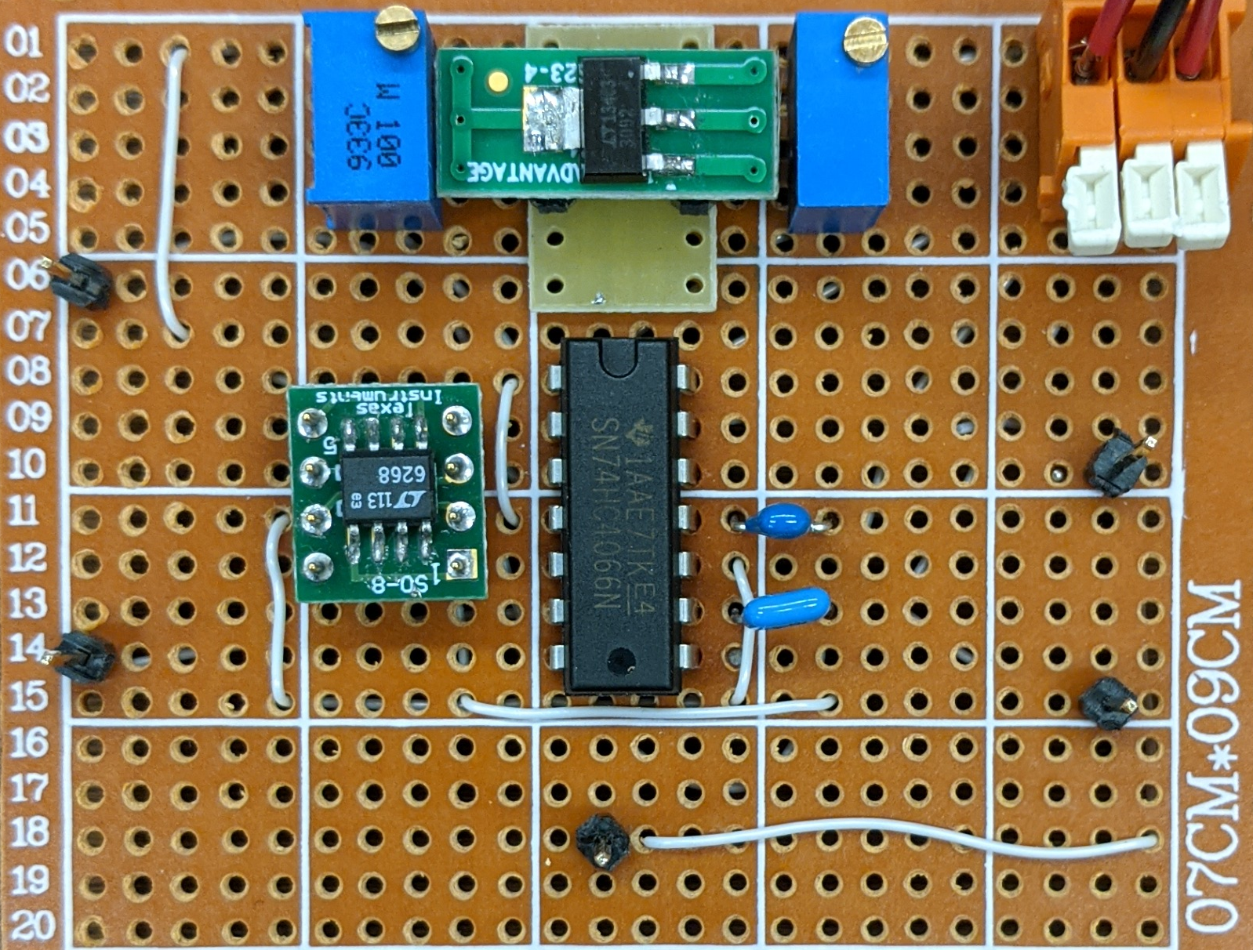
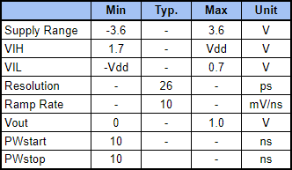
Overview and Specifications
26 ps resolution Time-to-Digital Converter for Time-of-Flight applications.

Slide 3
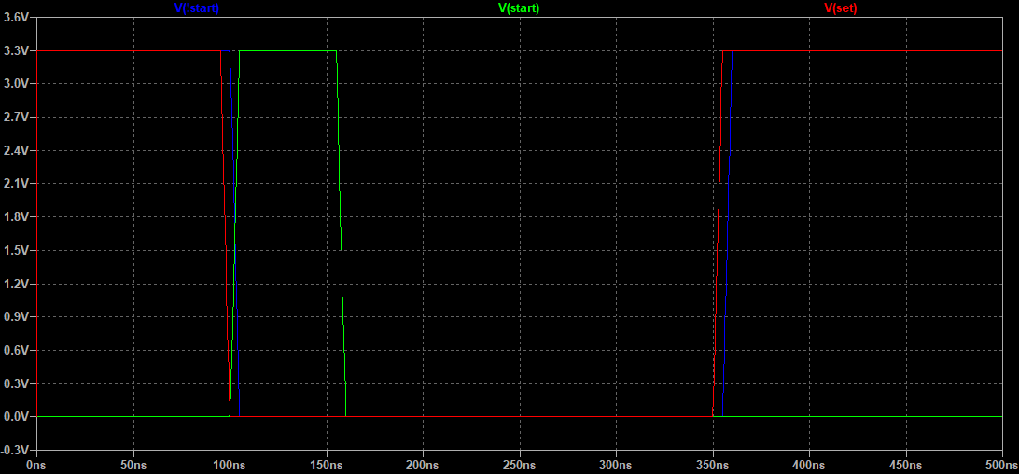
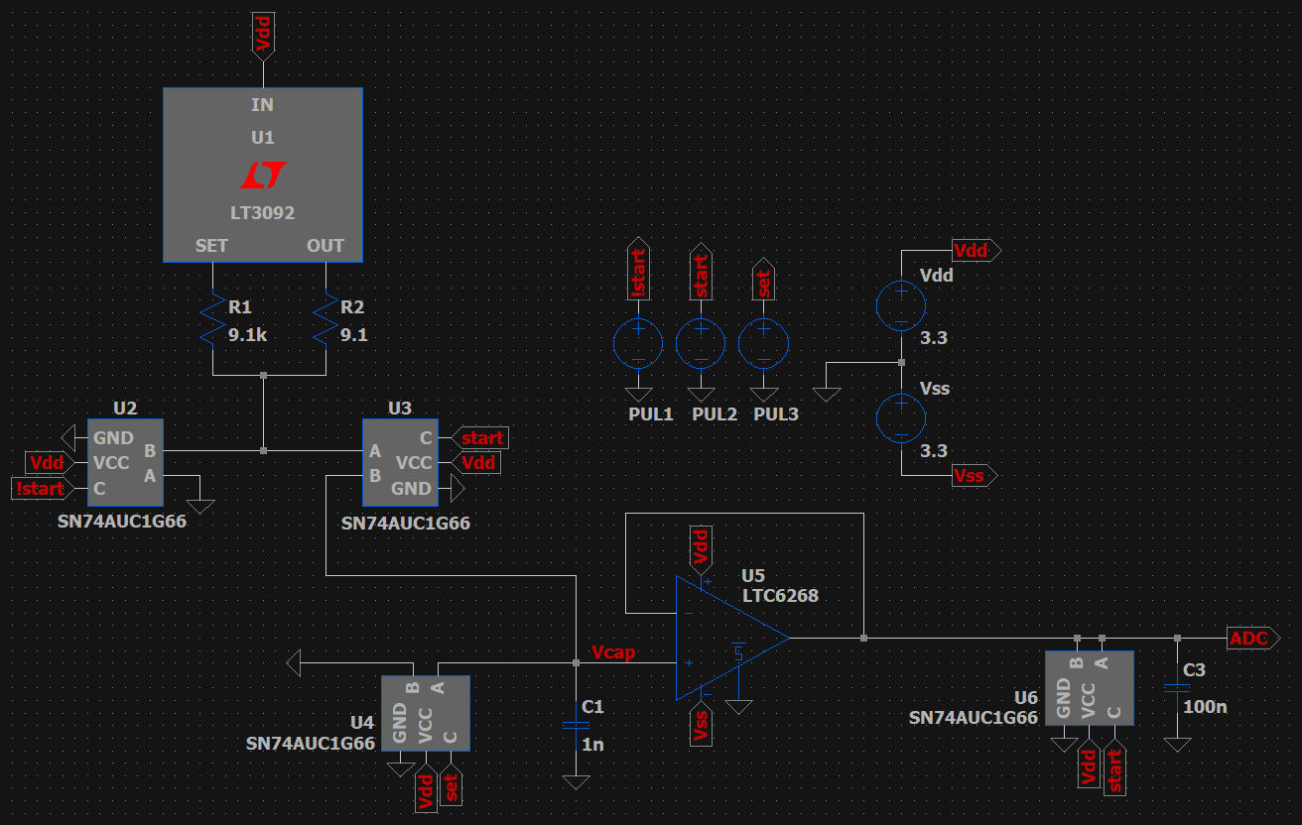
Schematic and Overview
For testing purposes only
Note: Due to issues, a SN74AHC4066 was used in place of SN74AUC1G66 for prototyping

Slide 4
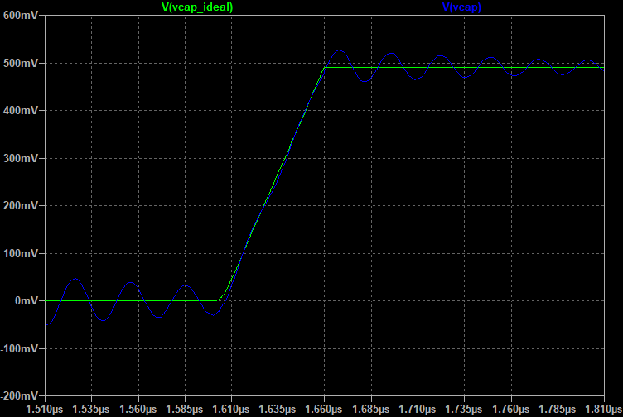
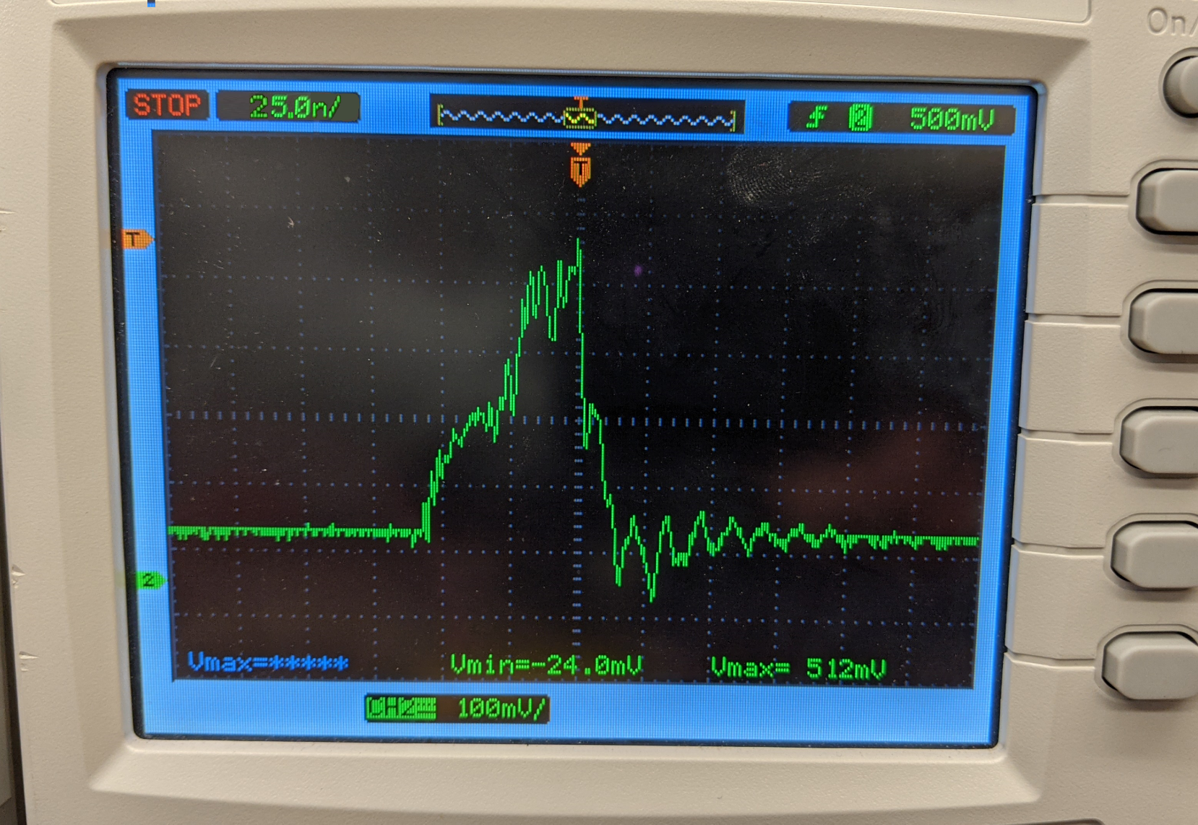
Simulation vs. Measurement
Measurement was taken at Vcap
discrepancy at ramp peak due to oscilloscope probe causing the sampling capacitor to discharge
Measurement and Simulation information
Time Div. → 25 ns/div
Volt. Div. → 100 mV/div
Vmax(sim:ideal) → 496 mV
Vmax(sim:non-ideal) → 525 mV
Vmax(sim:measured) → 512 mV
Vcap

Slide 5
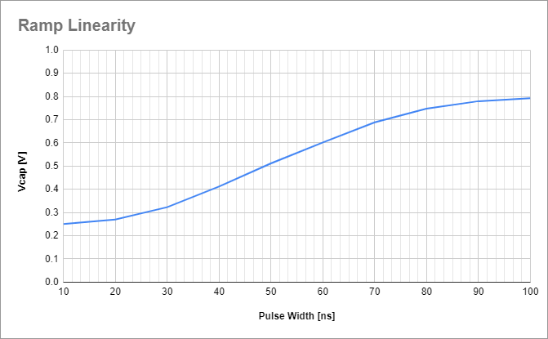
Capacitor Ramp Linearity
Non-Linear Region
Non-Linear Region
Linear Region

Slide 6
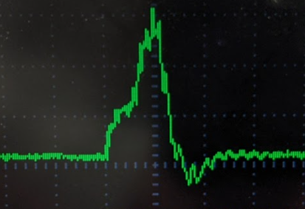
Future Works
Improve linear range
switches with better isolation to reduce leakage current
Reduce Noise
Survey for alternate parts with better noise performance
Implement on board using layout techniques
Create circuit at the transistor level

Slide 7
Q&A
Thank you for your time and attention
? The floor is now open for questions

