Slide 1
The 𝜈BDX-DRIFT Experiment to Study New Physics and CE𝜈NS at Fermilab
Dan Snowden-Ifft / Occidental College
CYGNUS Physics and Analysis Meeting
November 4, 2021

Slide 2
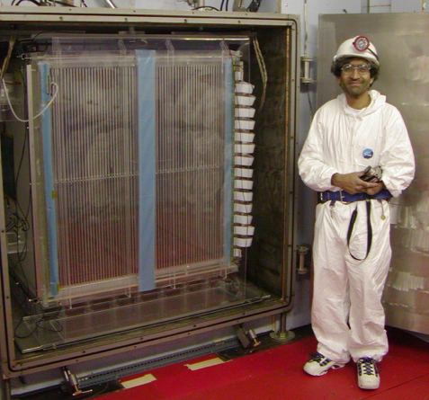
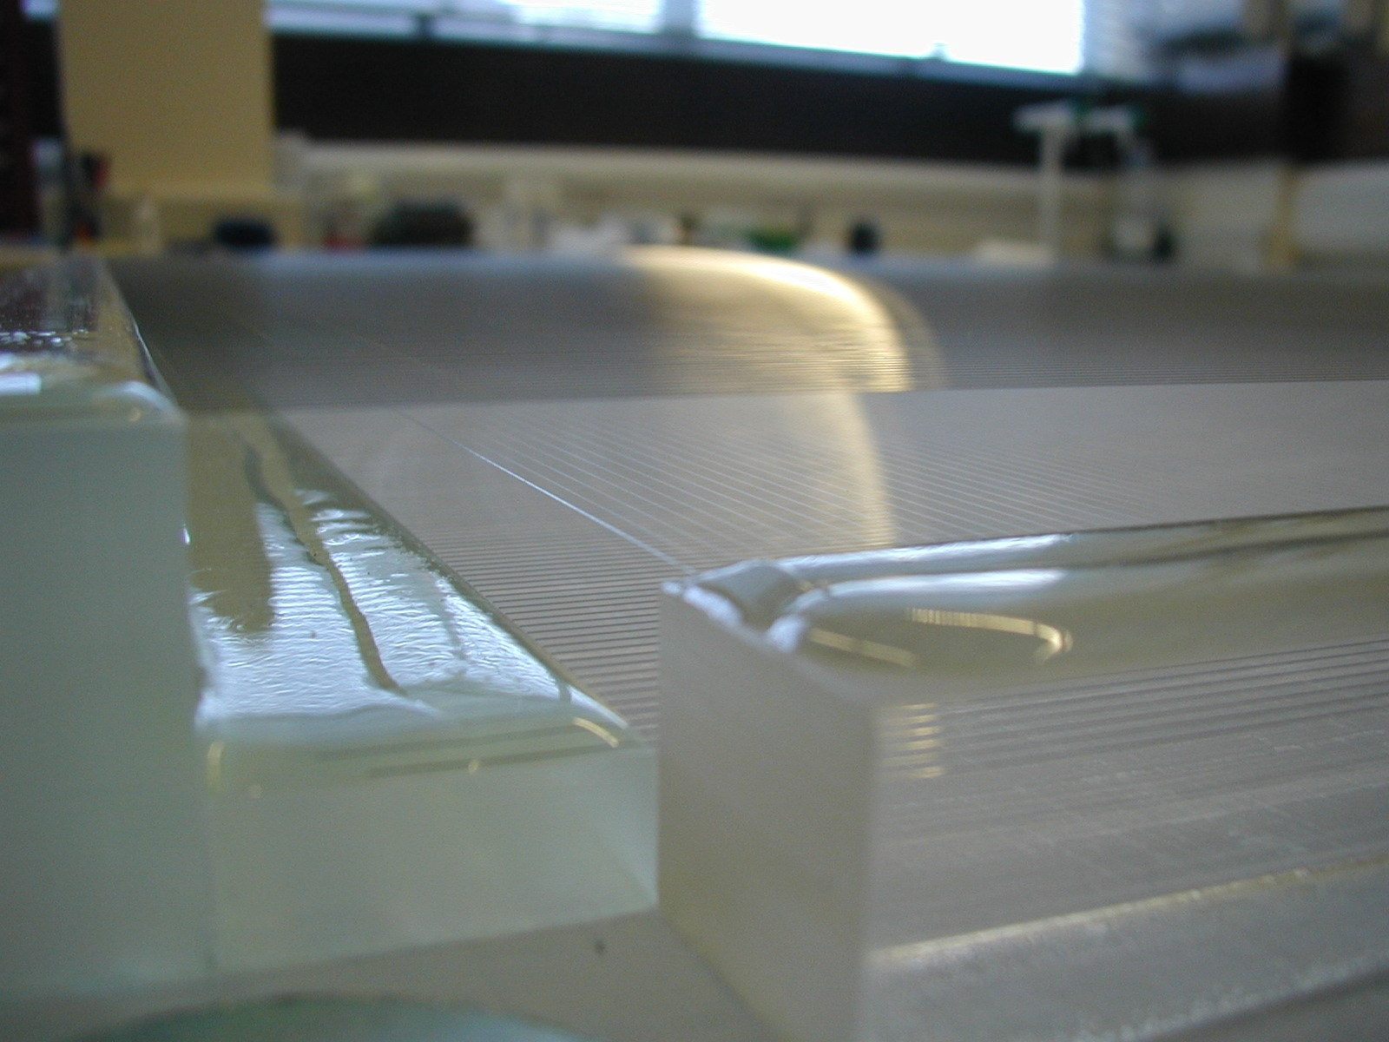
DRIFT: Lightning Summary
Started = 1998, US/UK
Directional Recoil Identification From Tracks (DRIFT)
40 Torr, CS₂, 1 m³ detector
Operated for ~15 years in the Boulby Mine
Low energy (35 keV) threshold for nuclear recoils
Zero Background Results
AstroPle, 91, 2017

Slide 3
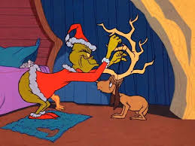
The Wisdom of Dr. Seuss
"All I need is a reindeer..." The Grinch looked around.
But, since reindeer are scarce, there was none to be found.
Did that stop the old Grinch? No! The Grinch simply said,
"If I can't find a reindeer, I'll make one instead!"
from "How the Grinch Stole Christmas" by Dr. Seuss

Slide 4
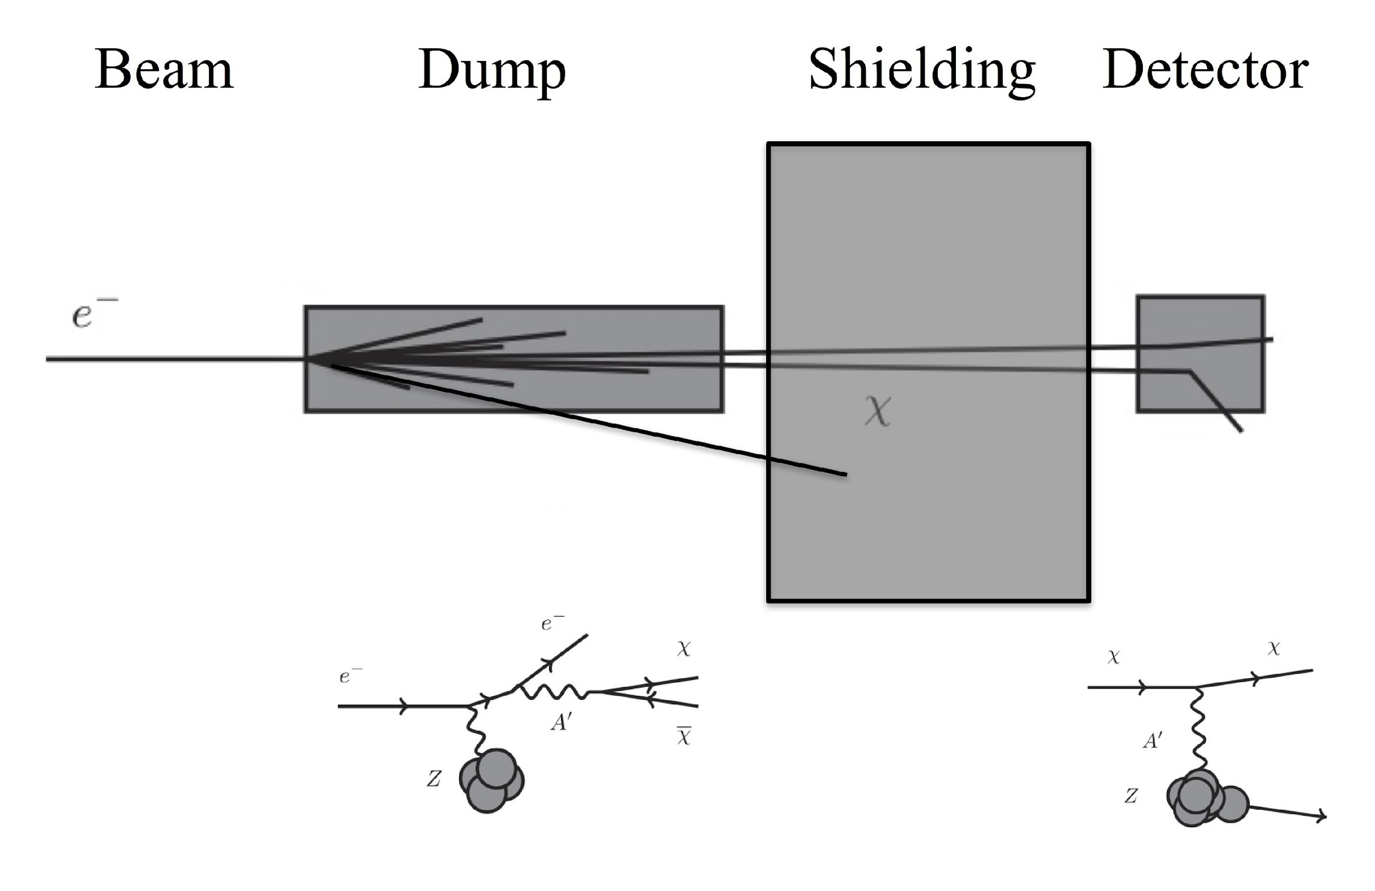
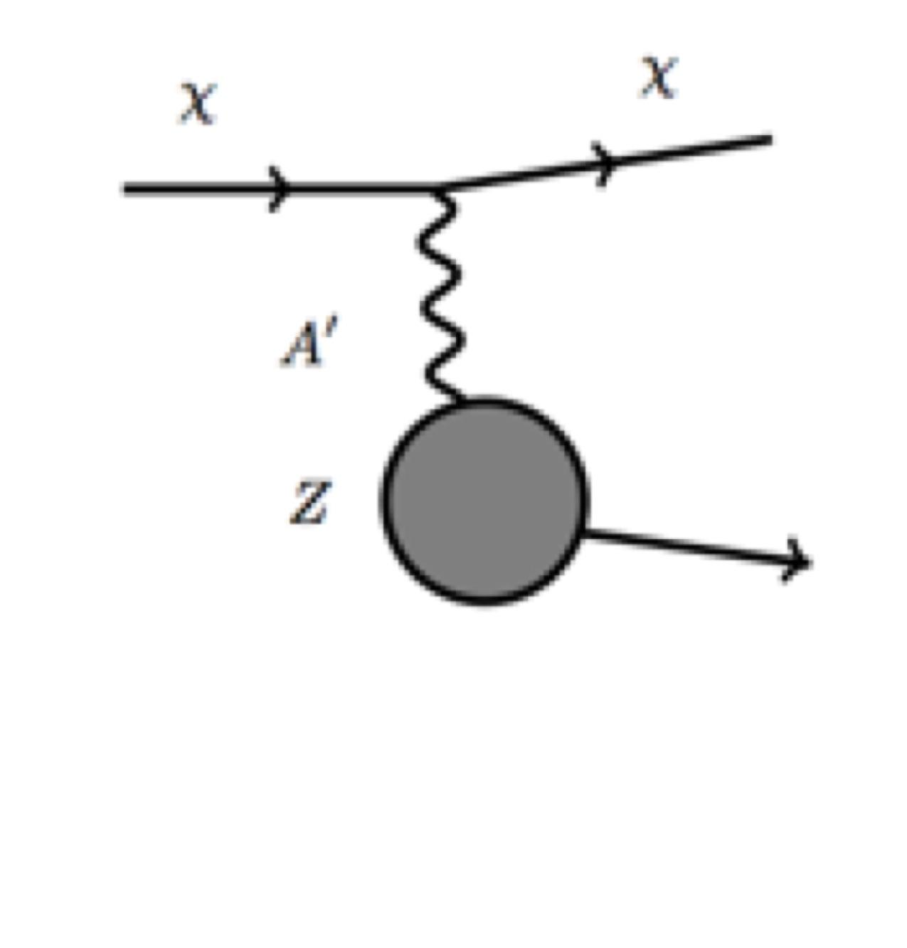
Detecting Light Dark Matter at Accelerators

Slide 5
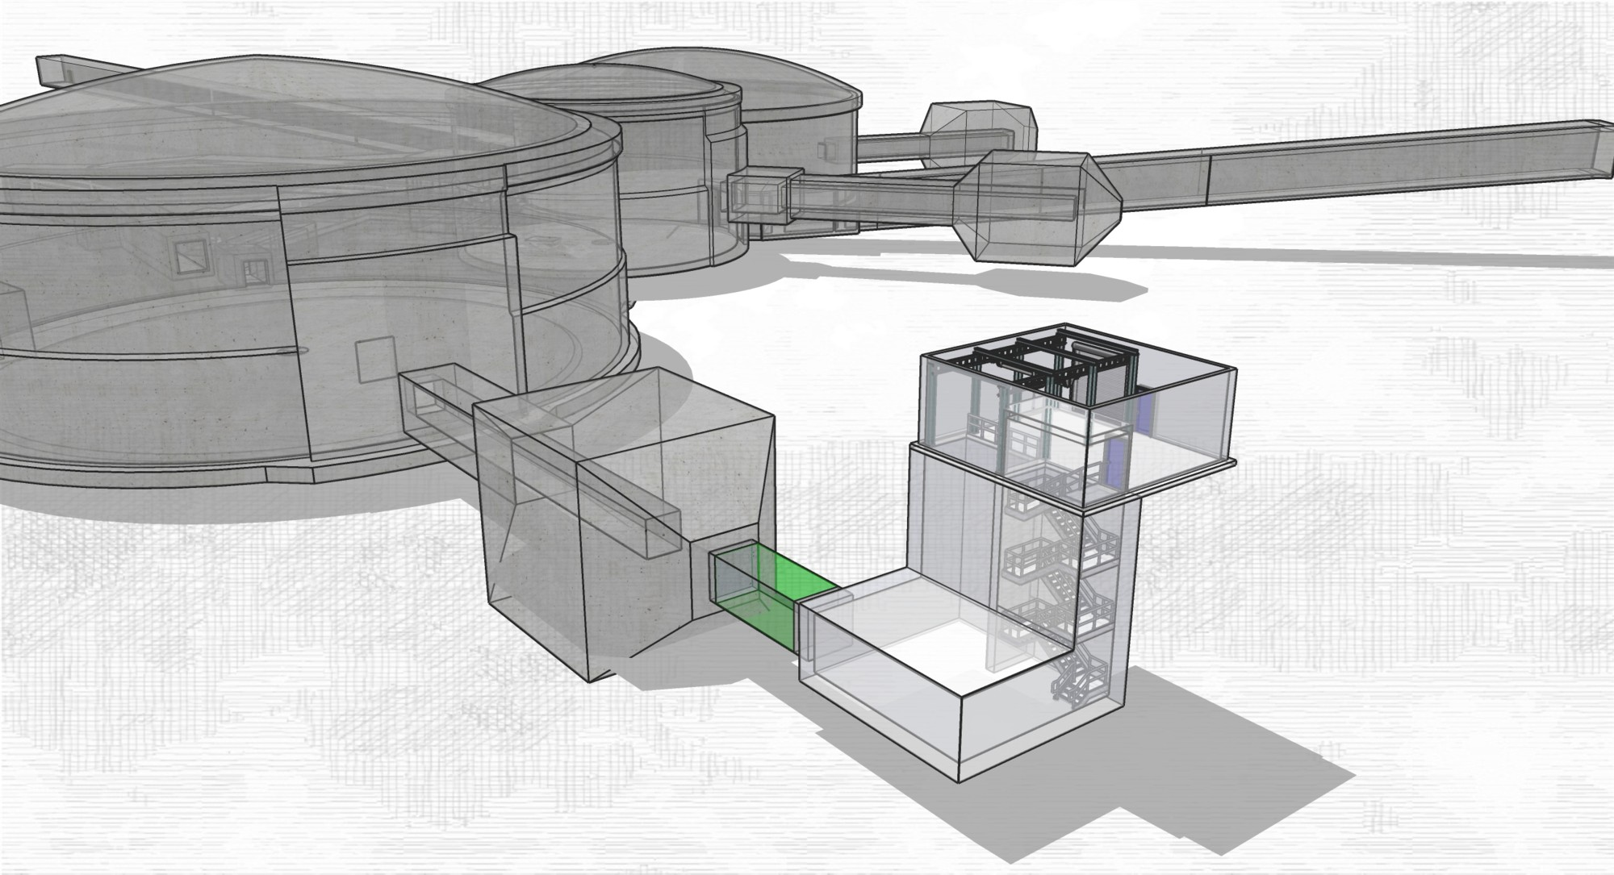
BDX-DRIFT at JLab

Slide 6
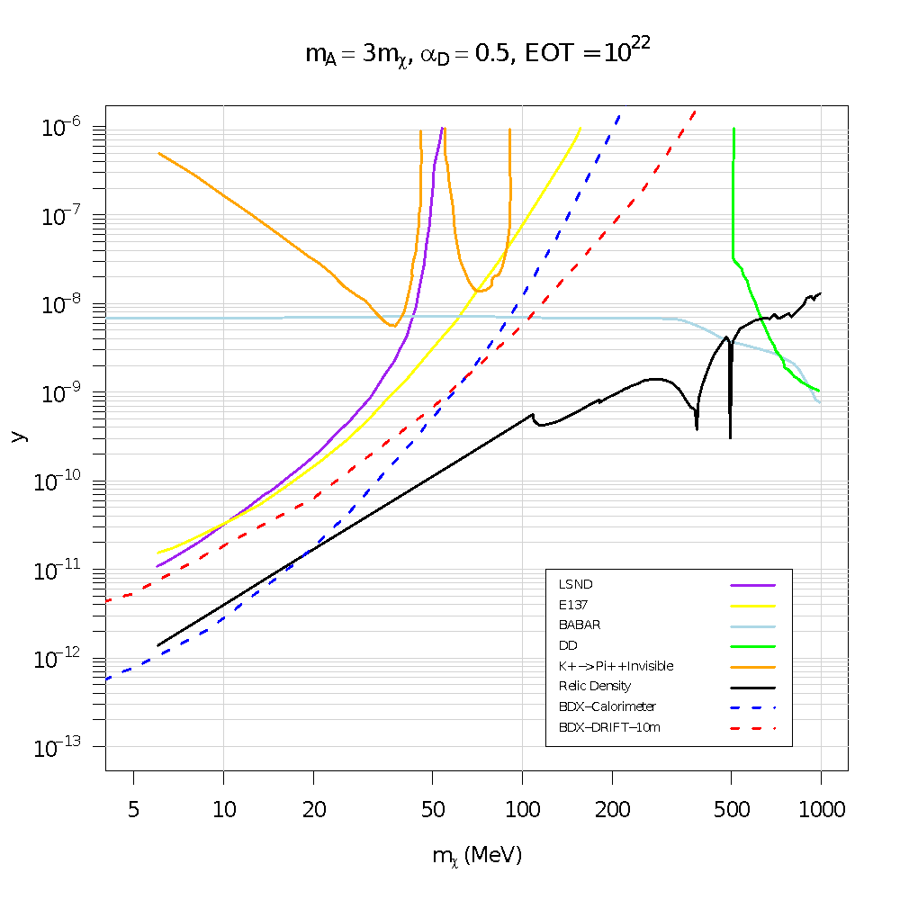
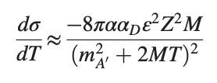
BDX-DRIFT – Sensitivity at JLab
How can BDX-DRIFT compete with a detector 1000x its mass?
Nuclear recoils
Coherent Interactions (Form factor included)
Low Threshold
Low Background?
y = ε² α_{D} (m_{χ} / m_{A’})⁴
m_{χ} (MeV)
PRD, 99, 2019

Slide 7
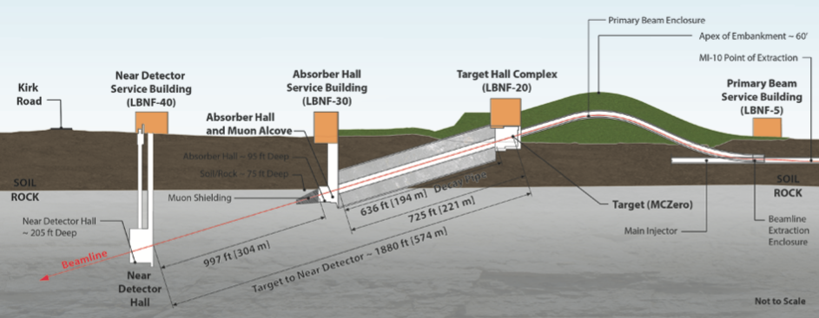
𝜈BDX-DRIFT at DUNE

Slide 8
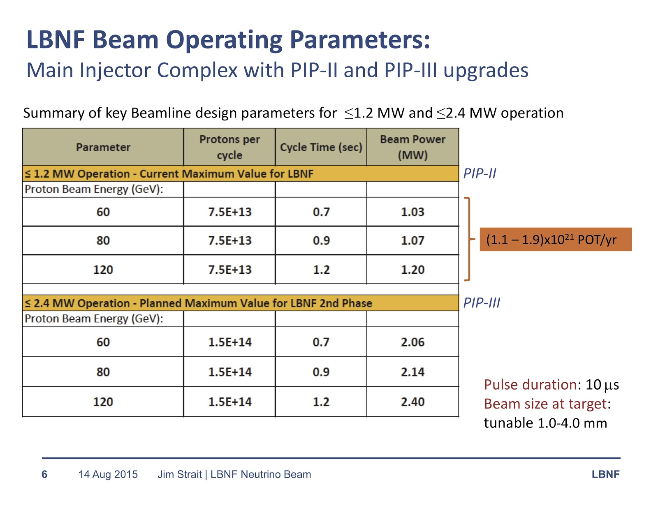
Near Detector LDM Flux

Slide 9




The 𝜈BDX-DRIFT Collaboration
University of New Mexico
Dinesh Loomba
Occidental College
Dan Snowden-Ifft
Jean-Luc Gauvreau
Texas A&M University
Louis Strigari
Bhaskar Dutta
Doojin Kim
Universidad Technica Federico Santa Maria
Diego Aristizabal Sierra

Slide 10
Fermilab PAC
Presented this idea to the 2020 Fermilab PAC
Asked to consider a stronger physics case, both standard and BSM
Asked to consider a more detailed analysis of backgrounds

Slide 11
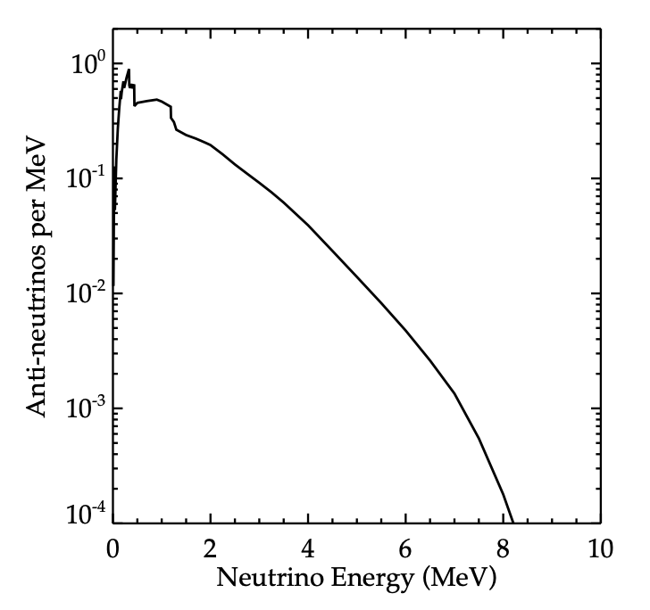
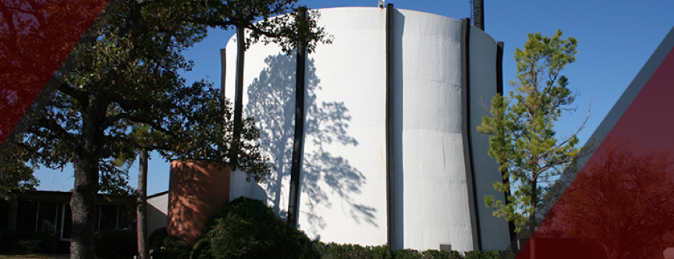
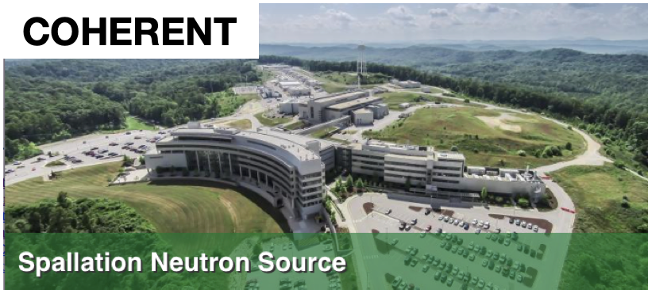
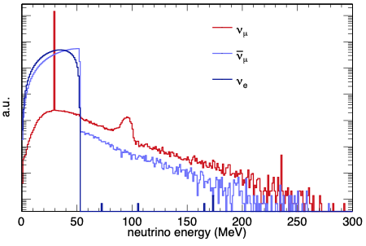
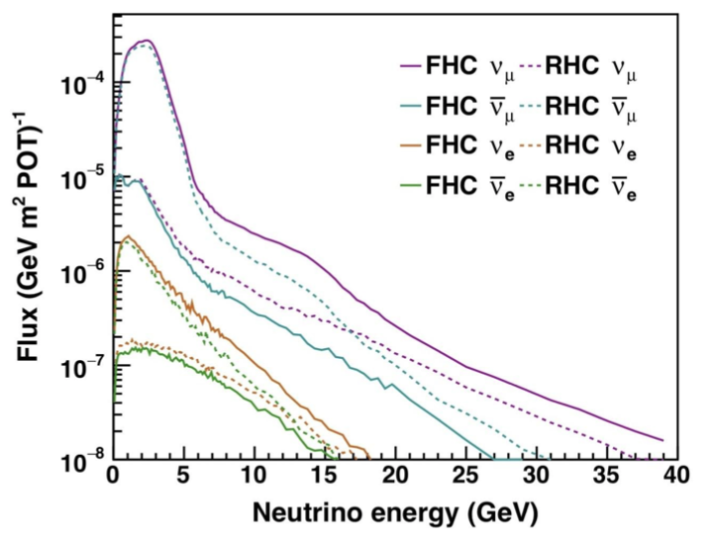
Sources for CE𝜈NS

Slide 12
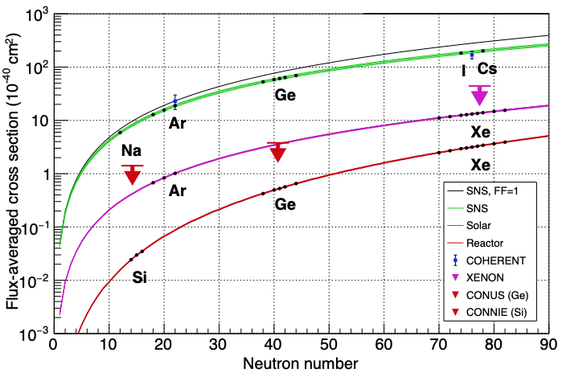
CE𝜈NS Measurements and Limits
Figure: K. Scholberg

Slide 13
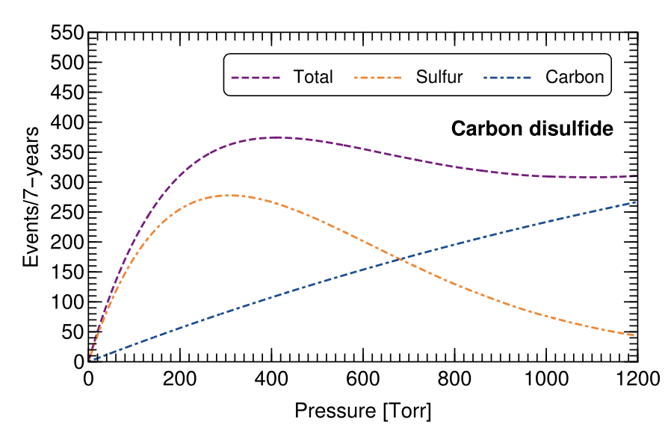
CE𝜈NS Physics – Event Rates
Max rate @ 400 Torr CS₂
Significant detection, ~400 events for 7 yrs with 10 m³
Different nuclei possible
Directionality for signature
PRD 104, 2021, arXiv:2103.10857, Aristizabal-Sierra et al.

Slide 14
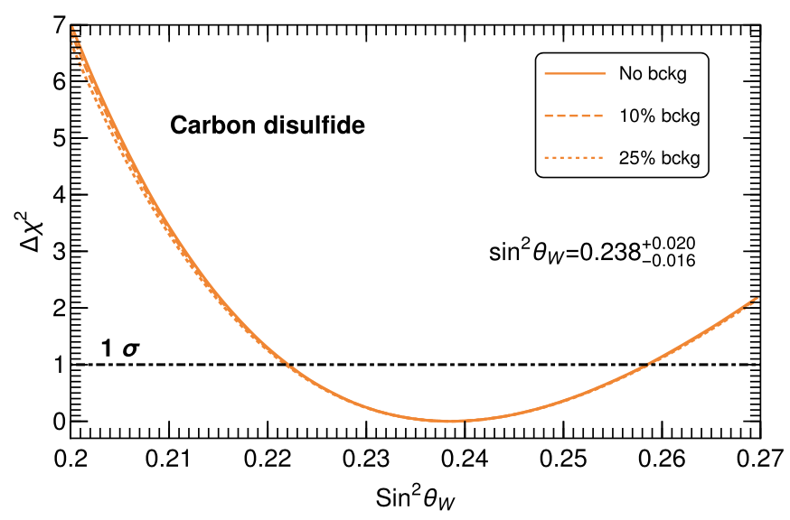
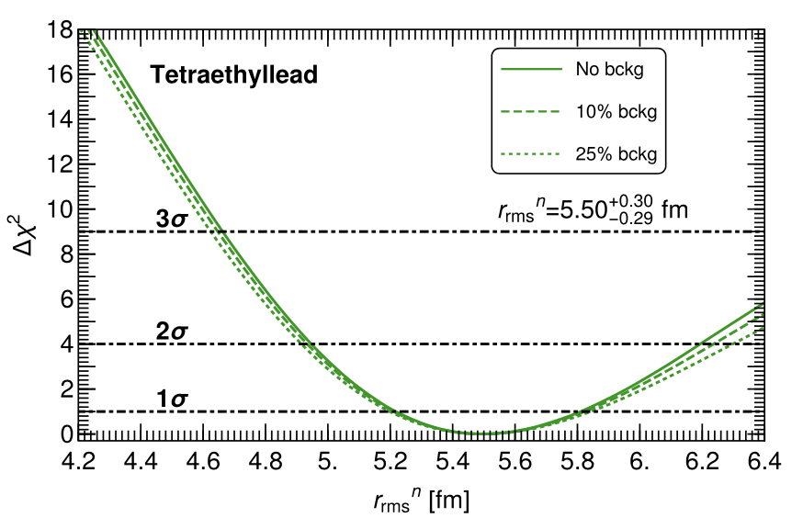
CE𝜈NS Physics - Measurements
Measurement of the weak mixing angle on S to 8%
Measurement neutron distribution in Pb to 5%
Larger neutrino energy => Sufficient stats at high Q
Systematics on form factor are small
Comparison with PREX
PRD 104, 2021, arXiv:2103.10857, Aristizabal-Sierra et al.

Slide 15
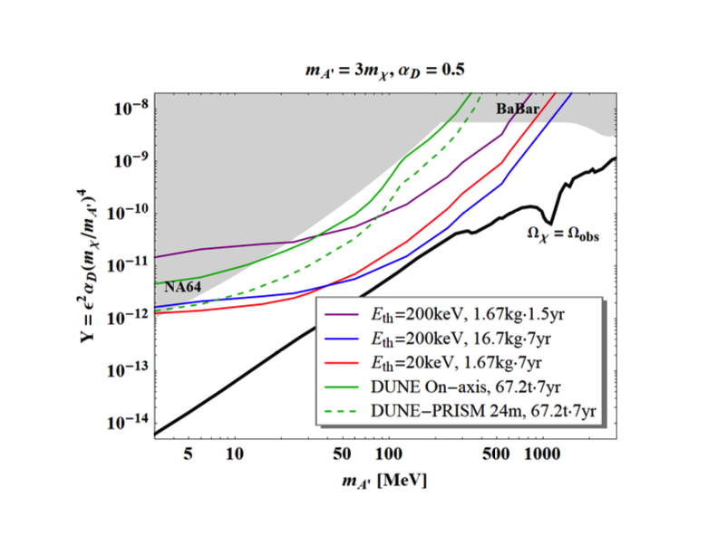
𝜈BDX-DRIFT – Sensitivity at DUNE ND
Red line = 10 m³ @ 40 Torr, nominal pressure, with 20 keV threshold
Blue line = 10 m³ @ 400 Torr with 200 keV threshold to preserve recoil length
Purple line = 1 m³ @ 400 Torr with 200 keV threshold
All assume zero background

Slide 16
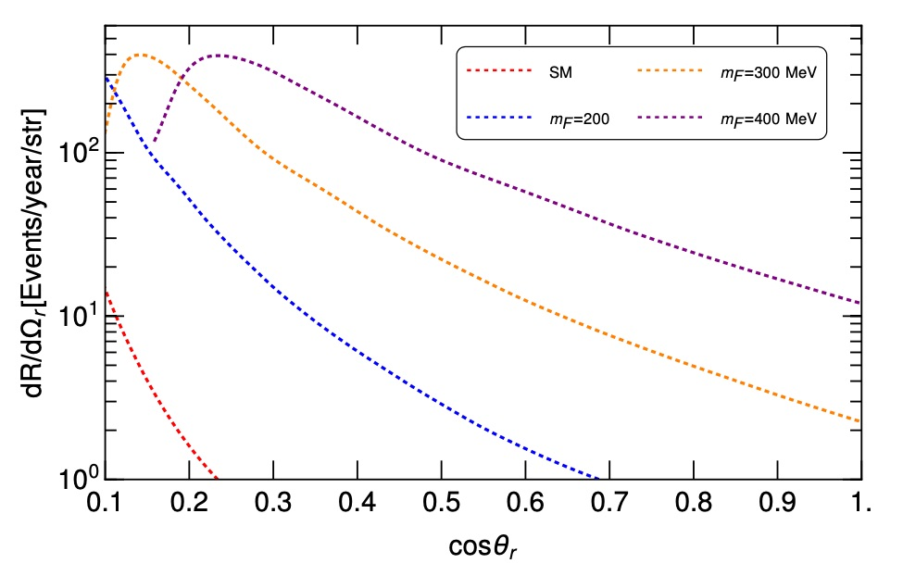
Non-Perpendicular Scatters
Inelastic neutrino collisions could provide a directional signal linked to the mass of the BSM scale.
ν + N -> ν + F
F = heavy fermion, for example heavy right handed ν

Slide 17
Backgrounds – Beam Unrelated
Detector backgrounds
Cosmic ray neutrons
Cosmic ray muons, betas and gammas
Cosmic ray muon-induced neutrons
Neutrons from radioactive decay in the walls – ~events per day
Beam timing - With fiducialization we expect to be able to calculate the time when the event occurred within the 𝜈BDX-DRIFT detector to within 10 μs. With this timing cut we expect to reduce any beam-unrelated backgrounds to zero for near-term exposures regardless of pressure.

Slide 18
Backgrounds – Beam Related
“Rock neutrons” created by ν – N interactions
Asked by Fermilab PAC December 2020 to estimate “rock neutron” backgrounds for a planned NuMI run
We came up with a framework for solving this problem
Decided to try to benchmark our calculation using COUPP experiment run in the NuMI underground near detector hall in 2009

Slide 19
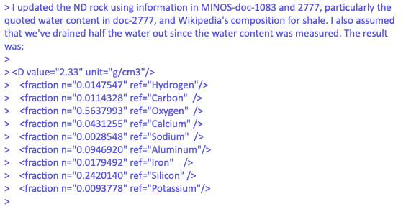
Backgrounds - Inputs
Dolomite composition from Fermilab

Slide 20
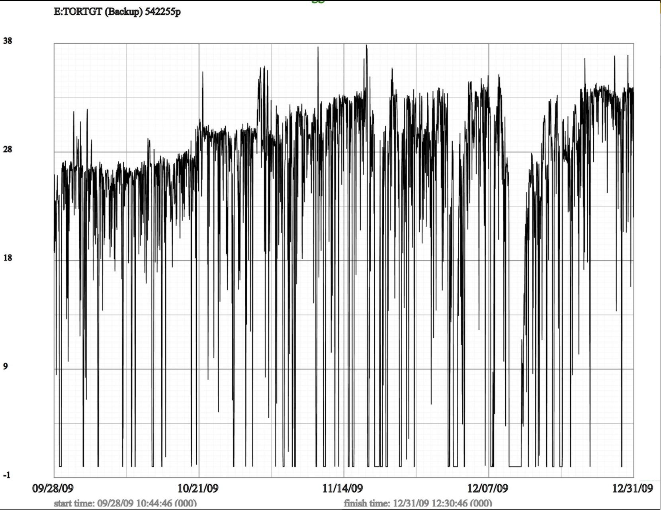
Backgrounds - Inputs
Dolomite composition from Fermilab
POT per pulse
Time between pulses

Slide 21
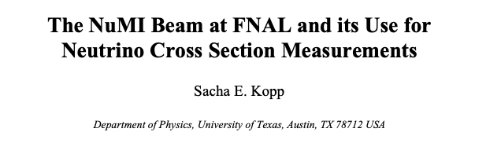
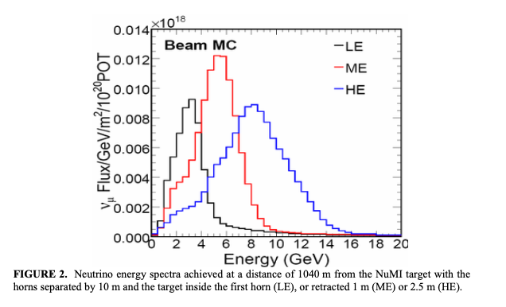
Backgrounds - Inputs
Dolomite composition from Fermilab
POT per pulse
Time between pulses
NuMI neutrino flux
LE mode

Slide 22

Backgrounds - Code
Dolomite composition from Fermilab
POT per pulse
Time between pulses
NuMI neutrino flux
LE mode
Used Genie to generate end-state particles coming from 𝜈 - nuclei interactions

Slide 23

Backgrounds - Code
Dolomite composition from Fermilab
POT per pulse
Time between pulses
NuMI neutrino flux
LE mode
Used Genie to generate end-state particles coming from 𝜈 - nuclei interactions
Used GEANT to generate recoils

Slide 24
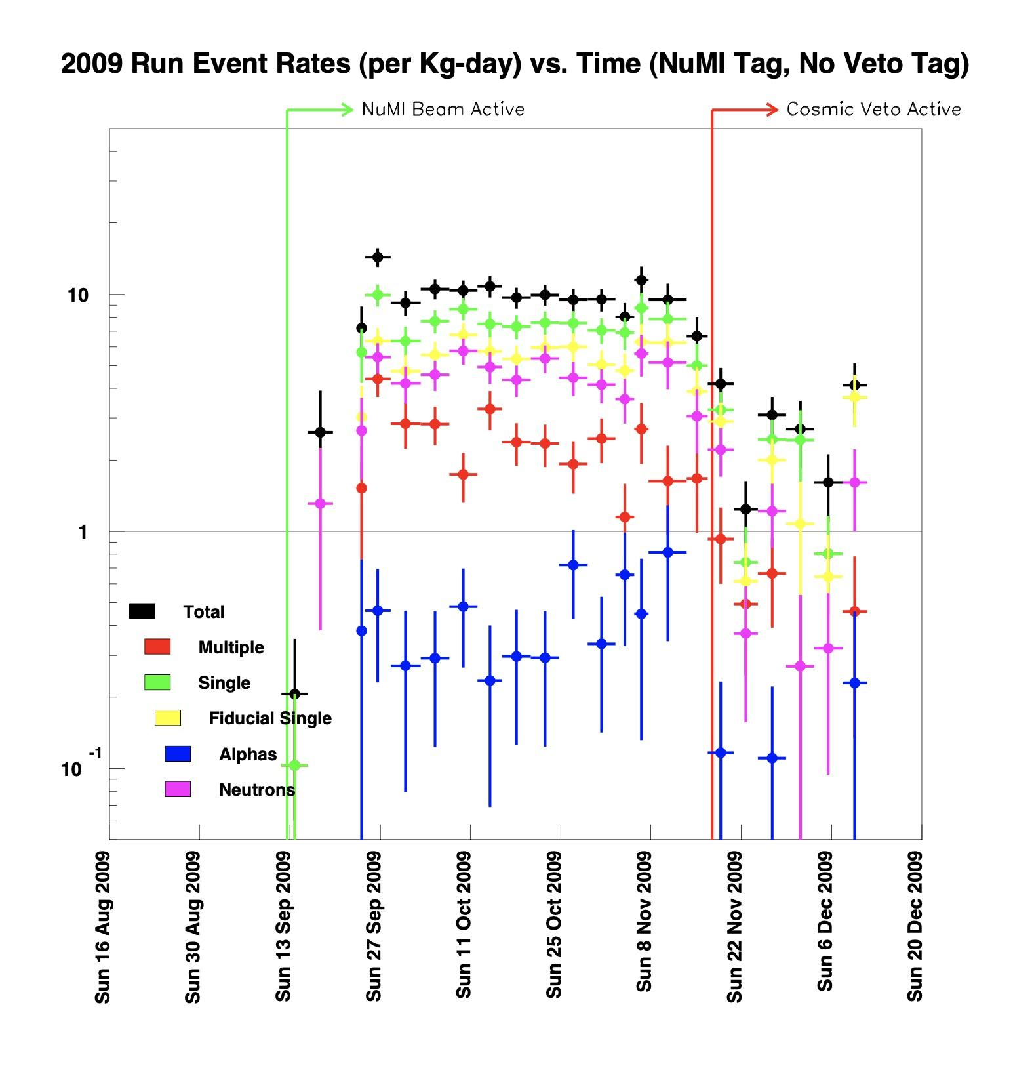
Backgrounds - Benchmarking
Use COUPP 2009 nuclear recoil data to benchmark the simulation
3.25 kg CF₃I, 19 keV threshold
COUPP (unpublished) measured 5.9 +/- 0.2 events/kg/day
Genie/GEANT predict 4.4 +/- 0.3 events/kg/day
Accurate to ~30%

Slide 25
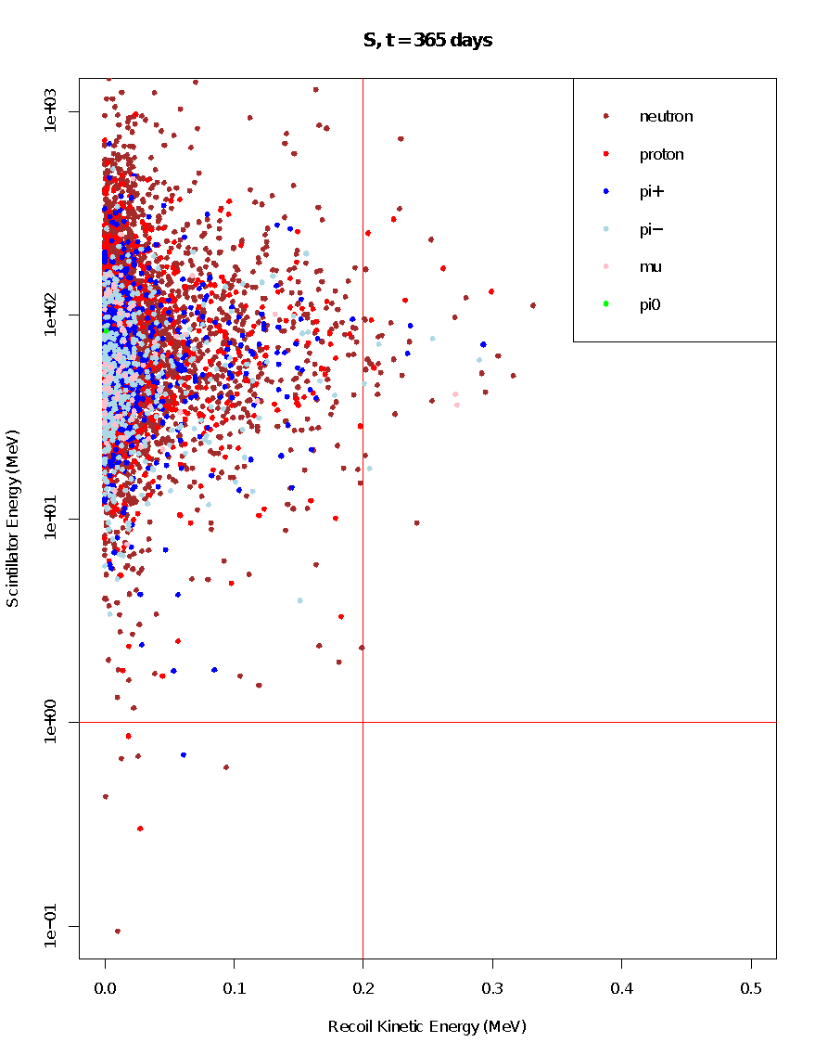
Backgrounds - Predictions
1 m³ 𝜈BDX-DRIFT detector filled with 400 Torr CS₂
0.16 +/- 0.02 events per day above 𝜈BDX-DRIFT thresholds (200 keV S, 123 keV C)
This rate can be significantly reduced by adding a Gd-loaded scintillator around the 𝜈BDX-DRIFT detector

Slide 26
BDX-DRIFT-1m Module
Readout
400 Torr CS₂
1 m
S recoil
(200 keV)
1 m
beam
Readout
Central cathode
Field cage

Slide 27
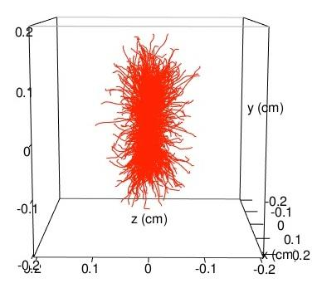
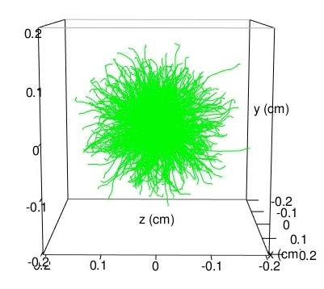
Directional Signal and Background
1,000 50 keV
signal events
1,000 50 keV background events
z
PRD, 99, 2019

Slide 28
Directional Signal vs Background
PRD, 99, 2019

Slide 29
Pulling signal from background
Number of signal events to 90% C.L. detection
Number of background events
PRD, 99, 2019

Slide 30
Conclusion
𝜈BDX-DRIFT brings a unique, proven, halo-dark-matter detector to CE𝜈NS research
A 10 m³ 𝜈BDX-DRIFT detector in the Near Detector hall in DUNE could detect 400 CE𝜈NS events in a 7-year run
Interesting new capabilities and complementarity for CE𝜈NS
Measurements of WMA and n distribution available
NSI, BSM and new physics
Backgrounds are expected to be minimal
In the near term we hope to deploy a 1 m³ 𝜈BDX-DRIFT prototype in the NuMI beam at Fermilab to test these ideas out

Slide 31
The End

