Slide 1

PMT Test Results
Gary Smith
gary.smith@ed.ac.uk
Watchman Collaboration Meeting
PMT Working Group
10th January 2019
08:00 HST (18:00 GMT)

Slide 2
CONTENTS
OPERATIONS
  Timeline
  Test Rig
  Procedure
RESULTS
  Gain Calibration Liz Kneale
  Gain Consistency Leon Pickard
  Peak To Valley Matt Needham
  Dark Rate Steve Quillin and Tom Shaw
  Afterpulsing Anthony Ezeribe
CONCLUSIONS
  Next Stage
  Summary

Slide 3
OPERATIONS

Slide 4
Timeline
July – Aug Set up test stand in Edinburgh and Sheffield
Aug - Sept Installation and commissioning at Boulby
Sept – Oct Initial testing and refinement of procedure
Oct 12th First official tests begin – run one
Nov 15th Both tents operational – eight PMTs per day max.
Nov 22nd Thanksgiving - all 101 PMTs tested at least once
Nov – Dec Underground testing of eight PMT sample
Tested PMTs Google Sheets

Slide 5
Boulby Shifts Breakdown
Institute # Shifts
AWE 35
Davis 15
Edinburgh 39
Livermore 9
Liverpool 10
Sheffield 49
A BIG thank you to all shift takers!

Slide 6
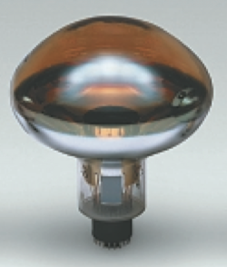
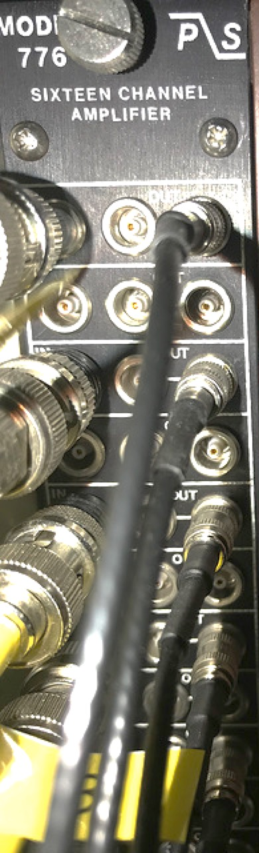
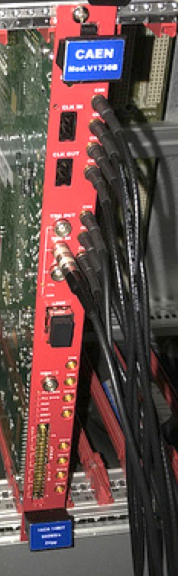
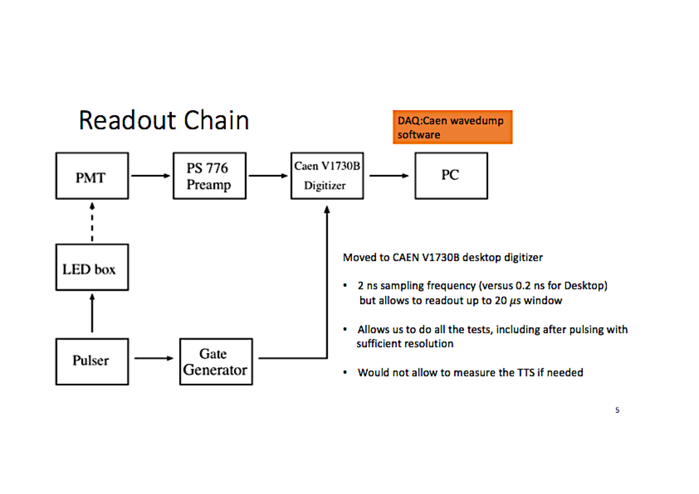
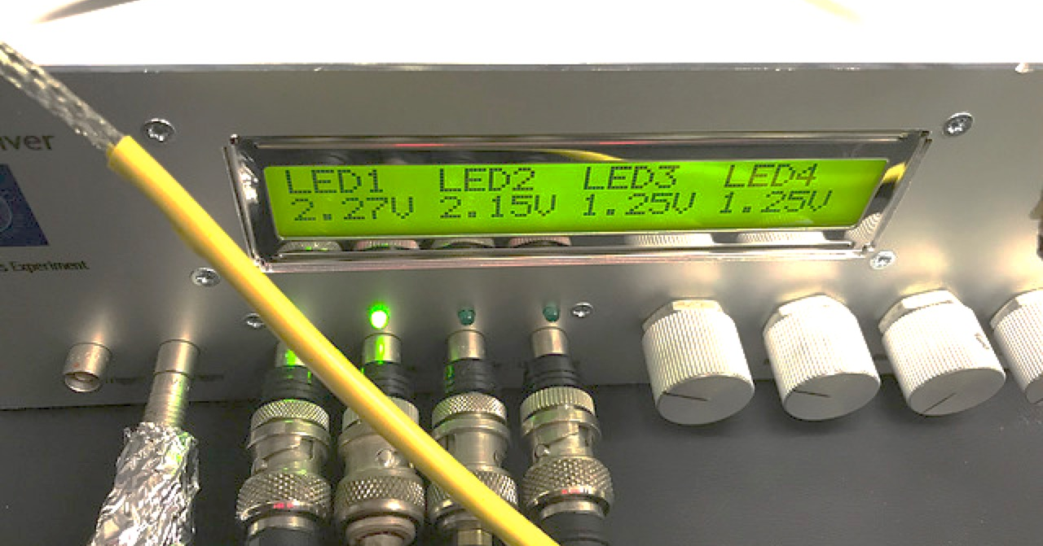
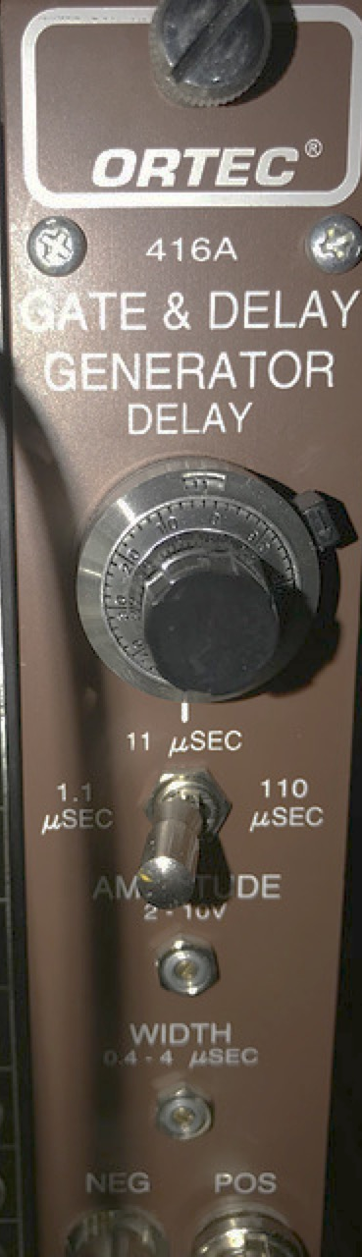
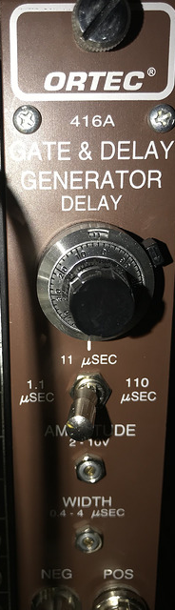
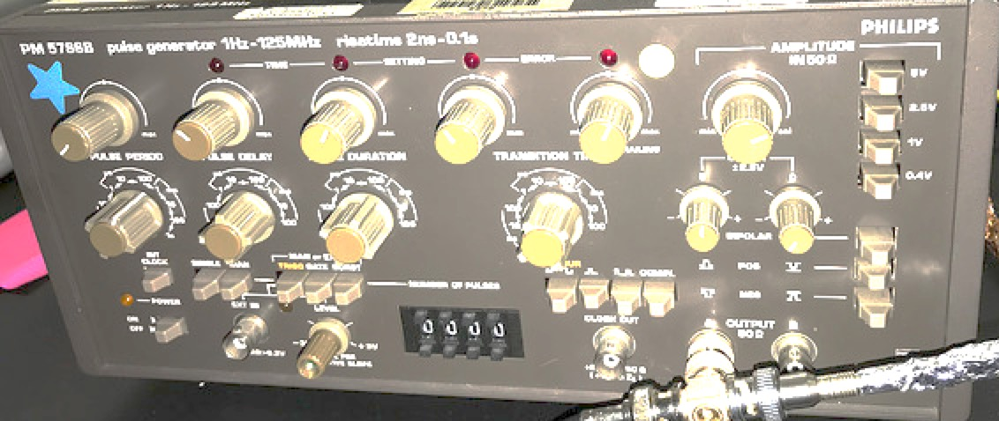
Boulby Test Rig
PS 776
10 x
Amp.
CAEN V1730B
2 ns sampling (0.5 GHz)
Up to 20 us readout
R7081
10 inch PMT
Edinburgh LED driver
Phillips PM 5786B
Pulse Generator
~10 kHz
Ortec 416 A
Gate generator

Slide 7
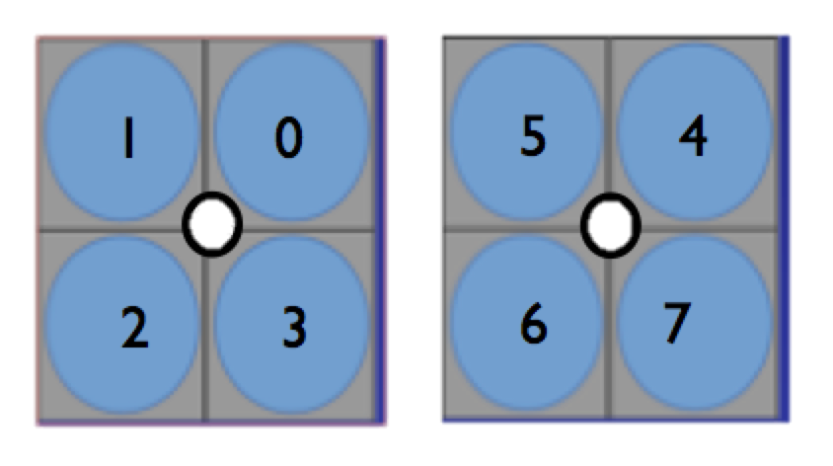
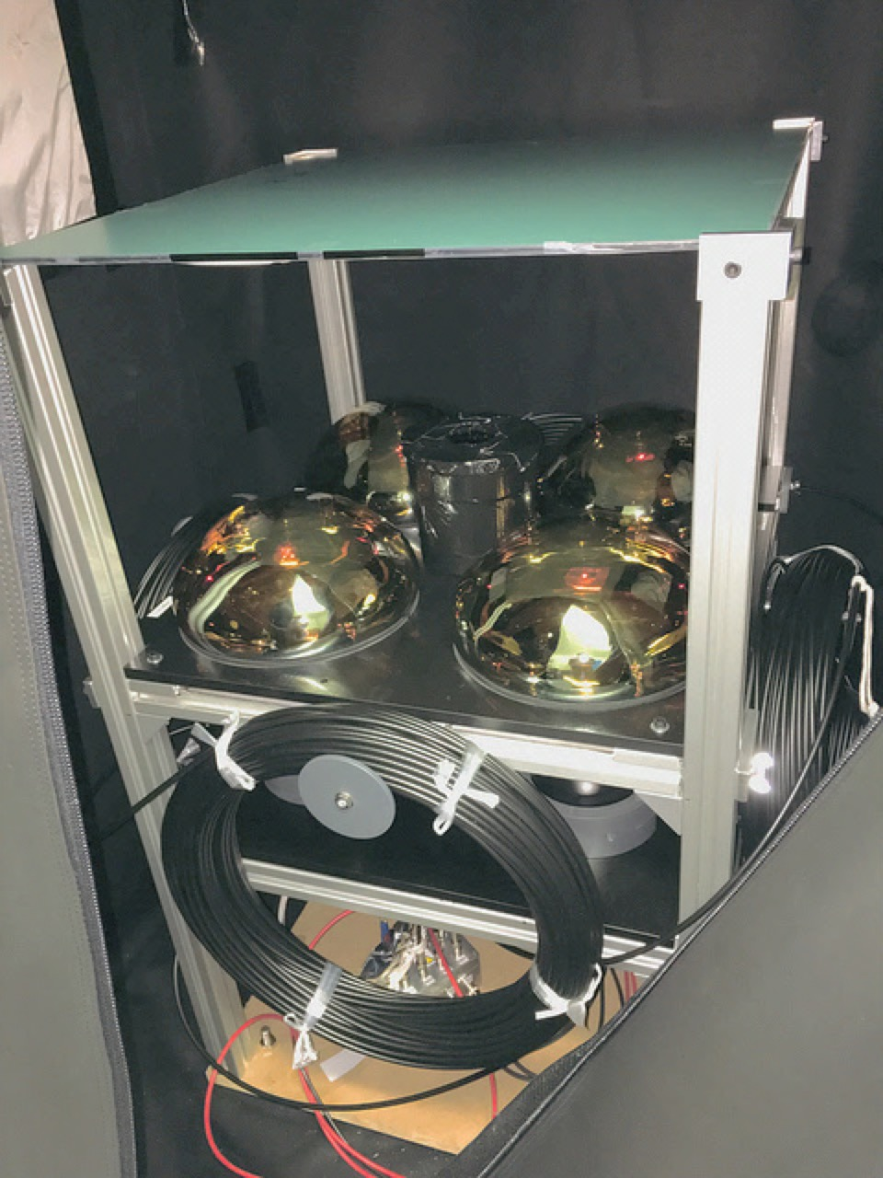
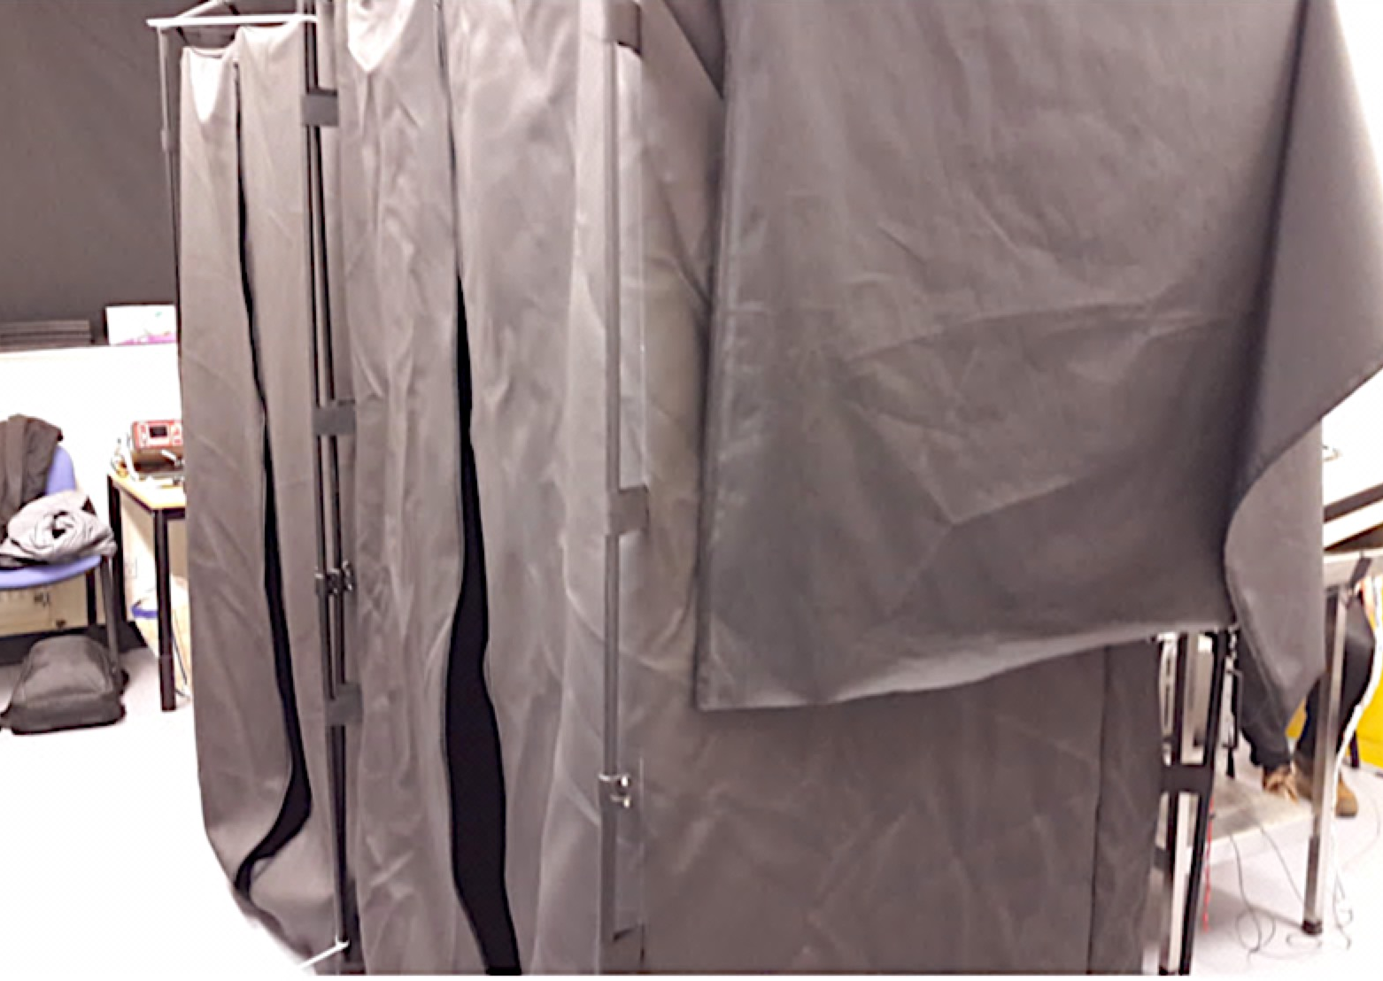
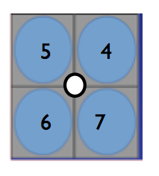
Boulby Test Rig
PMT positions
Square mirror /attenuator
Single optical fiber under central ND filter
Four PMTs
Tent B
Custom mechanical support structure (1/2)
The mechanical structures were located inside mobile photographers dark tents within a dedicated lab room. Image above shows Tent A (B) at back left (front right).
PMT positions

Slide 8
Data Taking Procedure
Afternoon Load next set of PMTs and ramp to nominal HV
Other tasks: PMT cable crimping, software development,…
Next morning Testing begins - follow operating instructions guide
Main data taking steps shown in table below
Periodic checks (data volume, charge spectra) and e-log entries
Meta-data recorded in Tested PMTs Google sheets:
  PMT serial numbers, HV current, ambient temp, …
Operations meeting conference call held daily
 | Test | Events (M) | Time (min) | Gate (ns) | Volume (G)
1 | Nominal HV | 3.0 | 5 | 220 | 0.7
2 | Gain – 5 HV steps | 3.0 x 5 | 25 | 220 | 3.5
3 | Operating HV | 3.0 | 5 | 220 | 0.7
4 | Afterpulsing | 0.5 | 15 | 10200 | 3.0
5 | Dark Rate | 9.0 | 15 | 220 | 2.1

Slide 9
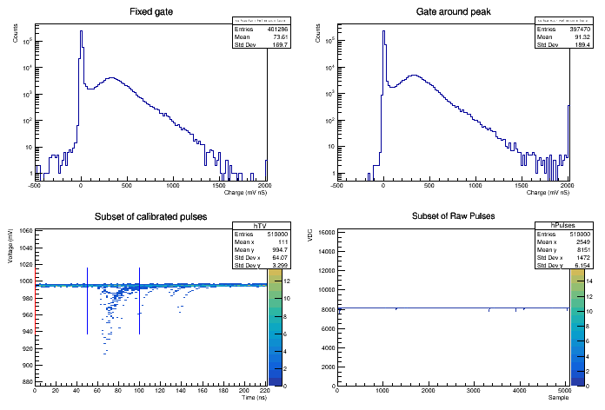
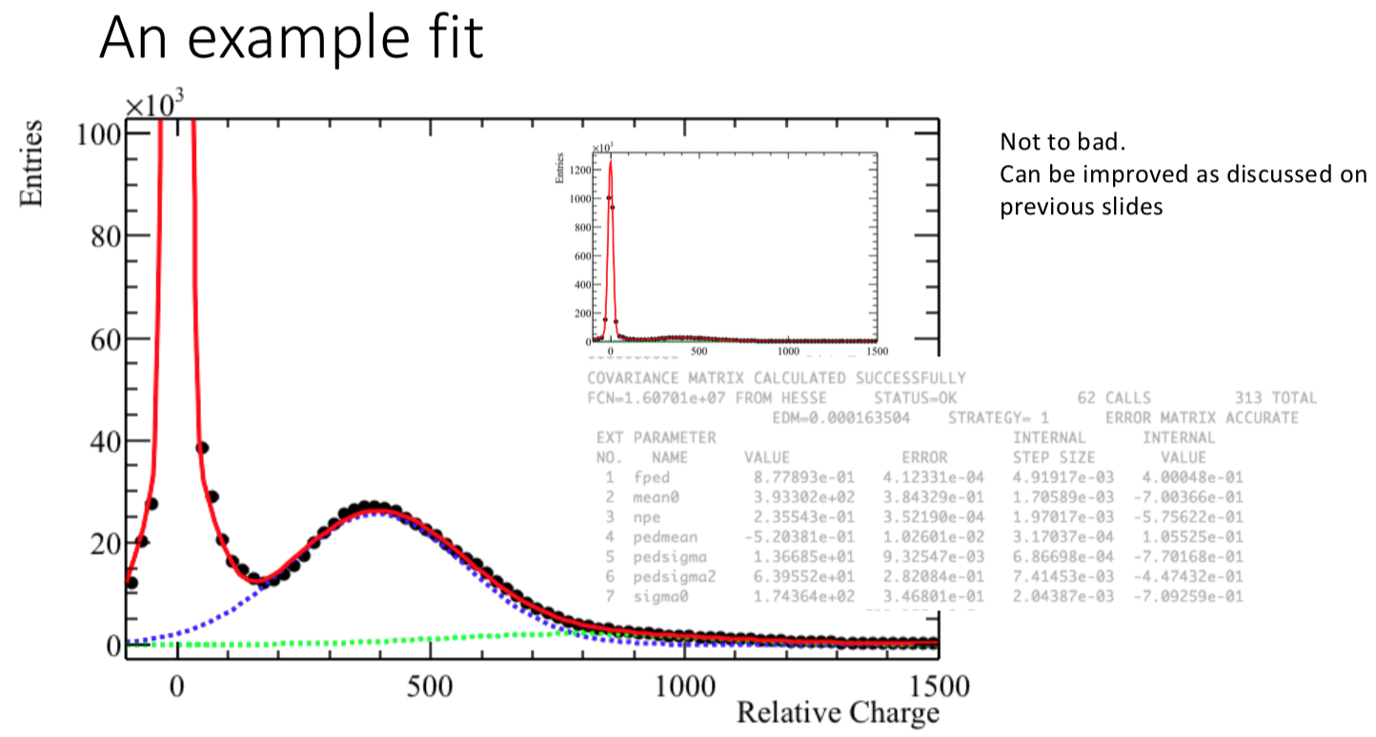
Common Software Tools
Fixed window charge histograms
  Gain Calibration
  Peak to Valley
  Full Spectrum Fit
Peak to valley fitting routine
  Peak to valley results
  Gain calibration and consistency results
In progress
  Full fit working and ready to utilise
  Common analysis framework skeleton on Github
baseline
signal
late and/or afterpulsing
Calibrated waveforms sample
showing example fixed windows
Full fit to charge spectrum example
npe = 0.2

Slide 10
RESULTS

Slide 11


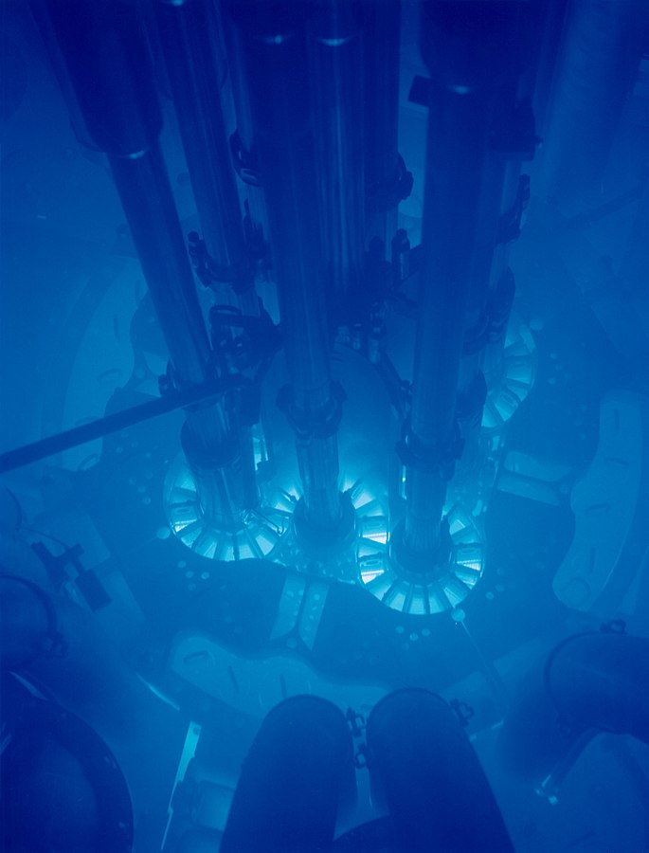
PMT gain analysis
Gain Calibration
Liz Kneale

Slide 12
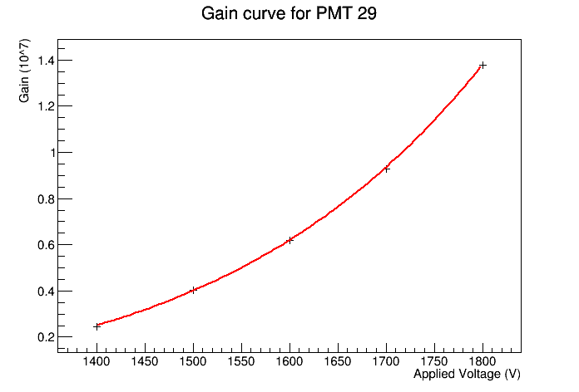
Gain Calibration
Procedure
Record SPE spectrum at 5 HV settings
100 V intervals around operating voltage
Find SPE peak - three methods studied
  Maxima in fixed ranges above pedestal
  TSpectrum – use second peak
  TSpectrum then Gaussian from peak to valley fit
Determine HV for10⁷ Gain
Fit TGraph with power law
Gain calculated relative to the charge of the electron
R = 50 Ohms, electronics gain = 10 / 2 = 5
Gain = 10⁷ for Q = 400 mV ns (or 8 pC)
Power law
fit example

Slide 13
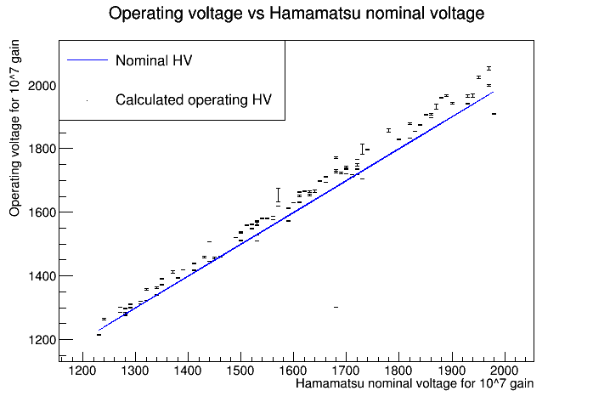
Gain Calibration
Results
Good agreement with Hamamatsu shipping data
Some workarounds required to include all data due to
spectra with more than two peaks
TSpectrum finding fake peaks
No clear peak for some low HV steps
Areas which can developed further are understood

Slide 14

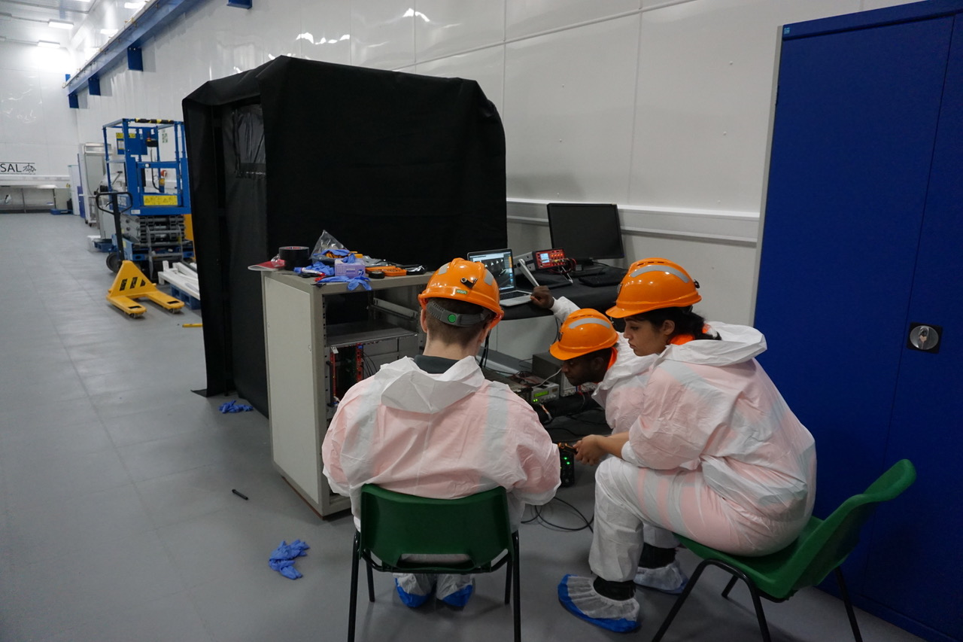
Gain Consistency
Leon Pickard
UC Davis

Slide 15

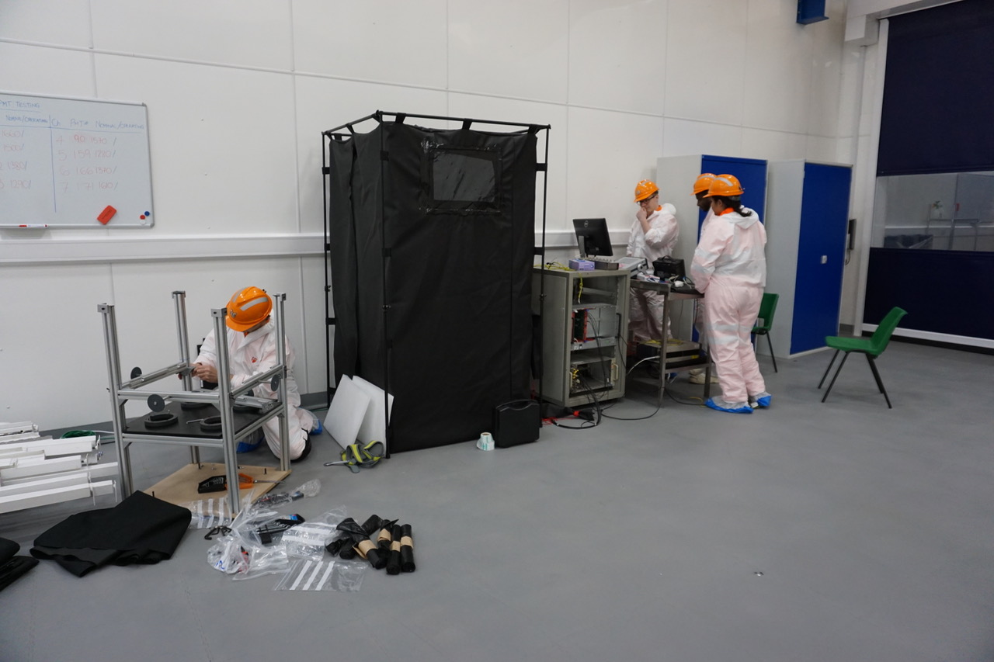
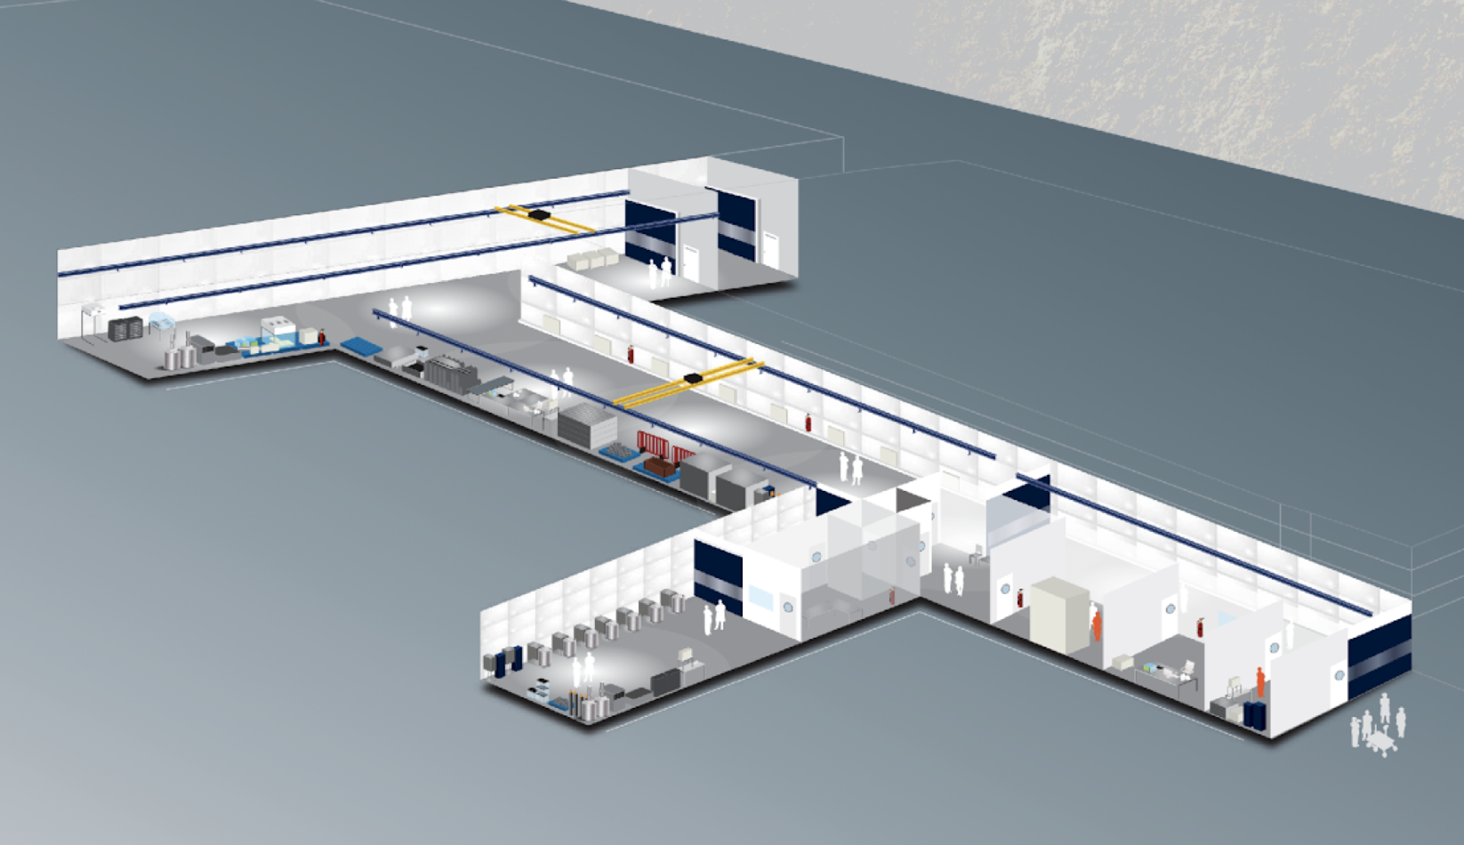
Shipping Underground
Eight PMTs were transported in two sealed skips (temporary PMT shipping solution)
Other equipment was transported in a third open skip
Timeline
November
22nd, (23rd) surface testing - batch one (two)
  26th shipped underground in afternoon
  27th arrived underground in morning
  29th, (30th) underground testing – batch one (two)
  December
  4th shipped to surface
  6th,(7th) surface testing = batch one (two)
Testing location. Furthest away from possible light sources (e.g. communal room)

Slide 16
Surface & Underground Conditions
 | Surface | Underground
Temp. range (°C) | 20 – 24 | 23 – 24
Light exposure | PMT testing room in darkness. | Lab in darkness overnight. Testing carried out remotely (dark rate test done locally)
Time of tests | 9 am – 5 pm | 5 am – 10 am
Average Magnetic field (μT) | 45 | 49
Vertical / Horizontal field (μT) | 42 / 16 | 45 / 19
Cosmics rate | 2 ×10⁻² cm⁻²s⁻¹ | 4 ×10⁻⁸ cm⁻²s⁻¹

Slide 17

Gain Calibration Repeatability
Measured operating voltages consistent over runs (HV for Gain 10⁷)
The largest range only 9V (PMT #171)
No discrepancy observed between the underground (UG) and the surface runs.
The fit uncertainties were also consistent over all run periods – all below 1V
Operating voltages consistent under repeat testing!

Slide 18

Peak to Valley
Matthew Needham

Slide 19
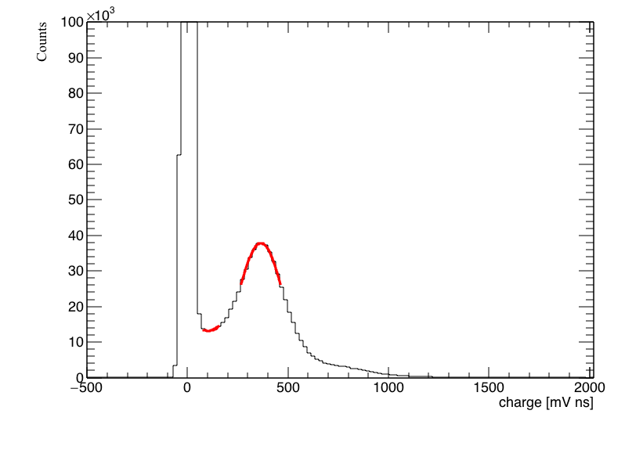
Procedure
TSpectrum to identify pedestal and SPE peak
Gaussian fit around SPE using TSpectrum result
repeat fitting with range adjusted to maximum
Parabola fit to valley using TSpectrum result
repeat fitting with range adjusted to found minima
Peak to valley calculated from fit parameters
Charge histograms with window around peak gave slightly larger ratio (~ 0.2)
Peak to valley uncertainty from fit ~0.01
Gaussian fit
Parabola fit
Results reproducible at 0.01-0.02 level

Slide 20
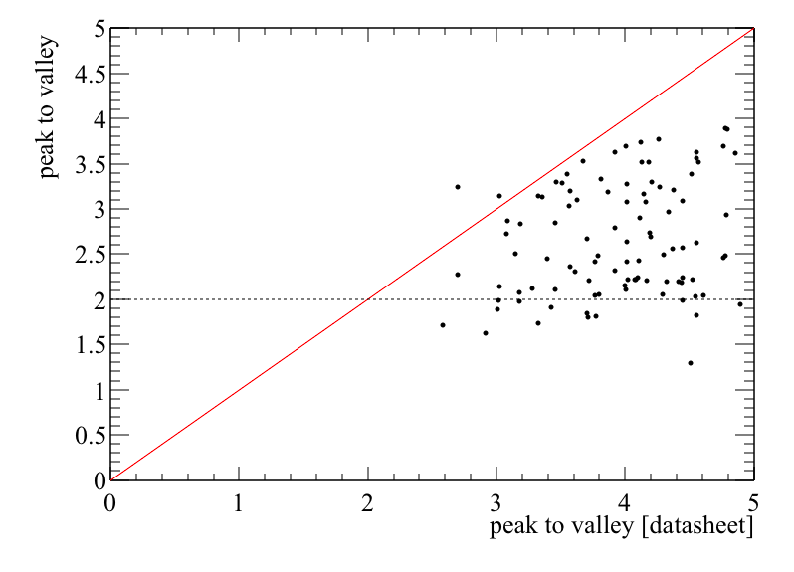
Results
Our results are clearly correlated with those from Hamamatsu ☺
Most tubes measuring slightly smaller peak-to-valley ☹
Peak-to-valley mostly above 2 though
Double Chooz report higher ratios when using u-metal shield
[ C. Bauer et al. 2011]

Slide 21
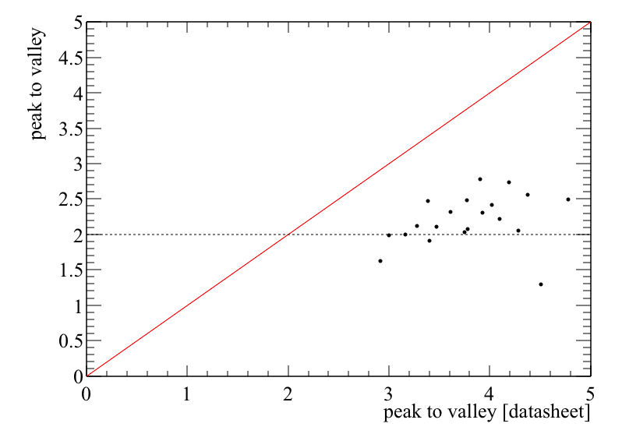
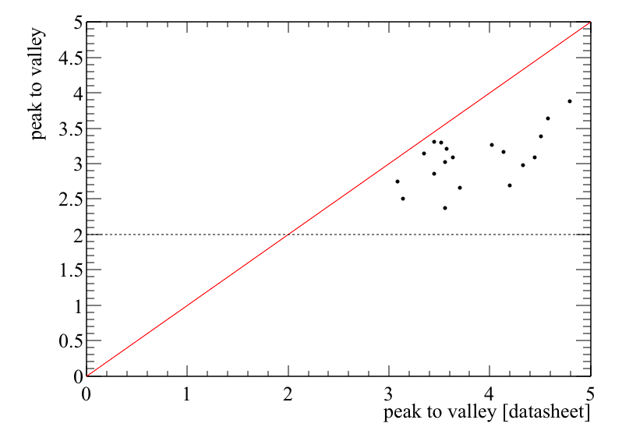
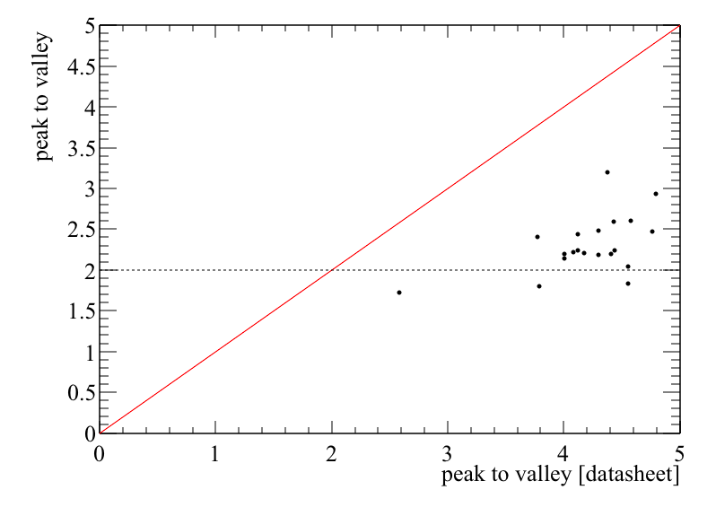
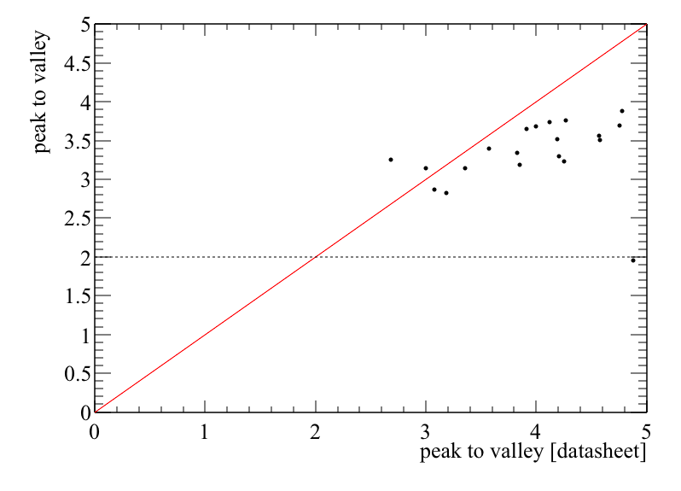
Results
Data divided according to position in Rig A
Position 1
Position 0
Could differences lower ratios be down to position in the rig ?
Related to noise?
Bad
Good
Position 2
Position 3
Bad
Good

Slide 22
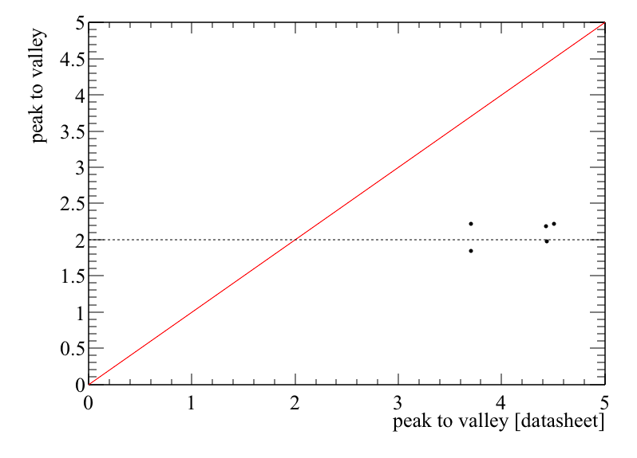



Results
Data divided according to position in Rig B
Position 5
Position 4
Twenty PMTs were tested in the second rig (tent B) during run one
80 were tested in rig A
Bad
Good
Position 6
Position 7
Bad
Good

Slide 23

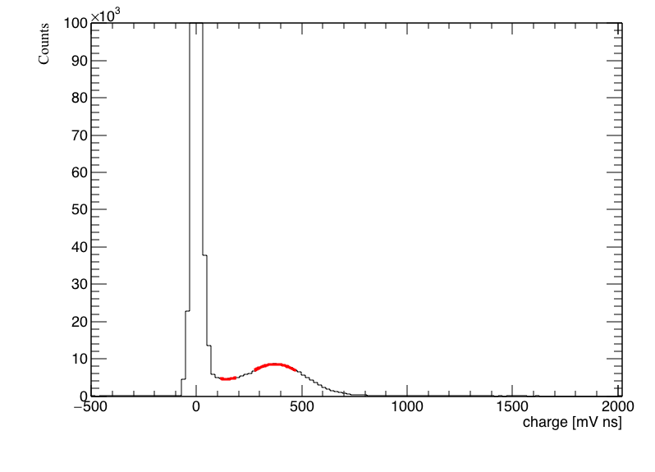
Visible differences
PMT 42 in location 3
PMT 32 in location 6
Do results hint at noise or illumination playing a role ?

Slide 24
Surface and Underground
PMT ID | Surface test 1 | Underground | Surface test 2
130 | 3.9 | 4.4 | 3.8
131 | 2.5 | 3.2 | 2.4
132 | 2.2 | 3.1 | 2.3
133 | 3.3 | 3.0 | 3.3
90 | 2.9 | 3.6 | 2.8
159 | 2.4 | 3.2 | 2.3
166 | 2.5 | 3.4 | 2.5
171 | 3.5 | 3.5 | 3.6
PMTs appear to perform better underground
Could this be due to a less noisy environment?

Slide 25
Peak To Valley
Summary
Fits were successful for all PMT data
Surface results are similar before and after transit
Higher ratios for underground results not prescribed to underground specific conditions
Good comparison to Hamamatsu shipping data found for certain rig positions
Further investigations into consistency of grounding, illumination and background noise required

Slide 26
Dark Rate
Steve Quillin
Tom Shaw

Slide 27
Dark Rate
Count events above SPE threshold
Fixed: ADC = 630
Calculated: Ped+(SPE-Ped)/2
Manually determined
The fixed threshold method is comparable to Double Chooz (10 mV threshold)
Baseline noise and offsets motivated studying a second method
clean spectrum
(PMT 84)
Example of pulse peak histogram
(peak of voltage pulse in arbitrary units)

Slide 28
Dark Rate
Count events above SPE threshold
Fixed: ADC = 630
Calculated: Ped+(SPE-Ped)/2
Manually determined
The fixed threshold method is comparable to Double Chooz (10 mV threshold)
Baseline noise and offsets motivated studying a second method
A third manual threshold method was used to allow outliers to be included
noisy spectrum
(PMT 1)
Example of pulse peak histogram
(peak of voltage pulse in arbitrary units)

Slide 29
Dark Rate
Tested vs Hamamatsu dark rate using manual threshold method
 | mean | std dev
Shipping Data | 3044 | 1763
Manual Threshold | 2489 | 1172
Double Chooz | 2200 | 500

Slide 30
Dark Rate
Comparison of dark rates for surface and underground testing
The fixed threshold method used for these results
Need to investigate noise and baseline
Run ID
underground

Slide 31
Afterpulsing
Anthony C. Ezeribe

Slide 32
Types of Afterpulsing
Two categories of Afterpulsing
photoelectron in-elastically scatters off PMT dynode - afterpulse arrives up to 80 ns after signal pulse
positive ion is created in PMT residual gas - afterpulse arrives between 100 ns and 10.2 us after signal (delay can also be larger)
Late pulsing is caused by elastic scattering of electron off first dynode: not preceded by a initial pulse.
Aim to measure rates and multiplicities

Slide 33
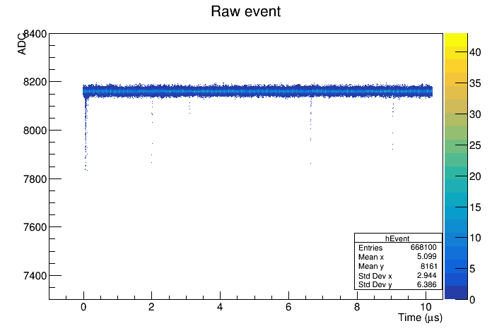
Afterpulsing Examples
PMT: 131
3.1 us
9.0 us
Main Signal

Slide 34
CONCLUSIONS

Slide 35
Next Stages
The first pass analysis was carried out over the Christmas period
More time is required to digest and refine the results
Some areas clearly need attention
  detailed understanding of noise
  relationship between figures of merit and light levels
  contribution of fields to noise and performance
After-pulsing analysis is underway
Further data analysis and testing is necessary
Documentation of analysis and results to come

Slide 36
Summary
PMT testing was a real success
Data was acquired for101 PMTs by thanksgiving
A sample of 8 PMTs underwent testing underground
Comparisons to Hamamatsu shipping data look good
There are clear pathways forward to improve methods and automation towards large scale testing
Great collaboration to work in!

Slide 37
Thanks!
Gary Smith
gary.smith@ed.ac.uk

