Slide 1
The Search for Neutrino-less Double Beta Decay in High-Pressure ¹³⁶Xe Gas
David Nygren
Department of Physics
University of Texas at Arlington

Slide 2
Or:
The Matter – Antimatter
Asymmetry of the Universe:
Why is there something, rather than nothing?
David Nygren
Department of Physics
University of Texas at Arlington

Slide 3
Or:
How we hope to learn something about the first 10^{—36} second of the Universe by exploiting a biochemistry technique to search for a rare nuclear decay with an expected lifetime a trillion times the age of the universe to determine if the neutrino is its own anti-particle, which would support the notion that heavy right-handed neutrinos exist that broke the matter-anti-matter asymmetry

Slide 4
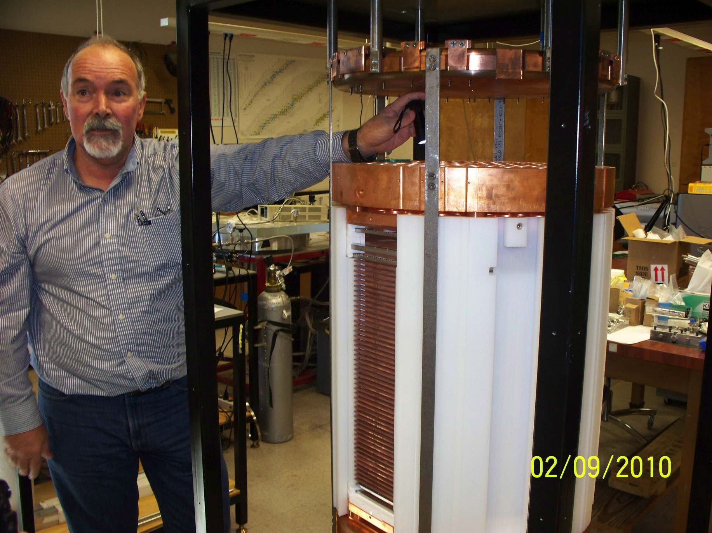
James White, TAMU, 1953 - 2013

Slide 5
Menu
Matter-Antimatter asymmetry ?
Double beta-decay
Sensitivity and the Curse of Backgrounds!
NEXT-White, and beyond…
¹³⁶Xe and its daughter: barium
A new way to detect the birth of barium?

Slide 6
Cosmology
Universe must begin in a symmetric state
  N_{particles} = N_{anti-particles}
  Particles and anti-particles are in equilibrium between annihilation and creation – at first…
  but when cool enough,
  Almost all particles & antiparticles annihilate
  leading to a bath of photons and neutrinos
  Energies stretched away by expansion of space
    ~2.7° K for photons, less for neutrinos
Notes:
Question is more aptly phrased this way
First of three Sakharov conditions

Slide 7
Cosmology
  Eventually,
  the ratio of surviving particles N_{B} plus surviving antiparticles N_{B*} becomes tiny:
  (N_{B} +N_{B*}) /N_{γ+v} ≈ 10⁻¹⁹
  N_{γ+v} is roughly the number of particles + antiparticles
Notes:
This is what the Concordance Model of Cosmology predicts

Slide 8
The Universe is not symmetric!
  Measured ratio: N_{B}/N_{γ+v} = 6 x 10⁻¹⁰
  N_{B*} ≈ 0
  So the prediction that (N_{B} +N_{B*}) /N_{γ+v} ≈ 10⁻¹⁹
is wrong, by ~ 10⁹
This is a problem!
Notes:
no significant anti-matter anywhere

Slide 9
The Universe is not symmetric!
  Measured ratio: N_{B}/N_{γ} = 6 x 10⁻¹⁰
  N_{B*} ≈ 0
  So the prediction that (N_{B} +N_{B*}) /N_{γ} ≈ 10⁻¹⁹
is wrong, by ~ 10⁹
This is a problem!
Notes:
no significant anti-matter anywhere

Slide 10
Big Bang Cosmology
Sakharov conditions:
  Universe must begin in a symmetric state (CPT)
  Both C and CP violation occur in some process
  Evolution of universe stays out of equilibrium long enough to establish a remnant asymmetry on matter/antimatter abundance

Slide 11
Leptogenesis
  Assumes heavy right-handed neutrinos ~10¹² GeV
  These neutrinos satisfy Sakharov conditions
  C & CP breaking → leptonic asymmetry
  Leptonic asymmetry → baryon asymmetry
  Heavy right-handed neutrinos leave imprint on:
    universe
    neutrinos
Notes:
Satisfy Sakharov conditions for generating asymmetry: Initial Even → odd, C, CP, B-L violation, out of equilibrium → leaves fingerprint on universe
Theoretical turbulence still exists about washout.

Slide 12
Leptogenesis
  Assumes heavy right-handed neutrinos ~10¹² GeV
  These neutrinos satisfy Sakharov conditions
  C & CP breaking → leptonic asymmetry
  Leptonic asymmetry → baryon asymmetry
  Heavy right-handed neutrinos leave imprint on:
    universe
    neutrinos
Notes:
Satisfy Sakharov conditions for generating asymmetry: Initial Even → odd, C, CP, B-L violation, out of equilibrium → leaves fingerprint on universe
Theoretical turbulence still exists about washout.

Slide 13
Leptogenesis
  Forces neutrinos to be Majorana particles
    Majorana: particle and anti-particle are identical
    Neither “matter” nor “antimatter”
    Forces neutrinos to have a Majorana mass term
    Among fermions, only neutrinos could be Majorana
Notes:
Majorana particles: heavy neutrinos introduce a mass term
Why is the neutrino mass so small? electron mass 10,000,000 times larger

Slide 14
Leptogenesis
  Forces neutrinos to be Majorana particles
    Majorana: particle and anti-particle are identical
    Neither “matter” nor “antimatter”
    Forces neutrinos to have a Majorana mass term
    Among fermions, only neutrinos could be Majorana
  Predicts: n_{B}/n_{γ} ≈ 6 x 10⁻¹⁰
    Prediction ≈ measured √
  Predicts: m_{ν} ≈ a few 10’s of meV (see-saw: m²/M)
    Oscillations indicate m_{ν} ≈ 50 meV √
Notes:
Majorana particles: heavy neutrinos introduce a mass term
Why is the neutrino mass so small? electron mass 10,000,000 times larger

Slide 15
Leptogenesis
  A very appealing theoretical mechanism
  Neutrinos have a Majorana mass
  Neutrinos have a mass ≈ 50 meV
Notes:
Majorana particles: heavy neutrinos introduce a mass term (via see-saw mechanism)
Oscillations: reactors, solar, cosmic rays, accelerators,
Why is the neutrino mass so small? electron mass 10,000,000 times larger

Slide 16
Leptogenesis
  A very appealing theoretical mechanism
  Neutrinos have a Majorana mass
  Neutrinos have a mass ≈ 50 meV
    → Lepton number is not conserved !
    → Neutrinoless double beta decay !
Notes:
Majorana particles: heavy neutrinos introduce a mass term (via see-saw mechanism)
Oscillations: reactors, solar, cosmic rays, accelerators,
Why is the neutrino mass so small? electron mass 10,000,000 times larger

Slide 17
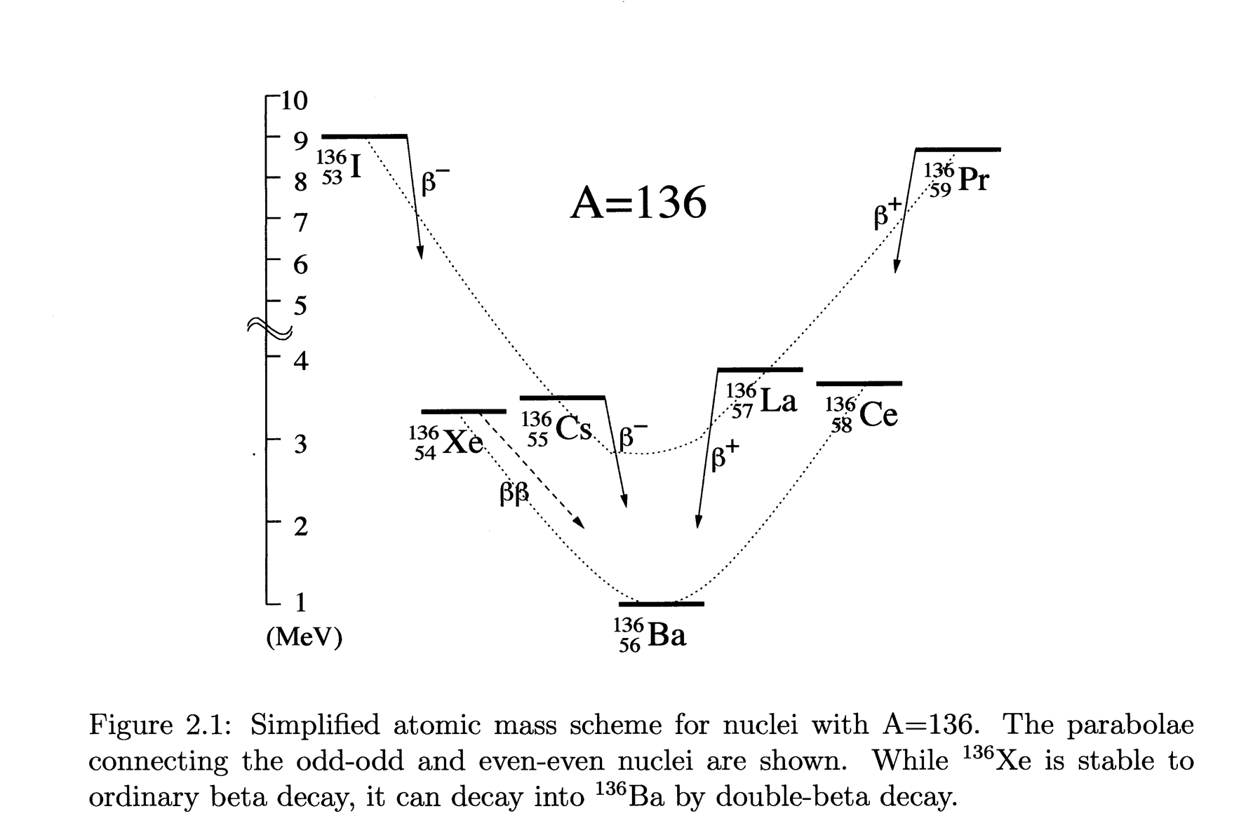
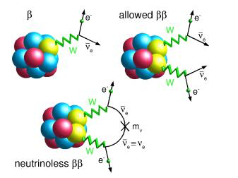
Double-Beta Decay
  An extremely rare radioactive process, energetically allowed for some even-even nuclei where m_{Z+1} > m_{Z} > m_{Z+2}
(Z,A) → (Z+2,A) + e⁻₁ + ν₁ + e⁻₂ + ν₂
Notes:
Parabolae connect odd-odd and even-even nuclei are shown; pairing energy lifts odd-even above even-even Z – N;
Calculation of matrix elements have to include contributions of all virtual intermediate excited states.

Slide 18
Neutrino-less Double-Beta Decay
Predicted in 1934
Discovered in 1987, in ⁸²Se
Observed in several isotopes since:
Violates lepton number; not observed yet
Phase space
factor
Nuclear matrix element
Majorana mass
Notes:
wrong helicity if neutrino is massless – can transform to opposite helicity state if non-zero mass
We already know neutrino mass is non-zero from oscillation experiments.
A factor of ten in mbb → a factor of one hundred in lifetime
Background-free experiment: mbb → t^1/2

Slide 19
Experiment: – the ideal result
Only
2-v decays
Only
0-v decays
Rate
No backgrounds above Q-value
0
Σ visible Energy
Q-value
The ideal result is a spectrum of all ββ events, with a 0-ν signal present as a narrow peak, well-separated from 2-ν tail.
Notes:
the 2-nu spectrum reaches Q, and can invade the 0-nu peak ROI if energy resolution is insufficient!

Slide 20
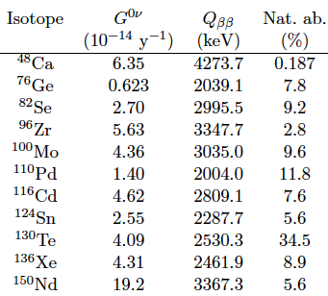
Some attractive candidate isotopes
G factor ≈ Q⁵ → higher Q is better.
Q-values above the most troublesome
γ-ray energies
²¹⁴Bi (2447 keV) and ²⁰⁸Tl (2615 keV) are more attractive, due to less background in the energy ROI
Notes:
need to avoid bismuth and Thallium gamma rays at 2447 keV, 2615 keV

Slide 21
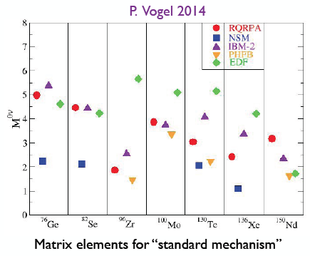
Nuclear Matrix Elements
Notes:
EDF= energy density functional method

Slide 22
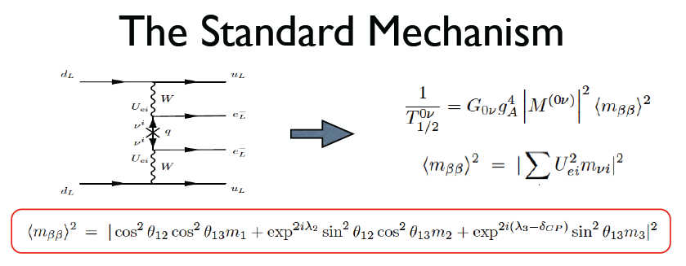
Majorana Mass
We don’t know the phases δ_{CP} and λ_{2,3}
or the absolute values of the masses
Notes:
unknown phases introduce a range for mbb, even if we know theta angles

Slide 23
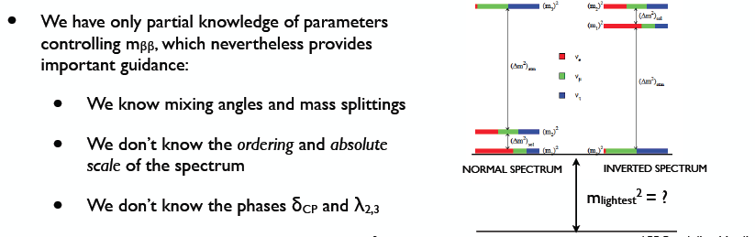
More known unknowns
Slide: Cirigliano & Wilkerson, NLDBD LRP meeting April 2015

Slide 24
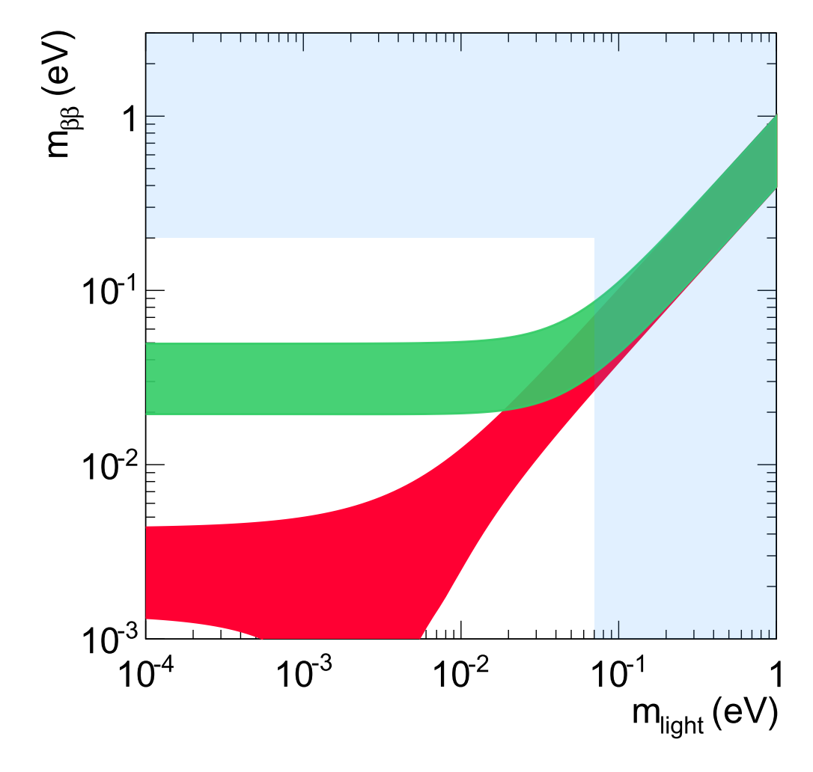
The Quest
Prediction uncertainty due to unknown neutrino parameters
Kamland Zen limit
Uncertainty on the limit due to NMEs
Green:
Prediction under inverted mass ordering
Red:
Prediction under normal mass ordering
cosmology
Notes:
Clearly, not for the faint-hearted!

Slide 25
The Quest
What would a perfect experiment look like?
1.5 ton yr of ¹⁵⁰Nd, ¹³⁰Te, or ⁸²Se
or
2 ton yr of ¹³⁶Xe
or
3 ton yr of ⁷⁶Ge
WITH ZERO BACKGROUND
cosmology
Given worst case NMEs

Slide 26
Experiment: the ideal result
Only
2-v decays
Only
0-v decays
Rate
No backgrounds above Q-value
0
Σ visible Energy
Q-value
How do real experiments differ from the ideal case?
Notes:
the 2-nu spectrum reaches Q, and can invade the 0-nu peak ROI if energy resolution is insufficient!

Slide 27
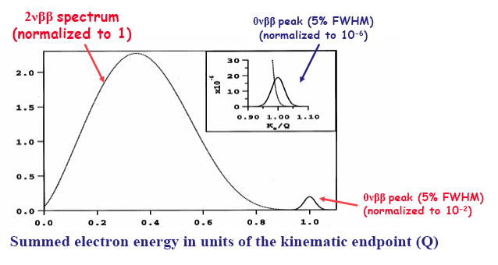
Energy resolution is essential to avoid 2v background !
Not yet sufficient to reject backgrounds!
Notes:
Take-away: energy resolution not worse than 1% FWHM seems prudent; at 2% FWHM, no safety margin for non-gaussian effects.

Slide 28
Energy resolution to prevent overlap: δE/E < 2% FWHM
Not yet sufficient to reject backgrounds!
Background index b:
counts/keV-ton-year
B = b x energy ROI
Notes:
Take-away: energy resolution not worse than 1% FWHM seems prudent; at 2% FWHM, no safety margin for non-gaussian effects.

Slide 29
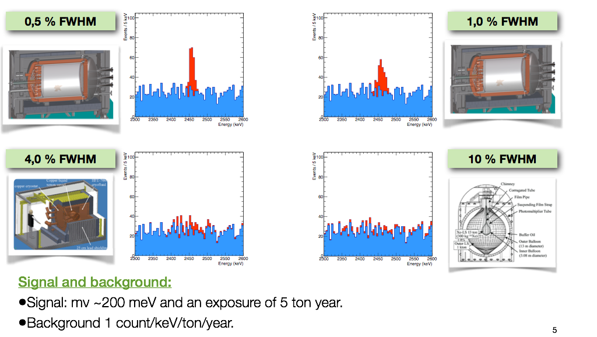
Importance of energy resolution – when backgrounds are present

Slide 30
If background is present:
b = background cts/keV
ΔE = Energy ROI
M = active isotopic mass
t_{live} = graduate students
Significant Background → brick wall !

Slide 31
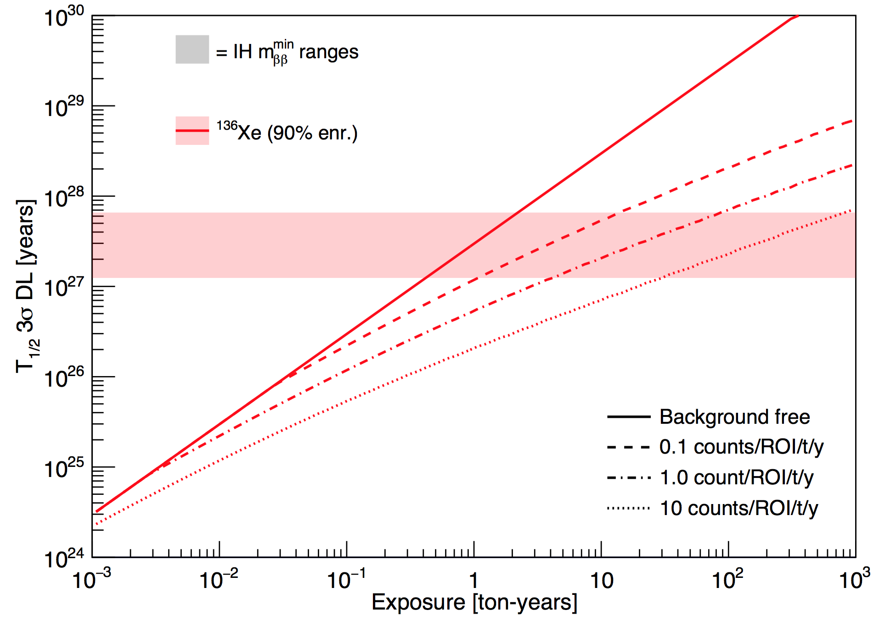
Ultimately, a ton-scale experiment with excellent background rejection (<1 ct ton yr) is the key to crossing the IH in finite time.
Run for 2-3 years
Inverted Heirachy
Run for 15 years
Run for 100 years
Run for 1000 years
1000 kg experiment

Slide 32
The NSAC goal:
http://science.energy.gov/~/media/np/nsac/pdf/docs/2016/NLDBD_Report_2015_Final_Nov18.pdf
“In addition, it seems that at least for several of the methods this goal translates into a roughly common goal for background in the range of 0.1 counts per ton of isotope per year in the region of interest (ROI). The subcommittee generally agrees with this approach to projecting the goals of future experiments and would like to see this trend continue. Indeed, achievement of this rate of background in the next generation experiment seems like a desirable goal for the near-term R&D program.”

Slide 33
Background characterization
    b = counts /(keV-ton-year)
    ΔE = width of energy Region of Interest (keV)
  We need bΔE < 0.1 cty – this is not easy! *
  How can such low backgrounds be demonstrated?
  Easy: take 1kg, count for 100,000 years!
Notes:
Take one kg of your detector, put in a well-counter, and count for 10,000 years!

Slide 34
Background characterization
    b = counts /(keV-ton-year)
    ΔE = width of energy region of interest (keV)
  We need bΔE < 0.1 cty – this is not easy! *
  How can such low backgrounds be demonstrated?
  Easy: take 1kg, count for 100,000 years!
Notes:
Take one kg of your detector, put in a well-counter, and count for 10,000 years!

Slide 35
Nature of the neutrino ?
Majorana or not Majorana – one of the six central questions of HEP a few years back
Then, suddenly, it disappeared!
Where did it go? Who stole it?
Answer: DOE HEP traded it to DOE NP, while DOE NP traded Dark Matter (WIMP) to HEP
Actually, this is not bureaucratic deviousness.

Slide 36
Nature of the neutrino ?
Majorana or not Majorana – one of the six central questions of HEP a few years back
Then, suddenly, it disappeared!
Where did it go? Who stole it?
Answer: DOE HEP traded it to DOE NP, while DOE NP traded Dark Matter (WIMP) to HEP
Actually, this is not bureaucratic deviousness.*
Notes:
window of funding in NP, but not DOE

Slide 37
Nuclear Science Advisory Committee:
NSAC 2015 Long Range Plan:
“We recommend the timely development and deployment of a US-led ton-scale
neutrino-less double beta decay experiment”
Notes:
Why DOE NP? Maybe a slot will open soon for new major experimental enterprise in NP…
Phased approach is also permissible

Slide 38
Nuclear Science Advisory Committee:
NSAC 2015 Long Range Plan:
“We recommend the timely development and deployment of a US-led ton-scale
neutrino-less double beta decay experiment”
Where? When? Who ? How?How? Who?
Notes:
Why DOE NP? Maybe a slot will open soon for new major experimental enterprise in NP…
Phased approach is also permissible

Slide 39
Nuclear Science Advisory Committee:
NSAC 2015 Long Range Plan:
“We recommend the timely development and deployment of a US-led ton-scale
neutrino-less double beta decay experiment”
Where? When? Who ? How?How? Who?
Notes:
Why DOE NP? Maybe a slot will open soon for new major experimental enterprise in NP…
Phased approach is also permissible

Slide 40
Contenders!
KamLAND-ZEN – 800 kg ¹³⁶Xe in liquid scintillator
SNO+ – Te-loaded liquid scintillator (planning stage)
CANDLES – ⁴⁸Ca-loaded crystal scintillator
SuperNEMO – scintillators, tracking, and foils ⁸²Se source
GERDA – ⁷⁶Ge ionization signal → 200 kg LEGEND
Majorana – ⁷⁶Ge ionization signal → 200 kg LEGEND
CUORE → CUPID – bolometer – TeO → Scintillating bolometer
EXO → nEXO – ¹³⁶Xe LXe TPC 200 kg → 5 ton LXe TPC
LZ – 7 tons natural LXe TPC ( WIMP search)
NvDEX – HPSeF₆ TPC (pre-proposal stage)
PandaX-III – HPXe TPC (Jin Ping lab)
AXEL – HPXe TPC (R&D stage)
NEXT – XXX – HPXe TPC (advanced R&D stage)

Slide 42
NSAC goal

Slide 43
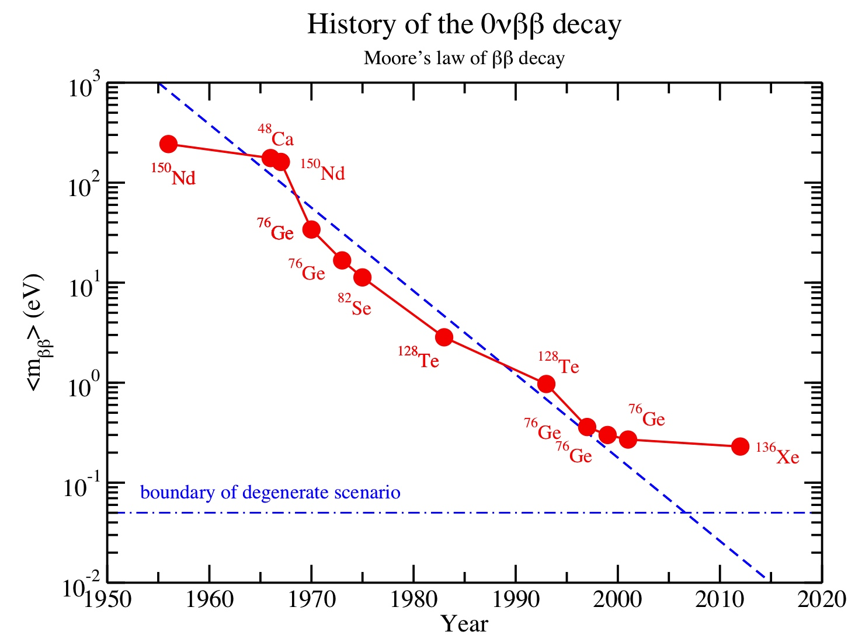
ββ trends (updated Elliott/Vogel plot by Vogel)
The Old Era
Historically, there are
> 100 experimental
limits on T_{1/2} of the
0νββ decay.
Here are the records
expressed as limits on
<m_{ββ}> using one set
of nuclear matrix
elements (RQRPA of
Simkovic et al. 2009.)
During the last decade
the complexity and
cost of experiments
has increased very
dramatically. The
slope constant is now
leveling off!
Heidlelberg-Moscow
Notes:
Take-away: Life has gotten tough, a new era: “too big and costly to fail, but maybe not good enough to succeed.”

Slide 44
Approaches to background rejection:
Superb energy resolution
Heroic radio-purity & shielding
Identification of two-electron topology
Identification of decay daughter:
Z → (Z+2)

Slide 45
Approaches to background rejection:
Superb energy resolution
Heroic radio-purity & shielding
Identification of two-electron topology
Identification of decay daughter:
Z → (Z+2)

Slide 46
About Xenon
No long-lived radioactive isotopes ( ¹³⁶Xe)
Natural abundance of ~9%
Easy to enrich by centrifuge
Relatively inexpensive: 1 ton ¹³⁶Xe already exists
Important difference between liquid & gas:
  Energy partition fluctuations:
  scintillation ⬅➔ ionization
  Fluctuations are large in liquid Xe
  Fluctuations are small in gaseous Xe
Notes:
Measure all photons? hard to get more than 10% ← statistical poverty

Slide 47
About Xenon
No long-lived radioactive isotopes ( ¹³⁶Xe)
Natural abundance of ~9%
Easy to enrich by centrifuge
Relatively inexpensive: 1 ton ¹³⁶Xe already exists
Important difference between liquid & gas:
  Energy partition fluctuations:
  scintillation ⬅➔ ionization
  Fluctuations are large in liquid Xe
  Fluctuations are small in gaseous Xe

Slide 48
About Xenon
No long-lived radioactive isotopes ( ¹³⁶Xe)
Natural abundance of ~9%
Easy to enrich by centrifuge
Relatively inexpensive: 1 ton ¹³⁶Xe already exists
Important difference between liquid & gas:
  Energy partition fluctuations:
  scintillation ⬅➔ ionization
  Fluctuations are large in liquid Xe
  Fluctuations are small in gaseous Xe
Notes:
Measure all photons? hard to get more than 10% ← statistical poverty

Slide 49
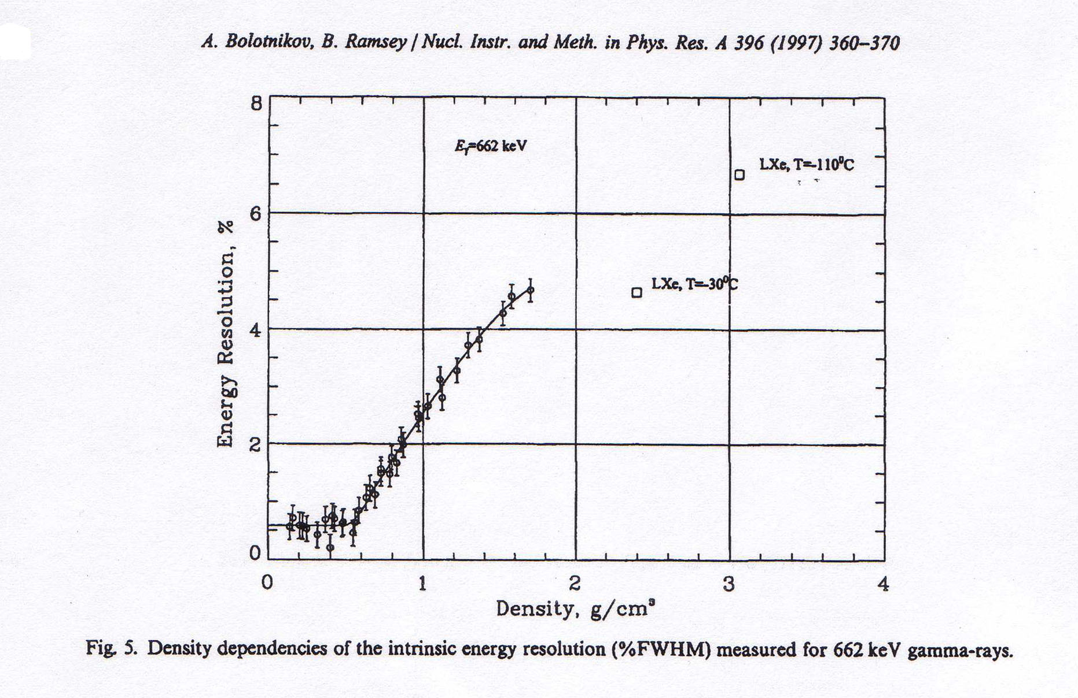
Partition fluctuations in xenon depend strongly on density!
Here, the fluctuations are normal
Fano factor
F ≈ 0.15
Unfolded resolution:
δE/E ~0.6% FWHM
F ≈ 20
Ionization signal only
For ρ <0.55 g/cm³, ionization energy resolution is “intrinsic”
Notes:
energy partition fluctuations are due to delta rays in high atomic density + (conduction band?)

Slide 50
Intrinsic Energy resolution at Q_{ββ} = 2457 keV
  Q ≡ Energy ¹³⁶Xe --> ¹³⁶Ba: 2457 keV
  w ≡ Average energy per ion pair: 25 eV
  N = Q/w ~100,000 primary electrons
  F ≡ Fano factor (HPXe): F = 0.15 ±0.03
  σ_{N} = (F⋅N)^{1/2} = (F⋅Q/w)^{1/2} ~124 electrons rms!
δE/E = 2.35 ⋅ (F⋅w/Q)^{1/2} FWHM
δE/E = 0.3% FWHM intrinsic Gas-phase Xe
Ionization signal only!
Notes:
Only about x3 worse than Ge diodes!

Slide 51
Intrinsic Energy resolution at Q_{ββ} = 2457 keV
  Q ≡ Energy ¹³⁶Xe --> ¹³⁶Ba: 2457 keV
  w ≡ Average energy per ion pair: 25 eV
  N = Q/w ~100,000 primary electrons
  F ≡ Fano factor (HPXe): F = 0.15 ±0.03
  σ_{N} = (F⋅N)^{1/2} = (F⋅Q/w)^{1/2} ~124 electrons rms
δE/E = 2.35 ⋅ (F⋅w/Q)^{1/2} FWHM
δE/E = 0.3% FWHM intrinsic Gas-phase Xe
Ionization signal only!
Notes:
Only about x3 worse than Ge diodes!

Slide 52
Intrinsic Energy resolution at Q_{ββ} = 2457 keV
  Q ≡ Energy ¹³⁶Xe --> ¹³⁶Ba: 2457 keV
  w ≡ Average energy per ion pair: 25 eV
  N = Q/w ~100,000 primary electrons
  F ≡ Fano factor (HPXe): F = 0.15 ±0.03
  σ_{N} = (F⋅N)^{1/2} = (F⋅Q/w)^{1/2} ~124 electrons rms
δE/E = 2.35 ⋅ (F⋅w/Q)^{1/2} FWHM
δE/E = 0.3% FWHM intrinsic Gas-phase Xe
Ionization signal only!
Notes:
Only about x3 worse than Ge diodes!

Slide 53
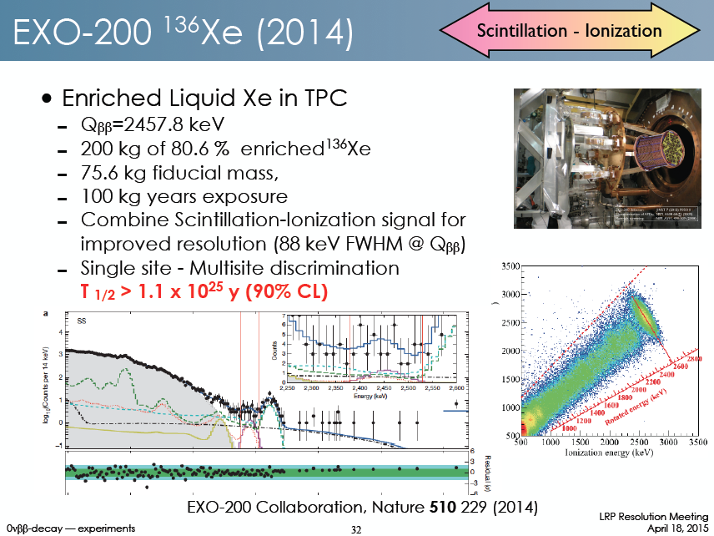
δE/E = 3.6% FWHM
Notes:
Appropriate linear combination restores resolution if one counts all scintillation photons and ionization electrons
But scintillation signal is statistically impoverished by QE and geometry, and by noise. → poor energy resolution

Slide 54
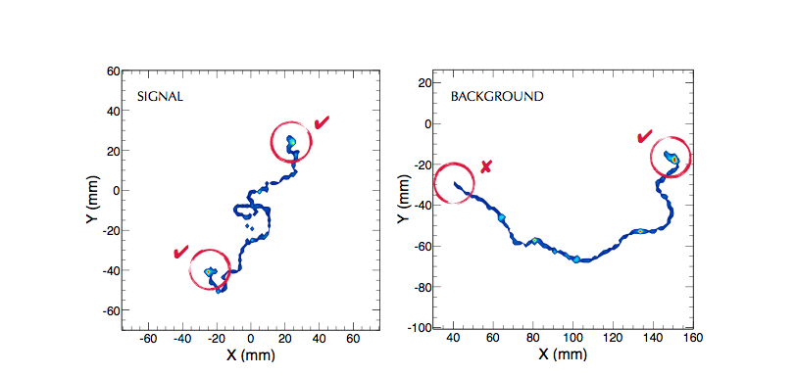
Topological signature - simulation
Two “meatballs”
= two electrons
One “meatball”
= one electron

Slide 55
Gas Phase Xenon – takeaway:
Excellent energy resolution is available–in principle–using only ionization information
Detailed topological information is available–this permits strong discrimination against false events caused by γ-rays

Slide 56














The NEXT Collaboration
USA (co-spokesperson David Nygren)
Spain (co-spokesperson JJ Gomez Cadenas)
Others (Portugal, Russia, Israel, Colombia)

Slide 57
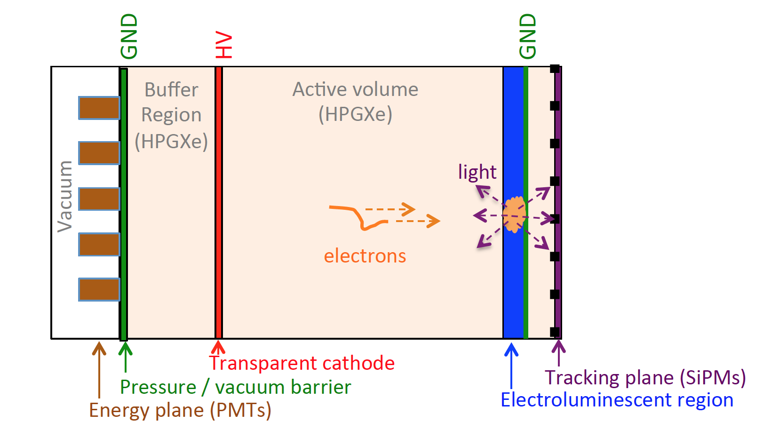
Neutrino Experiment Xenon TPC
Schematic design of NEXT detectors:

Slide 58
Amplifying the charge
In high pressure gas, measuring ionization charge alone gives excellent energy resolution (δE/E = 0.3% FWHM) in principle.
Now the challenge is to amplify it without introducing excessive fluctuations.
Use electroluminescent gain mechanism:
Avalanche mode
-HV
EL mode
-HV
e⁻
e⁻
e+Xe → e⁻ +Xe*
e+Xe → 2e⁻+Xe⁺
e+Xe → e⁻+Xe*
γ
γ
GND
GND
Electrons get enough energy to ionize
→ big fluctuations in photon yield
Only enough energy to excite Xe
→ small fluctuations in photon yield

Slide 59
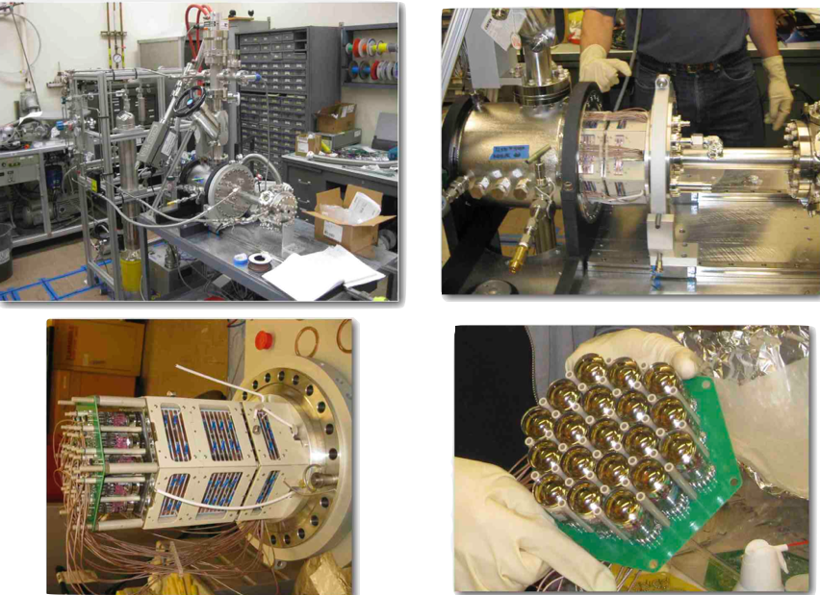
NEXT-DBDM at LBNL
Notes:
No tracking plane

Slide 60
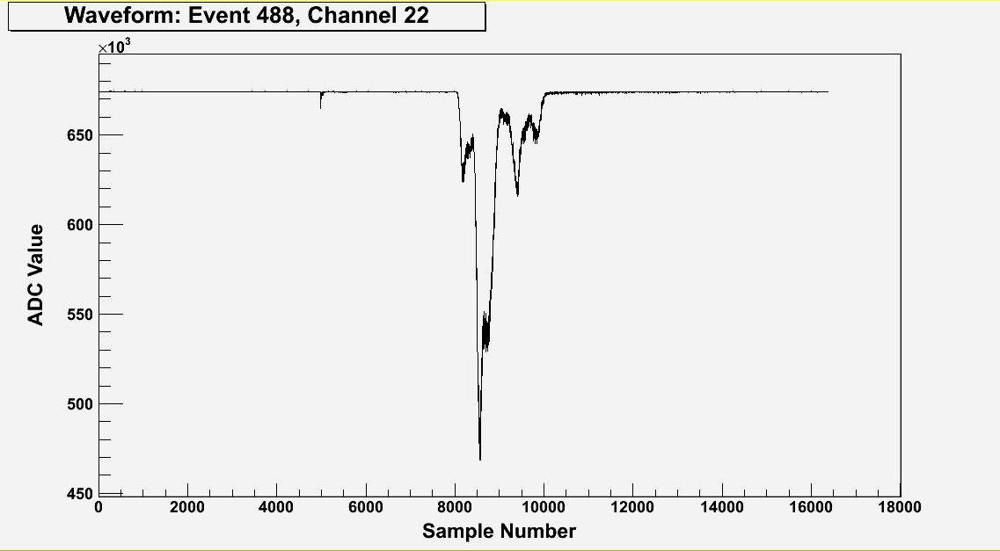
A typical ¹³⁷Cs γ waveform (sum of 19 PMTs)
~300,000 detected photoelectrons
Primary Scintillation (S1)
T0 of event
Electroluminescence (S2)
structure reflects topology
Drift Time:z-position
(~0.01mm/sample)
Drift velocity ~1 mm/ms
TIPP 2011
59
10ns/sample

Slide 61
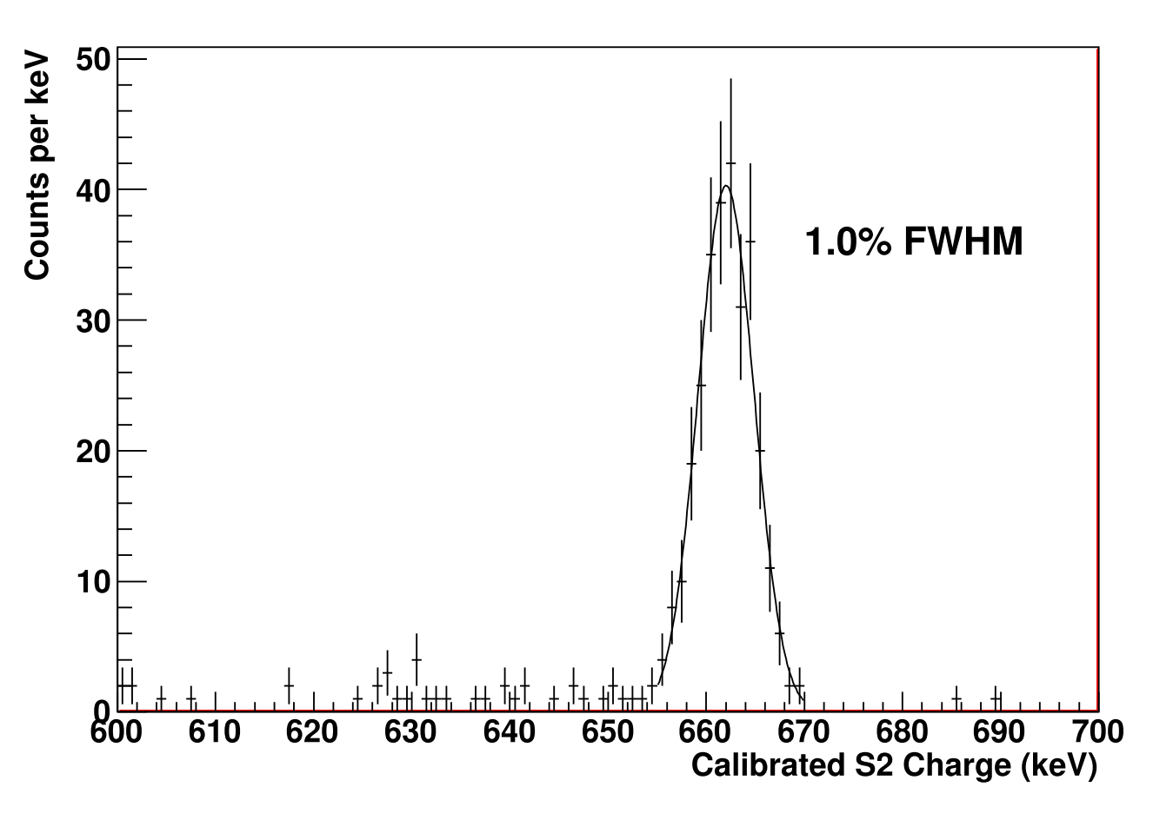
Energy Resolution from DBDM
662 keV ¹³⁷Cs gamma ray
Extrapolates to 0.57% at Q_{ββ}
Uses only ionization signal, amplified by electroluminesence
NEXT collab - NIMA708 (2013) 101-114

Slide 62
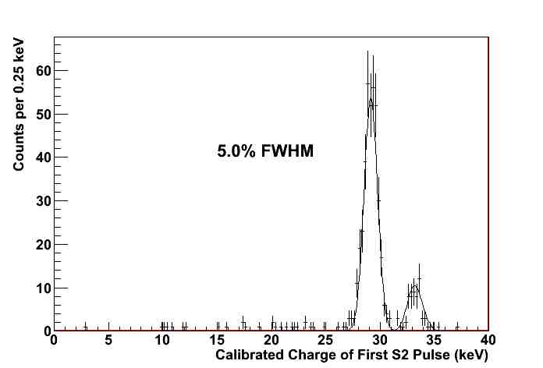
The x-ray peaks at ~30 keV are captured precisely

Slide 63
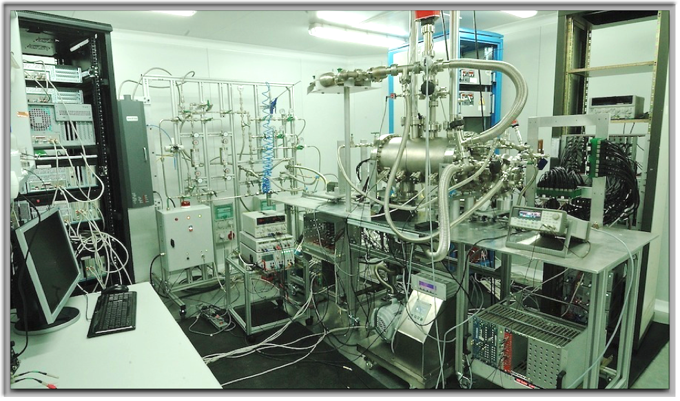
NEXT-DEMO in situ at IFIC-Valencia

Slide 64
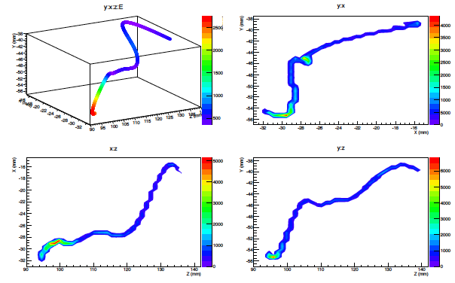
DATA: Real track from ¹³⁷Cs γ-ray – reconstructed with SiPMs
DATA from NEXT-DEMO IFIC, Valencia

Slide 65
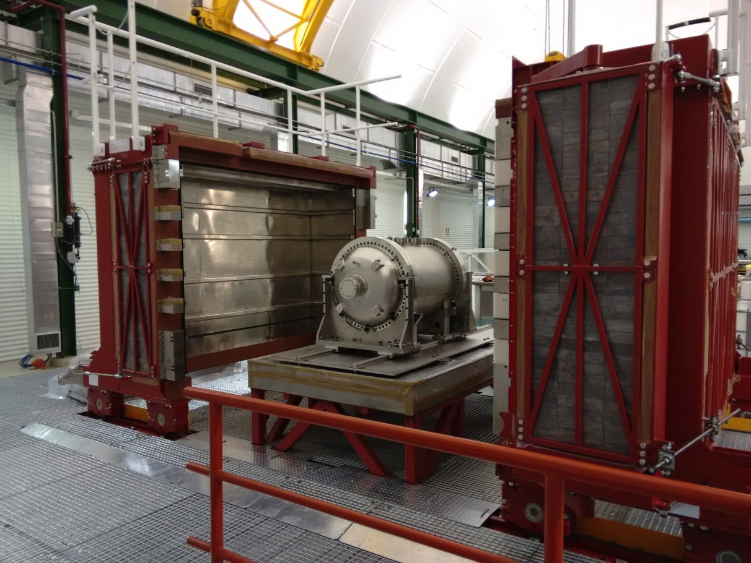
NEXT-White at the Laboratorio Subteranneo de Canfranc (LSC); first operation: April 2017
NEXT-10 on the seismic support table, inside the Lead Castle at the LSC

Slide 66

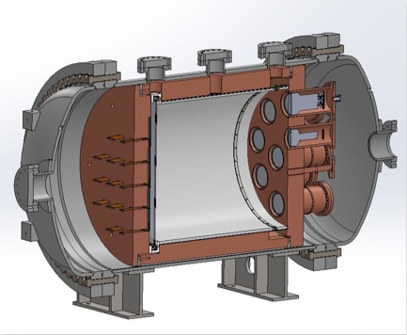



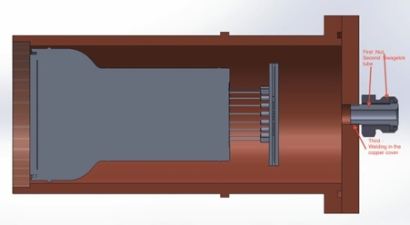
NEXT-White at a glance
Time Projection Chamber:
10 kg active region, 50 cm drift length
Pressure vessel:
316-Ti steel, 30 bar max pressure
Tracking plane:
1,800 SiPMs,
1 cm pitch
Energy plane:
12 PMTs,
30% coverage
Inner shield:
copper, 6 cm thick

Slide 67
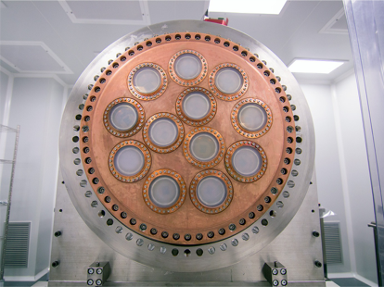
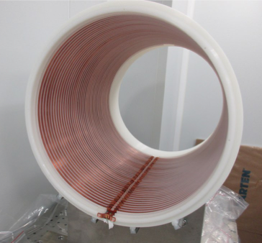
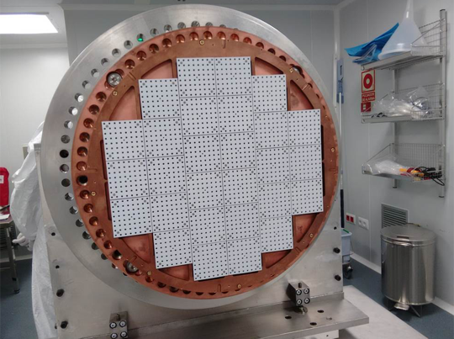
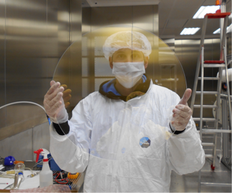
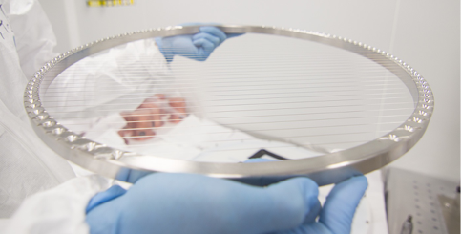
Energy Plane
Field Cage
Tracking Plane
Plates and Gates

Slide 68
Valencia
Grid:
1 cm
New low-background SiPM implementation

Slide 69
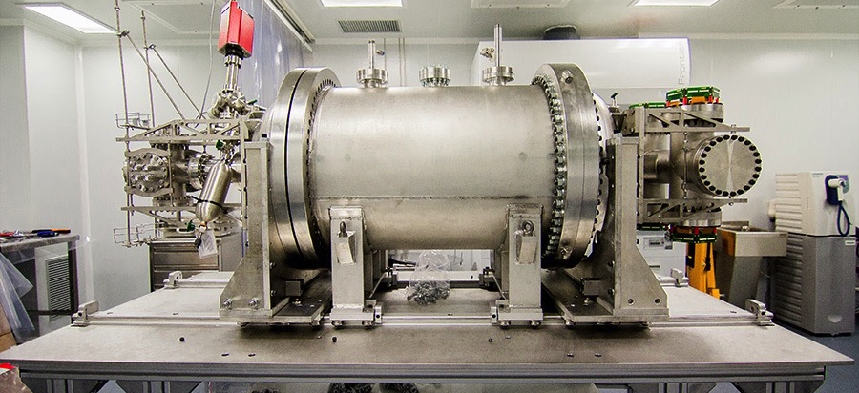
NEXT-White at Canfranc Laboratory
Stainless Steel 316 alloy.
Radiopure and light

Slide 70
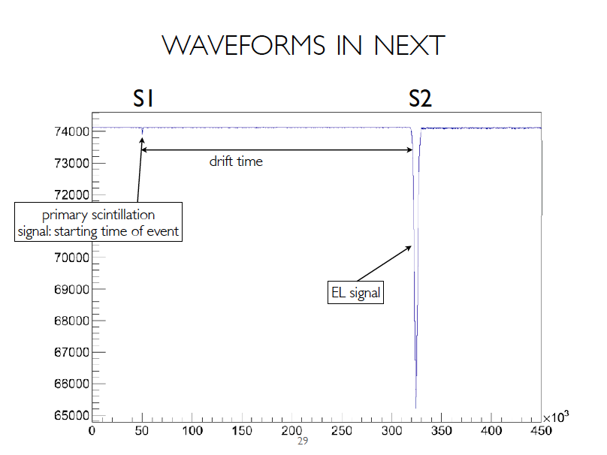

Slide 71
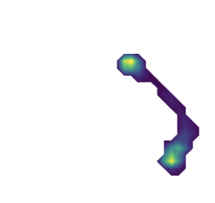
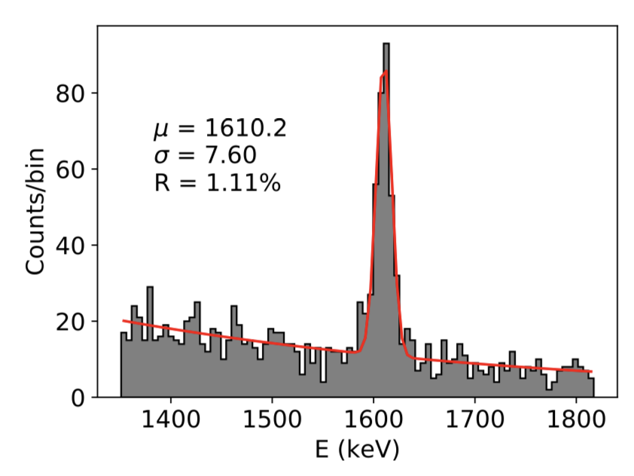
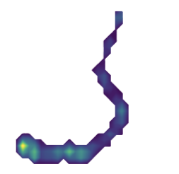
Topological Reco with Double Escape Peaks
NEXT-White data
On double escape peak
15cm
208Tl double escape
NEXT-White data
→ 0.89% at Q_{bb}
15cm
Compton continuum
Off double escape peak

Slide 72
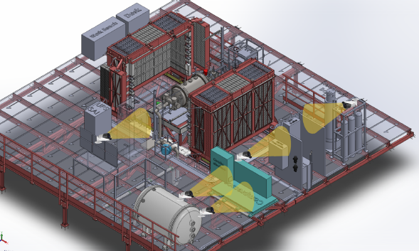
NEXT-White at Canfranc

Slide 73
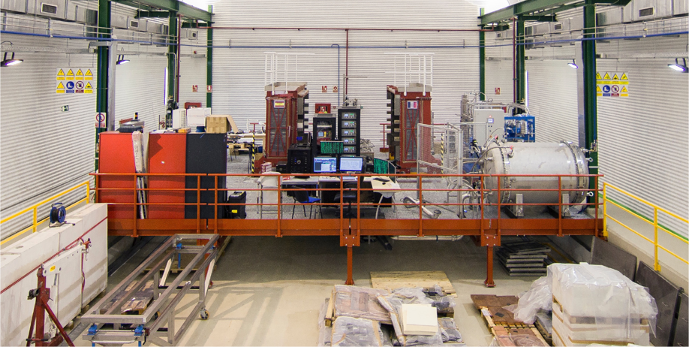
NEXT-White at Canfranc
Lead castle shielding
Compressor / gas system
NEXT-NEW
NEXT-100 Pressure vessel is emergency relief tank for NEW

Slide 74
NEXT-100 Pressure Vessel

Slide 75

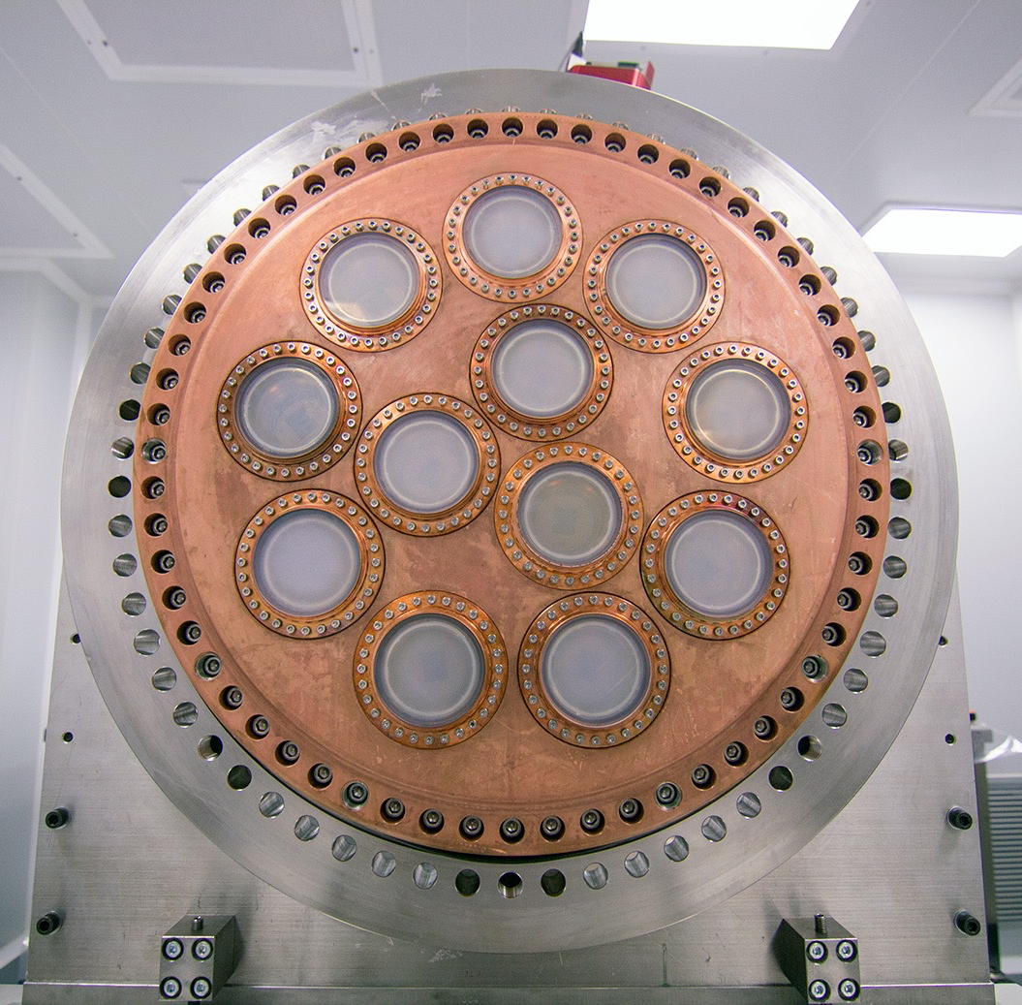
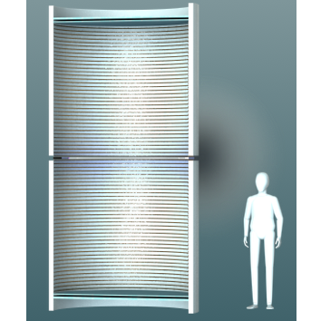
Why Xenon Gas?
NEXT-NEW
Running
NEXT-100
2019
1.2m
66 cm
1) Energy resolution
2) Topology
3) Practicality at ton-scale
Fluctuation-less EL gain produces resolution comparable with solid-state technologies in a monolithic TPC experiment
NEXT-XXX: 202?
Lower density allows powerful single-vs-multi electron and single-vs-multi-site topological background rejection
1.5m
Reliance on active background rejection rather than self shielding means program uses isotope efficiently and can be phased

Slide 76
Barium Tagging !
¹³⁶Xe → ¹³⁶Ba + e + e
Barium ion is only produced in a true ββ decay, not in any other radioactive event
Identification of Ba ion plus ~1% FWHM energy measurement would give a background-free experiment.
Is it plausible to detect an individual barium ion or atom in a ton of material?
Barium tagging for 0nubb has been actively explored in liquid and gas xenon for >15 years; w the holy grail is a scalable single ion sensitive technology.

Slide 77
Original tagging idea:
1980 - 1991
Identify the barium daughter
by optical spectroscopy
(M.Moe PRC44 (1991) 931)
Ba⁺ system best studied
(Neuhauser, Hohenstatt,
Toshek, Dehmelt 1980)
Single ions can be detected
from a photon rate of 10⁷/s
Pursued by EXO…
But:
Triplet state is quenched
in dense gas!
Challenging, in R&D stage
²P_{1/2}
650nm
493nm
⁴D_{3/2}
metastable 80s
²S_{1/2}

Slide 78
“Tagging” the barium daughter atom
The Reward:
    a (possibly) background-free experiment*
The Challenge:
    Must detect the birth of one barium daughter:
The Situation:
    Suppose ~10²⁷ atoms in your fiducial volume*
The Solution (if any exists):
    Will not likely involve only conventional ideas!
Notes:
Free trip to Stockholm
normal backgrounds can not make barium
10^27 → one grain of sand in one cubic kilometer of water.
2ν ββ decays are occurring fairly often

Slide 79
Xenon’s barium daughter
In the decay xenon → barium, the daughter atom is strongly ionized by the nascent electrons emerging from the nucleus and by shell relaxation
  Partial neutralization of barium occurs by electron capture from nearby neutral xenon atoms (ionization potential IP = 12.14 eV)
  Process stops at Ba⁺⁺ because the ionization potential of Ba⁺⁺ is 10.04 eV; it can’t take another electron from a neutral xenon atom: IP = 12.14 eV
  Ba⁺⁺ is the expected outcome in pure xenon gas
Notes:
molecular impurities can induce unwanted chemistry

Slide 80
There might be a way to use Ba⁺⁺
The technique of Single Molecule Fluorescent Imaging may be adaptable here (used in biochemistry, biology,…)
My idea is to exploit a remarkable chemical effect: the transformation of non-fluorescent molecular precursors into a robust fluorescent state by capture and chelation of doubly ionized alkaline earth elements, such as Ca⁺⁺
Calcium and Barium are congeners → similar chemistry…
Maybe Ba⁺⁺ too!

Slide 81
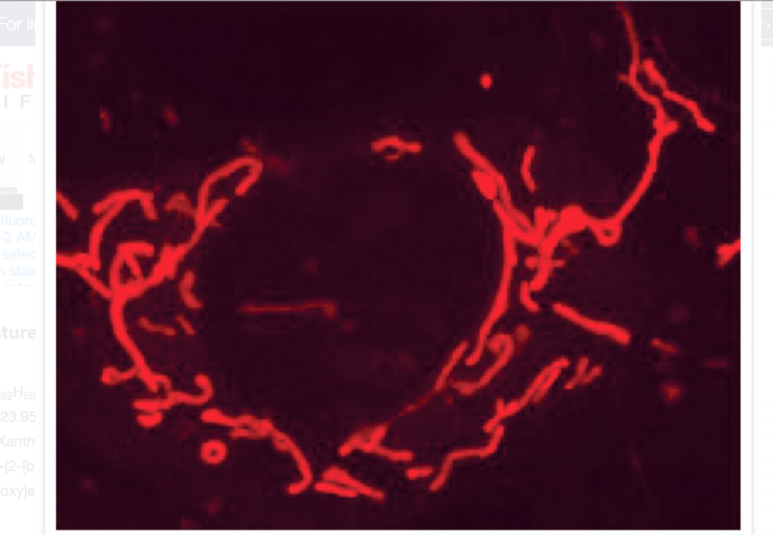
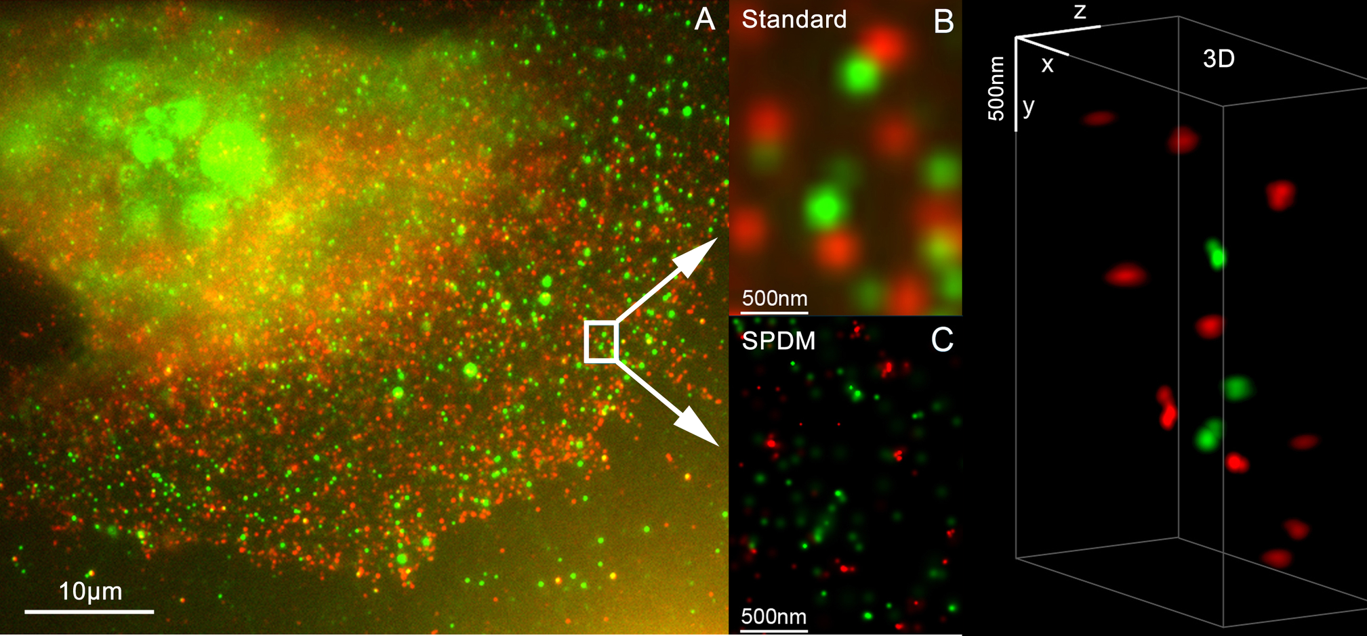
SMFI is a technique from biochemistry with demonstrated single-ion resolution.
Sensing Ca⁺⁺ production
← Rhod-2 sensing Ca⁺⁺ production in rat astrocyte cells
J Microsc. 2011 Apr;242(1):46-54
J Cell Biol 145, 795 (1999).
Single molecule tracking using SMFI is the basis of super-resolution microscopy→
Demonstrated single molecule sensitivity

Slide 82
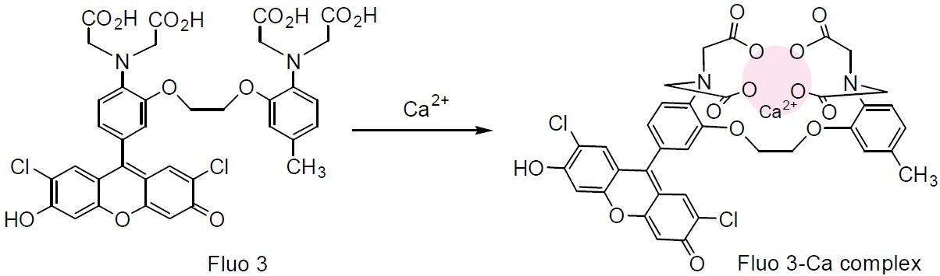
Fluo-3 converts from non-fluorescent to a fluorescent state by chelation!
2014 Nobel Prize in Chemistry awarded to three physicists
for developing SMFI and super-resolution microscopy
Notes:
Once Ca⁺⁺ is captured by Fluo-3, its responsiveness to external excitation
increases by a factor of 60 -80. Two-photon excitation with IR is also possible
This might work for Barium as well since barium and calcium are congeners.
Fluorophores exist for for Pb⁺⁺, Hg⁺⁺, Cu…)

Slide 83
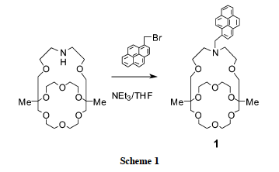
A Fluorescent indicator specific to Ba⁺⁺!
“Monoazacryptand 1”
Y. Nakahara, T. Kida, Y. Nakatasuji, M. Akashi,
Chem. Comm., Roy. Soc. of Chem., 2004, p224-225

Slide 84
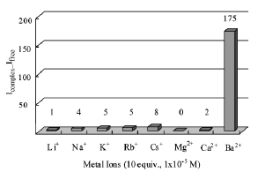

Highly specific to Ba⁺⁺ !

Slide 85
Gas microphysics
Nuclear Physics
Mass Spectrometry
Atomic physics
Barium Tagging
Organic Synthesis
Analytic Chemistry
Microscopy

Slide 86
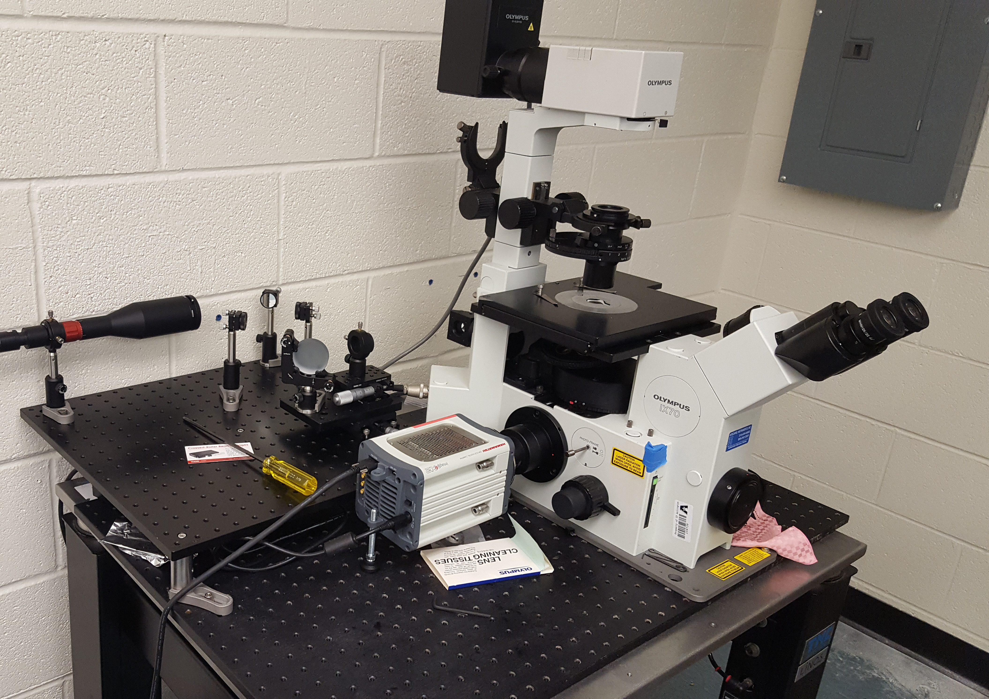
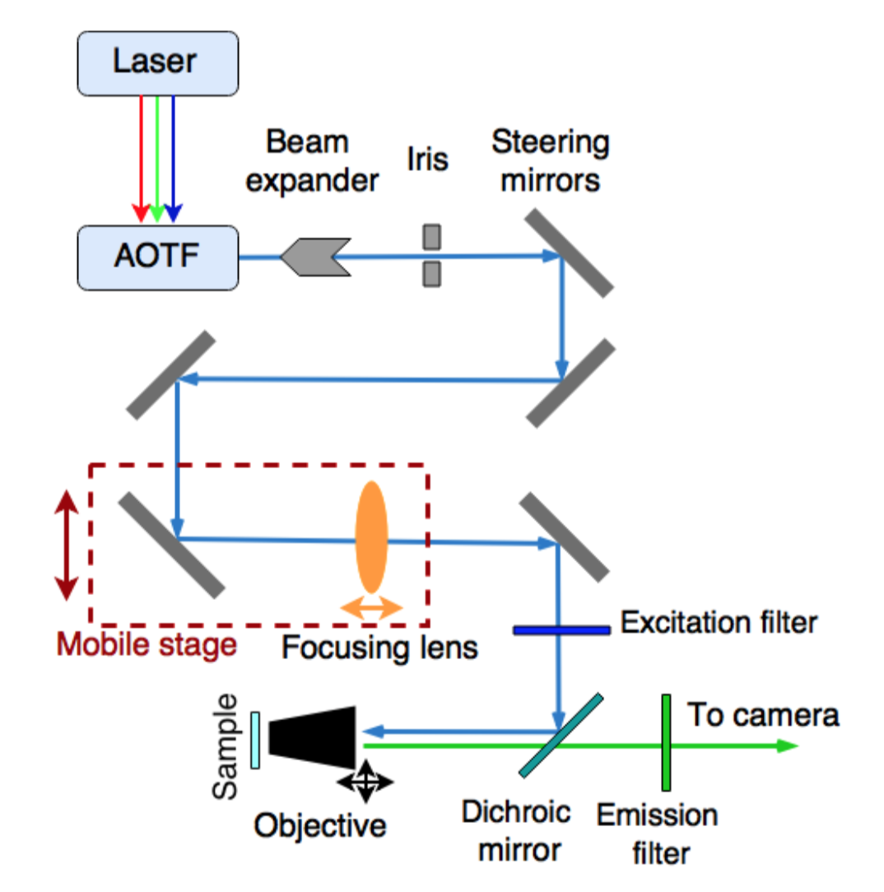
TIRF
Total Internal Reflection Fluorescence microscopy

Slide 88
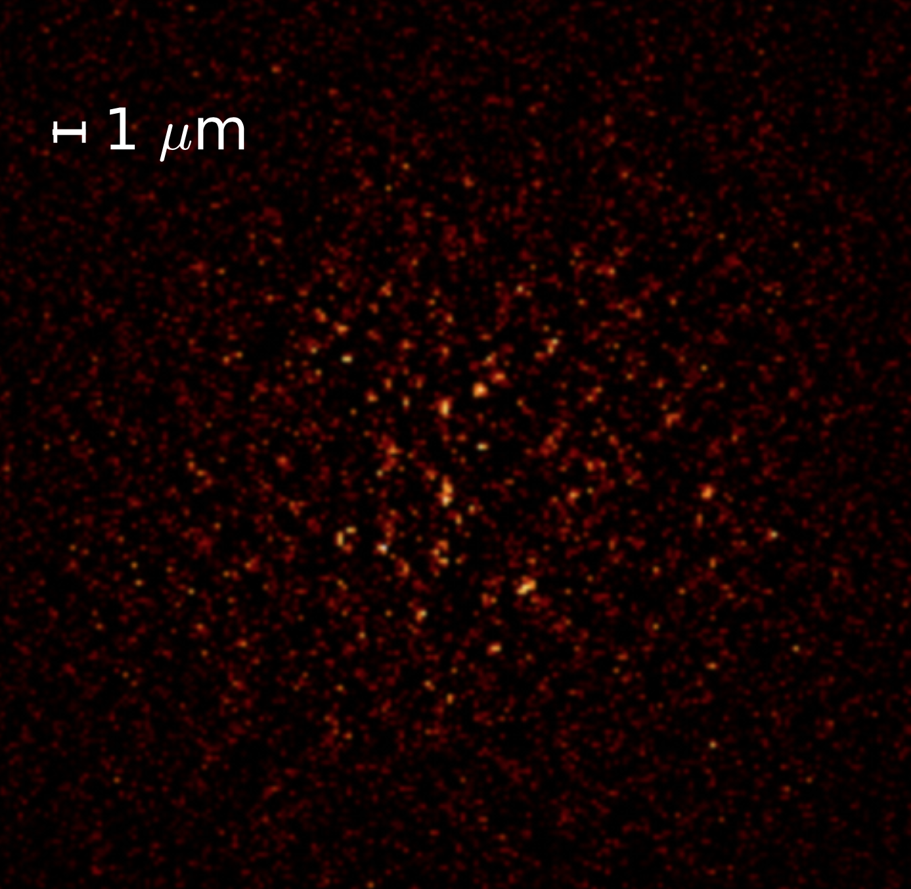
Single Ba⁺⁺ TIRF images from our lab at UTA
This image shows a weak solution of barium perchlorate salt on our sensor.
Each spot is a single barium ion.
Brighter spots are near the TIRF surface, dimmer ones are deeper in the sample.
In a xenon detector, only brightest ones will be present.

Slide 89
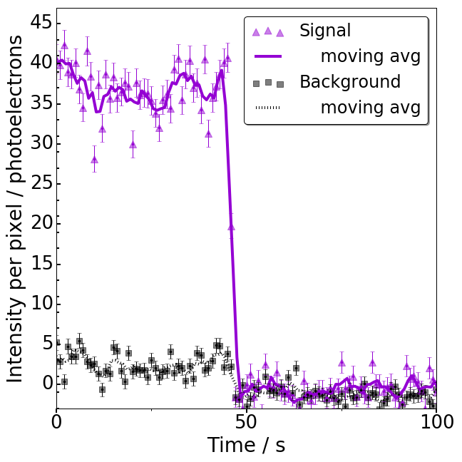
Fluo-4 with calcium: very bright!
On-off step
confirms a
single-ion
interpretation

Slide 90
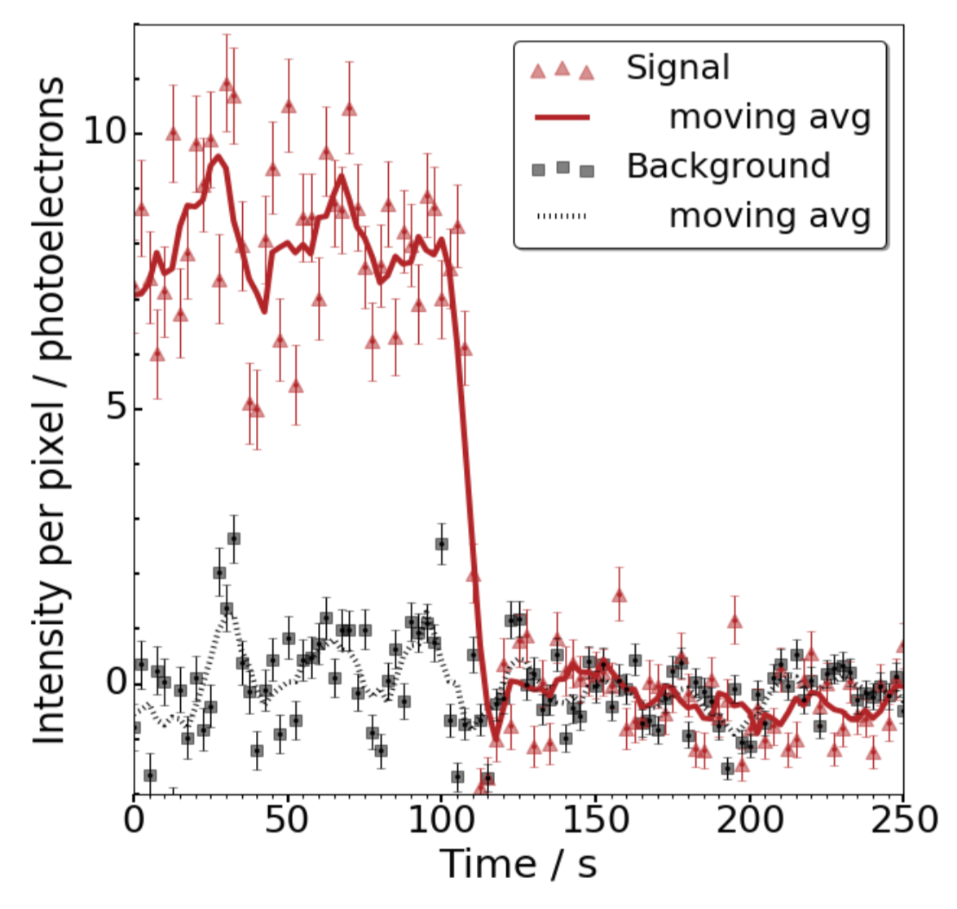
This “step” is how you know it is exactly one ion.

Slide 91
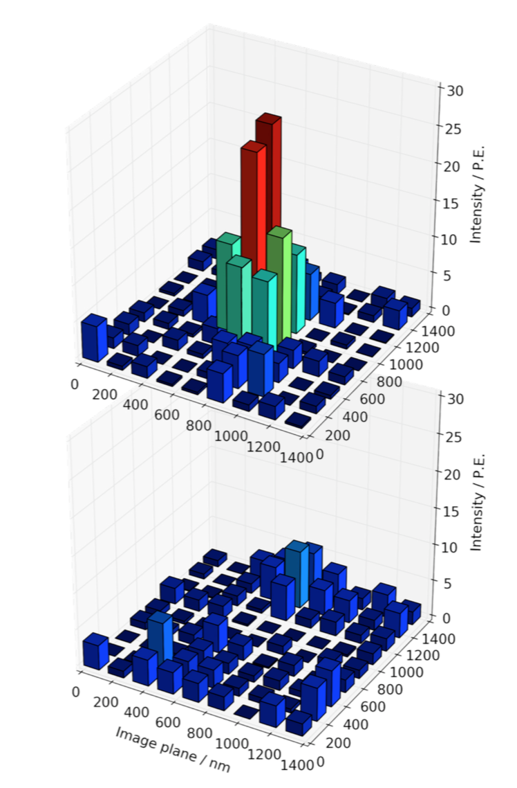
0.5s exposure
before:
Single ions barium resolved with 2nm super-resolution and 12.9 sigma stat. significance.
published in PRL:
0.5s exposure after:
Demonstration of Single Barium Ion Sensitivity for Neutrinoless Double Beta Decay using Single Molecule Fluorescence Imaging,
A.D. McDonald*, B.J.P. Jones*, et al
arXiv:1711.04782
A significant step for the field
(if we do say so ourselves!)

Slide 92
“The Texas
Two-Step”

Slide 93
How might one use this idea?
The barium ion will move to the TPC cathode
Movement to cathode: 3D → 2D problem
  Will it move with a unique mobility?
  Or, will evanescent clusters complicate drift?
  Would clustering help or hurt this scheme?
It seems necessary to measure Ba⁺⁺ mobility
  Theoretical and experimental studies underway

Slide 94

The barium beam
Building blocks of first high pressure xenon gas fluorescence microscope
(our lab @ UTA)

Slide 96
Barium di-cation clustering
Energy Density Functional theory:
Intriguing ionic clustering formation behavior predicted in the Ba⁺⁺Xe_{N} system
[BaXe₆]⁺⁺ is overwhelmingly most likely configuration due to anomalously high molecular entropy
Stability of Ba⁺⁺ against neutralization reaction confirmed
E. Bainglass and Ben Jones, UTA
Paper in preparation

Slide 97
Next challenge: get it into HPGXe
Ba⁺⁺
96
Drift to cathode
RF ion surfing
SMFI sensor
1mm²
RF carpets already realized at O(1m) scale and for barium drift in HPGXe
Objective lens on xyz stage
HPGXe
Quartz viewport
Air
To camera
Dichroic mirror
similar optics to our existing setup externally
From laser

Slide 98

100kg-class experiments:
Majorana
our projection
w/ high density SiPMs
w/ barium tag
NEXT-100 in basic configuration:
Runs in 2019; demonstrates background index 5-10 @100kg scale; Needs total of $1M+effort over 2 years (FY19-20)
NEXT-100 in advanced configuration (w/high density SiPMs and multiplexing)
Achieve worlds best background index; Needs total $5M+effort over 2 years (FY19-20)
NEXT with Barium tagging
Path to “background-free” detector; Needs continued support for R&D (requested via Early Career)

Slide 99
Summary
We are part-way through a program of detectors which includes NEXT-DBDM, NEXT-DEMO, NEXT-White, soon to have NEXT-100, and then NEXT-XXX.
NEXT-White is now operating, demonstrating good energy and topology performance
NEXT-100 will perform a genuine 100kg-scale 0νββ search, validate background model and technology scalability.
Barium tagging with EL HPGXe TPCmay uniquely maximize the sensitivity of the ton-scale 0νββ search.

Slide 100
Perspective
HPXe TPC may offer a path to a plausibly background-free NLDBD experiment
  Barium daughter identification in situ may be possible: single molecule fluorescence imaging may facilitate the “biochemistry of ¹³⁶Xe” and discovery of NLDBD, and provide insight into
  Why there is something, rather than nothing

Slide 101
Perspective
HPXe TPC may offer a path to a plausibly background-free NLDBD experiment
  Barium daughter identification in situ may be possible: single molecule fluorescence imaging may facilitate the “biochemistry of ¹³⁶Xe” and discovery of NLDBD, and provide insight into
  Why there is something, rather than nothing

Slide 102


Thanks for your attention

Slide 103
Backup slides

Slide 104


NEXT: Salient features
Excellent resolution (~1% FWHM measured at 662 keV by NEXT prototypes, extrapolates to 0.5 % FWHM at Qbb if all systematics are well controlled
Topological signature (TS) is the ability to distinguish between signal (“double electrons”) and background (“single electrons”); evidence exists that this works well.
Target = detector. Tracking establishes fiducial region, away from surfaces.
TPC: generally scalable. Economies of scale; V/S ratio increases linearly with L.
Xenon: the cheapest isotope to enrich in the market (NEXT owns 100 kg of enriched xenon, ~1 ton exists worldwide).

Slide 105


Slide 106


NEXT Expected Performance
Systematic assay of ALL detector components at the LSC HPGe facility
Development of full MonteCarlo simulations
10^{–4} /(keV kg yr)

Slide 107

Background Limit:
5.8 x 10^{–4} ckky

Slide 108


NEXT-XX: A series of photonic TPCs
NEXT: High Pressure Xenon (HPXe) TPC operating in electroluminescent (EL) mode.
NEXT-100: 100 kg of Xenon enriched at 90% in Xe-136 (in stock) at a pressure of 15 bar.
The event energy is integrated by a plane of radiopure PMTs located behind a transparent cathode (energy plane),
PMTs also provide t₀ – essential for the z coordinate and fiducialization.
The event topology is reconstructed by a plane of radiopure silicon pixels (SiPMs) (tracking plane).
TPB coated surfaces
xenon
gas
ionization
EL mode is essential to obtain linear gain, therefore avoiding avalanche fluctuations and fully exploiting the excellent Fano factor in gas

Slide 109
Credit: Cirigliano & Wilkerson, NLDBD LRP meeting April 2015
Notes:
Unknown phases enter, three in all.
mass ordering important too

Slide 110


Slide 111








Canfranc underground laboratory
2500 m water equivalent

