Slide 1
Technology Comparison Update
Sven Vahsen (Hawaii)

Slide 2
Goal
Estimate cost-to-discover different WIMP scenarios with different directional detection technologies
Assume zero background can be reached
Focus on TPCs first, then other approaches
Warm-up exercise: compare “recoil-energy threshold for directionality” of different TPC readout types
Specifically: how many recoils required to distinguish a recoil angle distribution that’s a 3delta function from an isotropic distribution, at five sigma?
Expect TPC w/ highly segmented 3D-pixel readout to require the fewest recoils, especially at lowest recoil energies
But 3D is the most costly readout…
The final result will factor in (relative or absolute) cost.

Slide 3
Status
Outline of this chapter, in latex format, is in Git repository: https://uhhepvcs.phys.hawaii.edu/cygnus/recoil-observatory-paper
Simulation work is ongoing

Slide 4
Overview of Simulation Steps
Low pressure Gas TPCs
Cosmology Simulation [or delta functions]
WIMP + neutrino recoil distributions
Simulation of nuclear recoils and resulting ionization
Charge transport (drift, diffusion, reabsorption etc. )
Readout plane simulation
Wires
Strips
Optical
Pixels
Mu-pic
Discovery variables
Discovery cost
Ionization clouds
Other detector technologies
Ciaran O’Hare
Tom Thorpe
Cosmin Deaconu
Sven Vahsen
Sven Vahsen
Kentaro Miuchi
w/ help from technology experts
(Tom Thorpe will also get involved)

Slide 5
Cosmology Simulation [or delta functions]
WIMP + neutrino recoil distributions
Simulation of nuclear recoils and resulting ionization
Charge transport (drift, diffusion, reabsorption etc. )
Readout plane simulation
1D
Wires
Strips
Pixels
Discovery variables
Discovery cost
Ionization clouds
Other detector technologies
Ciaran O’Hare
Tom Thorpe
Cosmin Deaconu
Sven Vahsen

Slide 6
Current Work
Simulating TPC with 20 torr SF₆ gas
1D plane, wires, x/y strips, pixels
how many recoils required to detect isotropy at five sigma?
Interesting in itself, and validates simulation steps
Goal: First results for workshop by next week…
Then interface with cosmology simulation

Slide 7
BACKUP SLIDES

Slide 8
Cosmology Simulation
WIMP Input parameters:
Target Nucleus
WIMP mass
WIMP halo model parameters
Interaction details (SD, SI, other)
Form factor / nuclear physics
Neutrino Input parameters: ?
Ciaran will provide recoil vectors in format px, py, pz, event time. We agreed to start with a WIMP recoil test event sample based on:
Flourine
M_WIMP = 1, 10, 100, 1000 GeV/c^2
SHM with v_0 = 220 km/s and v_esc = 533 km/s and rho_0 = 0.3 GeV/cm^3.
From Ciaran:
“For the form factor/nuclear physics. In the past we've usually adopted a simple Born form factor for F spin-dependent. It should be fine to use this for now, at the very least it will agree with previous work. In my last paper with Bradley Kavanagh we were a bit more rigorous and took some more up to date form factors and values for the spin contents so if we wanted something a bit more accurate (but a bit more involved) then I already have that in place.
For the recoil time what I usually do is just use a year's running time and then to get results for different exposures I just need to vary the detector mass factor. The events are a lot easier to handle like this, and it turns out it has the same effect as if you were changing the length of time by the same factor. Then I can just label the recoil time in days since Jan 1st (or whenever).
Event generation takes no time at all, I can generate as many events as you need really. I would imagine quite a lot of events (closer to a million) would be needed to smoothly represent the distribution though since it is quite spread out in the lab frame thanks to the rotation of the Earth. “
In addition to WIMP/neutrino recoils, will also use recoil distributions that are delta functions in theta, phi, E (in steps of E)
compare energy threshold for directionality of different technologies: how many recoils required to detect isotropy at five sigma?
Interesting in itself, and validates downstream simulation steps

Slide 9
Recoil Simulation
Input parameters
Gas composition
Gas pressure
→ affect straggling, stopping power (recoil length)
Use SRIM. Many possible approaches, showing four. Top is most precise. Bottom is fastest.
Create large number of individual 3D recoils for each recoil energy bin in SRIM, draw recoils from appropriate sample.
Create large number of individual 1D recoils for each recoil energy bin in SRIM, draw recoils from appropriate sample.
Create 1D SRIM dE/dX p.d.f. for largest possible recoil energy. Use this single pdf to create recoils of all energies.
Create 1D SRIM dE/dX p.d.f. for largest possible recoil energy, numerically convolute it to obtain 3D p.d.f. for recoil charge distribution that includes detector simulation as well. Use this single pdf to create recoils of all energies.
Sven has implemented 3 and 4 for D³ (TPC w/ pixel readout) (they are largely equivalent)
Cosmin has implemented 1 for DMTPC (TPC w/ optical readout)
Plan
compare 1 with 3 to validate both and assess impact of straggling on our results.
use 1 if fast enough. Otherwise 4.

Slide 10
TPC Charge Transport & Readout Plane Simulation
“Gas” Input parameters:
E –field strength
Drift length
Gas mixture
Gas pressure
Gas purity
affect drift velocity, diffusion (L/T), charge losses during drift
Readout plane input parameters
Gain, noise, x,y, segmentation, shaping time, digitization specs, etc (list depends on technology)
For electron drift gases, Magboltz can accurately calculate drift velocity, diffusion
Not fully sure what to do for NID gases
Can probably get most quantities from measurements by Dinesh
velocity, diffusion (reattachment effect included?), max gain, gain resolution
Not sure if we can reliably extrapolate to lower pressures.

Slide 11
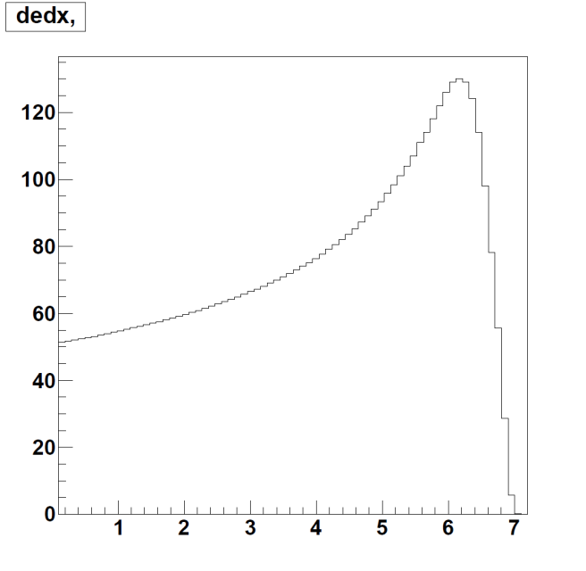
D³ Toy Monte Carlo (“method 3”)
Simulates every single electron in python (precise but slow)
Features with “Y” will be included
Features in green have been implemented
Physical Effect | Included in toy MC?
dE/dX | Y
W | Y
Fano factor | Y
electron clusters | N ?
Recombination | N ?
Longitudinal, transverse diffusion in drift gap | Y
drift velocity in drift gap | Y
reabsorption in drift gap (impurities, space charge etc) | Y
GEM gain | Y
Gain resolution/uniformity | Y / N
gem hole spacing | Y
gem shower shape | rough approx.
diffusion (l,t) in transfer gap | Y
diffusion (l,t) in collection gap | Y
time spent in transfer, collection gaps? | rough approx.
quantization into pixel x,y positions | Y
quantization into pads | Y ?
detailed modeling of pixel arrival time distribution? | Y ?
quantization of charge arrival time into BCIDs | Y
charge, treshold, TOT scale -> TOT in each pixel | Y (COT)
hitor modeling | Y
Bragg peak
dE/dX
Po-210 α-particle
in He:C0₂ (70:30)
tail
head
X (mm)

Slide 12
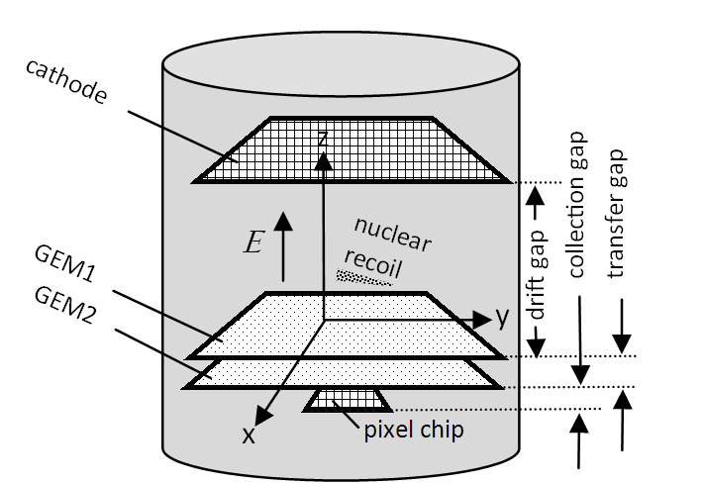
Example of TPC simulation: one event
Double GEM pixel TPC
750 keV He-recoil in HeC0₂
Drift: 5 cm
gain = 900 per GEM

Slide 13
generated
Simulating individual electrons, but quantizing when visualizing
Quantization: (500μm)³

Slide 14
post drift

Slide 15
post GEM1

Slide 16
post transfer gap

Slide 17
post GEM2

Slide 18
post collection gap

Slide 19
above threshold
now with finer quantization - equal to that of pixel chip
npoints = 17443

Slide 20
above threshold
rendering of box edges turned on

Slide 21
fully digitized
npoints= 1211

Slide 22
fully digitized (non transparent)

Slide 23
2nd Simulation approach
Recoil p.d.f. that incorporates detector effects (from charge transport and readout plane)

Slide 24
Charge Cloud PDF – before detection
dE/DX distribution from SRIM – quantized
Each point charge then numerically convoluted with a Gaussian to account for charge diffusion during drift & detector resolution

Slide 25
Charge Cloud PDF – after detection
Charge integrated in the drift direction pseudo-analytically, and detector threshold applied
59 $μ$s per space point [in python]

Slide 26
Summary
Technology comparison involves integration of multiple simulation codes
Simulation of Cosmology, Nuclear Recoils, Charge propagation, TPC+Mu-Pic readouts exists
Next steps, roughly:
Complete exercise all the way to end (cost / discovery) w/ pixel TPC
delta function recoil distribution for debugging
SF4 at 34 torr (same density at SF6 @ 20 torr + we have exp. data for validation)
Add Mu-pic w/ Kentaro, then other readout plane technologies
Simulate SF₆ at ~ 20 torr
Switch to WIMP / neutrino cosmology as input
Tidy up code and put in Git
Still pondering:
Best discovery variables for TPC that don’t fit tracks
How to deal with non-TPC technologies

Slide 27
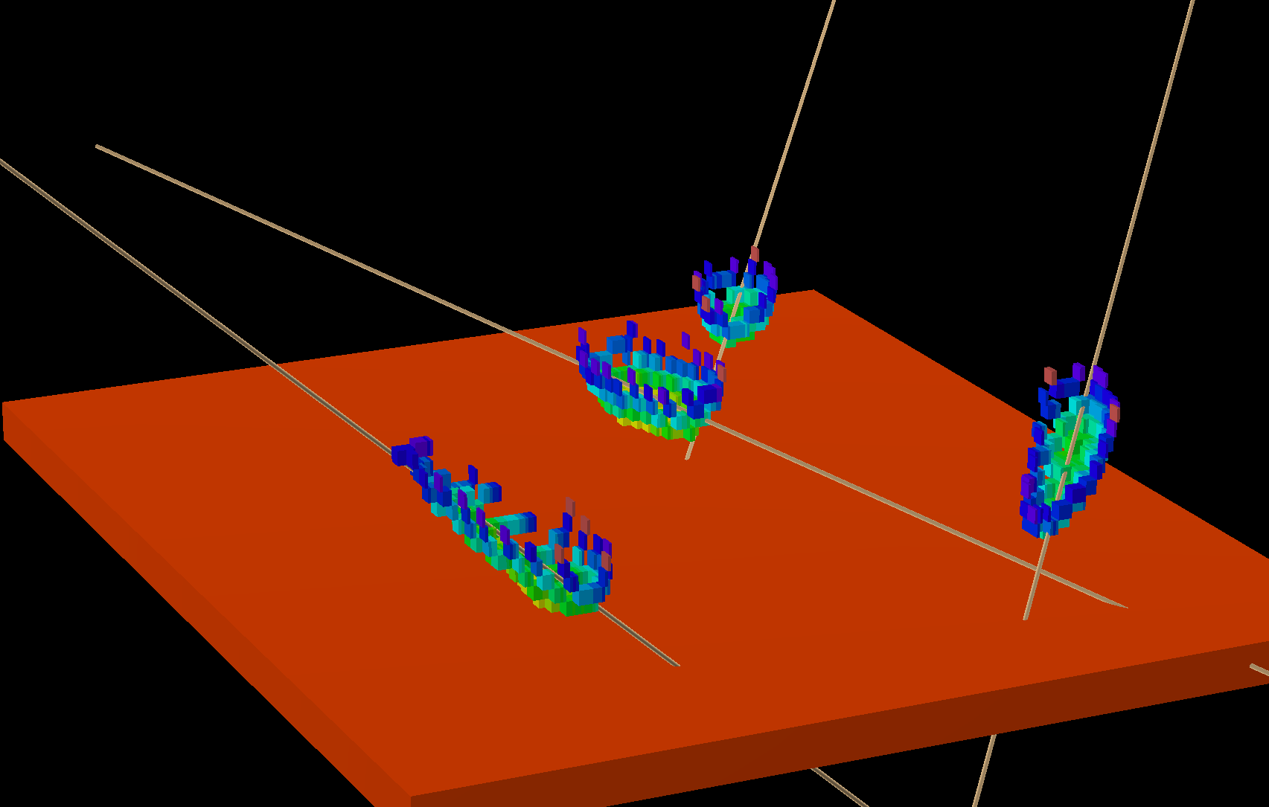
Exerimental data

Slide 28
Simulation Approach
Simulating every single electron at all stages of detector
millions per track. Slow, but doable.
Visualizing + storing only quantized charge distribution
same format as final data
at different stages of simulation
same binning as pixel chip or different
crucial for visualizing and fitting before digitization

Slide 29
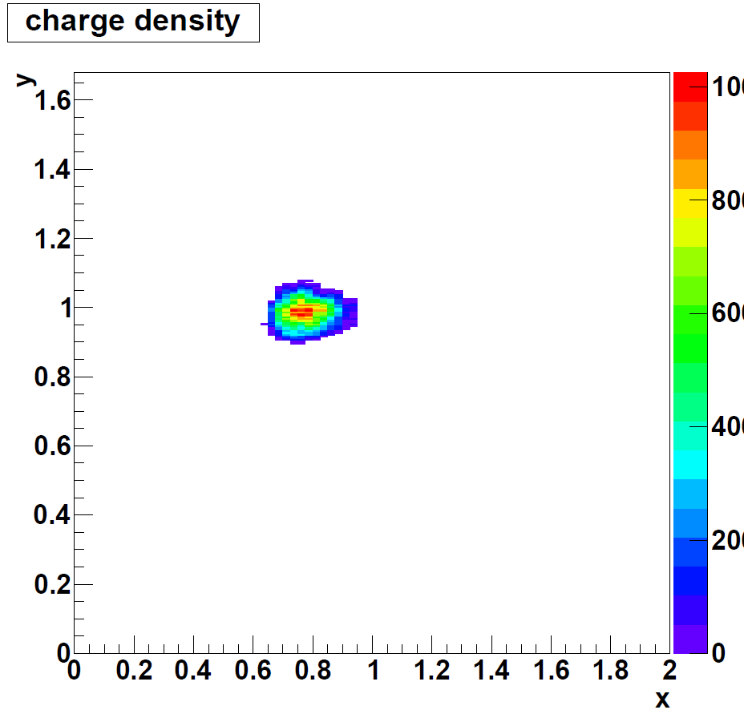
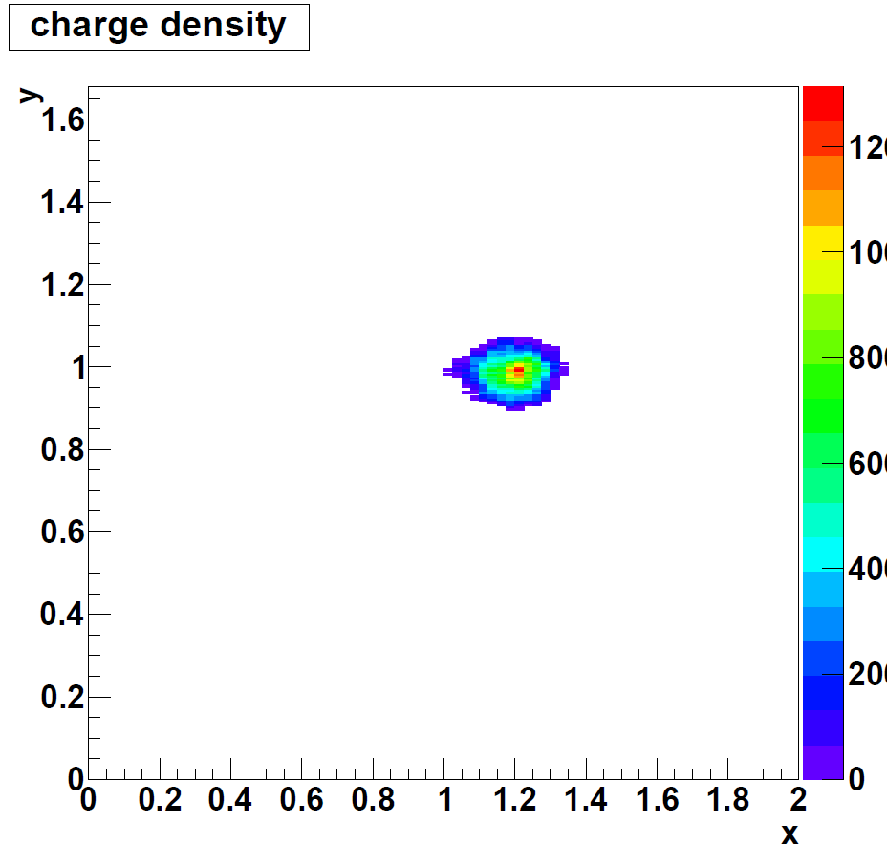
60 keV: can you see the head/tail ?
(same event, after 2k electron pixel threshold)

Slide 30
60 keV: can you see the head/tail ?
(same event, after 2k electron pixel threshold)

