Slide 1
Possible Cygnus Sites: Kamioka, Japan
Kentaro Miuchi

Slide 2
Kamioka site
Lab-B (current NEWAGE site ~5*10m) can be used for 1m^3 detector.
Infrastructure is OK, oversea researchers are welcome.
Larger hall, potentially yes. Depends on how things will go.
Kentaro Miuchi

Slide 3
Possible funding sources and deadlines in different countries
Japan/NEWAGE status

Slide 4
Japanese Funding Situation
Fiscal Year : Apr – next Mar. (Application October -> result Apr 1st).
FUNDED
  NEWAGE + Emulsion funding: FY 2014-1018 total $0.6M -> low BG uPIC ongoing
  NEWAGE + CYGNUS funding: FY 2016-2019 total $0.35M -> CYGNUE/NEWAGE “observatory”
  -> CYGNUS R&D detector for readout technology study and demonstration for directionality.
Kentaro Miuchi

Slide 5
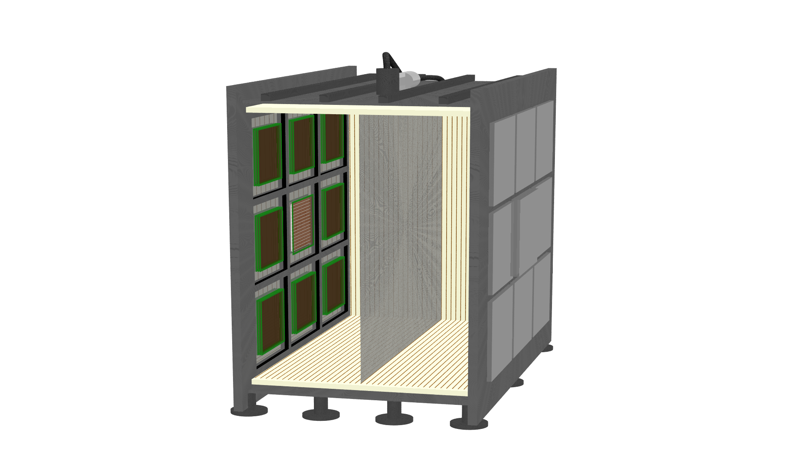
CYGNUS/NEWAGE “observatory”, or test bench
SPECS
  Vessel material: steel (baseline) or plastic (as a future R&D)
  Vessel shape: cube (baseline) or cylinder (cheaper option )
  50cm polyethylene shield
  Equipped with 18 modules
HV
X-ray tube
1.8m
1.8m
DRIFT Plane
SF₆
detector modules
（50×50cm²）
0.5m
0.5m

Slide 6
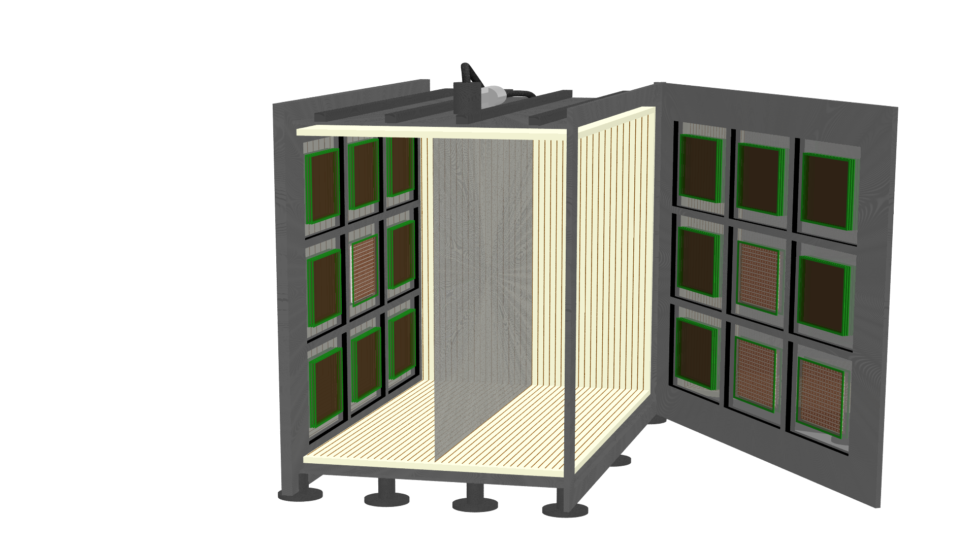
Schedule
  2016-2017 construction
  2018-2019 commissioning: 14×GEM modules + 4×uPIC modules -> confirm low BG environment
  2020- open to other readouts: pixel chips, optical…. (Radon emanation screening prior to the installation)
1.8m
detector module
（50×50cm²）
DRIFT Plane
1.8m
SF₆
0.5m
0.5m

Slide 7
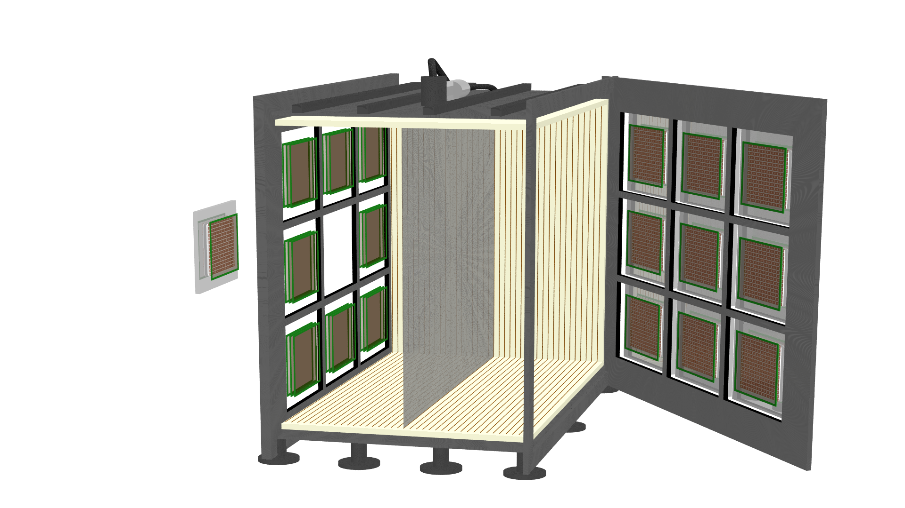
Design discussion
  Drift field for hybrid-system
  gain voltage would vary among detectors
1.8m
-HV
-30kV (minimum)
-50kV (typical)
GND
GND
top of amplifier GND
Detection area
+HV
possible readout scheme
PAD
3-GEMs
DRIFT Plane
1.8m
SF₆
3-GEMs
pixel chip
0.5m
0.5m
resistive foil
+ polyimide

Slide 8
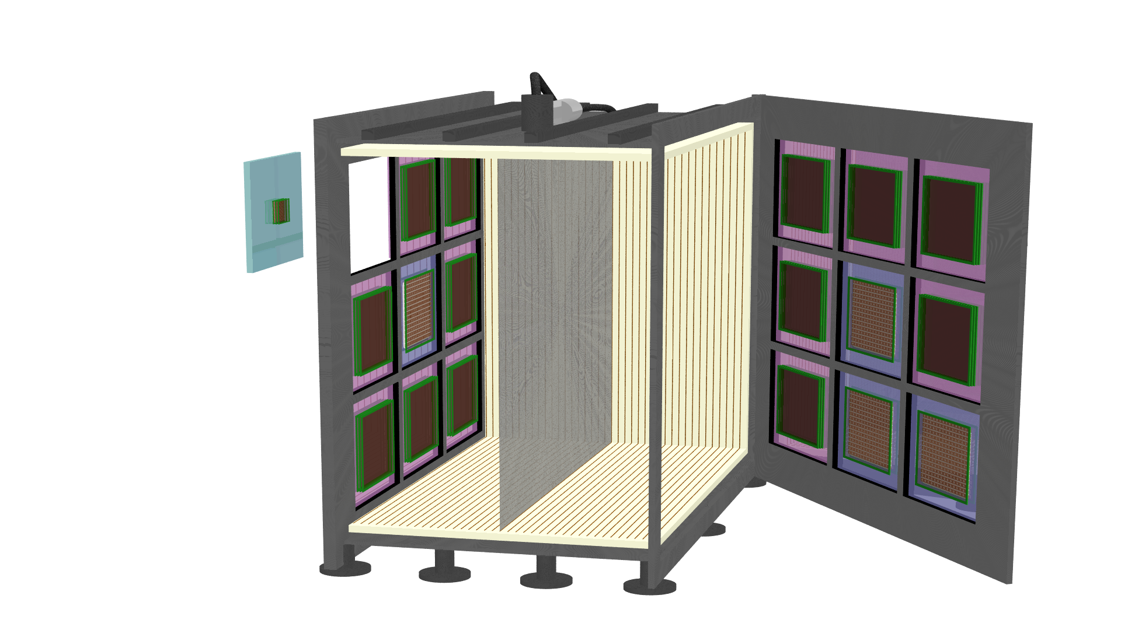

Slide 9
AC-coupled readout

Slide 10
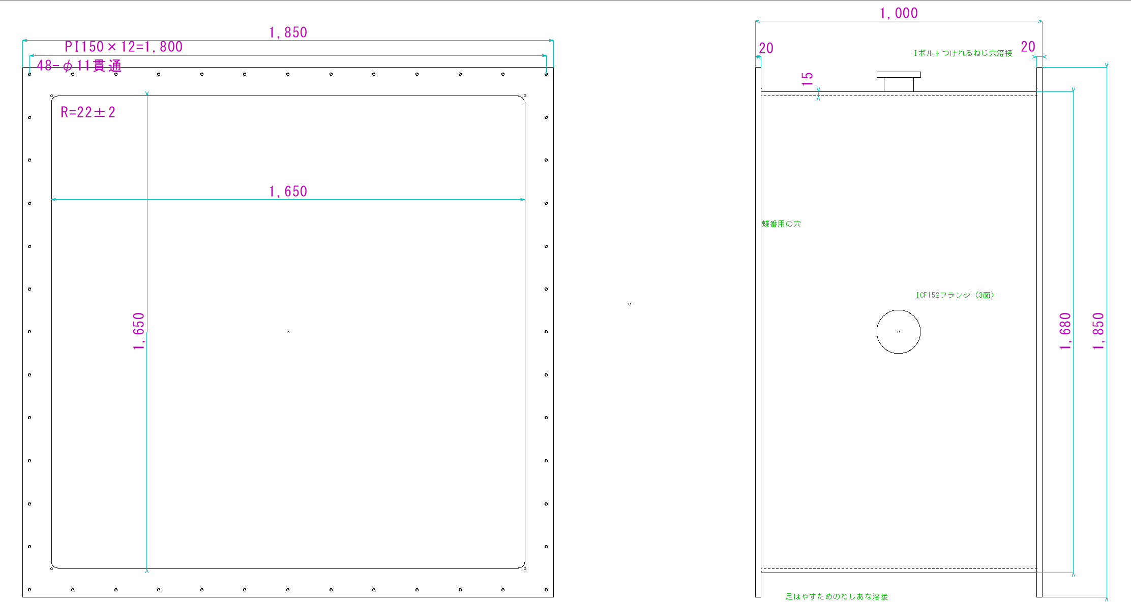
plans(unit: mm)
VESSEL

Slide 11

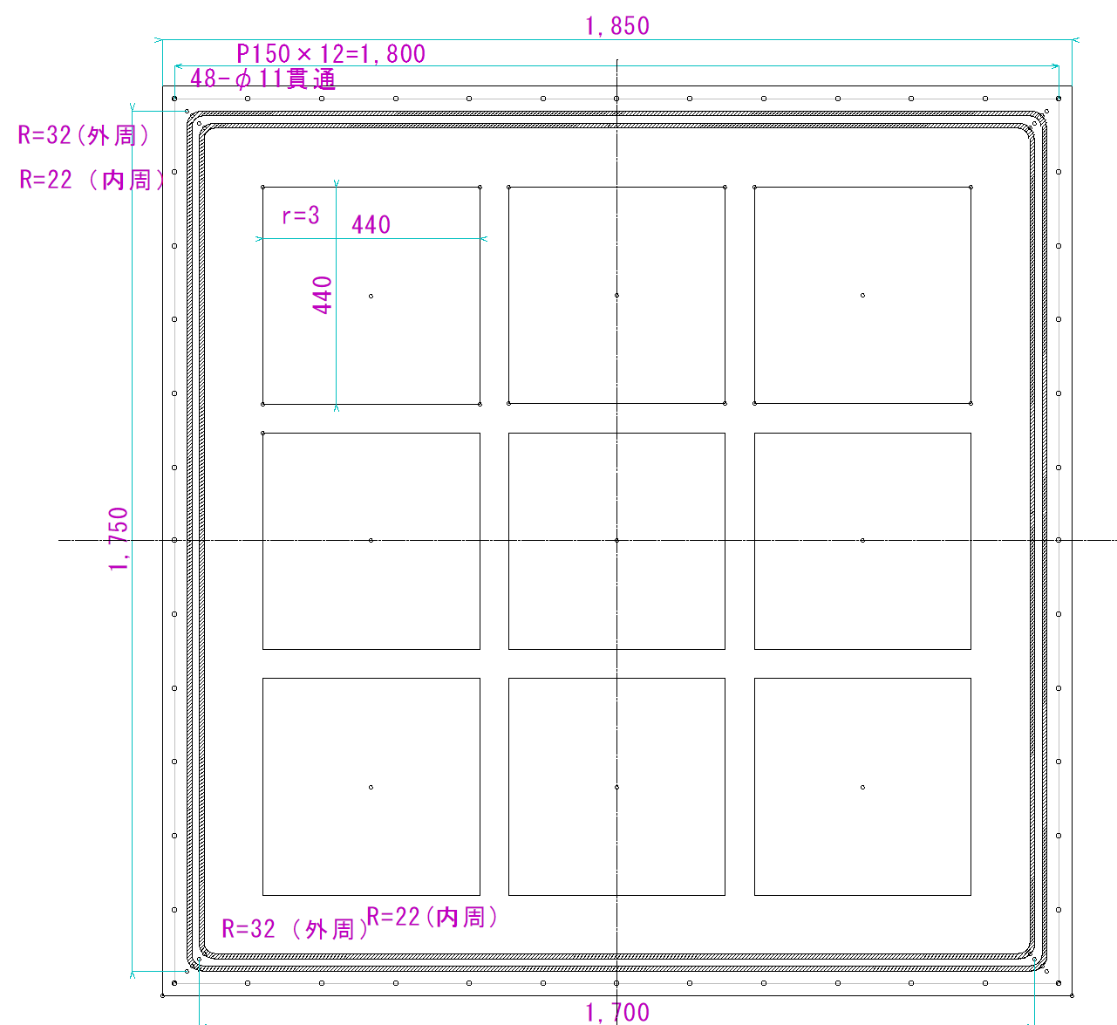
endcap plate （inside）

Slide 12
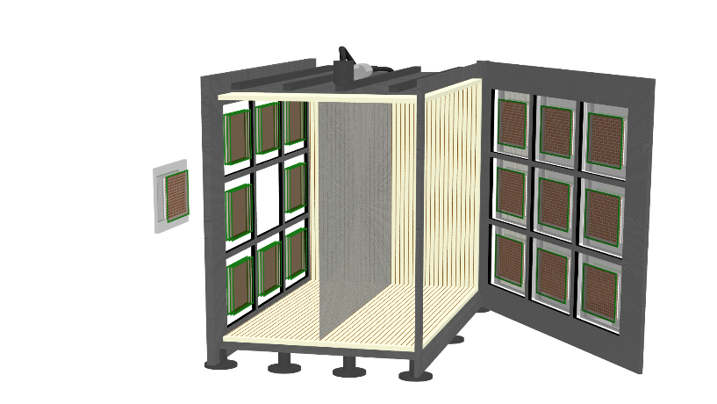
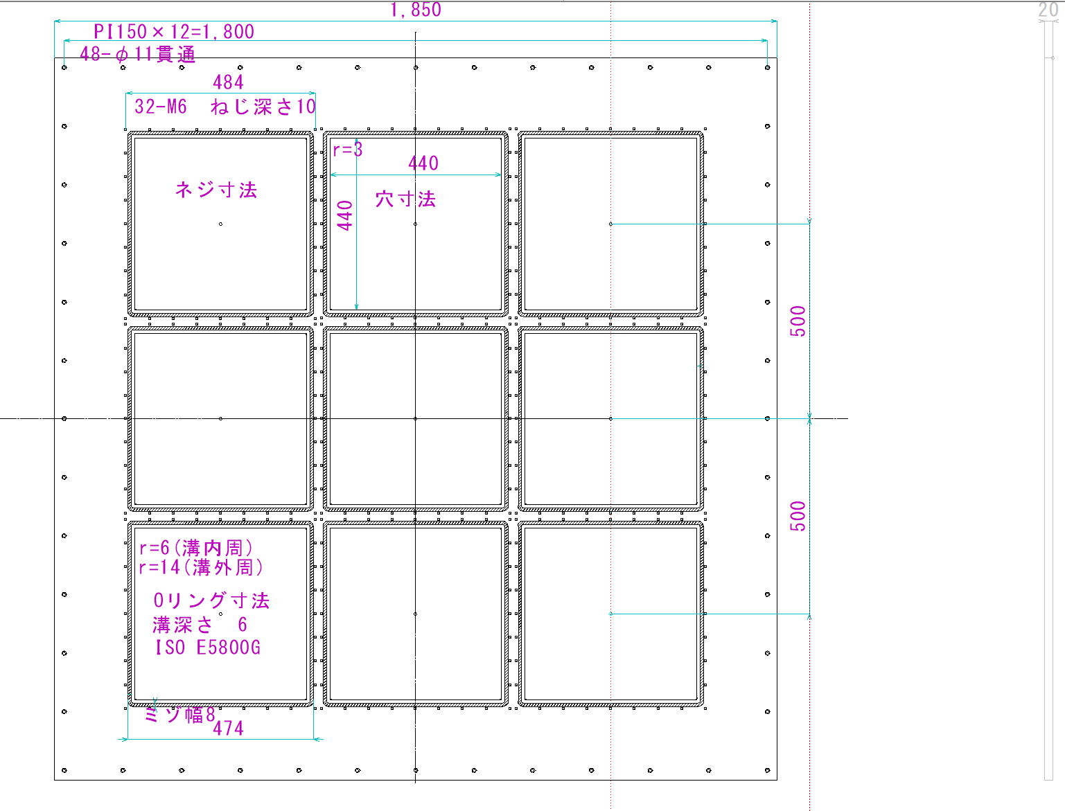
endcap（outside）

Slide 13

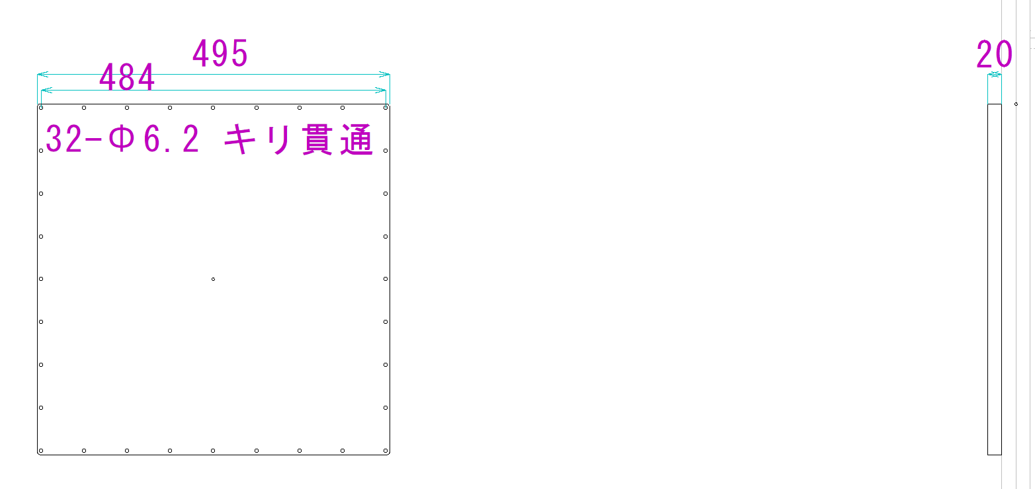
module base

Slide 14
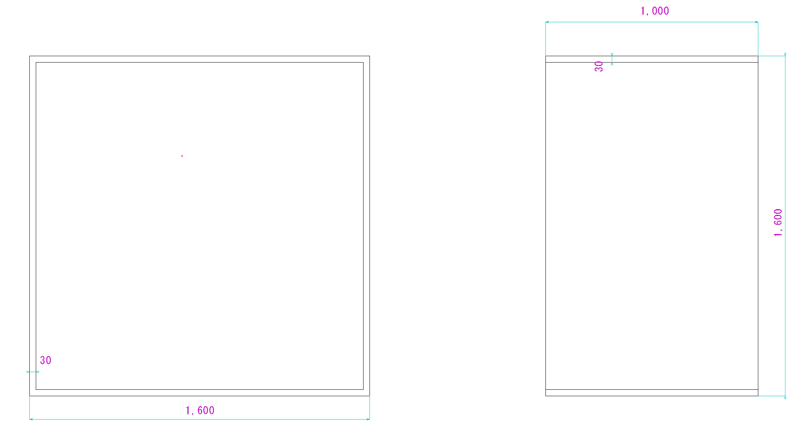
TPC

