Slide 1
US Funding Situation
Three second generator (G2) dark matter experiments selected by DOE, NSF (and P5) summer 2014
  http://www.symmetrymagazine.org/article/july-2014/us-reveals-its-next-generation-of-dark-matter-experiments
  http://science.energy.gov/hep/community-resources/next-generation-of-direct-detection/
LZ, SuperCDM-SNOLAB, ADMX-Gen2

Slide 2
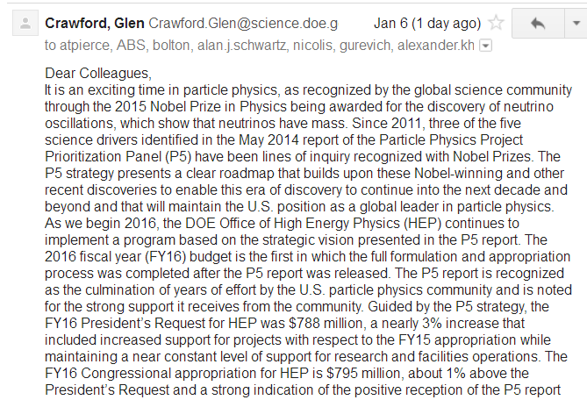
US Funding Outlook

Slide 3
US Funding Outlook

Slide 4
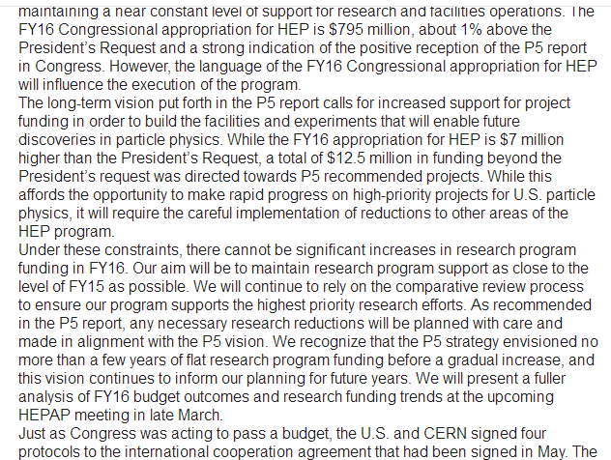
US Funding Outlook

Slide 5
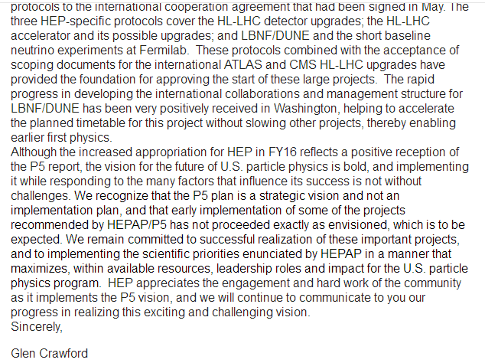
US Funding Outlook

Slide 6
US types of proposals
US Department Of Energy (DOE) HEP
  University grants:
    Cosmic / intensity / energy / R&D
  “projects”: go through a DOE critical decision process. Funding separate from university grants, overseen by national labs.
National Science Foundation (NSF)
  Individual proposal
  collaborative proposal

Slide 7
Plan
Engage DOE for R&D funds this fall
  Pixel readout plane + pixel chip design with LBNL
  Coherent neutrino scattering w/ COHERENT experiment
Complete demonstration of SF₆ TPC
Submit NSF + DOE proposals summer 2017
  Would like to have by then:
    a real CYGNUS collaboration
    White paper

