Slide 1
Modeling the Earths Magnetic Field Interaction with the Solar Wind
Justin R Bergonio
2 May 2012
PHYS 305

Slide 2
It’s a Trap! Particles in the Earth’s Magnetic Field
Justin R Bergonio
2 May 2012
PHYS 305
http://shirtshovel.com/products/movies/starwars/itsatrap-434.jpg

Slide 3
Objectives
Plot Earth’s magnetic field as a simple magnetic dipole
Track an electron’s path through that field
Observe it getting trapped (in the Van Allen Radiation Belt)

Slide 4
Earth’s Invisible Shield
Earth’s magnetic field
Created by liquid Fe core
Approx. dipole field
0.25 to 0.65 Gauss
Solar Wind
Stream of charged particles
Ejected from Sun’s upper atmosphere
Travels at 450 km/s
(http://www.dailymail.co.uk/sciencetech/article-1096360/Hole-discovered-Earths-magnetic-field-protects-planet-suns-rays.html)

Slide 5
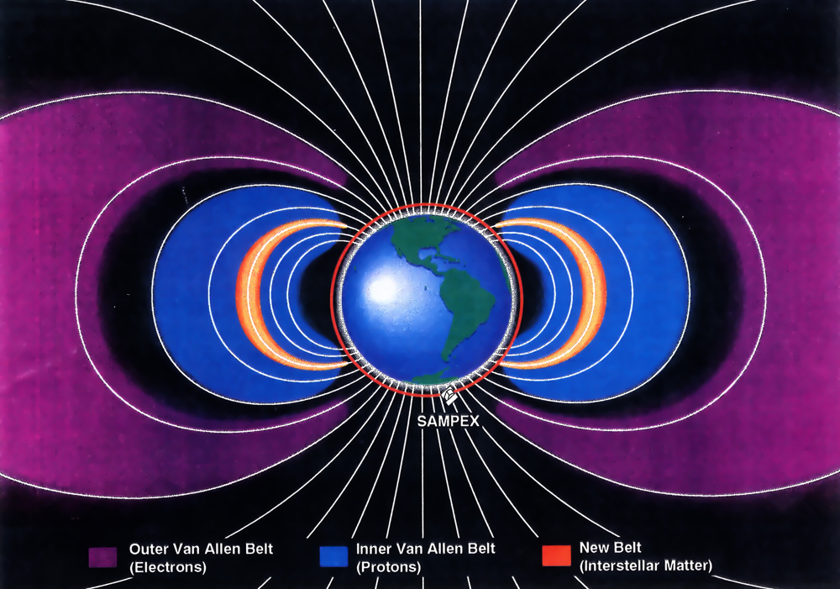
Van Allen Radiation Belts
Discovered in early 1958 by Explorer 1 and 3
Inner belt: protons (within 1 – 3 R_{E})
Outer belt: electrons (3 – 10 R_{E} –mostly between 5 – 6 R_{E})
http://r3zn8d.files.wordpress.com/2012/01/new_radiation_belt1.jpg
Notes:
Van Allen Radiation Belt
Discovered in 1958 by Explorer 1 and 3
Named after James Van Allen, a researcher who insisted on putting a geiger counter in Explorer 1
Most likely leaked particles from solar wind
Outer belt
Mostly high energy electrons (0.1 to 10MeV)
Most dense between 5-6 Earth radii
Inner belt
Mostly protons (10 – 50 MeV)
1 to 3 Earth radii

Slide 6
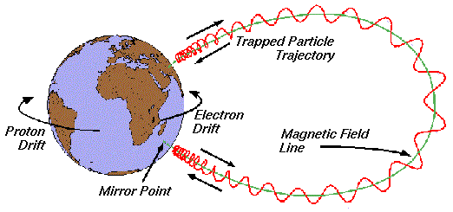
Magnetic Mirroring
What does this look like?
http://www.spenvis.oma.be/help/background/traprad/motion.gif

Slide 7
Approach
Create a program to generate field lines for Earth’s Magnetic Field
Use 4th Order Runge Kutta to track particle through non-uniform field

Slide 8
Equations for B-Field
Cartesian Coordinates
Spherical Coordinates
(Walt, Introduction to Geomagnetically Trapped Radiation)

Slide 9
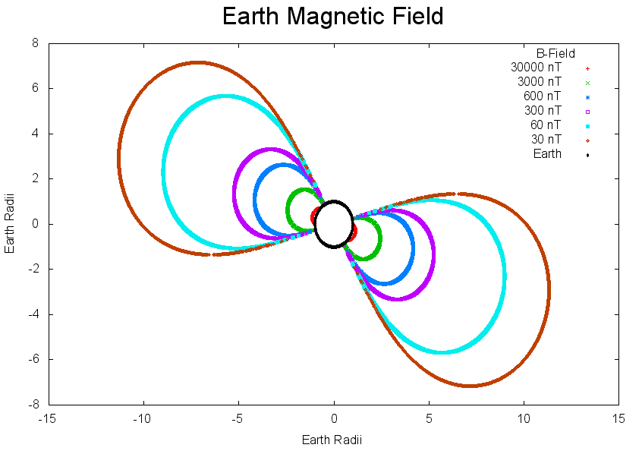
Results
Plot a cross section (xz-plane or yz-plane preferably)

Slide 10
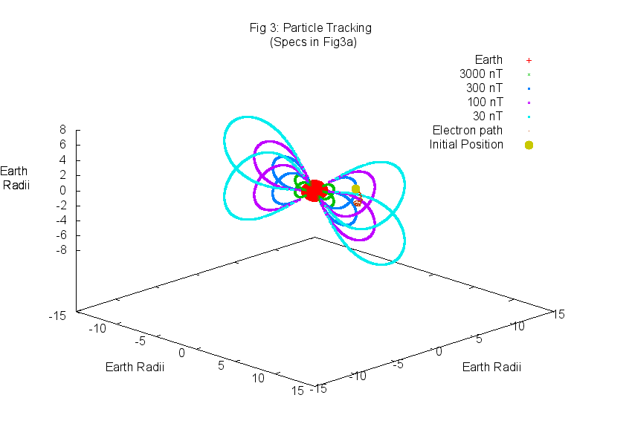
Results
Plot it in 3D!

Slide 11
Equations for RK4
(initial conditions)
(Force on particle by B-field)
(Use in RK4 to predict velocity)
(Use in RK4 to predict position)
q………………..….charge of particle
m………………..…particle’s mass
B…………….…….magnetic field vector
v…………………..velocity vector
x…………………..position vector

Slide 12
Particle Tracking Algorithm
Set position (km) and velocity (km/s)
Calculate
Calculate for new velocity and position w/ RK4
Reinitialize position and velocity
Output new positions (in R_{E})

Slide 13
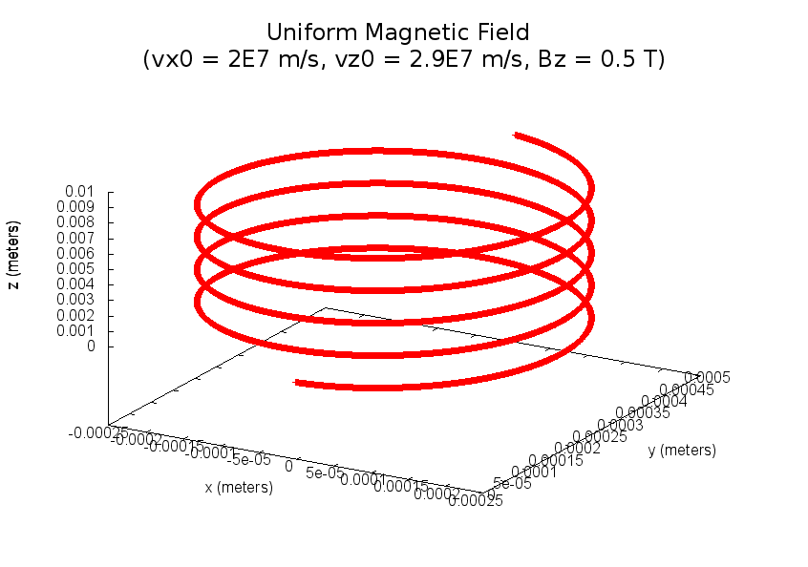
Test Accuracy of RK4

Slide 14
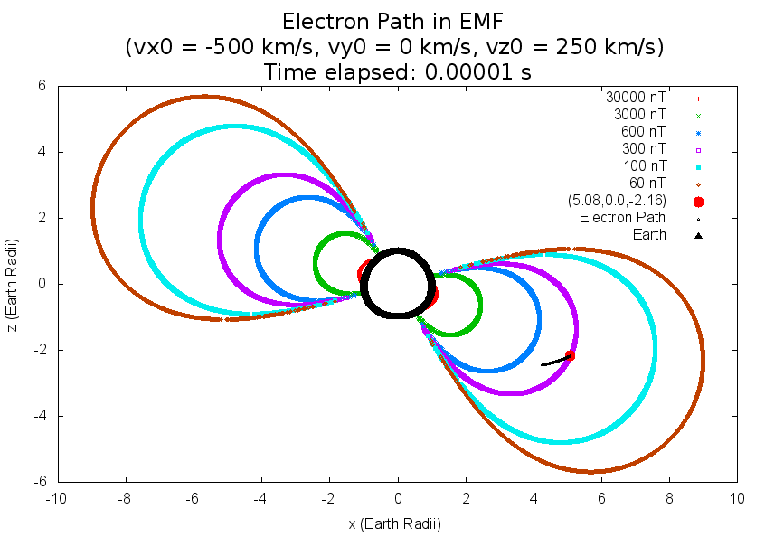
Results: Particle Tracking

Slide 15
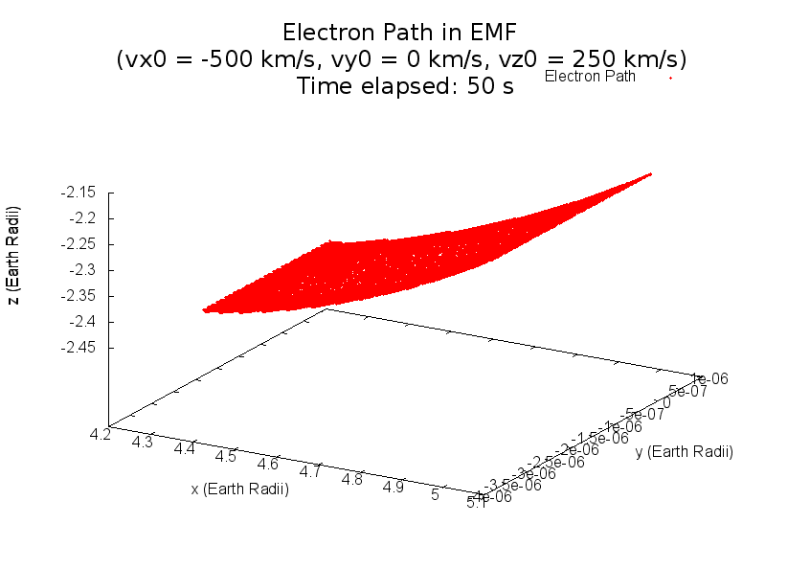
Results: Particle Trapping
Particles NOT getting trapped

Slide 16
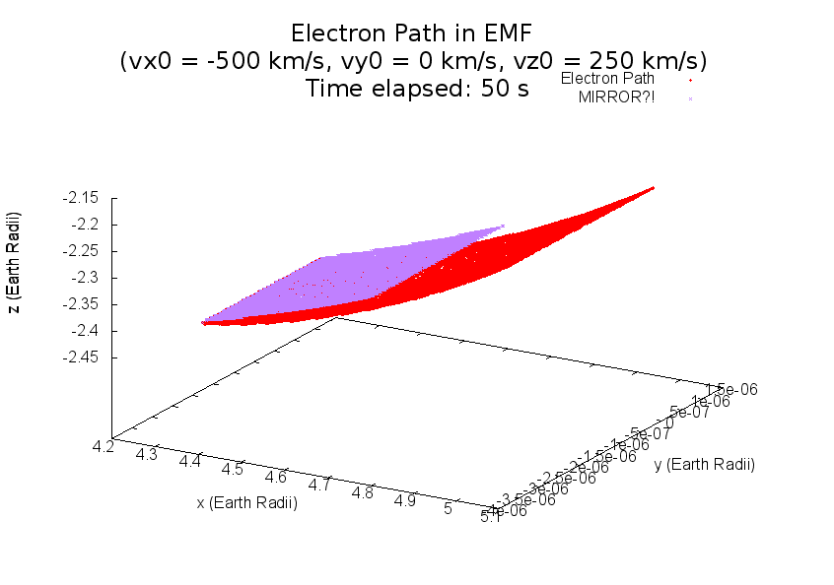
Results: Particle Tracking

Slide 17
Results: Particle Tracking

Slide 18
Conclusion
Plot Earth’s magnetic field as a simple magnetic dipole
Track an electron’s path through that field
Observe it getting trapped (in the Van Allen Radiation Belt)
Need to find the right velocities/positions
Need to keep it out of the loss cone

Slide 19
Thank You’s
Tutors at Learning Emporium/Physics Library (Keita, Erin, and Pat)
Professor Varner
KURTIS NISHIMURA!!!

Slide 20
I’m a Survivor

Slide 21
RK4: First Order Equations

Slide 22
RK4: Second Order Equations

Slide 23
RK4: Third Order Equations

Slide 24
RK4: Fourth Order Equations

Slide 25
RK4: New Values
← Positions!
Velocities!→

Slide 26
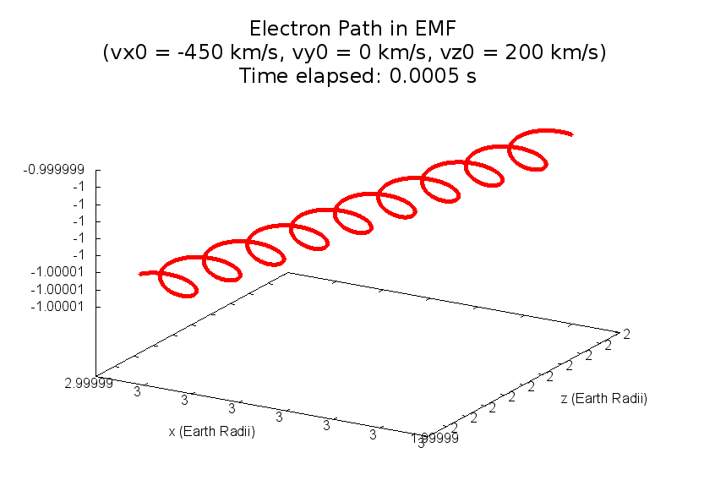
Results: Particle Tracking
Particle approximately 3.75 Earth radii

Slide 27
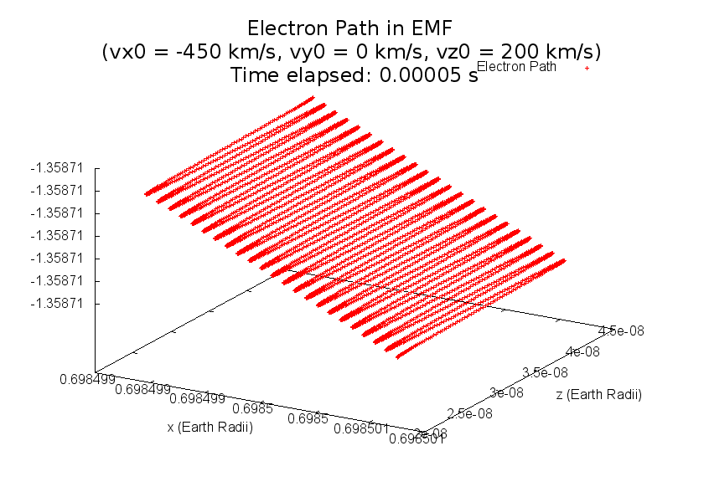
Results: Particle Tracking
Particle nearing Earth’s south pole

Slide 28
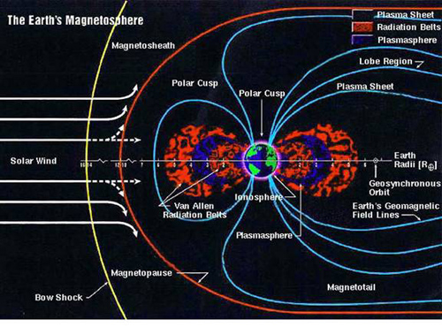
Earth’s Invisible Shield
Notes:
The Earth’s Magnetosphere
Created by swirling of liquid Fe core
It’s approximately a dipolel field
Varies on the Earth surface from 0.25 to 0.65 Gauss (0.25 to 0.65 microtesla)--weak
For comparison, a strong refrigerator magnet has a field strength of about 100 Gauss
Solar wind
Stream of charged particles
Plasma = charged gas that’s overall neutral
Ejected from Sun’s upper atmosphere
Travels avg. 450 km/s (~1,000,000 miles/hour!)
-

